Slide 1
Caesar Cipher
By Daniel Williams and nikolas pavlovic

Slide 2
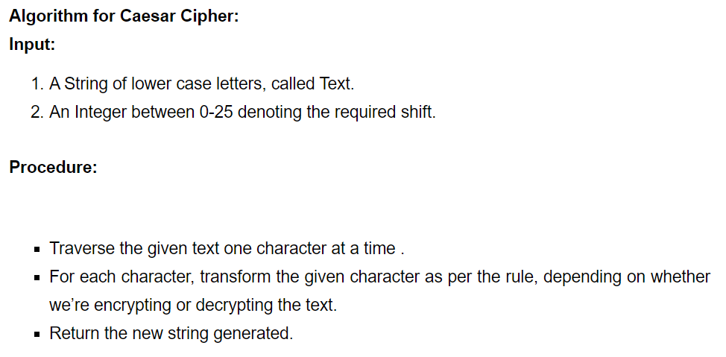
How to code a Caesar cipher

Slide 3
Plan of Action
Initially, we were both kind of unsure how to go about it and both us needed to do some research.
Our plan of action was to complete the Caesar Cipher first and then incorporate it with a Linked List.
Simplicity

Slide 4
Approach
We planned on meeting up the following Thursday after the project was assigned
Our approach was basically just trying to build the program piece by piece making sure it worked properly.
Get the cipher working first, then implement list, then link the 2

Slide 5
challenges
First, we had trouble getting our linked list to work properly
Secondly, we ran into an issue where the first letter of our encryption was adding twice
Next, we realized that our program could not recognize symbols and numbers
Finally, it would only accept numbers and not symbols, vice versa

Slide 6
resolution
Online resources (youtube, stackoverflow, geeksforgeeks.com)
Lots of testing
Making use of breakpoints in Eclipse

Slide 7
results
DEMO

Slide 8
Caesar cipher example
Rule = add 2
Input = A
Encryption = C
Decryption = A

Slide 9

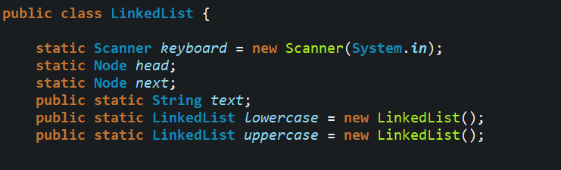
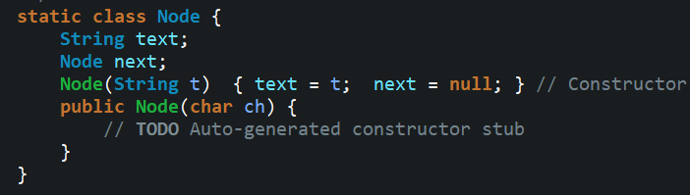
How to initialize a linked list
Node is its own class because it is a Noun/thing.
Verbs/actions that a Noun does, would be its methods.
In our project, Node and LinkedList are classes, while encryption/decryption are methods.

Slide 10
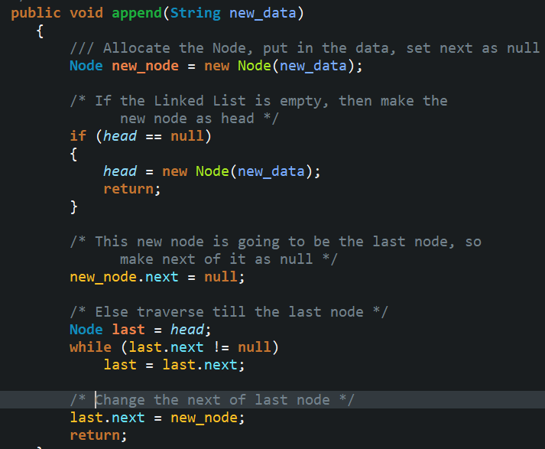
Appending a linked list
We must parse user input for numbers and special characters, only accepting lowercase and uppercase letters
A good algorithm will ignore these parameters without adding them to the list or breaking the program

Slide 11
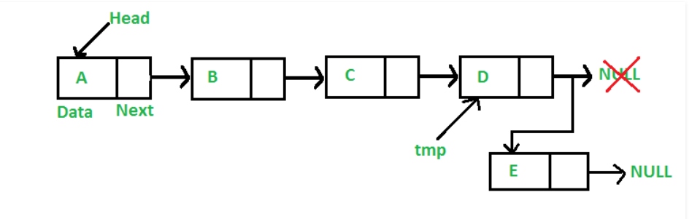
Appending a linked list
NULL

Slide 12
Appending a linked list
NULL

Slide 13
Appending a linked list
NULL

Slide 14
Appending a linked list

Slide 15
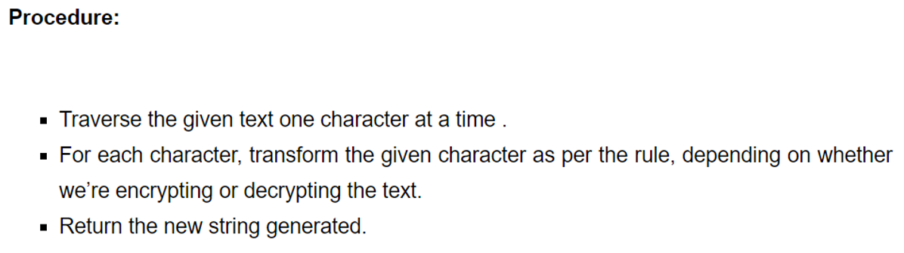
encryption
Once our Linked List has been populated, we pass it through an encryption method.
We must again, parse for numbers and special characters as these will not be encrypted by this program

Slide 16

decryption
Decrypting is nearly the same as encryption, simply backwards
If our encryption adds a letter shift, our decryption must subtract the same letter shift amount

Slide 17
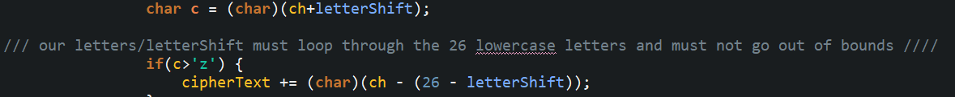
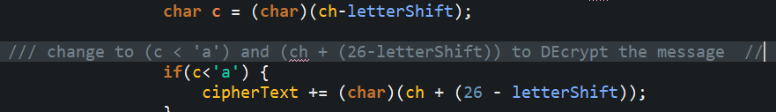
ENCRYPTION
DECRYPTION

Slide 18
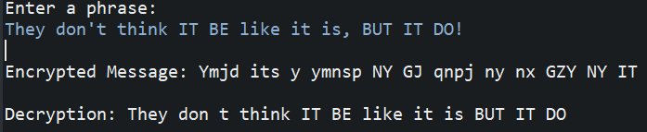
Caesar cipher
Final result with letter shift of five (5).

Slide 19
Final notes
All non-letters are replaced with whitespace through a regex expression below.
String str = text.replaceAll("[^\\p{Alnum}]+", " ");

