Slide 1
Caesar Cipher
By Daniel Williams and nikolas pavlovic

Slide 2
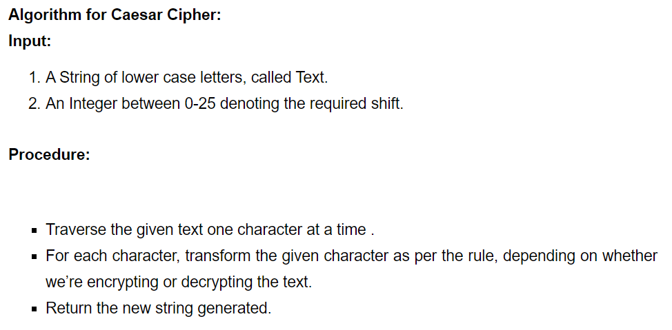
How to code a Caesar cipher

Slide 3

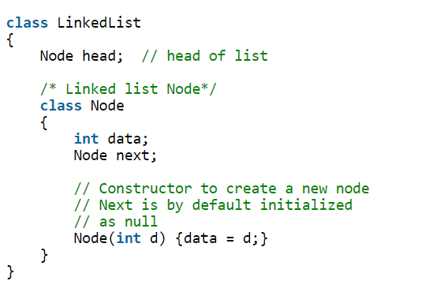
How to initialize a linked list
Node is its own class, as each node must be an object.

Slide 4
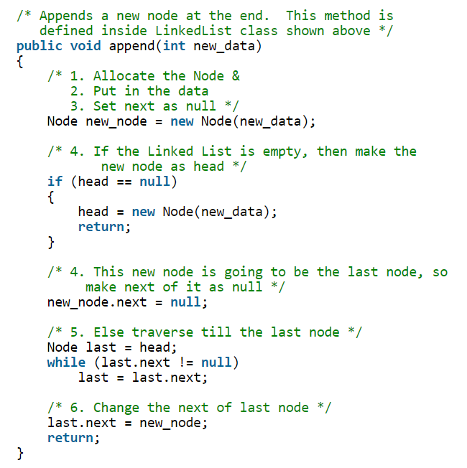
Appending a linked list
We must parse user input for numbers and special characters
A good algorithm will ignore these parameters without adding them to the list or breaking the program
Our algorithm will only accept lowercase and uppercase letters

Slide 5
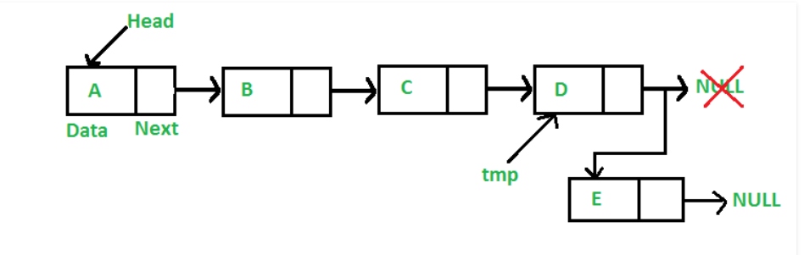
Appending a linked list

Slide 6
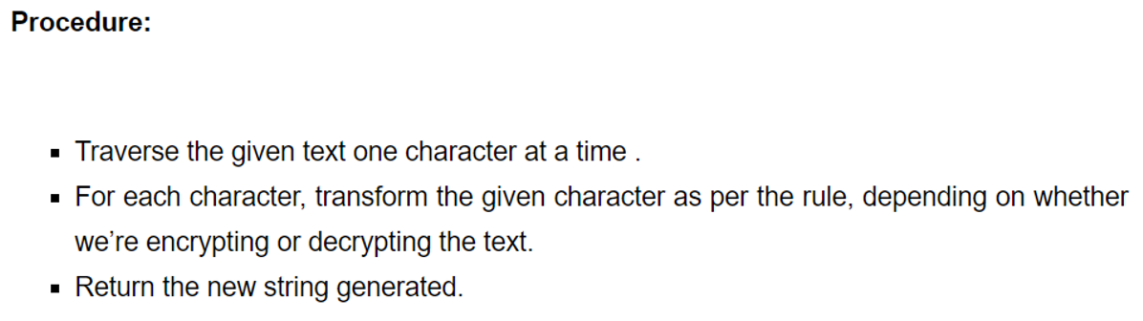
encryption
Once our Linked List has been populated, we pass it through an encryption method.
We must again, parse for numbers and special characters as these will not be encrypted by this program

Slide 7

decryption
Decrypting is nearly the same as encryption, simply backwards
If our encryption adds a letter shift, our decryption must subtract the same letter shift amount

Slide 8
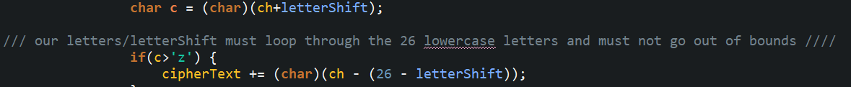
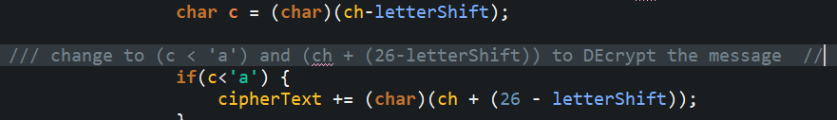
ENCRYPTION
DECRYPTION

Slide 9
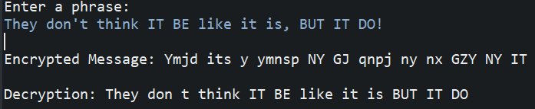
Caesar cipher
Final result with letter shift of five (5).

Slide 10
Final notes
Our program will allow input any character, number, letter or special character without breaking, and will populate the list with only letters.
All non-letters are replaced with whitespace.

