Slide 1
SPMC 350
Sports Data Visualization and Analysis
Matt Waite
@mattwaite
matt.waite@unl.edu

Slide 2
Who will be in the playoffs in the National League?

Slide 3
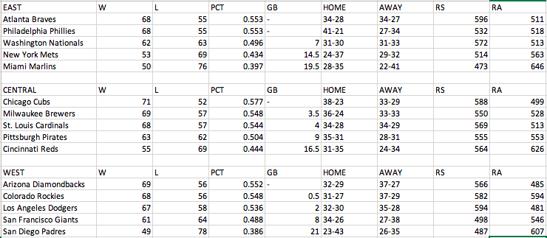

Slide 4
Introductions

Slide 5
Syllabus

Slide 6
What is this class about?

Slide 7
Expectations

Slide 8
Assignments

