Slide 1

P2P data retrieval
DHT (Distributed Hash Tables)
Partially based on Hellerstein’s presentation at VLDB2004

Slide 2

Outline
Motivations
Early Architectures
DHT: Chord
Conclusions

Slide 3
What is P2P
P2P means Peer-to-Peer and has many connotations
Common use: filestealing systems (Gnutella, eDonkey) and user-centric networks (ICQ, Yahoo! Messenger)
Our focus: many independent data providers, large-scale systems, non-existent management

Slide 4
Motivations
IM (Instant Messaging)
50 million users identified by username.
To connect to user A we have to resolve username A to her ip-address
Centralized solution: fault-tolerance, load balancing?

Slide 5
Motivations
PM (Profile management): Amazon, Google, Yahoo!
100 million users store, retrieve and update their profiles
1000 computers are available for PM
How to build fast, robust, fault-tolerant storage?

Slide 6
Motivations
File-sharing(stealing) networks
20 million users share files identified by keywords
How to build efficient file search?
High churn rate! Average lifetime of a node in the networks = 2 hours

Slide 7
What is common?
  High Churn
  Few guarantees on transport, storage, etc.
  Huge optimization space
  Network bottlenecks & other resource constraints
  No administrative organizations

Slide 8
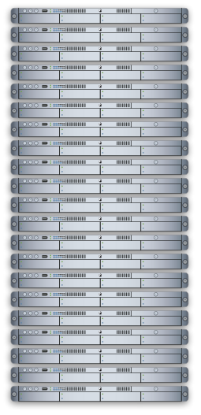
Early P2P I: Client-Server
Napster
xyz.mp3
xyz.mp3 ?

Slide 9
Early P2P I: Client-Server
Napster
  C-S search
xyz.mp3

Slide 10
Early P2P I: Client-Server
Napster
  C-S search
xyz.mp3
xyz.mp3 ?

Slide 11
Early P2P I: Client-Server
Napster
  C-S search
  “pt2pt” file xfer
xyz.mp3
xyz.mp3 ?

Slide 12
Early P2P I: Client-Server
Napster
  C-S search
  “pt2pt” file xfer
xyz.mp3
xyz.mp3 ?

Slide 13
Early P2P I: Client Server
SETI@Home
  Server assigns work units
My machine
info

Slide 14
Early P2P I: Client Server
Task: f(x)
SETI@Home
  Server assigns work units

Slide 15
Early P2P I: Client Server
SETI@Home
  Server assigns work units
Result: f(x)
60 TeraFLOPS!

Slide 16
Early P2P II: Flooding on Overlays
xyz.mp3
xyz.mp3 ?
An overlay network. “Unstructured”.

Slide 17
Early P2P II: Flooding on Overlays
xyz.mp3
xyz.mp3 ?
Flooding

Slide 18
Early P2P II: Flooding on Overlays
xyz.mp3
xyz.mp3 ?
Flooding

Slide 19
Early P2P II: Flooding on Overlays
xyz.mp3

Slide 20
Early P2P II.v: “Ultrapeers”
Ultrapeers can be installed (KaZaA) or self-promoted (Gnutella)

Slide 21
What is a DHT?
Hash Table
  data structure that maps “keys” to “values”
  essential building block in software systems
Distributed Hash Table (DHT)
  similar, but spread across the Internet
Interface
  insert(key, value)
  lookup(key)

Slide 22
How?
Every DHT node supports a single operation:
  Given key as input; route messages toward node holding key

Slide 23
DHT in action
K V
K V
K V
K V
K V
K V
K V
K V
K V
K V
K V

Slide 24
DHT in action
K V
K V
K V
K V
K V
K V
K V
K V
K V
K V
K V

Slide 25
DHT in action
K V
K V
K V
K V
K V
K V
K V
K V
K V
K V
K V
Operation: take key as input; route messages to node holding key

Slide 26
DHT in action: put()
K V
K V
K V
K V
K V
K V
K V
K V
K V
K V
insert(K₁,V₁)
K V
Operation: take key as input; route messages to node holding key

Slide 27
DHT in action: put()
K V
K V
K V
K V
K V
K V
K V
K V
K V
K V
insert(K₁,V₁)
K V
Operation: take key as input; route messages to node holding key

Slide 28
DHT in action: put()
(K₁,V₁)
K V
K V
K V
K V
K V
K V
K V
K V
K V
K V
K V
Operation: take key as input; route messages to node holding key

Slide 29
DHT in action: get()
K V
K V
K V
K V
K V
K V
K V
K V
K V
K V
K V
retrieve (K₁)
Operation: take key as input; route messages to node holding key

Slide 30
Iterative vs. Recursive Routing
Previously showed recursive.
Another option: iterative
K V
K V
K V
K V
K V
K V
K V
K V
K V
K V
K V
retrieve (K₁)
Operation: take key as input; route messages to node holding key

Slide 31
DHT Design Goals
An “overlay” network with:
  Flexible mapping of keys to physical nodes
  Small network diameter
  Small degree (fanout)
  Local routing decisions
  Robustness to churn
  Routing flexibility
Not considered here:
  Robustness (erasure codes, replication)
  Security, privacy

Slide 32
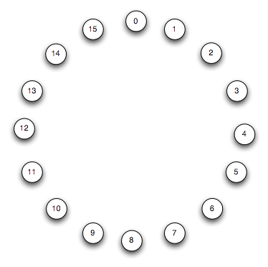
An Example DHT: Chord
Assume n = 2^{m} nodes for a moment
  A “complete” Chord ring
  We’ll generalize shortly

Slide 33
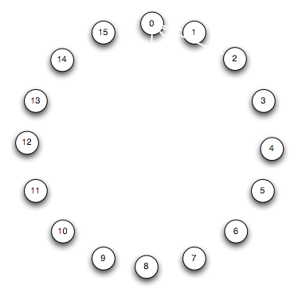
An Example DHT: Chord

Slide 34
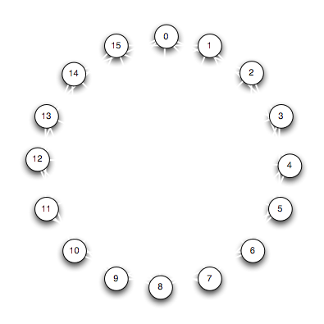
An Example DHT: Chord

Slide 35
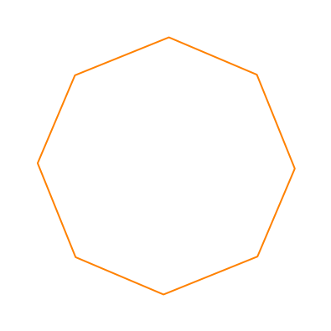
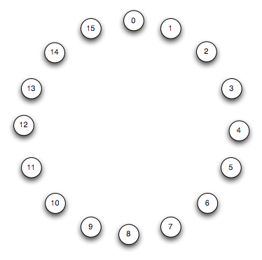
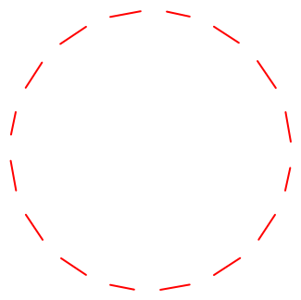
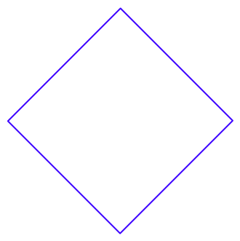
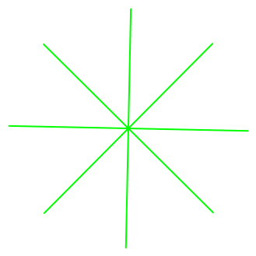
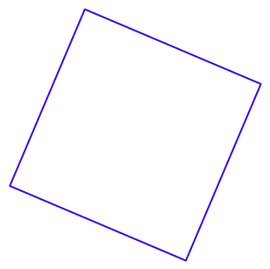
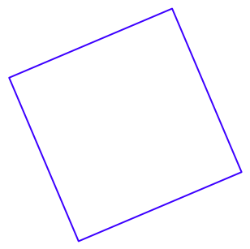
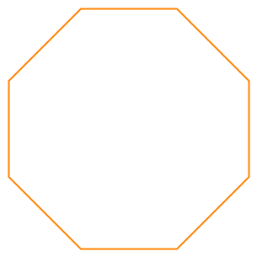
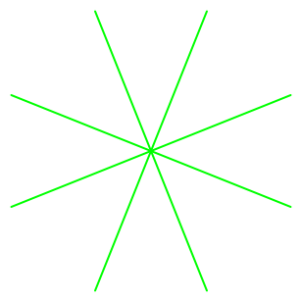

An Example DHT: Chord
Overlayed 2^{k}-Gons

Slide 36
Routing in Chord
At most one of each Gon
E.g. 1-to-0

Slide 37
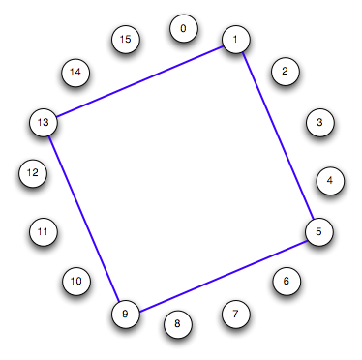

Routing in Chord
At most one of each Gon
E.g. 1-to-0

Slide 38
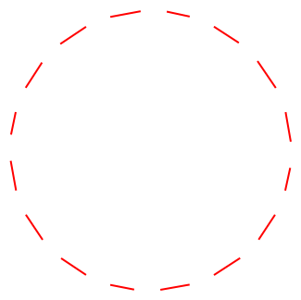

Routing in Chord
At most one of each Gon
E.g. 1-to-0

Slide 39


Routing in Chord
At most one of each Gon
E.g. 1-to-0

Slide 40

Routing in Chord
At most one of each Gon
E.g. 1-to-0

Slide 41
Routing in Chord
At most one of each Gon
E.g. 1-to-0
What happened?
  We constructed the
  binary number 15!
  Routing from x to y
  is like computing
  y - x mod n by
  summing powers of 2
2
4
8
1
Diameter: log n (1 hop per gon type)
Degree: log n (one outlink per gon type)

Slide 42

Joining the Chord Ring
Need IP of some node
Pick a random ID (e.g. SHA-1(IP))
Send msg to current owner of that ID
  That’s your predecessor

Slide 43
Joining the Chord Ring
Need IP of some node
Pick a random ID (e.g. SHA-1(IP))
Send msg to current owner of that ID
  That’s your predecessor
Update pred/succ links
  Once the ring is in place, all is well!
Inform app to move data appropriately
Search to install “fingers” of varying powers of 2
  Or just copy from pred/succ and check!
Inbound fingers fixed lazily

Slide 44
Conclusions
DHT implements log n lookup, insert,
Log2 n newNode, DeleteNode
Next part: P2P database systems

