Slide 1
Artemmis Framework for Automotive Platforms - Overview – Business Unit ID HMI Software Group BBU
B. Bach, ID RD SW GA M
Revision: 1.1

Slide 2
Artemmis Framework & Tool Chain for Automotive Platforms
Widget building and properties

Slide 3
Artemmis Framework & Tool Chain for Automotive Platforms Widget Tree
Memory Representation: Widget Object Tree
Visual Representation
Scene
#1
Frame
Display Scene Level
Settings
TextArea
Display Section Level
Section
A
Section
B
Frame
Clock
ListBox
Date
Parent Widget Level
Sttings
ListBox
ScrollBar
Language
Country
Buttons
Child Widget Level
Display
Clock
Date
Lang
Country
Back
Cursor
ScrollBar
Notes:
Lets repeat about Widgets:
Widgets are organized in hierarchical structure forming a tree of widgets.
Visually widgets occupy rectangular area on screen, with all children inside this rectangular area.
Widgets are dynamic objects living their own life in a tree. They display different things depending on data and communication with other widgets or external world.
To implement dynamic nature of widgets they need some kind of internal state and data to keep and display.
Widgets attributes (fundamental data valid for all widgets) like:
- Visible
- Enabled
- Focused (important attribute, the one who has the focus gets focused events, example a parent widget with two textbox children)
Widget properties are other important data, which is different for different widgets. For example widget which will display vehicle speed will keep property “speed”, while widget which displays temperature will have a property “temp”. Some widgets may need a property which depends on the properties of other widgets. For example lets assume that we have widgets with properties “speed” and “trip time” and we want to have another widget which will display distance from start. So we can define that property “distance” of our widget is “speed” * “trip time” using properties from other two widgets. What we need is that our “distance” widget is notified every time when some of this widget changes its value. Artemmis provides such thing and we call it property link.

Slide 4
Artemmis Framework & Tool Chain for Automotive Platforms HMI interface to external world (other applications)
functional interface
(SendMessage)
APImanager
interface
notify on change
notify on change
OSEK
App1
App2
API mgr
HMI
HMI
APIM
DPool
Task activation
send message
enqueue message
EPF loop
freeze buffer
Value
Value
Task activation
Write DPool
Value
Value
Value
Value
Task activation (because of DPool change)
Mark API change
Value
Value
Value
Value
Value
Value
EPF loop
Task activation
handle data
changes
Main entry points for HMI
Data (DPool) all changes in DPool are monitored and action is taken on change by API manager which informs HMI about data change. API manager interface is for exclusive use only by API manager.
Functional interface: Messages, send to HMI by calling send methods (C style) with HMI_boSendMessage.
Functional interface provides several methods which are executed in task context of a caller. When sending message it is enqueued and retruns to caller immediately.
handle
messages
Finish EPF loop
Request Painting
Paint cycle
Task activation
Painting

Slide 5
Artemmis Framework & Tool Chain for Automotive Platforms Handling of changes (EPF loop)
Update (EPF loop)
Draw (Paint cycle)
Triggered by external event, e.g.
Incoming message(s)
Application value changed
Messages are dispatched to the widget tree
Widgets react to the messages in their (manually-written) code or through their (generated) final hooks
Further events might be generated
Properties might be modified, resulting in window invalidation
Widget trees (or sub-trees) might get rebuilt, resulting in window invalidation

Slide 6
Artemmis Framework & Tool Chain for Automotive Platforms Drawing new state (Paint Cycle)
Update
Draw (Paint Cycle)
Triggered by the end of an Update Phase
A surface (destination buffer) is attached to the GS context for the thread
Windows that need to repaint are traversed in the correct order (Painter’s Algorithm)
Each window’s painter gets a Paint( ) call, providing them the GS context to paint with
After all the necessary windows have repainted, the surface will be flipped

Slide 7
Artemmis Framework & Tool Chain for Automotive Platforms Widget Creation
For every widget class there is generated (by Brutus) “builder” method which creates widget (as an instance) and assigns default attribute (visible, focused, …) and properties (x, y position, width, height, …) reading them from resource.
Widgets are always build with their children. Every widget has a list of children as a resource (they are not dynamic and it is not possible to add programmatically widget) and when build is started all children of a widget are build too (and initialized too).
When tree is build (or rebuild because of lifecycle controllers) it goes thru following phases:
creating widgets (as instances) and initializing their default attributes and properties
sending initialize message, so that widgets shall make more complex initialization and read data from DPool if needed. Widgets go to state Init
send message that tree is build and normal operation starts. Widgets are now in state Running.
1. Widget tree created
Init attributes and properties
resoureces
widgets are
in state “New”
Send TreeInit message to all widgets
2. Broadcast “TreeInit” message
Some widgets read props from API
widgets enter
State “Init”
API (DPool)
3. Switch widgets to
State “Running”
Send TreeBuildDone message to all widgets
4. Broadcast “TreeBuildDone”
Notes:
Creation of widgets is generated by BRUTUS according to provided model.
Widgets are never built alone; they are always build as a part of subtree (unless subtree consists of just one widget).
Brutus generates a special method for each widget class. These methods are widget builders.
During build widgets are assigned properties specified in model. These properties are read from resources.

Slide 8
Artemmis Framework & Tool Chain for Automotive Platforms Widget Base Properties
Widget base class defines the base properties which are inherited by all widgets. We call this properties: attributes. The initial values of these attributes are configured in the model.
Focus - This attribute determines the path of focused message in widget tree.
Focusable - This attribute determines whether a widget instance is allowed to be set to Focused.
Visible - This attribute determines whether or not a widget should be drawn on the display.
Enabled - This attribute is another attribute of widget instances, although it doesn’t have any effect internally, it is available for use by clients.
Do Update - This attribute determines whether or not an instance is allowed to receive API updates.
Widget State – could be “New”, “Init”, “Running”, “PrepareToDestroy” … and represents the state of a lifecycle of widget.
Widget Id – not an attribute. It is an important value of a widget (16 bit integer), this is its well known unique id over the entire widget tree. Widget gets its id by the tools during toolchain execution, so this id never changed and is known during compile time. Available as a member only for debug.
For some of the attributes (Focus, Visible, Enabled, DoUpdate) effective value is a cumulative value from root until the widget are all true. For example widget is actually visible only if all parents are also visible.
Green widgets are visible.
Hollow one are hidden
Left-down group of 3 widgets
wants to be visible but in fact is not,
because parent is not visible
8 / T A Devi / ID RD CDS HF / Jul-2012 © Continental Automotive Singapore

Slide 9
Artemmis Framework & Tool Chain for Automotive Platforms Propagating attributes
Propagating attributes is a way to optimize checks for widget attributes which has dependency to parent widgets. This applies to attributes:
Visible
Enabled
Focused
doUpdate
For every attribute (which is represented by one bit) there is additional one which represents cumulative state of a parents.
Reading (testing) of a value is done more often than changing value (switching visibility or enabling).
We need to have different values (own and parent), because own value is a desire of a widget, which shall not change when parent status is changed.
Example of propagating visibility attribute
1. Hide
1. Show
2. Parent
hidden
Switch visibility
2. Parent
shown
4. Parent
hidden
3. Parent
hidden
3. Parent
shown
4. Parent
shown
Notes:
Important thing to notice about subtrees is that widget attributes has additionally special meaning for entire subtree. This means if parent is not visible/focused/enabled/updatable – then entire subtree is not visible./focused/enabled. As a consequence that means that every widget needs to know attribute of its’ parent. Why: for the performance reasons. Let’s consider visibility property. When widget needs to check whether it is currently visible it shall check whether its own state is visible. But widget visibility is just the visibility state of the widget relative to its parent. So if widget is visible then it is truly visible if its parent is visible, but its parent is visible if it is visible and grandparent is visible and so on. So we can go that way up to the root of the tree. Checking widget attributes is something which is done often and to optimize it there is copy of real parent visibility inside every widget. All this attributes are implemented as bit flags, so waste of memory is not big (4 additional bits) but performance gain is important. Every time some widget changes visibility state it notifies (in fact method call of child widgets) about this change and all children change real attribute state for the parent (and will notify their children as well). Now you see that attribute change will in fact activate a chain of method calls to notify entire subtree, but attribute change happens not so often (in contrast to checking attributes). This notification of all children about attribute change we call “attribute propagation”. When checking attributes (for example visibility) widget checks whether its own flag is set to true AND parent status is true.

Slide 10
Artemmis Framework & Tool Chain for Automotive Platforms
Messages

Slide 11

Widget Communication Overview
There are two ways by which external entity can communicate with the widgets, through Messages and through API (data binding). Besides external tasks, messages are also used for internal communications between widgets.
Messages All widgets can receive information or command in form of WCS::Message objects. WCS::Message can carry message ID, type, and memory pool ID, as well as optional receiver ID, and data. The main message receiving interface of the widgets is Handle-Message which consists of these processing:
Class-specific message processing (Process-Message)
Instance-specific message processing (Final-Hook)
Optional special hooks
API Widgets can be configured for exchanging data with external entity through APIM and DPOOL

Slide 12
Artemmis Framework & Tool Chain for Automotive Platforms Widget Tree Communication: Focused Message
Among several types of messages, the most important is the focus driven message.
The Focus Path starts always at the root widget and ends at any leaf widget within the widget tree
A focus driven message always will be navigated along the Focus Path:
Focus driven messages have two variants, a tunneling and a bubbling one
The tunneling variant is propagated from the root down the widget tree along the focused path, until it is blocked. Latest a tree leaf blocks the message
The block converts the message into its bubbling variant, which is the variant that can be consumed
It bubbles up the widget tree along the focused path, until a widget consumes it or it reaches the root
Message
Queue
Consume
Block
Tunneling
Bubbling
Focus
Notes:
The important thing to say is: why we have such complicated handling for focused message.
Answer is that this way provides a possibility for parents to handle message before it is seen by the children.

Slide 13
Artemmis Framework & Tool Chain for Automotive Platforms Message Propagation (1)
Broadcast Messages
Message will be delivered to every widget in the widget tree, starting from tree root.
The Message Sender knows, that all alive widgets will receive the message
There are two flavors of Broadcast message: TopDown and BottomUp broadcast messages
Message
Queue
TopDown broadcast sends
message first to some widget,
then to all widget children.
Message is sent:
top to bottom, left to right
Message
Queue
BottomUp broacast sends
message first to children
then to parent.
Message is sent:
bottom to top, left to right
Hong.Pei ID RD SW GA M / 31-Jan-2009 © Continental AG
Notes:
Direct message and broadcast message are easy to understand. Can spend less time to explain.

Slide 14
Artemmis Framework & Tool Chain for Automotive Platforms Message Propagation (1)
Direct Messages
Direct message is send to predefined (in model) list of recipients (widgets). Brutus generates a list with widget IDs and every widget which is alive will receive message
The Message Sender does not know the message receiver(s)
Addressable Messages
Addressable Messages are directly delivered to a message receiver, which is specified by widget ID <ID>
The Message Sender needs to know the message receiver. This is considered not good practice for external message.
Message
Queue
Message
Queue
Deliver
Deliver
Hong.Pei ID RD SW GA M / 31-Jan-2009 © Continental AG
Notes:
Direct message and broadcast message are easy to understand. Can spend less time to explain.

Slide 15
Artemmis Framework & Tool Chain for Automotive Platforms Widget Communication: Internal Message Queue
Beneath external messaging, an internal messaging is available in the Artemmis subsystem
Internal messages can be posted to an internal Message Queue from widgets
All propagation strategies available for the external message queue are supported as well for the Internal message queue: Broadcast, Focused, Direct and Addressable
Like the external message queue, the internal message queue is organized in a FIFO structure
Posting a message on the internal message queue initiates a new (internal) message cycle, which is typically presented to the widget tree root (focused, broadcast)
Normally EPF handles one message from external message queue. Then all messages from internal queue are handled, before taking next message from external message queue.
External
Events
Artemmis
HMI Subsystem
External
Message
Queue
Internal
Events
Internal
Message
Queue
15 / B. Bach / ID RD SW GA-M/ Nov-2010 © Continental AG

Slide 16
Artemmis Framework & Tool Chain for Automotive Platforms Widget Communication: Message Stack
Message
Queue
The Message Stack can be used by widgets during a running message cycle without initiating a new one (via the internal or external queue)
The message stack is organized as a LIFO
During handling of a message a widget is allowed to push a message to the message stack.
All messages inside the Message Stack will be presented to each widget along the bubbling path, until all messages are consumed or until the bubbling path ends at the root widget.
If the root widget has been passed, message is silently destroyed.
4. Pop
Stack: Local
Messages
3. Push
2. Consume
1. Block
Tunneling
Bubbling
Stack
Focus
16 / B. Bach / ID RD SW GA-M/ Nov-2010 © Continental AG

Slide 17
Artemmis Framework & Tool Chain for Automotive Platforms Multiple display support
Supporting more than one display means that there are several widget trees: one per display. Addressable messages are send to specified widgets, so there is nothing special to do. For broadcast and focused messages it is important to which widget tree this message will be sent. Posted broadcast and focused messages are:
Global messages – these messages are send to ALL displays. There are Global Direct, Global Broadcast and Global Tunneling messages.
Has Display ID – so there is specified display inside message to which it shall be send. This messages are named Tree Direct, Tree Broadcast and Tree Tunneling.
No Display ID – in that case message is send to currently focused display if it is external message or to currently active widget tree if it is internal message (so internal messages are handled by default internally inside those display controller in which they are created). Message name is same: Tree Direct, Tree Broadcast and Tree Tunneling
Messages for
Display 2
Messages for
Display 1
Messages without
DisplayID
Global Messages
focused display
Display 1
Display 2
focus path
f path
focused
focused

Slide 18
Artemmis Framework & Tool Chain for Automotive Platforms
Controlling Scenes

Slide 19
Artemmis Framework & Tool Chain for Automotive Platforms Widget Tree Control: Scene Management
Controllers are widgets which control which child (with its entire subtree) is show at any moment
Logic which scene (sub-tree) is shown is implemented as a finite-state-machine (or simply state machine)
For every state of a state machine there is usually associated sub-tree to display
Depending of the type of Controllers:
Visibility controllers show current scene and hide all others
Lifetime controllers keep alive only current scene, all other sub-trees are destructed
Transition controllers act like Lifetime but keep previous scene for a while, so new one and old one coexist for a short time
State machine may change state in response to some message or may decide to change scene based on some data (properties or data from DPool)
Manager is
implemented as
a state-machine
Root is implemented as
SceneController widget
Root
Manager
Display Scene 1
Display Scene n
Widget Tree Control to switch between multiple Scenes
Notes:
Not all the data is displayed at once on the screen, there are usually different modes which display different data or in a different way on the screen. To manage this we have to hide some of the widgets and show other widgets. This is done by showing and hiding entire subtree of widgets. Often we have not enough space for all widgets in a cluster (some project has several hundreds of widgets in total), in such cases we not just hide widget, we destroy entire subtree of widgets and then rebuild new one (for the new mode).
Which subtree to be shown and how to react on some messages is decided by a state machines. State machines are implementation of finite-state machine (FSM) or finite-state automaton, or simply a state machine. State machines have several states and transition between states. FSM react on received messages by changing (or not changing) their state. When they change state they trigger some action (usually calling some method or methods) and during that action subtrees of widgets are rebuild and entire widget tree changes.

Slide 20
Artemmis Framework & Tool Chain for Automotive Platforms Scene Manager: State Machines
State-Machines are applied for Scene Management Logic
Artemmis supports state-machines with states, transitions, guards, actions, on-entry sections, on-exit sections, shallow history and deep history
A transition is triggered by a message, which leads to a state change or which stays in the current state (self-transition)
An action (as a result of a transition) can be a method invocation, an API update or the generation of new messages
An on-entry section can consist out of a guard condition, a list of actions and a list of generated messages
An on-exit section also can consist out of a guard condition, a list of actions and a list of generated messages
State machine objects will be generated by the HMI Language Compiler and constructed at runtime
Artemmis also provides a “light weight” non-hierarchical state machine class
Within one widget tree, multiple state machines can be applied
S1: Play
S2: Settings
classic
state machine
S3: Help
Hierarchical
state machine
S0: Top State
S1: Radio
S2:
Help
S11: Play
S12: Setting
20 / B. Bach / ID RD SW GA-M/ Nov-2010 © Continental AG

Slide 21
Artemmis Framework & Tool Chain for Automotive Platforms Widget Tree Control: Visibility- and Lifecycle Management (i)
All screen contents for one display are described by a single widget tree configuration in ROM, which contains all potentially visible elements, scenes, menu pages, etc.
The Scene Manager implements the basic display scene HMI logic and knows at each point in time, which widget sub-tree to be activated or de-activated.
The activation or de-activation of a widget sub-tree is handled by the Scene Controller, which can be computed by controlling - either the visibility of a widget sub-tree - or the lifecycle of a widget sub-tree The scene control strategy will be determined by the Scene Controller class
If the Scene Controller Strategy is set to Visibility Control, the complete widget tree is constructed at startup. All widgets within the widget sub-tree will be kept in RAM memory and do not loose their data while switching to another scene.
Controller 1: Lifecycle Strategy
Tree Builder
Scene Controller
Scene Manager 1
21 / B. Bach / ID RD SW GA-M/ Nov-2010 © Continental AG
Notes:
Entire user interface usually consists of several modes to display, like “settings”, “board computer”, “Status”, … Every such mode requires different set of widgets while old set is not needed to be shown. There are two different approaches to implement this behavior:
Hide all widgets which are not needed and show set of needed widgets.
Keep alive only needed widgets and remove not needed.
We have a special widgets (containers, usually without visual part, i.e. not drawing) which will keep just one set of their children visible. They are called controllers. Controllers have a set of children to manage and a state machine to control states of the controller. For every state there are defined set of children. Switching between states is usually controlled with messages or is configured in model. We have have two types of controllers (well in fact 3, because we have one special transitional controller, but it will be described later):
VisibilityController: this controller will show just one set of children configured for current state. All other children will be hidden.
SceneController: this controller will keep alive only needed set of children all non needed children will be destructed.
Both approaches have advantages and disadvantages.
Having all widgets alive will quickly switch between modes. Widgets will not loose information about their current internal state and will not loose their internal properties. Disadvantage is that we need a lot more memory (we need to have all widgets alive at once) and for some projects there several hundreds widgets in total. Other possible problem could be that there are too many widgets to handle broadcast events and getting data from DPool.
Keeping only needed widgets alive will have fewer widgets at once, so we need less memory, moreover: because we have a tool to handle model, this tool is capable of calculating max memory needed at any mode. Only alive widgets will handle broadcast messages and will get data from DPool. Disadvantage is that properties of non existing widgets are not available, but there is a solution to that problem: we have persistent properties for widgets. Another disadvantage is that there is a moment in timer during tree change, where some of the widgets are destructed, some of them come to live and tree rebuild is a little bit hard and time consuming process.

Slide 22
Artemmis Framework & Tool Chain for Automotive Platforms Widget Tree Control: Visibility- and Lifecycle Management (ii)
Controller 1: Lifecycle Strategy
If the Scene Control Strategy is set to Lifecycle Control, only partial widget sub-trees will be constructed by the Tree Builder on demand of the Scene Controller. Widget sub-trees, which are not required for a display scene will be removed from memory. In this mode, widgets will loose their data, if there are not present within the active display scene.
Scene Controllers can be put at any container position within the widget tree, where the Scene Control Strategies are set individually
Tree Builder
Scene Controller
Scene Manager 1
Scene Manager 2
Controller 2: Lifecycle Strategy
Scene Manager 3
Controller 3: Visibility Strategy
22 / B. Bach / ID RD SW GA-M/ Nov-2010 © Continental AG

Slide 23
Artemmis Framework & Tool Chain for Automotive Platforms Rebuilding tree
Rebuilding a tree for the new scene
Common widgets
Transitional Controllers
Steps to build a new scene (and destroy the old one)
Find common widgets
Send message to inform widgets (common/non common) that tree is destructed and a new one will be created (ChangeTree/PreDestroy). Tree is not touched until all widgets get their message.
Detach common widgets, destroy others
Build new tree (same way as normal build, except that common widgets are attached back instead of constructed)
Finally send (as usual) TreeBuildDone message (to entire tree, i.e. from root)
PreDestroy
destroy old tree
tree destroyed
Broadcast ChangeTree
same widget (with subtree)
finally
TreeBuildDone
initialize new tree
create new tree
Init
attach common widget
same widget (with subtree)
Init sent as InitAgain
for common widgets
Notes:
Building of a new tree happens in fact just once, during initial strat-up and we can simply assume that it is like rebuild of a tree with no old tree. Rebuilding of a (sub)tree happens when state machine inside some SceneController changes its state and current set of children has to be removed and new set of children will come to live. This happens in two phases:
old widgets (entire sub-tree) are removed.
new widgets (entire sub-tree) is created.
There are following exceptions:
1. There are widgets which may exist in both old and new mode. This widgets are called “common” widgets. They are not killed and then constructed again, but simply move from one sub-tree to the other. Common widgets move to new sub-tree with their entire sub-tree (so with all children if any). Common widgets may change some of their properties (like X/Y position and/or width/height).
2. There are some special cases where we need both old and new tree alive for a moment of transition (to be able to make animation for the transition). These are special controllers called TransitionalControllers and they do exactly this – they first create new sub-tree and then kill the old one. In such a case there are no common widgets allowed, because widget can not belong to two parents at once.

Slide 24
Artemmis Framework & Tool Chain for Automotive Platforms Rebuilding tree with Lifecycle Controler inside
Rebuilding a tree which has lifecycle controller inside is more complicated
Lets try to build a tree with tree widgets: w1, C and w2. Where w1 and w2 are simple widgets (perhaps with children) and C is a lifecycle controller widget which has to be build with one (number 2) of its children (there is one more controller at the end of a tree)
step 1
w1
C
w2
build all widgets
create widget tree
w1
C
w2
1
2
3
1
2
3
C
C
broadcast TreeInit msg
rebuild
queue
step 2
send rebuild message
step 3
step 4
w1
C
w2
Initialize
initialize widgets
send TreeInit msg
w1
C
w2
w1
C
w2
Rebuild queue is not empty build subtree 2
broadcast TreeInit msg
1
2
3
1
2
3
1
2
3
C
C
C
rebuild
queue
send rebuild message
Notes:
Rebuilding is a complicated process. The thing is that it is possible to have (in a new tree) another SceneController, which doesn’t know exactly what set of children it needs during creation of SceneController. So it needs to get data from DPool, calculate all properties (possibly using prop links to other widgets) and calculate its state. Then it can build its set of children and again there could be another SceneController. When this entire process of creating and initializing SceneControllers ends tree is finally build and normal execution of HMI can continue, just before it continues a message TreeBuildDone to newly created sub-tree is broadcasted and at that moment all widgets in that sub-tree will know that now normal execution of HMI starts.
In step 1 all widgets are build and tree is created.
Children of “C” are not build because its state machine is in non initialized state. In such state it is possible to have default children to build, but maybe it is not good to do because perhaps state will change after init.
In step 2 all created widgets are initialized.
During initialization state machine of a controller gets initialized and state is changed.
When state machine changes state controller widgets sends a RebuildMessage which goes to rebuild queue.
Controller may send several times rebuild message, because during init it may happen that C depends on prop link to a widget which is still not initialized, so it has some default property there.
Step 3
Depending on state machine (lets assume it has state 2) a widget tree 2 is build.
Step 4
It is initialized
There is another controller (just created and initialized which sends rebuild message) … so we repeat rebuild for the newly created controller.
And so on, … till there are no more controllers and rebuild queu is empty …
Finally we send a TreeBuildDone message to the root.
For more info see WAS1S1 document.

Slide 25
API
25 / R. Bermejo / 13.07.2010 © Continental Automotive GmbH
Notes:
Here we make a short introduction of each other. I start with my background.
Check if all participants have some knowledge about ARTEMMIS, HMI and GS2!

Slide 26


API Manager
“API Manager“
- communicates between Applications and Embedded HMI Framework (EPF).
TOOLING
Model
XML
Code
Generator
<<defines>>
EMBEDDED
API
API
API
API
API
Manager
Freeze Buffer
Embedded
HMI
Framework
Application
DPOOL
<<uses>>

Slide 27
Terms
“Getter/Setter”
API naming is somehow ambiguous, so here’s the meaning …
Setter/Getter are used by HMI, direction is from HMI to System
A Setter writes to the Data Pool, a Getter reads from it
Setters can only have NONE update behaviour (see below)
Getters can have an update behaviour (see below)
“Update Behaviour”
An API function also specifies the update behaviour of the HMI subsystem as follows
NONE - No update trigger is sent to HMI
( freeze buffer is constant from reset values)
ONCE - Triggering of HMI once
(explanation: with ref to HMI state, it’s called once before we reach HMI state and once after we are at HMI state and initialized)
ONCHANGE - Retriggering of HMI on each change of the monitored data

Slide 28
Data Consistency (1)
API definition in XML has particular Get/Set functions for each single value
DATA_OUTTP_STRING GetCurrentHour (DATA_TYPE_VOID);
DATA_OUTTP_STRING GetCurrentMinutes (DATA_TYPE_VOID);
DATA_OUTTP_STRING GetAmPmExtension (DATA_TYPE_VOID);
10:52 PM
Data Consistency
Problem:
Output of real-time applications
can change during display
update cylce or evaluation
of a state machine condition
Widget Properties
are bound to
API functions

Slide 29
Data Consistency (1)
Objective:
- Provide a consistent set of HMI data during HMI update cycle for ...
- API‘s logically belonging together (e.g. ODO and distance unit)
- API‘s multiply accessed during an update cycle
- API‘s used in the state machine
Constraints:
HMI task is preemptive
Applications have higher task priority than HMI
So consistency during processing is not guaranteed
Solution:
Double - buffering of the required system data
A copy of all data required for the current visual and the state machine is created
This copy is used by the HMI to perform state handling and render the widget tree

Slide 30
Data Consistency (3)
copying of all HMI data from DPOOL to the API
Data to be captured is determined by a list of used API's
This list is passed from the EPF to the API Manager during tree creation or change
Each API in the list needs to be associated to the API_Managers data
Problem: 1 struct in the API can be associate by n API's
Solution:
- API List is parsed before capturing the data
For all API's that are double-buffered all 1:n references are merged
A List of data to be captured is generated -> 1:n associations will only lead to one copy operation
DPOOL
API_MANAGER
API
D_Clock
M_Clock
M_Clock'
GetCurrentHour
hour
1:1
1:n
minute
hour
minute
GetCurrentMinute
flags

Slide 31
Common Services

Slide 32
Artemmis Framework & Tool Chain for Automotive Platforms Memory management
Memory management is done by WMMS
Two main groups of objects
created by framework – more static behavior, mainly driven by init/deinit of subsytem
widgets (WFC objects) – very dynamic, on each scene change subtrees are created and destroyed
Goal for WMMS is to reduce memory fragmentation.
tool SizeOfGenerator is used to print out sizes of objects
Brutus analyzes model and estimates maximum objects alive at any moment
HMI memory is divided in smaller portions called memory pools for WFC common widgets, WFC unique widgets, WFC data, EPF, CIA, ACE, External Messages, Internal Messages, Window.
Every memory pool has its own configuration for protection access, depending on whether it used from more than one task context.
WMMS controlled memory
different task contexts
ACE mempool
CIA mempool
External messages
only HMI task context
WFC common widgets
WFC unique widgets
Window mempool
Widget data mempool
Internal messages
EPF mempool
Notes:
The HMI Subsystem is completely developed in EEC++. To have deterministic memory consumption, it is a mandatory SMK rule to implement a memory management system, which maps all dynamic allocations to a statically configured memory area.
This role is taken over by the package WMMS. In principle, allocated objects can be separated into two main groups, the framework ( EPF ) part and the widgets ( WFC ).
The EPF has a more static allocation behavior, mainly driven by init and deinit of the subsystem.
The WFC objects have a very dynamic allocation behavior, with each scene change on the display objects are allocated and destroyed.
The main idea is to avoid memory fragmentation. This is possible because we know in advance size and number of memory blocks that are needed for widgets. BRUTUS can calculate sizes of all possible widgets which we need during runtime and even in which combinations they will be alive
The full memory configuration for WMMS is generated by the Brutus Compiler, based on a configuration and the analysis of the HMI model.
To make possible estimation of memory and configuring different pools with objects it is needed to have size of different objects calculated. This is done by a SizeOfGenerator tool. This tool generates a C++ code which prints out sizes of needed types, then it is executed either on PC or emulated on PC (depending on whether we need it for PC or for target cluster). Finally SizeOfGenerator writes SizeOf.XML which is read by BRUTUS and used in memory calculations.
A RAM portion of HMI subsystem is divided into smaller RAM sections called Memory Pools. There are several memory pools – WFC common widgets, WFC unique widgets, WFC data, EPF, CIA, ACE, External Messages, Internal Messages, Window, Single Threaded ACE (optional).
The access protection mechanism for each pool can be separately configured for allocation and deallocation – interrupt or resource (with resource name: default RES_SCHEDULER).
CIA and ACE memory pool, which are accessed by more than one task context, needs memory protection.
External Message Memory Pool
Allocation: Needs protection (RES_SCHEDULER)
Deallocation: Resource (RES_SCHEDULER). In XML, the resource name may be left out, because the default value is RES_SCHEDULER.
Display controllers (for each): Internal message memory pool, Window memory pool (all windows belonging to the widgets), Common Widgets memory pool, Unique Widgets memory pool, Widget data memory pool
No protection for all internal memory pools, because access is done only from HMI task context
CIA and ACE memory pool
Allocation: Resource (RES_SCHEDULER)
Deallocation: Resource (RES_SCHEDULER)
EPF memory pool and Single threaded ACE memory pool (optional)
Allocation: No protection
Deallocation: No protection

Slide 33
Artemmis Framework & Tool Chain for Automotive Platforms Artemmis Memory Management: Comparison of Allocators
There are two main strategies to allocate memory.
Fixed size memory allocator: Memory is allocated only if there is a memory section with required memory block size and there is available block in that section. If not then a NULL is returned and an exception is thrown in the Widget Error Services (WES).
Flexi size memory allocator: Same as above, but if block is not found then a search for larger block is done and returned if found.
 | Fixed | Flexi
Total Pool Memory Footprint | High | Optimized
Fragmentation | Not possible | Not possible
Alloc() Search time | Log(n) | Log(n) + m
Free() Search time | Log(n) | Log(n)
Average Speed alloc()/free() | Faster | Slower
33 / B. Bach / ID RD SW GA-M/ Nov-2010 © Continental AG

Slide 34
Error Reporting Reading EXEA reports and solving filename problem
EXEA gets following parameters (shall be specified in method call, by programmer):
Module ID, Error ID, Line Number (32 bit, __LINE__ can be used), Optional uint (32 bit)
EXEA reports errors as table with 5 columns containing above 4 values plus additional count number which gives the number of occurrences if same error occurs more than once.
WES provides wrapping macros to easily use EXEA functionality. Ideal would be to have:
WES_ThrowError(ErrorID, ...) EXEA(mod, err, FILE&LINE, optional)
So that we can use it with or without second (optional parameter). Macro definition syntax permits for more optional parameters, but only one is actually possible.
To implement this wrapping macro we need to somehow define Module and File (because __LINE__ is not useful without file)
In fact we can provide always ModuleId, but it’s not nice and combined with copy/paste technology it could be used with wrong parameter.
Filenames in module are enumerated and a number is used which is combined with LINE.
So there should be __FILEID__ macro defined in the beginning of a cpp file (right after last include). This __FILEID__ will be used inside wrapping macro with standard __LINE__.
WES assumes that there will be no more than 65536 lines in a single file and combines file number with line number: 16 bit for file id and 16 bit for line number.

Slide 35
Error Reporting Defining __FILEID__
Every cpp (in which we want to be able to use WES_ThrowError) shall define __FILEID__
Defining as a constant (example 1) is not a good solution, although new file is not introduced often it is still inconvenient to find appropriate constant.
An include file with all filenames defined as a enumeration is introduced. In Artemmis you can see this as file XXX_ErrorIds.hpp in every folder (where XXX stands for our module abbreviation, like CIA, ACE, WAS, ...). Which means we have example 2.
Inside include file an enum type is defined with all filenames used in module (period is replaced with underscore or any other convention is used).
Every Artemmis module with such enum has as it is last item XXX_aretemmis_next, which can be used if projects want to reuse ModuleID and continue with their files, in that case they shall start thier enum with this item and not put explicit values.
One more important thing is using this macros in header files. It works well, with just one additional thing. At the end of header file __FILEID__ has to be undefined, so that it will not affect and conflict other cpp files.
1. Define in cpp as constant
…
#include ….
#include ….
…
#define __FILEID__ 17
void vDoSomething() { …
2. Use include file with enum
…
#include "WAS_ErrorIDs.hpp"
#define __FILEID__ WAS_Framework_cpp
void vDoSomething() { …
WAS_ErrorIDs.hpp
…
#include "WES1C1.hpp"
enum { WAS_artemmis_none = 0
, HMI1C1_cpp = 1
, WAS_MessageTimer_cpp = 2
, WAS_Framework_i_hpp = 3
, WAS_Framework_cpp = 4
, WAS_artemmis_next}; …
2. Use include file with enum inside include file
…
#include "WCS_ErrorIDs.hpp"
#define __FILEID__ WAS_Framework_i_hpp
… // inline methods which throw errors
#undef __FILEID__
35 / G. Petrov © Continental Automotive GmbH

Slide 36
Error Reporting Defining __PACKAGE__ and Errors
In order to generate correct EXEA call macro needs to provide module id (or package in Artemmis terms)
Package name and errors are defined in .sdh files
In general such .sdh file will exist for every package.
Now one can write line like:
WES_ThrowError(WAS_Exc_FatalInit);
File ID shall be defined as explained (as __FILEID__)
Line number will come from standard macro __LINE__ provided by compiler
Error id is defined in .sdh file and is used directly (note FATAL or MALFUNC modifier)
Now the only thing which is missing for the macro generation is package name
__PACKAGE__ macro defines the name of a package
Macro is defined just once in XXX_ErrorIDs.hpp
If used in hpp files it should be undefined at the end (like __FILEID__)
In general every hpp file with inline methods shall end with undef of both __FILEID__ and __PACKAGE__
Package name definition
Packge and Errors in WAS.sdh
…
EXEA DEFINE EXCEPTION NAMESPACE WAS_Package;
EXEA DEFINE MALFUNC EXCEPTION WAS_Exc_MsgQueue IN NAMESPACE WAS_Package;
EXEA DEFINE FATAL EXCEPTION WAS_Exc_FatalInit IN NAMESPACE WAS_Package;
…
Error definitions
36 / G. Petrov © Continental Automotive GmbH

Slide 37
Error Reporting Putting it all together
Declarations in hpp file
WAS_ErrorIDs.hpp
Inside every XXX_ErrorIDs.hpp:
Define __PACKAGE__ which is used as module id in WES macro. It should be before header protection conditional compilation, because it maybe undefined by _i.hpp file and when included by cpp it will be defined correctly. If any redefinition is reported then there is some wrong usage. BTW with pragma ONCE will not work correctly.
Contains enumeration with filenames declared as cpp identifiers. It starts with XXX_artemmis_none and ends with XXX_artemmis_next, so that customer extensions may continue fileIDs in their own customer specific file.
Every CPP file (which uses WES, usually all cpp files) shall include XXX_ErrorIDs.hpp as last include before start of code, so that correct __PACKAGE__ will take place.
XXX_ErrorIDs.hpp shall not be included in any hpp file except for _i.hpp files (if needed, i.e. if they use WES) and in those files at the end there shall be #undef for __FILEID__ and __PACKAGE__ so that there will be no accidental usage in other modules where it is included.
If compiler reports an error for redefinition of __PACKAGE__ or __FILEID__ then this usually means that some _i.hpp file does not #undef them at the end.
#define __PACKAGE__ WAS
#ifndef WAS_ERRORIDS_HPP
#define WAS_ERRORIDS_HPP
#include "WES1C1.hpp"
enum {WAS_artemmis_none = 0
, HMI1C1_cpp = 1
, WAS_MessageTimer_cpp = 2
…
Define __PACKAGE__
Declare all filenames as enum ids
Usage in CPP file
WDS_Core.cpp
…
#include “WAS_ErrorIDs.hpp"
#define __FILEID__ WAS_Framework_cpp
void vDoSomething() {
…
Define __FILEID__
…
#include “WAS_ErrorIDs.hpp"
#define __FILEID__ WAS_Framework_i_hpp
namespace HMI {
namespace WCS {
…
WES_ThrowError(…);
…
} // namespace WCS
} // namespace HMI
#undef __FILEID__
#undef __PACKAGE__
Usage in _i.hpp file
WAS_Framework_i.hpp
Define __FILEID__
Usage of WCS_ThrowError inside inline methods
At the end undefine
__PACKAGE__ and __FILEID__
37 / G. Petrov © Continental Automotive GmbH

Slide 38
Tracing Widget Debug Services
WDS is a way to write trace info in Artemmis
WDS is again set of wrapping macros. It uses (internally) same __PACKAGE__ as defined by WES
WDS defines following macros:
WDS_start(TPname, level, text, …);
WDS_stop(TPname, level, text, …);
WDS_trace(TPname, level, text, …);
WDS_start/stop are meant for using in methods. Beginning and at the end.
WDS_trace is for regular usage in any place
There are modifications of this macros with M at the end (i.e. WDS_traceM) which additionally send “this” pointer as a parameter, and they are meant for usage inside methods of a class.
TPname is a unique identifier for the trace point (should be in uppercase). It is not used for JGP platform (yet), but plans are that Trace&Debug will be introduced later.
Trace Level is: Fatal, Error, Warning, Info, Debug, DebugFine, DebugExtra
Info level to trace some important events which every developer could be interesetd, like Display ON, Display OFF, Switching Mode, …
Debug is level which is important for developer of a package
DebugFine is used (by default) with macros start/stop (used on entry/exit of a methods)
DebugExtra is used for debugging some even more rear cases which will be normally switched off

Slide 39
CIA Basics
39 / R. Bermejo / 13.07.2010 © Continental Automotive GmbH
Notes:
Here we make a short introduction of each other. I start with my background.
Check if all participants have some knowledge about ARTEMMIS, HMI and GS2!

Slide 40
Artemmis Framework & Tool Chain for Automotive Platforms CIA - Detailed architecture overview
ARTEMMIS
WFC
WAS
WCS
ACE
WSMS
CIA
Embedded Presentation Framework
Image Assembly & Animation
WMMS
WRS
WDS
WES
Common services
CIA and ACE can be used standalone but the common services are always needed. In some projects CIA is used even without ACE (but ACE needs CIA)
40 / R. Bermejo / 13.07.2010 © Continental Automotive GmbH
Notes:
WidgetFoundationClasses
WidgetSceneManagement
WidgetCommunicationClasses
WidgetMediaServices
WigetSystemIntegrationServices
WidgetAdministrationServices
AnimationControlExecution
CompositeImageAssembly
WidgetMemoryManagementServices
WidgetResourceServices
WidgetDebugServices
WidgetErrorServices

Slide 41
Artemmis Framework & Tool Chain for Automotive Platforms CIA - Everything is about windows!
Window
as a window
Window
as a window manager
Surface
41 / R. Bermejo / 13.07.2010 © Continental Automotive GmbH

Slide 42
Artemmis Framework & Tool Chain for Automotive Platforms CIA - Image Assembly
Widget Tree
Window
contains the view of one or more widgets
can be stacked in z-order (overlapping)
is used to decompose a scene
is painting on a surface
is not buffered
accesses the surface to draw its contents via a BUFlet
can be transparent (true/false), but has no alpha-channel
Widget
Widget
BUFlet
-manages the buffers of a surface
-handles the flip operation
-hides the buffer management to the windows
-optimizes the drawing operations on surface level
-handles drawing contexts
BUFlet
Surface
has a relation to a buffer (off-screen or layer)
has an alpha channel
can be stacked in z-order (overlapping)
is visible or invisible
Srfc
Buffer
Srfc
Buffer
Srfc
Buffer
42 / R. Bermejo / 13.07.2010 © Continental Automotive GmbH

Slide 43
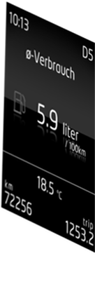
Artemmis Framework & Tool Chain for Automotive Platforms CIA - Drawing Contents to Surface
BUFlet
BUFlet
executes the flipping of buffers
Window
Attach BUFLet
Detach BUFLet
Surface
Paint
Event
Paint into
Buffer
Call Painter
Painter
Painter
base class implementing the paint method
paints its contents into a surface buffer resource
Window
receives the paint event
attaches the buflet for painting
broadcasts the paint to its children
requests a painter (e.g. Widget) for painting
detaches the buflet
Widget
WMapp
43 / R. Bermejo / 13.07.2010 © Continental Automotive GmbH
Notes:
Attach BUFlet
[optional] Do copyback if required
LockFlip
Broadcast paint to all children
painting is done by painting the window and then all children ->preorder traversal
UnlockFlip
Detach BUFlet
[optional] do flip ->

Slide 44
Artemmis Framework & Tool Chain for Automotive Platforms CIA - Time Domains
Caution: Synchronization required !
You may not flip surface 2 while surface 1 is rendering!
VSync
Event
Window
Surface 2
Time Domain
Surface 1
TimeDomain
dispatches paint events to windows
assure the synchronization between dependent surfaces
perform centralized and synchronous flip execution
44 / R. Bermejo / 13.07.2010 © Continental Automotive GmbH

Slide 45
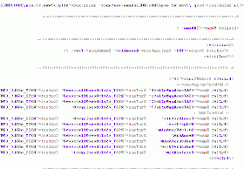
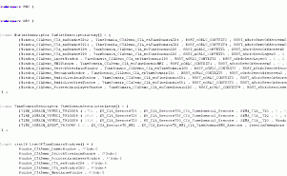
Artemmis Framework & Tool Chain for Automotive Platforms CIA - Main tasks about CIA for a project
Design the CIA assembly
WMapp
Surface
WMapp
Layer
WMapp
WMapp
WMapp
WMapp
Configure the CIA assembly
XML
Data
Conti
HMI Language Compiler
(BRUTUS)
Implement all necessary WMapp‘s
WMapp<1>
WMapp<2>
WMapp<3>
45 / R. Bermejo / 13.07.2010 © Continental Automotive GmbH
Notes:
Design the CIA assembly according the project requirments and need about image assembly and animations:

Slide 46
ACE Basics
46 / R. Bermejo / 13.07.2010 © Continental Automotive GmbH
Notes:
Here we make a short introduction of each other. I start with my background.
Check if all participants have some knowledge about ARTEMMIS, HMI and GS2!

Slide 47
Animation translated into our world…
Animation
A set of blit or rendering (graphical) operations executed over time
Typical operations are Move (Blit), Scale, Rotate and Alpha blending (pixmap, layer).
The preparation is done within a low priority runtime context (event driven TimeDomain of the CIA) by Widgets.
The HMI (EPF) or better the widget controlling the animation and prepares all necessary data for the animation.
Scheduler is responsible for animation lifecycle and animation updates (Scheduler task)
The painting of an animation happens in a high priority runtime context to meet the real-time requirements (CIA TimeDomain)
Has parameters like direction, easing type, duration (Nr. of Frames), …

Slide 48

Animation pipeline
Sample of a possible animation pipeline:
global paint order of operations
Op.Parameter(s)
Op.Parameter(s)
Surface
(off-screen)
Op
Surface
(off-screen)
Op
WMapp
Surface
(HW-Layer)
Surface
(off-screen)
z-Order (local paint order)
WMapp
z-Order (local paint order)
Op
Surface
(off-screen)
Op
Op.Parameter(s)
Op.Parameter(s)
Display
: single buffered surface
: double buffered surface
Op.Parameter
: Start value, end value, Nr. Of frames, easing type …
Op
: Operation impl. by a WMapp (e.g. Scale, Rotate)
Notes:
WMapp = Window Manager application

Slide 49
Animation pipeline
Animation - Pipeline
Defined set of (graphical-) operations with parameters
(Graphical-) Operations are implemented via WMapps and their properties (parameters of operations, static)
The parameters of an operation are modified over time via AnimParam objects with their specific configuration (dynamic)
The pipeline can have an arbitrary number of surfaces (mainly off-screen) to do all the necessary modifications needed to create the final frame for an Animation
A pipeline is executed from left to right within one paint cycle
Static dependencies between all operations, parameters and surfaces (graphical data or better animation bitmaps) used for an animation.
CIA assemblies (surfaces - off-screen or HW-Layer) are the main objects in a pipeline of an Animation
WMapps with their static operations define the basic operations between the assemblies.
AnimParam objects bring in the animation part by modifying the parameters of an operation over time (e.g. move x – Position from 100 to 350 with 50 frames using easing type LinearInOut)

Slide 50
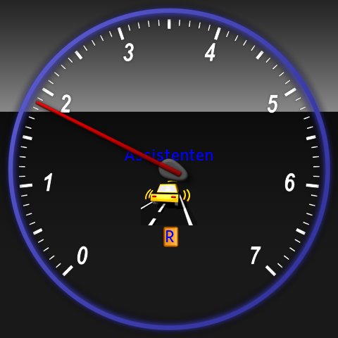
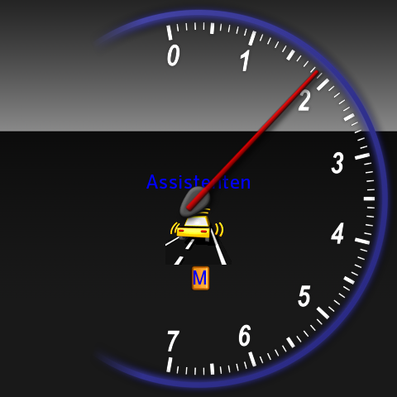
Sample gauge application with 3D (WAG package)
Figure 4‑1 Typical WAG configuration running inside simulation environment. | Figure 4‑2 Same configuration switched to another state.
Notes:
Including 3D pointer and dial animations

Slide 51
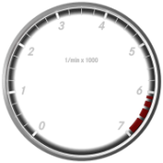
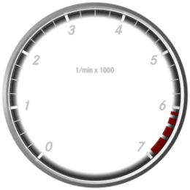
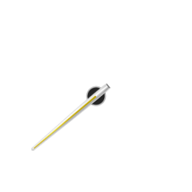

Widget Tree and Composite Window Manager Actions
Widget Tree
Composite Window Manager
Enable
Disable
FadeIn
FadeOut
…
Animation
Preparation
Animation Real-Time Phase
Alpha
Blending
VSync
Pointer Render App
WAG Gauge
WAG_WMAppPointer3D
Visible Surface
Pointer Animation
WAG_AnimControlPointer
Rotation Angle
Interpolator
DPOOL

Slide 52
Data Flow
RSST
3D Data
WAG_
WMAppPointer3D
Composition
Management
Textures
Geometry ?
???
DPOOL
Vehicle Speed
Engine Speed
Values
Coolant Temp.
Rendering
Fuel Level
Surface n
...
Control
WAG_Gauge
WAG_AnimControl Pointer
Control
Composite Window Manager
VSync

Slide 53
Model
53 / R. Bermejo / 13.07.2010 © Continental Automotive GmbH
Notes:
Here we make a short introduction of each other. I start with my background.
Check if all participants have some knowledge about ARTEMMIS, HMI and GS2!

Slide 54
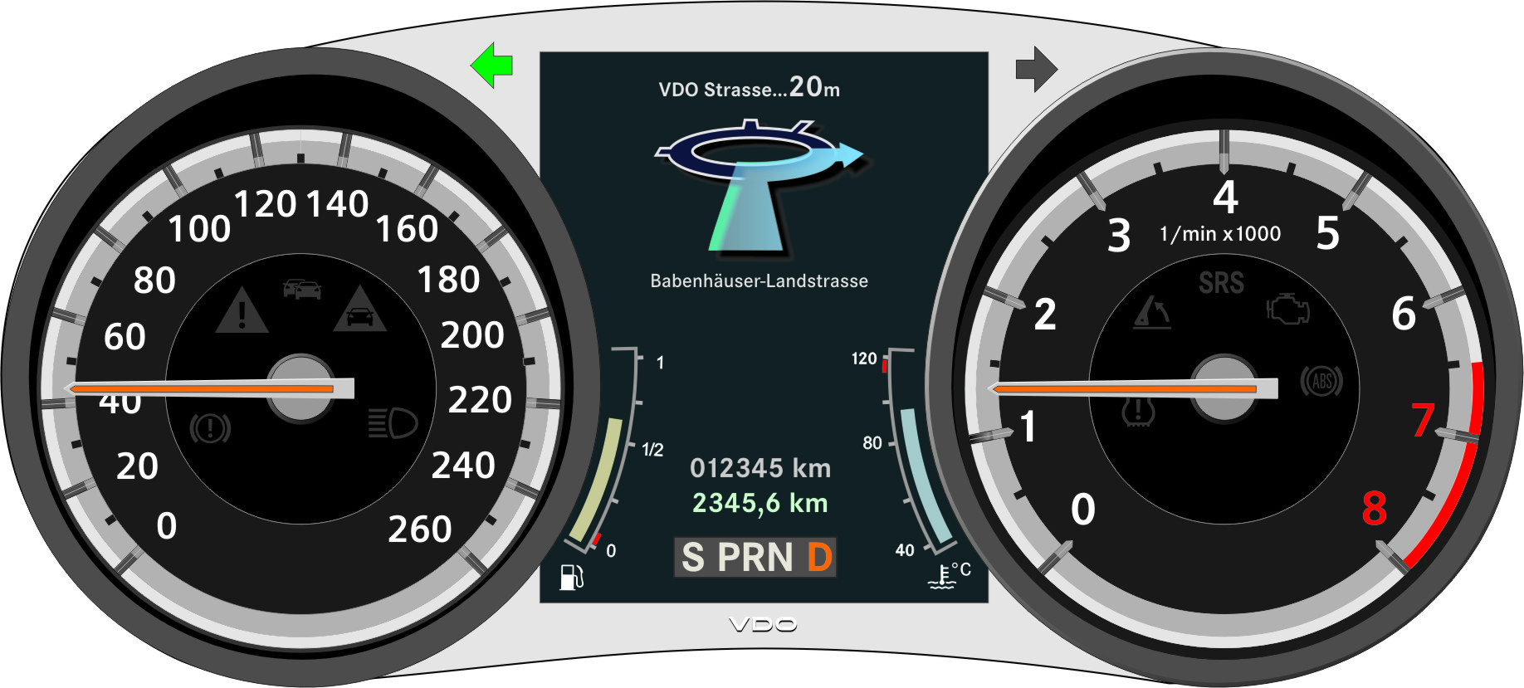
Artemmis Framework Model based approach in Artemmis
HMI Subsystem
Customer
Modeling Tool
Compilable system
Project Specific
Widgets
Customer Tool
Tool generated
code
C++ Compiler
Artemmis
HMI framework
HMI Language Compiler
Brutus
Tool generated
code
Customer model
HMI generated C++ code
BINARY IMAGE
Code Generation
VDO Embedded HMI Language
XML based
Model Description
configs & resources
tools
Resources
RSST export
Cross Compiler
Model Transformation
configurations
PROSECO
Cluster Instrument
…
…
Notes:
Creating all widgets programmatically would be a huge amount of hardcoded widgets and is not easily maintainable. Moreover even during implementation phase it will be hard to work.
All GUI frameworks provide a way to create widget tree by defining it not programmatically, but in a configurable way. This is what we call “model”. Model in Artemmis is a configuration of widget tree plus all resources we would need for it (like images, fonts, …).
Model is described in XML text format in HMI language. This XML description (consisting of many XML files) is processed by “HMI language compiler BRUTUS”. It produces some resource data (used during tree build) and even some code for the defined by the model widget reactions to some messages. This generated code is known as “final hooks” in HMI.

Slide 55
Brutus folder structure
Project.xml -> Top-level project file, specifying all other directories and XML files
ACE -> Directory where animation configurations (storyboard, scene, animation parameter, conflict) are placed
Cache -> Cache configuration for ROMG tool
CIA -> Directory where CIA configurations (BUFlet, time domain, windows, WMApp) are placed
Configuration -> Directory where project-specific configurations (memory, display, event, keys, generated files) are placed
Controller -> Directory where custom decision strategy is specified
Internals -> Internal Brutus configuration is specified here. It’s usually delivered together with the Brutus.exe and not to be modified.
XSD -> Directory where schema files (*.XSD) are placed. Delivered together with the Brutus.exe
Resources -> Directory & settings for RSST Export
API (API.xml) -> API to be implemented and used in the system (also used by API generator)
RSST (grADI_Project.xml and RSST_ExportData.xml) -> specifies graphics resources and configurations for RSSTExport tool
StateMachines -> Directory where state machine specifications are placed
TD -> Directory where widget types and other related widget types are placed
Widgets -> Specify all the visuals (one XML File per visual )
RootVisual (Main.xml) -> Specifies the available displays and the possible visuals (scenes) for each
Note: In examples Model is inside Model\Color folder

Slide 56
Artemmis Framework & Tool Chain for Automotive Platforms Type descriptors
To generate widget builders Brutus needs an information about Widget type. Type descriptors are description of widget classes in XML format inside model.
For every widget class in C++ code which we want to use in model there shall be corresponding definition in XML format inside model.
For example type descriptor for Widget is:
<WidgetType Type="Widget" Namespace="HMI::WFC" DeclarationFile="WFC_Widget.hpp">
<Properties>
<Property Name="PosX" Type="int16" Init="0" Setter="vSetPosX“ Getter="i16GetPosX“ ConstructorDefault="0“ UpdateValueAtTreeChange="true"/>
<Property Name="PosY“ Type="int16“ Init="0“ Setter="vSetPosY“ Getter="i16GetPosY“ ConstructorDefault="0“ UpdateValueAtTreeChange="true"/>
. . .
</Properties>
<Constructor StringOfParameters="(id, begin-&gt;WidgetID +LastConfiguredWindowsID, begin - WRS::VisualDataGetter::pstGetDescriptorByIndex(0))" />
</WidgetType>
ControllerContainer (which inherits from Widget has following type descriptor):
<WidgetType Type="ControllerContainer" Namespace="HMI::WFC" DeclarationFile="WFC_ControllerContainer.hpp" DerivedFrom="WidgetExtension">
<Properties>
<Property Name="ControllerIndex" Type="int16" Init="-1" Setter="boSetStrategyByID" RAM="true" />
<Property Name="ControllerState" Type="uint16" Init="0" Setter="vSetControllerState" RAM="true" Exclude="true" Getter="u16GetControllerState" />
</Properties>
</WidgetType>
Type descriptors are in model inside folder with configurable name defined in file Project.XML as: <TypeDescription>name_of_folder</TypeDescription>

Slide 57
Artemmis Framework & Tool Chain for Automotive Platforms Widgets (Visual Trees)
Tip: Use FileLinks to keep the individual XML files small and manageable
<FileLink Name=“…”/>
Name: Filename of the linked file. Its contents will be treated as if it were expanded into this element’s parent (like include in C language)
Defining a Widget instance / visual tree
<Widget Type=“…” Name=“…”>
<Properties>…</Properties>
<Content>…</Content>
<Transitions>…</Transitions>
Type : The class of the widget (must be declared in TD)
Name : A unique ID for the widget / visual tree
Properties : A list of Property values for the widget (only needed if different from default)
Content (optional) : A list of child Widgets / sub-trees
Transitions (optional) : A list of Transitions (per-instance behavior)

Slide 58
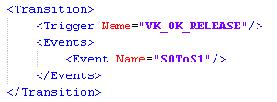
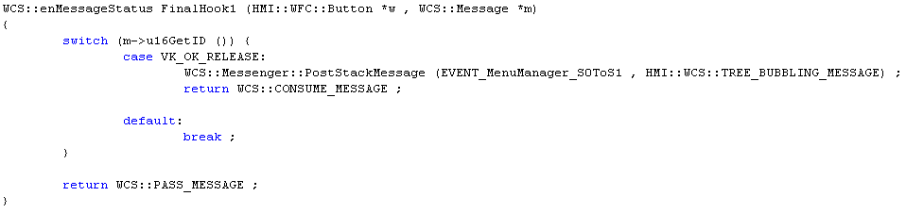
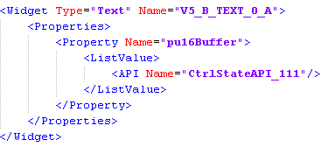
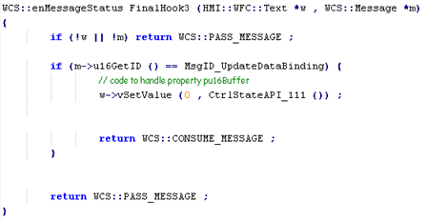
Artemmis Framework & Tool Chain for Automotive Platforms Final Hook
A final hook can be configured for each widget instance in the model.
Here one can define some instance specific behavior in reaction to specified messages.
Each widget call’s its final hook method after its class’s message processing method.
Final hooks are generated by Brutus for each widget depending on the model, and thus are not fully under programmer’s control.
Final hooks support both communication using API or messages.

Slide 59
Simulation
59 / R. Bermejo / 13.07.2010 © Continental Automotive GmbH
Notes:
Here we make a short introduction of each other. I start with my background.
Check if all participants have some knowledge about ARTEMMIS, HMI and GS2!

Slide 60
Simulation environment and toolchain setup Simulation Basics
JCP2011 simulation system is developed by Continental ID Architecture group
The main intention is to speed up development process:
Reduce the dependency to hardwarde availability
Integrator and developers can work in parallel
All developers are able to test their implementation before integration time
Some extra works to be done:
Integrate the same base system, graphics system, and HMI framework into simulation and target. The same configurations of OIL, sdi, sdh, etc are used.
Update both systems whenever there’s update to keep them in sync.
For more information about the features of simulation and new version of the simulation system, please contact the Architecture group.

Slide 61
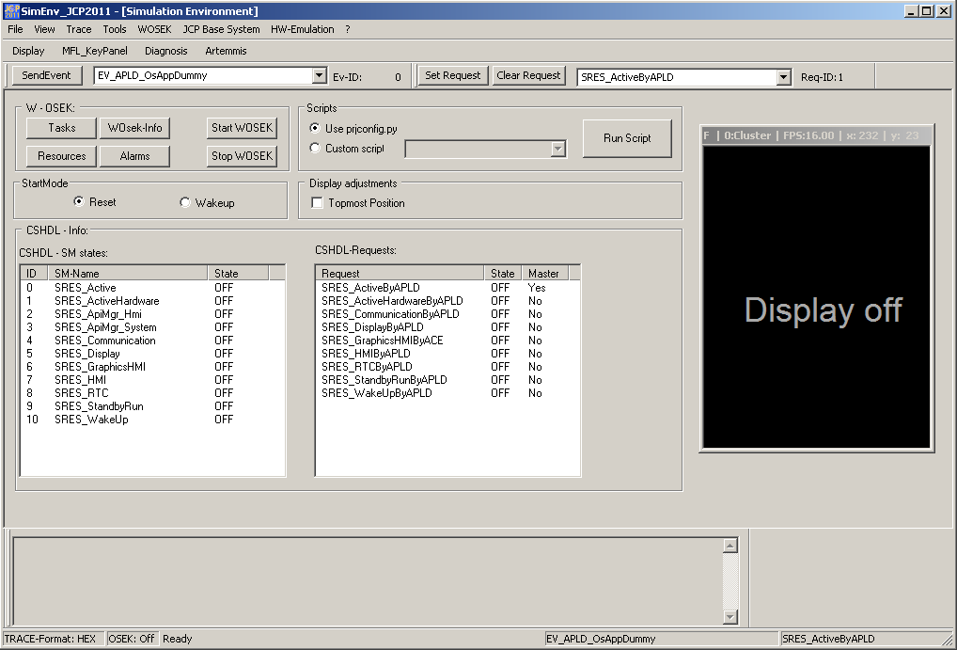
Simulation environment and toolchain setup Simulation Usage
After successful build of the simulation system, you will see the following screen.
4
5
2
Key features:
1. Start WOSEK
2. CSHDL Requests
3. Display area
4. Key panel
5. ARTEMMIS debug
Startup sequence:
Start WOSEK
CSHDL set request for SRES_DisplayByAPLD
Shutdown sequence:
CSHDL release for SRES_DisplayByAPLD
Stop WOSEK
1
3

Slide 62
Integrating HMI

Slide 63
Artemmis Framework & Tool Chain for Automotive Platforms Interdependencies
The HMI Subsystem depends on several packages which are not part of the HMI subsystem itself.
OSEK - Operating system - provide a task model and protection mechanism for critical sections
EXEA - Error log mechanism. - provide mechanism to log errors
APIM - Provide DPool access via API functions. - provide API functions to access data - notify about updated data values
EVHDL - Task activation
RSST - Data storage. - provide access to data based on IDs
GRLC - Graphic library. - provide draw functions for basic primitives, bitmaps, text.
GAUXL - specific package, used for string processing in some widget implementations
GBT - specific package, used for string processing in some widget implementations
Base System
GS2 subsystem
OSEK
RSST
GRLC
EXEA
HMI
GAUXL
EVHDL
GBT
APIM
Notes:
The HMI Subsystem depends on several packages which are not part of the subsystem itself.
The HMI Subsystem architecture follows the principle to abstract external dependencies.
By implementing variants of the internal packages and changing the internal configuration, the HMI Subsystem can also be integrated into other System Architectures and Operating Systems.
OSEK
Operating system. Functional requirements are - provide a task model - provide protection mechanism for critical sections
RSST
Data storage. Functional requirements are - provide access to data based on IDs
EXEA
Error log mechanism. Functional requirements are - provide mechanism to log errors
GRLC
Graphic library. Functional requirements are: - provide draw functions for basic primitives, bitmaps, text.
APIM
Provide system API functions. Functional requirements are: - provide API functions to access data - notify about updated data values
GAUXL
Specific package, used for -String processing in some widget implementations
DPOOL
Data handling mechanism Functional requirements are: - store and load data from non-volatile RAM
GBT
Specific package, used for -String processing in some widget implementations
EVHDL
Specific package, used for - Task activation

Slide 64
Artemmis Framework & Tool Chain for Automotive Platforms System integration
Integration steps
Get the HMI Subsystem delivery from PVCS / MKS
Integrate the HMI Subsystem into the system layer [usually only once] (more details can be found in HMI subsystem documentation)
Update OIL file with necessary HMI / APIM tasks, OS resources, semaphore, etc.
Modify .sdh files if necessary
Prepare the toolchain
Get the necessary tools, for example: Brutus, API generator, APIM generator, sizeof generator, RSSTExport, ROMG, and more (depends on project – cross compilers, etc.)
Design the correct order of tools
Prepare the necessary tool configuration / settings
Add an HMI model, this can be generated in the project, or a sample project delivered together with the HMI Subsystem
Run the toolchain, and if it’s successful, build the project

Slide 65
OIL configuration
Artemmis (excluding APIM) and GS subsystems are generally placed in their own non-trusted OsApp (eg OsApp2)
APIM is placed in OsAppBaseSystem (trusted)
APIM tasks are basic type and fully preemptive
All other Artemmis tasks must be extended type and fully preemptive
Painting tasks (TDEvent, TDCyclic) need access to GOSW, CIA, and ACE event/resource objects
Tasks (From high prio to low):
CIA_Manager_OsApp2
CIA_Manager
ACE_AnimSched_OsApp2
ACE_AnimSched
CIA_TDCyclic_x_OsApp2
CIA_TDCyclic_x
APIMgr & APIMgr_Main
CIA_TDEvent_HMI_OsApp2
CIA_TDEvent_HMI

Slide 66
Artemmis Framework & Tool Chain for Automotive Platforms HMI task model
CompositeManager
OS objects and their properties
Flip_AnimCtrl
high
Generally the highest HMI task (i.e. Flip control) is defined with higher priority than 100ms CAM
The Animation Scheduler task priority is above all Time Domains (Animation Painter) to schedule all animations immediately and predictable!
We need a OS-Resource to sync the Smart-Pointers memory management and the Time Ticks of Animation Painter task against the scheduling
For animation execution we need a low prio HMI time domain to control the animations and at least one time domain (based on VSync) to execute the animation(s)
For animations we need additional to the CIA setup an animation scheduler task with the priority above all time domains executing animations
All CIA / ACE related tasks have to be extended and full preemptive (using Semaphores)
The OS-Resource needs to be attached to the HMI TD, all Anim Painter TDs and the Animation Scheduler
APIMgr and APIMgr_Main have the same priority. They are used to handle different request, i.e. APIMgr_Main handles init/deinit and APIMgr handles all other events.
Task
prio
Anim Scheduler
AnimationScheduler
Consistency Point Control
TimeDomain_1
Animation Painter
OS-Resource
TimeDomain_2
TimeDomain_n
APIMgr
API manager
APIMgr_Main
HMI Msg-Processing
TimeDomain_HMI
Paint of HMI content
low
Consistency Point Control
66 / M. Büttner / 20.03.2010 © Continental Automotive GmbH
Notes:
ToDo:
OS-Resource to sync.

Slide 67
OIL configuration
Semaphores
Each non-event driven TimeDomain needs one Semaphore
CompositeAssembler semaphore (SEMA_CIA__ASSEMBLER)
Events
ACE_osEv_SyncCPAnimNormal
ACE_osEv_SyncCPAnimSelf
CIA_osEv_VSync1EventTD
CIA_osEv_Deinit
Resources
RES_ACE_SyncTimeTickWithScheduler
Trusted functions
APIM__boLock_Tsi
APIM__vUnlock_Tsi

Slide 68
CSHDL / CTHDL configuration
Each system has a different resource tree but this general sequence applies:
ActiveHardware: HMI_vReset, HMI_vWakeup [HMI1.sdh], APIM_vReset, APIM_vShutdown [APIM1.sdh]
…
APIMgr_System: APIM_vDoEventProcessing [APIM1.sdh]
GraphicsHMI (external) : [CTHDL]
GS2 Init
CIA Init
ACE Init
HMI (external) : [CTHDL]
HMI Display On
APIMgr_HMI: APIM_vDoEventProcessing [APIM1.sdh]
ActiveDisplay

Slide 69

Thank you for your attention!

