Slide 1
Artemmis Training – The Simple HMI Business Unit ID
Revision: 1.0

Slide 2
The Simple HMI Definition
Simple HMI world:
Represents the static scenes
Widget
Widget tree structure
Widget visual representation
Applies simple drawing concept
Draws with 1 task and surface
Basic window tree concept
Painter’s algorithm to consider
Supports data binding to modeller (application)
Includes the required behaviors
Widget communication (user interaction, inter-widget links)
Scene management

Slide 3
Static Scene
Representation

Slide 4
The Simple HMI Sample display requirements
Display size: 240 x 320
85 %
Green bar shows the current oil level in the range of 0-100.
Bar size: 200 x 40 pixels (centered)
Text displays the numeric value of the bar above.
Center aligned in the middle of the display.
Font : Calibri 30
Color: Red
Image change to sad face when value < 20, and smiley when value > 70. In all other case, It’s not showing.

Slide 5
Widget Concept
Definition:
A widget (window gadget) is an element of a Graphical User Interface (GUI) that displays an information arrangement changeable by the user
Characteristics:
has a set of properties that can be linked to a model
has a view part that draws the widgets
has a controller part that defines the behavior of the widget
reacts on user interaction
follows an object oriented approach
can be arranged hierarchical
Widget
Model
Properties
View
Controller

Slide 6
Widget States (1)
The following are the various states of the widgets:
New: Newly constructed widget.
Init: Widget has received Tree Init notification and is going through initialization for the first time.
Running: Widget has been initialized. At the end of tree build/change it will receive Tree Build Done notification.
Changing Trees: Widget has been detached from old tree and being moved to new tree.
Prepare To Destroy: Widget is being destroyed as it is not present in the new scene.
Init Again: Widget has been attached to a new tree and has received Tree Init notification.
Running Again: Widget is back to stable in a new tree.

Slide 7
Widget States (2)

Slide 8
Widget States (3)
Widget Builder
New
Init
Running
Construction
IsStateNew = true boIsReadyForClientAccess = false
Properties initialized
TreeInit message
Pre Hook
State change
Time
Property propagation
Final Hook
IsStateNew = false boIsReadyForClientAccess = false
API values copied
Tree is fully built
State is changed
to Running instantly (no message)
for entire subtree
State change (instant, no message)
TreeBuildDone message
Message Hooks
IsStateNew = false boIsReadyForClientAccess = true

Slide 9
Widget Base Properties
Widget base class defines the base properties which are inherited by all widgets. The initial values of these properties are configured in the model.
Focus This property determines the path of focused message in widget tree.
Focusable This property determines whether a widget instance is allowed to be set to Focused.
Visibility This property determines whether or not a widget should be drawn on the display.
Enabled This property is another property of widget instances, although it doesn’t have any effect internally, it is available for use by clients.
Do Update This property determines whether or not an instance is allowed to receive API updates.
Each widget has its own property, but the actual effect is taking place when the cummulative value from root until the widget are all true. For example: we have this constellation => root (visible) – A (invisible) – B (visible) In the actual display: A and B are both not visible!

Slide 10
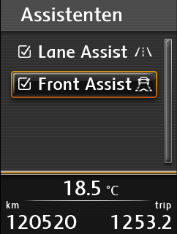
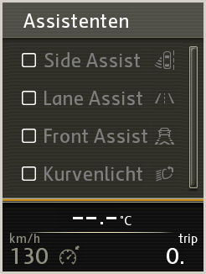
Example – Widget Properties
Not Focused, Enable, Visible,
Not Focused, Disable, Visible,
Not Focused, Disable, InVisible,
Focused, Enable, Visible,

Slide 11
Widget Classes, Widget Objects & Widget Tree
Widget Objects
Memory Representation: Widget Object Tree
Visual Representation
Widget Classes
Scene
#1
Frame
Title
TextArea
Section
A
Section
B
Frame
Clock
ListBox
Date
Title
ListBox
ScrollBar
Language
Country
Button
Back
Clock
Date
Lang
Country
Back
ScrollBar

Slide 12
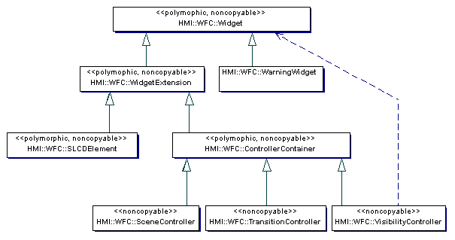
Widget Base Classes
The framework provided a basic set of widgets in WFC package
WidgetExtension: empty implementation where project can add own attributes
Controller widget type: has a link to state machine / controller strategy
SLCDElement: base class for SLCD widget (special paint for SLCD module)
Warning widget: special widget to be used with WWS package
Sample widgets: Image, StaticText, Text, ListBox, Button, ToggleButton – not in official delivery

Slide 13
Workflow – Custom Widget implementation (1)
Design
Think about:
Properties (data, logical, visual)
Class Inheritance/Hierarchy
Behavior
Class-level
Instance-level (via generated final hooks)
Re-use possibilities
Also consider: maybe a Scene Manager + StateMachine + primitive widgets (images, texts) are sufficient!

Slide 14
Workflow – Custom Widget implementation (2)
Implementation
Create an XML Type Description for your WidgetType
Implement the C++ code:
All your XML-declared property setters
WCS::enStatusMessage enProcessMessage(Message *m)
Check the message ID, type and (optionally) data, implementing functionality if necessary, like:
Change properties, fire events, etc.
Invalidate if necessary, to cause a repaint
Return the correct status (eg, CONSUME to remove the message)
void vDraw( uint16 u16GRLCContext )
Call GRLC functions to render your widget state
Note: Coordinates provided to GRLC calls (eg GRLC_vDrawBitmapAt( x, y )) are relative to the widget’s position (relative to top left widget corner)

Slide 15
Simple Drawing Concept

Slide 16
Widget Visualization (1)
A Widget object covers a rectangular area on the display (that is widget window), which is determined by its x- and y-position and by its x- and y-dimension (size and height).
A Widget Tree consists out of Widgets in parent-child relationship
A child widget is always visually contained inside a parent widget. It may never exceed the bounding box of its parent (Containment relationship), and the position values are relative to parent window.
Widgets are allowed to overlap on the display
If two widgets have an overlapping area, the z-position of the widget determines, which of both will be rendered in the front and which will be rendered behind the other widget
Widget z-positions is implicitly defined or can be set explicitly
If the z-position of a widget is not explicitly set, its z-position is determined by its position within the widget tree (implicit z-positioning) by the use of a depth-search algorithm
The rendering sequence of multiple widgets is executed from lowest z-order to the highest z-order (shown in red numbers)
Lowest z-order
→ „Back“
1
Scene
#1
2
Section
A
4
Section
B
Title
5
ListBox
11
ScrollBar
3
Clock
Date
Lang
Country
Back
6
7
8
9
10
Highest z-order
→ „Front“
Rendering Sequence

Slide 17
Widget Visualization (2)
CIA controls the painting on the display. Therefore, the base widget class derives from CIA::Painters.
When CIA orders its painter (widget) to paint, a drawing function of widget will be called.
Widget’s method vDraw is is the place to specify the widget’s visual representation by calling relevant GRLC methods.
Some rules:
Always call Widget base class vDraw method at the beginning of derived widget’s vDraw. It will perform the clearing of widget’s window area before redrawing the content.
Pass on the drawing properties (composition mode, font, alignment, etc) as necessary to relevant GRLC function calls during draw.
Drawing position to be passed to GRLC is relevant to the widget window’s position / size and is dependent on alignment.
Drawing context attribute is reset by framework before painting each widget. Don’t assume the previously set context Is still valid!
17 / T. A. Devi / ID RD CDS HF / Dec-2012 © Continental Automotive Singapore

Slide 18
Image Assembly
Widget Tree
Window
contains the view of one or more widgets
can be stacked in z-order (overlapping)
is used to decompose a scene
is painting on a surface
is not buffered
accesses the surface to draw its contents via a BUFlet
can be transparent (true/false), but has no alpha-channel
Widget
Widget
BUFlet
-manages the buffers of a surface
-handles the flip operation
-hides the buffer management to the windows
-optimizes the drawing operations on surface level
-handles drawing contexts
BUFlet
Surface
has a relation to a buffer (off-screen or layer)
has an alpha channel
can be stacked in z-order (overlapping)
is visible or invisible
Srfc
Buffer
Srfc
Buffer
Srfc
Buffer
Notes:
Flip handling of surface is done by framework => for multiple buffer surfaces
Only layer will be shown on display

Slide 19
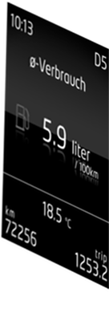
Drawing Contents to Surface
BUFlet
BUFlet
executes the flipping of buffers
Window
Attach BUFLet
Detach BUFLet
Surface
Paint
Event
Paint into
Buffer
Call Painter
Painter
Painter
base class implementing the paint method
paints its contents into a surface buffer resource
Window
receives the paint event
attaches the buflet for painting
broadcasts the paint to its children
requests a painter (e.g. Widget) for painting
detaches the buflet
Widget
WMapp

Slide 20
System Integration Task model and execution
high
…
Task
prio
CIA_TimeDomainHMI
EPF
CIA
CIA_Manager
CIA_Manager
CompositeManager
Process Msg‘s
…
Paint
CSHDL_InitDeinit
Filp (sync.)
CIA_TimeDomainHMI
HMI Msg-Processing
Paint of HMI content
IDLE
low
All CIA related task‘s have to be extended and full preemptive (using Semaphores)
Notes:
You have to configure in AROS the TimeDomain_HMI and to configure the CIA event usage in that task within the CIA.sdh configuration file.
The CIA – Manager can be used in an exisiting event driven context

Slide 21


Painter’s Algorithm
How would a painter draw this scene?
How would the window tree look like?
21 / T. A. Devi / ID RD CDS HF / Dec-2012 © Continental Automotive Singapore

Slide 22
Painter’s Algorithm
Paint the sky
Paint the sun
Paint the cloud
Paint the ground
Paint the tree
Window tree:
Root
Buflet
(surface)
Clear
Widget tree
root
Generally, for widget painter, window tree is equal to widget tree. Widget window is also implicitly managed by the widget.
Sky
Section
A
Section
B
Widget window tree
Sun
Cloud
Ground
Tree
22 / T. A. Devi / ID RD CDS HF / Dec-2012 © Continental Automotive Singapore

Slide 23
Demo 1 Sample display requirements (revisit)
Display size: 240 x 320
85 %
Green bar shows the current oil level in the range of 0-100.
Bar size: 200 x 40 pixels (centered)
Text displays the numeric value of the bar above.
Center aligned in the middle of the display.
Font : Calibri 30
Color: Red
- For first static scene,
hard-coded value 85% is used
- Default state for Smiley SM is
happy
Image change to sad face when value < 20, and smiley when value > 70. In all other case, It’s not showing.
Ignore this part for now!

Slide 24
Demo 1 Display decomposition
Break down the scene into smallest possible entities (i.e. widgets)
Identify if we need special type of widget
Do we need extra attribute?
Do we need special behavior support?
Create the widget tree structure
Consider painter’s algorithm
Widget and window tree:
Root
Buflet
(surface)
Clear
Widget tree
root
Scene
#1
85 %
(1) Special widget: SimpleGauge
Simple
Gauge
Text
Visibility
Controller
(2) Text widget (dynamic and RSST ID)
Sad
Happy
(3) Visibility controller + 2 image widgets

Slide 25
Demo 1 Creating Custom Widget: SimpleGauge
Set MinValue=0, MaxValue=100 (assumed to be not changeable)
CurValue initial value to be defined in model
FgColor and BgColor can be changed via model. Default: as above.
Use the GRLC_vPrimSetDrawColor & GRLC_vFillRect methods
Implement C++ class to realize the widget
FgColor
BgColor
MaxValue
MinValue
CurValue

Slide 26
Demo 1 Bridging model world and code
Brutus only understands HMI XML language
Need to translate widget classes (C++ code) to XML (i.e. type descriptor)
Type descriptor must be added for new derived widgets / WMApps only
Only properties and methods listed in type descriptors can be used in model
TD folder => collection of type descriptors
Type descriptor:
Specify declaration file (the actual C++ header file)
Specify the properties which are accessible from model
Specify setters and getters (if necessary)
Specify the init / default values of those properties
Specify constructor and its string of parameter
Specify methods which are callable from model

Slide 27
Demo 1 Graphical Resources Preparation
RSSTExport tool
Create / modify grADI_Project.xml and RSST_Export.xml
Usually the 2 files work as a pair with grADI focuses on specifying input files or model related values and RSST focuses on the output or target configuration.
Important tags to look out for:
Language, PixmapResource, PixFontResource, StringResource, ColorFormat/PixFormat, Dependency, SurfaceDescriptor, TargetConfiguration
ROMG tool
Create / modify Cache.xml
Important section: ApplicationCache
Surfaces => memory linked to SurfaceDescriptor configuration in RSST
Cardinality = #buffers, memory size = width*height*pixel depth
Texts and TmpTexts => memory for text decompression
Notes:
For more detailed training of both tools, contact the Graphics group

Slide 28
Demo 1 Modelling the widget tree
Widgets folder => to add widget tree model
Define the widget structure according to the tree we have designed
Each file can represent a single widget or a subtree
“FileLink” is used to link the subtree within 1 XML to another widget (sibling / child)
Specify the object specific properties => overwrite the default from TD
Example: width, height, position, focused, visible, etc.
Root
Buflet
(surface)
Clear
Widget tree
root
Widget tree structure
Scene
#1
Simple
Gauge
Text
Visibility
Controller
SM
Just config basic default state for now
Sad
Happy
Individual widget objects

Slide 29
Demo 1 Modelling the drawing task and image assemblies (1)
CIA folder => to configure drawing task (time domain) and assemblies (buflets, windows, ...)
Time domain used for simple HMI is linked to the low prio HMI task
TaskID, OSApplication, DisplaySyncEvent -> must be defined accordingly in OIL file
Trigger="TIME_DOMAIN_EVENT_TRIGGER"
HMITimeDomain="true“
BUFlet => Link to the RSST surfaces
Display => mapping the display configured in Configuration.xml to the HMI layer
WMApps
Non-widget painter, example: to clear the whole surface with single color
Will be used a lot in advanced HMI

Slide 30
Demo 1 Modelling the drawing task and image assemblies (2)
Windows
A root window links a BUFlet (place to draw) and TimeDomain (drawing task)
Each BUFlet must have a root window
ALL windows defined in CIA folder will be alive all the time (as long as the BUFlet exists)
Define the window structure according to the tree we have designed
Assign a painter to draw a content in the window
Widget / WMApp
For widget window sub-tree, only the root window needs to be defined explicitly
Painter: widget tree root
Root
Buflet
(surface)
WMApp
painter
Clear
Widget tree
root
Widget
Painter
(root)
Scene
#1
Simple
Gauge
Text
Visibility
Controller
Sad
Happy

Slide 31
Application Data Binding

Slide 32
Sample display requirements (revisit + additional requirement)
Display size: 240 x 320
85 %
Green bar shows the current oil level in the range of 0-100.
Bar size: 200 x 40 pixels (centered)
2 widgets
linked to
1 application
Text displays the numeric value of the bar above.
Center aligned in the middle of the display.
Font : Calibri 30
Color: Red
Oil level application:
Start at value 0
Increased every second by 5% until 100%
Image change to sad face when value < 20, and smiley when value > 70. In all other case, It’s not showing.
API design:
ONCHANGE
Buffered
Getter
Ignore this part for now!

Slide 33




API Manager
“API Manager“
- communicates between Applications and Embedded HMI Framework (EPF).
TOOLING
Model
XML
Code
Generator
<<defines>>
EMBEDDED
API
API
API
API
API
Manager
Embedded
HMI
Framework
Application
Mirror
DPOOL
<<uses>>

Slide 34
Use Case A1 - First XML delivery
„Start of development“, no API yet implemented
Generate API declarations according to the XML „Performance Specification“
Generate „Prototype“ API Implementations and Configurations (sdh-files)
API
xml
API Generator
HMI Performance
Specification
Stubs /
templates
Implement
Api.c
files
sdh
files
h
files
ODO
Api.c
ODO
sdh
<<includes>>
Constant
Developer
API
csv
API
txt
API
1c1.h
<<includes>>
Notes:
API.xml entry with parameter is assumed to be setter
If it’s actually a getter API, app developer must change it in sdh

Slide 35
Use Case A1 - First XML delivery
To implement an API the developer …
… shifts the generated (ONLY these)
… API configuration from one of the generated sdh-file to his module
… API implementation from one of the generated c-files to his module
Deletes the dummy data definitions (DPOOL stuff) referenced by the generated API
(only if DPOOL is already defined by existing modeller / application)
In order to see the API function prototype, the data IDs from the API Manager etc.
the module must #include „API_c1.h“
The API prototype must be kept in the generated header files, do not move somewhere else!
Notes:
If application is new, we can use the generated DPOOL stubs and adapt the app code accordingly

Slide 36
Use Case A1 - First XML delivery
The developer has to change a special javadoc comment in order to document
the implementation status of the API
Prototype
Under Development
Implemented
Obsolete
Generate
int32 bap_navi_TimeToDestination_TimeInfo_Year ( void ) /* @status Prototype*/
{
/******************************************************************************************
* Funktion gibt den Jahres-Wert zurueck. Der Wert ist nur Verfuegbar, wenn als
* TimeInfoType "ArrivalTime" gewaehlt wurde.
* @response => ONCHANGE
* @return => int32
* @param void
******************************************************************************************/
int32 Value;
APIM_boGetData( APIM_nData_API_bap_navi_TimeToDestination_TimeInfo_Year , &Value, (uint16)sizeof(Value) );
return ( Value );
}
Notes:
Potential issue if comment is not updated properly: duplicates of API as it’s generated again
Only Prototype is a must, other name can be configurable

Slide 37
Use Case A1 - First XML delivery
Prototype
Under Development
Implemented
Obsolete
Generate
int32 bap_navi_TimeToDestination_TimeInfo_Year ( void ) /* @status Development */
{
/******************************************************************************************
* Funktion gibt den Jahres-Wert zurueck. Der Wert ist nur Verfuegbar, wenn als
* TimeInfoType "ArrivalTime" gewaehlt wurde.
* @response => ONCHANGE
* @return => int32
* @param void
******************************************************************************************/
// In order to implement this function, I, the developer changed the comment above
// and will right now start to fill the function with very good code …
return ( 0 );
}
Notes:
For non-prototype, the sdh definition will not be regenerated
Sdh should be modified as per required

Slide 38
Use Case A1 - First XML delivery
Prototype
Under Development
Implemented
Obsolete
Generate
int32 bap_navi_TimeToDestination_TimeInfo_Year ( void ) /* @status Implemented */
{
/******************************************************************************************
* Funktion gibt den Jahres-Wert zurueck. Der Wert ist nur Verfuegbar, wenn als
* TimeInfoType "ArrivalTime" gewaehlt wurde.
* @response => ONCHANGE
* @return => int32
* @param void
******************************************************************************************/
DPOOL_tstTimeInfo stTimeInfo = {0};
if( APIM_boGetData( APIM_nData_TimeInfo , &stTimeInfo, (uint16)sizeof(stTimeInfo) ) )
{
if( stTimeInfo.biType != TIMEINFO_nType_ArrivalTime ){
stTimeInfo.i32Year = TIMEINFO_nInvalidYear; // return -1 if ArrivalTime is not selected
}
}
return ( stTimeInfo.i32Year );
}

Slide 39
Use Case A1 - First XML delivery
The code (./src and ./packages) is searched for available API implementations by the used javadoc comment „@status“ behind the closing bracket of the function parameter list
If an implementation is found, the automatic API prototype generation is skipped
For the code parsing the implementation files need to follow a clear naming convention in order to keep the runtime in an acceptable range of some seconds.
<PACK>_<something>_Api.c

Slide 40
Use Case A2 – Successive XML deliveries
The API’s are now implemented, some might still have “Prototype” status
The tool now only needs to generate new API functions
It must report all deviations between declaration (xml) and definition (implementation)
In below example an existing ODO API implementation deviates to the new xml declaration
API Generator
ODO
c
API
xml
ODO
c
ODO
c
ODO
Api.c
Implement
Developer
ODO
c
ODO
sdh
Templates
For new APIs
c
files
sdh
files
h
files
communicate
<<includes>>
Constant
API
csv
API
txt
API
1c1.h
API
log
FV

Slide 41
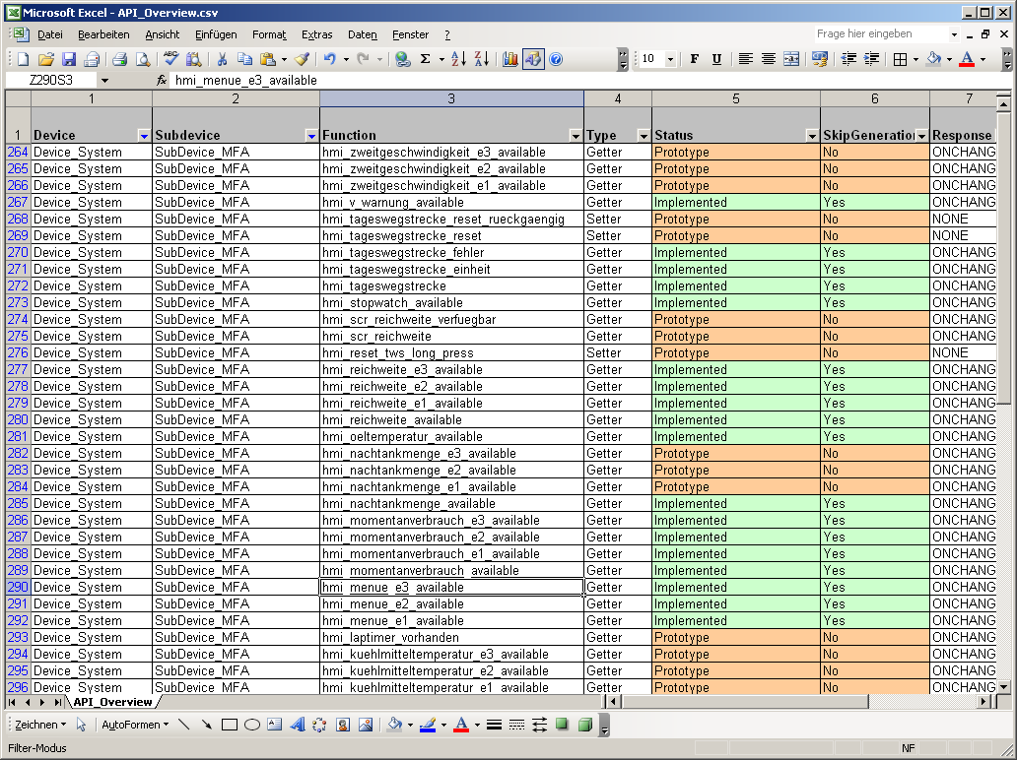
Use Case A2 – Successive XML deliveries
The tool will notice the deviation and report errors or warnings as shown in the matrix on the first slides.
The tool will generate a csv which shows the implementation status

Slide 42
Demo 2 Data binding implementation
Define the API at API.xml according to our API design
Getter, buffered, ONCHANGE
APIGenerator tool
Generate: .sdh, .c, .h
Move .sdh and .c to the application module folder
Implement the API logic (if necessary)
Update javadoc comments
APIMGenerator tool
Generate: .sdh
Run Toolchain (important chain: APIGenerator – APIMGenerator – Proseco)
Bind the API with widget
Run Brutus

Slide 43
Static Scene
Behaviors

Slide 44
Sample display requirements (revisit + change of requirement)
Display size: 240 x 320
85 %
Green bar shows the current oil level in the range of 0-100.
Bar size: 200 x 40 pixels (centered)
Text displays the numeric value of the bar above.
Center aligned in the middle of the display.
Font : Calibri 30
Color: Red
Oil level application to be controlled by user:
Key RIGHT : increase oil level by 5%
Key LEFT: decrease oil level by 5%
Image change to sad face when value < 20, and smiley when value > 70. In all other case, It’s not showing.
Behavior aspects:
Messaging
(Sub)scene management
Property link
Guard / Condition

Slide 45
Widget Communication Overview
There are two ways by which external entity can communicate with the widgets, through Messages and through API (data binding). Besides external tasks, messages are also used for internal communications between widgets.
API Widgets can be configured for exchanging data with external entity through APIM and DPOOL
Messages All widgets can receive information or command in form of WCS::Message objects. WCS::Message can carry message ID, type, and memory pool ID, as well as optional receiver ID, and data. The main message receiving interface of the widgets is Handle-Message which consists of these processing:
Class-specific message processing (Process-Message)
Instance-specific message processing (Final-Hook)
Optional special hooks

Slide 46
Widget Communication Process Message
Widget base class implements generic mechanisms of message processing.
Each widget class may define special behavior or response towards a message, based on message type, ID or data when the message is received, or choose to ignore them.
All derived classes should call their parent class’ message handler method before their specific implementation in order not to miss generic implementations of its base classes.
When derived widget doesn’t define its own ProcessMessage method, the implementation from the base class is used.
It is important for widget to return a correct “message status” after processing the message (in any message processing method / hook). There are 3 possible values:
BLOCK_MESSAGE Stop the tunneling propagation for this message and start the bubbling process
PASS_MESSAGE Widget did not do anything, and message should be propagated further.
CONSUME_MESSAGE Widget reacts on the message, and therefore message should be destroyed.

Slide 47
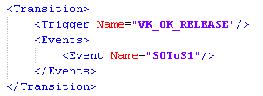
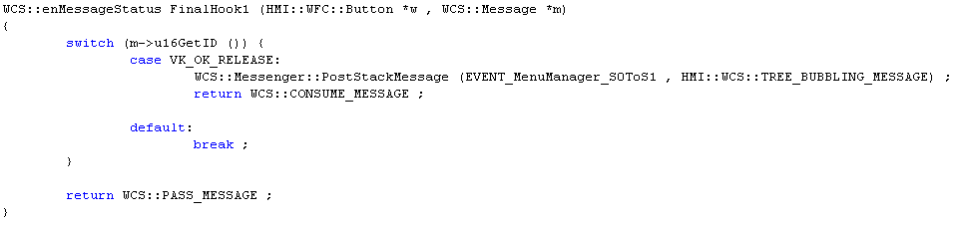
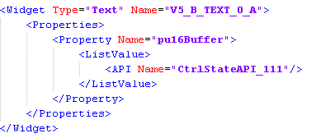
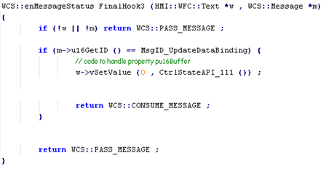
Widget Communication Final Hook
A final hook can be configured for each widget instance in the model.
Here one can define some instance specific behavior in reaction to specified messages.
Each widget call’s its final hook method after its class’s message processing method.
Final hooks are generated by Brutus for each widget depending on the model, and thus are not fully under programmer’s control.
Final hooks support both communication using API or messages.

Slide 48
Widget Communication Special Hooks
Firstly, there are 3 non-virtual methods:
PreMsgHook_
MiddleMsgHook_
PostMsgHook_
These methods implement the widget-generic mechanisms, and are not supposed to be over-written.
Currently, only PreMsgHook_ is in use, while the other two are only for future extensions.
Then, there are 3 virtual methods:
PreMsgHook
MiddleMsgHook
PostMsgHook
These methods are supposed to be over-written (if necessary) with project-specific implementations.
In the base class MiddleMsgHook is responsible for preventing Tunneling messages from entering Final Hook. Therefore, project specific overrides must also take over this role.

Slide 49
Widget Communication Handle Message
The main method for processing message, HandleMessage, has calls to these new methods before, after and in-between calls to ProcessMessage and Final Hook as below:
HandleMessage (Message m) { PreMsgHook _ (m) ; PreMsgHook(m) ;
enProcessMessage (m) ; // class specific method for processing messages
MiddleMsgHook _ (m) ; MiddleMsgHook(m) ;
pfGetFinalHookFunc () (this , m) ; // calls final hook of the widget
PostMsgHook _ (m) ; PostMsgHook(m) ;
}

Slide 50
Widget Communication Messaging – Generating Events (1)
Where can you generate events (i.e. post HMI message) from, via the model?
Widgets (final hooks)
Property changes (OnChange)
Transition
State machines
OnEntry / OnExit
Transition
Two key attributes in the model:
Storage : where the message will be stored temporarily It influences the message delivery order.
Propagation: how the message will be delivered to the widget (propagation strategy)

Slide 51
Widget Communication Messaging – Generating Events (2)
There are mainly 4 different set of interfaces supported, depending on the storage where the message is posted.
WAS::Framework::PostMessage
enqueue messages to the external message queue.
The memory location used for all these messages is the Memory pool for External messages.
All message types may be posted to the external message queue.
Xml example:
<Event Name="MyWidgetEvent1" Storage="External" Propagation="TopDownBroadcast"/>

Slide 52
Widget Communication Messaging – Generating Events (3)
WAS::DisplayController::PostMessage
enqueue messages to the internal message queue of a specific display controller.
The memory location used for all these messages is the Memory pool for Internal messages associated to the display controller which was used during the call.
Only a restricted set of messages may be posted here: TREE_BROADCAST_MESSAGE, TREE_TUNNELING_MESSAGE, ADDRESSABLE_MESSAGE, DIRECT_MESSAGE and TREE_BROADCAST_BOTTOM_UP_MESSAGE
Xml example:
<Event Name="MyWidgetEvent1" Storage="Internal" Propagation="Addressable" Receiver="V0"/>

Slide 53
Widget Communication Messaging – Generating Events (4)
WCS::Messenger::PostStackMessage
enqueue messages to the MessageList.
The memory location used for all these messages is the EPF memory pool.
Only a restricted set of messages may be posted here: TREE_BROADCAST_MESSAGE, TREE_BUBBLING_MESSAGE, ADDRESSABLE_MESSAGE, DIRECT_MESSAGE and TREE_BROADCAST_BOTTOM_UP_MESSAGE
Xml example:
<Event Name="MyWidgetEvent1" Storage="Stack" Propagation="Addressable" Receiver="V0"/>
Notes:
Default storage
Default propagation: bubbling

Slide 54
Widget Communication Messaging – Generating Events (5)
WCS::Messenger::SendMessage
send messages directly (they are executed in the same function call i.e. the calling method does not return until the message is not sent and processed).
All messages generated during this process are local objects on the stack, so they are not created using HMI memory manager and they don’t need to be deleted.
Only a restricted set of messages may be posted here: TREE_BROADCAST_MESSAGE, ADDRESSABLE_MESSAGE, DIRECT_MESSAGE and TREE_BROADCAST_BOTTOM_UP_MESSAGE
Xml example:
<Event Name="MyWidgetEvent1" Storage="Direct" Propagation="Addressable" Receiver="V0"/>

Slide 55
Widget Communication Messaging – Direct Message Registration
Direct message is a message which sent only to registered receivers. The list of receivers must be specified in the model. Affected xml: Configuration.xml : <Display> : <DirectMessage>
To-do: - Define List of Direct Messages per widget instance / class - Direct Message can be an integer, enum, Virtual Key => During runtime: These Direct messages are sent to these widgets without tree propagation.
Configure Receiver List:
<DirectMessaging>
<Widget Name="V0_B">
<DirectMessage>4</DirectMessage>
</Widget>
<Type Name="Container">
<DirectMessage>12</DirectMessage>
<DirectMessage>23</DirectMessage>
</Type>
</DirectMessaging>

Slide 56
Scene Management Controller Widget (1)
“Controller Widget” is special type of widget which has a role to manage the sub-tree below it
Each controller widget has a state machine attached to it, to specify all possible sub tree constellation / state
Multiple controller widgets may exist in one widget tree
There are 3 types of Controller Widget in WFC:
SceneController
VisibilityController
TransitionController
Scene Controller
Tree Builder
Scene Controller
Scene Manager 1
Scene Manager 2
VisibilityController
Scene Manager 3
TransitionController

Slide 57
Scene Management Controller Widget (2)
SceneController applies Lifecycle Control:
Not all its children are alive at the same time
The lifetime of children is specified by the state
When the state changes, it instructs Tree Builder to build / destroy its children as per need
It’s memory efficient, but may take more runtime during the state change
VisibilityController applies Visibility Control:
All children all alive at the same time
Visibility of children is specified by the state
When the state changes, it changes the visibility of its children as per need
It needs more memory, but has very fast reaction and able to react on messages
TransitionController is a special type of SceneController
It allows both old and new tree alive until an explicit “destroy” is requested for the old tree
It is taking more memory than the usual SceneController
Usecase: to support transition animation
Notes:
Influence on messages received
What happened with common widget?

Slide 58
Scene Management State Machines
There are 2 kinds of state machine provided by the framework:
Classical SM (flat)
Hierarchical SM (with sub-states)
Within one widget tree, multiple state machines can be applied
ARTEMMIS State-Machine supports
States
Transitions [Events, Guards, Actions, TargetState]
OnEntry / OnExit [Events, Guards, Actions]
History (shallow / deep) – only for Hierarchical SM
A Transition always will be triggered by a message, which leads to a state change or which stays in the current state (self-transition)
An action (as a result of a transition) can be a method invocation, an API update or the generation of new messages
S1: Play
S2: Settings
classic
state machine
S3: Help
Hierarchical
state machine
S0: Top State
S1: Radio
S11: Play
S2:
Help
S12: Setting

Slide 59
Special Modelling Topic Guards
A guard works like a filter. The evaluation of the guard is performed to decide which action to take or whether the action is to be taken. A guard is just a simple C++ expression which in the end will evaluate to a Boolean value.
There are 2 ways to represent guards:
XML tag with operator => supports unary, binary, ternary operators
Example: for a guard if (2!= TestAPI())
<Guard>
<BinaryOperator Operator="!=">
<Term>
<Constant>2</Constant>
</Term>
<Term>
<API Name="TestAPI">
</Term>
</BinaryOperator>
</Guard>
Condition string => more details at HMI XML language, or the schema
Example: for a guard if (2!= TestAPI())
<Guard Condition="2!=.API{TestAPI}()"/>
Notes:
Add the context where guard is placed

Slide 60
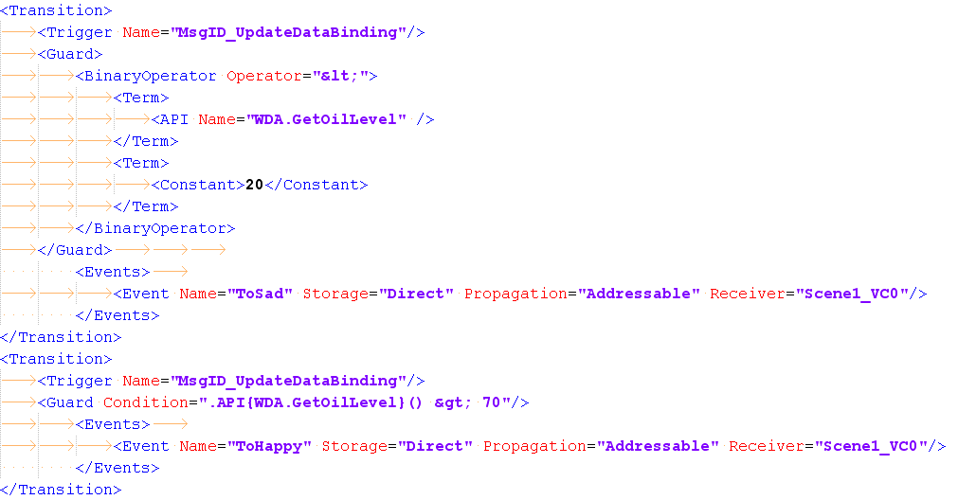
Special Modelling Topic Guards - example
If(WDA.GetOilLevel() < 20)
If(WDA.GetOilLevel() > 70)

Slide 61
Special Modelling Topic Property Links
A property link is a reference to a property of a widget instance
Property links can be used
for property values
<Property Name="Visible"> <PropLink WidgetName=“MyWidget" PropertyName="Visible" /> </Property>
in guard conditions
<Term> <PropLink WidgetName=“MyController" PropertyName=“CurrState" /> </Term>

Slide 62
Demo 3 Sample display requirements (revisit + change of requirement)
Display size: 240 x 320
85 %
Green bar shows the current oil level in the range of 0-100.
Bar size: 200 x 40 pixels (centered)
Alternative:
Use proplink
Text displays the numeric value of the bar above.
Center aligned in the middle of the display.
Font : Calibri 30
Color: Red
Oil level application to be controlled by user:
Key RIGHT : increase oil level by 5%
Key LEFT: decrease oil level by 5%
Image change to sad face when value < 20, and smiley when value > 70. In all other case, It’s not showing.
API design:
ONCHANGE
Buffered
Setter
Widget tree transition:
Event for SM depends
on oil level value.
3 states identified.

Slide 63
Demo 3 Messaging, SM, DataBinding, Guards, PropLink
Implement enProcessMessage of SimpleGauge:
If msg ID = VK_RIGHT_RELEASE , CurValue += 5
If msg ID = VK_LEFT_RELEASE , CurValue -= 5
Take care of max and min value
Implement API setter linked to CurValue property
Complete the state machine definition
3 states represents sad, none, happy
Possible transition between these states
Implement widget tree transition with guards
If CurValue < 20, send event to change from normal to sad
If 20 <= CurValue <= 70, send event to change from sad to normal
If CurValue > 70, send event to change from normal to happy
PropLink between CurValue of SimpleGauge and text widget value

Slide 64

Thank you for your attention!

Slide 65
HMI XML Language

Slide 66
Widget Configuration Widget type descriptions
Definition of all available Widget types (base classes) within a project:
The widget types (base classes) are given by the framework and are available for a project
Type: class name
Namespace: HMI::WFC (should be always this namespace, but new derived widget may use different namespace)
Declaration file: needed for the generated builder
SizeOf: object size (information needed for WMMS to calculate the static memory needs. This information is generated by SizeOfGenerator)
➔ The Widget Type-Description may be extended by project as necessary
<?xml version="1.0" encoding="UTF-8"?>
<Types xmlns:xsi="http://www.w3.org/2001/XMLSchema-instance" xsi:noNamespaceSchemaLocation="..\XSD\GenericTypeDefinition.xsd">
<WindowType Type="Window" Namespace="HMI::CIA" DeclarationFile="CIA_Window.hpp" SizeOf="40">
<Properties>
<Property Name="PosX" Type="int16" Init="0" EquivalentWidgePropertyName="PosX" />
<Property Name="PosY" Type="int16" Init="0" EquivalentWidgePropertyName="PosY" />
<Property Name="Width" Type="uint16" Init="800" EquivalentWidgePropertyName="Width" />
<Property Name="Height" Type="uint16" Init="480" EquivalentWidgePropertyName="Height" />
<Property Name="Transparent" Type="bool" Init="true" EquivalentWidgePropertyName="Transparency" />
</Properties>
</WindowType>
</Types>

Slide 67
Widget Configuration Visual Trees
Tip: Use FileLinks to keep the individual XML files small and manageable
<FileLink Name=“…”/>
Name : Filename of the linked file. Its contents will be treated as if it were expanded into this element’s parent
Defining a Widget instance / visual tree
<Widget Type=“…” Name=“…”>
<Properties>…</Properties>
<Content>…</Content>
<Transitions>…</Transitions>
Type : The class of the widget (must be declared in TD)
Name : A unique ID for the widget / visual tree
Properties : A list of Property values for the widget (only needed if different from default)
Content (optional) : A list of child Widgets / sub-trees
Transitions (optional) : A list of Transitions (per-instance behavior)

Slide 68
CIA Configuration WMapp type descriptions
Definition of all available WMapp types (classes) within a project:
Type: class name
Namespace: HMI::CIA (should be always this namespace)
Declaration file: needed for the generated builder
SizeOf: object size (information needed for WMMS to calculate the static memory needs. This information is generated by SizeOfGenerator)
➔ WMapp Type-Descriptions must be extended project specific
<?xml version="1.0" encoding="UTF-8"?>
<Types xmlns:xsi="http://www.w3.org/2001/XMLSchema-instance" xsi:noNamespaceSchemaLocation="..\XSD\GenericTypeDefinition.xsd">
<WmAppType Type="WMappBlitSurface" Namespace="HMI::CIA" DeclarationFile="CIA_WMappBlitSurface.hpp" SizeOf="20">
<Properties>
<Property Name="ComposeMode" Type="string" Init="GBT_nCompose_Overwrite"/>
<Property Name="ROP" Type="string" Init="GBT_nROP2_Src"/>
<Property Name="SrcMapOpt" Type="string" Init="GBT_nMapOpt_Auto"/>
<Property Name="DstMapOpt" Type="string" Init="GBT_nMapOpt_Auto"/>
<Property Name="ConstAlpha" Type="string" Init="0xff"/>
</Properties>
<Constructor StringOfParameters="(ID)"/>
</WmAppType>
</Types>
Notes:
Here we may need to use „Syntax Highlighting“ for a better readability
NOTE: SizeOf is generated by the SizeOfGenerator. Do not provide this information manually

Slide 69
CIA Configuration Window type descriptions
Definition of all available Window types (classes) of the CIA – Framework
The window types (classes) are given by the framework
All available types are available for a project
Window types are only for the usage at the assembly configuration (CIA.xml)
➔ The Window Type-Description must not be changed!
<?xml version="1.0" encoding="UTF-8"?>
<Types xmlns:xsi="http://www.w3.org/2001/XMLSchema-instance" xsi:noNamespaceSchemaLocation="..\XSD\GenericTypeDefinition.xsd">
<WindowType Type="Window" Namespace="HMI::CIA" DeclarationFile="CIA_Window.hpp" SizeOf="40">
<Properties>
<Property Name="PosX" Type="int16" Init="0" EquivalentWidgePropertyName="PosX" />
<Property Name="PosY" Type="int16" Init="0" EquivalentWidgePropertyName="PosY" />
<Property Name="Width" Type="uint16" Init="800" EquivalentWidgePropertyName="Width" />
<Property Name="Height" Type="uint16" Init="480" EquivalentWidgePropertyName="Height" />
<Property Name="Transparent" Type="bool" Init="true" EquivalentWidgePropertyName="Transparency" />
</Properties>
</WindowType>
</Types>

Slide 70
CIA Configuration CIA project configuration
The CIA configuration contains the whole assembly configuration:
Configuration of Displays (corresponds to the EPF displays)
Configuration of BUFlets
Configuration of TimeDomains
Configuration of WMapps (definition, overwriting the default parameter given by the Type-Descriptor)
Configuration of the Window – Tree (assemblies)
Here all objects are combined/linked together
<CIA xmlns:xsi="http://www.w3.org/2001/XMLSchema-instance"
xmlns:xsd="http://www.w3.org/2001/XMLSchema" xsi:noNamespaceSchemaLocation=".\XSD\CIA.xsd">
<Display Name=“CIADemo” TimeDomain=“MainCIA”>
<Buflets ClassName2D=“…” ClassName3D=“…”>… </Buflets>
<TimeDomains ClassName=“…”>… </TimeDomains>
<WmApps>… </WmApps>
<Windows>… </Windows>
</Display>
</CIA>
Notes:
Display corrensponds to an EPF Display - Controller

Slide 71
CIA Configuration BUFlet‘s
BUFlet configuration:
Surface : RSST surface desriptor ID
PosX / Y : only needed in case of a HW-Layer and the position should be not (0 / 0)
CopyBack : If true, copyback is performed before paint broadcast (only needed for DR Windows)
Is3D : If true, a BUFlet3D (EGL-based) surface is created instead of the normal 2D (GRLC) surface
DoFlip : If false, the client is responsible for actually flipping the surface (GRLC_vSurfaceFlip). Otherwise, CIA will do the flip.
SetVisibility : If false, the client is responsibile for setting the surface visibility in GRLC (GRLC_vSurfaceSetVisibility). Otherwise it is done by CIA after the first flip.
Priority : BUFlets with higher priority are painted before BUFlets with lower priority (@same TD)
MaxNumberOfDirtyRects : Used to calculate RAM usage for DirtyRects per for the BUFlet
<Buflets ClassName2D=“HMI::CIA::BUFlet2D” ClassName3D=“HMI::CIA::BUFlet3D”>
…
<Buflet Name="CIATestAppBuflet3"
Surface="RSST_nSrfcDescLayer0"
PosX=“10“
PosY=“100“
CopyBack=“true”/>
…
</Buflets>
Notes:
Is3D
- Only one buflet is allowed to be 3D for now

Slide 72
CIA Configuration BUFlet‘s (cont‘d)
BUFlet configuration:
Widget (optional) : If present, the widget window with the specified ID shall be attached to this BUFlet, instead of the HMI tree.
Type (optional): If the widget being attached is the root HMI widget, this field is not required. Otherwise (e.g., widget is a root of a sub-tree), it must be set to ProxyWindow.
<Buflets ClassName2D=“HMI::CIA::BUFlet2D” …>
…
<Buflet …>
<Widget Name=“CIADemo” />
</Buflet>
…
</Buflets>
Notes:
Widget is not allowed in future.
Widget window of widget that are attached to a BUFlet are CIA windows in future.
This is done to allow the configuration of z-Position.

Slide 73
CIA Configuration TimeDomains
TimeDomain configuration
Trigger: event driven, VSync1
Divider: in case of VSync1 the divider to control the execution cycle
Semaphore: Semaphore for time domain and assembler, cross time domain operations (has to be configured at the OS)
TaskID: The OS task ID used for this time domain
OsApplication: The OS application name for this time domain
Context2D: The GRLC context ID used for (2D) painting
Context3D (optional): The EGL context ID used for (3D) painting.
<TimeDomains ClassName=“HMI::CIA::TimeDomain”>
…
<TimeDomain Name="CIA_enTimeDomainID0"
Trigger="TIME_DOMAIN_VSYNC1_TRIGGER"
Divider=“2“
Semaphore="SEMA_CIA__TD1"
TaskID=“CIA_TDCyclic_1”
OSApplication=“OsApp2”
Context2D=“RSST_nGRLC_CONTEXT1”>
…
</TimeDomains>
Notes:
Context3D
- Only one TD is allowed to have 3D context for now (just set value to 0)

Slide 74
CIA Configuration TimeDomains (cont‘d)
TimeDomain configuration
Create/Process/Destroy : Elements which describe to CIA how to create,
process (execute), and destroy the context(s) for the TimeDomain
SendEvent : The EVHD send event ID to trigger the create/process/destroy
ProcessingFunction : The EVHD handler that will do the actual create/process/destroy at the right task context. The template for this handler is in the CIA ca file.
Priority : The EVHD priority for SendEvent
<TimeDomains ClassName=“HMI::CIA::TimeDomain”>
…
<TimeDomain Name="CIA_enTimeDomainID0“ …>
<Create SendEvent=“CIA_CreateContextTD1” ProcessingFunction=“CIA_TimeDomain1_Execute” Priority=“1” />
<Process SendEvent=“CIA_ExecuteTD1” ProcessingFunction=“CIA_TimeDomain1_Execute” Priority=“2”/>
<Destroy SendEvent=“CIA_DestroyContextTD1” ProcessingFunction=“CIA_TimeDomain1_Execute” Priority=“3”/>
</TimeDomain>
…
</TimeDomains>
Notes:
Brutus generates a Proseco .sdh file accordingly.
(WRS_CIA_gen.sdh)

Slide 75
CIA Configuration WMapps
WMapp configuration:
Define here all needed WMapps
Overwrite the default properties of the type description if needed
Give them an instance name
ClassName is required for RAM calculation
Source is optional and is the name of the BUFlet to read from.
Widget is now obsolete and was used to link ProxyWindows
ConsiderDependency is true by default. If false the BUFlet, that reads from this surface will not be requested when this assembly is built.
<WmApps>
…
<WmApp Name="BlitSwitchViewAnimWMapp" ClassName="WMappBlitSurface" Source="SwitchViewAnim">
<Properties>
<Property Name="ComposeMode" Value="GBT_nCompose_BlendSrcOver"/>
</Properties>
</WmApp>
…
</WmApps>

Slide 76
CIA Configuration Windows
The Window configuration reflects the designed assembly for a project
Here all configured objects are linked/configured together
A window can have all defined properties and in addition <TimeDomains> and <Buflets>
Here you define the z-Pos and the parent – child relation
Independent trees are connected via the WMapps and the configured Src-Surface
<Windows>
…
<Window Name="HMIWindow" ClassName="Window" >
<Properties>
<Buflet>WidgetTree</Buflet>
<TimeDomain>CIA_enTimeDomainHMI</TimeDomain>
</Properties>
<Children>
<Window Name="ClearHMIWindow" ClassName="Window">
<Properties>
<Painter>CIA_enWMappHMI2</Painter>
</Properties>
</Window>
</Children>
</Window>
…
</Windows>

Slide 77
State Machines (1)
Defining a new StateMachine
<StateMachine Name=“…” >
Name : A unique ID for the state machine
Defining a new State inside a StateMachine or inside another State
<State Name=“…” VisualElementName=“…”>
<OnEntry>…</OnEntry>
<OnExit>…</OnExit>
<Substates>…</Substates>
Name : A unique ID for the state
VisualElementName : The associated visual tree ID (widget ID) for this state
Note: If more than one visual element, use instead <VisualElements>
OnEntry/OnExit (optional) : A list of Guards, Actions, and/or Events to check and execute/emit once the state is entered or exited
Substates (optional) : A list of substates for this state

Slide 78
State Machines (2)
Defining Transition(s) inside a State
<Transitions>
<Transition>
<Trigger Name=“…”/>
<Guard Condition=“…” />
<TargetState>…</TargetState>
<Actions>…</Actions>
<Events>…</Events>
Trigger.Name : The event ID that can trigger this Transition
Guard (optional) : The specified condition that must pass before this transition is alloweds
TargetState: The ID of the next State to transition to
Actions (optional): A list of Actions to execute if this transition occurs
Events (optional): A list of Events to generate if this transition occurs

Slide 79
Data Binding (1) – Defining the APIs
API Definitions (API.xml)
<API UpdateType=“…” ReturnType=“…” Name=“…” HMIApi=“true|false” Description=“…”>
<Parameter Name=“…” Type=“…” Description=“…” />
UpdateType : (Unused by Brutus – used only by APIM generator)
ReturnType : The return value of the API function (void if none)
Name : The name of the API function (C or C++)
HMIApi : true if this API is only relevant for HMI Subsystem (no APIM generation will be done for this API)
Description (optional) : Textual description of the API function
Parameter (optional) : Only specify if the API needs parameters
Name : The name of the parameter
Type : The C/C++ type of the parameter
Description (optional) : Textual description of the parameter

Slide 80
Data Binding (2) – Using the APIs
Binding to Widget Properties
<Property Name=“…”>
<API Name=“…”/>
Property.Name : The name of the property to be bound to an API
API.Name : The name of the API to bound the property to. Must match the type of the Property!
Actions/Guards on a StateMachine Trigger/OnEntry/OnExit
Actions/Guards on a custom Widget Transition

Slide 81
Guards – Using Condition Strings (1)
The complete guard can be expressed as a “guard string”. Inside this string we support:
1. Support for constants
1.1 Booleans: true and false example: <Guard Condition="3==4"/>
1.2 Integer values: things like 3
1.3 String values: "abcd"
2. Enumerations: .ENUM{EnumerationName}
3. Virtual Keys: .VK{VirtualKeyName} example: <Guard Condition=“.VK{MYVKey}==4"/>
4. RSST IDs
4.1 Text: .TEXT{TextName}
4.2 Bitmaps: .PIX{BitmapName}
4.3 Fonts: .FNT{FontName}
4.4 Widgets: .WIDGET{WidgetName}
4.5 States: .STATE{StatemachineName ; StateName}
5. API invocations:
5.1 API Invocations without parameters: .API{ApiName} ()
5.2 API Invocations with parameters: .API{ApiName} (first , second , third)

Slide 82
Guards – Using Condition Strings (2)
6. Macros
7. Dependency in Widget Properties (.DEPENDENCY{...} )
Example:
<Property Name="PosX" Dependency="Country: England , Italy ; Language: French”
can also be expressed as:
<Property Name="PosX“ >
<Guard Condition=".DEPENDENCY{Country: England , Italy ; Language: French}"

Slide 83
Guards – Blocks/if-else
In guard expressions, blocks comparable with C blocks can be defined
Example: <Property Name="PosX"> <Guard Condition="x &gt 3" /> <!-- if (x > 3) --> <Block> <!-- { --> <Guard Condition="y &gt 4" /> <!-- if (y > 4) --> <Constant>1</Constant> <!-- SetPropertyValue(1) --> <Constant>2</Constant> <!-- else SetPropertyValue(2) --> </Block> <!-- } --> <Guard Condition="x &lt 2" /> <!-- else if (x < 2) --> <Block> <!-- { --> <Guard Condition="y &gt 5" /> <!-- if (y > 5) --> <Block> <!-- { --> <Guard Condition="z &gt 6" /> <!-- if (z > 6) --> <Constant>3</Constant> <!-- SetPropertyValue(3) --> </Block> <!-- } --> </Block> <!-- } --> <Constant>4</Constant> <!-- else SetPropertyValue(4) --> </Property>

Slide 84
Guards – Switch Case
Switch case constructs can be used at all levels of the VDO HMI Language
Example: <Property Name="PosX"> <Block> <Switch Expression="s"> <Case Value="ABC"> <Constant>1</Constant> </Case> <Case Value="CDE"> <Constant>2</Constant> </Case> <Case Value="EFG"> <Constant>3</Constant> </Case> <Default> <Constant>5</Constant> </Case> </Switch> </Block> </Property>

Slide 85
Backup
Slides

Slide 86
Design Principles (taken from GS2 UserGuide)
Principles steps for using GS2 System:
All resources will be addressed by IDs
Init GRLC
GOSW_vInit()
GRLC_vSWInit()
GRLC_vHWInit()
GRLC_vDisplayOn()
For every task you need a separate context. Store context ID returned by function
Resources
Get Context
CIA
GRLC_u16GetRenderContext()
Create Surfaces
Contexts
Surfaces
Bitmaps
Texts
Fonts
Lines
Rectangles
CLUTs
Sounds
Store Surface ID returned by function
GRLC_u16SurfaceCreate()
Set Destination Surface
(for the current render operation)
GRLC_vSetSurfaceID()
GRLC API
Destination Surface and drawing parameter (e.g. drawing color, composition mode et cetera) will be set within the context
GRLC_vPixSetCompMode()
Painters
- Set Drawing Parameter
GRLC_vPixSetCompMapOption()
- Call Rendering Function
GRLC_vDrawBitmapID
Before you can set another destination surface, the current surface has to be released from the context.
CIA
- Reset Destination Surface
GRLC_vResetSurfaceID
Delete Surfaces
GRLC_vSurfaceDelete
Render
Engine
Release Context
GRLC_vReleaseRenderContext
DeInit GRLC
GRLC_vDisplayOff()
GRLC_vHWDeInit()
GRLC_vSWDeInit()
GOSW_vDeInit()
Notes:
#GRLC_SWInit: initializes RSMG, RSST, ROCH
GRLC_HWInit: initializes GAD

Slide 87
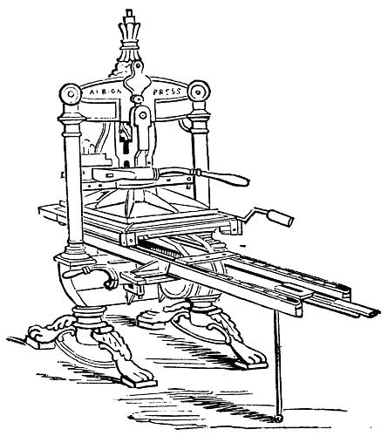
GRLC "Context" and "Surface“ (taken from GS2 Overview)
GRLC Context is standing for the printer engine !!!
Surface is standing for the paper !!!
Relationship detailed in UML:
Graphical/OSEK
Task
GRLC Context
(Target)
Surface
1
1
Srfc-Descriptor
1
1..n
1
0..1
1
1
ClipList

Slide 88












Legend
Surface
Offscreen
Surface
Time
Domain
Painter
Cyclic Time Domain
Generic Painter
Layer
Visible
Surface
Time
Domain
WMapp
Event-driven Time
Domain
WMapp
Context
GRLC
Context
Root
Widget
Root Window
Widget
BUFlet
BUFlet
Window
Widget
Tree
Normal Window
Widget Tree
Display
Display

Slide 89
Typical Configuration (HMI without Animations)
Time
Domain
Context
Window0
ClearApp
Root
HMIWnd
Widget
Tree
BUFlet
Layer
Display

Slide 90
Advanced APIM Features (refer to spec for more details)
Routing EVHD events to the HMI input queue
Mapping EVHD to HMI::boSendMessage()
In case of queue overflow, it’s possible to configure how APIM will react: pass, delay, discard
Cyclic triggering of the HMI subsystem
Cyclic update of freezebuffer data, update needed in sdh to configure API timer
Only ONCHANGE is overrideable
Event-driven Triggering of the HMI subsystem
Update immediately as triggered, even when data is not changed
Repetitive copying of DPOOL data into freeze buffer during locking freeze buffer data
Trying to update the freezebuffer content with new value if it’s interrupted during copy
Timeout should be set
Multiple data copying of DPOOL data into freeze buffer in single critical section lock
Optimize the copy time by clustering freeze buffer updates within 1 critical section lock

Slide 91
Thank you for your attention!

