Slide 1
Artemmis Training – The Advanced HMI Business Unit ID
Revision: 1.0

Slide 2
The Advanced HMI Definition
Advanced HMI world:
Represents the dynamic scenes (i.e. changing over time – animation)
Applies more advanced drawing concept
Drawing with multiple tasks and surfaces
Animation window tree concept
Controlling flip (the moment drawing content is made available)
Includes important animation concepts:
Animation, Storyboard, Scene, Parameter, Algorithm
Synchronization of content with static scene (Consistency Point)
Dealing with multiple animations (Interruptibility Matrix)
Communication between widget and animation (callbacks, update data)

Slide 3
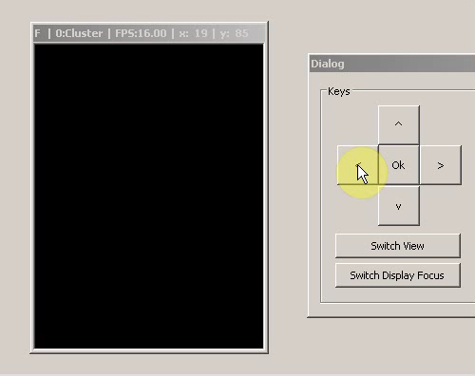
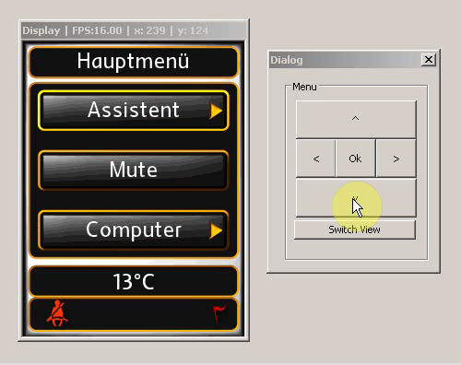
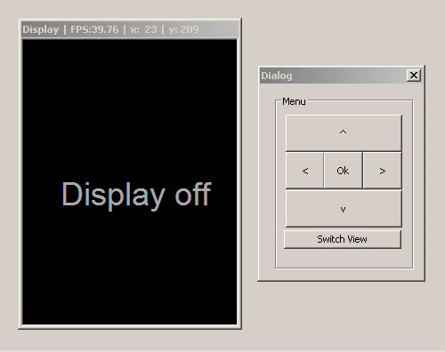
Sample Animation Requirements
Finite single animation
View change animation
(using HMI content)
Endless animation with subscene

Slide 4
Advanced
Drawing Concept

Slide 5
System Integration The extended task model to enable animations
CompositeManager
What‘s new
Flip_AnimCtrl
high
Now the Animation Scheduler task priority is above all Time Domains (Animation Painter) to schedule all animations immediately and predictable!
We need a OS-Resource to sync the Smart-Pointers memory management and the Time Ticks of Animation Painter task against the scheduling
Task
prio
AnimationScheduler
Anim Scheduler
Consistency Point Control
TimeDomain_1
Animation Painter
OS-Resource
OS objects and their properties
For animation execution we need a low prio HMI time domain to control the animations and at least on time domain (based on VSync) to execute the animation(s)
For animations we need additional to the CIA setup an animation scheduler task with the priority above all time domains executing animations
All CIA / ACE related tasks have to be extended and full preemptive (using Semaphores)
The OS-Resource needs to be attached to the HMI TD, all Anim Painter TDs and the Animation Scheduler
TimeDomain_2
TimeDomain_n
HMI Msg-Processing
TimeDomain_HMI
Paint of HMI content
Consistency Point Control
low
Notes:
Multiple time domains to accommodate different animation frequency

Slide 6
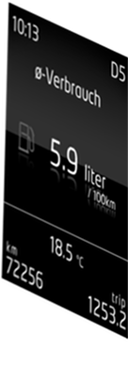
WMApp
How to paint non widget contents ?
How to paint surfaces within surfaces ?
BUFlet
Window
Attach BUFLet
Detach BUFLet
Surface
Paint
Event
Paint into
Buffer
Call Painter
Painter
Widget
WMapp
WMapp = Window Manager application
base class implementing the paint method
can be derived to implement specific paint commands
can be used to directly invoke GS2 drawing commands

Slide 7
Time Domains
Caution: Synchronization required !
You may not flip surface 1 while surface 2 is rendering!
VSync
Event
Window
Surface 2
Time Domain
Surface 1
TimeDomain
dispatches paint events to windows
assure the synchronization between dependent surfaces
perform centralized and synchronous flip execution

Slide 8
Flip Management
Surface may have single or multiple buffers
Multiple buffers:
used to avoid tearing effect on display
Need special administration to switch the hardware “read” between the buffers => Flip
Generally flip is handled by framework immediately after paint, with some exceptions:
“FlipLock” and CIA_nSynchronizationTimeDomainID If HMI layer is used for animation, it should not be flipped before the animation’s first frame. These settings ensure cyclic time domain synchronization with HMI to be flipped together.
CIA_UseTDSyncFlip Flip synchronously all painted buflets in one TD, except for the BUFlet configured to be “PropagateContent” true in XML or those that were not invalidated. Additionally, flip is only done on the next divider VSYNC.
au8FlipSyncGroups Time domain(s) within the same group will be flipped synchronously.
CIA_UseStableFrameRate / CIA_UseLateFlipInStableFrameRate Delay flipping for BUFlets of TimeDomain to match its divider frequency
Notes:
Example for CIA_UseTDSyncFlip == On:
If we have 25 HZ animation on every 3-rd VSYNC (i.e. TD divider=3), then even if the paint is done in the first VSYNC period – the flip will be delayed to the last one.

Slide 9
Using multiple surfaces
Two types of surfaces:
Layer (on-screen) – also called hardware layer
Content is seen on the display
# layer available is limited by hardware specs
Off-screen
Content is not visible on display until it’s copied to layer
# surfaces available is limited by the amount of memory available
Usually used as temporary buffer to assist animation
Surface (i.e. BUFlet) is not alive all the time. The assembly must be requested and released
explicitly by the framework (or animation on special cases)
Multiple BUFlets can be linked to the same surface (in XML) as long as they are not alive at the
same time!

Slide 10
Animation Concept

Slide 11
Animation AnimControl class – The mother of all Animations!
All Animations are derived from the base class AnimControl (= Animation)
The class provides several methods to overwrite for implementing a specific animation
You can either use an available Animaition with different parameter values
Or by implementation of a complete new Anim-Class
AnimControl
MainMenu
ChangeView
ChangeView

Slide 12
Animation Lifecycle (I) Animation State - Machine
Here the ACE releases all
CIA assemblies
Here the ACE requests the
CIA assemblies necessary for an animation

Slide 13
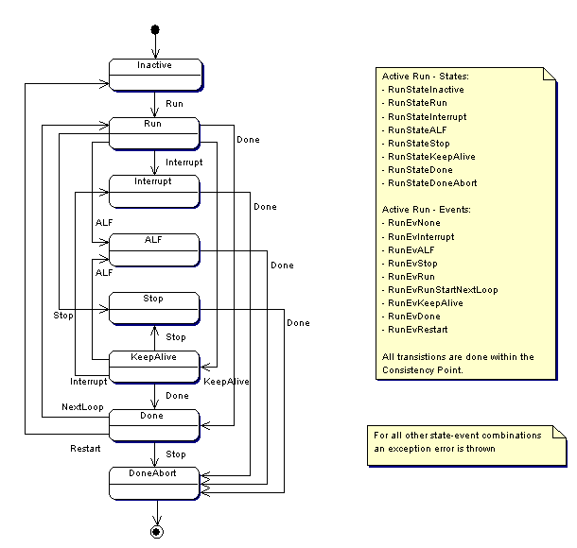
Animation Lifecycle (II) Animation run state machine and interuptability matrix

Slide 14
Animation The storyboard (I) - TimeTick
VSync
TimeDomain
Scheduler
Storyboard
AnimScene
AnimParam
EVHD
The Storyboard runs
In a certain TimeDomain
TimeTick
TimeTick
TimeTick
TimeTick

Slide 15
Animation The storyboard (II) – Control of AnimScene‘s
AnimParams are connected to WMapps that implement the operations
AnimScene
AnimParam
AnimParam
AnimScene
AnimParam
AnimParam
AnimScene
AnimParam
AnimScene
AnimParam
AnimParam
AnimParam
0
Frames

Slide 16
Consistency point synchronization mechanism
CIA_TimeDomainHMI
EPF
CIA
ACE_Scheduler
OS
ACE_Scheduler
OS
VSync
Behavior
Trigger scheduling
Process Msg‘s
Here all Animations can be created and controlled by commands. We have an extra list for those new Animations.
Behavior
Here we schedule all Animations and put them depending on the configured schedule policy either into the waiting list or into the active list. Here we synchronize the access of the new list and the waiting / active list with an OS Event
Paint
Consistency point becomes active
Trigger ACE Consistency point state machine
Set Event
Wait
Consistency point becomes inactive
Behavior
Here we change the schedulers state machine state and wait until the new requested animations has been processed by the scheduler
OS objects and it’s properties
We need for the Consistency point an OS-Event assigned to the low prio HMI Time Domain task
We use the same event for pre-scheduling

Slide 17
Interruptability - Matrix
The Matrix decides how the scheduler should handle Animations among each others based on Animation – Types.
The scheduler takes the Matrix into account if more than one Animation is requested (also more of the same type)
The Matrix consists of conflicts with dedicated behavior to consider for scheduling (described later).
In case more Animations are active the scheduler evaluates the whole line of the Matrix and uses the configurable priority of conflicts to decide what to do.
alive
alive
 | Anim 1 | Anim 2 | Anim 3 | Anim 4
Anim 1 | RUN | RUN | WAIT | RUN
Anim 2 | INTERRUPT | RUN | WAIT | RUN
Anim 3 | RUN | WAIT | RUN | WAIT
Anim 4 | RUN | RUN | SYNC | RUN
new
Behavior
Result of this scenario will be RUN and WAIT. The priority then decides which behavior wins.
Notes:
Interruptability matrix is a simple mechanism for arbitrating what the system shall do in case of starting animation when another animation is running. The interruptability matrix is a table stating the next transition state of the current running animation when the new animation becomes active.

Slide 18
Interruptability - Matrix Conflict types and it’s behavior
Run: the new requested animation should run and all current running animations should continue. The new animation will be activated (active /wait list)
Wait: the new animation should wait for a current active one to terminate and the running animation should continue. New animation will be queued if any wait result is active (wait / active list) animations in wait / active list are untouched
Interrupt: the new animation should run and the running animation should be interrupted new animation will be queued all animations configured with Interrupt found in wait/active list are interrupted
Interrupt_Sync: sync version of Interrupt (handled during pre-scheduling)
CancelNewIfRunning: the current running animation should continue the new animation should be aborted -> Ignore new animation will be canceled active animations will be untouched
CancelAllRunning: all current (active and waiting) animations will be stopped and the new one becomes active afterwards. new animation will be queued all at this processing step waiting and active animations will be stopped
CancelAllRunning_Sync:
sync version of CancelAllRunning (handled during pre-scheduling)

Slide 19
Animation Development Guidelines

Slide 20
Animation Design (1)
Analyze requirements
Inputs/Outputs
What input image content(s) do you need?
Where are these images coming from? (self-painted? Widgets?)
Where do you paint your animation output?
Functional requirements
Paint timing (eg, 5 fps? 60 fps?)
Trigger / Lifecycle / Conflicts?
Storyboard / Scenes / Parameters
Non-functional requirements
Reusability – What other contexts might your animation be needed?
Memory considerations (esp. VRAM)

Slide 21
Animation Design (2)
Design
Based on the requirements, you should think about and come up with:
Image assembly for the animation
Image assembly for static content (widget tree), if necessary
Custom animation controller class, if necessary
Interface to widget(s)?
Which behavior to override?
Custom painter(s), if necessary
Interface to animation controller
m_vPaint()

Slide 22
Implementation I
Derivation from base class – allowed methods to override and it’s special handling
Animation State Machine callbacks for state transitions
Има промени да се вземат от Павката???
virtual inline void m_vStateWait()
virtual inline void m_vStateWaitSelf()
virtual inline void m_vStateActive()
virtual inline void m_vStateDone()
Active State Machine callbacks for state transitions
virtual inline void m_vPrepareRun()
virtual inline void m_vPrepareInterrupt()
virtual inline void m_vPrepareReverse()
virtual inline void m_vPrepareALFCmd()
virtual inline void m_vPrepareStopCmd()
virtual inline void m_vPrepareRunNextLoop()
virtual inline void m_vPrepareReverse()
Notes:
New is constructor

Slide 23
Implementation II
Derivation from base class – allowed methods to override and it’s special handling
Callback for data update in ConsistencyPoint handling when m_vInvalidate was called on animation
virtual void m_vUpdateData()
See Павката
Preparation methods
virtual inline void m_vPreparePrePaint()
virtual inline void m_vPreparePostPaint()
virtual inline void m_vPrepareTimeTick( uint32 u32CurrentFrame)
Notification methods
virtual inline void m_vTimeTick( uint32 u32CurrentFrame)
The time tick is called from any cyclic TimeDomain but it is handled inside a critical section using OS_Resource to avoid data inconsistency. Therefore only some modifications of animation or painter are allowed. To Request / Release assemblies or to paint is forbidden.
Notes:
New is constructor

Slide 24
Preparation Creating animation bitmaps
CIA_TimeDomainHMI
EPF
CIA
ACE_Scheduler
AnimControl
ACE_Scheduler
CIA_CyclicTimeDomain
Process Msgs
The animation can override this function to copy parts of the old frame into an offscreen surface.
PreparePrePaint
Paint
PreparePostPaint
The animation can override this function to copy parts of the new frame into an offscreen surface.
Consistency point becomes active
Trigger ACE Consistency point state machine
PrepareRun
TimeTick
Paint
Notes:
1. Message

Slide 25
Execution What can be controlled while running
A running animation can be manipulated at any time related the the following parameter
Duration of the animation
Start- and End- Value for each AnimParam
Easing of the parameter function

Slide 26
CleanUp
The animation and storyboard objects of an animation are deleted when the last reference to the animation object is released.
The scene and parameter objects of an animation are deleted when the animation is done.
The scene and parameter objects are created and release in the Scheduler context.
Scene 4
Scene 2
Scene 3
Scene 1
Here the animation is added to the list of active animations. All scenes and anim params are created here.
Here the animation is done and all scenes and anim params are deleted.
Notes:
The animation and the storyboard objects are created when the animation is requested. HMI Time Domain
The scene and animparam objects are created when the animations are scheduled to the active list. CP (Scheduler Task)
The scene and animparam objects are deleted when the finished animation is changed to state Done. CP (Scheduler Task)

Slide 27
Demo 1 First animation – finite single animation
Requirements:
Animated item: Circle image
Animation frequency: 25 fps
Trigger: key press
Param1: move from right to left (240 to 0) for 20 frames
Param2: fade in from 0 to 255 for 20 frames
Prepare the animated item: image circle
Setup the necessary drawing task: AnimTD, 25Hz
Design the animation: AnimControl, Storyboard, Scene, 2 Params
Configure animation in XML
Code the painter: WMApp linked to the 2 parameters, paint method
Prepare the triggering entity: widget that receive key press

Slide 28
Demo 2 Multiple finite animations with interruptibility
Change and additional requirements:
Each button will now trigger different animation according to the direction
Button RIGHT to be used to trigger the first animation
Button UP anim will wait for the current running animation
Button DOWN anim will interrupt the current running animation
Button LEFT anim will run along with the current running animation
All other combination will results in interrupt
Design and define the animations
Configure animation in XML
Configure interruptibility matrix
Update the trigger to create correct animation

Slide 29
Demo 3 Implementing a list scroll animation
Requirements:
Animated item: list content (dependent on current HMI content)
Animation frequency: 25 fps
Trigger: list box move up / down with page change
Param: position of visible listbox item
Prepare animated item: drawn according to the current widget tree
Setup the necessary drawing task: AnimTD, 25Hz
Design the animation:
A: WMApp to redraw the list content during animation
B: List contents are drawn into offscreen surface and used for animation

Slide 30
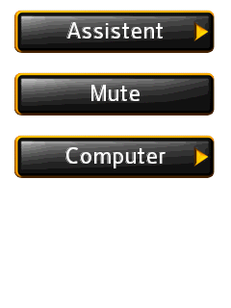

Demo 3 Implementing a list scroll animation
Design A
Pros: Straightforward, easy to implement. Uses least amount of surface memory.
Cons: Not so reusable. Hard to change when requirements change. Lots of text and bitmap painting done at animation TimeDomain – performance hit.
AnimLayer : BUFlet
ListBox : Widget
ListScroll :
AnimControl
ListScrollPainter :
WmApp
BitmapIDs
TextIDs
Positions
Direction
Notes:
What if my listbox is changed to have 4 visible elements?
What if my button has some more images inside? What if its content isn’t even a button?

Slide 31

Demo 3 Implementing a list scroll animation
Design B
Background : BUFlet
BlitSurface :
WmApp
AnimLayer : BUFlet
Outgoing : BUFlet
ListScrollPainter :
WmApp
Incoming : BUFlet
Notes:
Anim Assembly

Slide 32
Demo 3 Implementing a list scroll animation
Design B
Pros: More efficient runtime (all H/W blitting). Highly reusable / configurable.
Cons: More surface memory needed. More complex implementation.
Most real-world solutions will be in between these two extremes

Slide 33
Demo 3 Implementing a list scroll animation
Implement
Step 1: Preparing the static assemblies
We need to separate the list background, content, and even cursor into offscreen surfaces – because we’ll need them cleanly separated later for preparing the animation assembly
Then need to “assemble” those offscreen surfaces back into the HMI layer – so the user never notices that we separated them, even without animations running
Step 2: Implementing the actual animation
Once the input surfaces are prepared in Step 1 it is just a matter of copying them into the animation surfaces
Copy the outgoing content during pre-paint
Copy the incoming content during post-paint
Background doesn’t change – let’s just reuse that (for now)
When the animation becomes active just combine the background, outgoing, incoming surfaces into the Animation layer during paint

Slide 34
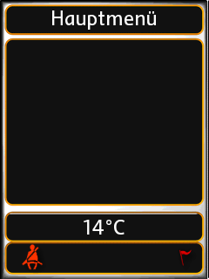
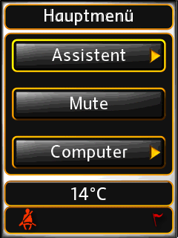
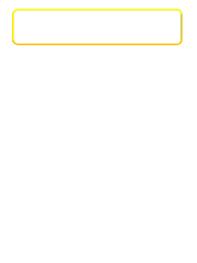

Demo 3 Implementing a list scroll animation
root + other: Widgets
Step 1: Preparing the static assemblies
Background : BUFlet
Background : Widget(s)
BlitSurface :
WmApp
HMILayer : BUFlet
ListBox : Widget
Content : Widget
ListContent : BUFlet
BlitSurface :
WmApp
…
Cursor : Widget
ListCursor: BUFlet
BlitSurface :
WmApp

Slide 35
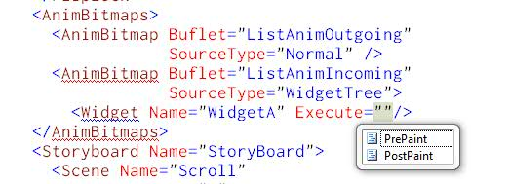
AnimBitmap – XML model
SourceType “Normal” means that we want to prepare the copying of content manually.
Request for the off screen surface
Do necessary processing
Copy the widget content to off screen surface
To be done on prepare pre-paint and prepare post paint methods
SourceType “WidgetTree” means that we let the framework do the necessary work for that
Framework will take care of creating the buflet and copying the contents
No overriding necessary to the prepare pre-paint and prepare post paint methods
Simple and easy, especially when
there is no specific processing
necessary to the widget contents.

Slide 36
Demo 4 Endless animation
Requirements:
When the system starts, a normal frame based welcome animation should start
The endless animation on idle state should follow
On demand scene should be started based on key event (movement or special action)
On finish scene is triggered when the switch view is pressed – the animation should die afterwards

Slide 37
Assembly Configuration
CIA.xml
AnimLayer
LayerWM0
ACE_Endless.xml
CleanWindow1
EndlessRootWindow
EndlessWindow
EndlessPainter
TextWindow
TextPainter

Slide 38

Painters
EndlessPainter
TextPainter

Slide 39
Storyboard Configuration
OnDemand
OnDemand
Move
(Left,Right,Up,Down)
Action
Endless
(NumberOfFrames=0)
Idle
Welcome
Goodbye
Frame-based
OnFinish

Slide 40
Widget and Animation Interaction

Slide 41
Basics How to handle an Animation inside Widget’s static part
AnimControlHandle is a smart pointer implementation which is intended to
store a reference to an AnimControl object
delete the AnimControl if it’s reference count drops to 0
Creation: It is a template class implementation, so we have to specify the type of animation properly during creation. At the minimum, AnimControl should be used as it is the mother of all animation.
ACE::AnimCtrlHandle<FadeInAnim> oFadeInAnim;
HMI::ACE::AnimAssembler::boCreateAnimation(AnimID, oFadeInAnim);

Slide 42
Basics How to handle an Animation inside Widget’s static part
Check of validity: Use the boIsValid namespace function to check if the handle contains a valid pointer:
HMI::ACE::boIsValid(oFadeInAnim);
Destruction:
Widgets should assign NULL to the AnimControlHandle if they do not need a reference to the AnimControl any more.
oFadeInAnim = NULL;
Scheduler also hold a reference count as long as the animation is inside new / waiting / active list.
AnimCtrlHandle can call AnimControl method as it is a pointer to AnimControl

Slide 43
Advanced How to handle an Animation inside Widget’s dynamic part
Handling more than one animation inside the widget
Retriggering of animations:
When the animation is done you can use oFadeInAnim.m_vRestart(3) in HMI time domain, in order to repeat its execution additional 3 times. It can be set also before the end of current execution (to set 3 additional loops)
Stop the animation before its end:
Call m_vStop() in HMI time domain
Notes:
Update data?

Slide 44
Advanced How to handle an Animation inside Widget’s dynamic part
Advance to last frame the animation:
Call m_vAdvanceToLastFrame() in HMI time domain
Update animation data while invalidating:
Perform oFadeInAnim.m_vInvalidate() in HMI time context and on the next CP, the Scheduler will call overwritten callback function oveoFadeInAnim.m_vUpdateData() where you can get a pointer to AnimParam or AnimScene and do specific changes/updates of animation
Request OnDemand scene to start/stop it in HMI time domain:
to start → m_vRequestScene(u16SceneID, true) or
to stop →m_vRequestScene(u16SceneID, false)

Slide 45
Animation communication to it‘s creator
AnimCreator
AnimAssembler
AnimControl
Can be an Artemmis Widget or something else (e.g. WILI)
boCreateAnimation()
Constructor(pCreator)
Store pointer to creator
Smart Pointer
Pointer to AnimControl object is stored in an AnimCtrlHandle
m_vStop
ACE_AnimationFeedback
m_vClearOwner
Clear pointer to creator
Notify AnimControl object that widget is destroyed
Notes:
Widget -> AnimControl:Call functions like m_vStop
AnimControl -> Widget: ACE_AnimationFeedback (currently sending an direct message to the widget)
During creation/destruction of the animation
During anim state changes (not run state changes)

Slide 46
How to give the Animation some Data?
Add new attributes to the AnimControl class
Set the values after sucessfull creation of an animation object
Connect the values to other object‘s (like WMapp‘s) at the preparation phase‘s
Widget
Scheduler
AnimControl
SpecAnimation
WMapp
Create
SpecAnimation
ChangeState
SetValue
PrepareRun
SetValue
It is also possible to make a copy of a widget image to render the animated part!
At that time it is ensured that all object‘s are alive!

Slide 47
Allowed Interface for Widget’s about Animations
Assembler
None
Scheduler
static inline bool boAnyRunningAnimations()
static bool boIsAnimationAlive(uint16 u16AnimID, const AnimCtrlHandle<T> &oHandle)
static bool boIsAnyAnimationAlive(void);
static void vAddALFCommand(AnimCtrlHandle<T> &oHandle)
static void vAddStopCommand(AnimCtrlHandle<T> &oHandle)
Notes:
ALF/Stop command is handled in Scheduler task based on VSync

Slide 48
Allowed Interface for Widget’s about Animations
AnimControl synchronous functions
virtual inline uint16 m_u16GetAnimID()
virtual inline uint16 m_u16GetAnimType()
inline AnimState m_u16GetAnimState()
inline RunState m_u16GetActiveRunState()
inline bool m_boIsVisible()
virtual inline void m_vClearOwner()
AnimControl asynchronous functions that have effect in the next CP
void m_vShow(bool boVisibility);
void m_vRestart(uint8 u8NrOfAdditionalLoops=0)
virtual void m_vAdvanceToLastFrame()
virtual void m_vStop()
virtual void m_vFinish()
void m_vRequestScene(uint16 u16SceneID, bool boStart = true, bool boForce = false);
Trigger AnimControl update via overridden m_vUpdateData function. This is done in CP.
void m_vInvalidate()
Notes:
m_vRestart
Dependent on the animation state we perform the following things:
NEW:
we add only the u8NrOfAdditionalLoops to the loop counter if the animation becomes active it runs u8NrOfAdditionalLoops loops in additon
WAITING:
we add only the u8NrOfAdditionalLoops to the loop counter if the animation becomes active it runs u8NrOfAdditionalLoops loops in additon
WAITING_SELF:
we add only the u8NrOfAdditionalLoops to the loop counter if the animation becomes active it runs u8NrOfAdditionalLoops loops in additon
ACTIVE:
we add only the u8NrOfAdditionalLoops to the loop counter the current running animation loops additionally u8NrOfAdditionalLoops
DONE:
the animation will be rewind and the u8NrOfAdditionalLoops will be added to the configured loop count then we put the animation into the new list to be scheduled as a new one
m_vInvalidate
If the animation should get new data on next ConsistencyPoint then you can call Invalidate. After MsgProcessing and Paint the update of the animations is triggered to use the new data at the next frame.

Slide 49
Demo 5 Update Data
Requirement:
Animation run from left to right initially
Triggered by key left
If user press key OK while animation is running, it must be reversed
Implement animation triggered by key LEFT, moving from 0 to 240
Implement m_vUpdateData() which will reverse the anim param data
Implement key trigger which will call animation invalidate

Slide 50

Thank you for your attention!

Slide 51
HMI XML Language

Slide 52
ACE Configuration AnimCtrl type descriptions
Definition of AnimControl class and all its AnimControl types (subclasses)
Type: class name
Namespace: HMI::ACE (should be always this namespace)
Declaration file: needed for the generated builder
SizeOf: object size (information needed for WMMS to calculate the static memory needs)
➔ AnimControl Type-Descriptions must be extended project specific
<?xml version="1.0" encoding="UTF-8"?>
<Types xmlns:xsi="http://www.w3.org/2001/XMLSchema-instance" xsi:noNamespaceSchemaLocation="..\XSD\GenericTypeDefinition.xsd">
<!-- Base class: ANIM_CONTROL - !!! Don't touch !!! -->
<AnimationType Type="AnimControl" Namespace="HMI::ACE" DeclarationFile="ACE_AnimCtrl.hpp">
<Properties>
<Property Name="NotificationActive" Type="bool" Init="false" />
</Properties>
<Constructor StringOfParameters="( creator, ID, AnimationGetter::GetAnimTimeDomain(ID) , AnimationGetter::GetNotificationActive(ID) )"/>
</AnimationType>
<!-- MainMenuKeyLeft -->
<!-- =================================================================================================== -->
<AnimationType Type="MainMenuKeyLeft" Namespace="HMI::ACE" DeclarationFile="ACE1ca.hpp" DerivedFrom="HMI::ACE::AnimControl”>
<Constructor StringOfParameters="( creator, ID, AnimationGetter::GetAnimTimeDomain(ID) , AnimationGetter::GetNotificationActive(ID) )"/>
</AnimationType>
</Types>
Notes:
Here we may need to use „Syntax Highlighting“ for a better readability

Slide 53
ACE Configuration ACE project configuration
The ACE configuration file ACE.xml contains all animation configuration
Configuration of Animation Parameters and Animation Parameter
Configuration of Scenes, Scene
Configuration of Storyboards, Storyboard
Configuration of Animations, Animation
Configuration of Conflicts (Interruptability Matrix)
<?xml version="1.0" encoding="UTF-8"?>
<ACE xmlns:xsi="http://www.w3.org/2001/XMLSchema-instance" xmlns:xsd="http://www.w3.org/2001/XMLSchema" xsi:noNamespaceSchemaLocation=".\XSD\ACE.xsd">
<AnimationParameters ClassName=“HMI::ACE::AnimParam" UseFloat="true"> ... </ACE>
<Scenes ClassName=“HMI::ACE::AnimScene"> ... </Scenes>
<Storyboards ClassName=“HMI::ACE::Storyboard"> ... </Storyboards>
<Animations> ... </Animations>
<Conflicts> ... </Conflicts>
</ACE>
Notes:
Display corrensponds to an EPF Display - Controller

Slide 54
ACE Configuration AnimationParameters
AnimationParameters configuration
Have a fixed size
UseFloat : use floating point type if true else fixed point format in algorithms
AnimationParameter configuration
Name : Unique as it can be referenced
Start,End : The start and end frame for the animation parameter
NumberOfFrames : Total no of frames
Algorithm : The algorithm that is applied to the AnimParameter
WindowID : The window name that animation parameter is active in, refer to CIA.xml
<AnimationParameters ClassName=“HMI::ACE::AnimParam" UseFloat="true">
...
<AnimationParameter Name="MainMenu"
Start="0" End="255"
NumberOfFrames="8"
Algorithm="HMI::ACE::SineInOut"
WindowID="MenuAnimWindow1" />
...
</AnimationParameters>

Slide 55
ACE Configuration Scenes
Scenes configuration
Have a fixed size
Scene configuration
Name : Unique name for WRS resource id generation
StartAt : The frame no to start the scene
Add AnimationParameter as needed
<Scenes ClassName=“HMI::ACE::AnimScene">
...
<Scene Name="MainMenuScene" StartAt="0”>
<AnimationParameter Name="MainMenu" />
</Scene>
...
</Scenes>
The AnimationParameter can
either be referenced or a new defintion
Notes:
Display corrensponds to an EPF Display - Controller

Slide 56
ACE Configuration Storyboards
Storyboards configuration
Have a fixed size
Storyboard configuration
Name : Unique as it can be referenced
Add Scenes as needed
<Storyboards ClassName=“HMI::ACE::Storyboard">
...
<!-- Storyboard for MainMenuScene : -->
<Storyboard Name="MainMenuStoryboard">
<Scene Name=“MainMenuScene" />
</Storyboard>
...
</Storyboards>
The Scene can
either be referenced or a new defintion
Notes:
Display corrensponds to an EPF Display - Controller

Slide 57
ACE Configuration Animations
Animations configuration
Have a fixed size
Animation configuration
Type : Animation type as defined in AnimationTypeDescriptions.xml
Name : Unique as it can be referenced
TimeDomain : Time domain which the animation should run in
Add Buflet(s) that will be requested (Parent Window) when animation is ready to draw. Refer to cia.xml
Add Storyboard as needed
<Animation Type="MainMenuFadeOutAnimType" Name="MainViewFadeOutAnim" TimeDomain="CIA_enTimeDomainID0">
<Buflet Name="MainMenuViewBuflet" />
<Buflet Name="SecondaryMenuViewBuflet" />
<Storyboard Name="MainMenuStoryboard“ />
</Animation>
The Storyboard can
either be referenced or a new defintion
Notes:
Display corrensponds to an EPF Display - Controller

Slide 58
ACE Configuration Conflicts (Interruptability matrix)
Conflicts configuration
DefaultValue : The default value for the new state of current animation when another animation becomes active
Conflict configuration
RunningAnimation : The current running animation
NewAnimation : The new animation
Value : The new state of the current animation
<Conflicts DefaultValue="ACE::Scheduler::Run">
...
<Conflict RunningAnimation="HMI::ACE::MainMenuKeyLeft" NewAnimation="HMI::ACE::MainMenuKeyRight" Value="ACE::Scheduler::Interrupt" />
...
</Conflicts>
Notes:
Display corrensponds to an EPF Display - Controller

Slide 59
Backup
Slides

Slide 60












Legend
Surface
Offscreen
Surface
Time
Domain
Painter
Cyclic Time Domain
Generic Painter
Layer
Visible
Surface
Time
Domain
WMapp
Event-driven Time
Domain
WMapp
Context
GRLC
Context
Root
Widget
Root Window
Widget
BUFlet
BUFlet
Window
Widget
Tree
Normal Window
Widget Tree
Display
Display

Slide 61
Typical Configuration (HMI with Animations – 1 layer)
Time
Domain1
Context1
Time
Domain0
Context0
ClearApp
Window0
Root1
ClearApp
Window0
Root0
Widget
Tree
HMIWnd
BlitApp
Window1
BUFlet1
BUFlet0
Surface1
AnimApp
Window2
Layer0
Display
Notes:
WMapp1 -> A WMapp that just clears the screen (GRLC_vClear)
WMapp2 -> A WMapp that blits from the source buflet to the destination buflet

Slide 62
Typical Configuration (HMI with Animations – multiple layers)
Time
Domain1
Context1
Time
Domain0
Context0
ClearApp
Window0
Root1
ClearApp
Window0
Root0
Widget
Tree
HMIWnd
AnimApp1
Window1
BUFlet1
BUFlet0
Layer order
is important!
Layer1
AnimApp2
Window2
Layer0
Display
Notes:
WMapp1 -> A WMapp that just clears the screen (GRLC_vClear)
WMapp2 -> A WMapp that blits from the source buflet to the destination buflet

Slide 64
Thank you for your attention!

