Slide 1
Artemmis Training – Debugging Tips Business Unit ID
Revision: 1.0

Slide 2
Contents
Helper tools for debugging
Widget tree debugger
CIAgent
Debugging tips
General
Messaging issue
State machine issue
Display / painting issue
Interesting arrays

Slide 3
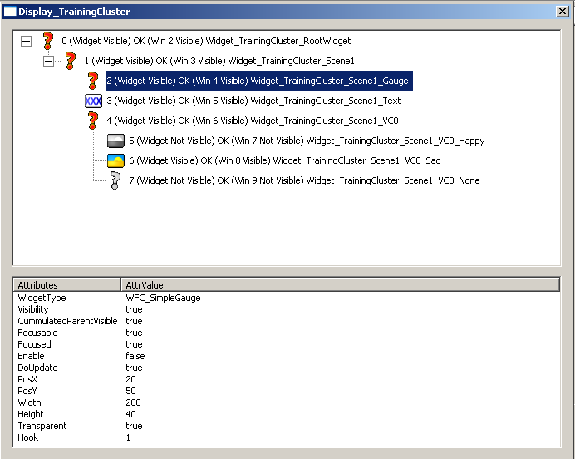
Debugging Tool Widget Tree Debugger
Widget tree structure
Widget ID and visibility info
Selected widget attributes
To be serialized in each
new widget class

Slide 4
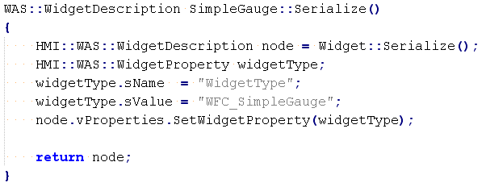
Debugging Tool Widget Tree Debugger
Filling the widget properties for tree debugger
Each new widget class need to extend serialized() method
Example:

Slide 5
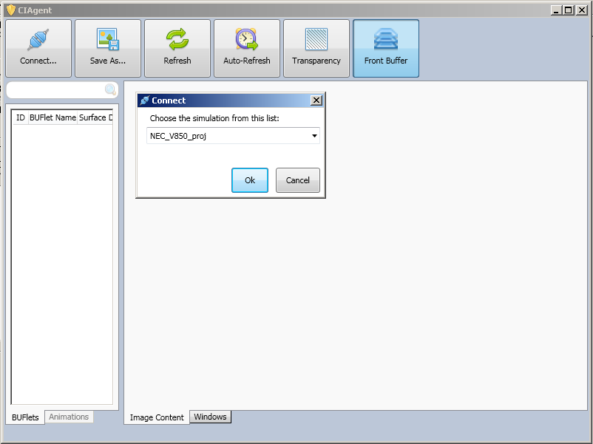
Debugging Tool CIAgent

Slide 6
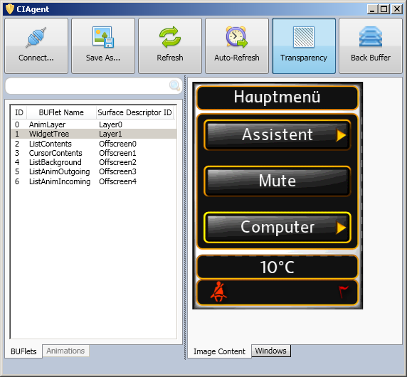
Debugging Tool CIAgent

Slide 7
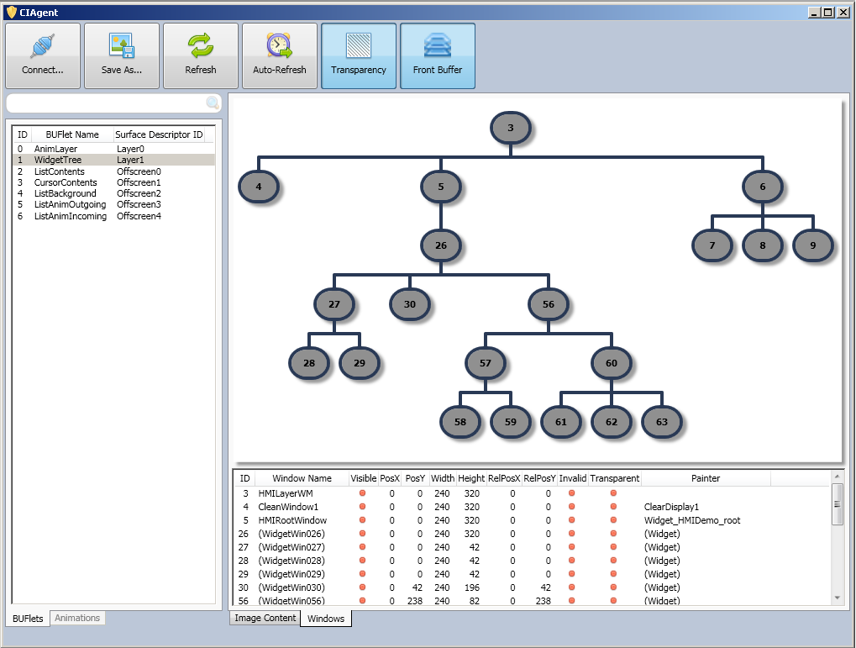
Debugging Tool CIAgent

Slide 8
Debugging Tips General
Catch error quickly
Put breakpoint at EXEA, GSES, WMMS for most common exceptions
Localized the problem
Use conditional breakpoint with widget ID, animation ID, status, etc.
Use the 'Threads' window in MSVC to examine the thread states
Are any of them frozen, eg, waiting for a GS/CIA/ACE event or semaphore?
Useful if the system seems "stuck“
If the bug is timing-sensitive, use MSVC 'When Hit..." breakpoint feature
Just ouput a log message and let the program continue
Useful if stopping the program affects the observed behavior

Slide 9
Debugging Tips Messaging
Check if widget receives the expected message
Put breakpoint at final hook (WRS generated file by Brutus) / process message
Check if widget is alive
If not, find out the “storage” where the message is expected to be
If message is not stored, trace from the sender immediately
If message is stored in stack (example: bubbling message), check WCS::MessageList class
Put breakpoint at vProcessNewMsg() / vProcessFeedbackMsg()
Check if message is destroyed and why
If message is strored in queue (internal / external), check WCS::Messenger class
Put breakpoint at vProcessMessage(), and check if message is received there
If not, check WCS::MultiLevelQueue class if any message is blocked due to priority
If not, check if the message is inside the queue at all

Slide 10
Debugging Tips Messaging
If message is found in the proper “storage” area, check for propagation type
Addressable / direct message is directly sent to widget
Check if the widget is alive
Broadcast message is handled in Messenger::BroadcastMessage
Check if widget is part of the widget tree
Focused message is handled in TreeDispatcher::vPropagateMessage (tunnelling) / vProcessBubbleUp (bubbling)
Check for unbroken focused path
Check for tree dispatcher strategy

Slide 11
Debugging Tips State Machine
Check if trigger is sent properly
Check the sender part (final hook / process message)
Check if transition happens correctly
Put breakpoint at state machine / custom controller’s process message
Is trigger message received?
Is the resulting state as expected?
Check the new state in controller widget process message
Check if tree build is triggered – for lifetime strategy
Put breakpoint at SceneController::enProcessMessage() – ChangeTree
Check if visibility change is triggered – for visibility strategy
Also check if the cummulative parent visibility is correct

Slide 12
Debugging Tips Display / Painting
Check if widget/wmapp draw
Put a breakpoint in your WMapp's/widget's m_vPaint/vDraw
Check if the window is visible
Check if the window is invalidated
Widgets should do this if their visual state changed
Animations should do this every time tick, when their AnimParams change
Check if the window is attached to a living buflet/window tree
If not, you may need to request for the assembly of the buflet first
Check if the TimeDomain is active
Put breakpoint at TimeDomain::m_vExecute()

Slide 13
Debugging Tips Display / Painting
If the paint method was called
Trace/step inside the GRLC calls to see if any errors occurred
Check if the composition mode is correct
Check if there is no other window drawing on top of it
Check if the window position and dimensions correct
Note for containment rule and drawing area size
Check if the widget / WMApp is painting to offscreen
Has it been blitted / copied to layer?
Check with CIAgent if the content is painted in any buflet (front / back buffer)
If it’s in back buffer, check if any flip is triggered
If not, check the BUFlet lock/unlock sequence for that surface, if correct

Slide 14
Debugging Tips Display / Painting
If the display seems frozen or unresponsive
Check if the HMI is still receiving messages
Put a breakpoint in HMI_boSendMessageToWidgetInstance
Check if the HMI is still processing the messages / API update
Put a breakpoint in WAS::DisplayController::vDisplayControllerTaskEntry
If it's not processing, check the HMI thread state
Check if the TimeDomains are still active/painting
Check m_vPaintBroadcastEventDriven for HMI TD -- it should be called after every HMI message processing cycle
Check m_vPaintBroadcastCyclics for animation TDs -- it should be called after every divider Vsyncs (as long as an animation on that TD is alive)
If they were deactivated, put a breakpoint in TimeDomain::m_vDeactivate to find out why
If they are active and painting, did the surface(s) get flipped?

Slide 15
Debugging Tips Global variable to be watched
Interesting global variables to watch
HMI::CIA::CompositeAssembler::apoWindows[u16WinID]
All window objects
HMI::CIA::CompositeAssembler::apoBUFlets[u16BUFletID]
All BUFlet objects
HMI::CIA::CompositeAssembler::apoWMapps[u16WMappID]
All WMapp objects
HMI::CIA::CompositeAssembler::au8BUFletRequestCnt
How many users for this BUFlet are active?
BUFlet won't get destroyed unless this goes to 0
HMI::ACE::Scheduler::apo{New,Active,Waiting}Animations
Linked list of all animations currently in {New,Active,Waiting} state

Slide 16

Thank you for your attention!

