Slide 1
List Animation (namespace)
Kien Trung Khuong

Slide 2
History
Date | Author | Description
2013-12-16 | Kien Trung Khuong | First draft

Slide 3
Introduction
Daimler defines 4 different types of list animations, all of which are available in both High Line and Entry Line:
Overlay Menu
Texture List
Graphical List
ABC Anchoring
At most 3 of them can be alive and visible at the same time. However, only one is active and receives key events.

Slide 4
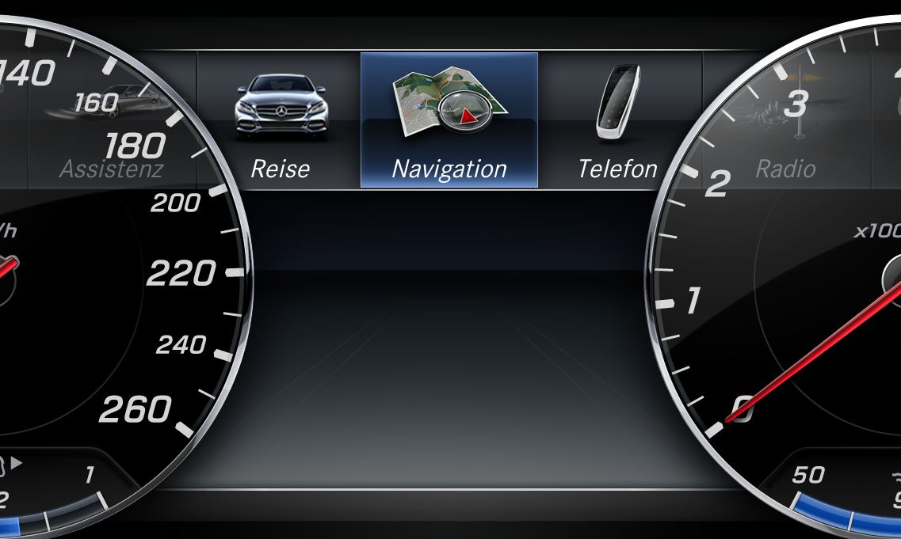
Overlay Menu – Introduction
Separators
Entries
Cursor
Band
Grey Mask

Slide 5
Overlay Menu – Introduction (cont.)
At most 4 entries can be visible at the same time.
No difference between selected and non-selected entries.
Possible effects:
Fading
Scrolling:
Normal Scroll (1 step)
Fast Scroll (multiple steps)
Caps Feedback
Skinning (???)

Slide 6



Overlay Menu – Rendering Strategy
Order of composing
25Hz
Overlay_Background
Overlay_Background
+
25Hz
Overlay_Separators
Overlay_Separators
+
25Hz
Overlay_Cursor
Overlay_Cursor
+
Event-Driven
Overlay_Entries
Overlay_Entries

Slide 7


Overlay Menu – Rendering Strategy (cont.)
Overlay_Background
Overlay_Separators
Overlay_Cursor
SW Compositor
Overlay_Entries
UpdateCommand
Animation

Slide 8
Overlay Menu – Rendering (cont.)
The background contains the following components:
Grey mask
Gradient black band (NO separator)
Bottom chrome bar
An entry contains the following components:
Icon
Text

Slide 9
Overlay Menu – Layout
A detached widget renders an entry to a section of a buflet (Overlay_Entries) whose sections are arranged in a vertical order, i.e. the next section is placed below the previous one.
Currently only 1 widget can be detached to one section, i.e. a one-to-one relationship.
The detached widget visibility is always true.
The detached widget position (its properties PosX and PosY, i.e. its position on the display) is ignored.
All entries are available at the same time.
The layout information will be known to the animation. It is responsible to layout and animate all components.

Slide 10
Overlay Menu – Layout (cont.)
Cursor Anchored Positions
Entry Anchored Positions
detached
Section
ABCD
ABCD
ABCD
ABCD
ABCD
ABCD
ABCD
ABCD
ABCD
ABCD
ABCD
Buflet

Slide 11
Overlay Menu – Layout (cont.)
Layout information is not available to the animation developer. It is defined in the widget models.
Therefore, XCompiler (XC) is responsible to transfer this information to the animation by setting certain values of its painters. (the animation controller is a better option but currently the framework does not support this)
Layout information:
Entry anchored points: defined in order: left to right, top to bottom, indexed from 0 to n-1
Number of entry anchored pointers E ≥ 3
Maximum number of displayed entries M = E – 2
Points 0 and n-1 are for invisible entries; they are needed to define motion destination.
Points 0+1 to n-2 are for displayed entries.
Cursor anchored points: defined in order: left to right, top to bottom
Number of cursor anchored points C ≥ 0. If C = 0, there is no cursor.
Filling rules: determines how entries are arranged if the number of displayed entries is smaller than that of entry anchored points.

Slide 12
Overlay Menu – Design Concept
Overview
Definitions of animation effects:
Fade In/Out: all components are faded in/out.
Scroll Forward/Backward: the cursor moves to the next/previous cursor anchored point.
Edge-Scroll Forward/Backward: every entry moves to the next/previous entry anchored point.
Caps-Feedback Forward/Backward: the cursor moves forward/backward from its current position (anchored points) then returns.
Skin (???)
The animation does NOT execute any paintings. All it does is to control the composition of its components by sending update commands to the SW compositor.
The animation is endless, i.e. triggered and stopped by its owner. When it is triggered, the default first action is to hide all components.

Slide 13
Overlay Menu – Design Concept (cont.)
Window Tree
As the animation developer does not know how many entries there are, XML configurations of sections & associated detached widgets are generated by XC.
For every section, the corresponding “Brutus-generated” section ID is added to the painter of the window “Entries” as a property by XC. This is needed as the painter needs to know all sections that it needs to handle.
Window Tree
Root
OverlayMenuCtrl
Background
Separators
Cursor
Entries

Slide 14
Overlay Menu – Design Concept (cont.)
Types of painters:
Background: AVIEXT::PAINT::BufletCompositionPainter
Separators: AVIEXT::PAINT:: BufletCompositionPainter
Cursor: AVIEXT::PAINT:: BufletCompositionPainter
Entries: ANIM::<namespace>::EntriesCompPainter
The description of ANIM::<namespace>::EntriesCompPainter is as followed:
Property | Init | Setter | Description
BufletID | InvalidBuflet | vSetBufletID
ListOfSetions | 0xFFFF | vSetListIndex

Slide 15

Overlay Menu – Design Concept (cont.)
Animation Modeling

Slide 16
Overlay Menu – Design Concept (cont.)
Widget – Animation Communication Protocol

