Slide 1
Example and Task
FAS Graphics PreSafe Icon
http://www.conti-online.com
ID S2 AD SW M1 A2

Slide 2
Agenda
1
Use Case
2
Approach / Implementation
3
Software from Toolchain
4
Tasks
5
Appendix

Slide 3
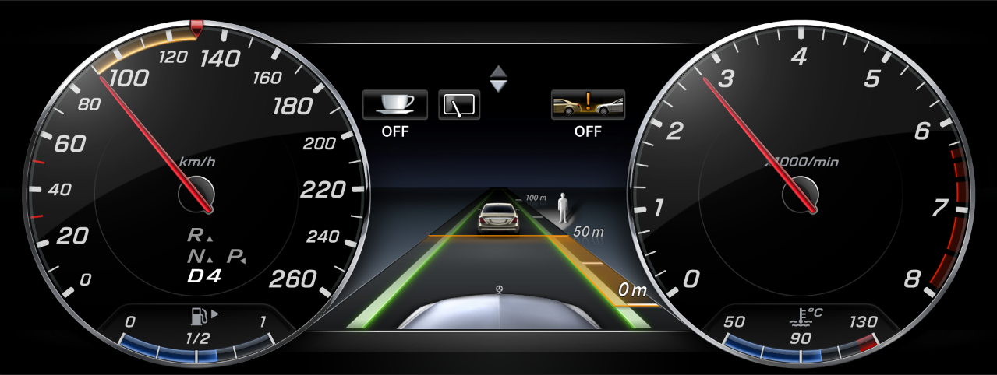
Use Case PreSafe off icon displayed in the FAS graphic

Slide 4
Agenda
1
Use Case
2
Approach / Implementation
3
Software from Toolchain
4
Tasks
5
Appendix

Slide 5
ScreensMDB.xml How does the screen appear from the XML files?
\pkg\xcmodel\mdl\02_Screens\ScreensMDB_High.xml
Result: There is no screen in the ScreensMDB.xml representing the FAS graphics
Where does the Screen come from?
SRSC HMI Config
/id/dag_PF3/sw/com/Functions/HumanMachineInterface/SRSC/project.pj
Result: Also here there is no screen to find FAS
Solution: DOORS → Modul General_Speed_Control_Sytems_V2

Slide 6
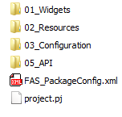
FASMDL How is the icon implemented? (1)
Fundamentally
There is no screen in the screen databases (ScreensMDB.xml)
Associated with this there are icons in the Icons.xml
Therefore, the complete display of FAS graphic is manually modelled.
FASMDL
\pkg\fasmdl\mdl

Slide 7
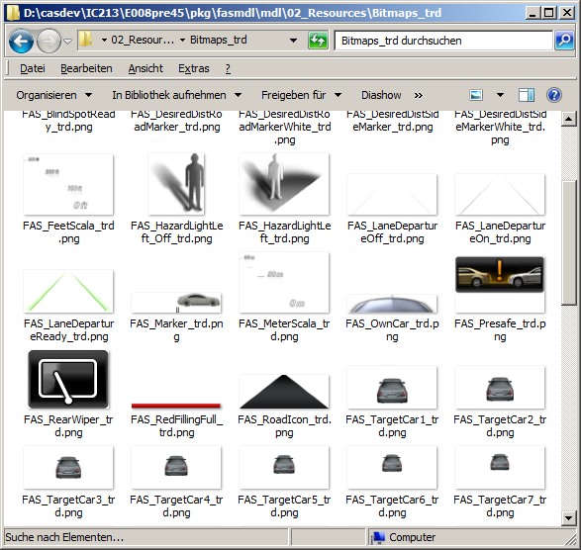
FASMDL How is the icon implemented? (2)
The resource can be found in the following locations
pkg\fasmdl\mdl\02_Resources\Bitmaps_trd (Traditional)
\pkg\fasmdl\mdl\02_Resources\Bitmaps_prg (Progressive)

Slide 8
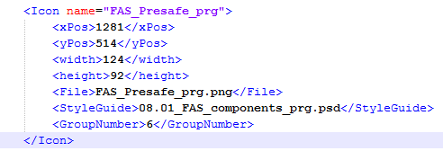
FASMDL How is the icon implemented? (3)
The resources are referenced in the FAS_AdditionalIcons_<Architecture>.xml
The file can be found in pkg\fasmdl\mdl\02_Resources
The following attributes are defined:
X and Y position on the display (absolute positions!)
Width and height of the Icons
Filename
From which file in the SRSC Styleguide are these icons generated
In which icon group is the resource located

Slide 9
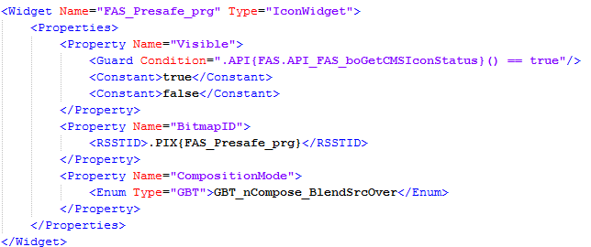
FASMDL How is the icon implemented? (4)
The manual modelling can be found in the following file
pkg\fasmdl\mdl\01_Widgets\FASContainer_prg.xml
Control the visibility
through a guard
Reference to this icon in AdditionalIcon.xml
Definition of
blend modes

Slide 10
FASMDL How is the icon implemented? (5)
What is missing?
Where are the positions?
They are generated by compiling of HMI models using XCompiler

Slide 11
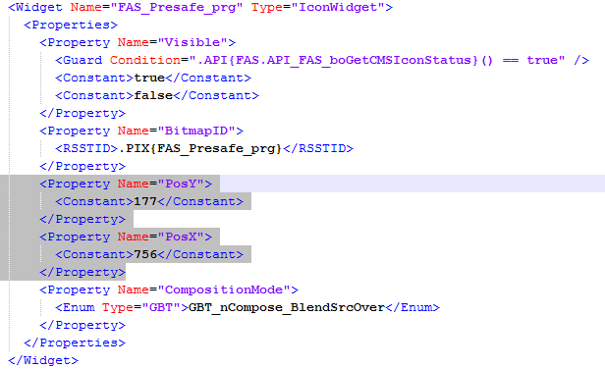
FASMDL How is the icon implemented? (6)
Generated icon in Brutus model:
\tool\brutus\adapt\model\60_Widgets\FASContainer_prg.xml
Relative positions
generated through XC

Slide 12

FASMDL How is the icon implemented? (7)
The used API is defined in the file FAS_API.xml
The file can be found under the directory
\pkg\fasmdl\mdl\05_API\
Update the API
in case of change

Slide 13
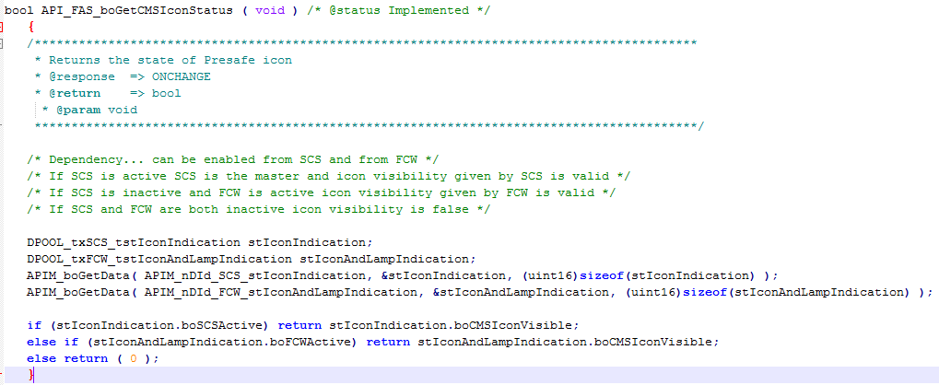
FASMDL How is the icon implemented? (8)
The implementation can be found in the FAS_Api.c file under pkg\fasmdl\adapt.

Slide 14
FASMDL How is the icon implemented? (9)
The used DPOOL datas are defined in the file FAS_Api.sdh under directory pkg\fasmdl\adapt
APIM DEFINE API_FUNCTION API_FAS_boGetCMSIconStatus IS { READ, ONCHANGE } ASSOCIATES { APIM_nDId_SCS_stIconIndication, APIM_nDId_FCW_stIconAndLampIndication };

Slide 15
FASMDL How is the icon implemented? (10)
The screen is stored in the TPOLConfig.xml together with defined Daimler HIL-ID. The file can be found under the following link
pkg\tpolmdl\mdl\03_Configuration
The connection of the screen with the name FAS for FASContainer_trd.xml is defined by the following XML file.
pkg\tpolmdl\mdl\TPOLMDL_PackageConfig.xml

Slide 16
Agenda
1
Use Case
2
Approach / Implementation
3
Software from Toolchain
4
Tasks
5
Appendix

Slide 17
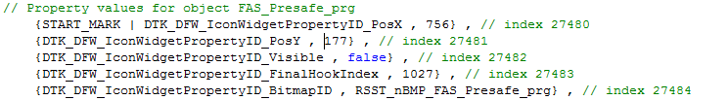
Implementation by toolchain Widget Generation
Generated widget attributes in
adapt\gen\brutus\wrs_visualtypes.cpp

Slide 18
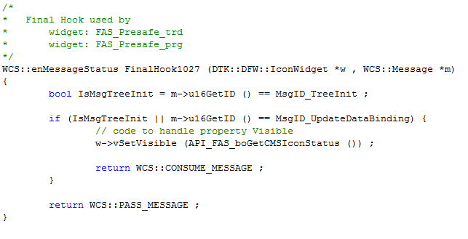
Implementation by toolchain Final Hook
Either the tree was first constructed
Or value has changed?
Set the visibility to
the result of API

Slide 19
Implementation by toolchain Icon in RSST
Can be found among others in
\adapt\gen\rsstexp\rsst__dbitmapid_213ic.h
[…] RSST_nBMP_FAS_Presafe_prg = 0x605e, […]
0110000001011110
Group: 6

Slide 20
Agenda
1
Use Case
2
Approach / Implementation
3
Software from Toolchain
4
Tasks
5
Appendix

Slide 21



Tasks
In order to complete the tasks use the software
GC_HL_BR213IC_Series_E008_08.00.rel01
Change the PreSafe icon from traditional to progressive resource
Which files need to be adjusted?
Which tools have to run?
Implement a software which displays the progressive PreSafe icon in Traditional
Implement a new software which displays a new icon widget for the FASContiner_trd → CHARGE_ICON_CHINA.png. Icon is found under: xcmodel\mdl\02_Screens\Resources\Bitmaps\CHARGE_ICON_CHINA.png
The icon will only be visible if the PreSafeIcon is also visible

Slide 22
Agenda
1
Use Case
2
Approach / Implementation
3
Software from Toolchain
4
Tasks
5
Appendix

Slide 23
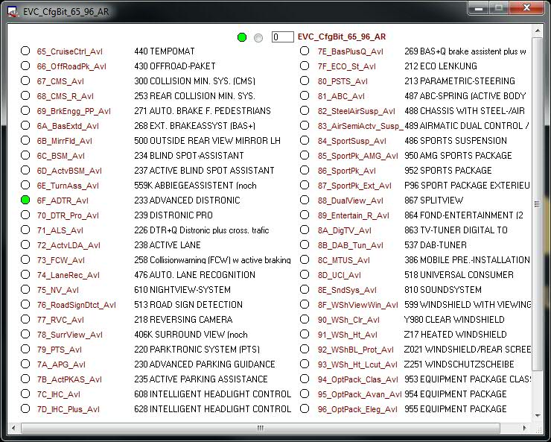
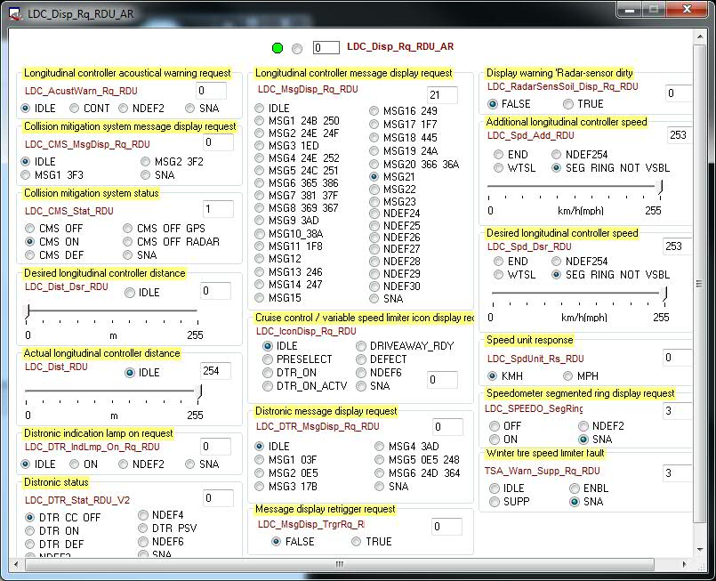
How is the PreSafe icon visible?
Open the FAS graphics on the target or in the simulation
Go to CANoe in EIS and activate the signal 6F_ADTR_Avl in EVC_CfgBit_65_96_AR
Thereafter the icon should be already visible
If not, open LDC_Disp_Rq_RDU_AR in EIS and activate CMS OFF / ON

