Slide 1
HMI Training
07 Debugging
Frank Nikolai
Thomas Godemann

Slide 2
Lecturers
Michael Gerhardt HMI Specialist
Thomas Godemann
HMI System Designer
Frank Nikolai
Artemmis EPF Function Responsible

Slide 3
Topics
Trace & Debug System
PC Simulation, Visual Studio
Target, Greenhills Debugger
Exceptions, EXEA, WES
SYRTO
WiTri
Debugging Hints

Slide 4
Trace & Debug
Trace & Debug is split into the 2 following parts:
Trace & Debug Subsystem (embedded software part)
Trace Tooling (collection of object oriented scripts for trace points code generation)

Slide 5
Trace & Debug
Trace & Debug Subsystem:
Record and log Trace Objects from the ECU
Convert data in human readable format
Convert data for a Tool for further analysis of the trace
work together with Trace Tooling
written in C++ in an object oriented programming method
Workflow
ECU software calls trace macro to log a trace point
the macro ask to ring buffer mechanism
If enough space, macro writes trace point data into the ring buffer
Set event to inform that ring buffer has data to be send to data sink
Event checks data sink communication
if all is OK, trace point data is sent to data sink

Slide 6
Trace & Debug
Trace Tooling:
responsible for read configuration system files TCS
And configuration module files TCM
generate code that works with Trace & Debug Subsystem

Slide 7
Trace & Debug
Trace Point:
used to dump RAM area or variables together with a time stamp
has a unique name
defined in the T&D configuration of the package or subsystem
TRACE
Data Sink
Host PC
Filter
Trace output
…
00:00:00.008319 PACKX STATE NORMAL
…
RAM
Buffer
Decoder
Send binary data over
CAN, TCP/IP,….

Slide 8
Trace & Debug
Trace Command:
used to call a function from T&D tooling in the target
has a unique name
defined in the T&D configuration of the package or subsystem
TRACE
Data Sink
Host PC
Trace Command Window
…
>PACKX.SETSTATE 5
OK
…
Command
Server
Encoder
Send binary data over
CAN, TCP/IP,….

Slide 9
Trace & Debug
Filtering Trace Data:
Lowest priority class bit is reserved
default 1 if no priority class is defined
ensures that the configuration of a specific priority class for a trace point is optional!
Constant trace point specific severity level:
1
0
0
0
0
0
0
0
0
0
0
0
0
0
0
0
0
0
0
0
0
0
0
0
0
0
0
0
0
0
0
1
&
&
Component specific filter variable in each data sink:
1
0
0
1
0
0
0
0
0
0
0
0
0
0
0
0
0
0
0
0
0
0
0
0
0
0
0
0
0
0
0
1
=
=
Both „and“ operations must be <> 0 to pass the filter
1
0
0
0
0
0
0
0
0
0
0
0
0
0
0
0
0
0
0
0
0
0
0
0
0
0
0
0
0
0
0
1
Severity levels (from TCS)
Priority classes (from TCM)
Lowest priority class filter bit must be set to see trace points with no priority class configured

Slide 10
Trace & Debug
Filtering with dynamic switches:
Optional for each trace point
individual switch per trace point
exists only once for each trace point, not for each data sink
checked after trace point passed severity level filter for data sink
default: no dynamic switch
if a dynamic switch is required, the configType has to be added:
configType="dynSwitchDefaultOn“ : Switch is default on
configType="dynSwitchDefaultOff“ : Switch is default off

Slide 11
Trace & Debug
Each trace point has a config type.
This type defines how the trace point can be controlled during run time and/or compile time
 | System | Component |  |  | TracePoint
Config Type | Trace state | Compile Level | Severity Level | Prio Class | TracePoint Switch | Description
Static | X | - | - | - | - | Trace point is always on when trace subsystem is activated
staticLevel | X | X | - | - | - | Trace point can only be controlled at compile time. Useful for time measurements because the checks during runtime are reduced to a minimum
Dynamic (default) | X | X | X | X | - | Trace point can be controlled during run time over the severity level filter for each sink and component
DynSwitchDefaultOn | X | X | X | X | X | For each trace point exist a single switch. Default of this switch is On
DynSwitchDefaultOff | X | X | X | X | X | For each trace point exist a single switch. Default of this switch is Off
X = can be filtered
high
low

Slide 12
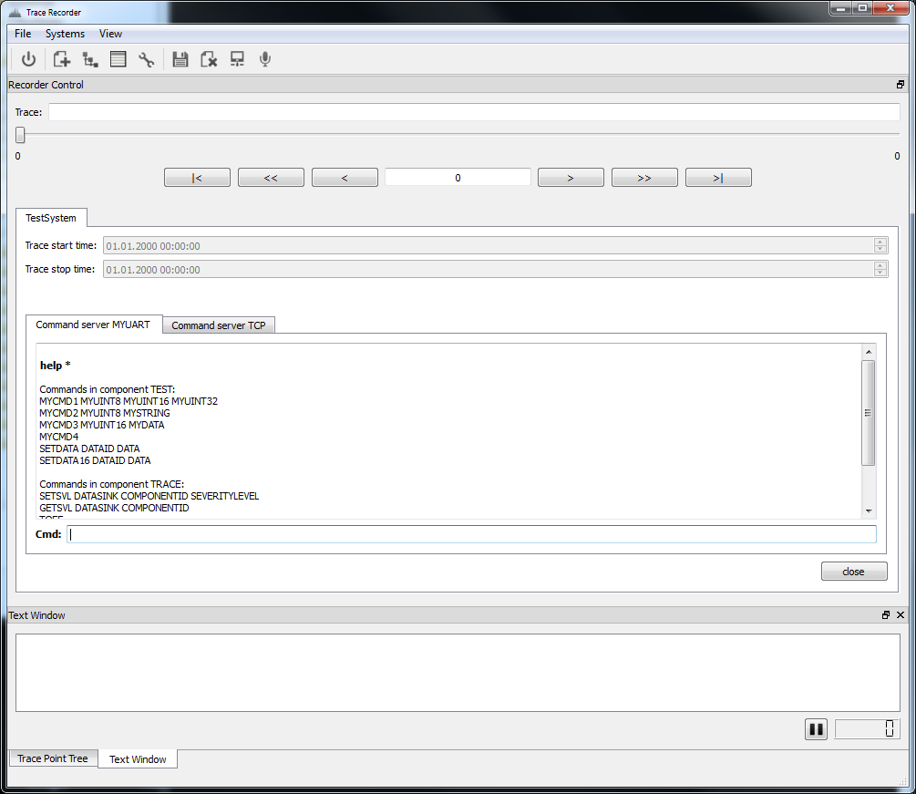
Trace & Debug
Trace Recorder
1. Load your tdf
2. Start recording
4. Save your TRC and/or export it to other file formats
3. Connect to Target

Slide 13
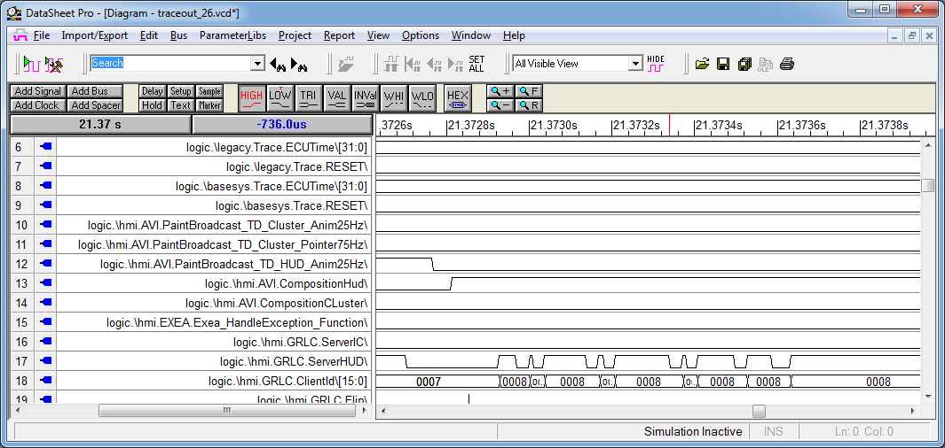
Trace & Debug
VCD Files
Exported trace point data as VCD file
VCD file viewer for visualize data as timing diagram

Slide 14
Development Environment Preparation
install_link.bat to install and prepare the SW frame
install_and_build_simu.bat same as install_link.bat + tool chain + build simu
install_and_build_target.bat same as install_link.bat + tool chain + build target
Preparation:
Clean SW frame (delete generated files)
Check tool version
Prepare project file (CMAKE)
Create goMSVCnet.bat

Slide 15
Development Environment CMAKE
CMAKE is used to create the project/solution tree in Visual Studio
Every package or subsystem has its own CMAKE file (… .cmk)
Generated file have to be explicitly marked in the CMAKE file
Generated file don’t have to exist during CMAKE run

Slide 16
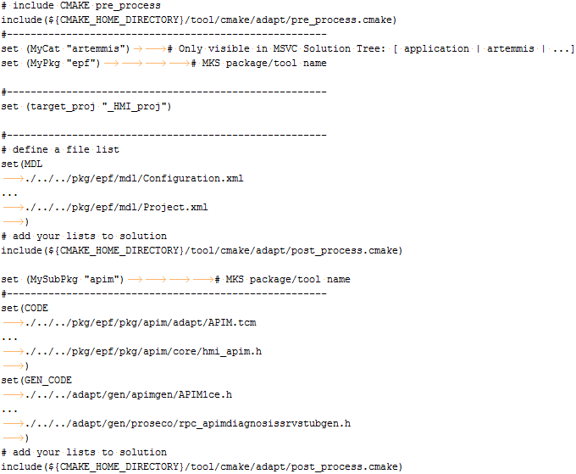
Development Environment CMAKE
Example:

Slide 17
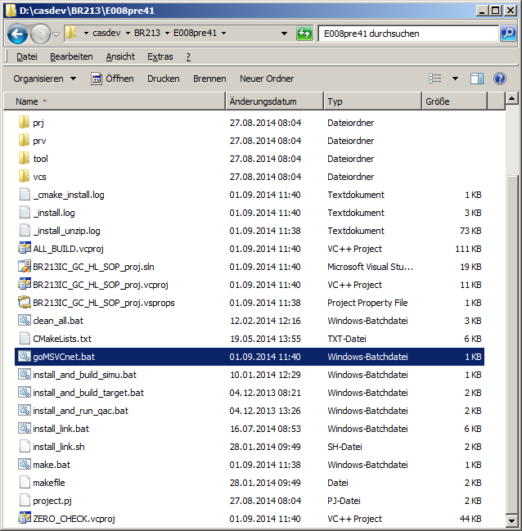
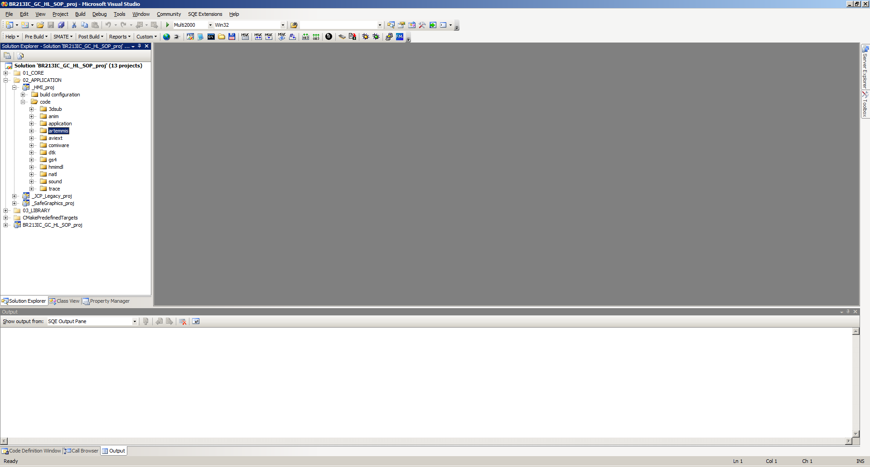
Development Environment Start IDE
Use goMSVCnet.bat to start the IDE (MS Visual Studio)

Slide 18
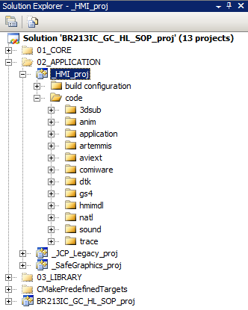
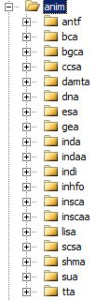
Development Environment HMI Project - Animations

Slide 19
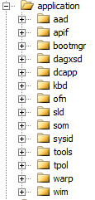
Development Environment HMI Project - Applications

Slide 20


Development Environment HMI Project - AVIEXT and DTK

Slide 21
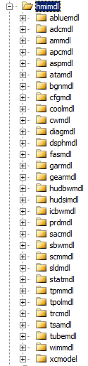
Development Environment HMI Project – HMI Model

Slide 22
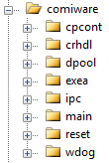
Development Environment HMI Project – COMIWARE

Slide 23
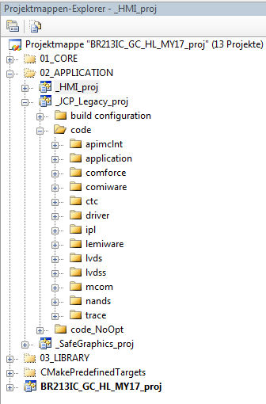
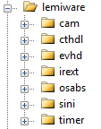
Development Environment Legacy Project – LEMIWARE

Slide 24
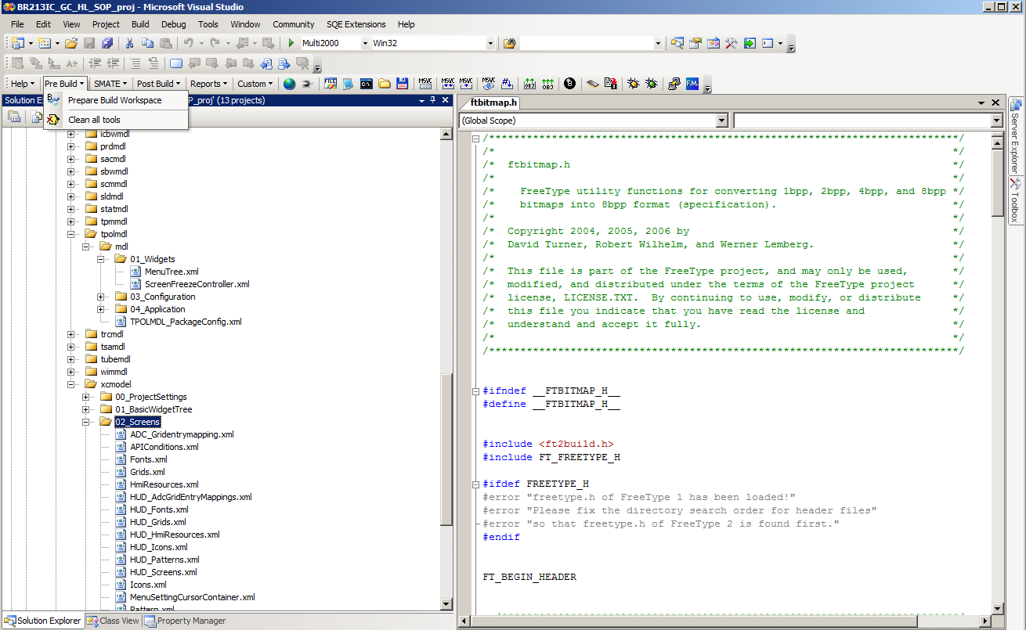
Development Environment Compiling target SW
Be sure that Multi 2000 is selected
1.
3.
2.
Run „Make Solution“
Run „Prepare Build Workspace“

Slide 25
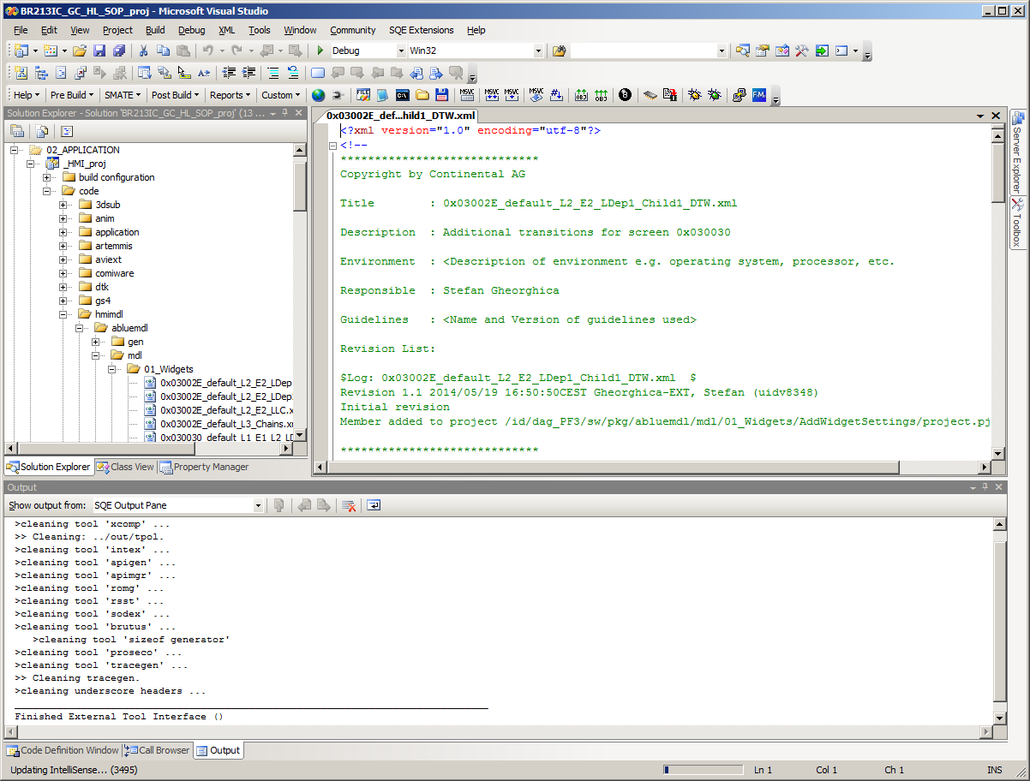
Development Environment Compiling simulation SW
Be sure that Debug is selected
F7, or Build / Build Solution
3.
1.
2.
Run „Prepare Build Workspace“

Slide 26
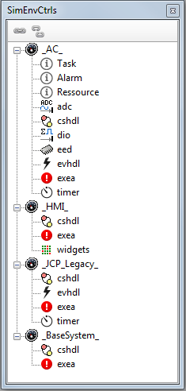

PC Simulation
The PC simulation:
can be used to debug GC SW frames without target HW
the corresponding AC SW is included as DLL (…\adapt\gen\ac_simulation\...)
can be stimulated with the CAN simulation (same as the target)
can be used without CAN HW
Microsoft Visual Studio can be used as debugger
PF3 Simulation Framework has to be installed
provides a Simulation Framework browser which shows additional information about the AC and GC SW system

Slide 27

PC Simulation – How to build
Open GC SW frame as usual: install.bat, goMSVCnet.bat
Switch MSVC solution from Multi2000 to Debug
Pre Build
213EL: Pre Build -> Simu: HMI (EPF + RSST)
213HL: Pre Build -> Prepare Build Workspace
Build Solution (F7)

Slide 28
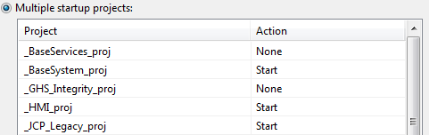
PC Simulation – How to build
213HL only:
Right click solution
Click “Set StartUp Projects…”
Common Properties -> Startup Project
Select “Multiple startup projects:”
Set “_BaseSystem_proj”, “_HMI_proj” and “_JCP_Legacy_proj” to “Start”
Only starting with E007pre35 set “_BaseSystem_proj”, “_HMI_proj”,“_JCP_Legacy_proj” and “_SafeGraphics_” to “Start”

Slide 29

PC Simulation – How to start/stop
Switch MSVC Solution from Multi2000 to Debug
Start Simulation via toolbar or F5
Two windows should appear: IC Main Display and HUD Display
Now you can use the project related CANoe simulation
Stopping the Simulation is done via toolbar or Shift+F5

Slide 30
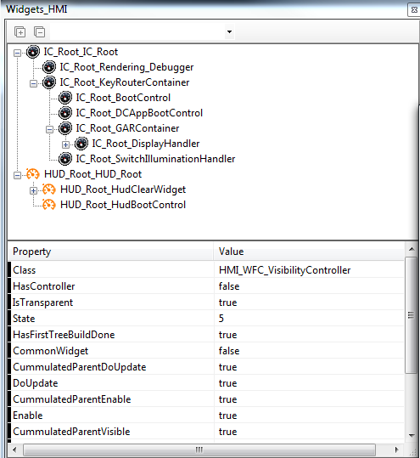
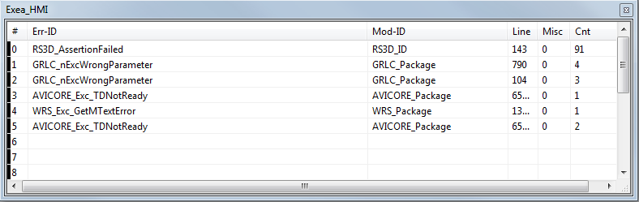
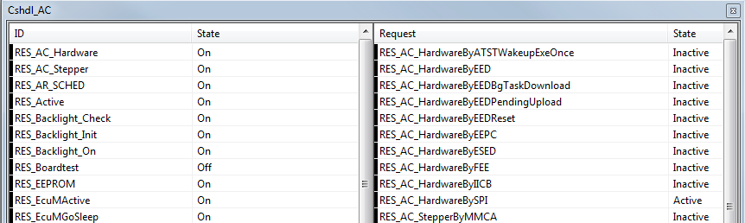
PC Simulation – How to use
Use the SimEnvBrowser to show the different visualizers.
Expand the leaf corresponding to AC or GC tasks to see which views/editors are available for it.
Double click an entry to show the corresponding visualizer.

Slide 31
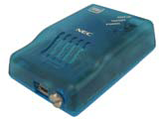

Greenhills Debugger
Debugger Hardware used with JCP2011PL / BR213 EL project
Minicube
On-Chip Debugger with Flash Memory Programming, only 2 hardware breakpoints, no Trace option
IECUBE 2
Debugger/Emulator with Flash Memory Programming, Trace function (stores a history of instructions and related data), supports up to 12 hardware breakpoints
Debugging Modes (Connection type)
Connect to debugger and flash application
Connect to application already on target

Slide 32
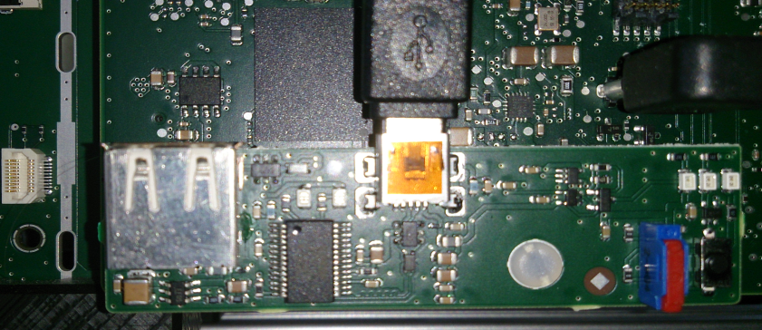
Greenhills Debugger
Debugger Hardware used with i.MX 6 (IC 213 HL project):
Debugger board connected to the target hardware; Can be used with USB or Ethernet link
Features
Supports flashing of application and eMMC
Connects to running application on target
With special build option, application processes can be started also by the Debugger

Slide 33
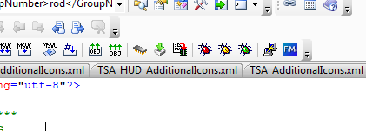
Greenhills Debugger
Debugger is started from the Visual Studio with the “bug” Buttons (part of the Conti SQE Extensions):
Red: Debug via Ethernet
Yellow: Debug via USB
Green: Debug in Freeze Mode
Flashing Application and external Flash Memory (eMMC) is done with these buttons:
Flash all via USB
Flash Application via USB
Flash SDF area via USB

Slide 34
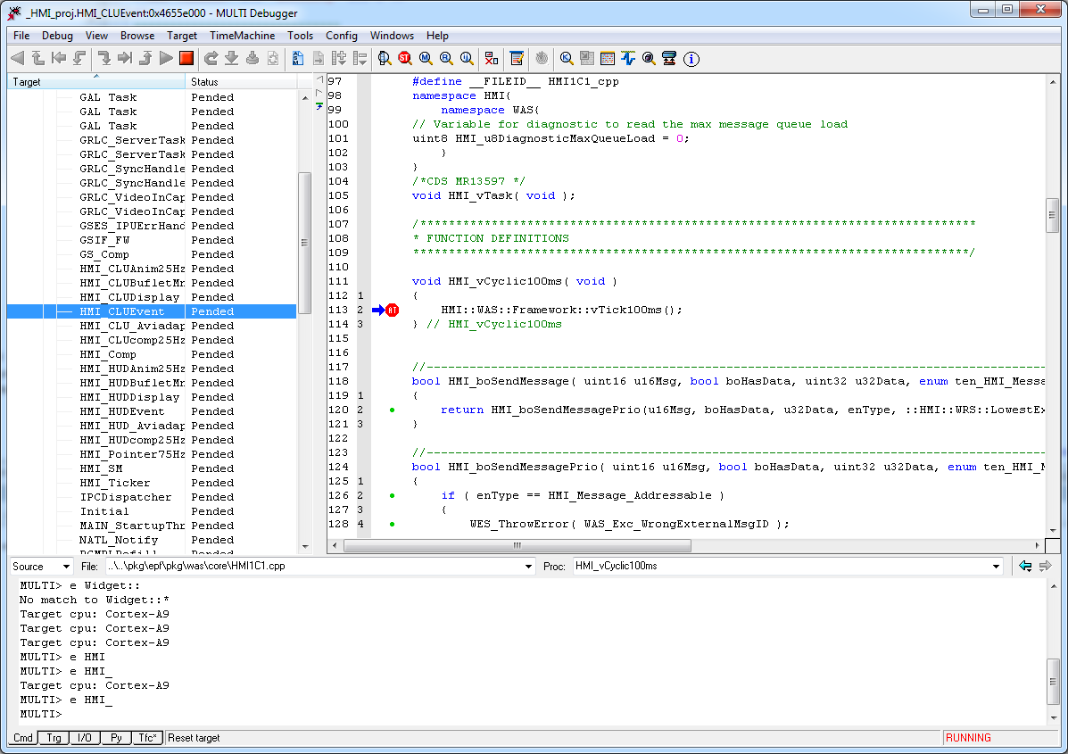
Greenhills Debugger
IDE Overview
Menu
Toolbar
Process/Task
Window
Breakpoint
Code
Window
Active Task
Source File
Browser
Function
Browser
Command
Window

Slide 35
Greenhills Debugger
IDE Elements and Features (Toolbar)
Reload Debug Symbols
Reset
Prepare Application
Restart Application
Halt
Run
Step out of current Procedure
Single Step
Step into Procedure
„Time Machine“ Controls (only available with special hardware/license)

Slide 36

Greenhills Debugger
IDE Elements and Features (Toolbar)
Time Machine Debugger
Edit Source
Connect/Disconnect Target
View Local Variables of current Procedure
Open the Register Viewer
Open the Memory Viewer
Open the Breakpoint Editor
Open the Call Stack Window
Move down one Call Stack Frame
Move up one Call Stack Frame
Switches to Code Line current PC points to
Shows Assembly of current Source

Slide 37

Greenhills Debugger
IDE Elements and Features (Toolbar)
Conti RC Scripts (see next slide)
Dump CTC Data (C1 Code Coverage)
Show Integrity Data for current context (process, task…)
Start MULTI Resource Analyzer (special license needed)
Start MULTI Event Analyzer (special license needed)
Dump Events and show Event log (special license needed)
OSA Kernel Explorer (special license needed)

Slide 38
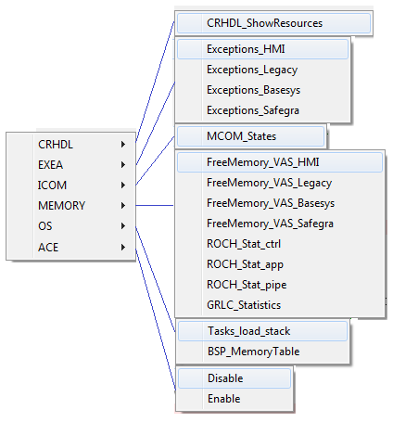
Greenhills Debugger
CONTI RC Scripts
The scripts are printing states of several system components into the Debugger’s output window
Infos:
CRHDL States
EXEA Exceptions
Memory consumption
BSP Memory
Stack

Slide 39
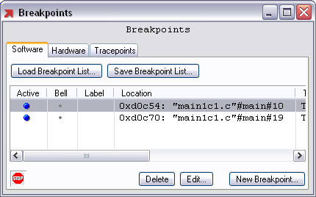
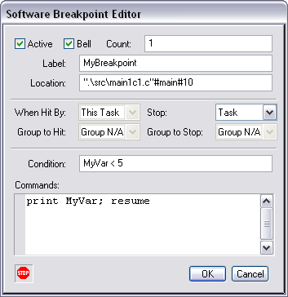

Greenhills Debugger
IDE Elements and Features: Breakpoint Editor
BP Editor can be invoked via BP Toolbar button or right-clicking on a BP in the code window.
Active: Enable/Disable BP
Bell: Sound is played when BP is hit
Count: BP hits before target halt
Label: BP name
Location: Address/source location of BP
Task Settings Selection of task/Task group and stop behavior
Condition: Expression that must evaluate to true, before target halts at this BP
Commands: List of commands to execute when BP is hit

Slide 40
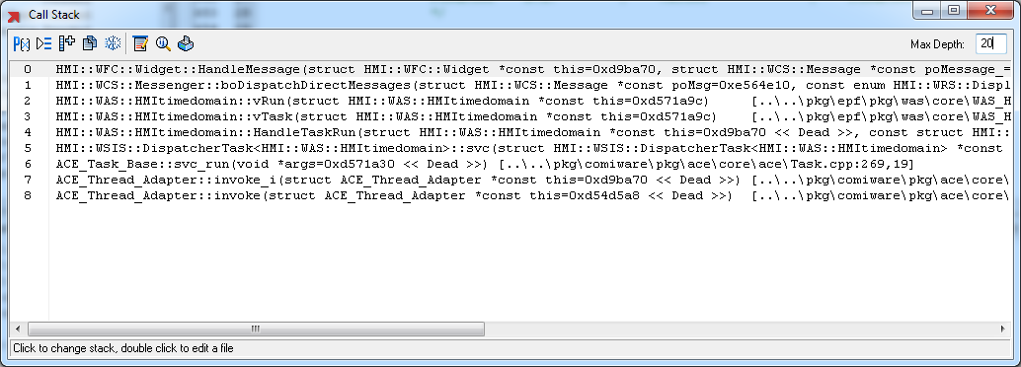
Greenhills Debugger
IDE Elements and Features (Call Stack Browser)
Can be invoked using the Toolbar Button. Displays the stack of function calls from current source position (halt mode).
Options: Hide/Show call parameters, Hide/Show source location, Increase stack depth, Copy Stack to Clipboard, Freeze Window Content, Invoke Source Editor, Show local variables, Print Window

Slide 41
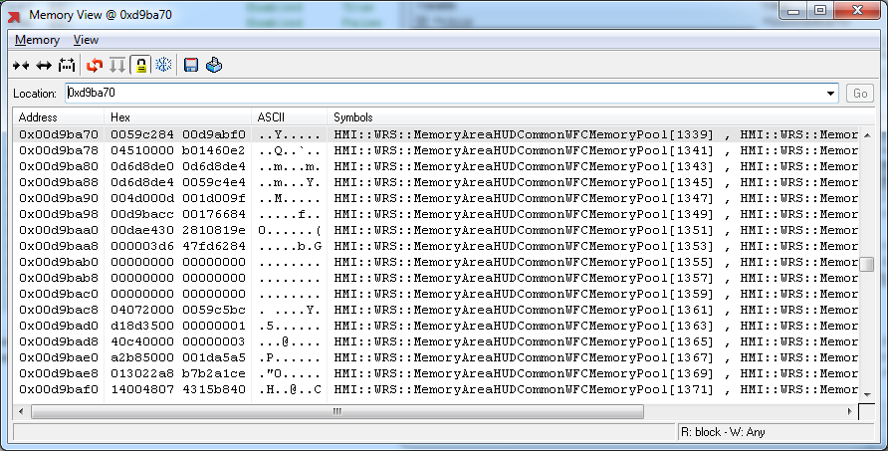
Greenhills Debugger
IDE Elements and Features (Memory Viewer)
Can be invoked by the Memory View Toolbar Button. Shows memory content at given address. The Memory drop-down menu allows memory manipulation (Fill, Copy, Save/Load File etc.). The Memory Window -Toolbar offers the features: Modification of the Memory View, Refresh, Writing modified data to the Target, Lock Address, Freeze Content, Save Memory to a file or Print data.

Slide 42
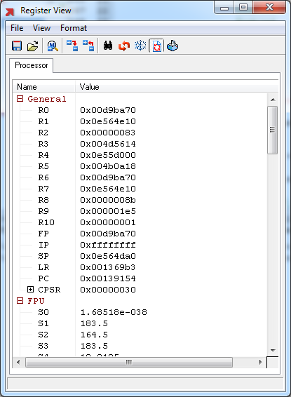
Greenhills Debugger
IDE Elements and Features (Register Window)
Use the Toolbar button to activate the Register Viewer. The displayed registers
are grouped by function, e.g.
General:
Program registers R0..R10
SP Stack Pointer
PC program counter
…
FPU:
Floating Point Unit Registers

Slide 43
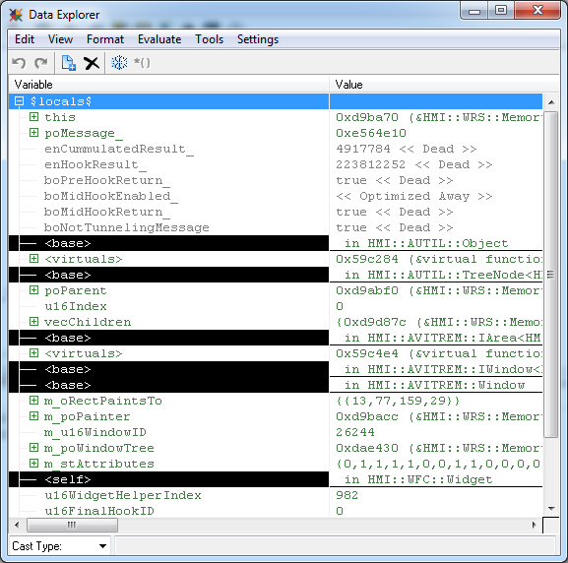
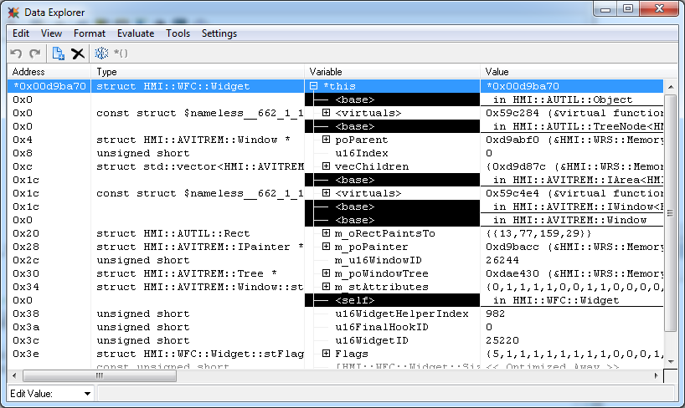
Greenhills Debugger
IDE Elements and Features (Data Explorer)
This window is invoked by the view command. The viewed data can also be edited. The Data Explorer menus offer several options: Add or remove variables, change view format and many more.

Slide 44
Greenhills Debugger
Debugger Commands (Navigation)
e <n>_ Moves back the callstack number of calls, e.g. e 2_
e <address> Moves to the code at this address, e.g. e 0x0bff38d0
e "<file>"[#<function>]#[<line]
Moves to the code in file, function and line, e.g. e “Start.c” e “Main1c1.c” #main#4
e <variable> Moves to source location of variable, e.g. e u16CurrentState
e <bp_name> Moves to code of breakpoint with given name
e <n>b Moves to code of breakpoint with ID n, e.g. e 2b
e * Displays function list (wildcard search), e.g. e NVIEWv_*
e $<register> Moves to code the register points to, e.g. e $sp

Slide 45
Greenhills Debugger
Debugger Commands (View)
view [/n] <expr> [, <expr>] … view *address | filename | $locals$
Opens the Data Explorer or the Browse window, examples: view MOD_u8State, view 0x0d231424, view MOD1c1.c, view $locals$
update [[-m] interval] Re-evaluates all currently open Data Explorer and Monitor with interval sec or [-m] milliseconds, update –m 500
Debugger Commands (Program Execution)
g <address> Modifies the program counter that address becomes the next instruction to execute
c [@<cnt>] [<address>] Continue a stopped process, with passing <cnt> breakpoints until next halt or stopping at given address, example: c , c @5 or c MOD_vMain#12
runtohere Runs to the current line or address
Halt Halts the current process

Slide 46
Greenhills Debugger
Debugger Commands (Memory)
copy <src> <dest> <len> [<size>] Copies a block of memory from src to dest, len elements of size e.g. copy 0x10000 0x10008 10 4
fill <dest> <len> [<value>] [<size>] Fills memory in dest with pattern value, len elements of size e.g. fill 0x10008 10 0x5A5A5A5A 4
memdump [-append] [srec | raw] <filename> <start> <len> Writes a block of memory to a file in Motorola or binary format, e.g. memdump raw „c:\temp\Memdump.bin“ 0x0BBF558 1024
memload [srec | raw] <filename> [<start>] [<len>] Reads from a file and writes data to a block of memory, example: memload srec „c:\temp\Memdump.srec“

Slide 47
Greenhills Debugger
Debugger Commands (Breakpoints)
B Lists information about breakpoints
b [%<label>] [@<count>] [&] [/off] [<address>] [{<commands>}] Installs a software breakpoint at the given address or function, with an optional label and count of BP hits before target is stopped. &: beep when BP is hit, /off: deactivates the BP, optional set of commands to execute when the BP is triggered, examples: b %BP_MainFunction @100 MOD_vMain#12 { print MOD_u8State } b “MOD1c1.c”#MOD_vMain#4 /off b 0x0BFF1234 b { mprintf(“Test=%d\n", u16TestNo); if (u16TestNo < 5 {resume}}
bA Same as b but sets a temporary BP that is disabled when hit first time
bif [%<label>] [@<count>] <address> <condition> Sets a conditional breakpoint, examples: bif MOD_vStateMachine { MOD_u8State==5 } bif 0x0BFF1234 { boInit == false }
resume [ <address> ] Resumes program execution at the specified address,
D Deletes all software breakpoints

Slide 48
Greenhills Debugger
Debugger Commands (Misc.)
help <cmd> Invokes documentation for the specific command
usage <command> Displays syntax description for the command
echo <txt> Prints to given text in the command pane. Used inside BP commands
mprintf (format_string, ...) Like the C-function printf, format and print text in the command pane
clear Clear text in the debugger command pane
q, quit, quitall Quit the debugger, closes all Multi windows
p, print <expr> Print an object pointed to by expr in the debugger command pane

Slide 49
Greenhills Debugger
Scripting (RC Scripts)
Debugger commands can be combined in scripts (*.rc)
Scripts contain „functions“ with a C-like syntax
Scripts are executed by calling them from the Debugger command pane
Scripts can be added to the Multi-Debugger GUI (e.g. Toolbar)
Example for a script (refer also to the ..\rc directory in your project):
define MyScript()
{
bA IDLE_vLoop_Tsk /* halt the target */
/* Print some variables from EXEA */
mprintf(">>EXEA__u32RecordCntr: %d",EXEA__u32RecordCntr)
mprintf("\n>>Active Error IDs:")
eval ($cnt=0)
while($cnt<10)
{
print EXEA__astErrorRecord[$cnt].enErrorID
eval ($cnt++)
}
c /* continue program */
}

Slide 50
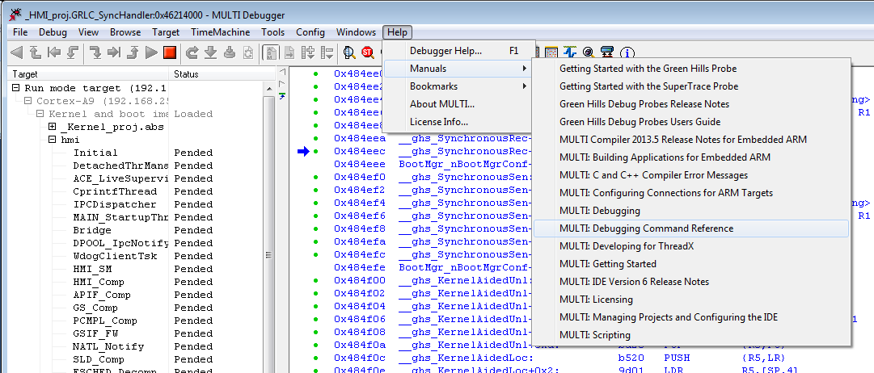
Greenhills Debugger
A detailed description of the debugging commands can be found in the Greenhills Multi Debugger Command Reference:

Slide 51
EXEA - Exceptions
Exception Handler EXEA
Central instance for processing system failure and malfunction
Each exception is associated to one EXEA error class:
Fatal Exception system is forced to shut down
Malfunction Exception less critical than a Fatal exception Configurable feature to raise a fatal exception after pre-defined number of malfunction errors (disabled by default in JGP2014)
Wrong Parameter Exception least critical exception Configurable feature to raise a fatal exception after pre-defined number of wrong parameter errors (disabled by default in JGP2014)

Slide 52
EXEA - Exceptions
mainly deals with exception logging
possibility to perform additional exception handling by configuring a common handler function (invoked whenever a specific type of exception is flagged)
Exceptions are stored in a ring buffer
Option for JGP2014: store the error record in a process-local ring buffer additionally in a global ring buffer which is stored in the No-init RAM (OCRAM)

Slide 53
EXEA - Exceptions
Configuration
EXEA configuration is done via ProSeCo
ProSeCo generates the file EXEAGen2ci.h
Following table shows a summary of the parameters:
ErrorID Index to the error table
enErrorClass error type and consequently action
ERSFunction DO NOT USE
ApplicationFunction DO NOT USE
ErrorStorageId DO NOT USE
u8StoreLocal Storage class of the error: 0x00: local + global 0x01: local only
u8NotStored Don’t store flag: 0x00: stored in ringbuffer 0x01: not stored in ringbuffer

Slide 54
EXEA - Exceptions
Usage
EXEA_vHandleException() must be placed at the point in the code where the error occurs
usable for diagnostics:
EXEA_vClearGlobalRingbuffer() clear the global ring buffer
EXEA_vClearRingbuffer() clear the local ring buffer of the process where the call was made
EXEA_pstRingbufferAccess() access the local ring buffer

Slide 55
EXEA - Exceptions
Example
SDH file (ProSeCo) define and configure the exception:
Error class
Error ID
Module ID (name space)
… EXEA DEFINE MALFUNC EXCEPTION GSCHED_Exc_ReadReqFail IN NAMESPACE GSCHED_Package; …
(all in one line)

Slide 56
EXEA - Exceptions
C file (source) call EXEA_vHandleException and provide:
Module ID
Error ID
Error line (in code file, 32 bit, __LINE__ can be used)
Additional data (optional)
A count number of the occurrences is added automatically
… EXEA_vHandleException( GSCHED_Package, // EXEA_tenModuleID GSCHED_Exc_ReadReqFail, // EXEA_tenErrorID __LINE__, (uint32)enRes); …

Slide 57
WES - Exceptions
WES is part of the ARTEMMIS framework and provides wrapping macros to easily use EXEA functionality within the framework:
WES_ThrowError
Only 1 parameter has to be provided for WES_ThrowError:
Error ID
Additional data (optional)
All other information for EXEA is added automatically by the wrapping macro
32 bit EXEA line number is split into
16 bit file ID and
16 line number

Slide 58
WES – Exceptions Usage
Inside every XXX_ErrorIDs.hpp (replace XXX with package name):
Define __PACKAGE__ (used as module ID in WES macro) Should be defined before header protection conditional compilation.
Contains enumeration with filenames declared as cpp and hpp identifiers
Starts with XXX_artemmis_none and ends with XXX_artemmis_next.
Enumeration has to contain the name of all files, which include XXX_ErrorIDs.hpp
Example:
… #define __PACKAGE__ XXX
#ifndef XXX_ERRORIDS_HPP #define XXX_ERRORIDS_HPP #include "WES1C1.hpp"
enum { XXX_artemmis_none = 0 , XXX_MessageTimer_cpp = 1 , XXX_Framework_i_hpp = 2 , XXX_Framework_cpp = 3 … , XXX_artemmis_next};
#endif

Slide 59
WES – Exceptions Usage
CPP file which uses WES:
Include XXX_ErrorIDs.hpp as last include before start of code.
Define __FILEID__ with one of the enum values from XXX_ErrorIDs.hpp. This enum value should correspond with the name of the CPP file.
Example:
… #include "XXX_ErrorIDs.hpp"
#define __FILEID__ XXX_Framework_cpp …

Slide 60
WES – Exceptions Usage
HPP files which uses WES:
XXX_ErrorIDs.hpp should not be included in any HPP file except for _i.hpp files.
At the end of the header file there should be an #undef for __FILEID__ and __PACKAGE__
If the compiler reports an error for redefinition of __PACKAGE__ or __FILEID__ then this usually means that some _i.hpp file does not #undef them at the end.
Example:
…
#include "XXX_ErrorIDs.hpp"
#define __FILEID__ XXX_Framework_i_hpp
…
#undef __FILEID__
#undef __PACKAGE__

Slide 61
SYRTO
System Real Time Observation – SYRTO
measures system relevant data
task and interrupt runtimes
provides test pins
acquired data is stored in RAM
Data can be read via debugger
trace messages for specific system states and events (on CAN bus)
Enable/disable via EEPROM bit
various SYRTO features can be enabled by compiler switches
uses HW timer for generating time stamps

Slide 62
SYRTO
Runtime measurement
measures:
Current runtime
Average runtime
Maximum runtime
provided function
SYRTO_u32GetTimeStamp (current time stamp, uint32)
A high resolution timer is used to generate time stamp
Time resolution is 1ms

Slide 63
SYRTO
Traces
provided functions
SYRTO_vStartTrace (starts tracing)
SYRTO_vStopTrace (stops tracing)
SYRTO_vCreateTraceEvent (creates trace message) requires notifier, trace event and additional data (uint32)
Creating a trace event results in a CAN message:
Byte0 = timer (low byte) in ms
Byte1 = timer (high byte) in ms
Byte2 = bit 7 node, bit 0-6 notifier
Byte3 = trace event
Byte4 - 7 = data bytes
Useful for debug data output with time stamps

Slide 64
SYRTO
Test pins
provided functions
SYRTO_vTestPinSet (set pin to provided level)
SYRTO_vTestPinToggle (toggles pin)
SYRTO_vTestPinPeak (creates a peak)
Several test pins are defined and preconfigured
Measurement can be done with oscilloscope or logic analyzer
Provides very precise timing measurements

Slide 65


WiTri – Widget Tree Inspector
Read current widget tree state
Check individual widget attributes
Search for “alive” widgets by name
Pros: - Quick check how the widget tree looks like at the moment - No “real” debugging necessary - Get relevant WidgetIds in WiTri without looking at the generated file
Cons: - Only for the BR213 EL - Attributes only supported for the standard widget - no HUD widget tree (only IC) - only good for a first glance and no “real” debugging

Slide 66
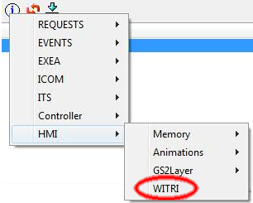
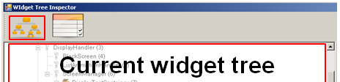
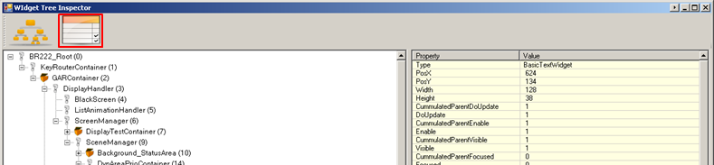
WiTri – Widget Tree Inspector
Start WiTri using the button at the top of IDE:
1. Step: Read current widget tree from the system:
2. Step: Browse widgets (Either browse through the tree or use the search field)
3. Step: Get selected widget properties

Slide 67
Debugging Hints
Catch error quickly
Put breakpoint at EXEA, WMMS for most common exceptions
Localize the problem
Use conditional breakpoint with widget ID, animation ID, status, etc.
Use the Tasks window in Greenhills Debugger to examine the thread states
Are any of them frozen, waiting for a event or semaphore?
Are there tasks that have become SUSPENDED by the OS?
Useful if the system seems "stuck“

Slide 68
Debugging Hints - Messaging
Check if widget receives the expected message
Put breakpoint at final hook (WRS generated file by Brutus) / process message
Check if widget is alive
If not, find out the “storage” where the message is expected to be (internal, external)
If message is not stored, trace from the sender immediately

Slide 69
Debugging Hints - Messaging
If message is stored in queue (internal / external), check WCS::Messenger class
Put breakpoint at vProcessMessage(), and check if message is received there
If not, check WCS::MultiLevelQueue class if any message is blocked due to priority
If not, check if the message is inside the queue at all

Slide 70
Debugging Hints - Messaging
If message is found in the proper “storage” area, check for propagation type
Addressable / direct message is directly sent to widget
Check if the widget is alive
Check if receiver is registered for message (direct message)
Broadcast message is handled in Messenger::BroadcastMessage
Check if widget is part of the widget tree
Focused message is handled in TreeDispatcher::vPropagateMessage (tunnelling) / vProcessBubbleUp (bubbling)
Check for unbroken focused path
Check for tree dispatcher strategy

Slide 71
Debugging Hints - State Machine
Check if trigger is sent properly
Check the sender part (final hook / process message)
Check if transition happens correctly
Put breakpoint at state machine / custom controller’s process message
Is trigger message received?
Is the resulting state as expected?
Check the new state in controller widget process message
Check if tree build is triggered – for lifetime controller
breakpoint at SceneController::enProcessMessage() – ChangeTree
Check if visibility change is triggered – for visibility controller
Also check if the cumulative parent visibility is correct

Slide 72
Debugging Hints - Display / Painting
Check if widget/animation draws
Put a breakpoint in your animation's/widget's vPaint
Check if the widget/window is visible
Check window coordinates
Check if the window is invalidated
Widgets should do this if their visual state changed
Animations should do this every time tick, when their AnimParams change
Check if the window is attached to a living buflet/window tree
If not, you may need to request for the assembly of the buflet first
Check if the TimeDomain is active
Put breakpoint at HMITimeDomain::vRun()

Slide 73
Debugging Hints - Display / Painting
If the paint method was called
Trace/step inside the GRLC calls to see if any errors occurred
Check if the composition mode is correct
Check if there is no other window drawing on top of it
Check if the window position and dimensions correct
Note for containment rule and drawing area size
Check if the widget / animation is painting to offscreen
Has it been blitted / copied to layer?
Check if the content is painted in any buflet (front / back buffer)
If it’s in back buffer, check if any flip is triggered
If not, check the buflet lock/unlock sequence for that surface

Slide 74
Debugging Hints - Display / Painting
If the display seems frozen or unresponsive
Check if the HMI is still receiving messages
Put a breakpoint in HMI_boSendMessageToWidgetInstance
Check if the HMI is still processing the messages / API update
Put a breakpoint in WAS::HMITimeDomain::vRun – External Message processing
Put a breakpoint in WAS::DisplayController::vRun - per display: handling of external message and processing all internal messages
If it's not processing, check the HMI thread states

Slide 75
Debugging Hints - Display / Painting
Check if the HMITimeDomains are still active/painting
Check DisplayController::vRenderAllTrees for HMI TD - it should be called after every HMI message processing cycle
Check AVICORE::AnimWorker::vOnExecute for animation TDs - it should be called after every divider Vsyncs (as long as an animation on that TD is alive)
If they were deactivated, put a breakpoint in HMI_vDeactivateProcessing to find out why
If they are active and painting, did the surface(s) get flipped? HMI flip could be locked

Slide 76
Debugging Hints – Access to Objects
Widget and Widget Windows
Call poGetWidgetByID (Widget ID) at Debugger command line
Find Widget ID in file wrs_visualresourceids.hpp
Returned address == NULL -> Widget is not alive
Otherwise cast valid address to widget type to view instance details
Note: Window is embedded in Widget
Animation Windows
Call poGetWindowByID (Window ID) at Debugger command line
Find Window ID in file wrs_ciaresourceids.hpp
Animations
Check creation by setting BP inside AVIAN_vCreateAnimation
Set BP in method vTimeTick in AVIAN::Scheduler
Find lists of animation objects
To be created in AVIAN::Scheduler::m_xNewAnimationsList
In waiting state inside AVIAN::Scheduler::m_xWaitingAnimationsList
Running animations inside AVIAN::Scheduler::m_xActiveAnimationsList
IDs of animations can be found in file wrs_aceresourceids.hpp

Slide 77
Debugging Hints – Miscellanous
Start Process from Debugger
To start a process within the Debugger modify file int_core.int
Option StartIt for the process must be set to false
Note: When done for the Process basesys complete target software execution is controlled by manual start of this task in Debugger
Debug Output
The “print” function can be used inside your code to write debug output to the Debuggers command window
Print Enum names instead of numbers
To get enum element names instead of numbers when printing variable values on breakpoints, add and subtract a random enum element of the wanted enum type to the value Breakpoint command: p poMessage_->u16MsgID command output: u16MsgID = 1000 Breakpoint command: p poMessage_->u16MsgID + MsgID_CompInfo - MsgID_CompInfo command output: MsgID_UpdateDataBinding (1000)

Slide 78
Kontakt
Schleißheimer GmbH
Am Kalkofen 10 D-61206 Wöllstadt Tel.: +49 6034 9148-701 Fax: +49 6034 9148-91 vertrieb@schleissheimer.de
www.schleissheimer.de

