Slide 1
DeepVerse
NLP GP 57
Dhyey Thummar
Dwip Dalal
Shruhrid Banthia

Slide 2
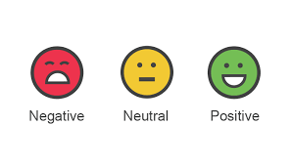
Analysis of reviews on Rotten Tomatoes
Rotten Tomatoes contains reviews of movies and thus is a great place to get data from. As a part of our project our NLP model will be categorizing the reviews provided by users into three sections, positive, negative and neutral upon processing the the labelled data provided by nlp.stanford.edu.

Slide 3
Proposed Approach
How did you approach the problem?
There are manys ways to approach this sentiment analysis problem some being lexicon based approach, SVMs and other ML algorithms. Here we used the most famous approach i.e deep learning approach where we shall have train neural network and then used that to understand and predict the sentiment of reviews.
How did you break down the problem?
#Dataset visualization and data analysis.
#Splitting the data into train, test and validation sets.
#Tokenization of the dictionary.
#Word embedding of the reviews.
#Training 3 different models : LSTM , Bidirectional LSTM and Feed forward neural network
#Integrated stacking of three different neural networks.

Slide 4
Technologies used:
#Tensorflow Library #Python
#Matplotlib #Pandas
#Sciikit Learn #Keras
#Numpy
Why did we use these technologies?
All of the above technologies are the state of the art libraries within python that enable us, tech freaks, to implement our model in the best possible manner. A specific reason for choosing Tensorflow over PyTorch was the added benefit of being able to use the TPUs in Google Colab.

Slide 5
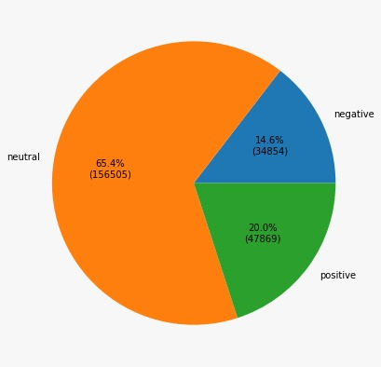
Dataset Visualization using Pie Chart:

Slide 6
Overall model pipeline:

Slide 7
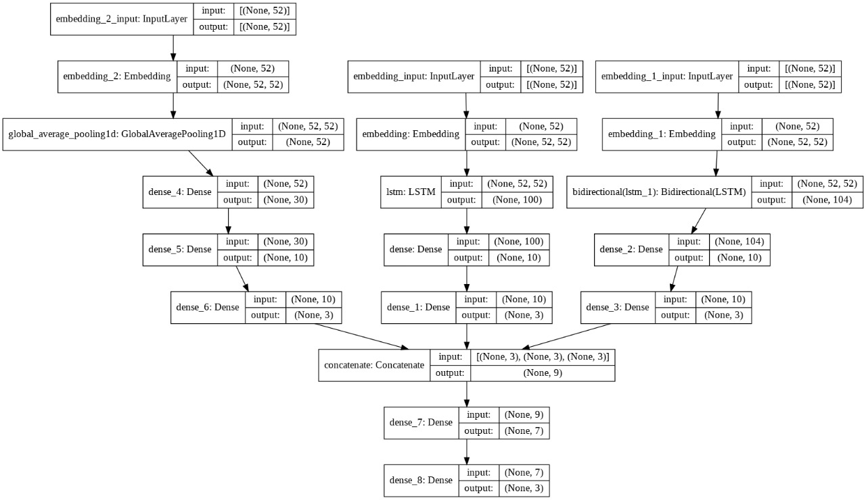

Slide 8
Few Salient Features of our Model
#We have used ensembled learning: Under ensembled learning we concatenated the dens layers of the three stated models into a single new layer that was fed further to the combined meta learner neural network. This can be seen from the model pipeline. This is also known as Integrated Stacking.
#Early Stopping: We trained our model such that the epochs trained only until it was required and the accuracy increased.

Slide 9
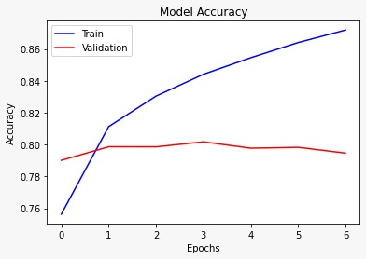
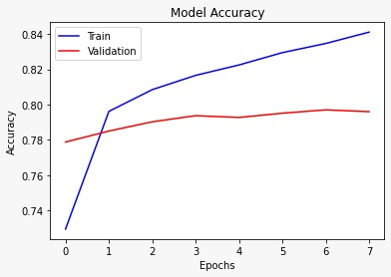
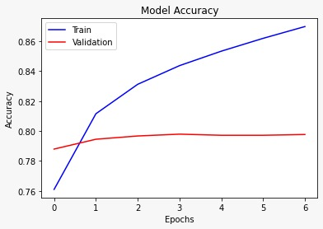
Accuracy of various Models:
LSTM Model
Feed Forward Model
Bidirectional LSTM Model

Slide 10
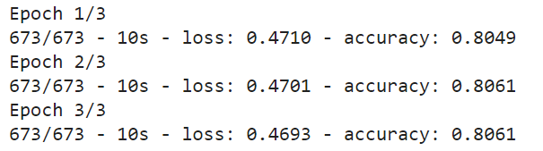
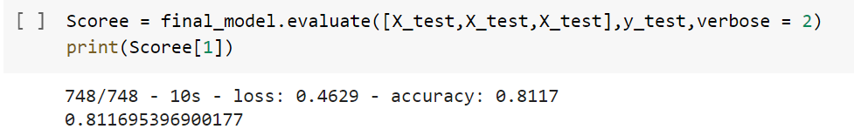
Final Model Accuracy on Train and Test Data:
Train Accuracy
Test Accuracy

Slide 11
The Road Ahead………..
BERT and other pretrained models could be used for transfer learning.
Using more models for integrated stacking like KNN,SVM etc.
Some more work on data preprocessing like part of speech tagging , etc.

