Slide 1
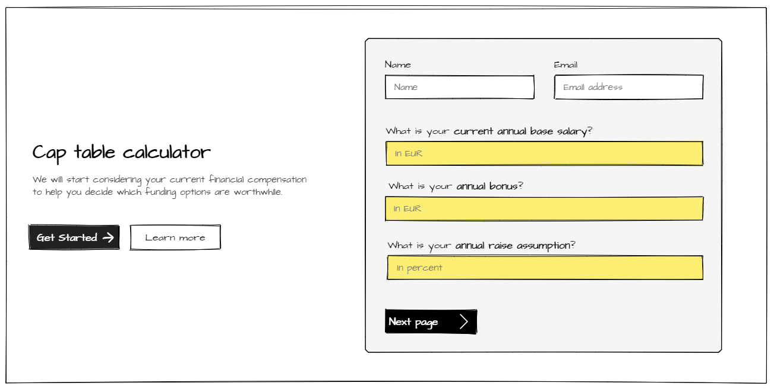
These are the personal questions included to inform decision making
Notes:
Help:
Early-stage startups: own risk, limited cash flow, lower salary until the company becomes profitable
Probable: 2.000 EUR monthly compensation after tax
Bonus: 4.000 EUR estimated bonus after tax (many clicks)
Raise assumption: 50% (for 4-5 years, before plateau)
Calculation:
Cost Per Thousand Impressions (CPM)
An average CPM rate of 2 EUR (depending on niche, user demographics, and ad quality)
If each of the 2 million visitor views an average of 3 pages, and each page displays 3 ads
2 million visitors x 3 pages x 3 ads = 18 million ad impressions
Revenue = (18 million impressions / 1000) x $2 = $36,000 per month

Slide 2
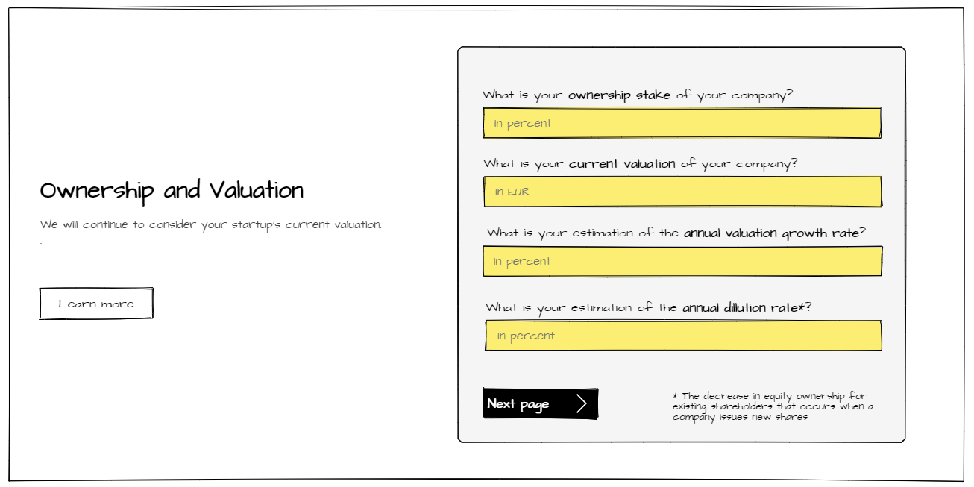
These are the questions on the business to inform decision making
Notes:
-

Slide 3
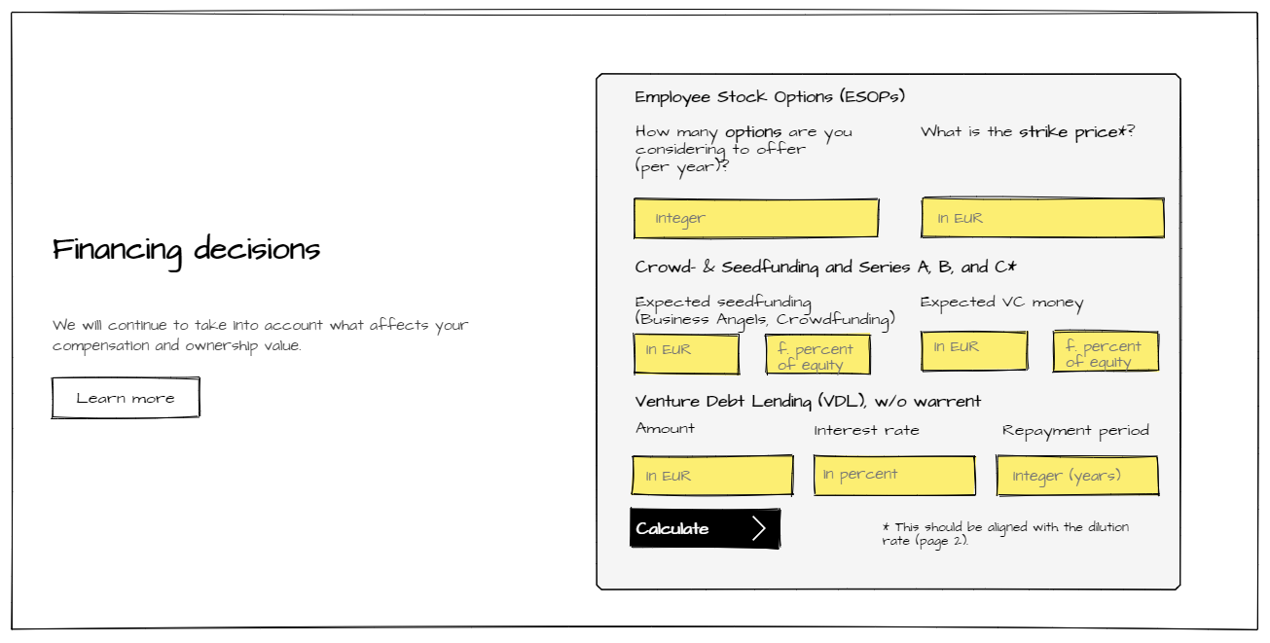
These are the questions on the financing decisions
Notes:
-

Slide 4
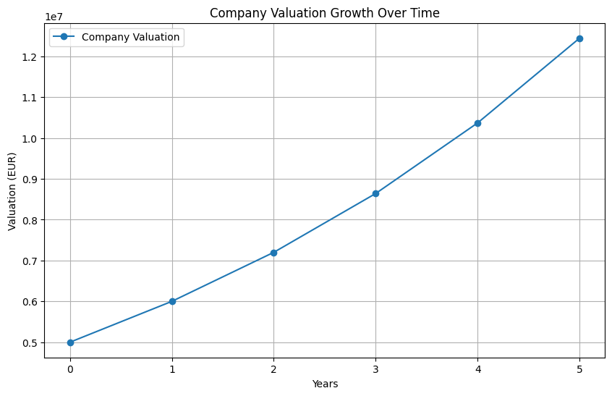
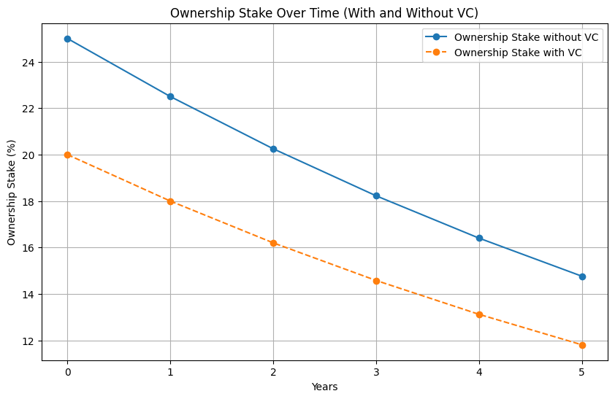
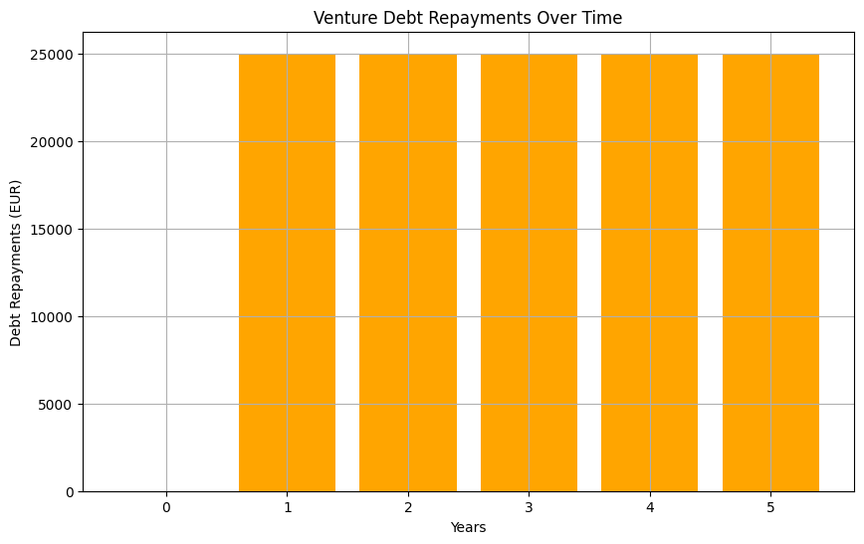
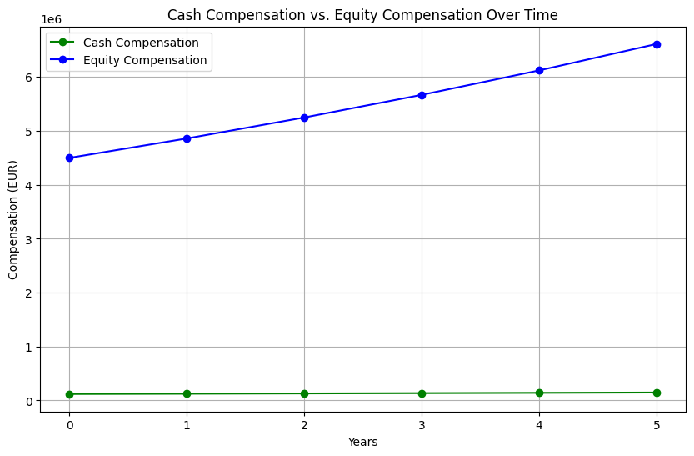
Cockpit

