Slide 1
Methodologies and tools
Methods
Methods - philosophy
Parameters and dependencies
Summary
Ontology Engineering
Lecture 5: Methods and Methodologies
Maria Keet
email: mkeet@cs.uct.ac.za
home: http://www.meteck.org
Department of Computer Science University of Cape Town, South Africa
Semester 2, Block I, 2019
1/71

Slide 2
Methodologies and tools
Methods
Methods - philosophy
Parameters and dependencies
Summary
Outline
Methodologies and tools Macro-level methodologies Micro-level methodologies
Methods
Logic-based debugging Logic & philosophy
Methods - philosophy
4
Parameters and dependencies
2/71

Slide 3
Methodologies and tools
Methods
Methods - philosophy
Parameters and dependencies
Summary
Ontology development
You have some experience with an ontology language and representing some knowledge, which was given to you
How to come up with the whole ontology in the first place?
What can, or should, you do when you have to develop your own ontology?
3/71

Slide 4
Methodologies and tools
Methods
Methods - philosophy
Parameters and dependencies
Summary
Ontology development
You have some experience with an ontology language and representing some knowledge, which was given to you
How to come up with the whole ontology in the first place?
What can, or should, you do when you have to develop your own ontology?
⇒ Just like in software engineering, there are methods and
methodologies to guide you through it
3/71

Slide 5
Methodologies and tools
Methods
Methods - philosophy
Parameters and dependencies
Summary
Ontology development
You have some experience with an ontology language and representing some knowledge, which was given to you
How to come up with the whole ontology in the first place?
What can, or should, you do when you have to develop your own ontology?
⇒ Just like in software engineering, there are methods and
methodologies to guide you through it
Recall (L1): an ontology is a logical theory “plus some more”
In this Block II, we also look into that “some more”
3/71

Slide 6
Methodologies and tools
Methods
Methods - philosophy
Parameters and dependencies
Summary
Topics for this lecture
Methodologies
Most are coarse-grained, i.e., a macro-level, processual information systems perspective; they do not (yet) contain all the permutations at each step
The actual modelling, or ontology authoring, using micro-level guidelines and tools
4/71

Slide 7
Methodologies and tools
Methods
Methods - philosophy
Parameters and dependencies
Summary
Topics for this lecture
Methodologies
Most are coarse-grained, i.e., a macro-level, processual information systems perspective; they do not (yet) contain all the permutations at each step
The actual modelling, or ontology authoring, using micro-level guidelines and tools
Methods, e.g.,:
Reverse engineering and text mining to start
OntoClean and OntoParts to improve an ontology’s quality
Parameters that affect ontology development (e.g.,purpose, starting/legacy material, language)
Tools to model, to reason, to debug, to integrate, to link to data
4/71

Slide 8
Methodologies and tools
Methods
Methods - philosophy
Parameters and dependencies
Summary
Outline
Methodologies and tools Macro-level methodologies Micro-level methodologies
Methods
Logic-based debugging Logic & philosophy
Methods - philosophy
4
Parameters and dependencies
5/71

Slide 9
Methodologies and tools
Methods
Methods - philosophy
Parameters and dependencies
Summary
Outline
Methodologies and tools Macro-level methodologies Micro-level methodologies
Methods
Logic-based debugging Logic & philosophy
Methods - philosophy
4
Parameters and dependencies
6/71

Slide 10
Methodologies and tools
Methods
Methods - philosophy
Parameters and dependencies
Summary
Typical stages of macro-level methodologies
Ontology management (scheduling, controlling, quality assurance)
Feasibility study (problems, opportunities, potential solutions, economic feasibility)
Ontology development and support
Domain Analysis (motivating scenarios, competency questions, existing solutions)
Conceptualisation (of the model, integration and extension of existing solutions)
Implementation (ontology authoring in a logic-based representation language)
Documentation
Knowledge acquisition
Ontology reuse
Evaluation
Ontology use
Maintenance (adapting the ontology to new requirements)
Use (ontology-based search, integration, negotiation)
7/71
Notes:
%\mbox{ } \hfill {\footnotesize {\em (based on Simperl et al., 2010)}}

Slide 11
Methodologies and tools
Methods
Methods - philosophy
Parameters and dependencies
Summary
Methodologies for ontology development
Waterfall
Lifecycle
Agile
8/71

Slide 12
Methodologies and tools
Methods
Methods - philosophy
Parameters and dependencies
Summary
Methodologies for ontology development
Waterfall
Lifecycle
Agile
Variants among them, such as eXtreme Design and TDD approaches, and different waterfalls
8/71

Slide 13
Methodologies and tools
Methods
Methods - philosophy
Parameters and dependencies
Summary
Methodologies for ontology development
Waterfall
Lifecycle
Agile
Variants among them, such as eXtreme Design and TDD approaches, and different waterfalls
They have not yet been compared in a controlled experiment
Nor is it clear which is popular (read: actually used) among the developers of domain ontologies, if any
8/71

Slide 14
Methodologies and tools
Methods
Methods - philosophy
Parameters and dependencies
Summary
A waterfall methodology: Methontology
Basic methodological steps:
Specification: why, what are its intended uses, who are the prospective users
Conceptualization: with intermediate representations
Formalization: transforms the domain-expert understandable ‘conceptual model’ into a formal or semi-computable model
Implementation: represent it in an ontology language
Maintenance: corrections, updates, etc.
9/71

Slide 15
Methodologies and tools
Methods
Methods - philosophy
Parameters and dependencies
Summary
A waterfall methodology: Methontology
Basic methodological steps:
Specification: why, what are its intended uses, who are the prospective users
Conceptualization: with intermediate representations
Formalization: transforms the domain-expert understandable ‘conceptual model’ into a formal or semi-computable model
Implementation: represent it in an ontology language
Maintenance: corrections, updates, etc.
Additional tasks:
Management activities (schedule, control, and quality assurance)
Support activities (knowledge acquisition, integration, evaluation, documentation, and configuration management)
9/71

Slide 16
Methodologies and tools
Methods
Methods - philosophy
Parameters and dependencies
Summary
A waterfall methodology: Methontology
Basic methodological steps:
Specification: why, what are its intended uses, who are the prospective users
Conceptualization: with intermediate representations
Formalization: transforms the domain-expert understandable ‘conceptual model’ into a formal or semi-computable model
Implementation: represent it in an ontology language
Maintenance: corrections, updates, etc.
Additional tasks:
Management activities (schedule, control, and quality assurance)
Support activities (knowledge acquisition, integration, evaluation, documentation, and configuration management)
Applied to chemical, legal domain, and others
9/71

Slide 17
Methodologies and tools
Methods
Methods - philosophy
Parameters and dependencies
Summary
Extending the methodologies
Methontology and others (e.g., On-To-Knowledge, KACTUS approach) are methods for developing one single ontology
Changing landscape in ontology development towards building “ontology networks”
10/71

Slide 18
Methodologies and tools
Methods
Methods - philosophy
Parameters and dependencies
Summary
Extending the methodologies
Methontology and others (e.g., On-To-Knowledge, KACTUS approach) are methods for developing one single ontology
Changing landscape in ontology development towards building “ontology networks”
Characteristics: dynamics, context, collaborative, distributed
E.g., the NeOn methodology
10/71

Slide 19
Methodologies and tools
Methods
Methods - philosophy
Parameters and dependencies
Summary
Extending the methodologies: NeOn
NeOn’s “Glossary of Activities” identifies and defines 55 activities when ontology networks are collaboratively built
Among others: ontology localization, -alignment,
-formalization, -diagnosis, -enrichment etc.
Divided into a matrix with “required” and “if applicable”
Recognises there are several scenarios for ontology development, refining the typical monolithic ‘waterfall’ approach
(more info in neon 2008 d5.4.1.pdf)

Slide 20
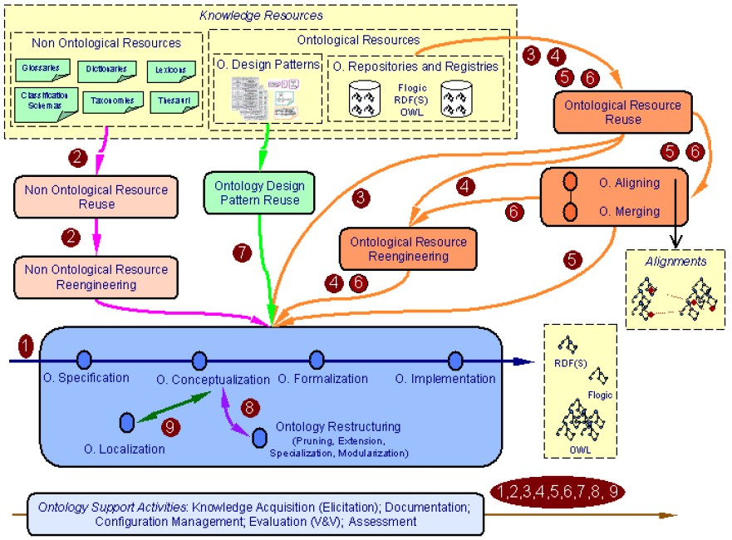
Methodologies and tools
Methods
Methods - philosophy
Parameters and dependencies
Summary
Several scenarios for Building Ontology Networks
Notes:
{\scriptsize (more info in neon\_2008\_d5.4.1.pdf)}

Slide 21
Methodologies and tools
Methods
Methods - philosophy
Parameters and dependencies
Summary
Tools for methodologies – not exactly
Current tools support one or more aspects of a methodology
e.g., WebProtégé, MOdelling wiKI MoKi for collaborative work, add a documentation plugin, a merging plugin etc. e.g., MoKi’s collaboration:
based on a SemanticWiki, used for collaborative and cooperative ontology development
‘multi-modal access at different levels of formality: informal, semi-formal and formal (enables actors with different expertise contribute)
13/71

Slide 22
Methodologies and tools
Methods
Methods - philosophy
Parameters and dependencies
Summary
Outline
Methodologies and tools Macro-level methodologies Micro-level methodologies
Methods
Logic-based debugging Logic & philosophy
Methods - philosophy
4
Parameters and dependencies

Slide 23
Methodologies and tools
Methods
Methods - philosophy
Parameters and dependencies
Summary
Micro-level methodologies
Guidelines detailing how to go from informal to logic-based representations with instructions how to include the axioms and figure out which ones are better than others
To represent the formal and ontological details
(very) Expressive ontology language, so as to include guidance also for the axioms and ontological quality criteria
15/71

Slide 24
Methodologies and tools
Methods
Methods - philosophy
Parameters and dependencies
Summary
Micro-level methodologies
Guidelines detailing how to go from informal to logic-based representations with instructions how to include the axioms and figure out which ones are better than others
To represent the formal and ontological details
(very) Expressive ontology language, so as to include guidance also for the axioms and ontological quality criteria
Notably: OntoSpec, “Ontology development 101” (outdated!!!), DiDOn, TDD
Methods & tools for sets of axioms; e.g.: FORZA, advocatus diaboli, SubProS & ProChainS, ...
15/71

Slide 25
Methodologies and tools
Methods
Methods - philosophy
Parameters and dependencies
Summary
More detailed steps (generalised from DiDOn) (1/2)
Requirements analysis, regarding expressiveness (temporal, fuzzy, n-aries etc.), types of queries, reasoning services needed;
Design an ontology architecture, such as modular, and if so, in which way, distributed or not, etc.
Choose principal representation language and consider encoding peculiarities;

Slide 26
Methodologies and tools
Methods
Methods - philosophy
Parameters and dependencies
Summary
A few basic hints for choosing a language
Is reasoning required?
No
Only data annotation?
Text annotation?
Yes
Use OBO or OWL 2 EL
Use SKOS, OBO, or
OWL 2 EL
Expressivity is important?
large ABox?
Use OWL 2 EL
Use OWL 2 QL
Decidability is important?
Use any FOL, extension thereof, or higher order logic, e.g. Common Logic, DLRus
Use OWL (2) DL

Slide 27
Methodologies and tools
Methods
Methods - philosophy
Parameters and dependencies
Summary
More detailed steps (generalised from DiDOn) (2/2)
Formalisation, including:
examine and add the classes, object properties, constraints, rules taking into account the imported ontologies;
use an automated reasoner for debugging/anomalous deductions;
use ontological reasoning services for quality checks
(OntoClean, Rbox Compatibility);
add annotations;
Generate versions in other ontology languages, ‘lite’ versions, etc, if applicable;

Slide 28





Methodologies and tools
Methods
Methods - philosophy
Parameters and dependencies
Summary
Test-driven Development
CQ added, template filled, or axiom written
TDD
cycle
TDD
cycle
Prior feasibility study, architecture, language decisions, ontology reuse decisions, etc etc, CQ specification
TDD
_{etc…} cycle
TDD
cycle
TDD
cycle
8. regression testing
1. select scenario
Ontology lifecycle
TDD
cycle
2. domain axiom for TDD test
7. refactor
TDD
cycle
TDD cycle
3. TDD test expected to fail
TDD
cycle
TDD
cycle
6. TDD test expected to pass
etc…
Deployment, documentation, etc.
5. classify ontology; no contradictions
4. update ontology
Notes:
From ESWC16 paper

Slide 29
Methodologies and tools
Methods
Methods - philosophy
Parameters and dependencies
Summary
The landscape
Isn’t ontology development just like conceptual data model development?
20/71

Slide 30
Methodologies and tools
Methods
Methods - philosophy
Parameters and dependencies
Summary
The landscape
Isn’t ontology development just like conceptual data model development?
yes: e.g., interaction with the domain expert, data analysis, “knowledge acquisition bottleneck”
20/71

Slide 31
Methodologies and tools
Methods
Methods - philosophy
Parameters and dependencies
Summary
The landscape
Isn’t ontology development just like conceptual data model development?
yes: e.g., interaction with the domain expert, data analysis, “knowledge acquisition bottleneck”
no: e.g., logic, automated reasoning, using (parts of) other ontologies, different scopes/purposes, specific isolated application scenario vs. general knowledge
20/71

Slide 32
Methodologies and tools
Methods
Methods - philosophy
Parameters and dependencies
Summary
The landscape
Isn’t ontology development just like conceptual data model development?
yes: e.g., interaction with the domain expert, data analysis, “knowledge acquisition bottleneck”
no: e.g., logic, automated reasoning, using (parts of) other ontologies, different scopes/purposes, specific isolated application scenario vs. general knowledge
Difference between writing down what you did (to make it a ‘guideline’) vs. experimentally validating a methodology
Difference between method and methodology
20/71

Slide 33
Methodologies and tools
Methods
Methods - philosophy
Parameters and dependencies
Summary
The landscape
Isn’t ontology development just like conceptual data model development?
yes: e.g., interaction with the domain expert, data analysis, “knowledge acquisition bottleneck”
no: e.g., logic, automated reasoning, using (parts of) other ontologies, different scopes/purposes, specific isolated application scenario vs. general knowledge
Difference between writing down what you did (to make it a ‘guideline’) vs. experimentally validating a methodology
Difference between method and methodology
There are plenty methods and guidelines for ontology development—use them
20/71

Slide 34
Methodologies and tools
Methods
Methods - philosophy
Parameters and dependencies
Summary
Outline
Methodologies and tools Macro-level methodologies Micro-level methodologies
Methods
Logic-based debugging Logic & philosophy
Methods - philosophy
4
Parameters and dependencies

Slide 35
Methodologies and tools
Methods
Methods - philosophy
Parameters and dependencies
Summary
Overview
Domain experts are expert in their subject domain, which is not logic
22/71

Slide 36
Methodologies and tools
Methods
Methods - philosophy
Parameters and dependencies
Summary
Overview
Domain experts are expert in their subject domain, which is not logic
Modellers often do not understand the subject domain well
22/71

Slide 37
Methodologies and tools
Methods
Methods - philosophy
Parameters and dependencies
Summary
Overview
Domain experts are expert in their subject domain, which is not logic
Modellers often do not understand the subject domain well
The more expressive the language, the easier it is to make errors or bump into unintended entailments
22/71

Slide 38
Methodologies and tools
Methods
Methods - philosophy
Parameters and dependencies
Summary
Overview
Domain experts are expert in their subject domain, which is not logic
Modellers often do not understand the subject domain well
The more expressive the language, the easier it is to make errors or bump into unintended entailments
Simple languages can represent more than it initially may seem (by some more elaborate encoding), which clutters the ontology and affects comprehension
22/71

Slide 39
Methodologies and tools
Methods
Methods - philosophy
Parameters and dependencies
Summary
Overview
Domain experts are expert in their subject domain, which is not logic
Modellers often do not understand the subject domain well
The more expressive the language, the easier it is to make errors or bump into unintended entailments
Simple languages can represent more than it initially may seem (by some more elaborate encoding), which clutters the ontology and affects comprehension
In short: people make errors (w.r.t. their intentions) in the modelling task, and automated reasoners and other approaches can help fix that
22/71

Slide 40
Methodologies and tools
Methods
Methods - philosophy
Parameters and dependencies
Summary
Overview
The methods can be divided roughly into:
  logic-based only
  purely based on philosophy
  a combination of the former two
  practical rules or guidelines
Each of these categories has several methods with more or less tool support

Slide 41
Methodologies and tools
Methods
Methods - philosophy
Parameters and dependencies
Summary
Example of heuristics: OOPS!
Pitfall: a (common) mistake, incorrect assumptions that may, or may not, concern the logic
Among others: undesirable deductions, inconsistent naming scheme, declaring a property transitive but has incompatible domain and range
Heuristic, because they are not always clear-cut cases and can have false positives; e.g.:
‘missing inverse’: but some relations don’t take one, not needed, or language has inverse() feature
‘(in)consistency in naming’: your ontology may be systematic, but an imported one may not be, or had a different naming convention
P7 merging different concepts: StyleAndPeriod should not be combined, but a RumAndRaisin flavour of ice cream does belong together

Slide 42
Methodologies and tools
Methods
Methods - philosophy
Parameters and dependencies
Summary
Outline
Methodologies and tools Macro-level methodologies Micro-level methodologies
Methods
Logic-based debugging Logic & philosophy
Methods - philosophy
4
Parameters and dependencies

Slide 43
Methodologies and tools
Methods
Methods - philosophy
Parameters and dependencies
Summary
Overview
Using automated reasoners for ‘debugging’ ontologies, requires one to know about reasoning services
Using standard reasoning services
Reasoning services tailored to pinpointing the errors and explaining the entailments

Slide 44
Methodologies and tools
Methods
Methods - philosophy
Parameters and dependencies
Summary
Common errors
Unsatisfiable classes
In the tools: the unsatisfiable classes end up as direct subclass of owl:Nothing
Sometimes one little error generates a whole cascade of unsatisfiable classes
27/71

Slide 45
Methodologies and tools
Methods
Methods - philosophy
Parameters and dependencies
Summary
Common errors
Unsatisfiable classes
In the tools: the unsatisfiable classes end up as direct subclass of owl:Nothing
Sometimes one little error generates a whole cascade of unsatisfiable classes
Satisfiability checking can cause rearrangement of the class tree and any inferred relationships to be associated with a class definition: ‘desirable’ vs. ‘undesireable’ inferred subsumptions
27/71

Slide 46
Methodologies and tools
Methods
Methods - philosophy
Parameters and dependencies
Summary
Common errors
Unsatisfiable classes
In the tools: the unsatisfiable classes end up as direct subclass of owl:Nothing
Sometimes one little error generates a whole cascade of unsatisfiable classes
Satisfiability checking can cause rearrangement of the class tree and any inferred relationships to be associated with a class definition: ‘desirable’ vs. ‘undesireable’ inferred subsumptions
Inconsistent ontologies: all classes taken together unsatisfiable
27/71

Slide 47
Methodologies and tools
Methods
Methods - philosophy
Parameters and dependencies
Summary
Common errors
Basic set of clashes for concepts (w.r.t. tableaux algorithms) are:
Atomic: An individual belongs to a class and its complement Cardinality: An individual has a max cardinality restriction but is related to more distinct individuals
Datatype: A literal value violates the (global or local) range restrictions on a datatype property
28/71

Slide 48
Methodologies and tools
Methods
Methods - philosophy
Parameters and dependencies
Summary
Common errors
Basic set of clashes for concepts (w.r.t. tableaux algorithms) are:
Atomic: An individual belongs to a class and its complement Cardinality: An individual has a max cardinality restriction but is related to more distinct individuals
Datatype: A literal value violates the (global or local) range restrictions on a datatype property
Basic set of clashes for KBs (ontology + instances) are:
  Inconsistency of assertions about individuals, e.g., an individual is asserted to belong to disjoint classes or has a cardinality restriction but related to more individuals
  Individuals related to unsatisfiable classes
  Defects in class axioms involving nominals (owl:oneOf, if present in the language)
28/71

Slide 49
Methodologies and tools
Methods
Methods - philosophy
Parameters and dependencies
Summary
Test-last vs test-first
The previous list is useful for starting where to look when an error (unsat class, ontology) occurs
Based on the approach ‘try and see’ what the reasoner says
Idea of ‘unit tests’ also introduced in ontology engineering ⇒
like test-last in programming
TDD is a test-first approach; can we use that for ontology development?
yes. Theory, draft methodology, and tool for it TDDonto2 description and link to Protégé plugin:
https://keet.wordpress.com/2016/12/15/
improved- tddonto- v2- more- types- of- axioms- supported- and- better- feedback/
29/71

Slide 50
Methodologies and tools
Methods
Methods - philosophy
Parameters and dependencies
Summary
Outline
Methodologies and tools Macro-level methodologies Micro-level methodologies
Methods
Logic-based debugging Logic & philosophy
Methods - philosophy
4
Parameters and dependencies
30/71

Slide 51
Methodologies and tools
Methods
Methods - philosophy
Parameters and dependencies
Summary
RBoxes: Questions and Problems
What are the features of a ‘good’ RBox w.r.t. object property expressions?
Modelling flaws in the RBox show up as unexpected or undesirable deductions regarding classes in the TBox, but current explanation algorithms mostly do not point to the actual flaw in the RBox
How to guide the modeller how to revise the ontology once a flaw is found?

Slide 52

Methodologies and tools
Methods
Methods - philosophy
Parameters and dependencies
Summary
Preliminaries (1/2)—OWL 2/SROIQ
“basic form” for sub-properties, i.e., S R ,
“complex form” with property chains
R C₁ × C₂ as shortcut for domain and range axioms
∃R C₁ and ∃R⁻ C₂ where C₁ and C₂ are generic classes;
ObjectPropertyDomain(OPE CE) and
ObjectPropertyRange(OPE CE) in OWL.
R T × T when no domain and range axiom has been
declared
Definition (User-defined Domain and Range Classes)
Let R be an OWL object property and R C₁ × C₂ its associated
domain and range axiom. Then, with the symbol D_{R} we indicate the User-defined Domain of R —i.e., D_{R} = C₁—and with the symbol R_{R} we indicate the User-defined Range of R —i.e., R_{R} = C₂.

Slide 53
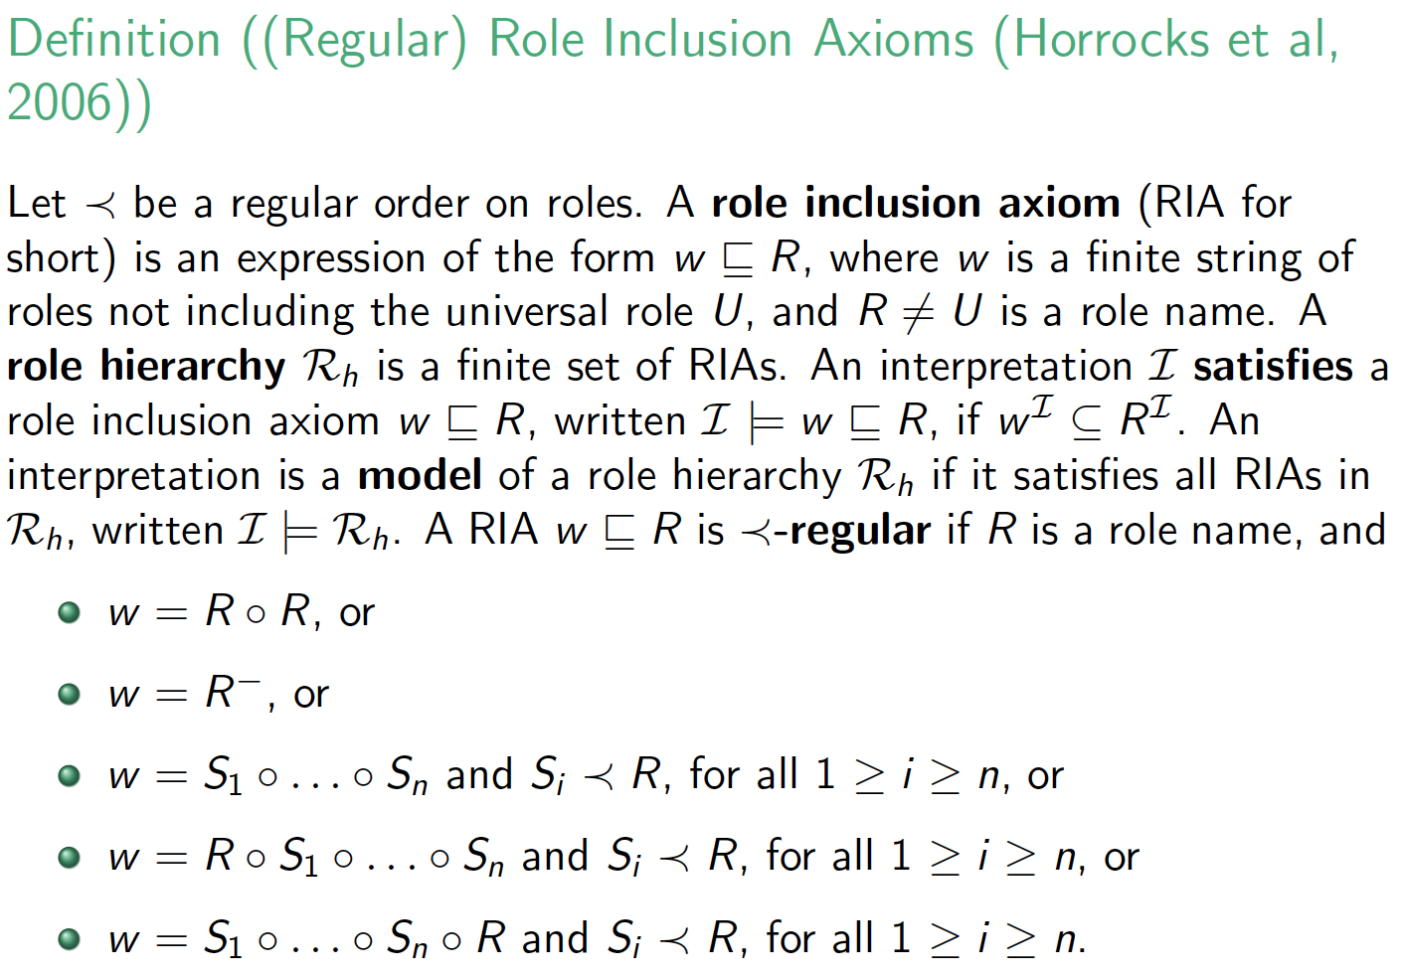
Methodologies and tools
Methods
Methods - philosophy
Parameters and dependencies
Summary
Preliminaries (2/2)—OWL 2/SROIQ
Definition ((Regular) Role Inclusion Axioms (Horrocks et al, 2006))
Let ≺ be a regular order on roles. A role inclusion axiom (RIA for
short) is an expression of the form w � R , where w is a finite string of
roles not including the universal role U , and R /= U is a role name. A
role hierarchy R_{h} is a finite set of RIAs. An interpretation I satisfies a
role inclusion axiom w � R , written I |= w � R , if w ^{I} ⊆ R^{I} . An
interpretation is a model of a role hierarchy R_{h} if it satisfies all RIAs in
R_{h} , written I |= R_{h} . A RIA w � R is ≺-regular if R is a role name, and
w = R ◦ R , or
w = R⁻, or
w = S₁ ◦ . . . ◦ S_{n} and S_{i} ≺ R , for all 1 ≥ i ≥ n, or
w = R ◦ S₁ ◦ . . . ◦ S_{n} and S_{i} ≺ R , for all 1 ≥ i ≥ n, or
w = S₁ ◦ . . . ◦ S_{n} ◦ R and S_{i} ≺ R , for all 1 ≥ i ≥ n.
33/71

Slide 54
Methodologies and tools
Methods
Methods - philosophy
Parameters and dependencies
Summary
Object sub-properties
Given S R , then all individuals in the property assertions
involving property S must also be related to each other
through property R .
Subsumption for OWL object properties (DL roles) holds if the subsumed property is more constrained such that in every model, the set of individual property assertions is a subset of those of its parent property
34/71

Slide 55
Methodologies and tools
Methods
Methods - philosophy
Parameters and dependencies
Summary
Object sub-properties
Given S R , then all individuals in the property assertions
involving property S must also be related to each other
through property R .
Subsumption for OWL object properties (DL roles) holds if the subsumed property is more constrained such that in every model, the set of individual property assertions is a subset of those of its parent property
Two ways to constrain a property, and either one suffices:
By specifying its domain or range
By declaring the property’s characteristics
34/71

Slide 56
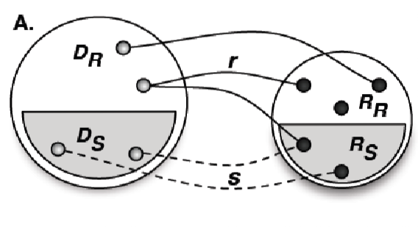
Methodologies and tools
Methods
Methods - philosophy
Parameters and dependencies
Summary
Constraining a property
B.
Relationship characteristic
{disjoint, complete}
Transitivity
Antisymmetry
Irreflexivity
Reflexivity
Asymmetry
Purely- reflexive
Intransitivity
Symmetry
Acyclicity
Strongly intransitive
Figure: A: Example, alike the so-called ‘subsetting’ idea in UML; B: hierarchy of property characteristics (Based on Halpin 2001)
35/71

Slide 57
Methodologies and tools
Methods
Methods - philosophy
Parameters and dependencies
Summary
*
Constraining a property
B.
Relationship characteristic
{disjoint}
Transitivity
Irreflexivity
Reflexivity
Asymmetry
Symmetry
Figure: A: Example, alike the so-called ‘subsetting’ idea in UML; B: hierarchy of property characteristics relevant for OWL 2.
36/71

Slide 58
Methodologies and tools
Methods
Methods - philosophy
Parameters and dependencies
Summary
Outline Sub-Property compatibility Service
First part extends the basic notions from the RBox compatibility (defined for ALCQI)
Informally, it first checks the ‘compatibility’ of domain and range axioms w.r.t the object property hierarchy and the class hierarchy.
37/71

Slide 59
Methodologies and tools
Methods
Methods - philosophy
Parameters and dependencies
Summary
Outline Sub-Property compatibility Service
First part extends the basic notions from the RBox compatibility (defined for ALCQI)
Informally, it first checks the ‘compatibility’ of domain and range axioms w.r.t the object property hierarchy and the class hierarchy.
After that, SubProS checks whether the object property characteristic(s) conform to specification, provided there is such an expression in the ontology.
It exhaustively checks each permutation of domain and range and then of the characteristic of the parent and child property in the object property hierarchy
37/71

Slide 60

Methodologies and tools
Methods
Methods - philosophy
Parameters and dependencies
Summary
Definition (Sub-Property compatibility Service (SubProS))
For each pair of object properties, R, S ∈ O such that O S R , and
O an OWL ontology adhering to the syntax and semantics as specified in
OWL 2 Standard, check whether:
Test 1. O D_{S} D_{R} and O R_{S} R_{R} ;
Test 2. O D_{R} D_{S} ;
Test 3. O R_{R} R_{S} ;
Test 4. If O Asym(R ) then O Asym(S );
Test 5. If O Sym(R ) then O Sym(S ) or O Asym(S );
Test 6. If O Trans(R ) then O Trans(S );
Test 7. If O Ref(R ) then O Ref(S ) or O Irr(S );
Test 8. If O Irr(R ) then O Irr(S ) or O Asym(S );
Test 9. If O Asym(R ) then O Sym(S );
Test 10. If O Irr(R ) then O Ref(S );
continues....
38/71

Slide 61
Methodologies and tools
Methods
Methods - philosophy
Parameters and dependencies
Summary
Definition (Sub-Property compatibility Service (SubProS))
... continued from previous page
Test 11. If O Trans(R ) then O Irr(R ), O Asym(R ),
O Irr(S ), and O Asym(S );
An OWL object property hierarchy is said to be compatible iff
Test 1 and (2 or 3) hold for all pairs of property-subproperty in O,
and
Tests 4-11 hold for all pairs of property-subproperty in O.

Slide 62
Methodologies and tools
Methods
Methods - philosophy
Parameters and dependencies
Summary
What to do if not compatible
Guidelines for fixing a flaw, with one or more options for revision
“raising a warning” denotes that it is not a logical error but an ontological one
“forcing” a revision indicates there is a logical error that must be fixed in order to have a consistent ontology with satisfiable classes
“propose” indicates suggestions how the flaw can be best revised

Slide 63

Methodologies and tools
Methods
Methods - philosophy
Parameters and dependencies
Summary
Revisions (selection)
A. If Test 1 fails, raise a warning “domain and range restrictions of either R or S are in conflict with the property hierarchy”, and propose to
Change the object property hierarchy, i.e., either remove
S R and add R S or add S ≡ R to ^{O}, or
Change domain and range restrictions of R and/or S , or
If the test on the domains fails, then propose a new axiom R D_{R}^{I} × R_{R} , where D_{R}^{I} ≡ D_{R} D_{S} (and similarly when Test
1 fails on the range).
B. ...
C. Run SubProS again if any changes have been made in steps A or B, and record changes in the hierarchy (to be used in
step I).

Slide 64
Methodologies and tools
Methods
Methods - philosophy
Parameters and dependencies
Summary
Revisions (selection)
...
F. If Irr(R ) and Test 8 fails to detect either Irr(S ) or Asym(S ), raise a warning “R is irreflexive, hence S should be either Irr(S ) or Asym(S ), and propose:
Add Asym(S ) or Irr(S ) to obtain expected inferences;
Remove Irr(R );
Change the positions of R and/or S in the object property hierarchy;
...
I. Run SubProS again if any changes have been made in steps D-H, and check any changes in the property hierarchy made against those recorded in step C. If a change from steps E or F reverts a recorded change, then report “unresolvable conflict on subproperty axiom. You must change at least one axiom to exit an otherwise infinite loop of swapping two expressions”.

Slide 65

Methodologies and tools
Methods
Methods - philosophy
Parameters and dependencies
Summary
BioTop’s inconsistent ‘has process role’
‘has process role’ in BioTop (v. June 17, 2010) is inconsistent. Relevant axioms are:
‘has process role’ ‘temporally related to’
‘has process role’ ‘processual entity’×role
‘temporally related to’
‘processual entity’ quality × ‘processual entity’ quality
role ¬quality
(E.1)
(E.2)
(E.3)
(E.4)
(E.5)
(E.6)
role ¬‘processual entity’
Sym(‘temporally related to’)

Slide 66
Methodologies and tools
Methods
Methods - philosophy
Parameters and dependencies
Summary
BioTop’s inconsistent ‘has process role’
Use SubProS to isolate the flaw:
^{Test 1: fail, because R}hasprocessrole ^{R}temporallyrelatedto ^{is}
false, as the ranges (see E.2 cf. E.3) are disjoint (see E.4, E.5) and therewith ‘has process role’ is inconsistent;
Test 2 and 3: pass.
Test 4: not applicable.
Test 5: fail, because ^{O} does not contain Sym(‘has process
role’).
Test 6-11: not applicable.

Slide 67
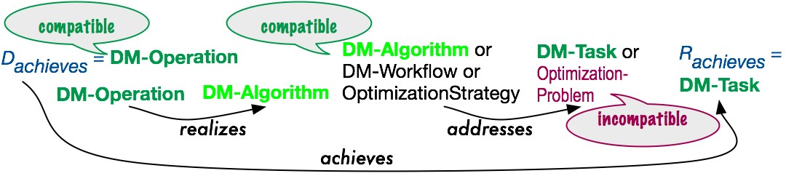
Methodologies and tools
Methods
Methods - philosophy
Parameters and dependencies
Summary
Similar for chains (ProChainS); ex.: DMOP chain in v5.2
Of type Case S. Test S-c (for corrections) failed because
^{O} ^{R}DM-Task OptimizationProblem ^{R}DM-Task^{. Considering the}
suggestions for revision, step B’s first option to revise the ontology was chosen, i.e., removing OptimizationProblem from the range axiom of addresses.

Slide 68
Methodologies and tools
Methods
Methods - philosophy
Parameters and dependencies
Summary
Outline
Methodologies and tools Macro-level methodologies Micro-level methodologies
Methods
Logic-based debugging Logic & philosophy
Methods - philosophy
4
Parameters and dependencies

Slide 69
Methodologies and tools
Methods
Methods - philosophy
Parameters and dependencies
Summary
OntoClean overview (extra, for those interested)
Problem: messy taxonomies on what subsumes what How to put them in the right order?
47/71

Slide 70
Methodologies and tools
Methods
Methods - philosophy
Parameters and dependencies
Summary
OntoClean overview (extra, for those interested)
Problem: messy taxonomies on what subsumes what How to put them in the right order?
OntoClean provides guidelines for this (see to Guarino & Welty, 2004 for an extended example)
Based on philosophical principles, such as identity and rigidity (see Guarino & Welty’s EKAW’00 and ECAI’00 papers for more information on the basics)
47/71

Slide 71

Methodologies and tools
Methods
Methods - philosophy
Parameters and dependencies
Summary
Basics
A property of an entity is essential to that entity if it must be true of it in every possible world, i.e. if it necessarily holds for that entity.
Special form of essentiality is rigidity
Definition (+R)
A rigid property φ is a property that is essential to all its instances, i.e., ∀xφ(x ) → φ(x ).
Definition (-R)
A non-rigid property φ is a property that is not essential to some of its instances, i.e., ∃xφ(x ) ∧ ¬ φ(x ).

Slide 72
Methodologies and tools
Methods
Methods - philosophy
Parameters and dependencies
Summary
Basics
Definition (∼R)
An anti-rigid property φ is a property that is not essential to all its instances, i.e., ∀xφ(x ) → ¬ φ(x ).
Definition (¬R)
A semi-rigid property φ is a property that is non-rigid but not anti-rigid.
Anti-rigid properties cannot subsume rigid properties

Slide 73
Methodologies and tools
Methods
Methods - philosophy
Parameters and dependencies
Summary
Basics
Identity: being able to recognize individual entities in the world as being the same (or different)
Unity: being able to recognize all the parts that form an individual entity; e.g., ocean carries unity (+U), legal agent carries no unity (-U), and amount of water carries anti-unity (“not necessarily wholes”, ∼U)
50/71

Slide 74
Methodologies and tools
Methods
Methods - philosophy
Parameters and dependencies
Summary
Basics
Identity: being able to recognize individual entities in the world as being the same (or different)
Unity: being able to recognize all the parts that form an individual entity; e.g., ocean carries unity (+U), legal agent carries no unity (-U), and amount of water carries anti-unity (“not necessarily wholes”, ∼U)
Identity criteria are the criteria we use to answer questions like, “is that my dog?”
Identity criteria are conditions used to determine equality (sufficient conditions) and that are entailed by equality (necessary conditions)
50/71

Slide 75
Methodologies and tools
Methods
Methods - philosophy
Parameters and dependencies
Summary
Basics
Definition
A non-rigid property carries an IC Γ iff it is subsumed by a rigid property carrying Γ.
Definition
A property φ supplies an IC Γ iff i) it is rigid; ii) it carries Γ; and
iii) Γ is not carried by all the properties subsuming φ. This means that, if φ inherits different (but compatible) ICs from multiple properties, it still counts as supplying an IC.
Any property carrying an IC: +I (-I otherwise).
Any property supplying an IC: +O (-O otherwise); “O” is a mnemonic for “own identity”
+O implies +I and +R

Slide 76
Methodologies and tools
Methods
Methods - philosophy
Parameters and dependencies
Summary
Formal ontological property classifications
+O | +I | +R | +D | Type | Sortal
 |  |  | -D
-O | +I | +R | +D | Quasi-Type
 |  |  | -D
-O | +I | ~R | +D | Material role
-O | +I | ~R | -D | Phased sortal
-O | +I | ¬R | +D | Mixin
 |  |  | -D
-O | -I | +R | +D | Category | Non-Sortal
 |  |  | -D
-O | -I | ~R | +D | Formal role
-O | -I | ~R | -D | Attribution
 |  | ¬R | +D
 |  |  | -D

Slide 77
Methodologies and tools
Methods
Methods - philosophy
Parameters and dependencies
Summary
Formal ontological property classifications
Category
Endurant, Abstract entity
Attribution
Blue, Spherical
Formal role Recipient Material role Student, Food
Phased sortal
Caterpillar, Chrysalis, Butterfly (for Papilionoidae)
Mixin
Type
Cat, Chair
Quasi-type
Herbivore
Non-sortal
Role
Property
Anti-rigid
Non-rigid
Sortal
Rigid
Notes:
From guarino00

Slide 78

Methodologies and tools
Methods
Methods - philosophy
Parameters and dependencies
Summary
Basic rules
Given two properties, p and q, when q subsumes p the following constraints hold:
If q is anti-rigid, then p must be anti-rigid
If q carries an IC, then p must carry the same IC
If q carries a UC, then p must carry the same UC
If q has anti-unity, then p must also have anti-unity
Incompatible IC’s are disjoint, and Incompatible UC’s are disjoint
And, in shorthand:
6. +R ∼R
7. −I +I
8. −U +U
9. +U ∼U
10. −D +D

Slide 79
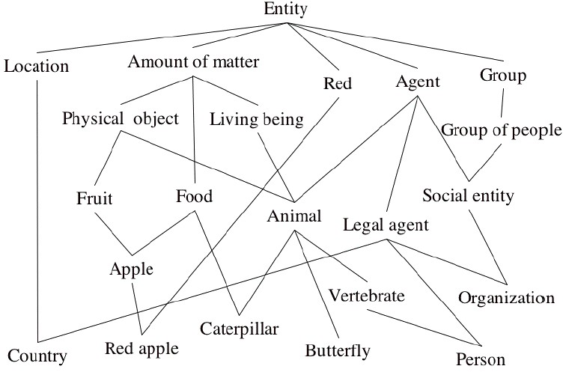
Methodologies and tools
Methods
Methods - philosophy
Parameters and dependencies
Summary
Example: before
Notes:
Guarino & Welty

Slide 80
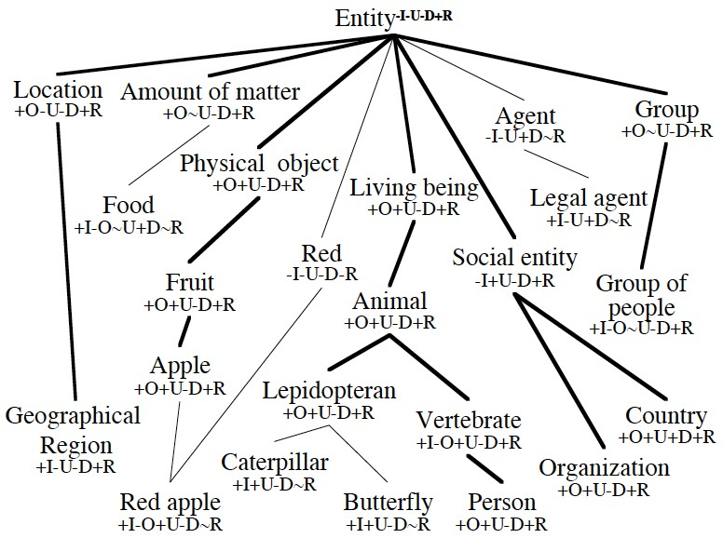
Methodologies and tools
Methods
Methods - philosophy
Parameters and dependencies
Summary
Example: after

Slide 81
Methodologies and tools
Methods
Methods - philosophy
Parameters and dependencies
Summary
Outline
Methodologies and tools Macro-level methodologies Micro-level methodologies
Methods
Logic-based debugging Logic & philosophy
Methods - philosophy
4
Parameters and dependencies

Slide 82
Methodologies and tools
Methods
Methods - philosophy
Parameters and dependencies
Summary
The changing landscape
Solving the early-adopter issues has moved the goal-posts, and uncovered new issues; e.g.:
Which ontologies are reusable for one’s own ontology, in whole or in part?
What are the consequences of choosing one ontology over the other?
OWL 2 has 5 languages: which one should be used for what and when?
Internationalisation/localisation of ontologies?
Note: Next slides are a partial recap of topics that have been mentioned before, but now presented in a different way

Slide 83
Methodologies and tools
Methods
Methods - philosophy
Parameters and dependencies
Summary
Parameters
Which parameters affect ontology development? Where?
How?
59/71

Slide 84
Methodologies and tools
Methods
Methods - philosophy
Parameters and dependencies
Summary
Parameters
Which parameters affect ontology development? Where?
How?
We consider:
Purposes
Reusing ontologies
Bottom-up development
Languages
Reasoning services
59/71

Slide 85
Methodologies and tools
Methods
Methods - philosophy
Parameters and dependencies
Summary
Purposes—examples
Querying data by means of an ontology (OBDA) through linking databases to an ontology
Database integration
Structured controlled vocabulary to link data(base) records and navigate across databases on the Internet (‘linked data’)
Using it as part of scientific discourse and advancing research at a faster pace, (including experimental ontologies)
Coordination among and integration of Web Services
TBC on next page...
60/71

Slide 86
Methodologies and tools
Methods
Methods - philosophy
Parameters and dependencies
Summary
Purposes (cont’d)
Ontology in an ontology-driven information system destined for run-time usage, e.g., in scientific workflows, MASs, ontology-mediated data clustering, and user interaction in
e-learning
Ontologies for NLP, e.g. annotating and querying Digital Libraries and scientific literature, QA systems, and materials for e-learning
As full-fledged discipline “Ontology (Science)”, where an ontology is a formal, logic-based, representation of a scientific theory
Tutorial ontologies, e.g., the wine and pizza ontologies

Slide 87
Methodologies and tools
Methods
Methods - philosophy
Parameters and dependencies
Summary
Reusing ontologies
Foundational ontologies
Reference ontologies
Domain ontologies that have an overlap with the new ontology;
62/71

Slide 88
Methodologies and tools
Methods
Methods - philosophy
Parameters and dependencies
Summary
Reusing ontologies
Foundational ontologies
Reference ontologies
Domain ontologies that have an overlap with the new ontology;
For each of them, resource usage considerations, such as
Availability of the resource (open, copyright)
If the source is being maintained or abandoned one-off effort;
Community effort, research group, and if it has already some adoption or usage;
Subject to standardisation policies or stable releases;
If the ontology is available in the desired or required ontology language.
62/71

Slide 89
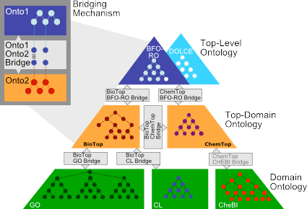
Methodologies and tools
Methods
Methods - philosophy
Parameters and dependencies
Summary
Example
Notes:
image from http://www.imbi.uni-freiburg.de/ontology/biotop/

Slide 90
Methodologies and tools
Methods
Methods - philosophy
Parameters and dependencies
Summary
Bottom-up development
Reuse of other knowledge-based representations:
conceptual data models (UML diagrams, ER, and ORM)
Database (and OO) reverse engineering, and least common subsumer and clustering to infer new concepts;
Abstractions from or formalisations of models in textbooks and diagram-based software;
Thesauri and other structured vocabularies;
Other (semi-)structured data, such as spreadsheets and company product catalogs;
Text mining of documents to find candidate terms for concepts and relations;
Terminologies, lexicons, and glossaries;
Wisdom of the crowds tagging, tagging games, and folksonomies;

Slide 91
Methodologies and tools
Methods
Methods - philosophy
Parameters and dependencies
Summary
Languages – preliminary considerations
Depending on the purpose(s) (and available resources), one ends up with either
a large but simple ontology, i.e., mostly just a taxonomy without, or very few, properties (relations) linked to the concepts, where ‘large’ is, roughly, > 10000 concepts, so that a simple representation language suffices;
a large and elaborate ontology, which includes rich usage of properties, defined concepts, and, roughly, requiring OWL-DL; or
a small and very complex ontology, where ‘small’ is, roughly, <250 concepts, and requiring at least OWL 2 DL
Certain choices for reusing ontologies or legacy material, or goal, may lock one a language
⇒ Separate dimension that interferes with the previous
parameters: the choice for a representation language
65/71

Slide 92
Methodologies and tools
Methods
Methods - philosophy
Parameters and dependencies
Summary
Languages
Older KR languages (frames, obo, conceptual graphs, etc.)
Web Ontology Languages:
OWL: OWL-Lite, OWL-DL, OWL full
OWL 2 with 4 languages to tailor the choice of ontology language to fit best with the usage scope in the context of a scalable and multi-purpose SW:
OWL 2 DL, based on the DL language SROIQ
OWL 2 EL
OWL 2 QL
OWL 2 RL
Extensions (probabilistic, fuzzy, temporal, etc.)
Alternatives (e.g., Common Logic)
Differences between expressiveness of the ontology languages and their trade-offs
66/71

Slide 93
Methodologies and tools
Methods
Methods - philosophy
Parameters and dependencies
Summary
Reasoning services
Description logics-based reasoning services
The standard reasoning services for ontology usage: satisfiability and consistency checking, taxonomic classification, instance classification;
‘Non-standard’ reasoning services to facilitate ontology development: explanation/justification, glass-box reasoning, pin-pointing errors, least-common subsumer;
Querying functionalities, such as epistemic and (unions of) conjunctive queries;
Ontological reasoning services (OntoClean, RBox reasoning service)
Other technologies (e.g., Bayesian networks)

Slide 94
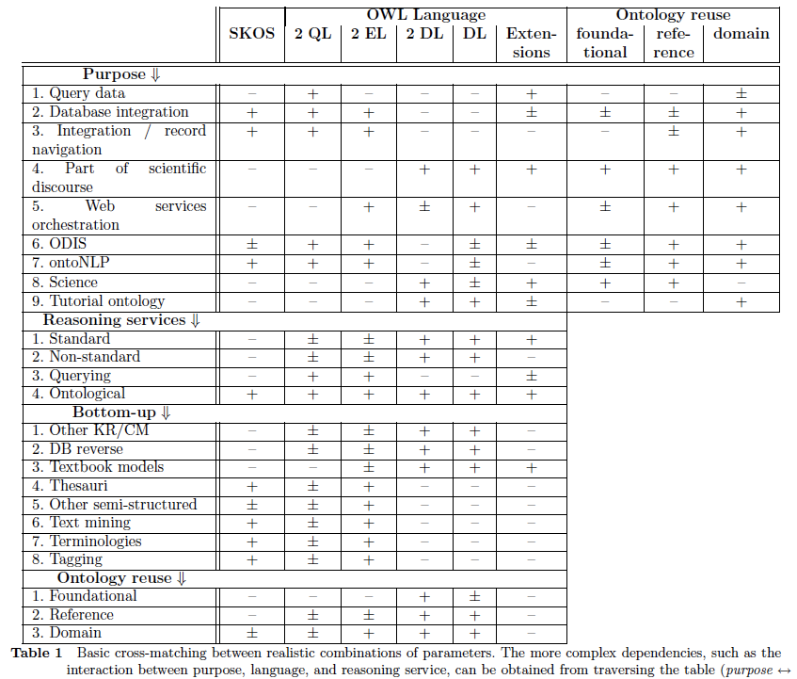
Methodologies and tools
Methods
Methods - philosophy
Parameters and dependencies
Summary

Slide 95
Methodologies and tools
Methods
Methods - philosophy
Parameters and dependencies
Summary
Tools
Thus far, no tool gives you everything
Software-supported methodologies
Ontology Development Environment (ODE)
Software-supported methods and other features
Portals
Exporting ontologies for a different rendering (visualisation, documentation, ...)
69/71

Slide 96
Methodologies and tools
Methods
Methods - philosophy
Parameters and dependencies
Summary
Tools: Develop your own tool
How to do that?
There are tools and APIs etc that help you manipulate OWL files and manage reasoners
Java: OWL API, OWLink, or Apache Jena
Python: Owlready
70/71

Slide 97
Methodologies and tools
Methods
Methods - philosophy
Parameters and dependencies
Summary
Summary
Methodologies and tools Macro-level methodologies Micro-level methodologies
Methods
Logic-based debugging Logic & philosophy
Methods - philosophy
4
Parameters and dependencies
71/71

