Slide 1
DOLCE
BFO
More foundational ontologies
Summary
Ontology Engineering
Lecture 6: Top-down Ontology Development I
Maria Keet
email: mkeet@cs.uct.ac.za
home: http://www.meteck.org
Department of Computer Science University of Cape Town, South Africa
Semester 2, Block I, 2019
1/46

Slide 2
DOLCE
BFO
More foundational ontologies
Summary
Outline
1
DOLCE
Overview
Formalisations and implementations
2
BFO
Overview
Formalisations and implementations Relation Ontology
3
More foundational ontologies Ontologies and choices
Where and how does it make a difference? GFO as ‘super’ foundational (extra slides)
2/46

Slide 3
DOLCE
BFO
More foundational ontologies
Summary
Introduction
Ontology development: what to represent, and how?
Where do you start?
How can you avoid reinventing the wheel?
What things can guide you to make the process easier to carry out successfully?
How can you make the best of ‘legacy’ material?
How can you make it interoperable with other ontologies?
Foundational ontologies provide principal categories of kinds of things and relations to give a basic structure to a domain ontology; informed by Ontology (analytic philosophy)
Legacy resources can provide useful classes and properties, and possibly also constraints, for domain ontologies
3/46

Slide 4
DOLCE
BFO
More foundational ontologies
Summary
Why use a foundational ontology?
Pros:
don’t have to ‘reinvent the wheel’ with respect to the basic categories and relationships to represent the subject domain
improves overall quality with modelling guidance
facilitates interoperability among ontologies
is useful when subtle distinctions, recognizing disagreement, rigorous referential semantics, general abstractions, careful explanation and justification of ontological commitment, and mutual understanding are important
4/46

Slide 5
DOLCE
BFO
More foundational ontologies
Summary
Why use a foundational ontology?
Pros:
don’t have to ‘reinvent the wheel’ with respect to the basic categories and relationships to represent the subject domain
improves overall quality with modelling guidance
facilitates interoperability among ontologies
is useful when subtle distinctions, recognizing disagreement, rigorous referential semantics, general abstractions, careful explanation and justification of ontological commitment, and mutual understanding are important
Cons:
too abstract
too expressive and comprehensive for the envisioned ontology-driven information system
takes excessive effort to understand them in sufficient detail
4/46

Slide 6
DOLCE
BFO
More foundational ontologies
Summary
General notions and principal choices
Provide a top-level with basic categories of kinds of entities
Principal choices on universals, particulars and individual properties:
Properties as repeatable universals, belonging to different entities or as non-repeatable tropes, inhering only in a specific entity
Particulars as aggregations (collections) of properties or the properties inhere in some substrate (bare particular)
5/46

Slide 7
DOLCE
BFO
More foundational ontologies
Summary
General notions and principal choices
Provide a top-level with basic categories of kinds of entities
Principal choices on universals, particulars and individual properties:
Properties as repeatable universals, belonging to different entities or as non-repeatable tropes, inhering only in a specific entity
Particulars as aggregations (collections) of properties or the properties inhere in some substrate (bare particular)
Persistence, principal choices:
How do entities persist? How do entities change in time? (Due to different phases or due to (whole) instantiation of different properties at different times?) How are change and persistence related?
5/46

Slide 8
DOLCE
BFO
More foundational ontologies
Summary
General notions and principal choices
More choices:
Are space and time absolute or relative, atomic or not? Localization: are there entities that are not in space/time (i.e., abstract), and is it possible to have different entities spatially or spatio-temporally colocalized?
6/46

Slide 9
DOLCE
BFO
More foundational ontologies
Summary
General notions and principal choices
More choices:
Are space and time absolute or relative, atomic or not? Localization: are there entities that are not in space/time (i.e., abstract), and is it possible to have different entities spatially or spatio-temporally colocalized?
Principal choices, with common terminology:
Endurantist vs. Perdurantist
Universals vs. Particulars
Descriptive vs. Prescriptive
(Onto)Logical economy and multiplicative vs. reductionist
6/46

Slide 10
DOLCE
BFO
More foundational ontologies
Summary
Outline
1
DOLCE
Overview
Formalisations and implementations
2
BFO
Overview
Formalisations and implementations Relation Ontology
3
More foundational ontologies Ontologies and choices
Where and how does it make a difference? GFO as ‘super’ foundational (extra slides)
7/46

Slide 11
DOLCE
BFO
More foundational ontologies
Summary
Descriptive Ontology for Linguistic and Cognitive Engineering
Strong cognitive/linguistic bias:
Descriptive (as opposite to prescriptive) attitude
Categories mirror cognition, common sense, and the lexical structure of natural language
Emphasis on cognitive invariants
Categories as conceptual containers: no ‘deep’ metaphysical implications
Focus on design rationale to allow easy comparison with different ontological options
Rigorous, systematic, interdisciplinary approach Rich axiomatization
37 basic categories
7 basic relations
80 axioms, 100 definitions, 20 theorems
Rigorous quality criteria Documentation
8/46

Slide 12
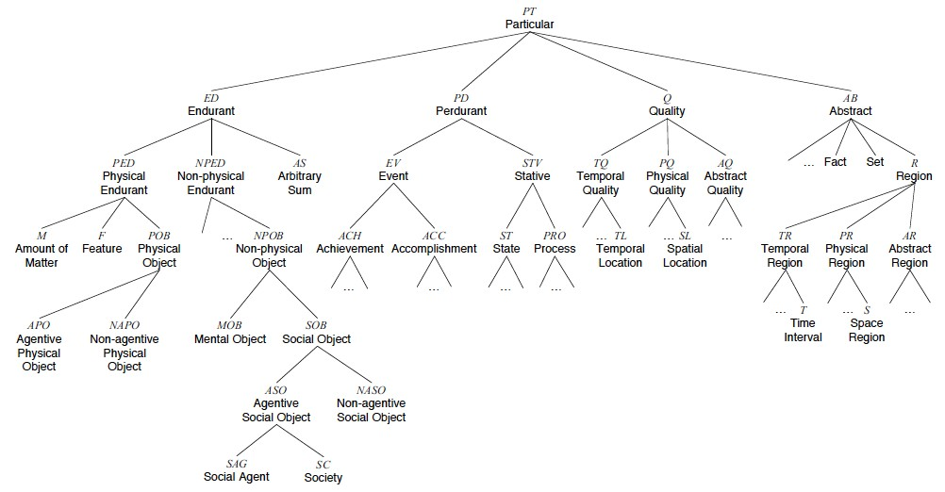
DOLCE
BFO
More foundational ontologies
Summary
Outline of DOLCE categories
9/46

Slide 13
DOLCE
BFO
More foundational ontologies
Summary
The African Wildlife Ontology and DOLCE
Where does Plant fit in DOLCE?
Giraffes drink Water: where should we put Water?
Impalas run (fast). Where should we put Running?
Lions eat impalas, and in the process, the impalas die. Where should we put Death?
Generic examples of DOLCE’s ‘leaf’ categories: see Table 1, p21 in the D18.pdf
10/46

Slide 14
DOLCE
BFO
More foundational ontologies
Summary
The African Wildlife Ontology and DOLCE
Where does Plant fit in DOLCE?
as a subtype of Non-Agentive Physical Object
Giraffes drink Water: where should we put Water?
Impalas run (fast). Where should we put Running?
Lions eat impalas, and in the process, the impalas die. Where should we put Death?
Generic examples of DOLCE’s ‘leaf’ categories: see Table 1, p21 in the D18.pdf
10/46

Slide 15
DOLCE
BFO
More foundational ontologies
Summary
The African Wildlife Ontology and DOLCE
Where does Plant fit in DOLCE?
as a subtype of Non-Agentive Physical Object
Giraffes drink Water: where should we put Water?
as a subtype of Amount of Matter
Impalas run (fast). Where should we put Running?
Lions eat impalas, and in the process, the impalas die. Where should we put Death?
Generic examples of DOLCE’s ‘leaf’ categories: see Table 1, p21 in the D18.pdf
10/46

Slide 16
DOLCE
BFO
More foundational ontologies
Summary
The African Wildlife Ontology and DOLCE
Where does Plant fit in DOLCE?
as a subtype of Non-Agentive Physical Object
Giraffes drink Water: where should we put Water?
as a subtype of Amount of Matter
Impalas run (fast). Where should we put Running?
as a subtype of Process
Lions eat impalas, and in the process, the impalas die. Where should we put Death?
Generic examples of DOLCE’s ‘leaf’ categories: see Table 1, p21 in the D18.pdf
10/46

Slide 17
DOLCE
BFO
More foundational ontologies
Summary
The African Wildlife Ontology and DOLCE
Where does Plant fit in DOLCE?
as a subtype of Non-Agentive Physical Object
Giraffes drink Water: where should we put Water?
as a subtype of Amount of Matter
Impalas run (fast). Where should we put Running?
as a subtype of Process
Lions eat impalas, and in the process, the impalas die. Where should we put Death?
as a subtype of Achievement...
Generic examples of DOLCE’s ‘leaf’ categories: see Table 1, p21 in the D18.pdf
10/46

Slide 18
DOLCE
BFO
More foundational ontologies
Summary
Selection of DMOP classes linked to DOLCE
dolce:particular
dolce:non-physical-endurant dolce:process dolce:quality
dolce:abstract
....
DM-Task DM-Data
DM-Algorithm
DataType
DataFormat
dolce:abstract-quality
DM-Operation
dolce:region
DM-Experiment
dolce:quale dolce:abstract-region
Characteristic Parameter
NeighborhoodRange
....
OpParameterSetting

Slide 19
DOLCE
BFO
More foundational ontologies
Summary
DOLCE’s basic relations
Parthood
Between quality regions (immediate)
Between arbitrary objects (temporary)
Constitution
Participation
Representation
Dependence: Specific/generic constant dependence
Inherence (between a quality and its host)
Quale
Between a quality and its region (immediate, for unchanging entities)
Between a quality and its region (temporary, for changing entities)
12/46

Slide 20
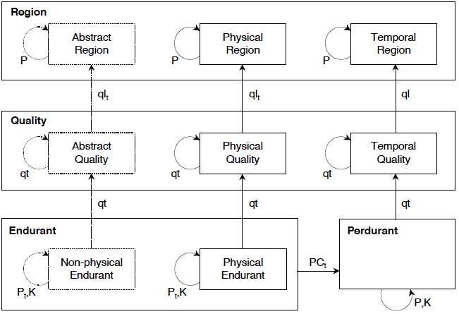
DOLCE
BFO
More foundational ontologies
Summary
DOLCE’s primitive relations between basic categories

Slide 21
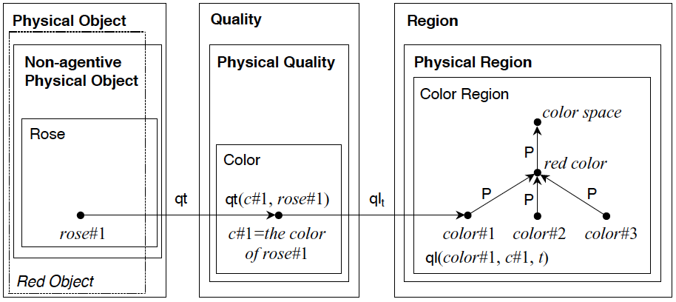
DOLCE
BFO
More foundational ontologies
Summary
DOLCE’s basic relations w.r.t. qualities

Slide 22
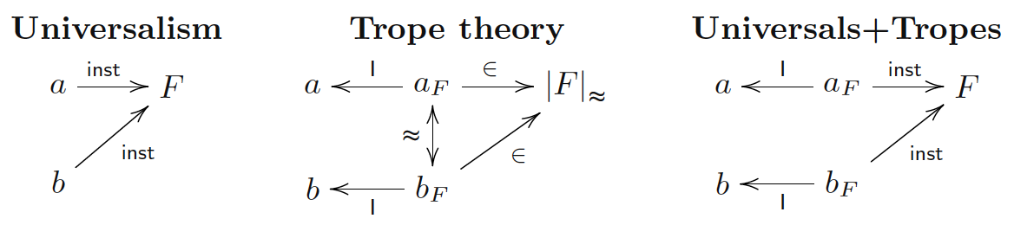
DOLCE
BFO
More foundational ontologies
Summary
Various commitments regarding ‘attributes’
Options:
see also (Borgo and Masolo, 2009)
DOLCE: [PerDurant/EnDurant] –qt– Quality –ql – Region: use Quality and Abstract branches with qt (inherence) and ql (quale) object properties
15/46

Slide 23
DOLCE
BFO
More foundational ontologies
Summary
Various commitments regarding ‘attributes’
Options:
see also (Borgo and Masolo, 2009)
DOLCE: [PerDurant/EnDurant] –qt– Quality –ql – Region: use Quality and Abstract branches with qt (inherence) and ql (quale) object properties
OWL: DataProperty with as domain class and range a datatype
More compact notation
But modelling based on arbitrary (and practical, application) decisions, increasing the chance of incompatibilities and less reusable
15/46

Slide 24
DOLCE
BFO
More foundational ontologies
Summary
The Wildlife Ontology and DOLCE
Giraffes eat leaves and twigs. how do Plant and Twig relate?
The elephant’s tusks (ivory) are made of apatite (calcium phosphate); which DOLCE relation can be reused?
How would you represent the Size (Height, Weight, etc.) of an average adult elephant?
16/46

Slide 25
DOLCE
BFO
More foundational ontologies
Summary
The Wildlife Ontology and DOLCE
Giraffes eat leaves and twigs. how do Plant and Twig relate?
(some type of) parthood relation
The elephant’s tusks (ivory) are made of apatite (calcium phosphate); which DOLCE relation can be reused?
How would you represent the Size (Height, Weight, etc.) of an average adult elephant?
16/46

Slide 26
DOLCE
BFO
More foundational ontologies
Summary
The Wildlife Ontology and DOLCE
Giraffes eat leaves and twigs. how do Plant and Twig relate?
(some type of) parthood relation
The elephant’s tusks (ivory) are made of apatite (calcium phosphate); which DOLCE relation can be reused?
constitution
How would you represent the Size (Height, Weight, etc.) of an average adult elephant?
16/46

Slide 27
DOLCE
BFO
More foundational ontologies
Summary
The Wildlife Ontology and DOLCE
Giraffes eat leaves and twigs. how do Plant and Twig relate?
(some type of) parthood relation
The elephant’s tusks (ivory) are made of apatite (calcium phosphate); which DOLCE relation can be reused?
constitution
How would you represent the Size (Height, Weight, etc.) of an average adult elephant?
with quality and quale
OWL data properties
16/46

Slide 28
DOLCE
BFO
More foundational ontologies
Summary
The Wildlife Ontology and DOLCE
Giraffes eat leaves and twigs. how do Plant and Twig relate?
(some type of) parthood relation
The elephant’s tusks (ivory) are made of apatite (calcium phosphate); which DOLCE relation can be reused?
constitution
How would you represent the Size (Height, Weight, etc.) of an average adult elephant?
with quality and quale
OWL data properties
What is the data type; integer, float, real, string?
Measure in meter, feet, kg, lb?
Introduce “ElephantHeight”, and also “LionHeight”, “GiraffeHeight’, “ImpalaHeight”, etc.?
16/46

Slide 29
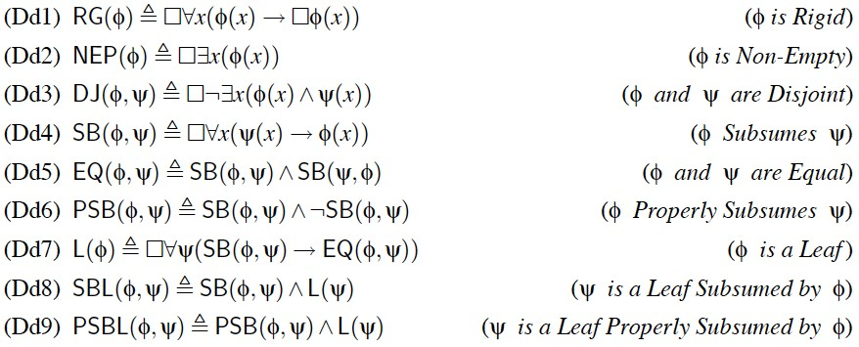
DOLCE
BFO
More foundational ontologies
Summary
DOLCE’s basics on universals
.......

Slide 30
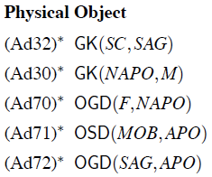
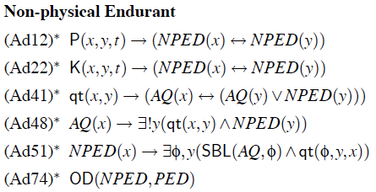

DOLCE
BFO
More foundational ontologies
Summary
DOLCE’s characterisation of categories
... etc...

Slide 31
DOLCE
BFO
More foundational ontologies
Summary
Can all that be used?
19/46

Slide 32
DOLCE
BFO
More foundational ontologies
Summary
Can all that be used?
DOLCE in KIF
DOLCE in OWL:
DOLCE-Lite: simplified translations of Dolce2.0
Does not consider: modality, temporal indexing, relation composition
Different names are adopted for relations that have the same name but different arities in the FOL version
Some commonsense concepts have been added as examples
19/46

Slide 33
DOLCE
BFO
More foundational ontologies
Summary
Can all that be used?
DOLCE in KIF
DOLCE in OWL:
DOLCE-Lite: simplified translations of Dolce2.0
Does not consider: modality, temporal indexing, relation composition
Different names are adopted for relations that have the same name but different arities in the FOL version
Some commonsense concepts have been added as examples
DOLCE-2.1-Lite-Plus version includes some modules for Plans, Information Objects, Semiotics, Temporal relations, Social notions (collectives, organizations, etc.), a Reification vocabulary, etc.
http://www.loa.istc.cnr.it/old/DOLCE.html
19/46

Slide 34
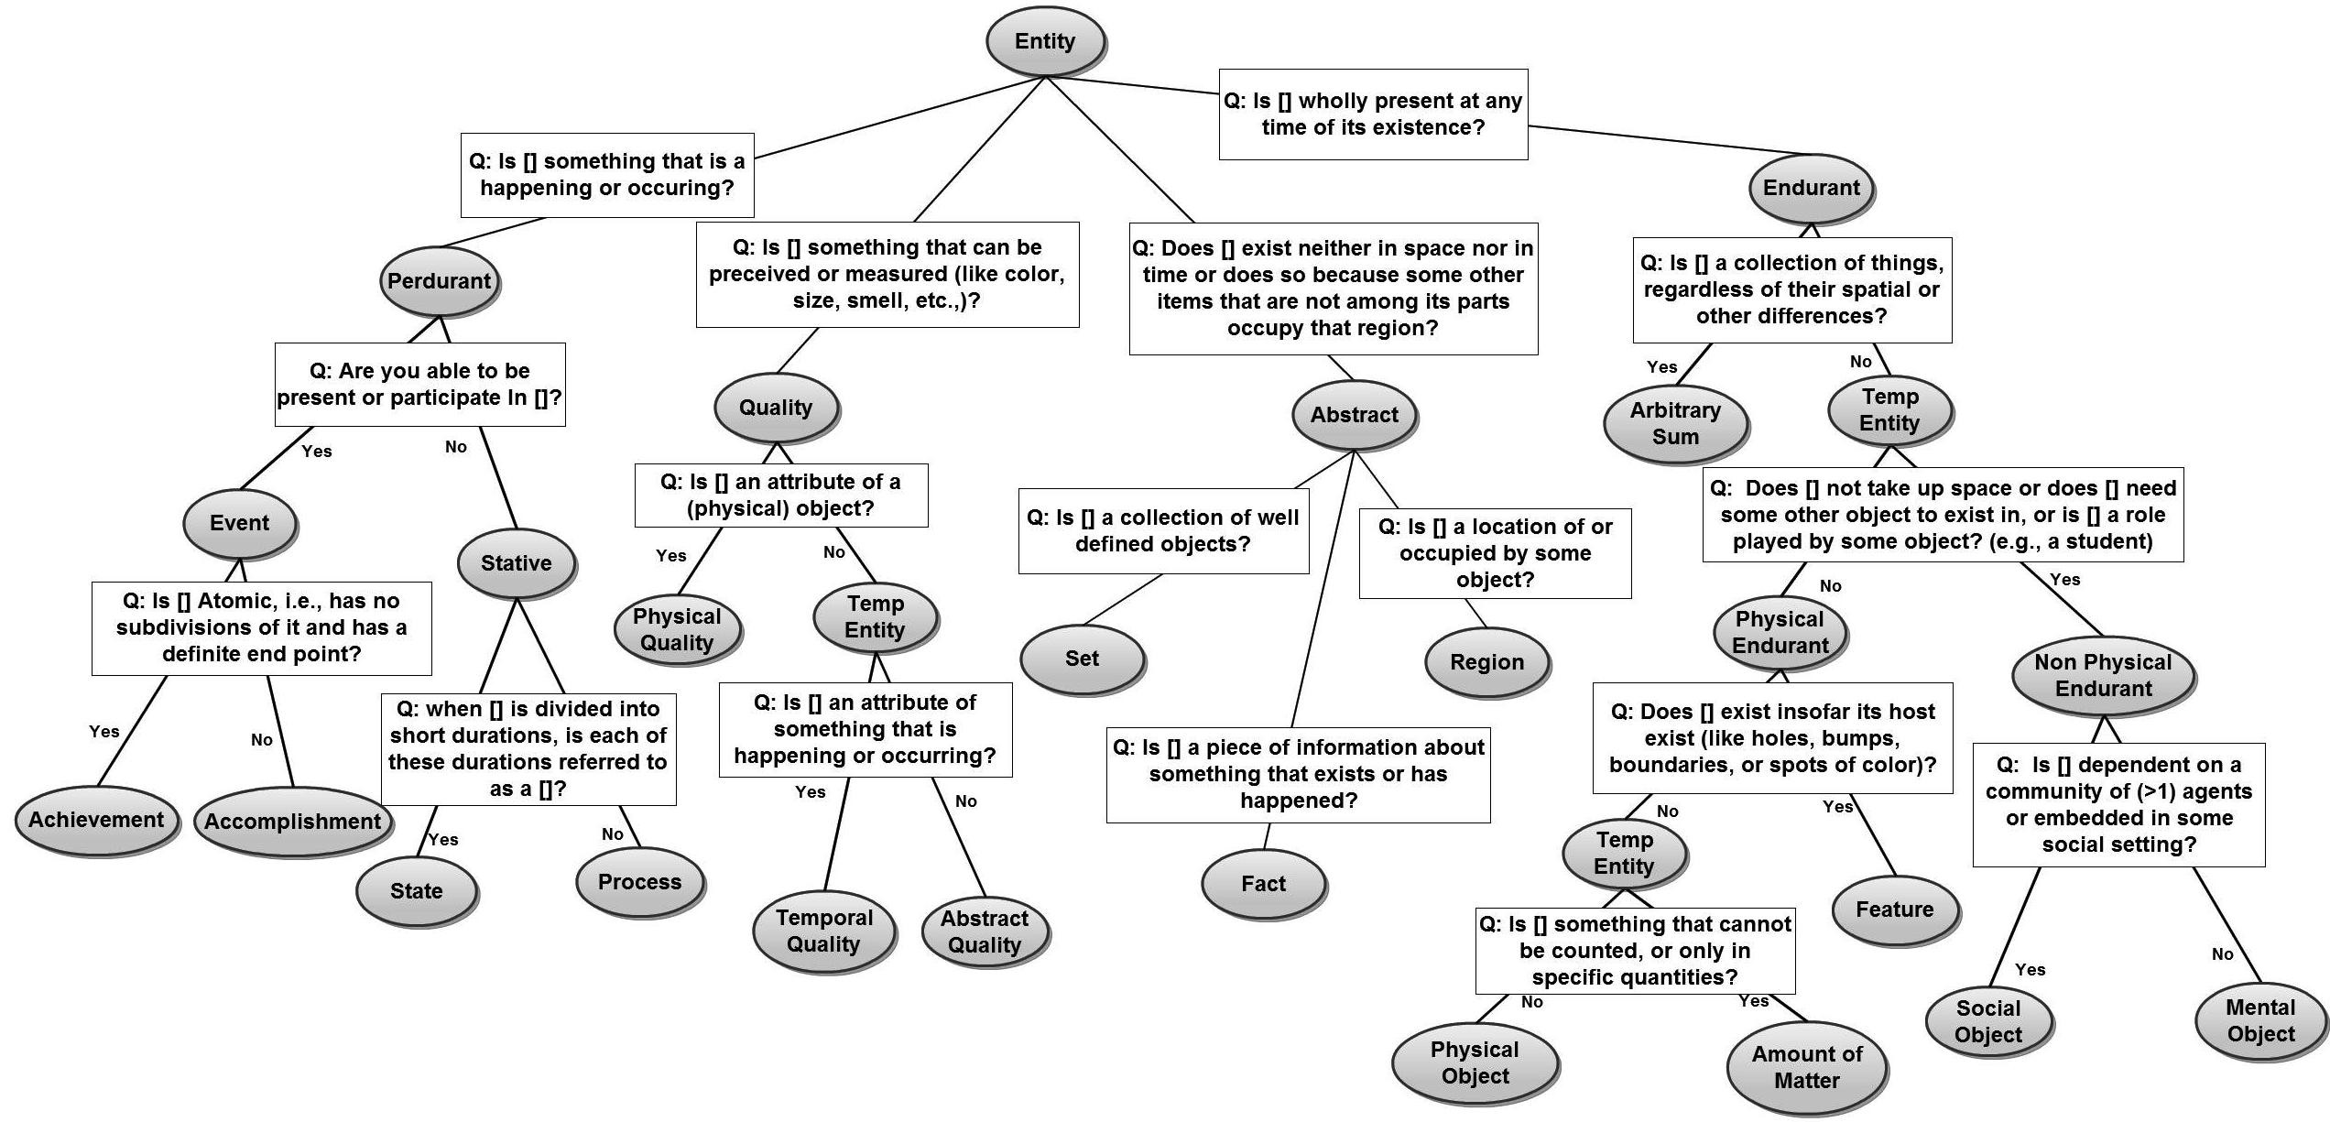
DOLCE
BFO
More foundational ontologies
Summary
D3
20/46

Slide 35
DOLCE
BFO
More foundational ontologies
Summary
Outline
1
DOLCE
Overview
Formalisations and implementations
2
BFO
Overview
Formalisations and implementations Relation Ontology
3
More foundational ontologies Ontologies and choices
Where and how does it make a difference? GFO as ‘super’ foundational (extra slides)

Slide 36
DOLCE
BFO
More foundational ontologies
Summary
BFO Overview
Ontology as reality representation
Aims at reconciling the so-called three-dimensionalist and four-dimensionalist views
Snap ontology of endurants which is reproduced at each moment of time and is used to characterise static views of the world
Span ontology of happenings and occurrents and, more generally, of entities which persist in time by perduring, or ‘unfolding in time’
Endurants (Snap) or perdurants (Span)
Limited granularity
Heavily influenced by parthood relations, boundaries, dependence

Slide 37
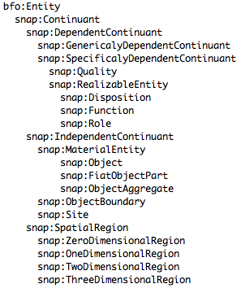
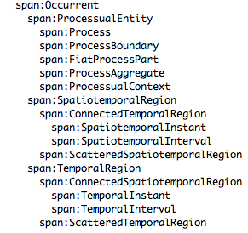
DOLCE
BFO
More foundational ontologies
Summary
BFO Taxonomy

Slide 38
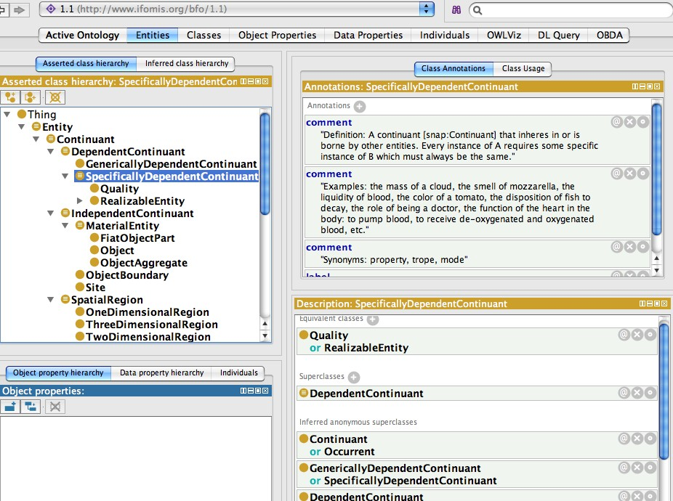
DOLCE
BFO
More foundational ontologies
Summary
Example section

Slide 39
DOLCE
BFO
More foundational ontologies
Summary
The Wildlife Ontology and BFO
Exercise: revisit the Wildlife & DOLCE and find corresponding BFO categories
Non-Agentive Physical Object, Amount of Matter, Process, and Achievement
parthood, constitution, quality & quale
25/46

Slide 40
DOLCE
BFO
More foundational ontologies
Summary
The Wildlife Ontology and BFO
Exercise: revisit the Wildlife & DOLCE and find corresponding BFO categories
Non-Agentive Physical Object, Amount of Matter, Process, and Achievement
parthood, constitution, quality & quale
Issues
Generally: to do this in a transparent and reusable way, we need a mapping between the two foundational ontologies
Immediacy: What with the relations?
There is a bfo-ro.owl to integrate relations of the Relation Ontology with BFO (extensions under consideration)
25/46

Slide 41
DOLCE
BFO
More foundational ontologies
Summary
Overview
BFO 1.1 in OWL with 39 classes, no object or data properties, in ALC.
There is a bfo-ro.owl to integration relations of the Relation Ontology with BFO (extensions under consideration)
Version in Isabelle (mainly part-wholes, but not all categories)
Version in OBO (the original Gene Ontology format, with limited, but expanding, types of relationships)
Version in Prover9 (first order logic model checker and theorem prover)
26/46

Slide 42
DOLCE
BFO
More foundational ontologies
Summary
The Relation Ontology
Definitions for is a, part of , integral part of , proper part of , located in, contained in, adjacent to, transformation of , derives from, preceded by , has participant, has agent, instance of
27/46

Slide 43
DOLCE
BFO
More foundational ontologies
Summary
The Relation Ontology
Definitions for is a, part of , integral part of , proper part of , located in, contained in, adjacent to, transformation of , derives from, preceded by , has participant, has agent, instance of
Proposed extensions under consideration, among others:
Relations between generically dependent continuants and specifically dependent continuants (a.o., concretizes, has quality , has function, ...)
A relation between a process and a process or quality (regulates)
Refinements on derived from
Measurements (has value, of dimension, ...)
27/46

Slide 44
DOLCE
BFO
More foundational ontologies
Summary
The Relation Ontology
Note: The OBO Relation ontology is undergoing substantial changes: Core domain-independent relations will live in BFO, Biology specific relations (defined in terms of core relations) will live in RO (http://groups.google.com/group/obo- relations/browse_thread/thread/
29fc616eb570f7dc/fc0647f190b5f178)
BFO will likely include the follow relations: BFO 0000050 part of
BFO 0000051 has part
BFO 0000056 participates in BFO 0000057 has participant BFO 0000062 preceded by BFO 0000063 precedes
BFO 0000060 immediately preceded by BFO 0000061 immediately precedes
Discuss.

Slide 45
DOLCE
BFO
More foundational ontologies
Summary
A relation ontology?
What are the ‘core’ and primitive relations necessary to develop a domain ontology?
29/46

Slide 46
DOLCE
BFO
More foundational ontologies
Summary
A relation ontology?
What are the ‘core’ and primitive relations necessary to develop a domain ontology?
Do we need a separate ontology for relations, or integrated in a foundational ontology?
29/46

Slide 47
DOLCE
BFO
More foundational ontologies
Summary
A relation ontology?
What are the ‘core’ and primitive relations necessary to develop a domain ontology?
Do we need a separate ontology for relations, or integrated in a foundational ontology?
Philosophers do not agree on the answers, but the modellers and engineers need agreement to facilitate interoperability among ontologies
29/46

Slide 48
DOLCE
BFO
More foundational ontologies
Summary
Other relation ontologies
The Relation Ontology (Smith et al, 2005, Genome Biol.) is not the only ‘relation ontology’—but no other claims to be the relation ontology
There are “RBoxes” that can be seen as a relation ontology, e.g., containing
Part-whole relations (next lecture)
Spatial relations (RCC)
Temporal relations (Allen)
30/46

Slide 49
DOLCE
BFO
More foundational ontologies
Summary
Outline
1
DOLCE
Overview
Formalisations and implementations
2
BFO
Overview
Formalisations and implementations Relation Ontology
3
More foundational ontologies Ontologies and choices
Where and how does it make a difference? GFO as ‘super’ foundational (extra slides)

Slide 50
DOLCE
BFO
More foundational ontologies
Summary
Ontologies and choices
Other more or less used foundational ontologies, a.o.:
GFO
SUMO
OCHRE
UFO
YAMATO
32/46

Slide 51
DOLCE
BFO
More foundational ontologies
Summary
Ontologies and choices
Other more or less used foundational ontologies, a.o.:
GFO
SUMO
OCHRE
UFO
YAMATO
A library of foundational ontologies with mappings between them: choose your pet ontology and be interoperable with the others
32/46

Slide 52
DOLCE
BFO
More foundational ontologies
Summary
How to choose?
FO Library: the Repository of Ontologies for MULtiple USes (ROMULUS)
Foundational ontology recommender: ONtology Selection and Explanation Tool (ONSET)
If you change your mind (or reuse an ontology that has an undesired FO linked): Software Used to Gain Ontology Interchangeability (SUGOI) to swap the FO
http://www.thezfiles.co.za/ROMULUS/ (and related papers)
33/46

Slide 53
DOLCE
BFO
More foundational ontologies
Summary
Section of the content comparison
the alignments numbered in bold font can also be mapped
Entity |  |  | Relational property
 | DOLCE-Lite | BFORO |  | DOLCE-Lite | BFORO
1. | endurant | Independent Continuant | 1. | generic- location | located in
2. | physical- endurant | MaterialEntity | 2. | generic- location-of | location of
3. | physical-object | Object | 3. | part | has part
4. | perdurant | Occurrent | 4. | part-of | part of
5. | process | Process | 5. | proper-part | has proper part
6. | quality | Quality | 6. | proper-part-of | proper part of
7. | spatio- temporal-region | SpatioTemporal Region | 7. | participant | has participant
8. | temporal-region | TemporalRegion | 8. | participant-in | participates in
9. | space-region | SpatialRegion

Slide 54
DOLCE
BFO
More foundational ontologies
Summary
Exercise: which FO in this scenario?
You are to develop an ontology of heart diseases. The ontology must capture the intrinsic nature of the real world only. As such, entities that are not extended in space and time must not be found in the ontology. Possible future conditions that are predicted and previous conditions of the heart must be modelled in the ontology. Since it is a biological ontology, you wish to register it with the OBO foundry to allow reuse and integration with other ontologies. This ontology must be modelled in OWL 2 EL.

Slide 55
DOLCE
BFO
More foundational ontologies
Summary
Exercise: which FO in this scenario?
You are to develop an ontology of heart diseases. The ontology must capture the intrinsic nature of the real world only. As such, entities that are not extended in space and time must not be found in the ontology. Possible future conditions that are predicted and previous conditions of the heart must be modelled in the ontology. Since it is a biological ontology, you wish to register it with the OBO foundry to allow reuse and integration with other ontologies. This ontology must be modelled in OWL 2 EL.

Slide 56
DOLCE
BFO
More foundational ontologies
Summary
Some practical effects
Adding DOLCE can increase reasoning time (with SUMO even much more so); not for BFO v1
“jumping on the bandwagon” multiplier effect; e.g.:
Using BFO makes it easier to align with other biology ontologies in the OBO Foundry
There are several conceptual models that use UFO already

Slide 57


DOLCE
BFO
More foundational ontologies
Summary
Modelling effects: compact vs elaborate
A.
* | *
Person
vs.
Marriage | * 2 | Person
 | participation
married to
0..1
1..*
Book
Book
* *
Person
vs.
Bookloan
participation
borrowed by
1..*
Person
1
Runner |  | Marathon
vs.
Endurant
Perdurant
B.
* runs*
Runner
1
* Running ^{* 1} Marathon
participation involvement
C.
Person
vs.
Person | * * | Skill
 | hasSkill
hasSkill: String
Endurant | 1..* * | Quality | * 1..* | Region
D.
Apple
vs.
has quality
quale
hasColour: RGBvalue
Apple
1..*
*
Colour
* ^{1..*} Physical
has quality
quale
Region
Person
Physical object | inherence | Social Object
 | 1 *
E.
vs.
Employee
Person
1
*
Employee
inherence

Slide 58
DOLCE
BFO
More foundational ontologies
Summary
Modelling effects: compact vs elaborate
The ‘elaborate’ way doesn’t work well for OBDA, likely increases reasoner time
The ‘compact’ way may hamper interoperability, likely faster reasoning time
39/46

Slide 59
DOLCE
BFO
More foundational ontologies
Summary
Modelling effects: compact vs elaborate
The ‘elaborate’ way doesn’t work well for OBDA, likely increases reasoner time
The ‘elaborate’ way captures more detail about the subject domain
The ‘compact’ way may hamper interoperability, likely faster reasoning time
The ‘compact’ way captures less detail, so less precise
39/46

Slide 60
DOLCE
BFO
More foundational ontologies
Summary
Modelling effects: theoretical
Whether you think the OWL classes to be universals or concepts or categories doesn’t matter for the artefact
Abundance vs parsimony of relations
When the FO doesn’t have a core entity (e.g., BFO has no abstract, no stuff): complicates modelling due to lack of guidance when modeller is convinced it does exist
Reuse well-investigated modelling decisions
Compatibility of ontologies that use the same FO
Integration of ontologies that are aligned to different ontologies
40/46

Slide 61
DOLCE
BFO
More foundational ontologies
Summary
The General Formal Ontology
“A Foundational Ontology for Conceptual Modelling” (Herre, 2010) [Note: actually, UFO is more so]
A component of an Integrated System of Foundational Ontologies
(3D) objects and (4D) processes
Admitting universals, concepts, and symbol structures and their interrelations
GFO is intended to be the basis for a novel theory of ontological modelling which combines declarative specifications with algorithmic procedures
Module for functions and a module for roles
GFO is designed for applications, firstly in medical, biological, and biomedical areas, but also in

Slide 62
DOLCE
BFO
More foundational ontologies
Summary
The General Formal Ontology (time permitting)
Three-layered meta-ontological architecture
Abstract core level (ACO)
The entities of the world (ATO) are exhaustively divided into categories and individuals, where individuals instantiate categories, and among individuals, there is a distinction between objects and attributives
Basic level ontology: contains all relevant top-level distinctions and categories
42/46

Slide 63
DOLCE
BFO
More foundational ontologies
Summary
Basic categories
Category (concept, universal, symbol structure)
Individuals, divided into
Space-time entities (something in which concrete entities can be located),
Abstract individuals (π, idealised prototypical individuals),
Concrete individuals (this pen),
Presentials, perpetuants (∼ endurant), with amount of
substrate and material object
Processual structure (∼ perdurant), with processes and
occurrents
Attributives (a.o. properties, roles, functions, dispositions)
43/46

Slide 64
DOLCE
BFO
More foundational ontologies
Summary
Basic relations
Existential dependency
instantiation
parthood relations for time, space, material structures, processes
coincidence, adjacent
occupation
participation
causality

Slide 65
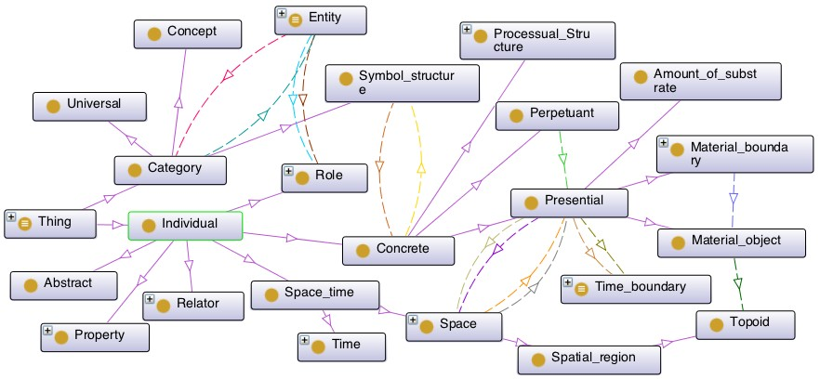
DOLCE
BFO
More foundational ontologies
Summary
Section of GFO

Slide 66
DOLCE
BFO
More foundational ontologies
Summary
Summary
1
DOLCE
Overview
Formalisations and implementations
2
BFO
Overview
Formalisations and implementations Relation Ontology
3
More foundational ontologies Ontologies and choices
Where and how does it make a difference? GFO as ‘super’ foundational (extra slides)

