Slide 1
Parts
Types of part-whole relations
Extending the foundations
Ontology Design Patterns
Ontology Engineering
Lecture 7: Top-down (and middle-out) Ontology Development II
Maria Keet
email: mkeet@cs.uct.ac.za
home: http://www.meteck.org
Department of Computer Science University of Cape Town, South Africa
Semester 2, Block I, 2019
1/59

Slide 2
Parts
Types of part-whole relations
Extending the foundations
Ontology Design Patterns
Outline
1
Parts
Meronymy Mereology Implementation
2 Taxonomy of types of part-whole relations The taxonomy
Using the taxonomy of part-whole relations RBox Compatibility
Extending the foundations for broader use
3
4 Ontology Design Patterns
2/59

Slide 3
Parts
Types of part-whole relations
Extending the foundations
Ontology Design Patterns
Outline
1
Parts
Meronymy Mereology Implementation
2 Taxonomy of types of part-whole relations The taxonomy
Using the taxonomy of part-whole relations RBox Compatibility
Extending the foundations for broader use
3
4 Ontology Design Patterns
3/59

Slide 4
Parts
Types of part-whole relations
Extending the foundations
Ontology Design Patterns
Some questions and problems (not exhaustive)
Is Cape Town a more specific instance of Western Cape Province, or a part of it?
Is a tunnel part of the mountain?
What is the difference, if any, between how Cell nucleus and Cell are related and how Receptor and Cell wall are related?
And w.r.t. Brain part of Human and/versus Hand part of Boxer? (assuming boxers must have their own hands)
A classical example: hand is part of musician, musician part of orchestra, but clearly, the musician’s hands are not part of the orchestra. Is part-of then not transitive, or is there a problem with the example?
4/59

Slide 5
Parts
Types of part-whole relations
Extending the foundations
Ontology Design Patterns
Part-whole relations in natural language (meronymy)
Part of?
Centimeter part of Decimeter
Decimeter part of Meter
— therefore Centimeter part of Meter
* Meter part of SI
— but not Centimeter part of SI
5/59

Slide 6
Parts
Types of part-whole relations
Extending the foundations
Ontology Design Patterns
Part-whole relations in natural language (meronymy)
Part of?
  Centimeter part of Decimeter
  Decimeter part of Meter
— therefore Centimeter part of Meter
* Meter part of SI
— but not Centimeter part of SI
Transitivity?
  Person part of Organisation
  Organisation located in Rondebosch
  therefore Person located in Rondebosch?
  but not Person part of Rondebosch
5/59

Slide 7
Parts
Types of part-whole relations
Extending the foundations
Ontology Design Patterns
Part-whole relations in natural language (meronymy)
Part of?
  Centimeter part of Decimeter
  Decimeter part of Meter
— therefore Centimeter part of Meter
* Meter part of SI
— but not Centimeter part of SI
Transitivity?
  Person member of Organisation
  Organisation located in Rondebosch
  therefore Person located in Rondebosch?
  but not Person member of Rondebosch
6/59

Slide 8
Parts
Types of part-whole relations
Extending the foundations
Ontology Design Patterns
Part-whole relations in natural language (meronymy)
Which part of?
  CellMembrane structural part of RedBloodCell
  RedBloodCell part of Blood
— but not CellMembrane structural part of Blood
* Receptor structural part of CellMembrane
— therefore Receptor structural part of RedBloodCell
7/59

Slide 9
Parts
Types of part-whole relations
Extending the foundations
Ontology Design Patterns
Part-whole relations in natural language (meronymy)
Which part of?
  CellMembrane structural part of RedBloodCell
  RedBloodCell contained in? Blood
— but not CellMembrane structural part of Blood
* Receptor structural part of CellMembrane
— therefore Receptor structural part of RedBloodCell
8/59

Slide 10
Parts
Types of part-whole relations
Extending the foundations
Ontology Design Patterns
Analysis of the issues from diverse angles
Mereological theories (Varzi, 2004), usage & extensions (e.g. mereotopology, relation with granularity, set theory) – Ontology
Early attempts with direct parthood, SEP triples, and other outstanding issues, some still remaining
Cognitive & linguistic issues from meronymy
Their use in conceptual modelling and ontology engineering (e.g. UML’s aggregation)
Subject domains: everywhere
9/59

Slide 11
Parts
Types of part-whole relations
Extending the foundations
Ontology Design Patterns
Ground Mereology
Reflexivity (everything is part of itself)
∀x (part of (x, x ))
(1)
Antisymmetry (two distinct things cannot be part of each other, or: if they are, then they are the same thing)
∀x, y ((part of (x, y ) ∧ part of (y , x )) → x = y ) Transitivity (if x is part of y and y is part of z, then x is part of z)
(2)
∀x, y , z ((part of (x, y ) ∧ part of (y , z )) → part of (x, z )) (3) Proper parthood
∀x, y (proper part of (x, y ) ≡ part of (x, y ) ∧ ¬part of (y , x )) (4)
10/59

Slide 12
Parts
Types of part-whole relations
Extending the foundations
Ontology Design Patterns
Ground Mereology
Proper parthood
∀x, y (proper part of (x, y ) ≡ part of (x, y ) ∧ ¬part of (y , x )) (5) Asymmetry (if x is part of y then y is not part of x )
∀x, y (proper part of (x, y ) → ¬proper part of (y , x )) (6) Irreflexivity (x is not part of itself)
∀x¬(proper part of (x, x ))
(7)
Transitivity
∀x, y , z ((proper part of (x,y )∧proper part of (y ,z )) → proper part of (x,z))
(8)

Slide 13
Parts
Types of part-whole relations
Extending the foundations
Ontology Design Patterns
Defining other relations with part of
Overlap (x and y share a piece z)
∀x, y (overlap(x, y ) ≡ ∃z (part of (z, x ) ∧ part of (z, y ))) (9) Underlap (x and y are both part of some z)
∀x, y (underlap(x, y ) ≡ ∃z (part of (x, z ) ∧ part of (y , z )))
(10)
12/59

Slide 14
Parts
Types of part-whole relations
Extending the foundations
Ontology Design Patterns
Defining other relations with part of
Overlap (x and y share a piece z)
∀x, y (overlap(x, y ) ≡ ∃z (part of (z, x ) ∧ part of (z, y ))) (9) Underlap (x and y are both part of some z)
∀x, y (underlap(x, y ) ≡ ∃z (part of (x, z ) ∧ part of (y , z )))
(10)
The ‘other direction’: has part
∀x, y (has part(x, y ) ≡ part of ⁻(x, y ))
(11)
12/59

Slide 15
Parts
Types of part-whole relations
Extending the foundations
Ontology Design Patterns
With x as part, what to do with the ‘remainder’ that makes up y?
Weak supplementation: every proper part must be supplemented by another, disjoint, part. MM
Strong supplementation: if an object fails to include another among its parts, then there must be a remainder. EM
13/59

Slide 16
Parts
Types of part-whole relations
Extending the foundations
Ontology Design Patterns
With x as part, what to do with the ‘remainder’ that makes up y?
Weak supplementation: every proper part must be supplemented by another, disjoint, part. MM
Strong supplementation: if an object fails to include another among its parts, then there must be a remainder. EM
Problem with EM: non-atomic objects with the same proper parts are identical, because of this (extensionality principle), but sameness of parts may not be sufficient for identity E.g.: two objects can be distinct purely based on arrangement of its parts, differences statue and its marble (multiplicative approach)
13/59

Slide 17
Parts
Types of part-whole relations
Extending the foundations
Ontology Design Patterns
General Extensional Mereology (extra)
Strong supplementation [EM]
¬part of (y , x ) → ∃z (part of (z, y ) ∧ ¬overlap(z, x )) (12)
And add unrestricted fusion [GEM]. Let φ be a property or condition, then for every satisfied φ there is an entity consisting of all entities that satisfy φ. ¹ Then:
∃xφ → ∃z∀y (overlap(y, z ) ↔ ∃x (φ ∧ overlap(y, x ))) (13)
Note that in EM and upward we have identity, from which one can prove acyclicity for ppo
There are more mereological theories, and the above is not uncontested (more about that later)
¹Need to refer to classes, but desire to stay within FOL. Solution: axiom schema with only predicates or open formulas
14/59

Slide 18
Parts
Types of part-whole relations
Extending the foundations
Ontology Design Patterns
Relations between common mereological theories
General Extensional Mereology
GEM = GMM
General Mereology
GM
Extensional Closure Mereology
CEM = CMM
Closure Mereology
CM
Extensional Mereology
EM
Minimal Mereology
MM
Ground Mereology
M
Fig. 1: Hasse diagram of mereological theories; from weaker to stronger, going uphill (after [44]).
15/59
Notes:
Varzi04

Slide 19
Parts
Types of part-whole relations
Extending the foundations
Ontology Design Patterns
Can any of this be represented in a decidable fragment of first order logic for use in ontologies and (scalable) software implementations?

Slide 20
Parts
Types of part-whole relations
Extending the foundations
Ontology Design Patterns
What we can(not) implement with DLs
Table: Properties of parthood and proper parthood compared to their
support in DLR_{µ}, SHOIN and SROIQ. ∗: properties of the parthood
relation (in M); ‡: properties of the proper parthood relation (in M).
Language ⇒ Feature ⇓ | DLR_{µ} | SHOIN (∼ OWL-DL) | SROIQ DL-Lite_{A} (∼ OWL 2 DL) (∼ OWL 2 Q
Reflexivity ∗ Antisymmetry ∗ Transitivity ∗ ‡ Asymmetry ‡ Irreflexivity ‡ | + – + + + | – – + + – | + – – – + – + + + –
Acyclicity | + | – | – –
L)

Slide 21
Parts
Types of part-whole relations
Extending the foundations
Ontology Design Patterns
Definitions in OBO Relations Ontology
Instance-level relations
c part of c₁ at t - a primitive relation between two continuant instances and a time at which the one is part of the other
p part of p₁, r part of r₁ - a primitive relation of parthood, holding independently of time, either between process instances (one a subprocess of the other), or between spatial regions (one a subregion of the other)
c contained in c₁ at t !:. c located in c₁ at t and not c overlap c₁ at t
c located in r at t - a primitive relation between a continuant instance, a spatial region which it occupies, and a time

Slide 22
Parts
Types of part-whole relations
Extending the foundations
Ontology Design Patterns
Definitions in OBO Relations Ontology
Class-level relations
C part of C₁ !:. for all c , t, if Cct then there is some c₁ such that C₁c₁t and c part of c₁ at t.
P part of P₁ !:. for all p, if Pp then there is some p₁ such that: P₁p₁ and p part of p₁.
C contained in C₁ !:. for all c , t, if Cct then there is some c₁ such that: C₁c₁t and c contained in c₁ at t
Need to commit to a foundational ontology.
Same labels, different relata and only a textual constraint: Label the relations differently
19/59

Slide 23
Parts
Types of part-whole relations
Extending the foundations
Ontology Design Patterns
Outline
1
Parts
Meronymy Mereology Implementation
2 Taxonomy of types of part-whole relations The taxonomy
Using the taxonomy of part-whole relations RBox Compatibility
3
Extending the foundations for broader use
4 Ontology Design Patterns
20/59

Slide 24
Parts
Types of part-whole relations
Extending the foundations
Ontology Design Patterns
Overview
Mereological part of (and subtypes) versus ‘other’ part-whole relations
Categories of object types of the part-whole relation changes
Structure these relations by (non/in)transitivity and kinds of relata
Simplest mereological theory, M.
Commit to a foundational ontology: DOLCE (though one also could choose, a.o., BFO, OCHRE, GFO, ...)
21/59

Slide 25
Parts
Types of part-whole relations
Extending the foundations
Ontology Design Patterns
DOLCE categories
PT
Particular
ED
Endurant
PD
Perdurant
…
…
PED
Physical Endurant
NPED
Non-physical Endurant
AS
Arbitrary Sum
EV
Event
ST
Stative
M
Amount of matter
F
Feature
POB
Physical object
…
NPOB
Non-physical object
ACH
Achievement
ACC ST
Accomplishment State
PRO
Process
…
…
…
…
APO
Agentive physical object
NAPO
Non-agentive physical object
MOB SOB
Mental object Social object
…
Notes:
D18

Slide 26
Parts
Types of part-whole relations
Extending the foundations
Ontology Design Patterns
Part-whole relations (small version)
Part-whole relation
mpart-of member-of
(object/role- collective)
part-of
constitutes
(stuﬀ-object)
s-part-of spatial-part-of involved-in
(objects) (processes)
contained-in located-in stuﬀ-part-of portion-of participates-in
(3D objects) (2D objects) (diﬀerent stuﬀs) (same stuﬀ) (object-process)

Slide 27
Parts
Types of part-whole relations
Extending the foundations
Ontology Design Patterns
Part-whole relations (meronymic ones)
“member-bunch”, collective nouns (e.g. Herd, Orchestra) with their members (Sheep, Musician)
∀x, y (member of_{n}(x, y ) =_{def} mpart of (x, y ) ∧ (POB (x ) ∨ SOB (x ))
∧SOB (y ))
“material-object”, that what something is made of (e.g., Vase and
Clay)
∀x, y (constitutes_{it} (x, y ) ≡ constituted of_{it} (y , x ) =_{def} mpart of (x, y )∧
POB (y ) ∧ M(x ))
“noun-feature/activity”, entity participates in a process, like
Enzyme that participates in CatalyticReaction
∀x, y (participates in_{it} (x, y ) =_{def} mpart of (x, y ) ∧ ED(x ) ∧ PD(y ))

Slide 28
Parts
Types of part-whole relations
Extending the foundations
Ontology Design Patterns
Part-whole relations (mereology)
“quantity-mass”, e.g., Salt as subquantity of SeaWater—different types of amounts of matter. partial formalisation:
∀x, y (sub quantity of_{n}(x, y ) =_{def} part of (x, y ) ∧ M(x ) ∧ M(y ))
“portion-object”, relating a smaller (or sub) part of an amount of matter to the whole; same type of stuff; e.g. glass of wine & bottle of wine. partial formalisation:
∀x, y (portion of (x, y ) =_{def} part of (x, y ) ∧ M(x ) ∧ M(y ))

Slide 29
Parts
Types of part-whole relations
Extending the foundations
Ontology Design Patterns
Part-whole relations (mereology)
processes and sub-processes (e.g. Chewing is involved in the grander process of Eating)
∀x, y (involved in(x, y ) =_{def} part of (x, y ) ∧ PD(x ) ∧ PD(y ))
Object and its 2D or 3D region, such as contained in(John’s address book, John’s bag) and located in(Pretoria, South Africa)
∀x, y (contained in(x, y ) =_{def} part of (x, y ) ∧ R (x ) ∧ R (y )∧
∃z, w (has 3D(z, x ) ∧ has 3D(w, y ) ∧ ED(z ) ∧ ED(w )))
∀x, y (located in(x, y ) =_{def} part of (x, y ) ∧ R (x ) ∧ R (y )∧
∃z, w (has 2D(z, x ) ∧ has 2D(w, y ) ∧ ED(z ) ∧ ED(w )))
∀x, y (s part of (x, y ) =_{def} part of (x, y ) ∧ ED(x ) ∧ ED(y ))

Slide 30
Parts
Types of part-whole relations
Extending the foundations
Ontology Design Patterns
Using the taxonomy of part-whole relations
Representing it correctly in ontologies and conceptual data models
Decision diagram
Using the categories of the foundational ontology Examples
Software application that simplifies all that
Reasoning with a taxonomy of relations
The RBox reasoning service to pinpoint errors
27/59

Slide 31
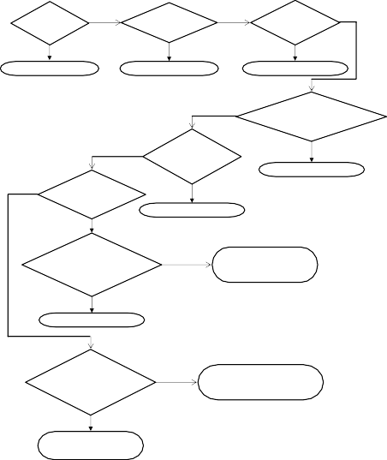
Parts
Types of part-whole relations
Extending the foundations
Ontology Design Patterns
Decision diagram
Is X made of Y?
Does the part-of role ^{No}
relate roles?
Is X a member of Y? (like player-team)
(like bike-steel, vase-clay)
Yes
X part-of Y → X involved-in Y
X part-of Y → X member-of Y X part-of Y → Y constituted-of X
Is X a portion or subquantity of Y? (like slice-pie, wine or
other mass noun)
Is X part-of an event Y? (like bachelor-party, enzyme-reaction)
X part-of Y → X sub-quantity-of Y
Is X a spatial part of Y? (like oasis-desert, nucleus-cell)
X part-of Y → X participates-in Y
Are X and Y geographical object types? (as in place-area, like Massif
Central in France)
Then
X part-of Y → X contained-in Y (like a book in the bag)
X part-of Y → X located-in Y
Is X part of Y and X is also functionally dependent on Y (or vv)? (like heart-body, handle-cup)
Then
X part-of Y → X s-part-of Y (structural part-of, like shelf-cupboard)
X part-of Y → X f-part-of Y (functional part-of)
Notes:
ORM06 paper

Slide 32
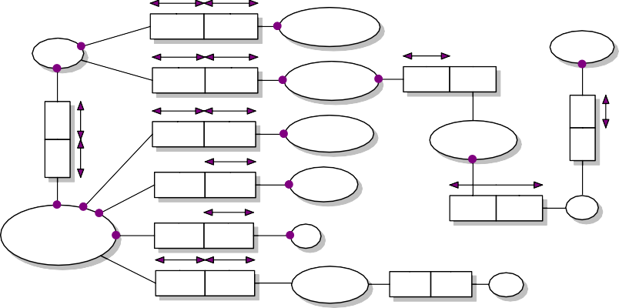
Parts
Types of part-whole relations
Extending the foundations
Ontology Design Patterns
Example - before
has part
part of
RegistrationReceipt
Env elope
WineSample
has part
part of
WineTastingTicket
part of
/has part
allow s entry to
part of
has part
part of
ConfProceedings
/has part
WineTastingEv ent
has part
part of
Compartment
has part part of
Wine
ConferenceBag
has part part of
Flap
has part part of
ShoulderHandle
part of
Linen

Slide 33
Parts
Types of part-whole relations
Extending the foundations
Ontology Design Patterns
Example - decisions
Envelope is not involved-in, not a member-of, does not constitute, is not a sub-quantity of, does not participate-in, is not a geographical object, but instead is contained-in the ConferenceBag.
Transitivity holds for the mereological relations: derived facts are automatically correct, like RegistrationReceipt contained-in ConferenceBag.
Intransitivity of Linen and ConferenceBag, because a conference bag is not wholly constituted of linen (the model does not say what the Flap is made of).
Completeness, i.e. that all parts make up the whole, is implied thanks to the closed-world assumption. ConferenceBag directly contains the ConfProceedings and Envelope only, and does not contain, say, the Flap.
30/59

Slide 34
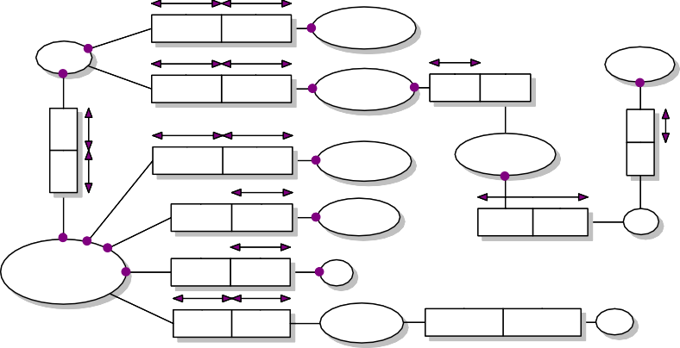
Parts
Types of part-whole relations
Extending the foundations
Ontology Design Patterns
Example - revised
contains
contained in
RegiistratiionReceiipt
contains contained in
Env ellope
WineSamplle
contains
contained in
contains contained in
WiineTastiingTicket
contained in
/contaiins
allllow s entry to
sub-quantity -of
contains
contained in
WineTastingEv ent
contains contained in
ConfProceedings
has s-part s-part of
Compartment
has s-part s-part of
Wine
partiicipates in
ConferenceBag
has s-part s-part of
has s-part s-part of
Flap
constituted of constitutes
has f-part f-part of
constituted of constitutes
Linen
has f-part f-part of
ShoulderHandle

Slide 35
Parts
Types of part-whole relations
Extending the foundations
Ontology Design Patterns
Using DOLCE’s categories
The participating objects instantiate some category (ED, PD, etc)
Given the formalisation, one immediately can exclude/identify appropriate relations, taking a shortcut in the decision diagram
E.g.: Chewing and Eating are both a kind of (a subtype of) PD, hence involved in
E.g.: Alcohol and Wine are both mass nouns, or M, hence sub quantity of
Demo of OntoPartS http:
//www.meteck.org/files/ontopartssup/supindex.html

Slide 36
Parts
Types of part-whole relations
Extending the foundations
Ontology Design Patterns
Requirements for reasoning over the hierarchy
Represent at least Ground Mereology,
Express ontological categories and their taxonomic relations,
Having the option to represent transitive and intransitive relations, and
Specify the domain and range restrictions (/relata/entity types) for the classes participating in a relation.

Slide 37
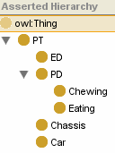
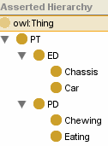





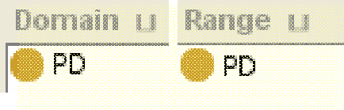



Parts
Types of part-whole relations
Extending the foundations
Ontology Design Patterns
Current behaviour of reasoners
A1. Class hierarchy with asserted conditions
A2. Other class hierarchy with
the same asserted conditions
B. Correct role box (object properties)
C. Wrong role box (object properties)

Slide 38
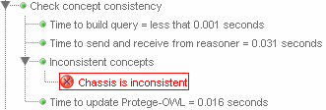
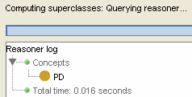
Parts
Types of part-whole relations
Extending the foundations
Ontology Design Patterns
Current behaviour of reasoners
1. A1+B+racer: ontology OK
2. A2+B+racer: ontology OK
3. A1+C+racer: class hierarchy is inconsistent
4. A2+C+racer: Chassis reclassified as PD

Slide 39


Parts
Types of part-whole relations
Extending the foundations
Ontology Design Patterns
The RBox Compatibility service – definitions
Definition (Domain and Range Concepts)
Let R be an OWL object property and R C₁ × C₂ its associated
domain and range axiom. Then, with the symbol D_{R} we indicate the User-defined Domain of R —i.e., D_{R} = C₁—and with the symbol R_{R} we indicate the User-defined Range of R —i.e., R_{R} = C₂.
Definition (RBox Compatibility)
For each pair of roles, R, S , such that (T , R) R S , check: Test 1. (T , R) D_{R} D_{S} and (T , R) R_{R} � R_{S} ;
Test 2. (T , R) D_{S} D_{R} ;
Test 3. (T , R) R_{S} R_{R} .
An RBox is said to be compatible iff Test 1 and (2 or 3) hold for all pairs of role-subrole in the RBox.

Slide 40

Parts
Types of part-whole relations
Extending the foundations
Ontology Design Patterns
The RBox Compatibility service – behaviour
If Test 1 does not hold: warning that domain & range restrictions of either R or S are in conflict with the role hierarchy proposing either
To change the role hierarchy or
To change domain & range restrictions or
If the test on the domains fails, then propose a new
axiom R D_{R}' × R_{R} , where D_{R}' ≡ D_{R} D_{S} ², which
subsequently has to go through the RBox compatibility service (and similarly when Test 1 fails on range restrictions).
²The axiom C1 ≡C2 is a shortcut for the axioms: C1 C2 and C2 C1.

Slide 41
Parts
Types of part-whole relations
Extending the foundations
Ontology Design Patterns
The RBox Compatibility service – behaviour
If Test 2 and Test 3 fail: warn that R cannot be a proper subrole of S but that the two roles can be equivalent. Then, either:
Accept the possible equivalence between the two roles or
Change domain & range restrictions.
Ignoring all warnings is allowed, too

Slide 42
Parts
Types of part-whole relations
Extending the foundations
Ontology Design Patterns
Outline
1
Parts
Meronymy Mereology Implementation
2 Taxonomy of types of part-whole relations The taxonomy
Using the taxonomy of part-whole relations RBox Compatibility
3
Extending the foundations for broader use
4 Ontology Design Patterns

Slide 43
Parts
Types of part-whole relations
Extending the foundations
Ontology Design Patterns
Extensions in various directions
Mereotopology, with location, GIS, Region Connection Calculus
Mereogeometry
Mereology and/vs granularity
Temporal aspects of part-whole relations
Any linguistic and/or cultural specifics
40/59

Slide 44
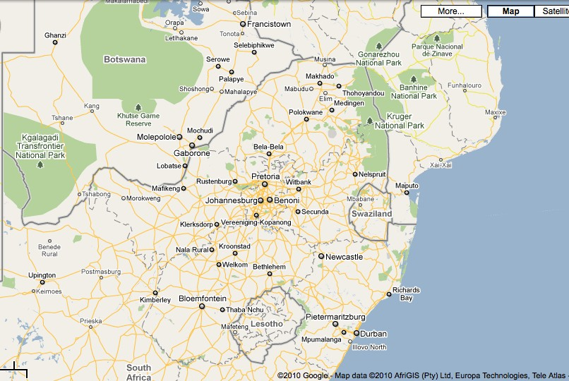
Parts
Types of part-whole relations
Extending the foundations
Ontology Design Patterns
Example (1/2)

Slide 45
Parts
Types of part-whole relations
Extending the foundations
Ontology Design Patterns
Exercise – Representation needs
How to represent that:
The Kruger Park overlaps with South Africa
Durban is a tangential proper part of South Africa
Gauteng is a non-tangential proper part of South Africa
Botswana is connected to South Africa (do they share a border?)
Lesotho is spatially located within the area of South Africa (but not part of)
Can we do all that with mereology? Use only spatial relations? Combining mereo+spatial?
42/59

Slide 46
Parts
Types of part-whole relations
Extending the foundations
Ontology Design Patterns
Mereology with spatial notions
Another primitive: C onnected, which is reflexive and symmetric
More and more expressive theories, e.g.:
T: C (x, x ) and C (x, y ) → C (y , x )
MT: T and P (x, y ) → E (x, y ) where E is enclosure
(E (x, y ) =_{def} ∀z (C (z, x ) → C (z, y )))
Two primitives, P and C , or part in terms of C ?
P =_{def} ∀z (C (z, x ) → C (z, y ))
or perhaps “x and y are connected parts of z” as primitive,
CP (x, y , z ), then:
P (x, y ) =_{def} ∃z CP (x, z, y ) and
C (x, y ) =_{def} ∃z CP (x, y , z )
43/59

Slide 47
Parts
Types of part-whole relations
Extending the foundations
Ontology Design Patterns
Some of the mereo- and topological theories
KGEMT
Reductive Mereotopology
RMT
General Extensional Mereotopology
GEMT
General Extensional Mereology
GEM
Minimal (mereo) Topology
MT
EM
Ground Topology
T
Ground Mereology
M
Note: one can add explicit variations with Atom/Atomless and Boundary/Boundaryless
Notes:
ESWC12

Slide 48
Parts
Types of part-whole relations
Extending the foundations
Ontology Design Patterns
Extension to the taxonomy of part-whole relations
Part-whole relation
part-of P
proper-part-of
PP
spatial-part
mpart-of mP
… …
s-part-of
-of
proper-spatial-part-of
PSpP
involved-in II
proper-involved-in
PII
StP
proper-s-part-of PStP
SpP
contained-in CI
Subsumption in the original taxonomy
located-in LI
proper-contained-in PCI
proper-located-in PLI
Subsumption for
proper part-of
equal-contained-in ECI
equal-located-in ELI
Subsumption
dividing non-proper, equal, from proper part-of
tangential-proper- contained-in
TPCI
nontangential-proper- contained-in
NTPCI
tangential-proper- nontangential-proper-
located-in TPLI
located-in NTPLI
Notes:
ESWC12

Slide 49
Parts
Types of part-whole relations
Extending the foundations
Ontology Design Patterns
Extension to the taxonomy of part-whole relations
∀x, y (ECI (x, y ) ≡ CI (x, y ) ∧ P(y, x )
(14)
∀x, y (PCI (x, y ) ≡ PPO(x, y ) ∧ R (x )∧R (y ) ∧ ∃z, w (has 3D(z, x ) ∧
has 3D(w, y ) ∧ ED(z ) ∧ ED(w )))
(15)
∀x, y | (NTPCI (x, y ) ≡ PCI (x, y ) ∧ ∀z (C (z, x )→O(z, y ))) | (16)
∀x, y | (TPCI (x, y ) ≡ PCI (x, y ) ∧ ¬NTPCI (x, y )) | (17)
∀x, y | (ELI (x, y ) ≡ LI (x, y ) ∧ P(y, x ) | (18)
∀x, y | (PLI (x, y ) ≡ PPO(x, y ) ∧ R (x ) ∧ R (y ) ∧ ∃z, w (has 2D(z, x ) | ∧ (19)
∀x, y | has 2D(w, y ) ∧ ED(z ) ∧ ED(w ))) (NTPLI (x, y ) ≡ PLI (x, y ) ∧ ∀z (C (z, x )→O(z, y ))) | (20)
∀x, y | (TPLI (x, y ) ≡ PLI (x, y ) ∧ ¬NTPLI (x, y )) | (21)

Slide 50
Parts
Types of part-whole relations
Extending the foundations
Ontology Design Patterns
Implementability
KGEMT requires second order logic
No definitions of relations in OWL
Recollect object property characteristics in the different OWL species
What is lost regarding representation and, consequently, reasoning within OWL?
Is there a way to avoid this?
Yes, but computationally costly and not ‘easy’ yet: e.g., OWL + Common Logic within DOL (recall Ch4)
47/59

Slide 51
Parts
Types of part-whole relations
Extending the foundations
Ontology Design Patterns
Outline
1
Parts
Meronymy Mereology Implementation
2 Taxonomy of types of part-whole relations The taxonomy
Using the taxonomy of part-whole relations RBox Compatibility
3
Extending the foundations for broader use
4 Ontology Design Patterns

Slide 52
Parts
Types of part-whole relations
Extending the foundations
Ontology Design Patterns
Rationale
It is hard to reuse only the “useful pieces” of a comprehensive (foundational) ontology, and the cost of reuse may be higher than developing a new ontology from scratch
Need for small (or cleverly modularised) ontologies with explicit documentation of design rationales, and best engineering practices
Hence, in analogy to software design patterns: ontology design patterns
ODPs summarise the good practices to be applied within design solutions
ODPs keep track of the design rationales that have motivated their adoption

Slide 53
Parts
Types of part-whole relations
Extending the foundations
Ontology Design Patterns
ODP definition
An ODP is an information object
A design pattern schema is the description of an ODP, including the roles, tasks, and parameters needed in order to solve an ontology design issue
An ODP is a modeling solution to solve a recurrent ontology design problem. It is an Information Object that expresses a Design Pattern Schema (or skin) that can only be satisfied by DesignSolutions. Design solutions provide the setting for Ontology Elements that play some ElementRole(s) from the schema. (Presutti et al, 2008)
OPs have their own metadata
50/59

Slide 54
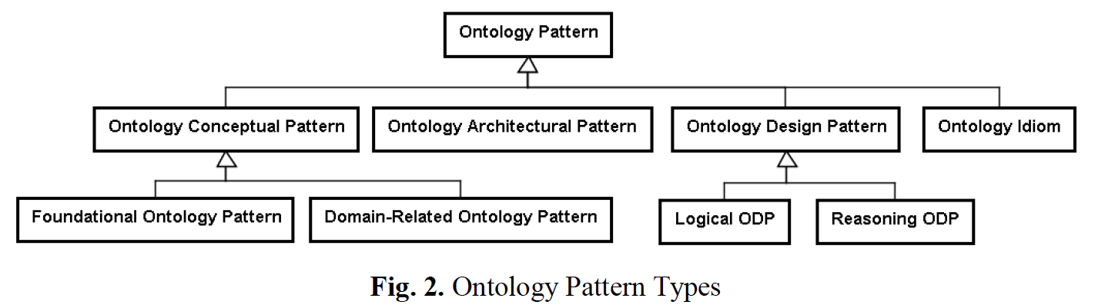
Parts
Types of part-whole relations
Extending the foundations
Ontology Design Patterns
Another OP/ODP hierarchy
Notes:
% {\small More detail: ``Ontology Patterns: Clarifying Concepts and Terminology'' by
%R. A. Falbo, G. Guizzardi, A. Gangemi, V. Presutti. WOP 2013.}

Slide 55
Parts
Types of part-whole relations
Extending the foundations
Ontology Design Patterns
Types of Patterns
Structural OPs, Correspondence OPs, Content OPs (CPs), Reasoning OPs, Presentation OPs, Lexico-Syntactic OPs, ...
CPs can be distinguished in terms of the domain they represent
Correspondence OPs (for reengineering and mappings—next lecture)
Reasoning OPs are typical reasoning procedures
Presentation OPs relate to ontology usability from a user perspective; e.g., Naming OPs and Annotation OPs
Lexico-Syntactic OP are linguistic structures or schemas that permit to generalize and extract some conclusions about the meaning they express (more in next lecture)

Slide 56
Parts
Types of part-whole relations
Extending the foundations
Ontology Design Patterns
Structural OPs
Logical OPs:
Are compositions of logical constructs that solve a problem of expressivity in OWL-DL (and, in cases, also in OWL 2 DL)
Only expressed in terms of a logical vocabulary, because their signature (the set of predicate names, e.g. the set of classes and properties in an OWL ontology) is empty
Independent from a specific domain of interest
Logical macros compose OWL DL constructs; e.g. the universal+existential OWL macro
Transformation patterns translate a logical expression from a logical language into another; e.g. n-aries

Slide 57
Parts
Types of part-whole relations
Extending the foundations
Ontology Design Patterns
Example: n-ary relation “Logical OP” idea
Reify the n-ary R into a class R'
Create n binaries between the classes and R'
Declare 1:1 cardinality constraints
Declare identifier across the n new binaries (often omitted)

Slide 58
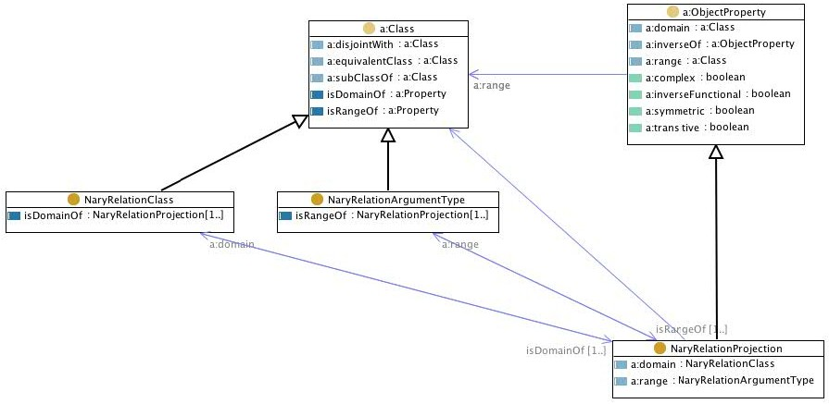
Parts
Types of part-whole relations
Extending the foundations
Ontology Design Patterns
Example: n-ary relation “Logical OP”
Notes:
Presutti el at 08

Slide 59
Parts
Types of part-whole relations
Extending the foundations
Ontology Design Patterns
Architectural OPs
Architectural OPs are defined in terms of composition of Logical OPs that are used in order to affect the overall shape of the ontology; i.e., an Architectural OP identifies a composition of Logical OPs that are to be exclusively used in the design of an ontology
Examples of Architectural OPs are: Taxonomy, Modular Architecture, and Lightweight Ontology
E.g., Modular Architecture Architectural OP consists of an ontology network, where the involved ontologies play the role of modules, which are connected by the owl:import operation with one root ontology that imports all the modules
56/59

Slide 60


Parts
Types of part-whole relations
Extending the foundations
Ontology Design Patterns
Correspondence and reengineering OPs
A.
* | *
Person
vs.
Marriage | * 2 | Person
 | participation
married to
0..1
1..*
Book
Book
* *
Person
vs.
Bookloan
participation
borrowed by
1..*
Person
1
Runner |  | Marathon
vs.
Endurant
Perdurant
B.
* runs*
Runner
1
* Running ^{* 1} Marathon
participation involvement
C.
Person
vs.
Person | * * | Skill
 | hasSkill
hasSkill: String
Endurant | 1..* * | Quality | * 1..* | Region
D.
Apple
vs.
has quality
quale
hasColour: RGBvalue
Apple
1..*
*
Colour
* ^{1..*} Physical
has quality
quale
Region
Person
Physical object | inherence | Social Object
 | 1 *
E.
vs.
Employee
Person
1
*
Employee
inherence
Notes:
ESWC17

Slide 61
Parts
Types of part-whole relations
Extending the foundations
Ontology Design Patterns
Lexico-Syntactic OPs
Linguistic structures or schemas that consist of certain types of words following a specific order, akin to a template or a pattern; verbalisation
E.g., “subClassOf” ends up as: Each <subclass> is a <superclass>
Other Lexical OPs provided for OWL’s equivalence between classes, object property, subpropertyOf relation, datatype property, existential restriction, universal restriction, disjointness, union of classes
Mainly for English language only, thus far
58/59

Slide 62
Parts
Types of part-whole relations
Extending the foundations
Ontology Design Patterns
Summary
1
Parts
Meronymy Mereology Implementation
2 Taxonomy of types of part-whole relations The taxonomy
Using the taxonomy of part-whole relations RBox Compatibility
3
Extending the foundations for broader use
4 Ontology Design Patterns
59/59

