Slide 1
RDBMSs
Thesauri
Natural language
Ontology Engineering
Lecture 8: Bottom-up Ontology Development
Maria Keet
email: mkeet@cs.uct.ac.za
home: http://www.meteck.org
Department of Computer Science University of Cape Town, South Africa
Semester 2, Block I, 2019
1/31

Slide 2
RDBMSs
Thesauri
Natural language
Outline
1 RDBMSs
From conceptual model to ontology From data to ontology
2
Thesauri
3
Natural language Introduction
Ontology learning and population
2/31

Slide 3
RDBMSs
Thesauri
Natural language
Bottom-up
From some seemingly suitable legacy representation to an OWL ontology
Database reverse engineering
Conceptual model (ER, UML)
Frame-based system
OBO format
Thesauri
Formalising biological models
Excel sheets
Text mining, machine learning, clustering
etc...
3/31

Slide 4
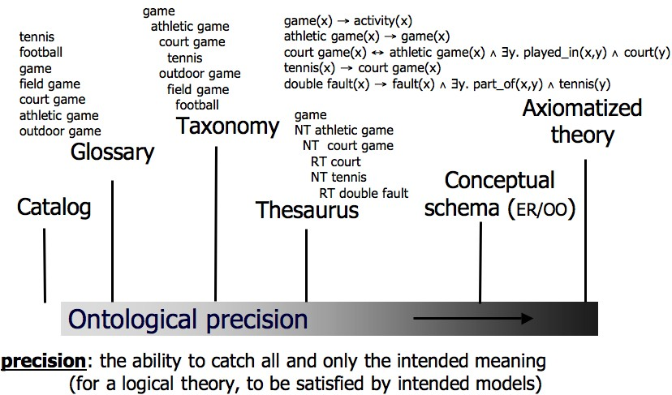
RDBMSs
Thesauri
Natural language
Levels of ontological precision
4/31
Notes:
% \mbox{ } \hfill {\footnotesize \em (from Gangemi, 2004)}

Slide 5
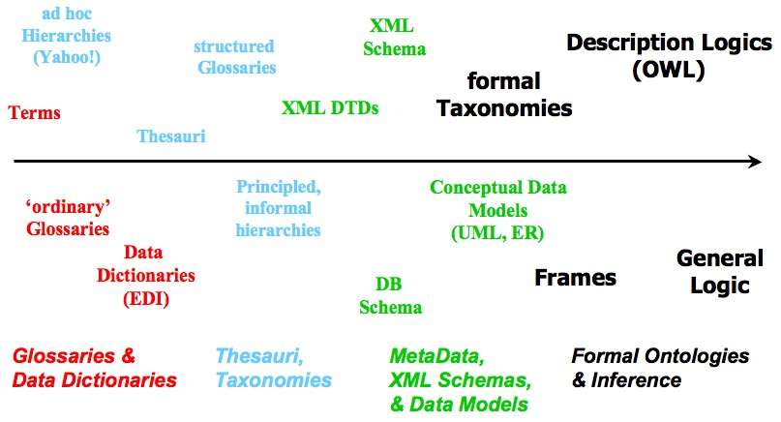
RDBMSs
Thesauri
Natural language
A few languages
5/31
Notes:
% \mbox{ } \hfill {\footnotesize \em (based on Keet, 2005, which was based on Gruniger)}

Slide 6
RDBMSs
Thesauri
Natural language
Outline
1 RDBMSs
From conceptual model to ontology From data to ontology
2
Thesauri
3
Natural language Introduction
Ontology learning and population
6/31

Slide 7








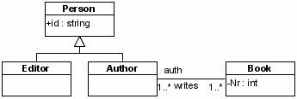
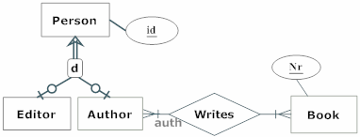
RDBMSs
Thesauri
Natural language
Example models
A
For each Person, exactly one of the following holds: some Author is that Person; some Editor is that Person.
It is possible that more than one Author writes the same
Book and that the same Author writes more than one Book.
Each Book, Author combination occurs at most once in the population of Author writes Book.
Each Author writes some Book.
For each Book, some Author writes that Book.
B
C
{disjoint,complete}
7/31
Notes:
%\mbox{ } \hfill {\tiny from BioKD13 chapter}

Slide 8
RDBMSs
Thesauri
Natural language
(Re-)using conceptual models
Recall differences between conceptual models and ontologies (lecture 1)
We may be able to reuse some of the classes and their associations
First step to address: most of those diagrams are informal, ontologies are logic-based
(sub step: there are multiple formalisations for UML, ER, ORM, ...; which one to choose, or make a new one?)
8/31

Slide 9

RDBMSs
Thesauri
Natural language
Toy example
Exercise: formalise the example(s) from the previous slide Note: you may be lenient to yourself, for now ...
The models are actually not exactly the same, notably: attributes, identifiers, DL role components
Editor Person, ∃writes.Book Author, ...,
Author = 1 writes.Book (or ∃ with ≤ 1—what difference
does it make?), ...
9/31

Slide 10
RDBMSs
Thesauri
Natural language
Brushing up
Generalise from, or remove, the application-specific components
e.g.: those part-whole relations w.r.t UML’s aggregation association
Perhaps use a foundational ontology to characterise the candidate classes and object properties
Could use OntoClean aspects (e.g., with OntoUML)
Add definitions (defined classes), disjointness where appropriate
More?
10/31

Slide 11
RDBMSs
Thesauri
Natural language
General considerations for RDBMSs
Assume resolved issues of data duplication, violations of integrity constraints, hacks, outdated imports from other databases, outdated conceptual data models
11/31

Slide 12
RDBMSs
Thesauri
Natural language
General considerations for RDBMSs
Some data in the DB—mathematically instances—actually assumed to be concepts/universals/classes
‘impedance mismatch’ DB values and ABox objects
11/31

Slide 13
RDBMSs
Thesauri
Natural language
General considerations for RDBMSs
Some data in the DB—mathematically instances—actually assumed to be concepts/universals/classes
‘impedance mismatch’ DB values and ABox objects
⇒
values-but-actually-concepts-that-should-become-OWL-classes and values-that-should-become-OWL-instances
11/31

Slide 14

RDBMSs
Thesauri
Natural language
Ontology
F
G
T
...
S
B
C
A
E
X
R
H
D
Env:1
Env:2
Env:3
Env:15
Env:25
...
...
...
C
B
A
ID
Env:123
Env:444
Env:512
D
X
...
E
H
...
F
G
X
ID | A | B | C | D | E | F | G | H
 |  |  |  |  |  |  |  | En
 |  |  |  |  |  |  |  | En
 |  |  |  |  |  |  |  | En
 |  |  |  |  |  |  |  | En
...
v:123 v:137 v:512
v:444
...

Slide 15
RDBMSs
Thesauri
Natural language
General considerations for RDBMSs
Reuse/reverse engineer the physical DB schema
Reuse conceptual data model (in ER, EER, UML, ORM, ...) But,
Assumes there was a fully normalised conceptual data model,
Denormalization steps to flatten the database structure, which, if simply reverse engineered, ends up in the ‘ontology’ as a class with umpteen attributes
Minimal (if at all) automated reasoning with it
Redo the normalization steps to try to get some structure back into the conceptual view of the data?
Add a section of another ontology to brighten up the ‘ontology’ into an ontology?
Establish some mechanism to keep a ‘link’ between the terms in the ontology and the source in the database?
13/31

Slide 16
RDBMSs
Thesauri
Natural language
Manual Extraction
Most database are not neat as assumed by ‘Automatic Extraction of Ontologies’ algorithms
Then what?
Reverse engineer the database to a conceptual data model Choose an ontology language for your purpose
Examples:
Manual: Reverse engineering from DB to ORM model with, e.g., VisioModeler v3.1 or NORMA: the HGT-DB about horizontal gene transfer, adolena for the portal for people with disabilities, EPnet with those amphorae
Automated: Lubyte & Tessaris’s presentation of the DEXA’09 paper
14/31

Slide 17
RDBMSs
Thesauri
Natural language
Outline
1 RDBMSs
From conceptual model to ontology From data to ontology
2
Thesauri
3
Natural language Introduction
Ontology learning and population

Slide 18
RDBMSs
Thesauri
Natural language
Overview
Thesauri galore in medicine, education, agriculture, ...
Core notions of BT broader term, NT narrower term, and RT related term (and auxiliary ones UF/USE)
E.g. the Educational Resources Information Center thesaurus:
reading ability BT ability
RT reading
RT perception
E.g. AGROVOC of the FAO:
milk
NT cow milk NT milk fat
How to go from this to an ontology?

Slide 19
RDBMSs
Thesauri
Natural language
Problems
Lexicalisation of a conceptualisation
Low ontological precision
BT/NT is not the same as is a, RT can be any type of relation: overloaded with (ambiguous) subject domain semantics
Those relationships are used inconsistently
Lacks basic categories alike those in DOLCE and BFO (ED, PD, SDC, etc.)

Slide 20
RDBMSs
Thesauri
Natural language
Simple Knowledge Organisation System(s): SKOS
W3C standard intended for converting Thesauri, Classification Schemes, Taxonomies, Subject Headings etc into one interoperable syntax
Concept-based search instead of text-based search
Reuse each other’s concept definitions
Search across (institution) boundaries
Standard software
Limitations:
‘unusual’ concept schemes do not fit into SKOS (original structure too complex)
skos:Concept without clear properties (like in OWL) and still much subject domain semantics in the natural language text
‘semantic relations’ have little semantics (skos:narrower does not guarantee it is is a or part of )
See slides SKOS.pdf

Slide 21
RDBMSs
Thesauri
Natural language
A rules-as-you-go approach (1/2)
Define the ontology structure (top-level hierarchy/backbone)
Fill in values from one or more legacy Knowledge Organisation System to the extent possible (such as: which object properties?)
Edit manually using an ontology editor:
make existing information more precise
add new information
automation of discovered patterns (rules-as-you-go)
Notes:
%\vfill {\footnotesize see (Soergel et al, 2004) for an example}

Slide 22
RDBMSs
Thesauri
Natural language
A rules-as-you-go approach (2/2)
Edit manually using an ontology editor: make existing information more precise add new information
automation of discovered patterns (rules-as-you-go); e.g.:
- observation: cow NT cow milk should become cow
<hasComponent> cow milk
– pattern: animal <hasComponent> milk (or, more generally
animal <hasComponent> body part)
— derive automatically: goat NT goat milk should become
goat <hasComponent> goat milk
other pattern examples, e.g., plant <growsIn> soil type and
geographical entity <spatiallyIncludedIn> geographical entity
20/31
Notes:
%\vfill {\footnotesize see (Soergel et al, 2004) for an example}

Slide 23
RDBMSs
Thesauri
Natural language
Outline
1 RDBMSs
From conceptual model to ontology From data to ontology
2
Thesauri
3
Natural language Introduction
Ontology learning and population

Slide 24
RDBMSs
Thesauri
Natural language
Natural language and ontologies
Using ontologies to improve NLP; e.g.:
To enhance precision and recall of queries
To enhance dialogue systems
To sort literature results
Using NLP to develop ontologies (TBox)
Searching for candidate terms and relations: Ontology learning
Using NLP to populate ontologies (ABox)
Document retrieval enhanced by lexicalised ontologies
Biomedical text mining
Natural language generation from a logic
Ameliorating the knowledge acquisition bottleneck
Other purposes; e.g., e-learning (question generation), readable medical information
22/31

Slide 25
RDBMSs
Thesauri
Natural language
Examples (out of many)
Generic tools: e.g.: for POS tagging, semantic tagging and annotation, ontology-based information extraction, morphological analysis etc. etc.
Textpresso and similar tools
Attempto Controlled English (ACE), rabbit, etc.; grammar engine, template-based approach

Slide 26
RDBMSs
Thesauri
Natural language
Background
Ontology development is time consuming
Bottom-up ontology development strategies, of which one is to use NLP
We take a closer look at ontology learning limited to finding terms for a domain ontology

Slide 27
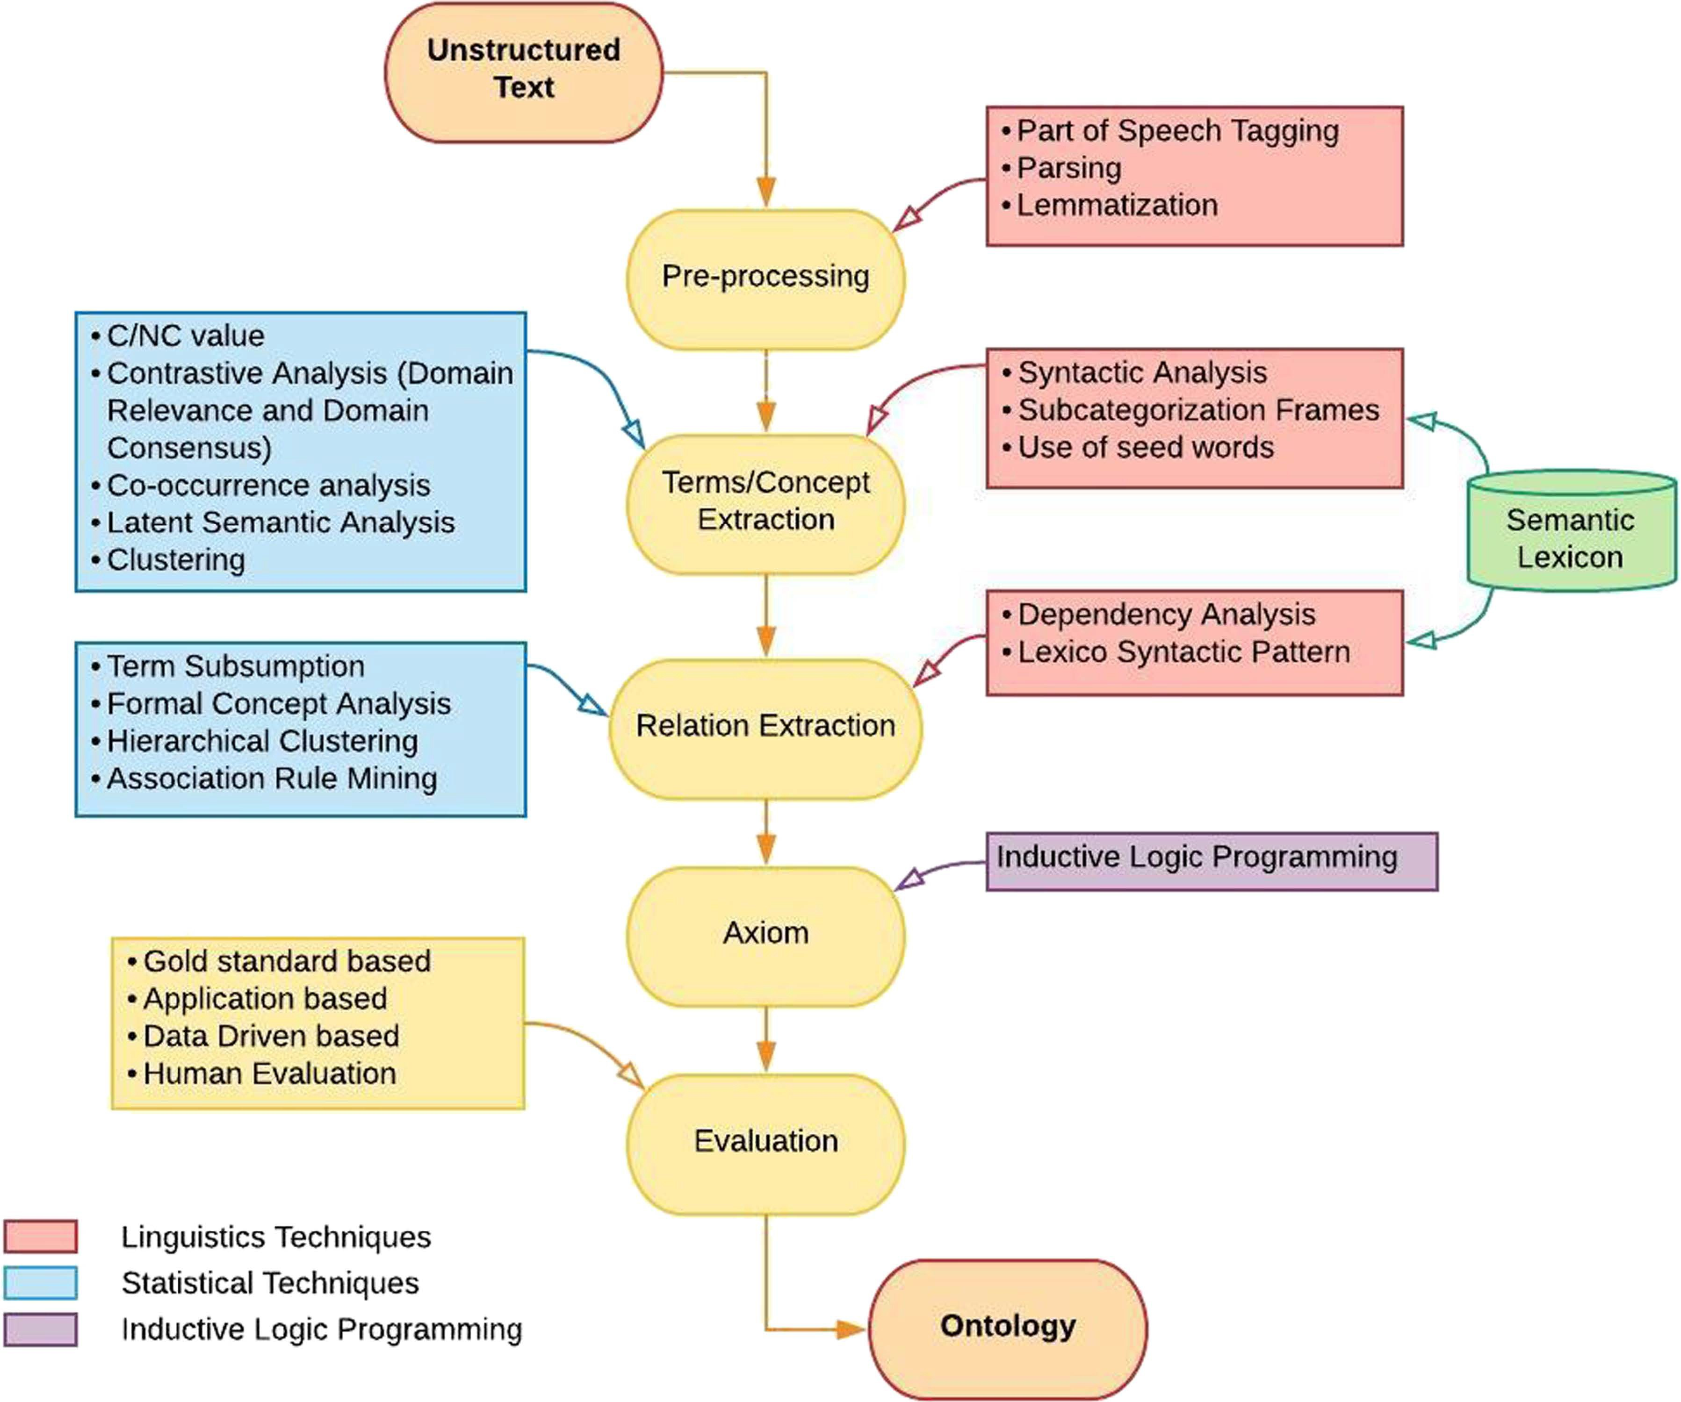
RDBMSs
Thesauri
Natural language
Sample pipeline
Notes:
%source: Muhammad Nabeel Asim, Muhammad Wasim, Muhammad Usman Ghani Khan, Waqar Mahmood, Hafiza Mahnoor Abbasi. A survey of ontology learning techniques and applications. Database, Volume 2018, 2018, bay101, https://doi.org/10.1093/database/bay101

Slide 28
RDBMSs
Thesauri
Natural language
Bottom-up ontology development with NLP
Usual parameters, such as purpose (in casu, document retrieval), formal language (an OWL species)
A standard kind of ontology (not a comprehensive lexicalised ontology)
Additional considerations for “text-mining ontologies”
Level of granularity of the terms to include (hypo/hypernyms)
How to deal with synonyms (e.g., ‘LDL I’ and ‘large LDL’) Handle term variations (e.g., ‘LDL-I’ and ‘LDL I’, ‘Tangiers’ disease’ and ‘Tangier’s Disease’)
Disambiguation; e.g. w.r.t. abbreviations

Slide 29
RDBMSs
Thesauri
Natural language
Method to test automated term recognition
Compare the terms of a manually constructed ontology with the terms obtained from text mining a suitable corpus
Build an ontology manually
Lipoprotein metabolism (LMO), 223 classes with 623 synonyms
Create a corpus
3066 review article abstract from PubMed, obtained with a ‘lipoprotein metabolism’ search
Automatic Term Recognition (ATR) tools, e.g.
Text2Onto: relative term frequency, TFIDF, entropy, WordNet, Hearst patterns
Termine: statistics of candidate term (total frequency of occurrence,
frequency of term as part of other longer candidate terms, length) OntoLearn: linguistic processor and syntactic parser, Domain relevance and domain consensus
RelFreq: relative frequency of a term in a corpus
TFIDF: RelFreq + doc. frequency derived from all phrases in PubMed
example figures for illustration: from Alexopoulou et al, 2008

Slide 30
RDBMSs
Thesauri
Natural language
What can go (went) wrong with some of the terms?
LMO terms that were not in the 50k abstracts grouped into:
Rarely occurring terms in general
Rarely occurring variants of terms (e.g., ‘free chol’ (0, instead of 2622 for ‘free cholesterol’))
Very long terms (e.g, ‘predominance of large low-density lipoprotein particles’, which can be decomposed into smaller terms)
Combinations of terms/variants (e.g., ‘increased total chol’ (0, instead of 116 for ‘increased total cholesterol’))
Terms that should normally be easily found, but limited corpus (e.g., ‘diabetes type I’ (126) and ‘acetyl-coa c-acyltransferase’)
Predicted terms, not in LMO or can be added [to LMO] (wrongly predicted (±25% of the TFIDF top50), and ±40% of the TFIDF top50, resp.))

Slide 31
RDBMSs
Thesauri
Natural language
Ontology population: Typical NLP tasks
Named Entity recognition/semantic tagging; e.g., “... the organisms were incubated at 37◦C”)
Entity normalization; e.g., different strings refer to the same thing (full and abbreviated name, or single letter amino acid, three-letter aminoacid and full name: W, Trp, Tryptophan)
Coreference resolution; in addition to synonyms (lactase and β-galactosidase), there as pronominal references (it, this)
Grounding; the text string w.r.t. external source, like UniProt, that has the representation of the entity in reality
Relation detection; most of the important information in contained within the relations between entities, NLP can be enhanced by considering semantically possible relations

Slide 32
RDBMSs
Thesauri
Natural language
Requirements for NLP ontologies
Domain ontology (at least a taxonomy)
Text model, concerns with classes such as sentence, text position and locations like abstract, introduction
Biological entities, i.e., contents for the ABox, often already available in biological databases on the Internet
Lexical information for recognizing named entities; full names of entities, their synonyms, common variants and misspellings, and knowledge about naming, like endo- and -ase
Database links to connect the lexical term to the entity represent in a particular database (the grounding step)
Entity relations; represented in the domain ontology
30/31

Slide 33
RDBMSs
Thesauri
Natural language
Summary
1 RDBMSs
From conceptual model to ontology From data to ontology
2
Thesauri
3
Natural language Introduction
Ontology learning and population
31/31

