Slide 1
Introduction
Multilingual ontologies
Ontology verbalisation
Ontology Engineering
Lecture 9: Ontologies and natural languages
Maria Keet
email: mkeet@cs.uct.ac.za
home: http://www.meteck.org
Department of Computer Science University of Cape Town, South Africa
Semester 2, Block I, 2019
1/45

Slide 2
Introduction
Multilingual ontologies
Ontology verbalisation
Outline
Introduction
Multilingual ontologies
Ontology verbalisation
2/45

Slide 3
Introduction
Multilingual ontologies
Ontology verbalisation
Outline
Introduction
Multilingual ontologies
Ontology verbalisation
3/45

Slide 4
Introduction
Multilingual ontologies
Ontology verbalisation
Natural language and ontologies
Using ontologies to improve NLP; e.g.:
To enhance precision and recall of queries
To enhance dialogue systems
To sort literature results
Using NLP to develop ontologies (TBox)
Searching for candidate terms and relations
Using NLP to populate ontologies (ABox)
Document retrieval enhanced by lexicalised ontologies
Biomedical text mining
Natural language generation from a logic
Ameliorating the knowledge acquisition bottleneck
Other purposes; e.g., e-learning (question generation), readable medical information
4/45

Slide 5
Introduction
Multilingual ontologies
Ontology verbalisation
Outline
Introduction
Multilingual ontologies
Ontology verbalisation
5/45

Slide 6
Introduction
Multilingual ontologies
Ontology verbalisation
Multilingual ontologies
What the previous sub-sections do not mention: they are “English ontologies” and work with natural language text in English
How to build an ontology for, say, Spanish organic agriculture? [Organic.Lingua project] ‘intelligent’ eGovernment portals in the 11 official languages of South Africa?
6/45

Slide 7
Introduction
Multilingual ontologies
Ontology verbalisation
Multilingual ontologies
What the previous sub-sections do not mention: they are “English ontologies” and work with natural language text in English
How to build an ontology for, say, Spanish organic agriculture? [Organic.Lingua project] ‘intelligent’ eGovernment portals in the 11 official languages of South Africa?
Multilingualism with ontologies
‘Ontology in different languages’?
NLP (NLU) for target language to learn
NLG for user and domain expert-friendly interface to the ontology
6/45

Slide 8
Introduction
Multilingual ontologies
Ontology verbalisation
Multilingual ontologies
What the previous sub-sections do not mention: they are “English ontologies” and work with natural language text in English
How to build an ontology for, say, Spanish organic agriculture? [Organic.Lingua project] ‘intelligent’ eGovernment portals in the 11 official languages of South Africa?
Multilingualism with ontologies
‘Ontology in different languages’?
NLP (NLU) for target language to learn
NLG for user and domain expert-friendly interface to the ontology
Despite OWL’s goal of internationalization, that has not been realised yet, and it is an active field of research
6/45

Slide 9
Introduction
Multilingual ontologies
Ontology verbalisation
How to create ‘ontologies in multiple languages?’ (does that question even make sense?)
How to manage those ontologies?
e.g., for one subject domain, for all 11 official language of South Africa
What to do with language peculiarities built into the current technologies?
(can you given an example of that?)
7/45

Slide 10
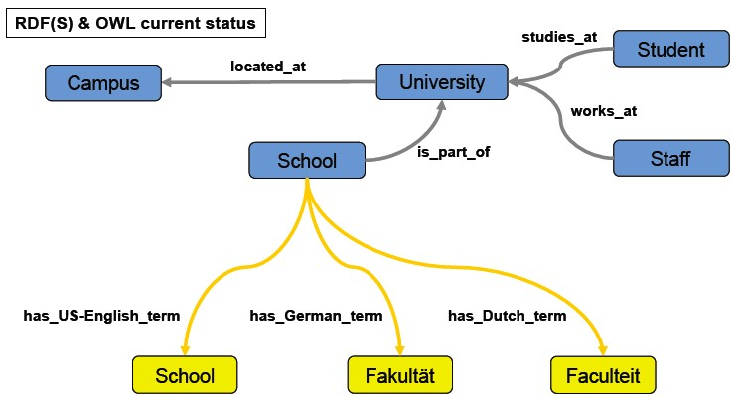
Introduction
Multilingual ontologies
Ontology verbalisation
Simple option: Semantic Tagging
8/45
Notes:
%\mbox{ } \hfill {\tiny http://www.deri.ie/fileadmin/documents/teaching/tutorials/DERI-Tutorial-NLP.final.pdf}

Slide 11
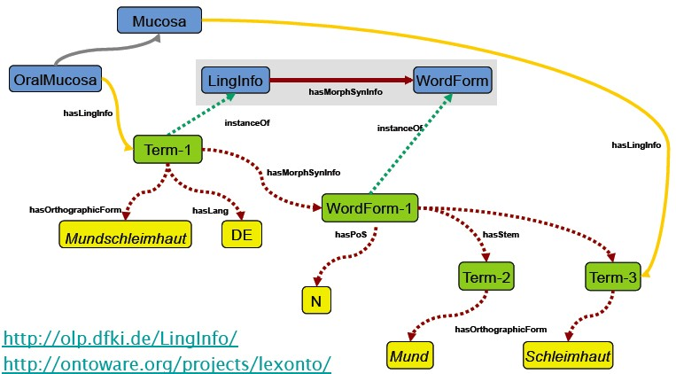
Introduction
Multilingual ontologies
Ontology verbalisation
Option with some effort: Semantic Tagging with a
Lexicalised Ontology
9/45
Notes:
%\mbox{ } \hfill {\tiny http://www.deri.ie/fileadmin/documents/teaching/tutorials/DERI-Tutorial-NLP.final.pdf}

Slide 12
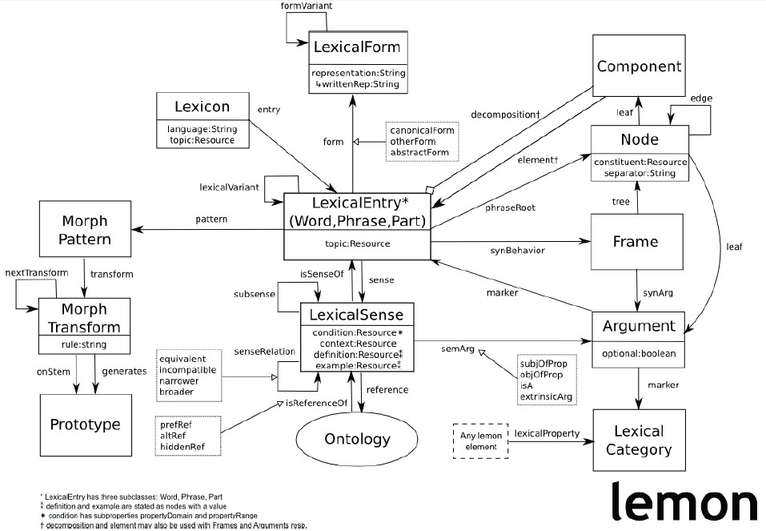
Introduction
Multilingual ontologies
Ontology verbalisation
More comprehensively Lexicalised Ontologies
10/45
Notes:
%\mbox{ } \hfill {\tiny Lemon Cookbook}

Slide 13
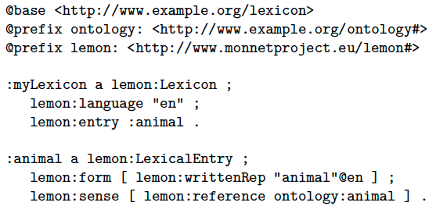
Introduction
Multilingual ontologies
Ontology verbalisation
Lemon example
Notes:
%\mbox{ } \hfill {\tiny Lemon Cookbook}

Slide 14
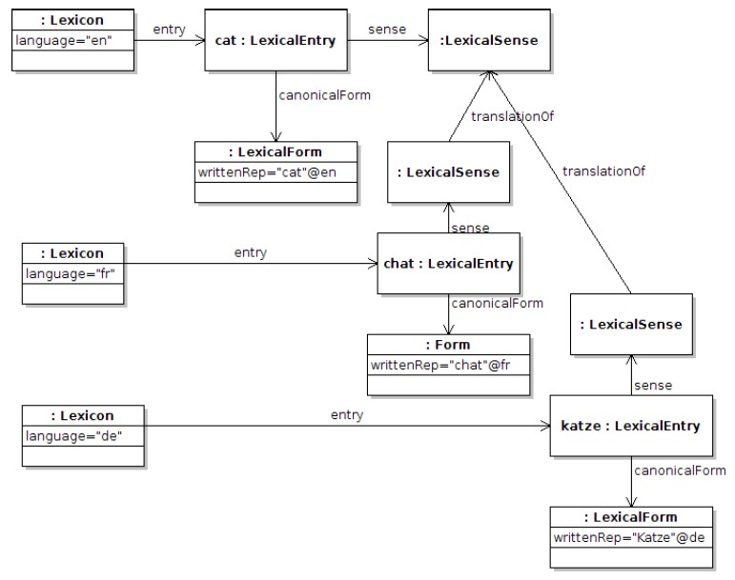
Introduction
Multilingual ontologies
Ontology verbalisation
Lemon example
Notes:
%\mbox{ } \hfill {\tiny Lemon Cookbook}

Slide 15
Introduction
Multilingual ontologies
Ontology verbalisation
:lexicon en lemon:entry :cat ; lemon:language "en" .
:lexicon de lemon:entry :katze ; lemon:language "de".
:lexicon fr lemon:entry :chat ; lemon:language "fr".
:cat lemon:canonicalForm [ lemon:writtenRep "cat"@en ] ; lemon:sense :cat sense .
:chat lemon:canonicalForm [ lemon:writtenRep "chat"@fr ] ; lemon:sense [ isocat:translationOf :cat sense ] .
:katze lemon:canonicalForm [ lemon:writtenRep "katze"@de ] ; lemon:sense [ isocat:translationOf :cat sense ] .
isocat:translationOf rdfs:subPropertyOf lemon:senseRelation .

Slide 16
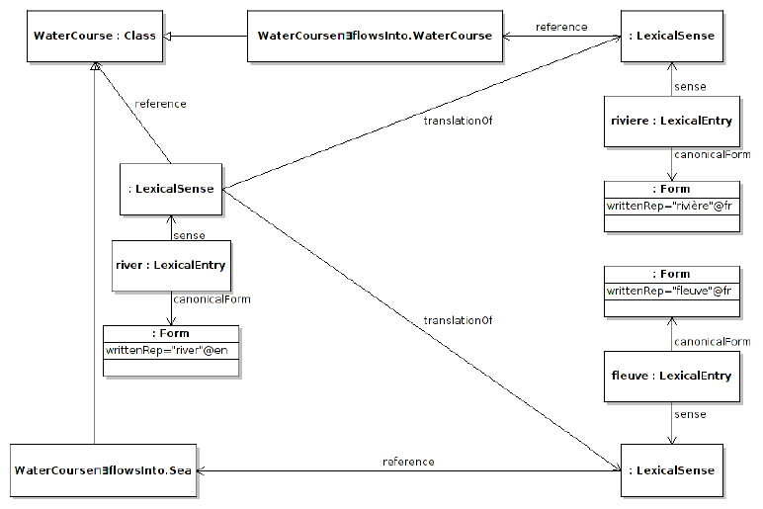
Introduction
Multilingual ontologies
Ontology verbalisation
Semantic Tagging — Lemon example
Notes:
%\mbox{ } \hfill {\tiny Lemon Cookbook}

Slide 17
Introduction
Multilingual ontologies
Ontology verbalisation
Extensions (complications) for, a.o., isiZulu
The noun classes
Treatment of verbs is different
There’s no single 3rd person singular, as in English (e.g., eats, teaches vs. human eats udla, giraffe idla etc. by noun class). so no fixed string for object property name
The preposition (part of etc.) typically associates with the noun (PC or nga-), not verb
15/45

Slide 18
Introduction
Multilingual ontologies
Ontology verbalisation
Extensions (complications) for, a.o., isiZulu
The noun classes
Treatment of verbs is different
There’s no single 3rd person singular, as in English (e.g., eats, teaches vs. human eats udla, giraffe idla etc. by noun class). so no fixed string for object property name
The preposition (part of etc.) typically associates with the noun (PC or nga-), not verb
For all languages other than English: ODE interfaces, Manchester syntax worse than useless (cognitive overload of code switching when reading an axiom)
15/45

Slide 19
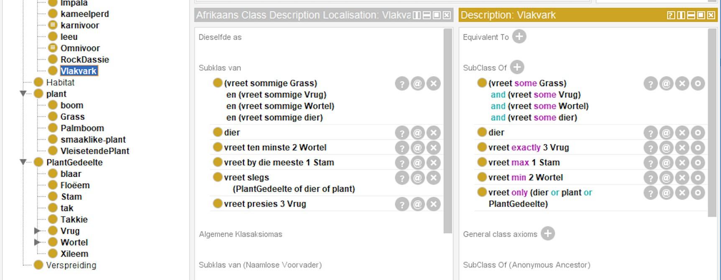
Introduction
Multilingual ontologies
Ontology verbalisation
Example of ODE issues and possible solution

Slide 20
Introduction
Multilingual ontologies
Ontology verbalisation
Outline
Introduction
Multilingual ontologies
Ontology verbalisation

Slide 21
Introduction
Multilingual ontologies
Ontology verbalisation
What is CNL, NLG?
Controlled Natural Language: constrain the grammar/vocabulary of a natural language
Natural Language Generation: generate natural language text from structured data, information, or knowledge

Slide 22
Introduction
Multilingual ontologies
Ontology verbalisation
Natural language interfaces with some CNL or NLG
Many tools, webpages, etc. with some natural language component
Querying of information in natural language (cf. a query language SQL, SPARQL)
Business rules typically specified in a natural language etc.

Slide 23

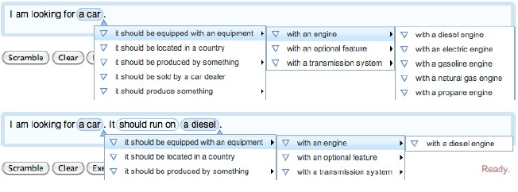
Introduction
Multilingual ontologies
Ontology verbalisation
Example: Query formulation with Quelo
[Franconi et al.(2010)]
20/45

Slide 24
Introduction
Multilingual ontologies
Ontology verbalisation
Example: Business rules and conceptual data models
Course | 1..* 1..* | Professor
 | teaches is
taught
by
Course
Professor
is taught by / teaches
Each Course is taught by at least one Professor
Each Professor teaches at least one Course

Slide 25
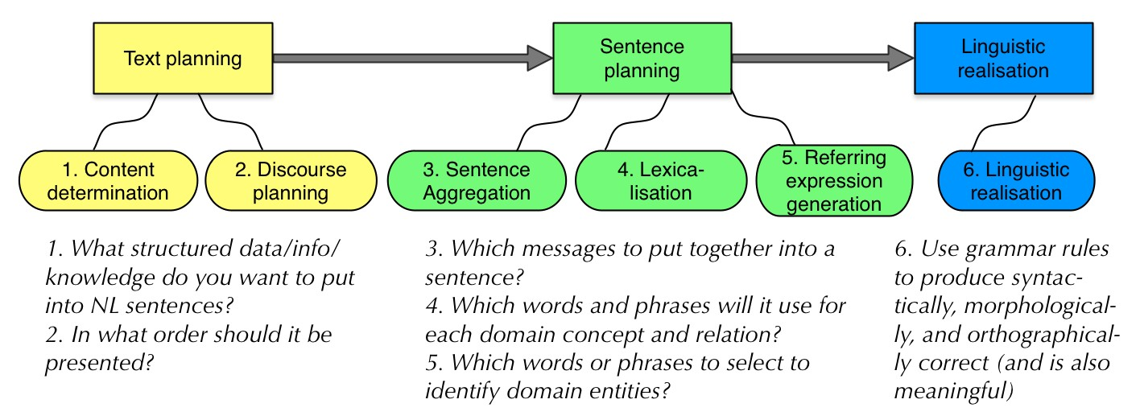
Introduction
Multilingual ontologies
Ontology verbalisation
The ‘NLG pipeline’

Slide 26
Introduction
Multilingual ontologies
Ontology verbalisation
NLG, principal approaches to generate the text
Canned text
Templates
Notably for English [Fuchs et al.(2010), Schwitter et al.(2008), Third et al.(2011), Curland and Halpin(2007)],
but also other languages [Jarrar et al.(2006)] (see list)
Grammar engines, such as [Kuhn(2013)], Grammatical Framework (http://www.grammaticalframework.org/), SimpleNLG
23/45

Slide 27
Introduction
Multilingual ontologies
Ontology verbalisation
NLG, principal approaches to generate the text
Canned text
Templates
Notably for English [Fuchs et al.(2010), Schwitter et al.(2008), Third et al.(2011), Curland and Halpin(2007)],
but also other languages [Jarrar et al.(2006)] (see list)
Grammar engines, such as [Kuhn(2013)], Grammatical Framework (http://www.grammaticalframework.org/), SimpleNLG
⇒ CNL, NLG
23/45

Slide 28
Introduction
Multilingual ontologies
Ontology verbalisation
Business rules/conceptual data models and logic
reconstruction
BR: Each Course is taught by at least one Professor
FOL: ∀x (Course(x ) → ∃y (is taught by(x, y ) ∧ Professor(y ))) DL: Course ⊑ ∃ is taught by.Professor

Slide 29
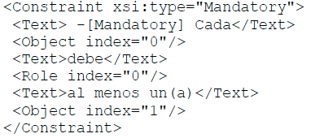
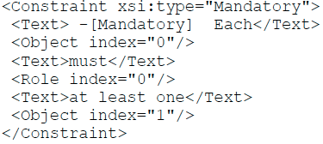
Introduction
Multilingual ontologies
Ontology verbalisation
Example of templates
for a large fragment of ORM, and 11 languages [Jarrar et al.(2006)]
25/45

Slide 30





Introduction
Multilingual ontologies
Ontology verbalisation
Example of templates
for a large fragment of ORM, and 11 languages [Jarrar et al.(2006)]
25/45

Slide 31

Introduction
Multilingual ontologies
Ontology verbalisation
Example of templates
for a large fragment of ORM, and 11 languages [Jarrar et al.(2006)]
25/45

Slide 32

Introduction
Multilingual ontologies
Ontology verbalisation
Example of templates
for a large fragment of ORM, and 11 languages [Jarrar et al.(2006)]
25/45

Slide 33
Introduction
Multilingual ontologies
Ontology verbalisation
NL Grammars, illustration
Sentence NounPhrase NounPhrase
. . .
−→ NounPhrase | VerbPhrase
−→
−→
Adjective | NounPhrase
Noun
Noun Adjective
. . .
−→ car | train
−→ big | broken
(and complexity of the grammar)

Slide 34
Introduction
Multilingual ontologies
Ontology verbalisation
Question
Can the template-based approach be used also for isiZulu?
27/45

Slide 35
Introduction
Multilingual ontologies
Ontology verbalisation
Question
Can the template-based approach be used also for isiZulu?
If so, create those templates
If not, start with basics for a grammar engine
27/45

Slide 36
Introduction
Multilingual ontologies
Ontology verbalisation
Question
Can the template-based approach be used also for isiZulu?
If so, create those templates
If not, start with basics for a grammar engine
Use a practically useful language to benefit both ICT and linguists and, possibly, some subject domain (e.g., medicine)
Details in [Keet and Khumalo(2014b),
Keet and Khumalo(2014a), Keet and Khumalo(2017)]
27/45

Slide 37
Introduction
Multilingual ontologies
Ontology verbalisation
A logic foundation for isiZulu knowledge-to-text
Roughly OWL 2 EL
OWL 2 EL is a W3C-standardised profile of OWL 2 Tools, ontologies in OWL 2 (notably SNOMED CT)

Slide 38

Introduction
Multilingual ontologies
Ontology verbalisation
Universal Quantification
Consider here only the universal quantification at the start of the concept inclusion axiom (‘nominal head’)
‘all’/‘each’ uses -onke, prefixed with the oral prefix of the noun class of that first noun (OWL class/DL concept) on lhs of
(U1) Boy ...
wonke umfana ... bonke abafana ...
(U2) Phone ...
lonke ifoni ... onke amafoni ...
(‘each boy...’; u- + -onke)
(‘all boys...’; ba- + -onke)
(‘each phone...’; li- + -onke)
(‘all phones...’; a- + -onke)

Slide 39
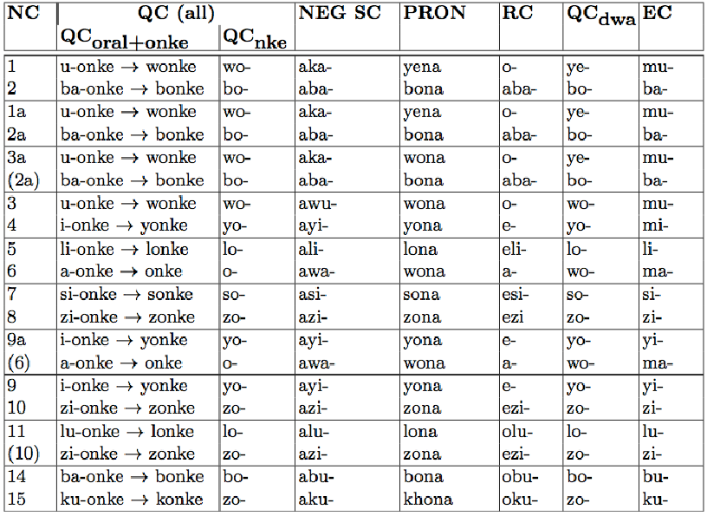
Introduction
Multilingual ontologies
Ontology verbalisation
30/45

Slide 40
Introduction
Multilingual ontologies
Ontology verbalisation
30/45

Slide 41
Introduction
Multilingual ontologies
Ontology verbalisation
30/45

Slide 42
Introduction
Multilingual ontologies
Ontology verbalisation
Subsumption
Two different ways of carving up the nouns to determine which rules apply: semantic and syntactic
Need to choose between
singular and plural
with or without the universal quantification voiced
generic or determinate
(S1) MedicinalHerb Plant
ikhambi ngumuthi (‘medicinal herb is a plant’)
amakhambi yimithi (‘medicinal herbs are plants’)
wonke amakhambi ngumuthi (‘all medicinal herbs are a plant’) (S2) Giraffes Animals
izindlulamithi yizilwane (S3) Cellphone Phone
Umakhalekhukhwini uyifoni
(‘giraffes are animals’; generic)
(‘cellphone is a phone’; determ.)

Slide 43
Introduction
Multilingual ontologies
Ontology verbalisation
Possible subsumption patterns
N₁ <copulative ng/y depending on first letter of N₂>N₂.
<plural of N₁> <copulative ng/y depending on first letter of plural of N₂><plural of N₂>.
<All-concord for NC_{x} >onke <plural of N₁, being of NC_{x} >
<copulative ng/y depending on first letter of N₂>N₂.

Slide 44
Introduction
Multilingual ontologies
Ontology verbalisation
Subsumption: adding negation
Need to choose between
singular and plural, and with or without the universal quantification voiced
Copulative is omitted
Combines the negative subject concord (NEG SC) of the noun class of the first noun (aku-) with the pronomial (PRON) of the noun class of second noun (-yona)
(SN1) Cup ¬Glass
indebe akuyona ingilazi
(‘cup not a glass’)
(‘all cups not a glass’)
zonke izindebe aziyona ingilazi

Slide 45
Introduction
Multilingual ontologies
Ontology verbalisation
34/45

Slide 46
Introduction
Multilingual ontologies
Ontology verbalisation
34/45

Slide 47
Introduction
Multilingual ontologies
Ontology verbalisation
34/45

Slide 48
Introduction
Multilingual ontologies
Ontology verbalisation
Possible negation (disjointness) patterns
<N₁ of NC_{x} > <NEG SC of NC_{x} ><PRON of NC_{y} > <N₂ of NC_{y} >.
<All-concord for NC_{x} >onke <plural N₁, being of NC_{x} >
<NEG SC of NC_{x} ><PRON of NC_{y} > <N₂ with NC_{y} >.

Slide 49
Introduction
Multilingual ontologies
Ontology verbalisation
Existential Quantification
(E1) Giraffe ∃eats.Twig
yonke indlulamithi idla ihlamvana elilodwa zonke izindlulamithi zidla ihlamvana elilodwa
(‘each giraffe eats at least one twig’) (‘all giraffes eat at least one twig’)
a. <All-concord for NC_{x} >onke <pl. N₁, is in NC_{x} >
<conjugated verb> <N₂ of NC_{y} > <RC for NC_{y} ><QC for NC_{y} >dwa.

Slide 50
Introduction
Multilingual ontologies
Ontology verbalisation
37/45

Slide 51
Introduction
Multilingual ontologies
Ontology verbalisation
37/45

Slide 52
Introduction
Multilingual ontologies
Ontology verbalisation
37/45

Slide 53
Introduction
Multilingual ontologies
Ontology verbalisation
Example
∀x (Professor(x ) → ∃y (teaches(x, y ) ∧ Course(y )))
Professor ∃ teaches.Course
Each Professor teaches at least one Course
38/45

Slide 54
Introduction
Multilingual ontologies
Ontology verbalisation
Example
∀x (uSolwazi(x ) → ∃y (ufundisa(x, y ) ∧ Isifundo(y )))
uSolwazi ∃ ufundisa.Isifundo
?
38/45

Slide 55

Introduction
Multilingual ontologies
Ontology verbalisation
39/45

Slide 56
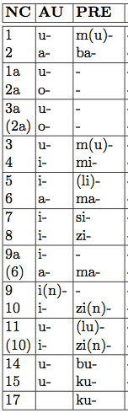

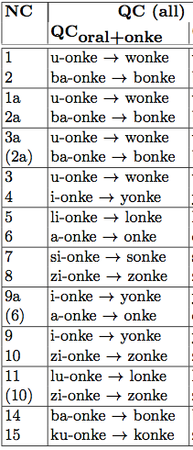


Introduction
Multilingual ontologies
Ontology verbalisation
text
look-up NC pluralise
for-all
Bonke oSolwazi
39/45

Slide 57

Introduction
Multilingual ontologies
Ontology verbalisation
text
... for relevant NC. Here: ngi-
u-
u-
si-
ni-
ba-
AlgoConjugate
Bonke oSolwazi bafundisa
39/45

Slide 58


Introduction
Multilingual ontologies
Ontology verbalisation
Bonke oSolwazi bafundisa Isifundo
39/45

Slide 59

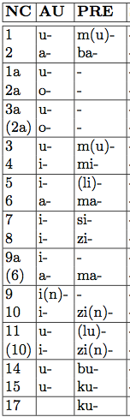
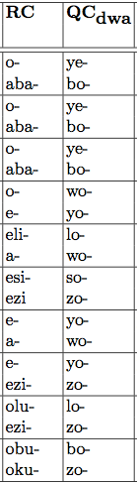

Introduction
Multilingual ontologies
Ontology verbalisation
text
look-up NC
get RC get QC add -dwa
Bonke oSolwazi bafundisa Isifundo esisodwa
39/45

Slide 60
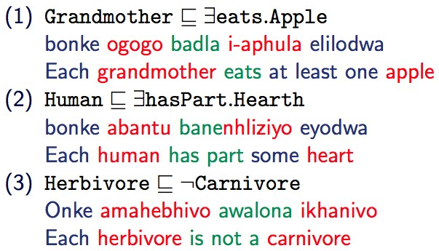
Introduction
Multilingual ontologies
Ontology verbalisation
example
40/45

Slide 61
Introduction
Multilingual ontologies
Ontology verbalisation
How to evaluate?
Typical way of evaluating: ask linguists and/or intended target group
Questions depend on what you want to know; e.g.,
Does the text capture the semantics adequately?
Must it really be grammatically correct or is understandable also acceptable?
Compared against alternate representation (figures, tables) or human-authored text?
41/45

Slide 62
Introduction
Multilingual ontologies
Ontology verbalisation
How to evaluate?
Typical way of evaluating: ask linguists and/or intended target group
Questions depend on what you want to know; e.g.,
Does the text capture the semantics adequately?
Must it really be grammatically correct or is understandable also acceptable?
Compared against alternate representation (figures, tables) or human-authored text?
Survey, asked linguists and non-linguists for their preferences 10 questions pitting the patterns against each other
Online, with isiZulu-localised version of Limesurvey
41/45

Slide 63
Introduction
Multilingual ontologies
Ontology verbalisation
Summary
Introduction
Multilingual ontologies
Ontology verbalisation

Slide 64
Introduction
Multilingual ontologies
Ontology verbalisation
References I
Sonja E. Bosch and Roald Eisele.
The effectiveness of morphological rules for an isiZulu spelling checker.
South African Journal of African Languages, 25(1):25–36, 2005.
M. Curland and T. Halpin.
Model driven development with NORMA.
In Proceedings of the 40th International Conference on System Sciences (HICSS-40), pages 286a–286a. IEEE Computer Society, 2007.
Los Alamitos, Hawaii.
Enrico Franconi, Paolo Guagliardo, and Marco Trevisan.
An intelligent query interface based on ontology navigation.
In Workshop on Visual Interfaces to the Social and Semantic Web (VISSW’10), 2010. Hong Kong, February 2010.
Norbert E. Fuchs, Kaarel Kaljurand, and Tobias Kuhn.
Discourse Representation Structures for ACE 6.6.
Technical Report ifi-2010.0010, Department of Informatics, University of Zurich, Zurich, Switzerland, 2010.
Mustafa Jarrar, C. Maria Keet, and Paolo Dongilli.
Multilingual verbalization of ORM conceptual models and axiomatized ontologies. Starlab technical report, Vrije Universiteit Brussel, Belgium, February 2006.
URL http://www.meteck.org/files/ORMmultiverb_JKD.pdf.
C. M. Keet and L. Khumalo.
Toward a knowledge-to-text controlled natural language of isiZulu.
Language Resources and Evaluation, 51(1):131–157, 2017. doi: 10.1007/s10579-016-9340-0.

Slide 65
Introduction
Multilingual ontologies
Ontology verbalisation
References II
C. Maria Keet and Langa Khumalo.
Toward verbalizing logical theories in isiZulu.
In B. Davis, T. Kuhn, and K. Kaljurand, editors, Proceedings of the 4th Workshop on Controlled Natural Language (CNL’14), volume 8625 of LNAI, pages 78–89. Springer, 2014a.
20-22 August 2014, Galway, Ireland.
C. Maria Keet and Langa Khumalo.
Basics for a grammar engine to verbalize logical theories in isiZulu.
In A. Bikakis et al., editors, Proceedings of the 8th International Web Rule Symposium (RuleML’14), volume 8620 of LNCS, pages 216–225. Springer, 2014b.
August 18-20, 2014, Prague, Czech Republic.
Langa Khumalo.
Advances in developing corpora in African languages.
Kuwala, 1(2):21–30, 2015.
Tobias Kuhn.
A principled approach to grammars for controlled natural languages and predictive editors.
Journal of Logic, Language and Information, 22(1):33–70, 2013.
B. Ndaba, H. Suleman, C. M. Keet, and L. Khumalo.
The effects of a corpus on isizulu spellcheckers based on n-grams.
In Paul Cunningham and Miriam Cunningham, editors, IST-Africa 2016. IIMC International Information Management Corporation, 2016.
11-13 May, 2016, Durban, South Africa.

Slide 66
Introduction
Multilingual ontologies
Ontology verbalisation
References III
D. J. Prinsloo and G.-M. de Schryver.
Spellcheckers for the south african languages, part 2: the utilisation of clusters of circumfixes.
South African Journal of African Languages, §:83–94, 2004.
R. Schwitter, K. Kaljurand, A. Cregan, C. Dolbear, and G. Hart.
A comparison of three controlled natural languages for OWL 1.1. In Proc. of OWLED 2008 DC, 2008.
Washington, DC, USA metropolitan area, on 1-2 April 2008.
Sebastian Spiegler, Andrew van der Spuy, and Peter A. Flach.
Ukwabelana – an open-source morphological zulu corpus.
In Proceedings of the 23rd International Conference on Computational Linguistics (COLING’10), pages 1020–1028. Association for Computational Linguistics, 2010.
Beijing.
Allan Third, Sandra Williams, and Richard Power.
OWL to English: a tool for generating organised easily-navigated hypertexts from ontologies. poster/demo paper, Open Unversity UK, 2011.
10th International Semantic Web Conference (ISWC’11), 23-27 Oct 2011, Bonn, Germany.

