Slide 1
Introduction
Where is it used?
What is an Ontology?
Summary
Ontology Engineering
Lecture 1: Introduction to Knowledge bases, ontologies, and the Semantic Web
Maria Keet
email: mkeet@cs.uct.ac.za
home: http://www.meteck.org
Department of Computer Science University of Cape Town, South Africa
Semester 2, Block I, 2019
1/31

Slide 2
Introduction
Where is it used?
What is an Ontology?
Summary
Outline
1 Introduction
2
Where is it used? ‘Ontology inside’ The Semantic Web
3 What is an Ontology?
2/31

Slide 3
Introduction
Where is it used?
What is an Ontology?
Summary
Outline
1 Introduction
2
Where is it used? ‘Ontology inside’ The Semantic Web
3 What is an Ontology?
3/31

Slide 4
Introduction
Where is it used?
What is an Ontology?
Summary
An ontology (very informally)
classes, relationships between them, and constraints that hold between/for them, with possibly individuals and their relations
as a representation of a particular subject domain
4/31

Slide 5
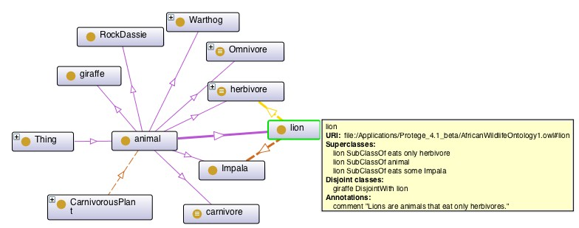
Introduction
Where is it used?
What is an Ontology?
Summary
‘pretty’ picture of a section of the AWO
¡ there’s a lot going on behind the scenes !
5/31

Slide 6
Introduction
Where is it used?
What is an Ontology?
Summary
Conceptual data models vs ontologies
Main differences:
Information needs for one application vs. representing the knowledge of a subject domain (regardless the particular application)
Formalization in a logic language (though one could do that for conceptual models as well)
6/31

Slide 7
Introduction
Where is it used?
What is an Ontology?
Summary
Conceptual data models vs ontologies
Main differences:
Information needs for one application vs. representing the knowledge of a subject domain (regardless the particular application)
Formalization in a logic language (though one could do that for conceptual models as well)
An ontology as a layer on top of conceptual data models
To improve the quality of a conceptual data model (hence, the software)
To facilitate system (database, application software) integration, or prevent the usual data integration problems
6/31

Slide 8
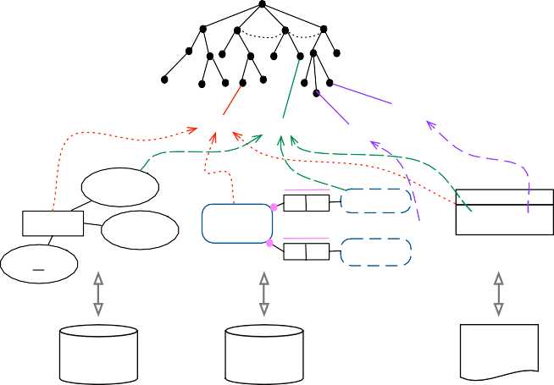




Introduction
Where is it used?
What is an Ontology?
Summary
PD
ED
Q
qt ql _{R}
A
Ontology
provides the common vocabulary and constraints that hold across the applications
AR
NAPO
PR
Pantone ColourRegion
Flower
Colour
Colour
Flower color:String height:inch
Conceptual model shows what is stored in that particular application
Kleur
(datatype: real)
Flower
Bloem (ID)
Height
ID
Lengte
Implementation
the actual information system that stores and manipulates the data
C++
application
Database
Database
7/31

Slide 9
Introduction
Where is it used?
What is an Ontology?
Summary
Databases vs. Knowledge bases
Main differences:
Representation of the knowledge
Rules
Reasoning to infer new or implicit knowledge, detect inconsistencies of the knowledge base
Open World Assumption (vs. Closed World Assumption in databases)
8/31

Slide 10
Introduction
Where is it used?
What is an Ontology?
Summary
What is the usefulness of an ontology?
Making, more or less precisely, the (dis-)agreement among people explicit
Enrich software applications with the additional semantics ⇒ ontology-driven information systems
Thus, practically, improving computer-computer, computer-human, and human-human communication
9/31

Slide 11
Introduction
Where is it used?
What is an Ontology?
Summary
Outline
1 Introduction
2
Where is it used? ‘Ontology inside’ The Semantic Web
3 What is an Ontology?
10/31

Slide 12
Introduction
Where is it used?
What is an Ontology?
Summary
Examples ontologies in information systems
e-learning with Inquire Biology [Chaudhri et al., 2013]: textbook annotated with terms of the ontology, generates questions and answers.
data integration, cultural heritage: combining resources of data and querying them, with a focus on the food system (in the Roman Empire) [Calvanese et al., 2016]
publishing of scientific papers, books: enable navigation and understanding of scholarly documents [Di Iorio et al., 2014]
meta-mining of data mining experiments (sections 1 and 5 of [Keet et al., 2015]): mine the (ontology-based) annotations of the data mining experiments, reason over that to have it propose the optimal data mining experiment
11/31

Slide 13
Introduction
Where is it used?
What is an Ontology?
Summary
More Examples
For science inside the scientific method: Outperforming humans (ontology+reasoner): classification of protein phosphatases [Wolstencroft et al., 2007]
Deep Question-Answering with Watson beating human top-performers in ‘Jeopardy!’; uses over 100 techniques, including ontologies for integration
Ontology-driven conceptual data modelling: being more precise than just drawing diagrams, e.g., on those ‘shared’ and ‘composite’ aggregations in UML Class diagrams [Keet & Artale, 2008], finding contradictions.

Slide 14
Introduction
Where is it used?
What is an Ontology?
Summary
Generalising from the examples:
Data(base) integration
Instance classification
Matchmaking and services
Querying, information retrieval
Ontology-Based Data Access
Ontologies to improve NLP
Bringing more quality criteria into conceptual data modelling to develop a better model (hence, a better quality software system)
Orchestrating the components in semantic scientific workflows, e-learning, etc.

Slide 15
Introduction
Where is it used?
What is an Ontology?
Summary
The Semantic Web – Introduction
(some motivations for ontologies and knowledge bases)
AI put to the test in the (uncontrollable?) very large field
Adding meaning to plain HTML pages and Web 2.0 by using theory and technologies of KBs and ontologies
But there is more to ontologies and knowledge bases than their application in the Semantic Web!
See slides semweb-intro.pdf (bit outdated)
Google’s version of it: its “Knowledge graph”
https://www.youtube.com/watch?v=mmQl6VGvX-c

Slide 16
Introduction
Where is it used?
What is an Ontology?
Summary
Outline
1 Introduction
2
Where is it used? ‘Ontology inside’ The Semantic Web
3 What is an Ontology?

Slide 17
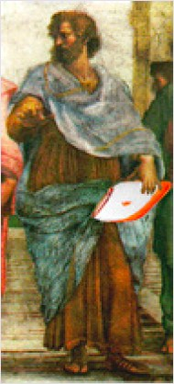
Introduction
Where is it used?
What is an Ontology?
Summary
Background
Aristotle and colleagues: Ontology
Engineering: ontologies (count noun)
Investigating reality, representing it
Putting an engineering artefact to use
What then, is this engineering artefact?
Notes:
source of the figure: http://ontolog.cim3.net/file/resource/presentation/NicolaGuarino\_20060202/DOLCE--NicolaGuarino\_20060202.pdf

Slide 18
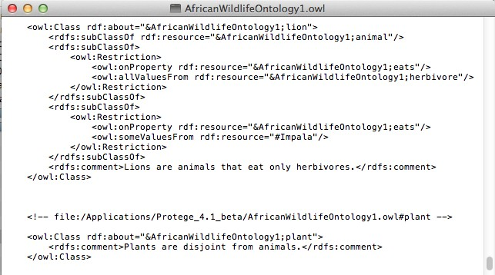
Introduction
Where is it used?
What is an Ontology?
Summary
First, let’s look at an artefact: a text file....

Slide 19
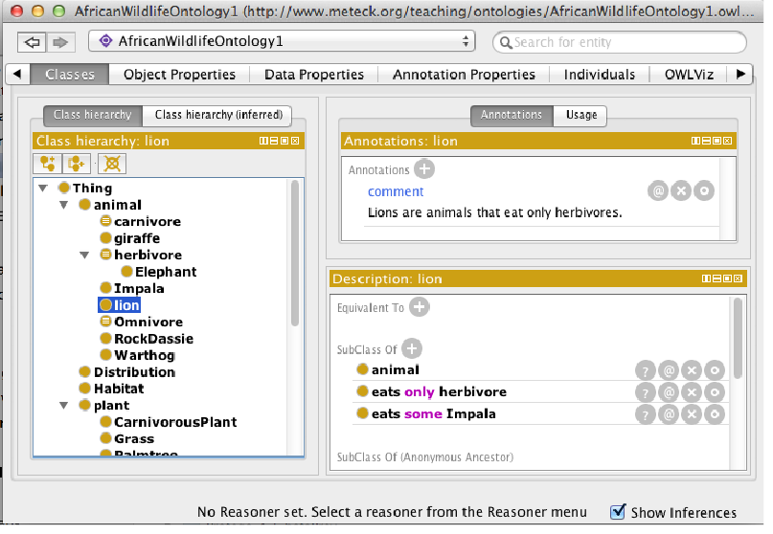
Introduction
Where is it used?
What is an Ontology?
Summary
... or rendered in an ontology editor

Slide 20
Introduction
Where is it used?
What is an Ontology?
Summary
Behind the facade
SubClassOf(awo:lion awo:animal)
SubClassOf(awo:lion ObjectSomeValuesFrom(awo:eats awo:Impala)) SubClassOf(awo:lion ObjectAllValuesFrom(awo:eats awo:herbivore))

Slide 21
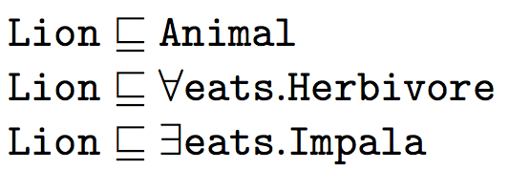
Introduction
Where is it used?
What is an Ontology?
Summary
And behind that serialisation
20/31

Slide 22
Introduction
Where is it used?
What is an Ontology?
Summary
A few definitions on what the text in the file is supposed to stand for
Most cited (but very inadequate definition): “An ontology is a specification of a conceptualization” (by Tom Gruber, 1993)
“a formal specification of a shared conceptualization” (by Borst, 1997)
“An ontology is a formal, explicit specification of a shared conceptualization” (Studer et al., 1998)
What is a conceptualization, and a formal, explicit specification? Why shared?
21/31

Slide 23
Introduction
Where is it used?
What is an Ontology?
Summary
More definitions
More detailed: “An ontology is a logical theory accounting for the intended meaning of a formal vocabulary, i.e. its ontological commitment to a particular conceptualization of the world. The intended models of a logical language using such a vocabulary are constrained by its ontological commitment. An ontology indirectly reflects this commitment (and the underlying conceptualization) by approximating these intended models.” (Guarino, 1998)
And back to a simpler definition: “with an ontology being equivalent to a Description Logic knowledge base” (Horrocks et al, 2003)
22/31

Slide 24
Introduction
Where is it used?
What is an Ontology?
Summary
Description Logic knowledge base
TBox
(Terminology)
Description language (a logic)
Automated reasoning (over the TBox and ABox)
ABox
(Assertions)
Knowledge base
Interaction with user applications
Interaction with other technologies

Slide 25
Introduction
Where is it used?
What is an Ontology?
Summary
From logical to ontological level (1/2)
Logical level (no structure, no constrained meaning¹):
∃x (Apple(x ) ∧ Green(x ))
“there exists an object that is an apple and it is green”
Epistemological level (structure, no constrained meaning):
∃x : apple Green(x ) (many-sorted logics)
“there exists an apple-object that is green”
∃x : green Apple(x )
“there exists a green-object that is an apple”
Apple(a) and hasColor (a, green) (description logics²)
“object a is an apple and that object a has the colour green”
Green(a) and hasShape(a, apple)
"object a is a green and that object a has the shape of an
apple”
¹meaning in the sense of subject domain semantics, not formal semantics
²DL has a model-theoretic semantics, so the axioms have a meaning in that sense of ‘meaning/semantics’
24/31
Notes:
% \vfill
% \hfill {\tiny {\em adapted from (Guarino, 2008)}}

Slide 26
Introduction
Where is it used?
What is an Ontology?
Summary
From logical to ontological level (2/2)
Ontological level (structure, constrained meaning):
Some structuring choices are excluded because of ontological constraints
‘apple objects’ seems better than ‘green objects’
objects having the colour green seems more sensible than having an ‘apple-shape’
There are reasons for that:
Apple carries an identity condition, so one can identify the object somehow (it is a ‘sortal’),
Green does not (is a value [‘qualia’] of the attribute [‘quality’] hasColor that a thing has)
25/31

Slide 27
Introduction
Where is it used?
What is an Ontology?
Summary
From logical to ontological level (2/2)
Ontological level (structure, constrained meaning):
Some structuring choices are excluded because of ontological constraints
‘apple objects’ seems better than ‘green objects’
objects having the colour green seems more sensible than having an ‘apple-shape’
There are reasons for that:
Apple carries an identity condition, so one can identify the object somehow (it is a ‘sortal’),
Green does not (is a value [‘qualia’] of the attribute [‘quality’] hasColor that a thing has)
Put differently: one way of representing things turn out to be better than others.
25/31

Slide 28
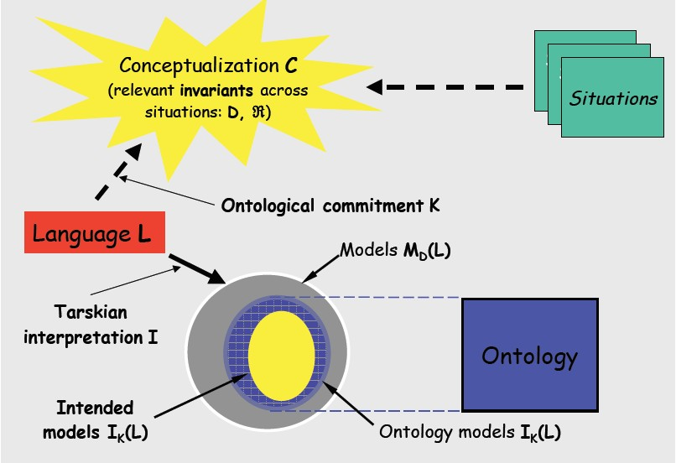
Introduction
Where is it used?
What is an Ontology?
Summary
Ontologies and meaning
Notes:
% \vfill
% {\tiny {\em from http://ontolog.cim3.net/file/resource/presentation/NicolaGuarino\_20060202/DOLCE--NicolaGuarino\_20060202.pdf}}

Slide 29

Introduction
Where is it used?
What is an Ontology?
Summary
Ontologies and reality
Reality

Slide 30
Introduction
Where is it used?
What is an Ontology?
Summary
Quality of the ontology
Good
Less good
what you want to represent
what you do/can represent with the language
Universe
Bad
Worse

Slide 31
Introduction
Where is it used?
What is an Ontology?
Summary
Initial Ontology Dimensions that have Evolved (Ontology Summit 2007)
Semantic
Degree of Formality and Structure
Expressiveness of the Knowledge Representation Language Representational Granularity
Pragmatic
Intended Use
Role of Automated Reasoning
Descriptive vs. Prescriptive
Design Methodology
Governance
29/31
Notes:
%{\tiny slide from, and more details available in:
%\url{http://ontolog.cim3.net/file/work/OntologySummit2007/symposium/OntologyFramework_symposium--Gruninger-Obrst_20070424.ppt}}

Slide 32
Introduction
Where is it used?
What is an Ontology?
Summary
Summary
1 Introduction
2
Where is it used? ‘Ontology inside’ The Semantic Web
3 What is an Ontology?
30/31

Slide 33
Introduction
Where is it used?
What is an Ontology?
Summary
Additional references
Calvanese, D., Liuzzo, P., Mosca, A., Remesal, J, Rezk, M., Rull, G. Ontology-Based Data Integration in
EPNet: Production and Distribution of Food During the Roman Empire. Engineering Applications of Artificial Intelligence, 2016, 51:212-229.
Chaudhri, V.K., Cheng, B., Overholtzer, A, Roschelle, J., Spaulding, A., Clark, P., Greaves, M., Gunning, D.. Inquire Biology: A Textbook that Answers Questions. AI Magazine, 2013, 34(3): 55-72.
Di Iorio, A., Peroni, S., Vitali, F., Zingoni, J. (2014). Semantic lenses to bring digital and semantic publishing together. In Zhao, J., van Erp, M., Kessler, C., Kauppinen, T., van Ossenbruggen, J., van Hage,
W. R. (Eds.), Proceedings of the 4th Workshop on Linked Science (LISC 2014), CEUR Workshop Proceedings 1282: 12-23. Aachen, Germany: CEUR-WS.org.
Keet, C.M., L- awrynowicz, A., d’Amato, C., Kalousis, A., Nguyen, P., Palma, R., Stevens, R., Hilario, M.
The Data Mining OPtimization ontology. Web Semantics: Science, Services and Agents on the World Wide Web, 2015, 32:43-53.
Keet, C.M., Artale, A. Representing and Reasoning over a Taxonomy of Part-Whole Relations. Applied Ontology, 2008, 3(1-2):91-110.
Note: where pictures and figures were taken from elsewhere, a note of the source is made in the LAT_{E}X source file as a comment. If there is no note about the source in that frame, then I made the figure.
31/31

