Slide 1
Introduction
Basic DL: ALC
DL and FOL
Reasoning services
Summary
Ontology Engineering
Lecture 3: Description Logics
Maria Keet
email: mkeet@cs.uct.ac.za
home: http://www.meteck.org
Department of Computer Science University of Cape Town, South Africa
Semester 2, Block I, 2019
1/33

Slide 2
Introduction
Basic DL: ALC
DL and FOL
Reasoning services
Summary
Outline
1 Introduction
2 Basic DL: ALC
Syntax Semantics
3
DL and FOL
4 Reasoning services Standard services Techniques
2/33

Slide 3
Introduction
Basic DL: ALC
DL and FOL
Reasoning services
Summary
Outline
1 Introduction
2 Basic DL: ALC
Syntax Semantics
3
DL and FOL
4 Reasoning services Standard services Techniques
3/33

Slide 4
Introduction
Basic DL: ALC
DL and FOL
Reasoning services
Summary
Why description logics
Just saw FOL, so why the hassle of looking at another logic?
4/33

Slide 5
Introduction
Basic DL: ALC
DL and FOL
Reasoning services
Summary
Why description logics
Just saw FOL, so why the hassle of looking at another logic?
Full FOL is undecidable, which is bad news for scalable implementations
4/33

Slide 6

Introduction
Basic DL: ALC
DL and FOL
Reasoning services
Summary
Why description logics
Just saw FOL, so why the hassle of looking at another logic? Full FOL is undecidable, which is bad news for scalable implementations
yes (w in L) no (w not in L)
input w
Algorithm (Recursive)
A
yes (w in L)
Procedure (Recursively Enumerable)
input w
P
non-Recursively Enumerable
input w
???
4/33

Slide 7
Introduction
Basic DL: ALC
DL and FOL
Reasoning services
Summary
Why description logics
Just saw FOL, so why the hassle of looking at another logic? Full FOL is undecidable, which is bad news for scalable implementations
yes (w in L) no (w not in L)
input w
Algorithm (Recursive)
A
yes (w in L)
Procedure (Recursively Enumerable)
input w
P
non-Recursively Enumerable
input w
???
Multiple applications (recall lecture 1) use OWL, which is actually DL-for-computational-use (except for OWL full)
Need to grasp basics of the language so as to understand what’s going on when developing an ontology (the reasoner output really is not magic)
4/33

Slide 8
Introduction
Basic DL: ALC
DL and FOL
Reasoning services
Summary
What are DLs?
A structured fragment of FOL
Different notation, but very same ideas as we’ve seen in previous lecture
(we’ll get back to the ‘fragment’ aspect later)
(Any (basic) Description Logic is a subset of L₃, i.e., the
function-free FOL using only at most three variable names)
Representation is at the predicate level: no variables are present in the notation (formalism)
Provide theories and systems for declaratively expressing structured information and for accessing and reasoning with it.
Used for, a.o.: terminologies and ontologies, formal conceptual data modelling, information integration, ....
5/33

Slide 9
Introduction
Basic DL: ALC
DL and FOL
Reasoning services
Summary
Description Logic knowledge base
TBox
(Terminology)
Description language (a logic)
Automated reasoning (over the TBox and ABox)
ABox
(Assertions)
Knowledge base
Interaction with user applications
Interaction with other technologies
6/33

Slide 10
Introduction
Basic DL: ALC
DL and FOL
Reasoning services
Summary
Outline
1 Introduction
2 Basic DL: ALC
Syntax Semantics
3
DL and FOL
4 Reasoning services Standard services Techniques
7/33

Slide 11


Introduction
Basic DL: ALC
DL and FOL
Reasoning services
Summary
ALC syntax
Concepts denoting entity types/classes/unary
predicates/universals, including top T and bottom ⊥;
Example: (primitive, atomic): Book, Course
Roles denoting relationships/associations/n-ary predicates/properties;
Example¹: ENROLLED, READS
Constructors: ‘and’ , ‘or’ , and ‘not’ ¬; quantifiers ‘for all’ (each) ∀ and ‘exists’ (at least one/some) ∃
Individuals (objects)
Example: Student(Mandla), Mother(Sally),
¬Student(Sally), ENROLLED(Mandla, CS101/19/2)
¹Capitalisation for roles for notational clarity, but not required
8/33

Slide 12
Introduction
Basic DL: ALC
DL and FOL
Reasoning services
Summary
ALC syntax
Complex concepts using constructors
Let C and D be concept names, R a role name, then
¬C , C D, and C D are concepts, and
∀R.C and ∃R.C are concepts
9/33

Slide 13

Introduction
Basic DL: ALC
DL and FOL
Reasoning services
Summary
ALC syntax
Complex concepts using constructors
Let C and D be concept names, R a role name, then
¬C , C D, and C D are concepts, and
∀R.C and ∃R.C are concepts
Examples:
Student ∃ENROLLED.(Course DegreeProgramme)
this is a primitive concept
Mother Woman ∃PARENTOF.Person
Parent ≡ (Male Female) n ∃PARENTOF.Mammal
∃CARESFOR.Mammal
this is a defined concept
9/33

Slide 14
Introduction
Basic DL: ALC
DL and FOL
Reasoning services
Summary
ALC syntax
Domain and range restrictions of roles
Or: specifying what kind of object the first (domain) and the second (range) object participating in the role has to be.
e.g., SONOF: the domain surely has to be male, and the range is a parent:
∃SONOF.T Male: “any object that has an outgoing relation
SONOF is a male”
T ∀SONOF.Parent: “all objects that have an incoming
relation SONOF are a parent”
∃SONOF⁻.T Parent: “the domain of the inverse of SONOF
(i.e., range of SONOF) is a parent”
10/33

Slide 15
Introduction
Basic DL: ALC
DL and FOL
Reasoning services
Summary
Semantics of ALC
Model-theoretic semantics
Domain ∆ is a non-empty set of objects
Interpretation: ·^{I} is the interpretation function, domain ∆^{I}
·^{I} maps every concept name A to a subset A^{I} ⊆ ∆^{I}
·^{I} maps every role name R to a subset R^{I} ⊆ ∆^{I} × ∆^{I}
·^{I} maps every individual name a to elements of ∆^{I} : a^{I} ∈ ∆^{I}
Note: T^{I} = ∆^{I} and ⊥^{I} = ∅

Slide 16











Introduction
Basic DL: ALC
DL and FOL
Reasoning services
Summary
Semantics of ALC (2/3)
(¬C )^{I} = ∆^{I} \C^{I}
(C n D)^{I} = C^{I} ∩ D^{I}
(C D)^{I} = C^{I} ∪ D^{I}
The cloud-shape is our domain of interpretation with objects Intersection of two concepts
motorised vehicles
bicycles
apples
oranges
Union of two concepts
Concept negation
apples OORR oranges
apples
NOT apples

Slide 17
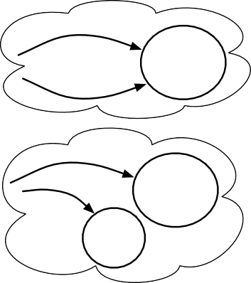

Introduction
Basic DL: ALC
DL and FOL
Reasoning services
Summary
Semantics of ALC
C and D are concepts, R a role
(∀R.C )^{I} = {x | ∀y.R^{I} (x, y ) → C^{I} (y )}
(∃R.C )^{I} = {x | ∃y.R^{I} (x, y ) ∧ C^{I} (y )}
The cloud-shape is our domain of interpretation with objects
SONOF
All SONOF relations relate to a parent
parents
SONOF
At least one DRINKS relation relates to
a can of beer, but there may be other DRINKS relations to other drinks, such as juices
DRINKS
DRINKS
cans of beer
juices

Slide 18
Introduction
Basic DL: ALC
DL and FOL
Reasoning services
Summary
Semantics of ALC
C and D are concepts, R a role, a and b are individuals
An interpretation I satisfies the statement C D if C^{I} ⊆ D^{I}
An interpretation I satisfies the statement C ≡ D if C^{I} = D^{I}
C (a) is satisfied by I if a^{I} ∈ C^{I}
R (a, b) is satisfied by I if (a^{I}, b^{I} ) ∈ R^{I}
An interpretation I = (∆^{I}, ·^{I} ) is a model of a knowledge base
KB if every axiom of KB is satisfied by I
A knowledge base KB is said to be satisfiable if it admits a
model
14/33

Slide 19
Introduction
Basic DL: ALC
DL and FOL
Reasoning services
Summary
Outline
1 Introduction
2 Basic DL: ALC
Syntax Semantics
3
DL and FOL
4 Reasoning services Standard services Techniques

Slide 20
Introduction
Basic DL: ALC
DL and FOL
Reasoning services
Summary
DLs are structured fragments of FOL
Recall that full FOL is undecidable
This is unpleasant for automated reasoning
yes (w in L) no (w not in L)
input w
Algorithm (Recursive)
A
yes (w in L)
Procedure (Recursively Enumerable)
input w
P
non-Recursively Enumerable
input w
???

Slide 21
Introduction
Basic DL: ALC
DL and FOL
Reasoning services
Summary
DLs are structured fragments of FOL
Approach: find a fragment—a sublanguage—of FOL that is decidable
Take some features, prove the computational complexity of some problem
But lets first demonstrate the two are related, so that we can do this

Slide 22
Introduction
Basic DL: ALC
DL and FOL
Reasoning services
Summary
Example correspondences
C D
∀x (C (x ) → D(x ))
C D E
∀x (C (x ) → D(x ) ∧ E (x ))
C ∃R.D
∀x (C (x ) → ∃y (R (x, y ) ∧ D(y ))
C ≡ ∃R.D ∃S.D
∀x (C (x ) ↔ ∃y ((R (x, y ) ∨ S (x, y )) ∧ D(y ))
18/33

Slide 23
Introduction
Basic DL: ALC
DL and FOL
Reasoning services
Summary
DLs are structured fragments of FOL
We end up with trade-offs of features in a DL
Some features always will make the language undecidable (e.g., true role composition, R ◦ S ≡ T )
Other features are only ‘problematic’ (computationally less desirable) when taken together with another
E.g., one could define a language where:
it is prohibited to use ∀ in an axiom, or
only ∃R.T (no range specified) but not ∃R.D, or
∃R only on the rhs of the inclusion but not on the lhs
There are many DLs, and most combinations have been investigated over the past 25 years
Roughly: the fewer features and the more restrictions, the more ‘computationally well-behaved’ the language is
19/33

Slide 24
Introduction
Basic DL: ALC
DL and FOL
Reasoning services
Summary
Outline
1 Introduction
2 Basic DL: ALC
Syntax Semantics
3
DL and FOL
4 Reasoning services Standard services Techniques
20/33

Slide 25
Introduction
Basic DL: ALC
DL and FOL
Reasoning services
Summary
Essential to automated reasoning
The choice of the class of problems the software program has to solve
The formal language in which to represent the problems
The way how the program has to compute the solution How to do this efficiently

Slide 26

Introduction
Basic DL: ALC
DL and FOL
Reasoning services
Summary
Logical implication
KB φ if every model of KB is a model of φ
Example:
TBox: ∃TEACHES.Course ¬Undergrad Professor
ABox: TEACHES(John, cs101), Course(cs101), Undergrad(John)
22/33

Slide 27
Introduction
Basic DL: ALC
DL and FOL
Reasoning services
Summary
Logical implication
KB φ if every model of KB is a model of φ
Example:
TBox: ∃TEACHES.Course ¬Undergrad Professor
ABox: TEACHES(John, cs101), Course(cs101), Undergrad(John)
KB Professor(John)
22/33

Slide 28
Introduction
Basic DL: ALC
DL and FOL
Reasoning services
Summary
Logical implication
KB φ if every model of KB is a model of φ
Example:
TBox: ∃TEACHES.Course ¬Undergrad Professor
ABox: TEACHES(John, cs101), Course(cs101), Undergrad(John)
KB Professor(John)
What if:
TBox: ∃TEACHES.Course Undergrad Professor
ABox: TEACHES(John, cs101), Course(cs101), Undergrad(John)
KB Professor(John)? or perhaps
KB ¬Professor(John)?
22/33

Slide 29

Introduction
Basic DL: ALC
DL and FOL
Reasoning services
Summary
Reasoning services for DL-based OWL ontologies
Concept (and role) satisfiability (KB C ⊥)
Is there a model of KB in which C (resp. R ) has a nonempty
extension?
Consistency of the knowledge base (KB T ⊥)
Is the KB = (T , A) consistent (non-selfcontradictory), i.e., is
there at least a model for KB?
Concept (and role) subsumption (KB C D)
i.e., is the extension of C (resp. R ) contained in the extension
of D (resp. S ) in every model of T ?
Instance checking (KB C (a) or KB R (a, b))
is a (resp. (a, b)) a member of concept C (resp. R ) in KB,
i.e., is the fact C (a) (resp. R (a, b)) satisfied by every interpretation of KB?
Instance retrieval ({a | KB C (a)})
find all members of C in KB, i.e., compute all individuals a s.t.
C (a) is satisfied by every interpretation of KB
23/33

Slide 30
Introduction
Basic DL: ALC
DL and FOL
Reasoning services
Summary
Automated reasoning techniques
How do we compute, say, satisfiability?
24/33

Slide 31
Introduction
Basic DL: ALC
DL and FOL
Reasoning services
Summary
Automated reasoning techniques
How do we compute, say, satisfiability?
Truth tables are too cumbersome
Several techniques are more efficient
Current ‘winner’ is tableau reasoning
24/33

Slide 32
Introduction
Basic DL: ALC
DL and FOL
Reasoning services
Summary
The idea–same as for FOL
A sound and complete procedure deciding satisfiability is all we need, and the tableaux method is a decision procedure which checks the existence of a model
It exhaustively looks at all the possibilities, so that it can eventually prove that no model could be found for unsatisfiable formulas.
φ ψ iff φ ∧ ¬ψ is NOT satisfiable—if it is satisfiable, we have found a counterexample
Decompose the formula in top-down fashion

Slide 33
Introduction
Basic DL: ALC
DL and FOL
Reasoning services
Summary
Basic rules (from previous lecture)
Tableaux calculus works only if the formula has been translated into Negation Normal Form, i.e., all the negations have been pushed inside
If a model satisfies a conjunction, then it also satisfies each of the conjuncts
If a model satisfies a disjunction, then it also satisfies one of the disjuncts. It is a non-deterministic rule, and it generates two alternative branches.
Apply the completion rules until either (a) an explicit contradiction due to the presence of two opposite literals in a node (a clash) is generated in each branch, or (b) there is a completed branch where no more rule is applicable.

Slide 34
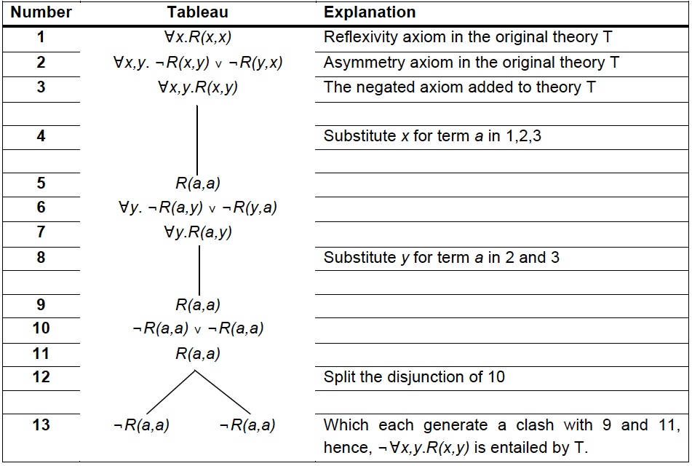
Introduction
Basic DL: ALC
DL and FOL
Reasoning services
Summary
Example (from previous lecture)

Slide 35


Introduction
Basic DL: ALC
DL and FOL
Reasoning services
Summary
Tableau reasoning for DLs
Most common for DL reasoners
Like for FOL:
Unfold the TBox
Convert the result into negation normal form
Apply the tableau rules to generate more Aboxes
Stop when none of the rules are applicable
T C D if all Aboxes contain clashes
T C D if some Abox does not contain a clash

Slide 36
Introduction
Basic DL: ALC
DL and FOL
Reasoning services
Summary
A note on soundness and completeness
“ ”: derivable with a set of inference rules,
“ ” as implies, i.e., every truth assignment that satisfies Γ
also satisfies φ
Completeness: if Γ φ then Γ φ
If the algorithm is incomplete, then there exist entailments that cannot be computed (hence, ‘missing’ some results)
Soundness: if Γ φ then Γ φ
If the algorithm is unsound then false conclusions can be derived from true premises, which his even more undesirable
29/33

Slide 37
Introduction
Basic DL: ALC
DL and FOL
Reasoning services
Summary
Negation Normal Form
C and D are concepts, R a role
¬ only in front of concepts:
¬¬C gives C
¬(C D) gives ¬C D
¬(C D) gives ¬C ¬D
¬(∀R.C ) gives ∃R.¬C
¬(∃R.C ) gives ∀R.¬C
30/33

Slide 38
Introduction
Basic DL: ALC
DL and FOL
Reasoning services
Summary
Tableau rules for ALC
n-rule If (C₁ C₂)(a) ∈ S but S does not contain both C₁(a) and
C₂(a), then
S = S ∪ {C₁(a), C₂(a)}
LJ-rule If (C₁ C₂)(a) ∈ S but S contains neither C₁(a) nor C₂(a),
then
S = S ∪ {C₁(a)}
S = S ∪ {C₂(a)}
∀-rule If (∀R.C )(a) ∈ S and S contains R (a, b) but not C (b), then
S = S ∪ {C (b)}
∃-rule If (∃R.C )(a) ∈ S and there is no b such that C (b) and
R (a, b), then
S = S ∪ {C (b), R (a, b)}

Slide 39
Introduction
Basic DL: ALC
DL and FOL
Reasoning services
Summary
Example
- Let’s say our ontology contains only:
1a Vegan ≡ Person ∀eats.Plant
1b Vegetarian ≡ Person ∀eats.(Plant Dairy )
- We want to know whether all vegans are vegetarians, i.e.:
T Vegan Vegetarian
32/33

Slide 40
Introduction
Basic DL: ALC
DL and FOL
Reasoning services
Summary
Example
- Let’s say our ontology contains only:
1a Vegan ≡ Person ∀eats.Plant
1b Vegetarian ≡ Person ∀eats.(Plant Dairy )
- We want to know whether all vegans are vegetarians, i.e.:
T Vegan Vegetarian
If that’s true, then there is, or can be, an individual that is an instance of both, or:
If that’s true, then some object that instantiates the subclass but not the superclass cannot exist
2 S = {(Vegan ¬Vegetarian)(a)}
32/33

Slide 41
Introduction
Basic DL: ALC
DL and FOL
Reasoning services
Summary
Example
- Let’s say our ontology contains only:
1a Vegan ≡ Person ∀eats.Plant
1b Vegetarian ≡ Person ∀eats.(Plant Dairy )
- We want to know whether all vegans are vegetarians, i.e.:
T Vegan Vegetarian
If that’s true, then there is, or can be, an individual that is an instance of both, or:
If that’s true, then some object that instantiates the subclass but not the superclass cannot exist
2 S = {(Vegan ¬Vegetarian)(a)}
Before entering the tableau, we’ll ‘unfold’ it (informally, here: complex concepts on the left-hand side are replaced with their properties declared on the right-hand side)
32/33

Slide 42
Introduction
Basic DL: ALC
DL and FOL
Reasoning services
Summary
Example
- Let’s say our ontology contains only:
1a Vegan ≡ Person ∀eats.Plant
1b Vegetarian ≡ Person ∀eats.(Plant Dairy )
- We want to know whether all vegans are vegetarians, i.e.:
T Vegan Vegetarian
If that’s true, then there is, or can be, an individual that is an instance of both, or:
If that’s true, then some object that instantiates the subclass but not the superclass cannot exist
2 S = {(Vegan ¬Vegetarian)(a)}
Before entering the tableau, we’ll ‘unfold’ it (informally, here: complex concepts on the left-hand side are replaced with their properties declared on the right-hand side)
Check for NNF and rewrite if needed
Then (finally) apply the tableau rules
32/33

Slide 43
Introduction
Basic DL: ALC
DL and FOL
Reasoning services
Summary
Summary
1 Introduction
2 Basic DL: ALC
Syntax Semantics
3
DL and FOL
4 Reasoning services Standard services Techniques
33/33

