Slide 1
Semantic Parsing: The Task, the State of the Art and the Future
ACL 2010 Tutorial
Uppsala, Sweden
Rohit J. Kate
Department of Computer Science
The University of Texas at Austin
USA
Yuk Wah Wong
Google Inc.
Pittsburgh, PA
USA

Slide 2
Acknowledgements
We thank Raymond Mooney, Ruifang Ge, David Chen, Wei Lu, Hwee Tou Ng and Luke Zettlemoyer for making their slides available to us.

Slide 3
Outline
Introduction to the task of semantic parsing
  Definition of the task
  Examples of application domains and meaning representation languages
  Distinctions from and relations to other NLP tasks
Semantic parsers
  Earlier hand-built systems
  Learning for semantic parsing
  Various forms of supervision
Semantic parsing beyond a sentence
  Learning language from perceptual contexts
  Using discourse contexts for semantic parsing
Research challenges and future directions
  Machine reading of documents: Connecting with knowledge representation
  Applying semantic parsing techniques to the Semantic Web
  Future research directions
Conclusions

Slide 4
Introduction to the Semantic Parsing Task

Slide 5
Semantic Parsing
“Semantic Parsing” is, ironically, a semantically ambiguous term
  Semantic role labeling
  Finding generic relations in text
  Transforming a natural language sentence into its meaning representation
→

Slide 6
Semantic Parsing
Semantic Parsing: Transforming natural language (NL) sentences into computer executable complete meaning representations (MRs) for domain-specific applications
Realistic semantic parsing currently entails domain dependence
Example application domains
  ATIS: Air Travel Information Service
  CLang: Robocup Coach Language
  Geoquery: A Database Query Application

Slide 7

ATIS: Air Travel Information Service
Interface to an air travel database [Price, 1990]
Widely-used benchmark for spoken language understanding
May I see all the flights from Cleveland to Dallas?
Air-Transportation
Show: (Flight-Number)
Origin: (City "Cleveland")
Destination: (City "Dallas")
NA 1439, TQ 23, …
Semantic Parsing
Query

Slide 8
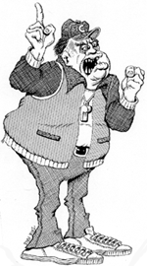
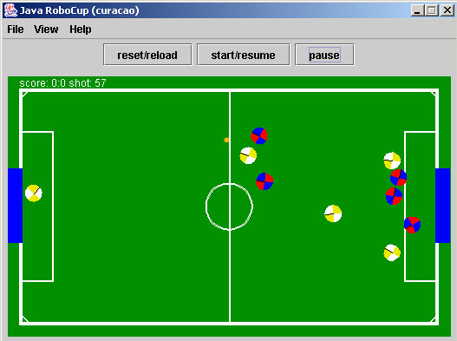
CLang: RoboCup Coach Language
In RoboCup Coach competition teams compete to coach simulated players [http://www.robocup.org]
The coaching instructions are given in a computer language called CLang [Chen et al. 2003]
If the ball is in our goal area then player 1 should intercept it.
Simulated soccer field
Semantic Parsing
(bpos (goal-area our) (do our {1} intercept))
CLang
Notes:
RoboCup is an international AI research initiative which uses robotic soccer as its domain, Several competitions are held every year and one of them is the coach competetion.

Slide 9

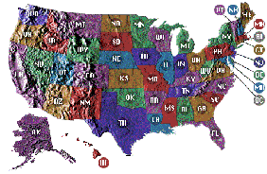
Geoquery: A Database Query Application
Query application for U.S. geography database containing about 800 facts [Zelle & Mooney, 1996]
Which rivers run through the states bordering Texas?
Arkansas, Canadian, Cimarron,
Gila, Mississippi, Rio Grande …
Answer
Semantic Parsing
Query
answer(traverse(next_to(stateid(‘texas’))))

Slide 10
What is the meaning of “meaning”?
Representing the meaning of natural language is ultimately a difficult philosophical question
Many attempts have been made to define generic formal semantics of natural language
  Can they really be complete?
  What can they do for us computationally?
  Not so useful if the meaning of Life is defined as Life’
Our meaning representation for semantic parsing does something useful for an application
Procedural Semantics: The meaning of a sentence is a formal representation of a procedure that performs some action that is an appropriate response
  Answering questions
  Following commands

Slide 11
Meaning Representation Languages
Meaning representation language (MRL) for an application is assumed to be present
MRL is designed by the creators of the application to suit the application’s needs independent of natural language
CLang was designed by RoboCup community to send formal coaching instructions to simulated players
Geoquery’s MRL was based on the Prolog database

Slide 12
Engineering Motivation for Semantic Parsing
Applications of domain-dependent semantic parsing
  Natural language interfaces to computing systems
  Communication with robots in natural language
  Personalized software assistants
  Question-answering systems
Machine learning makes developing semantic parsers for specific applications more tractable
Training corpora can be easily developed by tagging natural-language glosses with formal statements
Notes:
Why is semantic parsing important?

Slide 13
Cognitive Science Motivation for Semantic Parsing
Most natural-language learning methods require supervised training data that is not available to a child
  No POS-tagged or treebank data
Assuming a child can infer the likely meaning of an utterance from context, NL-MR pairs are more cognitively plausible training data

Slide 14
Distinctions from Other NLP Tasks: Deeper Semantic Analysis
Information extraction involves shallow semantic analysis
Show the long email Alice sent me yesterday
Sender | Sent-to | Type | Time
Alice | Me | Long | 7/10/2010

Slide 15
Distinctions from Other NLP Tasks: Deeper Semantic Analysis
Semantic role labeling also involves shallow semantic analysis
sender
recipient
Show the long email Alice sent me yesterday
theme

Slide 16

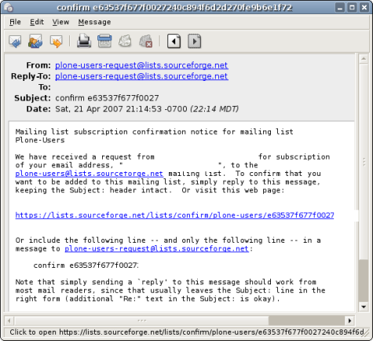
Distinctions from Other NLP Tasks: Deeper Semantic Analysis
Semantic parsing involves deeper semantic analysis to understand the whole sentence for some application
Show the long email Alice sent me yesterday
Semantic Parsing

Slide 17
Distinctions from Other NLP Tasks:
Final Representation
Part-of-speech tagging, syntactic parsing, SRL etc. generate some intermediate linguistic representation, typically for latter processing; in contrast, semantic parsing generates a final representation
sentence
noun phrase
sentence
verb phrase
noun phrase
noun phrase
verb phrase
verb
determiner
adjective
noun
noun
verb
pronoun
noun
Show the long email Alice sent me yesterday

Slide 18
Distinctions from Other NLP Tasks:
Computer Readable Output
The output of some NLP tasks, like question-answering, summarization and machine translation, are in NL and meant for humans to read
Since humans are intelligent, there is some room for incomplete, ungrammatical or incorrect output in these tasks; credit is given for partially correct output
In contrast, the output of semantic parsing is in formal language and is meant for computers to read; it is critical to get the exact output, strict evaluation with no partial credit

Slide 19
Distinctions from Other NLP Tasks
Shallow semantic processing
  Information extraction
  Semantic role labeling
Intermediate linguistic representations
  Part-of-speech tagging
  Syntactic parsing
  Semantic role labeling
Output meant for humans
  Question answering
  Summarization
  Machine translation

Slide 20
Relations to Other NLP Tasks:
Word Sense Disambiguation
Semantic parsing includes performing word sense disambiguation
State
River?
State?
Which rivers run through the states bordering Mississippi?
Semantic Parsing
answer(traverse(next_to(stateid(‘mississippi’))))

Slide 21
Relations to Other NLP Tasks:
Syntactic Parsing
Semantic parsing inherently includes syntactic parsing but as dictated by the semantics
MR: bowner(player(our,2))
A semantic derivation:
bowner(player(our,2))
player(our,2)
bowner(_)
our
player(_,_)
2
bowner(_)
null
our
player
2
has
null
null
the
ball

Slide 22
Relations to Other NLP Tasks:
Syntactic Parsing
Semantic parsing inherently includes syntactic parsing but as dictated by the semantics
MR: bowner(player(our,2))
A semantic derivation:
S-bowner(player(our,2))
NP-player(our,2)
VP-bowner(_)
PRP$-our
NN-player(_,_)
CD-2
VB-bowner(_)
null
our
player
2
has
null
null
the
ball

Slide 23
Relations to Other NLP Tasks:
Machine Translation
The MR could be looked upon as another NL [Papineni et al., 1997; Wong & Mooney, 2006]
Which rivers run through the states bordering Mississippi?
answer(traverse(next_to(stateid(‘mississippi’))))

Slide 24
Relations to Other NLP Tasks:
Natural Language Generation
Reversing a semantic parsing system becomes a natural language generation system [Jacobs, 1985; Wong & Mooney, 2007a]
Which rivers run through the states bordering Mississippi?
Semantic Parsing
NL Generation
answer(traverse(next_to(stateid(‘mississippi’))))

Slide 25
Relations to Other NLP Tasks
Tasks being performed within semantic parsing
  Word sense disambiguation
  Syntactic parsing as dictated by semantics
Tasks closely related to semantic parsing
  Machine translation
  Natural language generation

Slide 26
References
Chen et al. (2003) Users manual: RoboCup soccer server manual for soccer server version 7.07 and later. Available at http://sourceforge.net/projects/sserver/
P. Jacobs (1985). PHRED: A generator for natural language interfaces. Comp. Ling., 11(4):219-242.
K. Papineni, S. Roukos, T. Ward (1997). Feature-based language understanding. In Proc. of EuroSpeech, pp. 1435-1438. Rhodes, Greece.
P. Price (1990). Evaluation of spoken language systems: The ATIS domain. In Proc. of the Third DARPA Speech and Natural Language Workshop, pp. 91-95.
Y. W. Wong, R. Mooney (2006). Learning for semantic parsing with statistical machine translation. In Proc. of HLT-NAACL, pp. 439-446. New York, NY.
Y. W. Wong, R. Mooney (2007a). Generation by inverting a semantic parser that uses statistical machine translation. In Proc. of NAACL-HLT, pp. 172-179. Rochester, NY.
J. Zelle, R. Mooney (1996). Learning to parse database queries using inductive logic programming. In Proc. of AAAI, pp. 1050-1055. Portland, OR.

Slide 27
Outline
Introduction to the task of semantic parsing
  Definition of the task
  Examples of application domains and meaning representation languages
  Distinctions from and relations to other NLP tasks
Semantic parsers
  Earlier hand-built systems
  Learning for semantic parsing
  Various forms of supervision
Semantic parsing beyond a sentence
  Learning language from perceptual contexts
  Using discourse contexts for semantic parsing
Research challenges and future directions
  Machine reading of documents: Connecting with knowledge representation
  Applying semantic parsing techniques to the Semantic Web
  Future research directions
Conclusions

Slide 28
Earlier Hand-Built Systems

Slide 29
Lunar (Woods et al., 1972)
English as a query language for a 13,000-entry lunar geology database
  As opposed to English-like formal languages
Syntactic analysis followed by semantic interpretation
Meaning representation: Non-standard logic with quantifiers modeled on English determiners
System contains:
  Grammar for a subset of English
  Semantic interpretation rules
  Dictionary of 3,500 words

Slide 30
Lunar (Woods et al., 1972)
How many breccias contain olivine
(FOR THE X12 /
(SEQL
(NUMBER X12 / (SEQ TYPECS) :
(CONTAIN X12 (NPR* X14 / (QUOTE OLIV))
(QUOTE NIL)))) : T ;
(PRINTOUT X12))
(5)
What are they
(FOR EVERY X12 / (SEQ TYPECS) :
(CONTAIN X12 (NPR* X14 / (QUOTE OLIV))
(QUOTE NIL)) ; (PRINTOUT X12))
S10019, S10059, S10065, S10067, S10073

Slide 31
Chat-80 (Warren & Pereira, 1982)
Interface to a 1,590-entry world geography database
Translating English into logical forms:
  Syntactic analysis
  Slot filling
  Quantification scoping
Query planning: Transforming logical forms into efficient Prolog programs
Meaning representation: Prolog with standard quantifiers
System contains:
  Dictionary of 100 domain dependent words
  Dictionary of 50 domain independent words
  Grammar rules

Slide 32
Chat-80 (Warren & Pereira, 1982)
Which countries bordering the Mediterranean border Asian countries?
Logical form:
answer(C) <= country(C) & borders(C, mediterranean) & exists(C1, country(C1) & asian(C1) & borders(C, C1))
After query planning:
answer(C) <= borders(C, mediterranean) & {country(C)} & {borders(C, C1) & {asian(C1) & {country(C1)}}}
[Reads: Generate C bordering the mediterranean, then check that C is a country, and then check that it is possible to generate C1 bordering C, and then check that …]

Slide 33
Tina (Seneff, 1992)
System contains:
  Context-free grammar augmented with features that enforce syntactic and semantic constraints
  Trained probabilities for transition networks
Ported to multiple domains:
  Resource management
  City navigation
  Air travel
Porting to a new domain:
  Parse new sentences one by one
  Add context-free rules whenever a parse fails
  Requires familiarity with grammar structure
  Takes one person-month

Slide 34
Tina (Seneff, 1992)
What street is the Hyatt on?
SENTENCE
Q-SUBJECT
BE-QUESTION
LINK
SUBJECT
PRED-ADJUNCT
ARTICLE
A-PLACE
ON-STREET
A-HOTEL
WHAT
STREET
HOTEL-NAME
ON
A-STREET
What
street
is
the
Hyatt
on
Q-SUBJECT

Slide 35
References
J. Dowding, R. Moore, F. Andry, D. Moran (1994). Interleaving syntax and semantics in an efficient bottom-up parser. In Proc. of ACL, pp. 110-116. Las Cruces, NM.
S. Seneff (1992). TINA: A natural language system for spoken language applications. Comp. Ling., 18(1):61-86.
W. Ward, S. Issar (1996). Recent improvement in the CMU spoken language understanding system. In Proc. of the ARPA HLT Workshop, pp. 213-216.
D. Warren, F. Pereira (1982). An efficient easily adaptable system for interpreting natural language queries. American Journal of CL, 8(3-4):110-122.
W. Woods, R. Kaplan, B. Nash-Webber (1972). The lunar sciences natural language information system: Final report. Tech. Rep. 2378, BBN Inc., Cambridge, MA.

Slide 36
Outline
Introduction to the task of semantic parsing
  Definition of the task
  Examples of application domains and meaning representation languages
  Distinctions from and relations to other NLP tasks
Semantic parsers
  Earlier hand-built systems
  Learning for semantic parsing
    Semantic parsing learning task
    Early semantic parser learners
    Recent semantic parser learners
    Exploiting syntax for semantic parsing
    Underlying commonalities and differences between semantic parsers
  Various forms of supervision
Semantic parsing beyond a sentence
  Learning language from perceptual contexts
  Using discourse contexts for semantic parsing
Research challenges and future directions
  Machine reading of documents: Connecting with knowledge representation
  Applying semantic parsing techniques to the Semantic Web
  Future research directions
Conclusions

Slide 37
Learning for Semantic Parsing

Slide 38
Motivations
Manually programming robust semantic parsers is difficult
It is easier to develop training corpora by associating natural-language sentences with meaning representations
The increasing availability of training corpora, and the decreasing cost of computation, relative to engineering cost, favor the learning approach

Slide 39
Learning Semantic Parsers
Training Sentences &
Meaning Representations
Semantic Parser Learner
Sentences
Meaning Representations
Semantic Parser

Slide 40
Data Collection for ATIS
Air travel planning scenarios (Hirschman, 1992)
You have 3 days for job hunting, and you have arranged job interviews in 2 different cities! Start from City-A and plan the flight and ground transportation itinerary to City-B and City-C, and back home to City-A.
Use of human wizards:
  Subjects were led to believe they were talking to a fully automated systems
  Human transcription and error correction behind the scene
A group at SRI responsible for database reference answers
Collected more than 10,000 utterances and 1,000 sessions for ATIS-3

Slide 41
Sample Session in ATIS
may i see all the flights from cleveland to , dallas
can you show me the flights that leave before noon , only
could you sh- please show me the types of aircraft used on these flights
Air-Transportation
Show: (Aircraft)
Origin: (City "Cleveland")
Destination: (City "Dallas")
Departure-Time: (< 1200)

Slide 42
Chanel (Kuhn & De Mori, 1995)
Consists of a set of decision trees
Each tree builds part of a meaning representation
Some trees decide whether a given attribute should be displayed in query results
Some trees decide the semantic role of a given substring
  Each correpsonds to a query constraint

Slide 43
Chanel (Kuhn & De Mori, 1995)
show me TIME flights from CITY1 to CITY2 and how much they cost
Tree 1:
Display aircraft_code?
Tree 23:
Display fare_id?
Tree 114:
Display booking_class?
CITY tree:
For each CITY: origin, dest, or stop?
TIME tree:
For each TIME: arrival or departure?
Display Attributes: {flight_id, fare_id}
Constraints: {from_airport = CITY1,
to_airport = CITY2, departure_time = TIME}

Slide 44
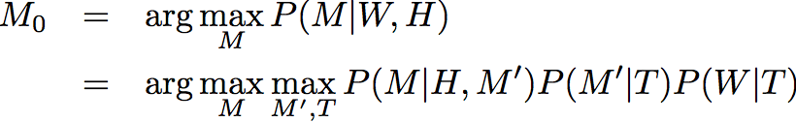
Statistical Parsing (Miller et al., 1996)
Find most likely meaning M₀, given words W and history H
(M': pre-discourse meaning, T: parse tree)
Three successive stages: parsing, semantic interpretation, and discourse
Parsing model similar to Seneff (1992)
  Requires annotated parse trees for training

Slide 45
Statistical Parsing (Miller et al., 1996)
/wh-question
flight
/np
arrival
/vp
flight-constraints
/rel-clause
departure
/vp
flight
/corenp
departure
/pp
location
/pp
time
/wh-head
/aux
/det
flight
/np-head
/comp
departure
/vp-head
departure
/prep
city
/npr
arrival
/vp-head
location
/prep
city
/npr
When
do
the
flights
that
leave
from
Boston
arrive
in
Atlanta

Slide 46
Machine Translation
Translation from a natural-language source sentence to a formal-language target sentence
Papineni et al. (1997), Macherey et al. (2001)
@destination
@origin
@train_determination
@want_question
@hello
@yes
ja
tag
ich
eine
nach
von
$CITY
guten
$CITY
bräuchte
Verbindung

Slide 47
Other Approaches
Inductive logic programming (Zelle & Mooney, 1996)
Hierarchical translation (Ramaswamy & Kleindienst, 2000)
Composite of HMM and CFG (Wang & Acero, 2003)
Hidden vector state model (He & Young, 2006)
Constraint satisfaction (Popescu, 2004)

Slide 48
Recent Approaches
Different levels of supervision
  Ranging from fully supervised to unsupervised
Advances in machine learning
  Structured learning
  Kernel methods
Grammar formalisms
  Combinatory categorial grammars
  Sychronous grammars
Unified framework for handling various phenomena
  Spontaneous speech
  Discourse
  Perceptual context
  Generation

Slide 49
References
Y. He, S. Young (2006). Spoken language understanding using the hidden vector state model. Speech Communication, 48(3-4):262-275.
L. Hirschman (1992). Multi-site data collection for a spoken language corpus. In Proc. of HLT Workshop on Speech and Natural Language, pp. 7-14. Harriman, NY.
R. Kuhn, R. De Mori (1995). The application of semantic classification trees to natural language understanding. IEEE Trans. on PAMI, 17(5):449-460.
K. Macherey, F. Och, H. Ney (2001). Natural language understanding using statistical machine translation. In Proc. of Eurospeech, pp. 2205-2208. Aalborg, Denmark.
S. Miller, D. Stallard, R. Bobrow, R. Schwartz (1996). A fully statistical approach to natural language interfaces. In Proc. of ACL, pp. 55-61. Santa Cruz, CA.
K. Papineni, S. Roukos, T. Ward (1997). Feature-based language understanding. In Proc. of Eurospeech, pp. 1435-1438. Rhodes, Greece.

Slide 50
References
A. Popescu, A. Armanasu, O. Etzioni, D. Ko, A. Yates (2004). Modern natural language interfaces to databases: Composing statistical parsing with semantic tractability. In Proc. of COLING. Geneva, Switzerland.
G. Ramaswamy, J. Kleindienst (2000). Hierarchical feature-based translation for scalable natural language understanding. In Proc. of ICSLP.
Y. Wang, A. Acero (2003). Combination of CFG and n-gram modeling in semantic grammar learning. In Proc. of Eurospeech, pp. 2809-2812. Geneva, Switzerland.
J. Zelle, R. Mooney (1996). Learning to parse database queries using inductive logic programming. In Proc. of AAAI, pp. 1050-1055. Portland, OR.

Slide 51
Outline
Introduction to the task of semantic parsing
  Definition of the task
  Examples of application domains and meaning representation languages
  Distinctions from and relations to other NLP tasks
Semantic parsers
  Earlier hand-built systems
  Learning for semantic parsing
    Semantic parsing learning task
    Early semantic parser learners
    Recent semantic parser learners
    Exploiting syntax for semantic parsing
    Underlying commonalities and differences between semantic parsers
  Various forms of supervision
Semantic parsing beyond a sentence
  Learning language from perceptual contexts
  Using discourse contexts for semantic parsing
Research challenges and future directions
  Machine reading of documents: Connecting with knowledge representation
  Applying semantic parsing techniques to the Semantic Web
  Future research directions
Conclusions

Slide 52
Outline
Zettlemoyer & Collins (2005, 2007)
  Structured learning with combinatory categorial grammars (CCG)
Wong & Mooney (2006, 2007a, 2007b)
  Syntax-based machine translation methods
Kate & Mooney (2006), Kate (2008a)
  SVM with kernels for robust semantic parsing
Lu et al. (2008)
  A generative model for semantic parsing
Ge & Mooney (2005, 2009)
  Exploiting syntax for semantic parsing

Slide 53
Semantic Parsing using CCG

Slide 54
Combinatory Categorial Grammar
Highly structured lexical entries
A few general parsing rules (Steedman, 2000; Steedman & Baldridge, 2005)
Each lexical entry is a word paired with a category
Texas := NP
borders := (S \ NP) / NP
Mexico := NP
New Mexico := NP

Slide 55
Parsing Rules (Combinators)
Describe how adjacent categories are combined
Functional application:
A / B | B | ⇒ | A | (>)
B | A \ B | ⇒ | A | (<)
Texas
borders
New Mexico
NP
(S \ NP) / NP
NP
>
S \ NP
<
S

Slide 56
CCG for Semantic Parsing
Extend categories with semantic types
Functional application with semantics:
Texas := NP : texas
borders := (S \ NP) / NP : λx.λy.borders(y, x)
A / B : f | B : a | ⇒ | A : f(a) | (>)
B : a | A \ B : f | ⇒ | A : f(a) | (<)

Slide 57
Sample CCG Derivation
Texas
borders
New Mexico
NP
texas
(S \ NP) / NP
λx.λy.borders(y, x)
NP
new_mexico
>
S \ NP
λy.borders(y, new_mexico)
<
S
borders(texas, new_mexico)

Slide 58
Another Sample CCG Derivation
Texas
borders
New Mexico
NP
texas
(S \ NP) / NP
λx.λy.borders(y, x)
NP
mexico
>
S \ NP
λy.borders(y, mexico)
<
S
borders(texas, mexico)

Slide 59
Probabilistic CCG for Semantic Parsing
Zettlemoyer & Collins (2005)
L (lexicon) =
w (feature weights)
Features:
  f_{i}(x, d): Number of times lexical item i is used in derivation d
Log-linear model: P_{w}(d | x) ∝ exp(w . f(x, d))
Best derviation: d* = argmax_{d} w . f(x, d)
  Consider all possible derivations d for the sentence x given the lexicon L
Texas := NP : texas
borders := (S \ NP) / NP : λx.λy.borders(y, x)
Mexico := NP : mexico
New Mexico := NP : new_mexico

Slide 60
Learning Probabilistic CCG
Training Sentences &
Logical Forms
Lexical Generation
Lexicon L
Parameter Estimation
Feature weights w
Sentences
Logical Forms
CCG Parser

Slide 61
Lexical Generation
Input:
Output lexicon:
Texas borders New Mexico
borders(texas, new_mexico)
Texas := NP : texas
borders := (S \ NP) / NP : λx.λy.borders(y, x)
New Mexico := NP : new_mexico

Slide 62
Lexical Generation
Input sentence:
Texas borders New Mexico
Output substrings:
Texas
borders
New
Mexico
Texas borders
borders New
New Mexico
Texas borders New
…
Input logical form:
borders(texas, new_mexico)
Output categories:
NP : texas
NP : new _mexico
(S \ NP) / NP : λx.λy.borders(y, x)
(S \ NP) / NP : λx.λy.borders(x, y)
…
×

Slide 63
Category Rules
Input Trigger | Output Category
constant c | NP : c
arity one predicate p | N : λx.p(x)
arity one predicate p | S \ NP : λx.p(x)
arity two predicate p | (S \ NP) / NP : λx.λy.p(y, x)
arity two predicate p | (S \ NP) / NP : λx.λy.p(x, y)
arity one predicate p | N / N : λg.λx.p(x) ∧ g(x)
arity two predicate p and constant c | N / N : λg.λx.p(x, c) ∧ g(x)
arity two predicate p | (N \ N) / NP : λx.λg.λy.p(y, x) ∧ g(x)
arity one function f | NP / N : λg.argmax/min(g(x), λx.f(x))
arity one function f | S / NP : λx.f(x)

Slide 64

Parameter Estimation
Maximum conditional likelihood
Derivations d are not annotated, treated as hidden variables
Stochastic gradient ascent (LeCun et al., 1998)
Keep only those lexical items that occur in the highest scoring derivations of training set

Slide 65
Results
Test for correct logical forms
Precision: # correct / total # parsed sentences
Recall: # correct / total # sentences
For Geoquery, 96% precision, 79% recall
Low recall due to incomplete lexical generation:
  Through which states does the Mississippi run?

Slide 66
Relaxed CCG for Spontaneous Speech
Zettlemoyer & Collins (2007)
Learned CCG works well for grammatical sentences
Works less well for spontaneous speech
Problems:
  Flexible word order
  Missing content words
Show me
the latest
flight
from Boston
to Prague
on Friday
S / NP
NP / N
N
N \ N
N \ N
N \ N
Boston
to Prague
the latest
on Friday
NP
N \ N
NP / N
N \ N

Slide 67
Flexible Word Order
Functional application:
Disharmonic application:
A / B : f | B : a | ⇒ | A : f(a) | (>)
B : a | A \ B : f | ⇒ | A : f(a) | (<)
A \ B : f | B : a | ⇒ | A : f(a) | (>≈)
B : a | A / B : f | ⇒ | A : f(a) | (<≈)
flights
one way
N
λx.flight(x)
N / N
λf.λx.f(x) ∧ one_way(x)
<≈
N
λx.flight(x) ∧ one_way(x)

Slide 68
Missing Content Words
Role-hypothesizing type shifting:
NP : c | ⇒ | N \ N : λf.λx.f(x) ∧ p(x, c) | (T_{R})
flights
Boston
to Prague
N
λx.flight(x)
NP
BOS
N \ N
λf.λx.f(x) ∧ to(x, PRG)
T_{R}
N \ N
λf.λx.f(x) ∧ from(x, BOS)
<
N
λx.flight(x) ∧ from(x, BOS)
<
N
λx.flight(x) ∧ from(x, BOS) ∧ to(x, PRG)

Slide 69
Complete Derivation
Boston
to Prague
the latest
on Friday
NP
BOS
N \ N
λf.λx.f(x) ∧ to(x, PRG)
NP / N
λf.argmax(λx.f(x), λx.time(x))
N \ N
λf.λx.f(x) ∧ day(x, FRI)
T_{R}
T_{N}
N \ N
λf.λx.f(x) ∧ from(x, BOS)
N
λx.day(x, FRI)
<B
N \ N
λf.λx.f(x) ∧ from(x, BOS) ∧ to(x, PRG)
<≈B
NP \ N
λf.argmax(λx.f(x) ∧ from(x, BOS) ∧ to(x, PRG), λx.time(x))
>≈
NP
argmax(λx.from(x, BOS) ∧ to(x, PRG) ∧ day(x, FRI), λx.time(x))

Slide 70
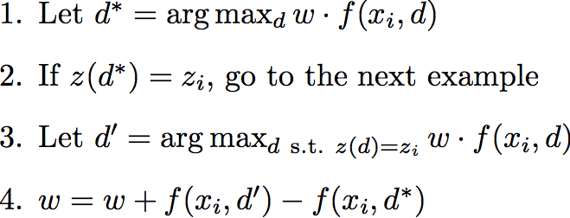
Parameter Estimation
New parsing rules can significantly relax word order
  Introduce features to count the number of times each new parsing rule is used in a derivation
Error-driven, perceptron-style parameter updates

Slide 71
Results
For ATIS, 91% precision, 82% recall
For Geoquery, 95% precision, 83% recall
  Up from 79% recall

Slide 72
References
Y. LeCun, L. Bottou, Y. Bengio, P. Haffner (1998). Gradient-based learning applied to document recognition. In Proc. of the IEEE, 86(11):2278-2324.
M. Steedman (2000). The Syntactic Process. MIT Press.
M. Steedman, J. Baldridge (2005). Combinatory categorial grammar. To appear in: R. Borsley, K. Borjars (eds.) Non-Transformational Syntax, Blackwell.
L. Zettlemoyer, M. Collins (2005). Learning to map sentences to logical form: Structured classification with probabilistic categorial grammars. In Proc. of UAI. Edinburgh, Scotland.
L. Zettlemoyer, M. Collins (2007). Online learning of relaxed CCG grammars for parsing to logical form. In Proc. of EMNLP-CoNLL, pp. 678-687. Prague, Czech Republic.

Slide 73
Semantic Parsing vs Machine Translation

Slide 74
WASP: A Machine Translation Approach to Semantic Parsing
Wong & Mooney (2006)
Based on a semantic grammar of the natural language
Uses machine translation techniques
  Synchronous context-free grammars (SCFG)
  Word alignments (Brown et al., 1993)

Slide 75
Synchronous Context-Free Grammar
Developed by Aho & Ullman (1972) as a theory of compilers that combines syntax analysis and code generation in one phase
  Formal to formal languages
Used for syntax-based machine translation (Wu, 1997; Chiang 2005)
  Natural to natural languages
Generates a pair of strings in a derivation

Slide 76
Context-Free Semantic Grammar
QUERY
QUERY → What is CITY
What
is
CITY
CITY → the capital CITY
CITY → of STATE
the
capital
CITY
STATE → Ohio
of
STATE
Ohio

Slide 77
Sample SCFG Production
Natural language
Formal language
QUERY → What is CITY / answer(CITY)

Slide 78
Sample SCFG Derivation
QUERY
QUERY

Slide 79
Sample SCFG Derivation
QUERY
QUERY
What
is
CITY
answer ( CITY )
QUERY → What is CITY / answer(CITY)

Slide 80
Sample SCFG Derivation
QUERY
QUERY
What
is
CITY
answer ( CITY )
the
capital
CITY
capital ( CITY )
of
STATE
loc_2 ( STATE )
Ohio
stateid ( 'ohio' )
What is the capital of Ohio
answer(capital(loc_2(stateid('ohio'))))

Slide 81
Another Sample SCFG Derivation
QUERY
QUERY
What
is
CITY
answer ( CITY )
the
capital
CITY
capital ( CITY )
of
RIVER
loc_2 ( RIVER )
Ohio
riverid ( 'ohio' )
What is the capital of Ohio
answer(capital(loc_2(riverid('ohio'))))

Slide 82
Probabilistic SCFG for Semantic Parsing
S (start symbol) = QUERY
L (lexicon) =
w (feature weights)
Features:
  f_{i}(x, d): Number of times production i is used in derivation d
Log-linear model: P_{w}(d | x) ∝ exp(w . f(x, d))
Best derviation: d* = argmax_{d} w . f(x, d)
QUERY → What is CITY / answer(CITY)
CITY → the capital CITY / capital(CITY)
CITY → of STATE / loc_2(STATE)
STATE → Ohio / stateid('ohio')

Slide 83
Learning Probabilistic SCFG
Training Sentences &
Meaning Representations
Unambiguous CFG for
Meaning Representations
Lexical Acquisition
Lexicon L
Parameter Estimation
Feature weights w
Sentences
Meaning Representations
SCFG Parser

Slide 84
Lexical Acquisition
SCFG productions are extracted from word alignments between training sentences and their meaning representations
The goalie should always stay in our half
( ( true ) ( do our { 1 } ( pos ( half our ) ) ) )

Slide 85
Extracting SCFG Productions
The
RULE → (CONDITION DIRECTIVE)
goalie
CONDITION → (true)
should
DIRECTIVE → (do TEAM {UNUM} ACTION)
always
TEAM → our
stay
UNUM → 1
in
ACTION → (pos REGION)
our
REGION → (half TEAM)
half
TEAM → our

Slide 86
Extracting SCFG Productions
The
RULE → (CONDITION DIRECTIVE)
goalie
CONDITION → (true)
should
DIRECTIVE → (do TEAM {UNUM} ACTION)
always
TEAM → our
stay
UNUM → 1
in
ACTION → (pos REGION)
TEAM
REGION → (half TEAM)
half
TEAM → our / our

Slide 87
Extracting SCFG Productions
The
RULE → (CONDITION DIRECTIVE)
goalie
CONDITION → (true)
should
DIRECTIVE → (do TEAM {UNUM} ACTION)
always
TEAM → our
stay
UNUM → 1
in
ACTION → (pos REGION)
TEAM
REGION → (half TEAM)
half

Slide 88
Extracting SCFG Productions
The
RULE → (CONDITION DIRECTIVE)
goalie
CONDITION → (true)
should
DIRECTIVE → (do TEAM {UNUM} ACTION)
always
TEAM → our
stay
UNUM → 1
in
ACTION → (pos REGION)
REGION
REGION → TEAM half / (half TEAM)

Slide 89
Output SCFG Productions
TEAM → our / our
REGION → TEAM half / (half TEAM)
ACTION → stay in REGION / (pos REGION)
UNUM → goalie / 1
RULE → [the] UNUM should always ACTION / ((true) (do our {UNUM} ACTION))
Phrases can be non-contiguous

Slide 90
Handling Logical Forms with Variables
Wong & Mooney (2007b)
FORM → state / λx.state(x)
FORM → by area / λx.λy.area(x, y)
FORM → [the] smallest FORM FORM
/ λx.smallest(y, (FORM(x), FORM(x, y))
QUERY → what is FORM
/ answer(x, FORM(x))
Operators for variable binding

Slide 91
Generation by Inverting WASP
Wong & Mooney (2007a)
Mapping a meaning representation to natural language
Can be seen as inverse of semantic parsing
Same synchronous grammar is used for both semantic parsing and generation
Output
Input
QUERY → What is CITY / answer(CITY)

Slide 92
Generation by Inverting WASP
Same procedure for lexical acquisition
Chart generator is very similar to chart parser, but treats meaning representations as input
Input can be logical forms with variables
Log-linear probabilistic model inspired by Pharaoh (Koehn et al., 2003), a phrase-based MT system
  Uses a bigram language model for target language
Resulting system is called WASP⁻¹

Slide 93
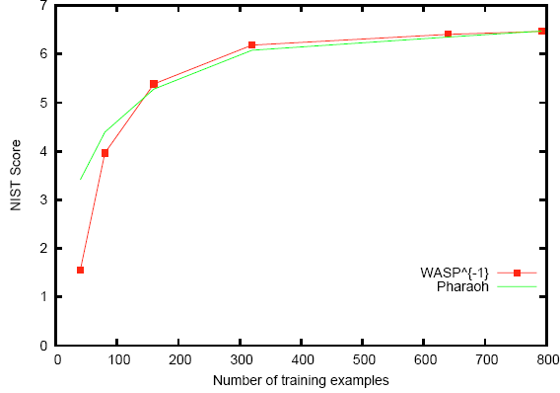
NIST Scores for Geoquery

Slide 94
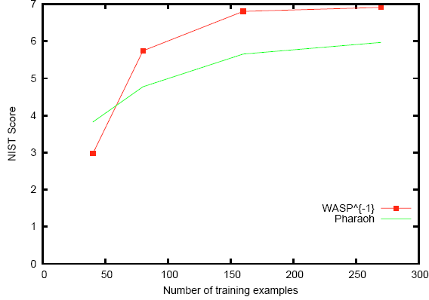
NIST Score for RoboCup

Slide 95
References
A. Aho, J. Ullman (1972). The Theory of Parsing, Translation, and Compiling. Prentice Hall.
P. Brown, V. Della Pietra, S. Della Pietra, R. Mercer (1993). The mathematics of statistical machine translation: Parameter estimation. Comp. Ling., 19(2):263-312.
D. Chiang (2005). A hierarchical phrase-based model for statistical machine translation. In Proc. of ACL, pp. 263-270. Ann Arbor, MI.
P. Koehn, F. Och, D. Marcu (2003). Statistical phrase-based translation. In Proc. of HLT-NAACL. Edmonton, Canada.
Y. W. Wong, R. Mooney (2006). Learning for semantic parsing with statistical machine translation. In Proc. of HLT-NAACL, pp. 439-446. New York, NY.

Slide 96
References
Y. W. Wong, R. Mooney (2007a). Generation by inverting a semantic parser that uses statistical machine translation. In Proc. of NAACL-HLT, pp. 172-179. Rochester, NY.
Y. W. Wong, R. Mooney (2007b). Learning synchronous grammars for semantic parsing with lambda calculus. In Proc. of ACL, pp. 960-967. Prague, Czech Republic.
D. Wu (1997). Stochastic inversion transduction grammars and bilingual parsing of parallel corpora. Comp. Ling., 23(3):377-403.

Slide 97
Semantic Parsing Using Kernels

Slide 98
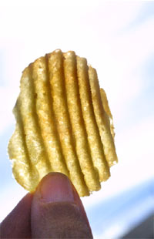
KRISP: Kernel-based Robust Interpretation for Semantic Parsing
Kate & Mooney (2006), Kate (2008a)
Learns semantic parser from NL sentences paired with their respective MRs given MRL grammar
Productions of MRL are treated like semantic concepts
A string classifier is trained for each production to estimate the probability of an NL string representing its semantic concept
These classifiers are used to compositionally build MRs of the sentences
Notes:
Key idea is that the productions of MRL are..

Slide 99
Meaning Representation Language
MR: answer(traverse(next_to(stateid(‘texas’))))
Parse tree of MR:
Productions: ANSWER → answer(RIVER) RIVER → TRAVERSE(STATE)
STATE → NEXT_TO(STATE) TRAVERSE → traverse
NEXT_TO → next_to STATEID → ‘texas’
ANSWER → answer(RIVER)
ANSWER
answer
RIVER
RIVER → TRAVERSE(STATE)
TRAVERSE
STATE
TRAVERSE → traverse
traverse
STATE → NEXT_TO(STATE)
NEXT_TO
STATE
NEXT_TO → next_to
STATE → STATEID
next_to
STATEID
STATEID → ‘texas’
stateid
‘texas’
Notes:
Before I go into details of my system…
Formal language, it has its grammar
THIS IS NOT NL GRAMMAR

Slide 100
Overview of KRISP
MRL Grammar
Semantic Parser Learner
NL sentences
with MRs
String classification probabilities
Semantic
Parser
Novel NL sentences
Best MRs

Slide 101
Semantic Parsing by KRISP
String classifier for each production gives the probability that a substring represents the semantic concept of the production
NEXT_TO → next_to
NEXT_TO → next_to
0.02
NEXT_TO → next_to
0.01
0.95
Which rivers run through the states bordering Texas?

Slide 102
Semantic Parsing by KRISP
String classifier for each production gives the probability that a substring represents the semantic concept of the production
TRAVERSE → traverse
0.91
TRAVERSE → traverse
0.21
Which rivers run through the states bordering Texas?

Slide 103
Semantic Parsing by KRISP
Semantic parsing reduces to finding the most probable derivation of the sentence
Efficient dymamic programming algorithm with beam search [Kate & Mooney 2006]
ANSWER → answer(RIVER)
0.89
RIVER → TRAVERSE(STATE)
0.92
TRAVERSE → traverse
0.91
STATE → NEXT_TO(STATE)
0.81
NEXT_TO → next_to
0.95
STATE → STATEID
0.98
STATEID → ‘texas’
0.99
Which rivers run through the states bordering Texas?
Probability of the derivation is the product of the probabilities
at the nodes.

Slide 104
Overview of KRISP
MRL Grammar
Semantic Parser Learner
NL sentences
with MRs
String classification probabilities
Semantic
Parser

Slide 105
KRISP’s Training Algorithm
Takes NL sentences paired with their respective MRs as input
Obtains MR parses using MRL grammar
Induces the semantic parser and refines it in iterations
In the first iteration, for every production:
  Call those sentences positives whose MR parses use that production
  Call the remaining sentences negatives
  Trains Support Vector Machine (SVM) classifier [Cristianini 2000 & Shawe-Taylor] using string-subsequence kernel

Slide 106
Overview of KRISP
MRL Grammar
Semantic Parser Learner
NL sentences
with MRs
Semantic
Parser

Slide 107
Overview of KRISP
Training
MRL Grammar
Collect positive and
negative examples
NL sentences
with MRs
Train string-kernel-based
SVM classifiers
Semantic
Parser

Slide 108
Overview of KRISP
Training
MRL Grammar
Collect positive and
negative examples
NL sentences
with MRs
Train string-kernel-based
SVM classifiers
Semantic
Parser

Slide 109
KRISP’s Training Algorithm contd.
First Iteration
STATE → NEXT_TO(STATE)
Positives
Negatives
which rivers run through the states bordering texas?
what is the most populated state bordering oklahoma ?
what is the largest city in states that border california ?
…
what state has the highest population ?
what states does the delaware river run through ?
which states have cities named austin ?
what is the lowest point of the state with the largest area ?
…
String-kernel-based
SVM classifier

Slide 110
String Subsequence Kernel
Define kernel between two strings as the number of common subsequences between them [Lodhi et al., 2002]
The examples are implicitly mapped to the feature space of all subsequences and the kernel computes the dot products
state with the capital of
STATE → NEXT_TO(STATE)
states with area larger than
the states next to
states that border
states through which
states bordering
states that share border
Notes:
What does the string subsequence kernel achieve..

Slide 111
Support Vector Machines
SVMs find a separating hyperplane such that the margin is maximized
STATE → NEXT_TO(STATE)
Separating
hyperplane
state with the capital of
next to state
0.63
states with area larger than
the states next to
states that border
states that are next to
states through which
states bordering
0.97
states that share border
Probability estimate of an example belonging to a class can be
obtained using its distance from the hyperplane [Platt, 1999]

Slide 112
Support Vector Machines
SVMs find a separating hyperplane such that the margin is maximized
STATE → NEXT_TO(STATE)
Separating
hyperplane
state with the capital of
next to state
0.63
states with area larger than
the states next to
states that border
states that are next to
states through which
states bordering
0.97
states that share border
SVMs with string subsequence kernel softly capture different ways of
expressing the semantic concept.

Slide 113
KRISP’s Training Algorithm contd.
First Iteration
STATE → NEXT_TO(STATE)
Positives
Negatives
which rivers run through the states bordering texas?
what is the most populated state bordering oklahoma ?
what is the largest city in states that border california ?
…
what state has the highest population ?
what states does the delaware river run through ?
which states have cities named austin ?
what is the lowest point of the state with the largest area ?
…
String-kernel-based
SVM classifier
String classification probabilities

Slide 114
Overview of KRISP
Training
MRL Grammar
Collect positive and
negative examples
NL sentences
with MRs
Train string-kernel-based
SVM classifiers
Semantic
Parser

Slide 115
Overview of KRISP
Training
MRL Grammar
Collect positive and
negative examples
NL sentences
with MRs
Train string-kernel-based
SVM classifiers
Semantic
Parser

Slide 116
Overview of KRISP
Training
MRL Grammar
Collect positive and
negative examples
NL sentences
with MRs
Train string-kernel-based
SVM classifiers
String classification probabilities
Semantic
Parser

Slide 117
Overview of KRISP
Training
MRL Grammar
Collect positive and
negative examples
NL sentences
with MRs
Best MRs (correct
and incorrect)
Train string-kernel-based
SVM classifiers
Semantic
Parser

Slide 118
Overview of KRISP
Training
MRL Grammar
Collect positive and
negative examples
NL sentences
with MRs
Best semantic
derivations (correct
and incorrect)
Train string-kernel-based
SVM classifiers
Semantic
Parser

Slide 119
KRISP’s Training Algorithm contd.
Using these classifiers, it tries to parse the sentences in the training data
Some of these derivations will give the correct MR, called correct derivations, some will give incorrect MRs, called incorrect derivations
For the next iteration, collect positive examples from correct derivations and negative examples from incorrect derivations

Slide 120
Overview of KRISP
Training
MRL Grammar
Collect positive and
negative examples
NL sentences
with MRs
Best semantic
derivations (correct
and incorrect)
Train string-kernel-based
SVM classifiers
Semantic
Parser

Slide 121
Overview of KRISP
Training
MRL Grammar
Collect positive and
negative examples
NL sentences
with MRs
Best semantic
derivations (correct
and incorrect)
Train string-kernel-based
SVM classifiers
Semantic
Parser

Slide 122
Overview of KRISP
MRL Grammar
Collect positive and
negative examples
NL sentences
with MRs
Best semantic
derivations (correct
and incorrect)
Train string-kernel-based
SVM classifiers
Semantic
Parser
Testing
Novel NL sentences
Best MRs

Slide 123
A Dependency-based Word Subsequence Kernel
Kate (2008a)
A word subsequence kernel can count linguistically meaningless subsequences
  A fat cat was chased by a dog.
  A cat with a red collar was chased two days ago by a fat dog
A new kernel that counts only the linguistically meaningful subsequences

Slide 124
A Dependency-based Word Subsequence Kernel
Kate (2008a)
Count the number of common paths in the dependency trees; efficient algorithm to do it
Outperforms word subsequence kernel on semantic parsing
was
was
cat
chased
cat
chased
a
fat
by
a
with
by
ago
dog
collar
dog
days
a
a
red
a
two
fat

Slide 125
References
Huma Lodhi, Craig Saunders, John Shawe-Taylor, Nello Cristianini, and Chris
Watkins (2002). Text classification using string kernels. Journal of Machine Learning Research, 2:419--444.
John C. Platt (1999). Probabilistic outputs for support vector machines and comparisons to regularized likelihood methods. Advances in Large Margin Classifiers, pages 185--208. MIT Press.
Rohit J. Kate and Raymond J. Mooney (2006). Using string-kernels for learning semantic parsers. In Proc. of COLING/ACL-2006, pp. 913-920, Sydney, Australia, July 2006.
Rohit J. Kate (2008a). A dependency-based word subsequence kernel. In Proc. of EMNLP-2008, pp. 400-409, Waikiki, Honolulu, Hawaii, October 2008.
Rohit J. Kate (2008b). Transforming meaning representation grammars to improve semantic parsing. In Proc. Of CoNLL-2008, pp. 33-40, Manchester, UK, August 2008.

Slide 126
A Generative Model for Semantic Parsing

Slide 127
Hybrid Tree
Lu et al. (2008)
NL-MR Pair
QUERY:answer(NUM)
NUM:count(STATE)
STATE:exclude(STATE STATE)
_{Hybrid sequences}
STATE:state(all)
STATE:loc_1(RIVER)
RIVER:river(all)
How many
states
do not
have
rivers
?
Notes:
Motivate hybrid trees

Slide 128
Model Parameters
QUERY:answer(NUM)
w: the NL sentence
m: the MR
T: the hybrid tree
NUM:count(STATE)
?
How many
STATE:exclude(STATE STATE)
STATE:state(all)
do not
STATE:loc_1(RIVER)
states
have
RIVER:river(all)
rivers
P(w,m,T)
=P(QUERY:answer(NUM)|-,arg=1)
*P(NUM ?|QUERY:answer(NUM))
*P(NUM:count(STATE)|QUERY:answer(NUM),arg=1)
*P(How many STATE|NUM:count(STATE))
*P(STATE:exclude(STATE STATE)|NUM:count(STATE),arg=1)
*P(STATE₁ do not STATE₂|STATE:exclude(STATE STATE))
*P(STATE:state(all)|STATE:exclude(STATE STATE),arg=1)
*P(states|STATE:state(all))
*P(STATE:loc_1(RIVER)|STATE:exclude(STATE STATE),arg=2)
*P(have RIVER|STATE:loc_1(RIVER))
*P(RIVER:river(all)|STATE:loc_1(RIVER),arg=1)
*P(rivers|RIVER:river(all))
_{MR Model Parameters}
_{ρ(m’|m,arg=k)}

Slide 129
Model Parameters
QUERY:answer(NUM)
w: the NL sentence
m: the MR
T: the hybrid tree
NUM:count(STATE)
?
How many
STATE:exclude(STATE STATE)
STATE:state(all)
do not
STATE:loc_1(RIVER)
states
have
RIVER:river(all)
rivers
P(How many STATE|NUM:count(STATE))
= P(m→wY|NUM:count(STATE))
* P(How|NUM:count(STATE),BEGIN)
* P(many|NUM:count(STATE),How)
* P(STATE|NUM:count(STATE),many)
* P(END|NUM:count(STATE),STATE)
_{Pattern Parameters}
_{Φ(r|m)}

Slide 130
Hybrid Patterns
#RHS | Hybrid Pattern | # Patterns
0 | M → w | 1
1 | M → [w] Y [w] | 4
2 | M → [w] Y [w] Z [w] | 8
 | M → [w] Z [w] Y [w] | 8
  M is an MR production, w is a word sequence
  Y and Z are respectively the first and second child MR production
  Note: [] denotes optional

Slide 131
Model Parameters
QUERY:answer(NUM)
w: the NL sentence
m: the MR
T: the hybrid tree
NUM:count(STATE)
?
How many
STATE:exclude(STATE STATE)
STATE:state(all)
do not
STATE:loc_1(RIVER)
states
have
RIVER:river(all)
rivers
P(How many STATE|NUM:count(STATE))
= P(m→wY|NUM:count(STATE))
* P(How|NUM:count(STATE),BEGIN)
* P(many|NUM:count(STATE),How)
* P(STATE|NUM:count(STATE),many)
* P(END|NUM:count(STATE),STATE)
_{Emission Parameters}
_{θ(t|m,Λ)}

Slide 132
Model Parameters
MR model parameters
  Σ_{mi} ρ(m_{i}|m_{j},arg=k) = 1
  They model the meaning representation
Emission parameters
  Σ_{t} Θ(t|m_{j},Λ) = 1
  They model the emission of words and semantic categories of MR productions. Λ is the context.
Pattern parameters
  Σ_{r} Φ(r|m_{j}) = 1
  They model the selection of hybrid patterns

Slide 133
Parameter Estimation
MR model parameters are easy to estimate
Learning the emission parameters and pattern parameters is challenging
Inside-outside algorithm with EM
  Naïve implementation: O(n⁶m)
  n: number of words in an NL sentence
  m: number of MR productions in an MR
Improved efficient algorithm
  Two-layer dynamic programming
  Improved time complexity: O(n³m)
Notes:
EM because only NL-MR

Slide 134
Reranking
Weakness of the generative model
  Lacks the ability to model long range dependencies
Reranking with the averaged perceptron
  Output space
    Hybrid trees from exact top-k (k=50) decoding algorithm for each training/testing instance’s NL sentence
  Single correct reference
    Output of Viterbi algorithm for each training instance
  Long-range features

Slide 135
Reference
Wei Lu, Hwee Tou Ng, Wee Sun Lee and Luke S. Zettlemoyer (2008). A generative model for parsing natural language to meaning representations. In Proc. of EMNLP-2008, Waikiki, Honolulu, Hawaii, October 2008.

Slide 136
Outline
Introduction to the task of semantic parsing
  Definition of the task
  Examples of application domains and meaning representation languages
  Distinctions from and relations to other NLP tasks
Semantic parsers
  Earlier hand-built systems
  Learning for semantic parsing
    Semantic parsing learning task
    Early semantic parser learners
    Recent semantic parser learners
    Exploiting syntax for semantic parsing
    Underlying commonalities and differences between semantic parsers
  Various forms of supervision
Semantic parsing beyond a sentence
  Learning language from perceptual contexts
  Using discourse contexts for semantic parsing
Research challenges and future directions
  Machine reading of documents: Connecting with knowledge representation
  Applying semantic parsing techniques to the Semantic Web
  Future research directions
Conclusions

Slide 137
Exploiting Syntax for Semantic Parsing

Slide 138
SCISSOR
Ge & Mooney (2005)
Semantic Composition that Integrates Syntax
and Semantics to get Optimal Representations
Integrated syntactic-semantic parsing
  Allows both syntax and semantics to be used simultaneously to obtain an accurate combined syntactic-semantic analysis
A statistical parser is used to generate a semantically augmented parse tree (SAPT)
Notes:
Insert an outline slides for scissor overview, integrated model(augment Collins’s parsemodel), experiment
Each internal node includes both a syntactic and semantic label
SAPT captures the semantic interpretation of individual words and the basic predicate-argument structure of the sentence

Slide 139
Syntactic Parse
S
NP
VP
PRP$
NN
CD
VB
NP
our
player
2
has
DT
NN
the
ball

Slide 140
SAPT
S-P_BOWNER
NP-P_PLAYER
VP-P_BOWNER
PRP$-P_OUR
NN-P_PLAYER
CD- P_UNUM
VB-P_BOWNER
NP-NULL
our
player
2
has
DT-NULL
NN-NULL
the
ball
Non-terminals now have both syntactic and semantic labels

Slide 141
SAPT
S-P_BOWNER
NP-P_PLAYER
VP-P_BOWNER
PRP$-P_OUR
NN-P_PLAYER
CD- P_UNUM
VB-P_BOWNER
NP-NULL
our
player
2
has
DT-NULL
NN-NULL
the
ball
Compose MR
MR: (bowner (player our {2}))

Slide 142
SCISSOR Overview
SAPT Training Examples
learner
Integrated Semantic Parser
TRAINING
Notes:
Animiation
Training
Examples
Parser

Slide 143
SCISSOR Overview
Integrated Semantic Parser
NL Sentence
SAPT
TESTING
Compose MR
MR
Notes:
Animiation
Training
Examples
Parser

Slide 144
Integrated Syntactic-Semantic Parsing
Find a SAPT with the maximum probability
A lexicalized head-driven syntactic parsing model
Extended Collins (1997) syntactic parsing model to generate semantic labels simultaneously with syntactic labels
Smoothing
  Each label in SAPT is the combination of a syntactic label and a semantic label which increases data sparsity
  Break the parameters down
    P_{h}(H | P, w)
    = P_{h}(H_{syn}, H_{sem} | P, w)
    = P_{h}(H_{syn} | P, w) × P_{h}(H_{sem} | P, w, H_{syn})
Notes:
P is parent, h stands for head constituent probabilities

Slide 145
Experimental Corpora
CLang (Kate, Wong & Mooney, 2005)
  300 pieces of coaching advice
  22.52 words per sentence
Geoquery (Zelle & Mooney, 1996)
  880 queries on a geography database
  7.48 word per sentence
  MRL: Prolog and FunQL

Slide 146
Prolog vs. FunQL (Wong & Mooney, 2007b)
What are the rivers in Texas?
Prolog:
answer(x₁, (river(x₁), loc(x₁,x₂), equal(x₂,stateid(texas))))
FunQL:
answer(river(loc_2(stateid(texas))))
Logical forms: widely used as MRLs in computational semantics, support reasoning

Slide 147
Prolog vs. FunQL (Wong & Mooney, 2007b)
What are the rivers in Texas?
Flexible order
Prolog:
answer(x₁, (river(x₁), loc(x₁,x₂), equal(x₂,stateid(texas))))
FunQL:
answer(river(loc_2(stateid(texas))))
Strict order
Better generalization on Prolog

Slide 148
Experimental Methodology
Standard 10-fold cross validation
Correctness
  CLang: exactly matches the correct MR
  Geoquery: retrieves the same answers as the correct MR
Metrics
  Precision: % of the returned MRs that are correct
  Recall: % of NLs with their MRs correctly returned
  F-measure: harmonic mean of precision and recall

Slide 149
Compared Systems
COCKTAIL (Tang & Mooney, 2001)
  Deterministic, inductive logic programming
WASP (Wong & Mooney, 2006)
  Semantic grammar, machine translation
KRISP (Kate & Mooney, 2006)
  Semantic grammar, string kernels
Z&C (Zettleymoyer & Collins, 2007)
  Syntax-based, combinatory categorial grammar (CCG)
LU (Lu et al., 2008)
  Semantic grammar, generative parsing model
SCISSOR (Ge & Mooney 2005)
  Integrated syntactic-semantic parsing

Slide 150
Compared Systems
Hand-built lexicon
for Geoquery
COCKTAIL (Tang & Mooney, 2001)
  Deterministic, inductive logic programming
WASP (Wong & Mooney, 2006)
  Semantic grammar, machine translation
KRISP (Kate & Mooney, 2006)
  Semantic grammar, string kernels
Z&C (Zettleymoyer & Collins, 2007)
  Syntax-based, combinatory categorial grammar (CCG)
LU (Lu et al., 2008)
  Semantic grammar, generative parsing model
SCISSOR (Ge & Mooney 2005)
  Integrated syntactic-semantic parsing
Small part of the lexicon hand-built

Slide 151
Compared Systems
COCKTAIL (Tang & Mooney, 2001)
  Deterministic, inductive logic programming
WASP (Wong & Mooney, 2006, 2007b)
  Semantic grammar, machine translation
KRISP (Kate & Mooney, 2006)
  Semantic grammar, string kernels
Z&C (Zettleymoyer & Collins, 2007)
  Syntax-based, combinatory categorial grammar (CCG)
LU (Lu et al., 2008)
  Semantic grammar, generative parsing model
SCISSOR (Ge & Mooney 2005)
  Integrated syntactic-semantic parsing
λ-WASP, handling logical forms

Slide 152
Results on CLang
 | Precision | Recall | F-measure
COCKTAIL | - | - | -
SCISSOR | 89.5 | 73.7 | 80.8
WASP | 88.9 | 61.9 | 73.0
KRISP | 85.2 | 61.9 | 71.7
Z&C | - | - | -
LU | 82.4 | 57.7 | 67.8
Memory overflow
Not reported
(LU: F-measure after reranking is 74.4%)

Slide 153
Results on CLang
 | Precision | Recall | F-measure
SCISSOR | 89.5 | 73.7 | 80.8
WASP | 88.9 | 61.9 | 73.0
KRISP | 85.2 | 61.9 | 71.7
LU | 82.4 | 57.7 | 67.8
(LU: F-measure after reranking is 74.4%)

Slide 154
Results on Geoquery
 | Precision | Recall | F-measure
SCISSOR | 92.1 | 72.3 | 81.0
WASP | 87.2 | 74.8 | 80.5
KRISP | 93.3 | 71.7 | 81.1
LU | 86.2 | 81.8 | 84.0
COCKTAIL | 89.9 | 79.4 | 84.3
λ-WASP | 92.0 | 86.6 | 89.2
Z&C | 95.5 | 83.2 | 88.9
FunQL
Prolog
(LU: F-measure after reranking is 85.2%)

Slide 155
Results on Geoquery (FunQL)
 | Precision | Recall | F-measure
SCISSOR | 92.1 | 72.3 | 81.0
WASP | 87.2 | 74.8 | 80.5
KRISP | 93.3 | 71.7 | 81.1
LU | 86.2 | 81.8 | 84.0
competitive
(LU: F-measure after reranking is 85.2%)

Slide 156
When the Prior Knowledge of Syntax Does Not Help
Geoquery: 7.48 word per sentence
Short sentence
  Sentence structure can be feasibly learned from NLs paired with MRs
Gain from knowledge of syntax vs. flexibility loss

Slide 157
Limitation of Using Prior Knowledge of Syntax
Traditional syntactic analysis
N₁
N₂
is the smallest
What state
answer(smallest(state(all)))

Slide 158
Limitation of Using Prior Knowledge of Syntax
Traditional syntactic analysis
Semantic grammar
N₁
N₁
N₂
is the smallest
What
N₂
What state
state is the smallest
answer(smallest(state(all)))
answer(smallest(state(all)))
Isomorphic syntactic structure with MR
Better generalization

Slide 159
When the Prior Knowledge of Syntax Does Not Help
Geoquery: 7.48 word per sentence
Short sentence
  Sentence structure can be feasibly learned from NLs paired with MRs
Gain from knowledge of syntax vs. flexibility loss

Slide 160
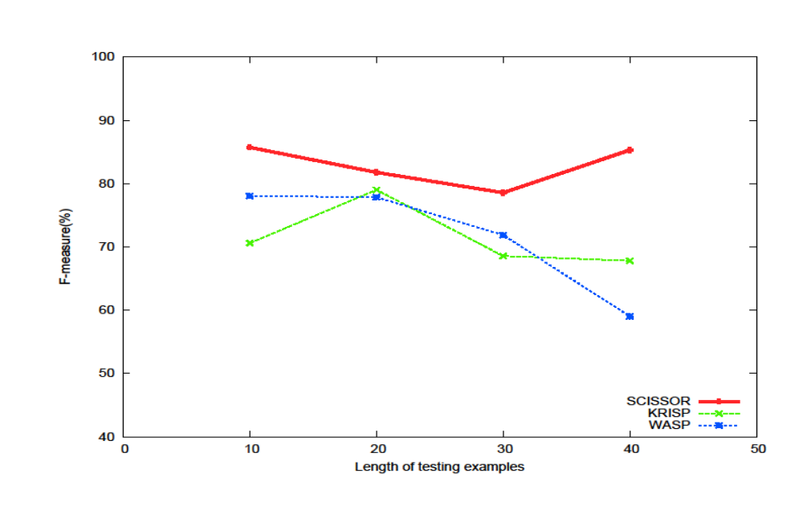
Clang Results with Sentence Length
Knowledge of syntax improves
performance on long sentences
0-10
(7%)
31-40
(13%)
0-10
(7%)
0-10
(7%)
11-20
(33%)
11-20
(33%)
11-20
(33%)
21-30
(46%)
0-10
(7%)
11-20
(33%)
21-30
(46%)
31-40
(13%)
21-30
(46%)
Sentence length

Slide 161
SYNSEM
Ge & Mooney (2009)
SCISSOR requires extra SAPT annotation for training
Must learn both syntax and semantics from same limited training corpus
High performance syntactic parsers are available that are trained on existing large corpora (Collins, 1997; Charniak & Johnson, 2005)
Notes:
Given the advantages of exploiting syntax..

Slide 162
SCISSOR Requires SAPT Annotation
S-P_BOWNER
NP-P_PLAYER
VP-P_BOWNER
PRP$-P_OUR
NN-P_PLAYER
CD- P_UNUM
VB-P_BOWNER
NP-NULL
our
player
2
has
DT-NULL
NN-NULL
the
ball
Time consuming.
Automate it!

Slide 163
SYNSEM Overview
Ge & Mooney (2009)
Syntactic
Parse
Syntactic Parser
Composition
Rules
Multiple
SAPTS
Disambiguation
Model
Best
SAPT
NL
Sentence
Semantic Lexicon
Multiple word
alignments

Slide 164
SYNSEM Training : Learn Semantic Knowledge
Syntactic
Parse
Syntactic Parser
Composition
Rules
NL
Sentence
Semantic Lexicon
Multiple word
alignments

Slide 165
Syntactic Parser
S
NP
VP
PRP$
NN
CD
VB
NP
our
player
2
has
DT
NN
the
ball
Use a statistical syntactic parser

Slide 166
SYNSEM Training: Learn Semantic Knowledge
Syntactic
Parse
Syntactic Parser
Composition
Rules
NL
Sentence
Semantic Lexicon
Multiple word
alignments
MR

Slide 167
Semantic Lexicon
P_OUR
P_PLAYER
P_UNUM
P_BOWNER
NULL
NULL
our
player
2
has
the
ball
our
player
2
has
the
ball
P_BOWNER
P_PLAYER
P_OUR
P_UNUM
Use a word alignment model (Wong and Mooney (2006) )

Slide 168
Learning a Semantic Lexicon
IBM Model 5 word alignment (GIZA++)
Top 5 word/predicate alignments for each training example
Assume each word alignment and syntactic parse defines a possible SAPT for composing the correct MR

Slide 169
SYNSEM Training : Learn Semantic Knowledge
Syntactic
Parse
Syntactic Parser
Composition
Rules
NL
Sentence
Semantic Lexicon
Multiple word
alignments
MR
MR

Slide 170
Introducing λvariables in semantic labels for missing arguments
(a₁: the first argument)
Introduce λ Variables
S
NP
VP
P_OUR
NP
λa₁P_BOWNER
NP
λa₁λa₂P_PLAYER
P_UNUM
NULL
NULL
our
player
2
has
the
ball
Notes:
Tree from syntactic parser, associations from word alignments..

Slide 171
Internal Semantic Labels
S
P_BOWNER
P_PLAYER
NP
VP
P_OUR
P_UNUM
P_OUR
NP
λa₁P_BOWNER
NP
λa₁λa₂P_PLAYER
P_UNUM
NULL
NULL
From Correct MR
our
player
2
has
the
ball
How to choose the dominant predicates?

Slide 172
Collect Semantic Composition Rules
?
P_BOWNER
λa₁λa₂P_PLAYER
P_UNUM
P_PLAYER
player
2
P_OUR
P_UNUM
λa₁λa₂PLAYER
+ P_UNUM
→
λa₁
P_PLAYER
, a₂=c₂
(c₂: child 2)

Slide 173
Collect Semantic Composition Rules
S
P_BOWNER
?
P_PLAYER
VP
P_OUR
P_UNUM
P_OUR
λa₁P_PLAYER
λa₁P_BOWNER
NP
λa₁λa₂P_PLAYER
P_UNUM
NULL
NULL
our
player
2
has
the
ball
λa₁λa₂PLAYER + P_UNUM → {λa₁P_PLAYER, a₂=c₂}

Slide 174
Collect Semantic Composition Rules
S
P_BOWNER
P_PLAYER
P_PLAYER
VP
P_OUR
P_UNUM
P_OUR
λa₁P_PLAYER
λa₁P_BOWNER
?
λa₁λa₂P_PLAYER
P_UNUM
NULL
NULL
our
player
2
has
the
ball
P_OUR +λa₁P_PLAYER → {P_PLAYER, a₁=c₁}

Slide 175
Collect Semantic Composition Rules
?
P_BOWNER
P_PLAYER
P_PLAYER
λa₁P_BOWNER
P_OUR
P_UNUM
P_OUR
λa₁P_PLAYER
λa₁P_BOWNER
NULL
λa₁λa₂P_PLAYER
P_UNUM
NULL
NULL
our
player
2
has
the
ball

Slide 176
Collect Semantic Composition Rules
P_BOWNER
P_BOWNER
P_PLAYER
P_PLAYER
λa₁P_BOWNER
P_OUR
P_UNUM
P_OUR
λa₁P_PLAYER
λa₁P_BOWNER
NULL
λa₁λa₂P_PLAYER
P_UNUM
NULL
NULL
our
player
2
has
the
ball
P_PLAYER + λa₁P_BOWNER → {P_BOWNER, a₁=c₁}

Slide 177
Ensuring Meaning Composition
N₁
N₂
is the smallest
What state
answer(smallest(state(all)))
Non-isomorphism

Slide 178
Ensuring Meaning Composition
Non-isomorphism between NL parse and MR parse
  Various linguistic phenomena
  Word alignment between NL and MRL
  Use automated syntactic parses
Introduce macro-predicates that combine multiple predicates
Ensure that MR can be composed using a syntactic parse and word alignment

Slide 179
SYNSEM Training: Learn Disambiguation Model
Syntactic
Parse
Syntactic Parser
Composition
Rules
Multiple
SAPTS
Disambiguation
Model
Correct
SAPTs
NL
Sentence
Semantic Lexicon
Multiple word
alignments
MR

Slide 180
Parameter Estimation
Apply the learned semantic knowledge to all training examples to generate possible SAPTs
Use a standard maximum-entropy model similar to that of Zettlemoyer & Collins (2005), and Wong & Mooney (2006)
Training finds a parameter that (approximately) maximizes the sum of the conditional log-likelihood of the training set including syntactic parses
Incomplete data since SAPTs are hidden variables

Slide 181
Features
Lexical features:
  Unigram features: # that a word is assigned a predicate
  Bigram features: # that a word is assigned a predicate given its previous/subsequent word.
Rule features: # a composition rule applied in a derivation

Slide 182
SYNSEM Testing
Syntactic
Parse
Syntactic Parser
Composition
Rules
Multiple
SAPTS
Disambiguation
Model
Best
SAPT
NL
Sentence
Semantic Lexicon
Multiple word
alignments

Slide 183
Syntactic Parsers (Bikel,2004)
WSJ only
  CLang(SYN0): F-measure=82.15%
  Geoquery(SYN0) : F-measure=76.44%
WSJ + in-domain sentences
  CLang(SYN20): 20 sentences, F-measure=88.21%
  Geoquery(SYN40): 40 sentences, F-measure=91.46%
Gold-standard syntactic parses (GOLDSYN)

Slide 184
Questions
Q1. Can SYNSEM produce accurate semantic interpretations?
Q2. Can more accurate Treebank syntactic parsers produce more accurate semantic parsers?

Slide 185
Results on CLang
 | Precision | Recall | F-measure
GOLDSYN | 84.7 | 74.0 | 79.0
SYN20 | 85.4 | 70.0 | 76.9
SYN0 | 87.0 | 67.0 | 75.7
SCISSOR | 89.5 | 73.7 | 80.8
WASP | 88.9 | 61.9 | 73.0
KRISP | 85.2 | 61.9 | 71.7
LU | 82.4 | 57.7 | 67.8
SYNSEM
SAPTs
(LU: F-measure after reranking is 74.4%)
GOLDSYN > SYN20 > SYN0

Slide 186
Questions
Q1. Can SynSem produce accurate semantic interpretations? [yes]
Q2. Can more accurate Treebank syntactic parsers produce more accurate semantic parsers? [yes]
Q3. Does it also improve on long sentences?

Slide 187
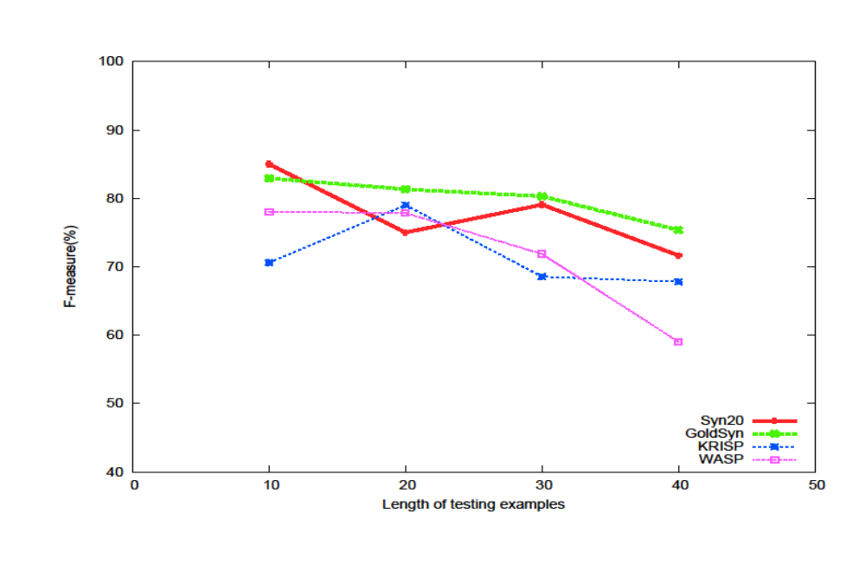
Detailed Clang Results on Sentence Length
Prior Knowledge
+ Flexibility +
Syntactic error
= ?
0-10
(7%)
11-20
(33%)
21-30
(46%)
31-40
(13%)

Slide 188
Questions
Q1. Can SynSem produce accurate semantic interpretations? [yes]
Q2. Can more accurate Treebank syntactic parsers produce more accurate semantic parsers? [yes]
Q3. Does it also improve on long sentences? [yes]
Q4. Does it improve on limited training data due to the prior knowledge from large treebanks?

Slide 189
Results on Clang
(training size = 40)
 | Precision | Recall | F-measure
GOLDSYN | 61.1 | 35.7 | 45.1
SYN20 | 57.8 | 31.0 | 40.4
SYN0 | 53.5 | 22.7 | 31.9
SCISSOR | 85.0 | 23.0 | 36.2
WASP | 88.0 | 14.4 | 24.7
KRISP | 68.35 | 20.0 | 31.0
SYNSEM
SAPTs
The quality of syntactic parser is critically important!

Slide 190
Questions
Q1. Can SynSem produce accurate semantic interpretations? [yes]
Q2. Can more accurate Treebank syntactic parsers produce more accurate semantic parsers? [yes]
Q3. Does it also improve on long sentences? [yes]
Q4. Does it improve on limited training data due to the prior knowledge from large treebanks? [yes]

Slide 191
References
Bikel (2004). Intricacies of Collins’ Parsing Model. Computational Linguistics, 30(4):479-511.
Eugene Charniak and Mark Johnson (2005). Coarse-to-fine n-best parsing and MaxEnt discriminative reranking. In Proc. of ACL-2005, pp. 173-180, Ann Arbor, MI, June 2005.
Michal J. Collins (1997). Three generative, lexicalized models for syntactic parsing. In Proc. of ACL-97, pages 16-23, Madrid, Spain.
Ruifang Ge and Raymond J. Mooney (2005). A statistical semantic parser that integrates syntax and semantics. In Proc. of CoNLL-2005, pp. 9-16, Ann Arbor, MI, June 2005.
Ruifang Ge and Raymond J. Mooney (2006). Discriminative reranking for semantic parsing. In Proc. of COLING/ACL-2006, pp. 263-270, Syndney, Australia, July 2006.
Ruifang Ge and Raymond J. Mooney (2009). Learning a compositional semantic parser using an existing syntactic parser. In Proc. of ACL-2009, pp. 611-619, Suntec, Singapore, August 2009.

Slide 192
Outline
Introduction to the task of semantic parsing
  Definition of the task
  Examples of application domains and meaning representation languages
  Distinctions from and relations to other NLP tasks
Semantic parsers
  Earlier hand-built systems
  Learning for semantic parsing
    Semantic parsing learning task
    Early semantic parser learners
    Recent semantic parser learners
    Exploiting syntax for semantic parsing
    Underlying commonalities and differences between semantic parsers
  Various forms of supervision
Semantic parsing beyond a sentence
  Learning language from perceptual contexts
  Using discourse contexts for semantic parsing
Research challenges and future directions
  Machine reading of documents: Connecting with knowledge representation
  Applying semantic parsing techniques to the Semantic Web
  Future research directions
Conclusions

Slide 193
Underlying Commonalities and Differences between Semantic Parsers

Slide 194
Underlying Commonalities between Semantic Parsers
A model to connect language and meaning

Slide 195
A Model to Connect Language and Meaning
Zettlemoyer & Collins: CCG grammar with semantic types
WASP: Synchronous CFG
KRISP: Probabilistic string classifiers
borders := (S \ NP) / NP : λx.λy.borders(y, x)
QUERY → What is CITY / answer(CITY)
NEXT_TO → next_to
0.95
Which rivers run through the states bordering Texas?

Slide 196
A Model to Connect Language and Meaning
Lu et al.: Hybrid tree, hybrid patterns
SCISSOR/SynSem: Semantically annotated parse trees
QUERY:answer(NUM)
w: the NL sentence
m: the MR
T: the hybrid tree
NUM:count(STATE)
?
How many
STATE:exclude(STATE STATE)
STATE:state(all)
do not
STATE:loc_1(RIVER)
states
have
RIVER:river(all)
rivers
S-P_BOWNER
NP-P_PLAYER
VP-P_BOWNER
PRP$-P_OUR
NN-P_PLAYER
CD- P_UNUM
VB-P_BOWNER
NP-NULL
our
player
2
has
DT-NULL
NN-NULL
the
ball

Slide 197
Underlying Commonalities between Semantic Parsers
A model to connect language and meaning
A mechanism for meaning composition

Slide 198
A Mechanism for Meaning Composition
Zettlemoyer & Collins: CCG parsing rules
WASP: Meaning representation grammar
KRISP: Meaning representation grammar
Lu et al.: Meaning representation grammar
SCISSOR: Semantically annotated parse trees
SynSem: Syntactic parses

Slide 199
Underlying Commonalities between Semantic Parsers
A model to connect language and meaning
A mechanism for meaning composition
Parameters for selecting a meaning representation out of many

Slide 200
Parameters to Select a Meaning Representation
Zettlemoyer & Collins: Weights for lexical items and CCG parsing rules
WASP: Weights for grammar productions
KRISP: SVM weights
Lu et al.: Generative model parameters
SCISSOR: Parsing model weights
SynSem: Parsing model weights

Slide 201
Underlying Commonalities between Semantic Parsers
A model to connect language and meaning
A mechanism for meaning composition
Parameters for selecting a meaning representation out of many
An iterative EM-like method for training to find the right associations between NL and MR components

Slide 202
An Iterative EM-like Method for Training
Zettlemoyer & Collins: Stochastic gradient ascent, structured perceptron
WASP: Quasi-Newton method (L-BFGS)
KRISP: Re-parse the training sentences to find more refined positive and negative examples
Lu et al.: Inside-outside algorithm with EM
SCISSOR: None
SynSem: Quasi-Newton method (L-BFGS)

Slide 203
Underlying Commonalities between Semantic Parsers
A model to connect language and meaning
A mechanism for meaning composition
Parameters for selecting a meaning representation out of many
An iterative EM-like loop in training to find the right associations between NL and MR components
A generalization mechanism

Slide 204
A Generalization Mechanism
Zettlemoyer & Collins: Different combinations of lexicon items and parsing rules
WASP: Different combinations of productions
KRISP: Different combinations of meaning productions, string similarity
Lu et al.: Different combinations of hybrid patterns
SCISSOR: Different combinations of parsing productions
SynSem: Different combinations of parsing productions

Slide 205
Underlying Commonalities between Semantic Parsers
A model to connect language and meaning
A mechanism for meaning composition
Parameters for selecting a meaning representation out of many
An iterative EM-like loop in training to find the right associations between NL and MR components
A generalization mechanism

Slide 206
Differences between Semantic Parsers
Learn lexicon or not

Slide 207
Learn Lexicon or Not
Learn it as a first step:
  Zettlemoyer & Collins
  WASP
  SynSem
  COCKTAIL
Do not learn it:
  KRISP
  Lu at el.
  SCISSOR

Slide 208
Differences between Semantic Parsers
Learn lexicon or not
Utilize knowledge of natural language or not

Slide 209
Utilize Knowledge of Natural Language or Not
Utilize knowledge of English syntax:
  Zettlemoyer & Collins: CCG
  SCISSOR: Phrase Structure Grammar
  SynSem: Phrase Structure Grammar
  Leverage from natural language knowledge
Do not utilize:
  WASP
  KRISP
  Lu et al.
  Portable to other natural languages

Slide 210
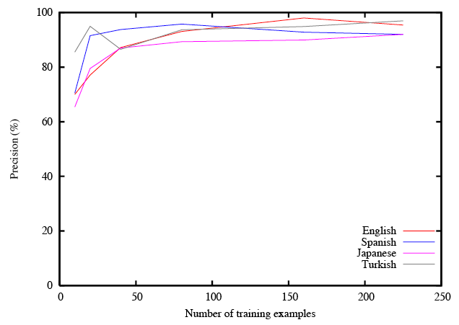
Precision Learning Curve for GeoQuery (WASP)

Slide 211
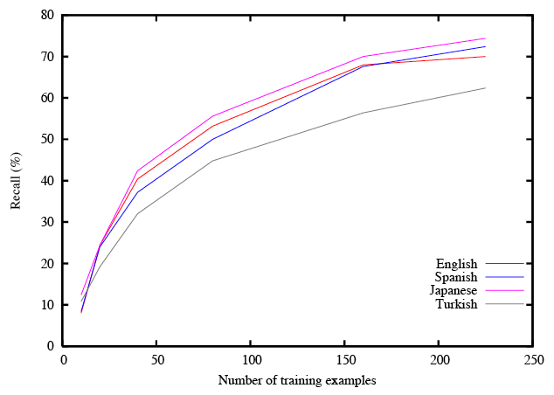
Recall Learning Curve for GeoQuery (WASP)

Slide 212
Differences between Semantic Parsers
Learn lexicon or not
Utilize general syntactic parsing grammars or not
Use matching patterns or not

Slide 213
Use Matching Patterns or Not
Use matching patterns:
  Zettlemoter & Collins
  WASP
  Lu et al.
  SCISSOR/SynSem
  The systems can be inverted to form a generation system, for e.g. WASP⁻¹
Do not use matching patterns:
  KRISP
  Makes it robust to noise

Slide 214
Robustness of KRISP
KRISP does not use matching patterns
String-kernel-based classification softly captures wide range of natural language expressions
⇒ Robust to rephrasing and noise
TRAVERSE → traverse
0.95
Which rivers run through the states bordering Texas?

Slide 215
Robustness of KRISP
KRISP does not use matching patterns
String-kernel-based classification softly captures wide range of natural language expressions
⇒ Robust to rephrasing and noise
TRAVERSE → traverse
0.65
Which rivers through the states bordering Texas?
Notes:
If the system was using an NL grammar, it wouldn’t be able to parse with the main verb missing…”Which rivers through” probably doesn’t mean anything other than the concept of traverse

Slide 216
Experiments with Noisy NL Sentences contd.
Noise was introduced in the NL sentences by:
  Adding extra words chosen according to their frequencies in the BNC
  Dropping words randomly
  Substituting words with_x0013_phonetically close high frequency words
Four levels of noise was created by increasing the probabilities of the above
We show best F-measures (harmonic mean of precision and recall)

Slide 217
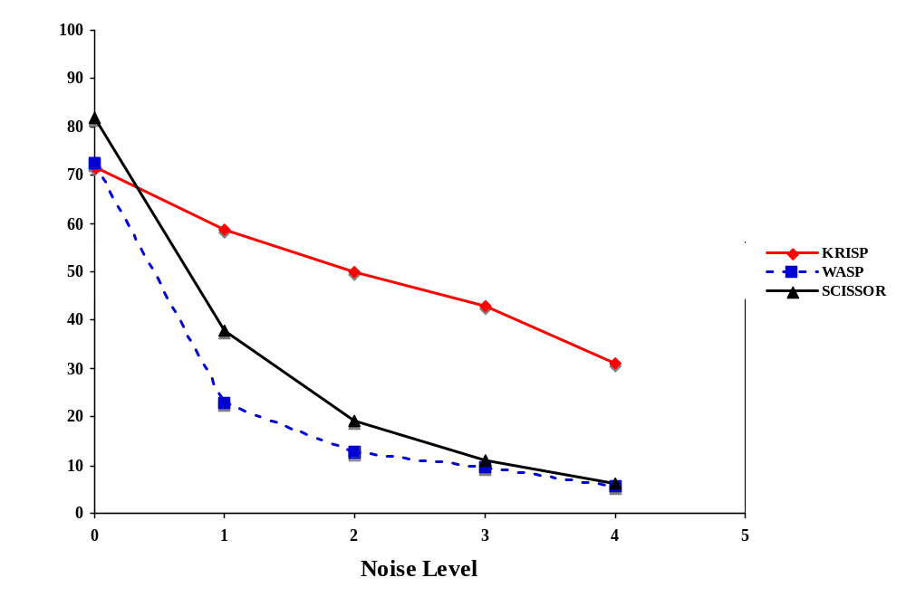
Results on Noisy CLang Corpus

Slide 218
Differences between Semantic Parsers
Learn lexicon or not
Utilize general syntactic parsing grammars or not
Use matching patterns or not
Different amounts of supervision

Slide 219
Different Amounts of Supervision
Zettlemoyer & Collins
  NL-MR pairs, CCG category rules, a small number of predefined lexical items
WASP, KRISP, Lu et al.
  NL-MR pairs, MR grammar
SCISSOR
  Semantically annotated parse trees
SynSem
  NL-MR pairs, syntactic parser

Slide 220
Differences between Semantic Parsers
Learn lexicon or not
Utilize general syntactic parsing grammars or not
Use matching patterns or not
Different forms of supervision

Slide 221
Outline
Introduction to the task of semantic parsing
  Definition of the task
  Examples of application domains and meaning representation languages
  Distinctions from and relations to other NLP tasks
Semantic parsers
  Earlier hand-built systems
  Learning for semantic parsing
  Various forms of supervision
Semantic parsing beyond a sentence
  Learning language from perceptual contexts
  Using discourse contexts for semantic parsing
Research challenges and future directions
  Machine reading of documents: Connecting with knowledge representation
  Applying semantic parsing techniques to the Semantic Web
  Future research directions
Conclusions

Slide 222
Various Forms of Supervision

Slide 223
Semi-Supervised Learning for Semantic Parsing (Kate & Mooney, 2007a)
Supervised Corpus
Unsupervised Corpus
Which rivers run through the states bordering Texas?
answer(traverse(next_to(stateid(‘texas’))))
What is the lowest point of the state with the largest area?
answer(lowest(place(loc(largest_one(area(state(all)))))))
What is the largest city in states that border California?
answer(largest(city(loc(next_to(stateid( 'california'))))))
……
Which states have a city named Springfield?
What is the capital of the most populous state?
How many rivers flow through Mississippi?
How many states does the Mississippi run through?
How high is the highest point in the smallest state?
Which rivers flow through the states that border California?
…….
Building supervised training data is expensive
Extended KRISP to utilize NL sentences not annotated with their MRs, usually cheaply available

Slide 224
SEMISUP-KRISP: Semi-Supervised Semantic Parser Learner (Kate & Mooney, 2007a)
Semantic Parsing
Supervised Corpus
Which rivers run through the states bordering Texas?
answer(traverse(next_to(stateid(‘texas’))))
What is the lowest point of the state with the largest area?
answer(lowest(place(loc(largest_one(area(state(all)))))))
What is the largest city in states that border California?
answer(largest(city(loc(next_to(stateid( 'california'))))))
……
Collect
labeled
examples
Transductive
SVM classifiers
Learned
Semantic
parser
-
+
-
-
+
Unsupervised Corpus
-
+
+
Which states have a city named Springfield?
What is the capital of the most populous state?
How many rivers flow through Mississippi?
How many states does the Mississippi run through?
How high is the highest point in the smallest state?
Which rivers flow through the states that border California?
…….
+
+
Collect
unlabeled
examples
Achieves the same
performance
with 25% less
supervised training data
Semantic Parsing

Slide 225
Response-Driven Learning for Semantic Parsing (Clarke et al. 2010)
Learning semantic parsers without any annotated meaning representations
Supervision in the form of binary feedback
  Does the predicted meaning representation when executed produces the desired response for a given input sentence?
Uses SVM with squared-hinge loss as base classifier
Geoquery: 80% accuracy
  Competitive compared to full supervision (86%)

Slide 226
Unambiguous Supervision for Learning Semantic Parsers
The training data for semantic parsing consists of hundreds of natural language sentences unambiguously paired with their meaning representations
Notes:
In all the previous work,

Slide 227
Unambiguous Supervision for Learning Semantic Parsers
The training data for semantic parsing consists of hundreds of natural language sentences unambiguously paired with their meaning representations
Which rivers run through the states bordering Texas?
answer(traverse(next_to(stateid(‘texas’))))
What is the lowest point of the state with the largest area?
answer(lowest(place(loc(largest_one(area(state(all)))))))
What is the largest city in states that border California?
answer(largest(city(loc(next_to(stateid( 'california'))))))
……

Slide 228
Shortcomings of Unambiguous Supervision
It requires considerable human effort to annotate each sentence with its correct meaning representation
Does not model the type of supervision children receive when they are learning a language
  Children are not taught meanings of individual sentences
  They learn to identify the correct meaning of a sentence from several meanings possible in their perceptual context
Notes:
They can figure out meaning of a sentence from several meanings possible in their pc

Slide 229





“Mary is on the phone”
???
Notes:
Consider the situation of a child in a room observing the perceptual context
Child learning language, many things happening in a room…
It could only mean one of these things..

Slide 230
Ambiguous Supervision for Learning Semantic Parsers
A computer system simultaneously exposed to perceptual contexts and natural language utterances should be able to learn the underlying language semantics
We consider ambiguous training data of sentences associated with multiple potential meaning representations
  Siskind (1996) uses this type “referentially uncertain” training data to learn meanings of words
  We use ambiguous training data to learn meanings of sentences
Capturing meaning representations from perceptual contexts is a difficult unsolved problem
  Our system directly works with symbolic meaning representations
Notes:
The closest previous work..

Slide 231
“Mary is on the phone”
???

Slide 232
???
“Mary is on the phone”

Slide 233
Ironing(Mommy, Shirt)
???
“Mary is on the phone”

Slide 234
Ironing(Mommy, Shirt)
Working(Sister, Computer)
???
“Mary is on the phone”

Slide 235
Ironing(Mommy, Shirt)
Carrying(Daddy, Bag)
Working(Sister, Computer)
???
“Mary is on the phone”

Slide 236
Ambiguous Training Example
Ironing(Mommy, Shirt)
Carrying(Daddy, Bag)
Working(Sister, Computer)
Talking(Mary, Phone)
???
Sitting(Mary, Chair)
“Mary is on the phone”

Slide 237
Next Ambiguous Training Example
Ironing(Mommy, Shirt)
Working(Sister, Computer)
Talking(Mary, Phone)
???
Sitting(Mary, Chair)
“Mommy is ironing shirt”

Slide 238
Sample Ambiguous Corpus
gave(daisy, clock, mouse)
Daisy gave the clock to the mouse.
ate(mouse, orange)
ate(dog, apple)
Mommy saw that Mary gave the hammer to the dog.
saw(mother,
gave(mary, dog, hammer))
broke(dog, box)
The dog broke the box.
gave(woman, toy, mouse)
gave(john, bag, mouse)
John gave the bag to the mouse.
threw(dog, ball)
runs(dog)
The dog threw the ball.
saw(john, walks(man, dog))
Notes:
The idea is that when a child or a computer hears this sentence then these things were happening

Slide 239
KRISPER: KRISP with EM-like Retraining
(Kate & Mooney, 2007b)
Extension of KRISP that learns from ambiguous supervision
Uses an iterative Expectation-Maximization-like method [Dempster et al. 1977] to gradually converge on a correct meaning for each sentence
Successfully learns semantic parser with ambiguous supervision

Slide 240
References
J. Clarke, D. Goldwasser, M. Chang, D. Roth (2010). Driving Semantic Parsing from the World's Response. To appear in Proc. of CoNLL-2010, Uppsala, Sweden.
Rohit J. Kate and Raymond J. Mooney (2007a). Semi-supervised learning for semantic parsing using support vector machines. In Proc. of NAACL-HLT 2007, pp. 81-84, Rochester, NY, April 2007.
Rohit J. Kate and Raymond J. Mooney (2007b). Learning language semantics from ambiguous supervision. In Proc. of AAAI-2007, pp. 895-900, Vancouver, BC, July 2007.
Jeffrey M. Siskind (1996). A computational study of cross-situational techniques for learning word-to-meaning mappings. Cognition 61(1):29-91.

Slide 241
Outline
Introduction to the task of semantic parsing
  Definition of the task
  Examples of application domains and meaning representation languages
  Distinctions from and relations to other NLP tasks
Semantic parsers
  Earlier hand-built systems
  Learning for semantic parsing
  Various forms of supervision
Semantic parsing beyond a sentence
  Learning language from perceptual contexts
  Using discourse contexts for semantic parsing
Research challenges and future directions
  Machine reading of documents: Connecting with knowledge representation
  Applying semantic parsing techniques to the Semantic Web
  Future research directions
Conclusions

Slide 242
Learning from Perceptual Context

Slide 243
Tractable Challenge Problem:
Learning to Be a Sportscaster
Goal: Learn from realistic data of natural language used in a representative context while avoiding difficult issues in computer perception (i.e. speech and vision).
Solution: Learn from textually annotated traces of activity in a simulated environment.
Example: Traces of games in the Robocup simulator paired with textual sportscaster commentary.
Notes:
One way to do that is to use simulated .. Instead of real speech and vision perceptual contexts

Slide 244

Grounded Language Learning in Robocup (Chen & Mooney, 2008)
Robocup Simulator
Simulated
Perception
Perceived Facts
Sportscaster
Goal!!!!
Grounded
Language Learner
Language
Generator
SCFG
Goal!!!!
Semantic
Parser

Slide 245
Robocup Sportscaster Trace
Natural Language Commentary
Meaning Representation
Time
badPass ( Purple1, Pink8 )
turnover ( Purple1, Pink8 )
Purple goalie turns the ball over to Pink8
kick ( Pink8)
pass ( Pink8, Pink11 )
Purple team is very sloppy today
kick ( Pink11 )
Pink8 passes the ball to Pink11
Pink11 looks around for a teammate
kick ( Pink11 )
ballstopped
kick ( Pink11 )
Pink11 makes a long pass to Pink8
pass ( Pink11, Pink8 )
kick ( Pink8 )
pass ( Pink8, Pink11 )
Pink8 passes back to Pink11

Slide 246
Robocup Sportscaster Trace
Natural Language Commentary
Meaning Representation
Time
badPass ( Purple1, Pink8 )
turnover ( Purple1, Pink8 )
Purple goalie turns the ball over to Pink8
kick ( Pink8)
pass ( Pink8, Pink11 )
Purple team is very sloppy today
kick ( Pink11 )
Pink8 passes the ball to Pink11
Pink11 looks around for a teammate
kick ( Pink11 )
ballstopped
kick ( Pink11 )
Pink11 makes a long pass to Pink8
pass ( Pink11, Pink8 )
kick ( Pink8 )
pass ( Pink8, Pink11 )
Pink8 passes back to Pink11

Slide 247
Robocup Sportscaster Trace
Natural Language Commentary
Meaning Representation
Time
badPass ( Purple1, Pink8 )
turnover ( Purple1, Pink8 )
Purple goalie turns the ball over to Pink8
kick ( Pink8)
pass ( Pink8, Pink11 )
Purple team is very sloppy today
kick ( Pink11 )
Pink8 passes the ball to Pink11
Pink11 looks around for a teammate
kick ( Pink11 )
ballstopped
kick ( Pink11 )
Pink11 makes a long pass to Pink8
pass ( Pink11, Pink8 )
kick ( Pink8 )
pass ( Pink8, Pink11 )
Pink8 passes back to Pink11
Notes:
English names for human readability, for the system they are arbitrary tokens

Slide 248
Robocup Sportscaster Trace
Natural Language Commentary
Meaning Representation
Time
P6 ( C1, C19 )
P5 ( C1, C19 )
Purple goalie turns the ball over to Pink8
P1( C19 )
P2 ( C19, C22 )
Purple team is very sloppy today
P1 ( C22 )
Pink8 passes the ball to Pink11
Pink11 looks around for a teammate
P1 ( C22 )
P0
P1 ( C22 )
Pink11 makes a long pass to Pink8
P2 ( C22, C19 )
P1 ( C19 )
P2 ( C19, C22 )
Pink8 passes back to Pink11

Slide 249
Sportscasting Data
Collected human textual commentary for the 4 Robocup championship games from 2001-2004.
  Avg # events/game = 2,613
  Avg # sentences/game = 509
Each sentence matched to all events within previous 5 seconds.
  Avg # MRs/sentence = 2.5 (min 1, max 12)

Slide 250
KRISPER-WASP
First iteration of EM-like training produces very noisy training data (> 50% errors).
KRISP is better than WASP at handling noisy training data.
  SVM prevents overfitting.
  String kernel allows partial matching.
But KRISP does not support language generation.
First train KRISPER just to determine the best NL→MR matchings.
Then train WASP on the resulting unambiguously supervised data.

Slide 251
WASPER-GEN
In KRISPER, the correct MR for each sentence is chosen based on maximizing the confidence of semantic parsing (NL→MR).
Instead, WASPER-GEN determines the best matching based on generation (MR→NL).
Score each potential NL/MR pair by using the currently trained WASP⁻¹ generator.

Slide 252
Strategic Generation
Generation requires not only knowing how to say something (tactical generation) but also what to say (strategic generation).
For automated sportscasting, one must be able to effectively choose which events to describe.

Slide 253
Example of Strategic Generation
pass ( purple7 , purple6 )
ballstopped
kick ( purple6 )
pass ( purple6 , purple2 )
ballstopped
kick ( purple2 )
pass ( purple2 , purple3 )
kick ( purple3 )
badPass ( purple3 , pink9 )
turnover ( purple3 , pink9 )

Slide 254
Example of Strategic Generation
pass ( purple7 , purple6 )
ballstopped
kick ( purple6 )
pass ( purple6 , purple2 )
ballstopped
kick ( purple2 )
pass ( purple2 , purple3 )
kick ( purple3 )
badPass ( purple3 , pink9 )
turnover ( purple3 , pink9 )

Slide 255
Learning for Strategic Generation
For each event type (e.g. pass, kick) estimate the probability that it is described by the sportscaster.
Use Iterative Generation Strategy Learning (IGSL), a variant of EM, to estimate the probabilities from the ambiguous training data.

Slide 256
Human Evaluation
(Quasi Turing Test)
Asked 4 fluent English speakers to evaluate overall quality of sportscasts.
Randomly picked a 2 minute segment from each of the 4 games.
Each human judge evaluated 8 commented game clips, each of the 4 segments shown twice: commented once by a human and once by the machine when tested on that game (and trained on the 3 other games).
The 8 clips presented to each judge were shown in random counter-balanced order.
Judges were not told which ones were human or machine generated.

Slide 257
Human Evaluation Metrics
Score | English Fluency | Semantic Correctness | Sportscasting Ability
5 | Flawless | Always | Excellent
4 | Good | Usually | Good
3 | Non-native | Sometimes | Average
2 | Disfluent | Rarely | Bad
1 | Gibberish | Never | Terrible

Slide 258
Results on Human Evaluation
Commentator | English Fluency | Semantic Correctness | Sportscasting Ability
Human | 3.94 | 4.25 | 3.63
Machine (WASPER-GEN) | 3.44 | 3.56 | 2.94
Difference | −0.5 | −0.69 | −0.69

Slide 259
References
David L. Chen and Raymond J. Mooney (2008). Learning to sportscast: A test of grounded language acquisition. In Proc. of ICML-2008, Helsinki, Finland, July 2008.
David L. Chen, Joohyun Kim, Raymond J. Mooney (2010). Training a multilingual sportscaster: Using perceptual context to learn language. Journal of Artificial Intelligence Research 37 (2010): 397-435.
Fleischman, M., & Roy, D. (2007). Situated models of meaning for sports video retrieval. In Proc. of NAACL-HLT-2007, Rochester, NY, April 2007.
Yu, C., & Ballard, D. H. (2004). On the integration of grounding language and learning objects. In Proc. of AAAI-2004, pp. 488-493.
Notes:
Other work was more focused on perceptual data.

Slide 260
Outline
Introduction to the task of semantic parsing
  Definition of the task
  Examples of application domains and meaning representation languages
  Distinctions from and relations to other NLP tasks
Semantic parsers
  Earlier hand-built systems
  Learning for semantic parsing
  Various forms of supervision
Semantic parsing beyond a sentence
  Learning language from perceptual contexts
  Using discourse contexts for semantic parsing
Research challenges and future directions
  Machine reading of documents: Connecting with knowledge representation
  Applying semantic parsing techniques to the Semantic Web
  Future research directions
Conclusions

Slide 261
Using Discourse Contexts for
Semantic Parsing

Slide 262
Discourse Contexts
May I see all the flights from Cleveland to Dallas?
Which of those leave before noon?
Show me the cheapest.
What about afternoon?

Slide 263
Discourse Contexts
May I see all the flights from Cleveland to Dallas?
λx.flight(x) ∧ from(x, CLE) ∧ to(x, DFW)
Which of those leave before noon?
λx.flight(x) ∧ from(x, CLE) ∧ to(x, DFW) ∧ morning(x)
Show me the cheapest.
argmin(λx.flight(x) ∧ from(x, CLE) ∧ to(x, DFW) ∧ morning(x), λy.cost(y))
What about afternoon?
argmin(λx.flight(x) ∧ from(x, CLE) ∧ to(x, DFW) ∧ afternoon(x), λy.cost(y))

Slide 264
A Supervised Learning Problem
Training examples: sequences of sentences and meaning representations
May I see all the flights from Cleveland to Dallas?
λx.flight(x) ∧ from(x, CLE) ∧ to(x, DFW)
Which of those leave before noon?
λx.flight(x) ∧ from(x, CLE) ∧ to(x, DFW) ∧ morning(x)
Show me the cheapest.
argmin(λx.flight(x) ∧ from(x, CLE) ∧ to(x, DFW) ∧ morning(x), λy.cost(y))
What about afternoon?
argmin(λx.flight(x) ∧ from(x, CLE) ∧ to(x, DFW) ∧ afternoon(x), λy.cost(y))

Slide 265
A Supervised Learning Problem
Sequences of
Training Sentences &
Meaning Representations
Semantic Parser Learner
Sequences of
Meaning Representations
Sequences of Sentences
Semantic Parser

Slide 266
Example Analysis
May I see all the flights from Cleveland to Dallas?
λx.flight(x) ∧ from(x, CLE) ∧ to(x, DFW)
Which of those leave before noon?
λx.flight(x) ∧ from(x, CLE) ∧ to(x, DFW) ∧ morning(x)

Slide 267
Example Analysis
May I see all the flights from Cleveland to Dallas?
λx.flight(x) ∧ from(x, CLE) ∧ to(x, DFW)
Which of those leave before noon?
λx.flight(x) ∧ from(x, CLE) ∧ to(x, DFW) ∧ morning(x)
Show me the cheapest.
argmin(λx.flight(x) ∧ from(x, CLE) ∧ to(x, DFW) ∧ morning(x), λy.cost(y))

Slide 268
Example Analysis
May I see all the flights from Cleveland to Dallas?
λx.flight(x) ∧ from(x, CLE) ∧ to(x, DFW)
Which of those leave before noon?
λx.flight(x) ∧ from(x, CLE) ∧ to(x, DFW) ∧ morning(x)
Show me the cheapest.
argmin(λx.flight(x) ∧ from(x, CLE) ∧ to(x, DFW) ∧ morning(x), λy.cost(y))
What about afternoon?
argmin(λx.flight(x) ∧ from(x, CLE) ∧ to(x, DFW) ∧ afternoon(x), λy.cost(y))

Slide 269
Context-Dependent Parsing using CCG
Zettlemoyer & Collins (2009)
Given a sequence of sentences x₁, …, x_{n}:
  Each sentence x_{i} is parsed using CCG to form an intermediate, context-independent logical form y_{i}
  Resolve all references in y_{i}
  Optionally, perform an elaboration
  Final logical form is z_{i}
  Last two steps depend on the context z₁, …, z_{i - 1}
A linear model for scoring derivations
Treat y₁, …, y_{n} as hidden variables

Slide 270
Context-Independent Parsing
Add referential lexical items
ones := N : λx.!f(x)
it := NP : !e
Which of those leave before noon?
λx.!f(x) ∧ morning(x)

Slide 271
Elliptical Expressions
Add type-shifting rules:
A / B : g | ⇒ | A : g(λx.!f(x))
A \ B : g | ⇒ | A : g(λx.!f(x))
the cheapest
NP / N
λg.argmin(g, λy.cost(y))
NP
argmin(λx.!f(x), λy.cost(y))

Slide 272
Resolving References
For each reference:
  Select an expression from the context
  Substitute into current logical form
For each logical form in context, enumerate e and <e,t> type subexpressions
CLE
DFW
λx.flight(x) ∧ from(x, CLE) ∧
to(x, DFW) ∧ morning(x)
λx.flight(x) ∧ from(x, CLE) ∧ to(x, DFW)
λx.flight(x) ∧ from(x, CLE) ∧ to(x, DFW) ∧ morning(x)
λx.flight(x) ∧ from(x, CLE) ∧ to(x, DFW)
λx.flight(x) ∧ from(x, CLE) ∧ morning(x)
λx.flight(x) ∧ to(x, DFW) ∧ morning(x)
λx.from(x, CLE) ∧
to(x, DFW) ∧ morning(x)
…

Slide 273
Elaboration
Use current logical form to expand an embedded variable
Can do deletions before elaboration
λx.flight(x) ∧ from(x, CLE) ∧ to(x, DFW)
λx.flight(x) ∧ from(x, CLE) ∧ to(x, DFW) ∧ morning(x)
argmin(λx.flight(x) ∧ from(x, CLE) ∧ to(x, DFW) ∧ morning(x), λy.cost(y))
what about afternoon
λx.afternoon(x)
λg.argmin(λx.flight(x) ∧ from(x, CLE) ∧ to(x, DFW) ∧ morning(x) ∧ g(x), λy.cost(y))
λg.argmin(λx.flight(x) ∧ from(x, CLE) ∧ to(x, DFW) ∧ morning(x) ∧ g(x), λy.cost(y))
argmin(λx.flight(x) ∧ from(x, CLE) ∧ to(x, DFW) ∧ afternoon(x), λy.cost(y))

Slide 274
Scoring Derivations
Linear model with the following features:
  Parsing features: Zettlemoyer & Collins (2007)
  Context features:
    Distance indicators: Resolve references with expressions from recent sentences?
    Copy indicators: Resolve references with expressions that contain a predicate p?
    Deletion indicators: Override a predicate p₁ from the context expression with a predicate p₂ in the current expression?

Slide 275
Inference and Learning
Use beam search to compute:
  Best derivation
  Best derivation with final logical form z
Error-driven, perceptron-style parameter update

Slide 276
Results
Test for correct logical forms
For ATIS, 83.7% accuracy
  Significantly higher than previous state-of-the-art (Miller et al., 1996)

Slide 277
References
S. Miller, D. Stallard, R. Bobrow, R. Schwartz (1996). A fully statistical approach to natural language interfaces. In Proc. of ACL, pp. 55-61. Santa Cruz, CA.
L. Zettlemoyer, M. Collins (2009). Learning context-dependent mappings from sentences to logical form. In Proc. of ACL-IJCNLP, pp. 976-984. Singapore.

Slide 278
Outline
Introduction to the task of semantic parsing
  Definition of the task
  Examples of application domains and meaning representation languages
  Distinctions from and relations to other NLP tasks
Semantic parsers
  Earlier hand-built systems
  Learning for semantic parsing
  Various forms of supervision
Semantic parsing beyond a sentence
  Learning language from perceptual contexts
  Using discourse contexts for semantic parsing
Research challenges and future directions
  Machine reading of documents: Connecting with knowledge representation
  Applying semantic parsing techniques to the Semantic Web
  Future research directions
Conclusions

Slide 279
Machine Reading of Documents: Connecting with Knowledge Representation
A wealth of knowledge is available in natural language text
Current question-answering systems can only detect answers from the text
Knowledge representation and reasoning (KR&R) systems can answer complex questions that require inference and also provide explanations (Barker et al. 2004)
Extract formal representation from text to augment KR&R systems

Slide 280
Machine Reading of Documents: Connecting with Knowledge Representation
Semantic parsing gives the capability to interpret a sentence for a domain
Extend it to interpret natural language passages for specific domains at a deeper semantic level than that of information extraction
Use it for machine reading text passages to build knowledge bases (Barker et al. 2007)
  Better semantic parsers can capture more knowledge from text

Slide 281
Machine Reading of Documents: Connecting with Knowledge Representation
What will be the meaning representation language?
The concepts and relations of an existing ontology for a domain could be treated as the formal meaning representation language
Use semantic parsing and discourse context to build meaning representations
Knowledge representation can in turn aid semantic parsing
“The kid caresses the black dog.”
Mary
HasColor
Canine
attr
isa
obj
isa
Black
Child
Spot
Petting
isa
patient
agent (Human)
Human

Slide 282
Machine Reading of Documents: Connecting with Knowledge Representation
What will be the meaning representation language?
The concepts and relations of an existing ontology for a domain could be treated as the formal meaning representation language
Use semantic parsing and discourse context to build meaning representations
Knowledge representation can in turn aid semantic parsing
“The kid caresses the black dog.”
Mary
HasColor
Canine
attr
isa
obj
isa
Black
Child
agent (Human)
Spot
Petting
isa
patient
Human

Slide 283
Machine Reading of Documents: Connecting with Knowledge Representation
How to get the training data?
Use semi-supervised or unsupervised techniques
Use domain adaptation techniques
Gather “noisy” training examples by correlating text and existing knowledge bases or databases

Slide 284
The Semantic Web
Extending the Web to allow the automation of information processing
Presupposes large amounts of formally structured relational data, and the ability to make inferences over this data
The fundamental decentralized information on the Web is text
This ever growing body of text must form the basis of the Semantic Web if it is to succeed (Wilks & Brewster, 2009)

Slide 285
Annotating the Semantic Web
Extract information from semi-structured text (Lerman et al., 2004)
Extract relational tuples from free text (Lin & Pantel, 2001; Banko et al., 2007)

Slide 286
Natural Language Interface to Semantic Web
Semantic web uses representations that require formal languages like RDF, OWL, SPARQL for querying
Natural language interfaces offer familiar and convenient way for querying semantic web (Schwitter & Tilbrook, 2004; Kaufmann & Bernstein, 2007)
Semantic parsing techniques could be used to query the semantic web in natural language

Slide 287
Unsupervised Semantic Parsing
Poon & Domingos (2009)
Complete formal meaning of sentences
Target predicates and constants are viewed as clusters of variations of the same meaning
  borders, is next to, share the border with
  Utah, the beehive state
Clustering over forms that are built recursively
  Forms used in composition with the same forms are encouraged to cluster together
Uses Markov logic
  A probabilistic extension of first-order logic

Slide 288
More Future Research Directions
Interactive communication with computers in natural language
  Semantic parsing is one-way
  Combine with generation and discourse processing
Reduce the requirement of training data
  Utilize word similarity, paraphrases
  Exploit active learning, domain adaptation etc.
Develop corpora for new domains

Slide 289
References
Barker et al. (2004). A question-answering system for AP chemistry. In Principles of Knowledge Representation and Reasoning 2004.
Barker et al. (2007). Learning by reading: A prototype system, performance baseline and leassons learned. In Proc. Of AAAI-2007, Vancouver, BC, July 2007.
M. Banko, M. Cafarella, S. Soderland, M. Broadhead, O. Etzioni (2007). Open information extraction from the Web. In Proc. of IJCAI, pp. 2670-2676. Hyderabad, India.
K. Lerman, C. Gazen, S. Minton, C. Knoblock (2004). Populating the semantic web. In Proc. of AAAI Workshop on Advances in Text Extraction and Mining. San Jose, CA.
Esther Kaufmann and Abraham Bernstein (2007). How useful are natural language interfaces to the semantic web for casual end-users? In Proc. of ISWC-2007, pp. 281-294.
D. Lin, P. Pantel (2001). DIRT - Discovery of inference rules from text. In Proc. of KDD, pp. 323-328. San Francisco, CA.

Slide 290
References
H. Poon, P. Domingos (2009). Unsupervised semantic parsing. In Proc. of EMNLP, pp. 1-10. Singapore.
R. Schwitter, M. Tilbrook (2004). Controlled Natural Language meets the Semantic Web. In: A. Asudeh, C. Paris, S. Wan (eds.), Proc. of the Australasian Language Technology Workshop, pp. 55-62. Sydney, Australia.
Y. Wilks, C. Brewster (2009). Natural language processing as a foundation of the semantic web. Now Publishers Inc.

Slide 291
Conclusions
Semantic parsing is an interesting and challenging task and is critical for developing computing systems that can understand and process natural language input
The state-of-the-art in semantic parsing has been significantly advanced in recent years using a variety of statistical machine learning techniques and grammar formalisms
Semantic parsing has also been extended to work beyond a sentence
There are several promising future research directions which can have significant impact
  Machine reading of documents
  Applying to the Semantic Web
  Interactive communication with computers in natural language

Slide 292
Thank You!
Questions??
Resources:
Geoquery and CLang data:
  http://www.cs.utexas.edu/users/ml/nldata/geoquery.html
  http://www.cs.utexas.edu/users/ml/nldata/clang.html
  WASP and KRISP semantic parsers:
  http://www.cs.utexas.edu/~ml/wasp/
  http://www.cs.utexas.edu/~ml/krisp/
  Geoquery Demo:
  http://www.cs.utexas.edu/users/ml/geo.html

