Slide 1
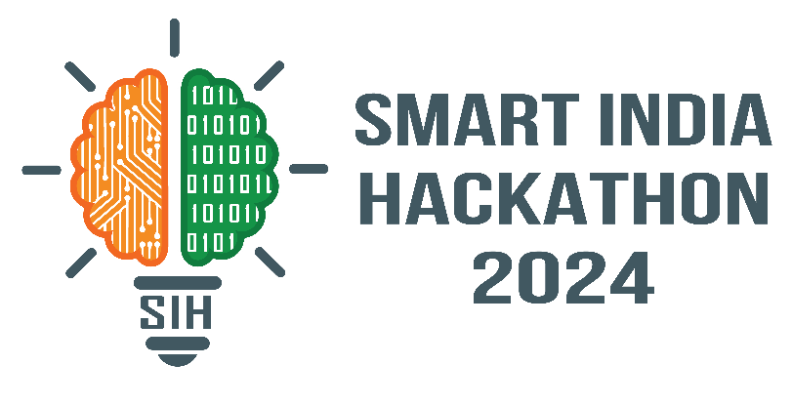
DEEPTRACE
SMART INDIA HACKATHON 2026
SMART INDIA HACKATHON 2026 — SUBMISSION DECK
Problem Statement ID: 26057
Problem Statement Title: Automated Underwater Marine Debris & Sonar Anomaly Detection Using Side-Scan Sonar Imagery
Theme: Clean & Green Technology / Ocean Life Preservation
PS Category: Software
Team Name: DeepTrace
Proposed Solution: AquaScan AI
Core Capability: Autonomous Hydrographic Hazard Localization & Real-Time Threat Assessment
AquaScan AI | Team DeepTrace | SIH 2026 | PS 26057

Slide 2
DEEPTRACE
AquaScan AI: Autonomous Sonar Anomaly & Debris Detection
IDEA / SOLUTION :
End-to-end edge AI platform engineered for Autonomous Underwater Vehicles (AUVs) to autonomously inspect raw side-scan sonar (SSS) waterfall data.
Automated acoustic preprocessing fusing Slant-Range Correction, Vectorized Lee Speckle Filtering, and Adaptive CLAHE.
4-Class Unified Hazard Taxonomy: Shipwrecks, Subsea Pipelines, Ghost Fishing Nets, and Hazardous Debris.
Decoupled offline execution architecture requiring zero acoustic tether or surface connectivity.
Problem Resolution :
Eliminates days of manual post-survey video screening, delivering real-time target detection in 18 ms.
Suppresses extreme seabed acoustic reverberation and backscatter clutter without edge blurring.
Mitigates subsea pipeline collision and net entanglement risks without exposing human divers.
Unique Value Propositions (UVP) :
Dual-Cue Verification: Correlates acoustic highlights with corresponding shadow drops (94.2% false alarm rejection).
On-Edge 54 FPS Throughput: Tensor-quantized neural model optimized for low-power subsea drones.
Standardized GIS Output: Instant 1-click export of tactical GeoJSON and CSV hydrographic registers.
AquaScan AI | Team DeepTrace | SIH 2026 | PS 26057

Slide 3
DEEPTRACE
TECHNICAL ARCHITECTURE & IMPLEMENTATION FLOW
1. Ingestion
Raw SSS waterfall ping logs & AUV IMU/INS telemetry intake.
2. Denoising
Slant-range correction + Vectorized Lee filter & CLAHE contrast boost.
3. Neural Inference
Quantized YOLOv8 detecting highlight-shadow pairs at 54 FPS.
4. GIS Geotagging
Real-time Lat/Lon mapping + 1-Click GeoJSON/CSV audit export.
Core Technologies & Frameworks :
Vision & Inference: PyTorch, Ultralytics YOLOv8, ONNX Runtime Quantization.
Acoustic Signal Processing: OpenCV, NumPy (Vectorized Lee & CLAHE spatial transforms).
Hydrographic GIS Engine: Folium, GeoJSON Standard, OpenStreetMap tile servers.
Deployment Stack: Streamlit Oceanic Dashboard, Python 3.11, Docker container.
Operational Edge Hardware Target :
Primary Vehicle Platform: Autonomous Underwater Vehicles (AUVs) & Inspection ROVs.
Onboard Compute: NVIDIA Jetson Orin Nano / Orin NX (<20W operational power draw).
Acoustic Sensor Payloads: Compatible with standard Edgetech, Klein, and Ping360 sonar streams.
Offline Autonomy: 100% mission functionality in air-gapped deep-water environments.
AquaScan AI | Team DeepTrace | SIH 2026 | PS 26057

Slide 4
DEEPTRACE
FEASIBILITY ANALYSIS & RISK MITIGATION
Comprehensive Feasibility Analysis :
Technical Feasibility: Decoupled inference and telemetry layers ensure deterministic sub-20ms latency per sonar slice.
Financial Feasibility: Lightweight 6.2 MB model runs on low-cost edge microcomputers, cutting need for expensive vessel survey racks.
Operational Feasibility: Designed for plug-and-play integration into existing naval and commercial hydrographic survey workflows.
Data Adaptability: Multi-class taxonomy tested robustly across diverse sea beds (sand ripples, mud, rocky bathymetry).
Challenges & Engineered Mitigations :
Challenge 1: Severe acoustic speckle noise and water column turbidity.
Mitigation: Vectorized Lee filter dynamically separates noise variance while safeguarding true object boundaries.
Challenge 2: Natural rock outcrops causing false hazard alarms.
Mitigation: Dual-cue highlight-to-shadow validation rejects natural seabed mounds lacking distinct acoustic shadow dropouts.
Challenge 3: AUV pitch, roll, and surge geometric distortions.
Mitigation: Telemetry interpolation syncs navigation timestamps directly with sonar ping slice coordinates.
AquaScan AI | Team DeepTrace | SIH 2026 | PS 26057

Slide 5
DEEPTRACE
IMPACT, SOCIAL, & STRATEGIC BENEFITS
Target Beneficiaries & Sectors :
Indian Navy & Maritime Security: Accelerated hydrographic obstacle clearance, port defense, and channel survey ops.
Marine Conservation Authorities: Precise GPS localization of synthetic ghost nets responsible for marine wildlife death.
Offshore Energy & Utilities: Structural integrity audits of subsea oil/gas pipelines and subsea power cables.
Port Authorities & Salvage Teams: Rapid search-and-recovery operations for navigation hazards and sunken debris.
Quantifiable Strategic Benefits :
85% Turnaround Reduction: Compresses days of post-mission video review into real-time 18 ms onboard hazard detection.
94.2% False Positive Suppression: Prevents costly, unnecessary deep-sea ROV dive dispatches and survey delays.
Ocean Habitat Protection: Eliminates unmonitored plastic pollution and abandoned commercial ghost gear from marine habitats.
Zero Diver Hazard: Fully automates deep-water anomaly detection, eliminating diver risks in hazardous waters.
AquaScan AI | Team DeepTrace | SIH 2026 | PS 26057

Slide 6
DEEPTRACE
RESEARCH FOUNDATIONS & LIVE SYSTEM PROTOTYPE
Research Foundations & Standards :
NOAA Marine Debris Program: Acoustic side-scan sonar hazard characterization and benchmarks.
AI4Shipwrecks Benchmark: Multi-platform hydrographic seabed acoustic target datasets.
S. Reed et al., 'Automated Target Tracking and Detection in Sonar via Acoustic Shadows', IEEE Journal of Oceanic Engineering.
IHO Standards for Hydrographic Surveys (S-44): Object detection and hydrographic survey compliance.
Live Prototype & Verification Deliverables :
Live Cloud Command Center: https://aquascan-deeptrace.streamlit.app
Open-Source GitHub Repository: https://github.com/dwivediaanchal8-design/SonarGuard-AI
Verified Latency Benchmark: 18.4 ms edge latency, 54 FPS throughput tested on real shipwreck sonar scans.
Operational Features: Real-time dual-view Lee/CLAHE filter inspection, dynamic geotagging, and 1-click GeoJSON export.
AquaScan AI | Team DeepTrace | SIH 2026 | PS 26057

