Slide 1



AIR QUALITY INDEX PREDICTION

Slide 2

Learning Objectives
Data Collection & Cleaning
Acquire raw air quality dataset (UCI repository).
Handle formatting inconsistencies (e.g., commas vs. dots in decimals, date/time formats).
Identify and remove invalid rows, NaN values, and placeholder values (e.g., -200).
Impute missing data using statistical techniques (mean replacement).
Data Preparation for Modeling
Reformat dataset to meet requirements of forecasting models (merge date & time, define ds and y columns).
Split dataset into training (80%) and testing (20%) for model evaluation.
Forecasting with Facebook Prophet
Learn Prophet’s input requirements and structure (time series with ds and y).
Train, test, and forecast individual attributes (e.g., Relative Humidity, CO).
Evaluate performance using metrics (MAPE, MAE, RMSE, SMAPE).
Understand interpretation of model accuracy (excellent, good, acceptable, poor).
AQI Prediction Pipeline
Predict environmental constituents (CO, NO₂, humidity, etc.) using Prophet.
Use predicted values as input features for an AQI prediction model (XGBoost).
Forecast future AQI (e.g., next 7 days) based on historical data and modeled features.
Model Evaluation & Insights
Compare actual vs. predicted trends visually and numerically.
Understand limitations of forecasting models (e.g., acceptable but not highly accurate predictions).
Develop ability to interpret error metrics in environmental forecasting context.
GOAL
Source :
www.freepik.com/

Slide 3
Tools and Technology used
Tool / Technology | Use Case in Project
XGBoost Algorithm | Main machine learning algorithm for predicting AQI from multiple features.
Facebook Prophet Model | Time-series forecasting of environmental attributes (CO, NO₂, humidity, etc.).
scikit-learn (sklearn.model_selection) | Splitting data into training and testing sets.
scikit-learn (sklearn.metrics) | Evaluating model performance using MAE, RMSE, MAPE, SMAPE.
joblib | Saving and loading trained models efficiently.
pandas | Data cleaning, handling missing values, preparing dataset.
numpy | Numerical computations and transformations.
matplotlib | Visualization of data trends, actual vs. predicted graphs.
Python | Core programming language for the entire workflow.
Jupyter Notebook | Interactive environment for running code, visualizations, and documentation.
UCI Air Quality Dataset | Source of historical air quality data for training and testing models.

Slide 4
Methodology
Data Collection & Understanding
Collect dataset from UCI repository.
Explore dataset structure and identify inconsistencies (NaN values, -200 placeholders, wrong formats).
Data Cleaning & Preprocessing
Remove invalid rows and missing values.
Convert placeholders (-200) into NaN and impute with mean values.
Reformat date and time columns into standard Prophet-compatible format.
Merge date and time into a single timestamp column.
Split dataset into training (80%) and testing (20%).
Time-Series Forecasting
Apply Facebook Prophet for forecasting individual environmental attributes (CO, NO₂, humidity, etc.).
Evaluate accuracy using error metrics (MAPE, MAE, RMSE, SMAPE).
Forecast future values for environmental attributes beyond dataset range.
AQI Prediction Pipeline
Use predicted environmental attributes (from Prophet) as inputs.
Train XGBoost model to predict AQI.
Test AQI predictions on historical data and forecast AQI for future days (e.g., 7-day forecast).
Model Evaluation & Validation
Compare actual vs. predicted trends visually (plots) and numerically (error metrics).
Interpret results (acceptable vs. poor accuracy ranges).
Model Persistence & Reusability
Save trained models using joblib for future use without retraining.

Slide 5
Problem Statement:
PROBLEM STATEMENT DETAILS :
Air pollution poses a significant threat to environmental sustainability and public health, and accurate forecasting of air quality remains a major challenge due to inconsistent, incomplete, and noisy datasets. There is a need for a reliable system that can predict future Air Quality Index (AQI) levels to support timely decision-making and effective preventive measures.

Slide 6
Solution:
SOLUTION WORKFLOW PIPELINE :-
Cleaned and preprocessed historical air quality data to address missing values, anomalies, and formatting issues.
Applied Prophet for time-series forecasting of key environmental attributes (e.g., CO, NO₂, humidity).
Trained an XGBoost model using forecasted attributes to predict Air Quality Index (AQI).
Evaluated model performance with error metrics (MAE, RMSE, MAPE, SMAPE) and visual comparisons.
Saved trained models with joblib and documented the workflow in Python/Jupyter Notebook for reproducibility and deployment readiness.

Slide 7
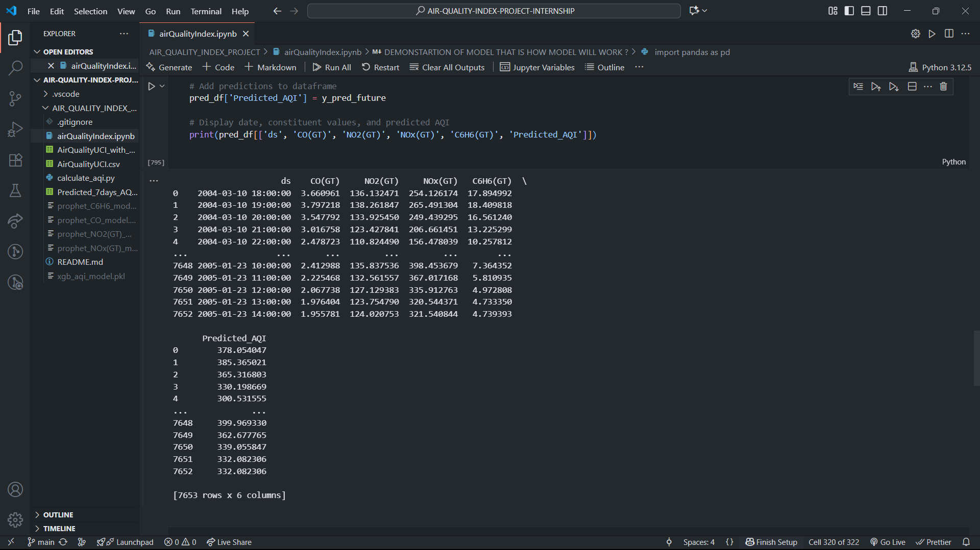
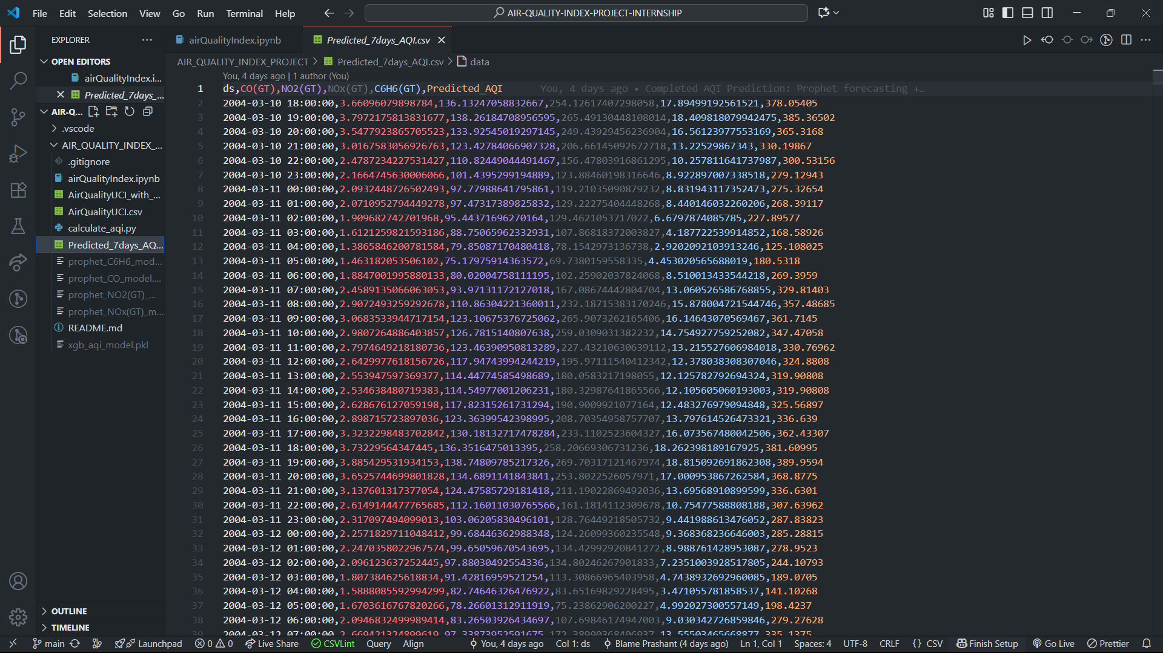
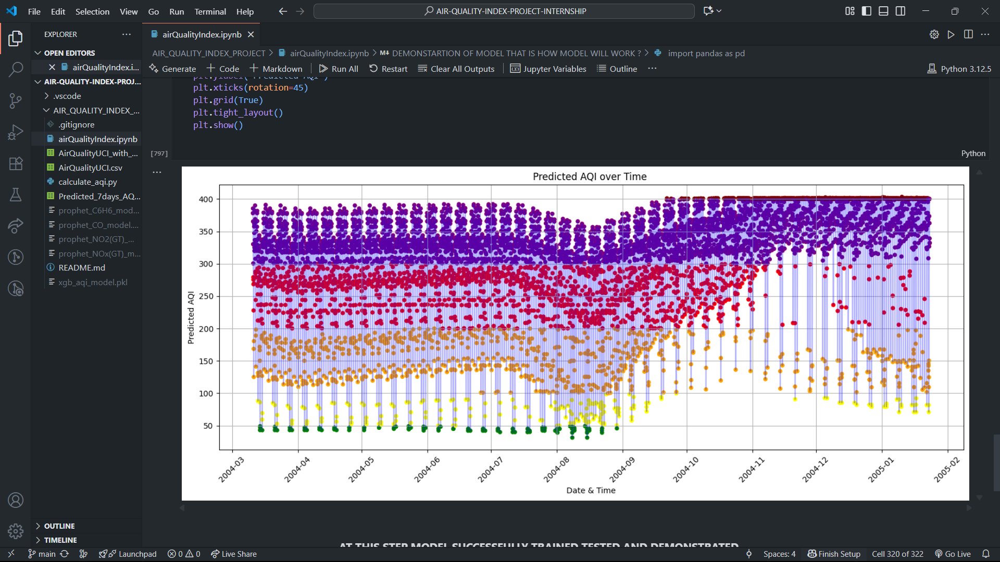
Screenshot of Output:
MODEL PREDICTION’S STRENGTH GRAPH
OUTPUT IN CODE CELL
OUTPUT SAVED IN CSV FILE

Slide 8
Conclusion:
This project delivers a practical, reproducible pipeline for short-term Air Quality Index (AQI) forecasting by transforming noisy historical measurements into actionable predictions. After careful data cleaning and harmonization, the workflow models key pollutant and meteorological attributes with time-series forecasting and then uses those predicted features to estimate AQI with a robust gradient-boosting model. Quantitative error metrics and visual comparisons demonstrate the system’s ability to capture meaningful temporal patterns suitable for short-term warnings while also identifying opportunities for improved accuracy through richer features and expanded data. With saved models and notebooked documentation, the solution is ready to be refined into an operational tool that supports public-health alerts, urban planning, and policy decisions.

