Slide 1

DEPOINDEX: AI-POWERED DEPOSITION TOPIC INDEX
Presented by:
Saumya Dwivedi
Project: DepoIndex (PROBLEM 3)
Source: Persis Yu Deposition
Date: 13 September 2026
Problem:
  Long deposition transcripts are difficult to navigate manually.
  Attorneys need to quickly locate where specific subjects were discussed.
  A topic label is useful only when its page/line citation is verifiable.
Key Requirements:
  Identify meaningful topics and topic transitions
  Determine topic start/end boundaries
  Preserve exact page & line references
  Handle continuing topics and brief digressions
  Provide source evidence for independent verification
Objective:
Build a system that converts a deposition transcript into a chronological, verifiable Topic Index.
Input: Persis Yu Deposition
Output: Topic Index in JSON + Markdown

Slide 2
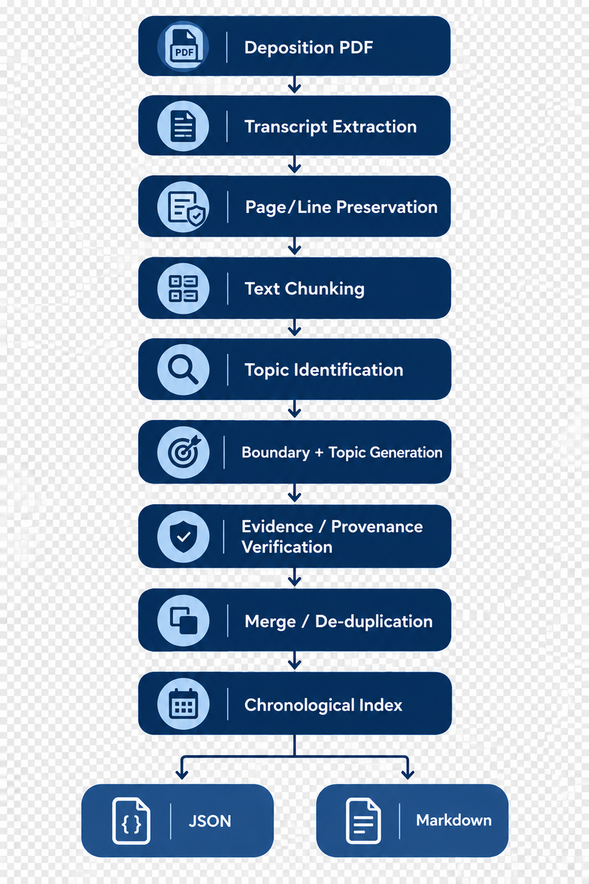

SYSTEM ARCHITECTURE
DEPOINDEX PIPELINE
Architecture Principle:
LLM generates topics, but source references remain tied to the original transcript.
Core Design Goals:
  Evidence-grounded topic labels
  Exact source addressability
  Chronological ordering
  Attorney-verifiable output

Slide 3
TOPIC SEGMENTATION & PROVENANCE
Boundary Strategy:
Candidate boundaries are based on changes in the testimony's subject matter and discourse flow.
The generated topic label should be grounded in the evidence inside its own citation range, rather than unrelated surrounding context.
Topic Segmentation:
The system must distinguish between:
  New topic → genuine subject-matter change
  Continuation → same subject continues
  Digression → short deviation within a larger topic
  Re-entry → earlier topic returns later
  Related subject → closely connected but independently useful topic
Provenance Strategy: Each entry stores:
  Topic
  Start Page + Line
  End Page + Line
  Supporting Evidence / Source Reference
Verification Principle: A plausible topic with the wrong page/line is treated as a failure.

Slide 4

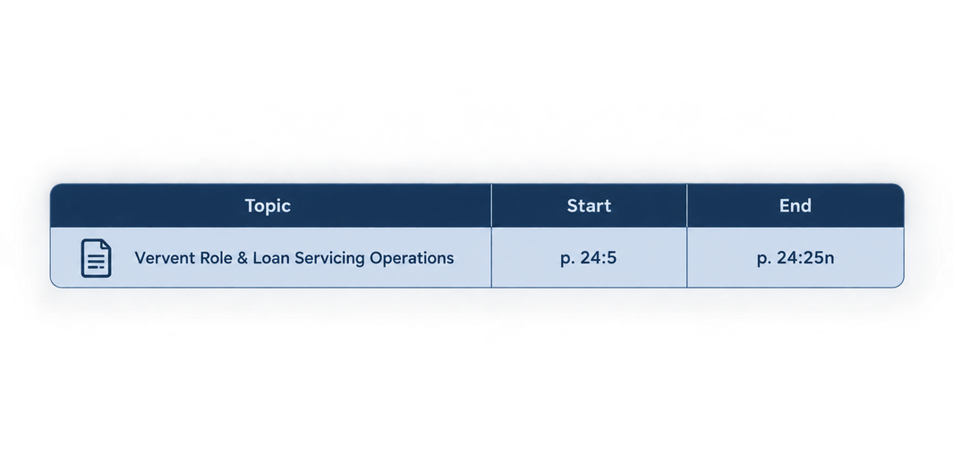
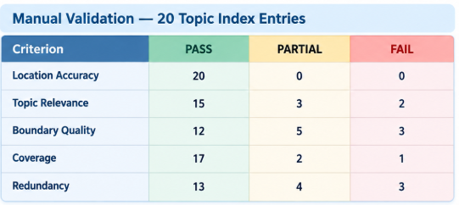
EXAMPLE & VALIDATION RESULTS
Example Topic Index Entry
Manual Validation
Supporting evidence: Original deposition testimony at the cited location.
Overall Assessment:
PROTOTYPE-STAGE:
Strong source-location accuracy, but topic segmentation and evidence-grounded labeling require further refinement.
Main finding: 20/20 sampled page/line locations were correctly mapped to the actual Persis Yu PDF.

Slide 5
STABILITY, FAILURES & NEXT STEPS
Three Major Failure Cases:
1. Nested Topic Ranges
  Some entries were completely contained within neighboring entries.
  Fix: Detect nested ranges and merge/redraw boundaries where no genuine topic change exists.
2. Incorrect Topic Labels
  Some labels did not match the cited testimony.
  Fix: generate labels strictly from the cited evidence + controlled topic vocabulary.
3. Overlapping Ranges
  Some neighboring entries claimed overlapping testimony.
  Fix: Add overlap detection + merge/de-duplication + clean boundary enforcement.
Stability Test:
Observed topic counts:
Run 1 → 20 raw entries
Run 2 → 15 topics
Run 3 → 9 topics
Verdict: UNSTABLE
Important limitation:
Run 2 and Run 3 were manual proxy re-segmentations, not genuine automated re-runs of the pipeline.
Next Steps:
  Run the actual pipeline 3+ times with deterministic settings
  Add automated provenance verification
  Add merge/de-duplication
  Establish fixed segmentation granularity
  Improve evidence-grounded topic labeling
Final Verdict:
Promising prototype — strong location accuracy, but segmentation and topic-label grounding need improvement before unsupervised professional use.

