Slide 1
Active Contour Models
(Snakes)
Amyn Poonawala
EE 264
Instructor: Dr. Peyman Milanfar

Slide 2
What is the objective?
To perform the task of Image Segmentation.
What is segmentation?
Subdividing or partitioning an image into its constituent regions or objects.
Why use it when there are many methods already existing??

Slide 3
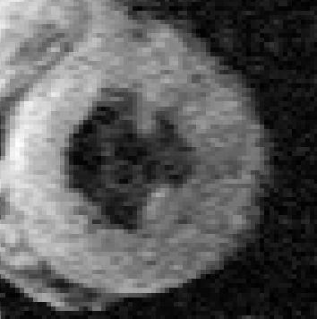
Problems with common methods
No prior used and so cant separate image into constituent components.
Not effective in presence of noise and sampling artifacts (e.g. medical images).

Slide 4
Solution
Use generalize Hough transform or template matching to detect shapes
But the prior required are very high for these methods.
The desire is to find a method that looks for any shape in the image that is smooth and forms a closed contour.

Slide 5
Active Contour Models
First introduced in 1987 by Kass et al,and gained popularity since then.
Represents an object boundary or some other salient image feature as a parametric curve.
An energy functional E is associated with the curve.
The problem of finding object boundary is cast as an energy minimization problem.

Slide 6
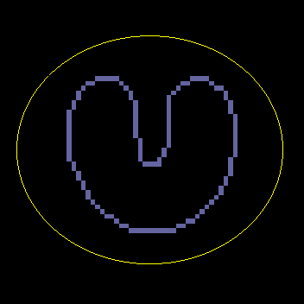
Framework for snakes
A higher level process or a user initializes any curve close to the object boundary.
The snake then starts deforming and moving towards the desired object boundary.
In the end it completely “shrink-wraps” around the object.
courtesy
(Diagram courtesy “Snakes, shapes, gradient vector flow”, Xu, Prince)

Slide 7
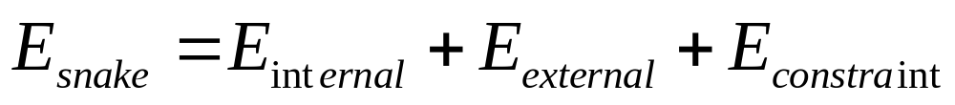
Modeling
The contour is defined in the (x, y) plane of an image as a parametric curve
    v(s)=(x(s), y(s))
Contour is said to possess an energy (E_{snake}) which is defined as the sum of the three energy terms.
The energy terms are defined cleverly in a way such that the final position of the contour will have a minimum energy (E_{min})
Therefore our problem of detecting objects reduces to an energy minimization problem.
What are these energy terms which do the trick for us??

Slide 8
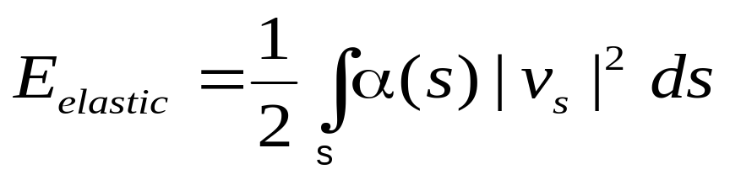
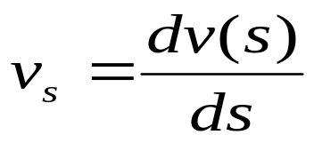
Internal Energy (E_{int} )
Depends on the intrinsic properties of the curve.
Sum of elastic energy and bending energy.
Elastic Energy (E_{elastic}):
The curve is treated as an elastic rubber band possessing elastic potential energy.
It discourages stretching by introducing tension.
Weight α(s) allows us to control elastic energy along different parts of the contour. Considered to be constant α for many applications.
Responsible for shrinking of the contour.

Slide 9
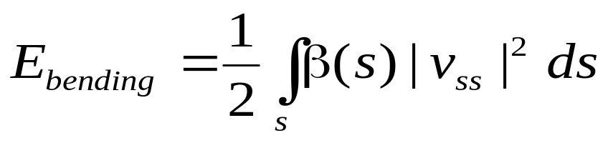
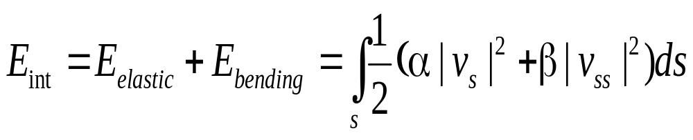
Bending Energy (E_{bending}):
The snake is also considered to behave like a thin metal strip giving rise to bending energy.
It is defined as sum of squared curvature of the contour.
β(s) plays a similar role to α(s).
Bending energy is minimum for a circle.
Total internal energy of the snake can be defined as

Slide 10
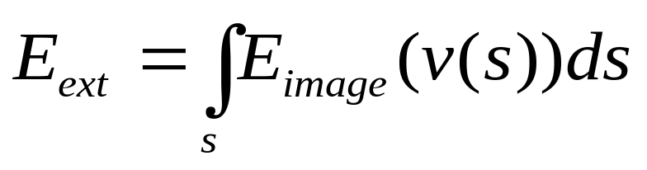
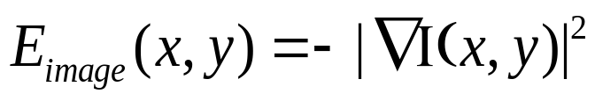
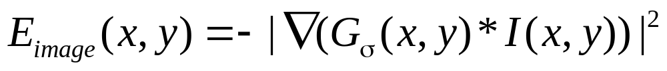
External energy of the contour (E_{ext})
It is derived from the image.
Define a function E_{image}(x,y) so that it takes on its smaller values at the features of interest, such as boundaries.
Key rests on defining E_{image}(x,y). Some examples

Slide 11
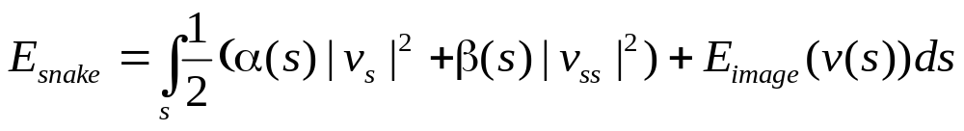
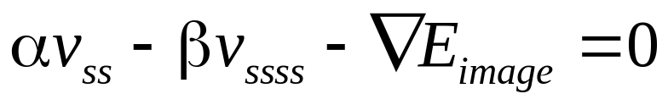
Energy and force equations
The problem at hand is to find a contour v(s) that minimize the energy functional
Using variational calculus and by applying Euler-Lagrange differential equation we get following equation
Equation can be interpreted as a force balance equation.
Each term corresponds to a force produced by the respective energy terms. The contour deforms under the action of these forces.

Slide 12
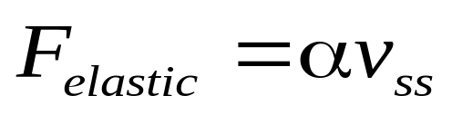
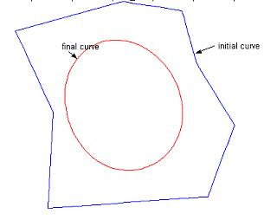
Elastic force
Generated by elastic potential energy of the curve.
Characteristics (refer diagram)

Slide 13
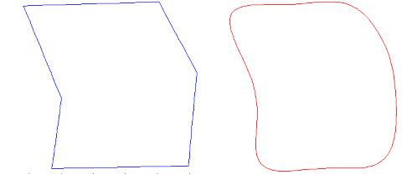
Bending force
Generated by the bending energy of the contour.
Characteristics (refer diagram):
Thus the bending energy tries to smooth out the curve.
Initial curve
(High bending energy)
Final curve deformed by bending force. (low bending energy)

Slide 14
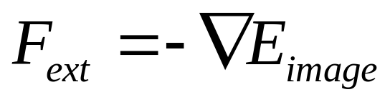
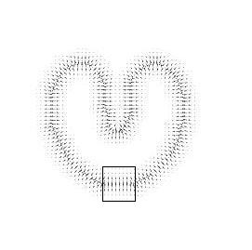

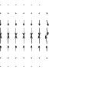
External force
It acts in the direction so as to minimize E_{ext}
Image
External force
Zoomed in

Slide 15

Discretizing
the contour v(s) is represented by a set of control points
The curve is piecewise linear obtained by joining each control point.
Force equations applied to each control point separately.
Each control point allowed to move freely under the. influence of the forces.
The energy and force terms are converted to discrete form with the derivatives substituted by finite differences.

Slide 16
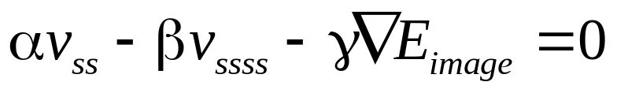
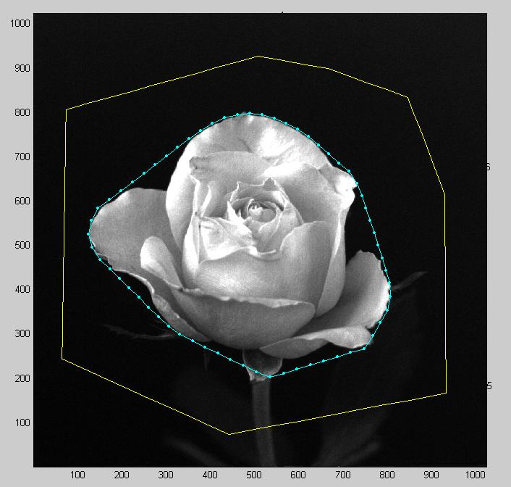
Solution and Results
Method 1:
γ is a constant to give separate control on external force.
Solve iteratively.

Slide 17
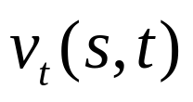
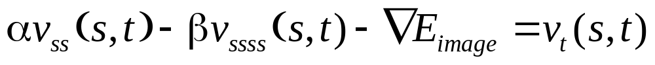
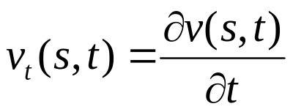
Method 2:
Consider the snake to also be a function of time i.e.
If RHS=0 we have reached the solution.
On every iteration update control point only if new position has a lower external energy.
Snakes are very sensitive to false local minima which leads to wrong convergence.

Slide 18
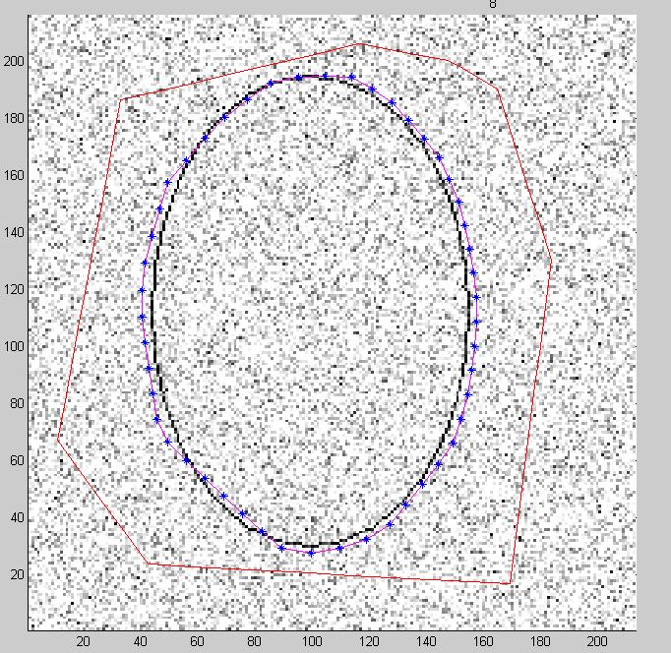
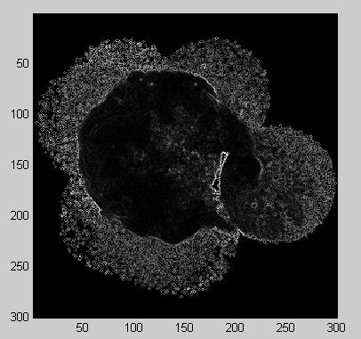
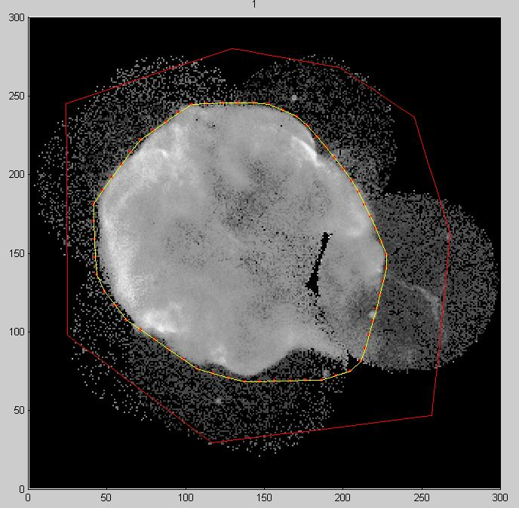
Noisy image with many local minimas
WGN sigma=0.1
Threshold=15

Slide 19
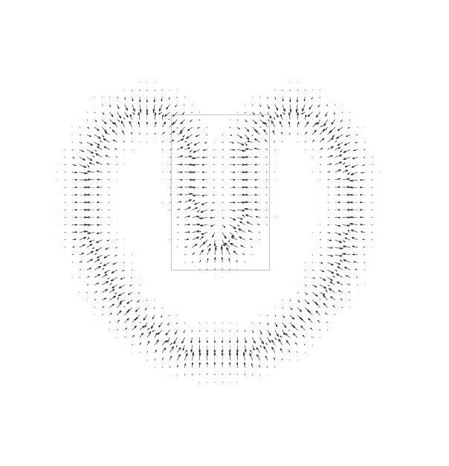

Weakness of traditional snakes (Kass model)
Extremely sensitive to parameters.
Small capture range.
No external force acts on points which are far away from the boundary.
Convergence is dependent on initial position.

Slide 20
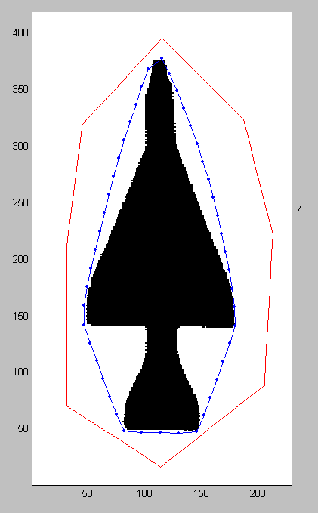
Weakness (contd…)
Fails to detect concave boundaries. External force cant pull control points into boundary concavity.

Slide 21
Gradient Vector Flow (GVF)
(A new external force for snakes)
Detects shapes with boundary concavities.
Large capture range.

Slide 22
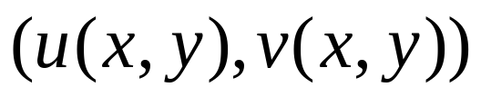
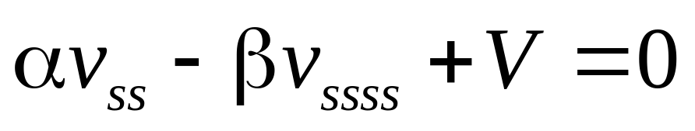
Model for GVF snake
The GVF field is defined to be a vector field
V(x,y) =
Force equation of GVF snake
V(x,y) is defined such that it minimizes the energy functional
f(x,y) is the edge map of the image.

Slide 23
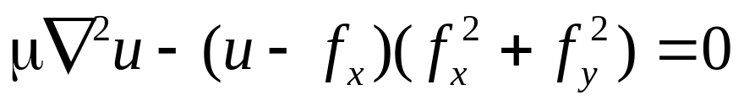
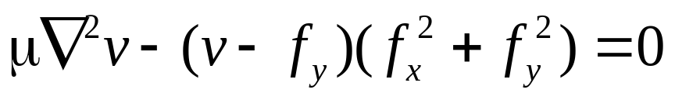
GVF field can be obtained by solving following equations
∇² Is the Laplacian operator.
Reason for detecting boundary concavities.
The above equations are solved iteratively using time derivative of u and v.

Slide 24
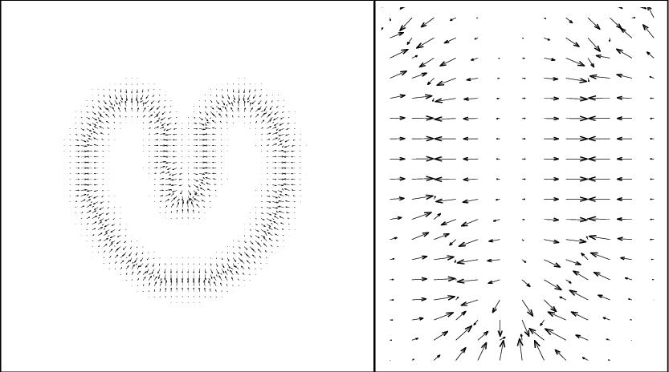
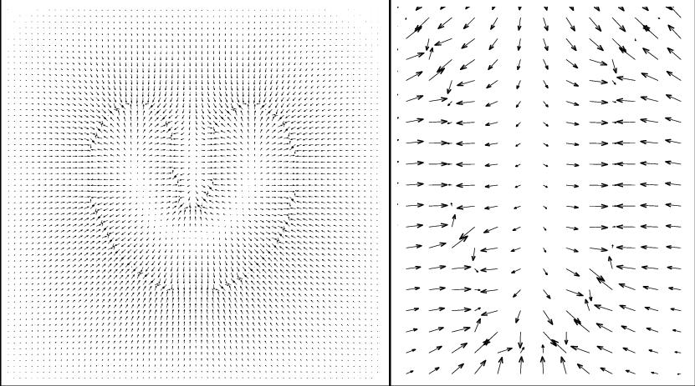
Traditional external force field v/s GVF field
Traditional force
GVF force
(Diagrams courtesy “Snakes, shapes, gradient vector flow”, Xu, Prince)

Slide 25
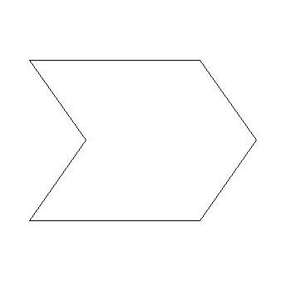
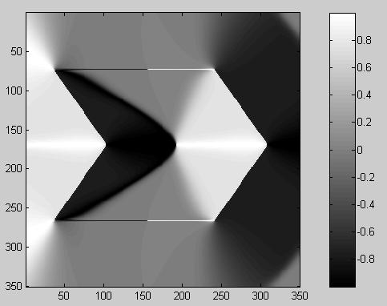
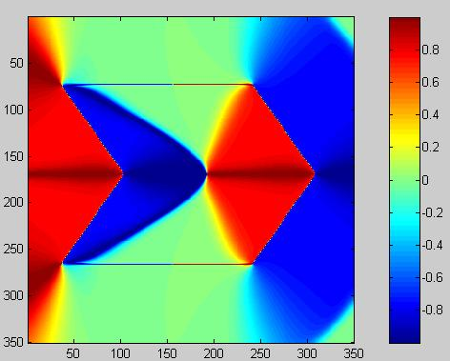
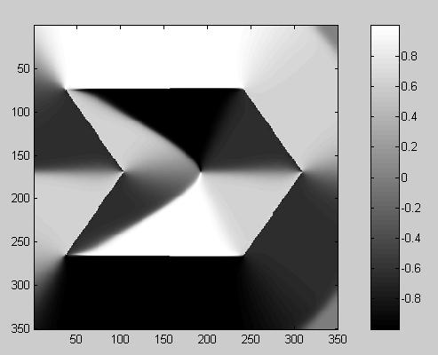
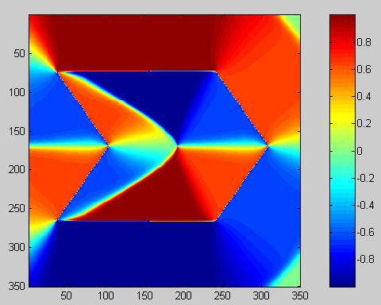
A look into the vector field components
u(x,y)
v(x,y)
Note forces also act inside the object boundary!!

Slide 26
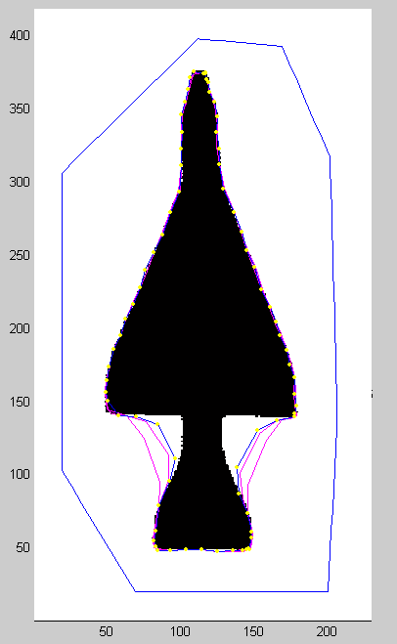
Results
Traditional snake
GVF snake

Slide 27
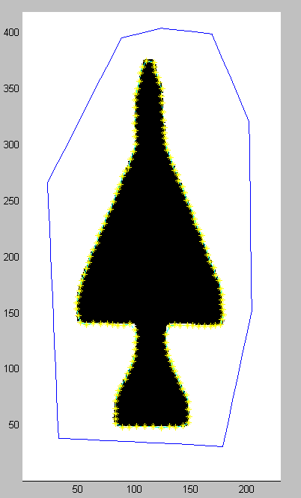
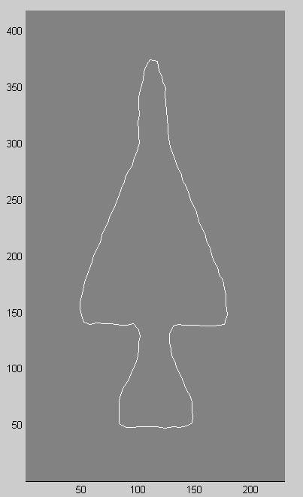
Cluster and reparametrize the contour dynamically.
Final shape detected

Slide 28
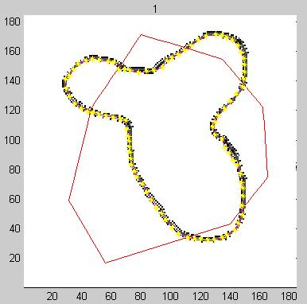
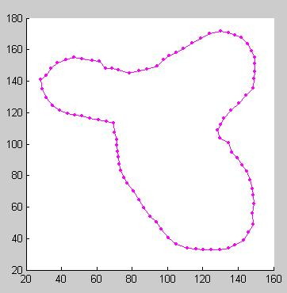
The contour can also be initialized across the boundary of object!!
Something not possible with traditional snakes.

Slide 29
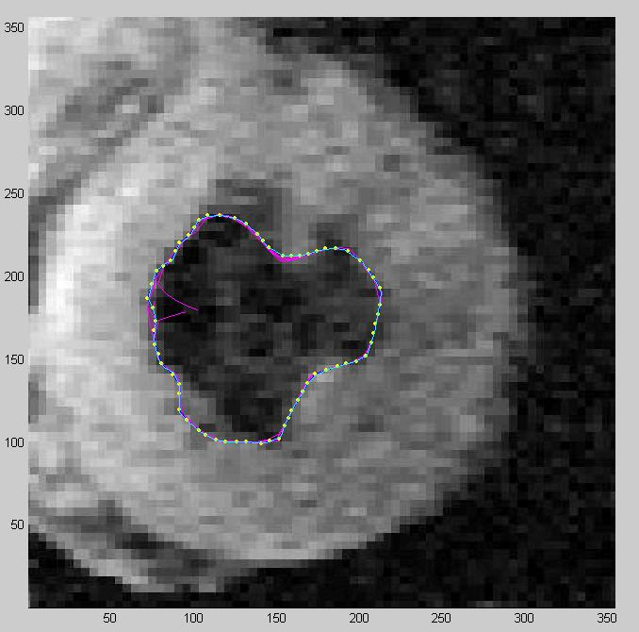
Medical Imaging
Magnetic resonance image of the left ventricle of human heart
Notice that the image is poor quality with sampling artifacts

Slide 30
Problem with GVF snake
Very sensitive to parameters.
Slow. Finding GVF field is computationally expensive.

Slide 31
Applications of snakes
Image segmentation particularly medical imaging community (tremendous help).
Motion tracking.
Stereo matching (Kass, Witkin).
Shape recognition.

Slide 32
References
M. Kass, A. Witkin, and D. Terzopoulos, "Snakes: Active contour models.“, International Journal of Computer Vision. v. 1, n. 4, pp. 321-331, 1987.
Chenyang Xu and Jerry L. Prince , "Snakes, Shape, and Gradient Vector Flow“, IEEE Transactions on Image Processing, 1998.
C. Xu and J.L. Prince, “Gradient Vector Flow: A New External Force for Snakes”, Proc. IEEE Conf. on Comp. Vis. Patt. Recog. (CVPR), Los Alamitos: Comp. Soc. Press, pp. 66-71, June 1997.

Slide 33
Questions??

