Slide 1
RECESSIONARY THUMBPRINTS ALL OVER THIS UMICH REPORT
经济衰退的迹象遍布这份密歇根大学报告

Slide 2
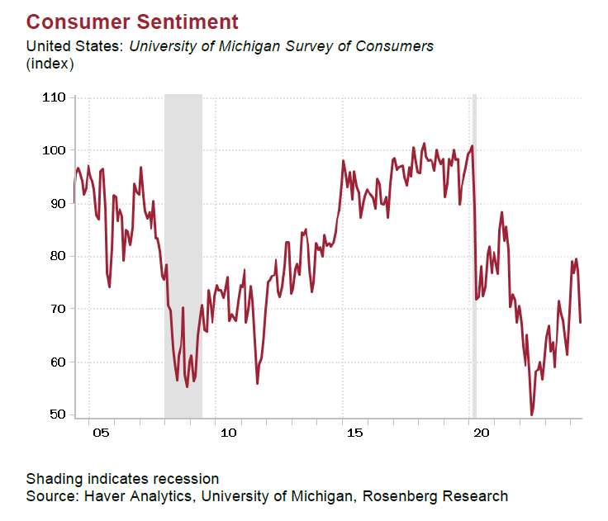
The preliminary May reading for the University of Michigan Survey of Consumers plunged to 67.4 from 77.2 in April. This came as a downside surprise to expectations of a one-point decrease to 76.2, while marking the lowest level since November and the second straight fall-off in sentiment.
5月的初步密歇根大学消费者调查指数从4月的77.2骤降至67.4。这超出了预期的一点降幅（76.2），标志着自11月以来的最低水平，也是连续第二次情绪下降。

Slide 3
The -10 point decline was the worst monthly performance since August 2021. The deterioration was across the board, as both current conditions (68.8 from 79.0; consensus: 79.0) and expectations (66.5 from 76.0; consensus: 75.0) fell to six-month lows.
这次10点的降幅是自2021年8月以来最糟糕的月度表现。这种恶化是全方面的，因为无论是当前状况指数（从79.0降至68.8；预期为79.0）还是预期指数（从76.0降至66.5；预期为75.0）都跌至六个月来的低点。

Slide 4
For current conditions, this marked the biggest pullback since April 2020. This report was nothing short of recessionary, with the weakness seen by consumers across all ages, incomes, and levels of education.
对于当前状况，这标志着自2020年4月以来最大的回落。这份报告无疑显示出经济衰退的迹象，消费者在各年龄层、收入层次和教育水平上的信心都出现了下降。

Slide 5
Household views on the economy have soured dramatically, as both near-term and long-term opinions on business conditions slumped to their worst levels in six months. Ditto for opinions on personal finances. The expected change in real incomes index plunged to 57.0 from 67.0, a level not seen since June 2012.
家庭对经济的看法急剧恶化，短期和长期的商业条件意见均降至六个月来的最差水平。个人财务状况的看法也是如此。实际收入预期指数从67.0骤降至57.0，这是自2012年6月以来的最低水平。

Slide 6
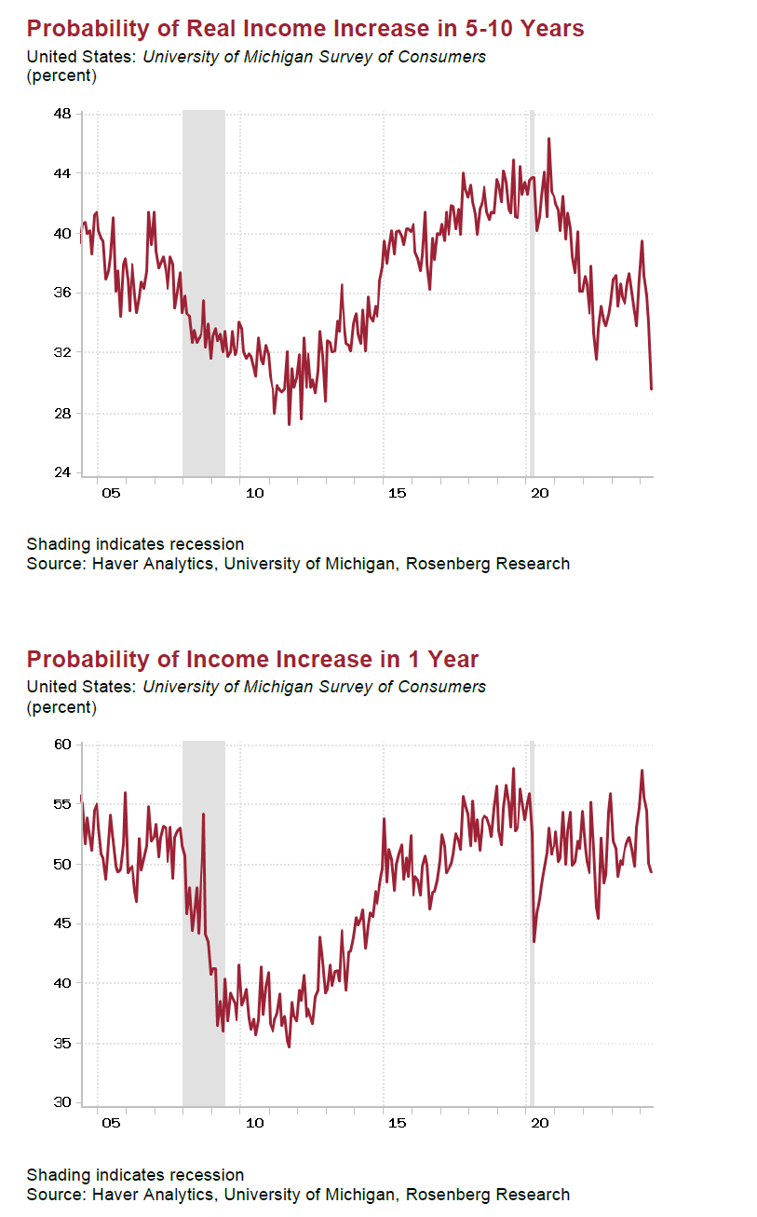
This was sitting at 81.0 at the beginning of the year for context. The probability of higher incomes over the coming year fell for the fourth straight month to 49% from 50% in April, 54% in March, 56% in February, and 58% in January. Consumers haven’t been this bearish on their wages since March 2023. Odds of real income gains over the next five years have been whittled down to just 30% (also the lowest since 2012).
作为对比，今年初这一指数为81.0。未来一年的收入增加概率连续第四个月下降，从4月的50%降至49%，3月为54%，2月为56%，1月为58%。消费者对工资的看法自2023年3月以来未曾如此悲观。未来五年实际收入增长的可能性已下降到仅有30%（也是自2012年以来的最低水平）。

Slide 7
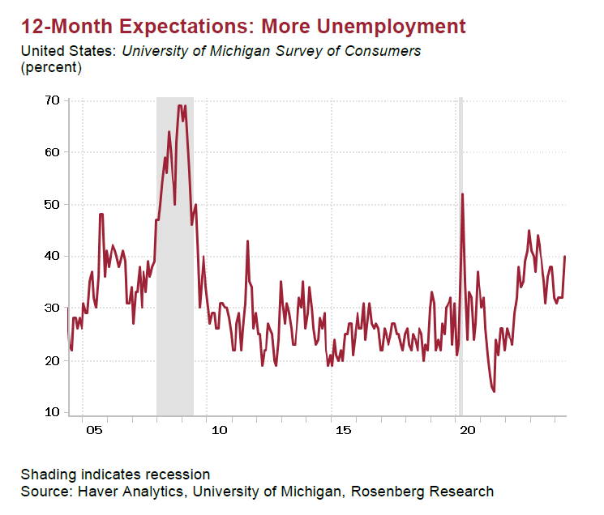
Fully 40% of respondents believe that unemployment will increase over the coming year — the most since this time last year. We can add this UMich report to the list of weakening labor market readings of late.
完全有40%的受访者认为未来一年失业率将上升——这是自去年同期以来的最高水平。我们可以将这份密歇根大学报告加入到近期劳动市场疲软的报告名单中。

Slide 8
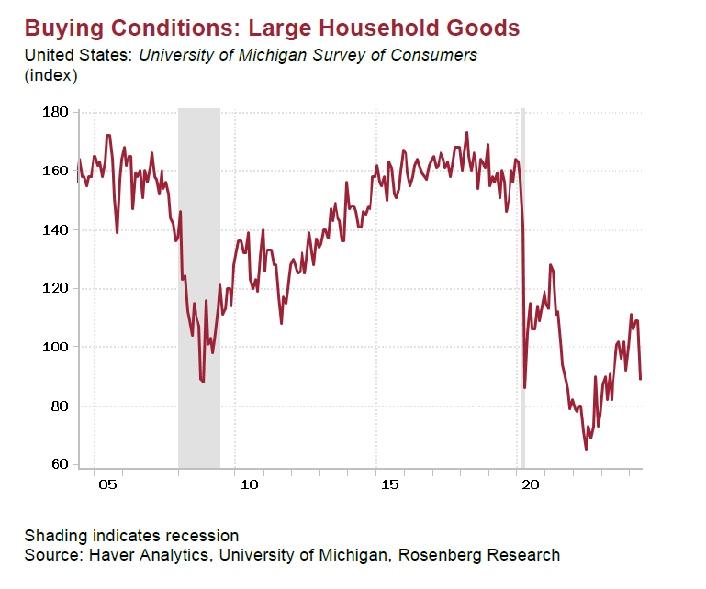
Unsurprisingly, the negative outlook on personal finances and jobs/wages translated into a dismal set of buying conditions readings. Indeed, views on large household goods plummeted -20 points (89.0 from 109.0) to stand at a 12-month low (the largest decline since April 2020).
不出所料，对个人财务和工作/工资的负面展望导致了糟糕的购买条件指标。实际上，对大型家用商品的看法下降了20点（从109.0降至89.0），处于12个月来的最低点（自2020年4月以来的最大降幅）。

Slide 9
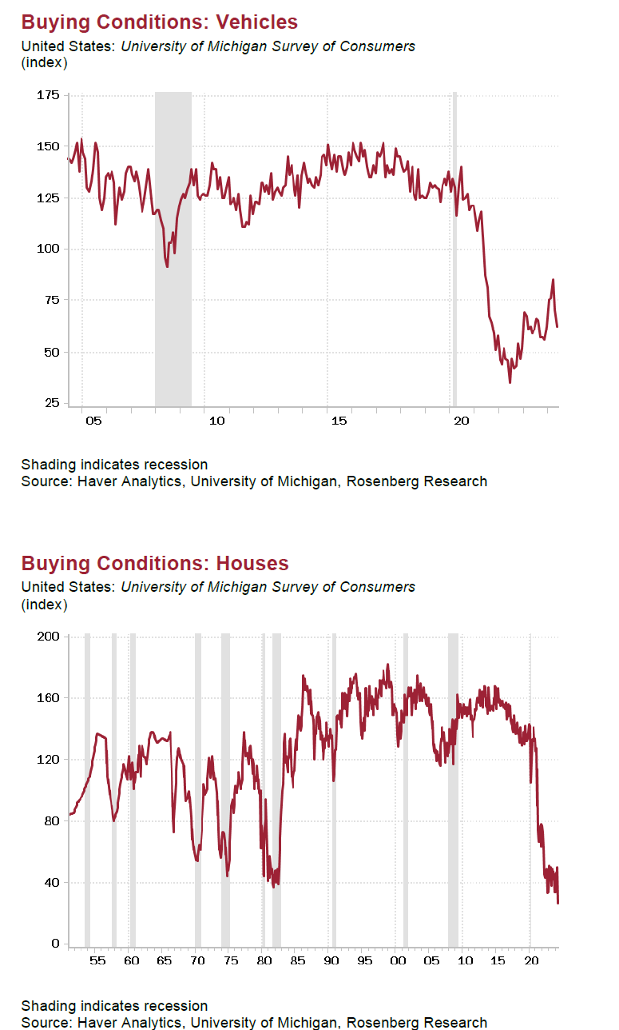
Auto buying plans (62.0 from 70.0) hit their worst in five months. Of particular concern was the fact that intentions to buy a home plunged to the worst on record (!) based on data back to the 1950s.
购车计划（从70.0降至62.0）达到了五个月来的最差水平。特别令人担忧的是，购房意向降至有记录以来的最差水平（数据可追溯至1950年代）。

Slide 10
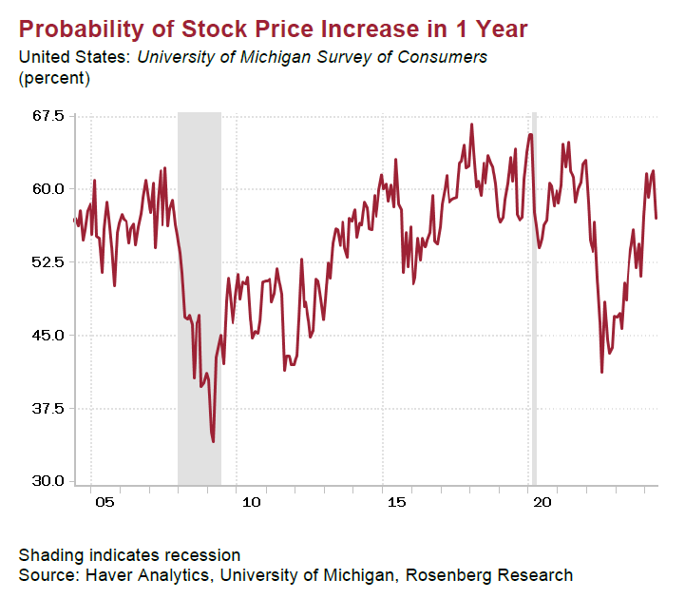
Households have abandoned their bullish views on the stock market as the mean probability of rising stock prices over the coming year fell to 57% from 62%.
家庭已放弃对股市的乐观看法，因为未来一年股价上涨的平均概率从62%降至57%。

Slide 11
From a wealth perspective, this view was offset by where assessments of home prices are going — 51% believe the value of their home will be higher next year compared to 49% prior (most since April 2022). Perhaps to be expected given the sclerotic housing market implied by such a dismal reading on homebuying intentions.
从财富的角度来看，这一观点被对房价走势的评估所抵消——51%的人相信明年他们的房屋价值会更高，相比之前的49%（这是自2022年4月以来的最高水平）。鉴于购房意向如此低迷，房市僵化也许是预料之中的。

Slide 12
At play has been the Fed’s successful efforts to push back on rate cut timing, and the re-emergence of “higher for longer” creeping into consumers’ views on interest rates. Three-quarters of respondents believe that interest rates will either “stay the same” or “go up” (most since November), while 25% believe they will be heading lower over the coming year.
正在发挥作用的是美联储成功推迟降息时间的努力，以及“高利率持续更久”重新出现在消费者对利率的看法中。四分之三的受访者相信利率将“保持不变”或“上升”（自11月以来最多），而25%的人相信未来一年利率将下降。

Slide 13
Year-ahead inflation expectations did disappoint, rising to 3.5% from 3.2% (consensus: 3.2%) though it’s hard to imagine a scenario where this plays out given such weak demand indicators present in this report.
未来一年的通胀预期令人失望，从3.2%上升到3.5%（预期：3.2%），尽管很难想象在这份报告中显示的如此疲软的需求指标下会出现这种情况。

Slide 14
To us, the biggest influence on this front comes from the 50% of respondents who believe gas prices are heading higher — the most since November. We can also add the home price expectations given their outsized influence on CPI inflation.
对我们来说，这方面最大的影响来自50%受访者相信汽油价格将会上涨——这是自11月以来最多的。

Slide 15
More important was the fact that long-term price measures remain incredibly stable — inching up to 3.1% from 3.0%, remaining in their well-established range since January 2022.
更重要的是，长期价格指标依然非常稳定——从3.0%小幅上升到3.1%，自2022年1月以来一直在其既定范围内。

