Slide 1
Transition (Part III - Part IV)
COMP-SCI 5542 (SP17) - Big Data Analytics and Applications
Paper 12 Presentation (Team 9 and Team 15)
Virtual Body Swap: A New Feasible Tool to be Explored in Health and Education
Part IV - Methods
Speaker: Dayu Wang (45) (From Team 9)

Slide 2
Dayu Wang (45) - Page 1
·Part IV - Methods
Dayu Wang (45) - Page 1
·Design of the Present Study - 2 Different Procedures
TMBA
Evaluate
Perception of Presence
SL
Impact of Feeling in Another Body
A person is immersed in another virtual environment, captured from the real world through a video camera.
Head-Controlled Illusion | Full Body Swap Illusion
Provides immersion (P in VE). | Experiences full body control.
Head-mounted display (HMD). | Contains the same HMD.
Performer’s body available. | Performer’s body not available.
Real person vs. virtual avatar. | Freely moving the head.

Slide 3
Dayu Wang (45) - Page 2
·Experiment Set-up
Dayu Wang (45) - Page 2
 | Experiment 1 | Experiment 2
Aim | Show that it is possible that immersion in another person’s body. Evaluate subject impact. | Examine the effects of body image. Examine the effects of body agency.
Consideration | With head and body agencies, see other person’s body from my perspective. | In a 3D virtual world environment, performers can freely move head, but no body agency, no seeing of virtual body.
Participants | Same group of people. | Same group of people.
Order | First | Second
Questionnaire | Subtle adaption to the context. | Same questionnaire.

Slide 4
Dayu Wang (45) - Page 3
·Experiment Procedure - Participants and Illusions
Page 3
16 Participants
Body Swap Illusion
Exploration  2 min  Slow move  See their own body
Explore Touch  2 min  2 assistants  Touch hand palm
Narrative with Object  3 min  Held an orange  Move the object freely
Face-to-Face Handshake  3 min  Performer vs. user  Immediate interview
13 Effective Participants
5 Females
8 Males
Age
Under 18
Pregnant
Nausea
Labyrinthitis
Heart Disease

Slide 5
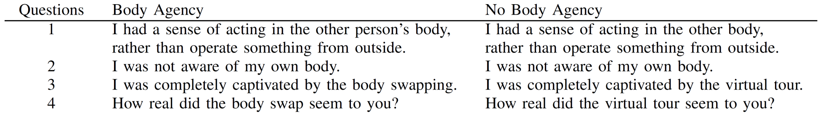

Dayu Wang (45) - Page 4
·Experiment Procedure - Question are and Statistics
4
Questionnaire Items
Qualitative Method
Taken immediately after the experiment
Statistical Data Analysis
SPSS 22.0
TMBA Procedure
(Body Agency)
Presence Induction Efficacy
Repeated measures ANOVA
SL Procedure
(No Body Agency)

Slide 6
Transition (Part IV - Part V)
COMP-SCI 5542 (SP17) - Big Data Analytics and Applications
Paper 12 Presentation (Team 9 and Team 15)
Virtual Body Swap: A New Feasible Tool to be Explored in Health and Education
Part V - Results
Speaker: Chen Wang (44) (From Team 9)

Slide 7
Chen Wang (44) - Page 1
Result - Mean of Presence (M)
Chen Wang (44) - Page 1
Procedure | M
TMBA | 1.80
SL | 0.62
TMBA procedure has higher performance than SL procedure
Interview about the TMBA: | Answer
Whole experience | “It was very interesting to experience a body different from my own body!”
Feeling about the performer | “I would like to be her friend!”
Experience about the last step | “I’m shaking hands with myself!”.

Slide 8
Chen Wang (44) - Page 2
Result - Standard Deviation (SD)
Chen Wang (44) - Page 2
Procedure | SD
TMBA | 0.21
SL | 1.37
Deviation of SL is larger than TMBA.
Influenced factor
Fatigue of the participants.
Misinterpretation of the questions.
Diversity in the expectations of the participants that arouse after they experienced the body swap illusion.

Slide 9



Chen Wang (44) - Page 3
Result - Existing Ethic Problem
Chen Wang (44) - Page 3
Participants never see their own real body or their entire avatar’s body
Their own real body
VS
But they can feel both of them
Their virtual body
There is no conceptual difference if a virtual body was replaced by a real-person’s body except for emotional and affective aspects.
It was not known whether this could be generalized to another real entire body with body agency.

Slide 10
Transition (Part V - Part VI)
COMP-SCI 5542 (SP17) - Big Data Analytics and Applications
Paper 12 Presentation (Team 9 and Team 15)
Virtual Body Swap: A New Feasible Tool to be Explored in Health and Education
Part VI - Conclusion
Speaker: Yunlong Liu (22) (From Team 9)

Slide 11
Yunlong Liu (22) - Page 1
Yunlong Liu (22) - Page 1
Conclusion
Significance: 1. Show an effective and low cost way to induce body swap
illusion with body agency.
2. The participant can face his or her own real body without noticing of the technological mediation.
3. Experience of controlling another body, having a real person as our avatar.

Slide 12
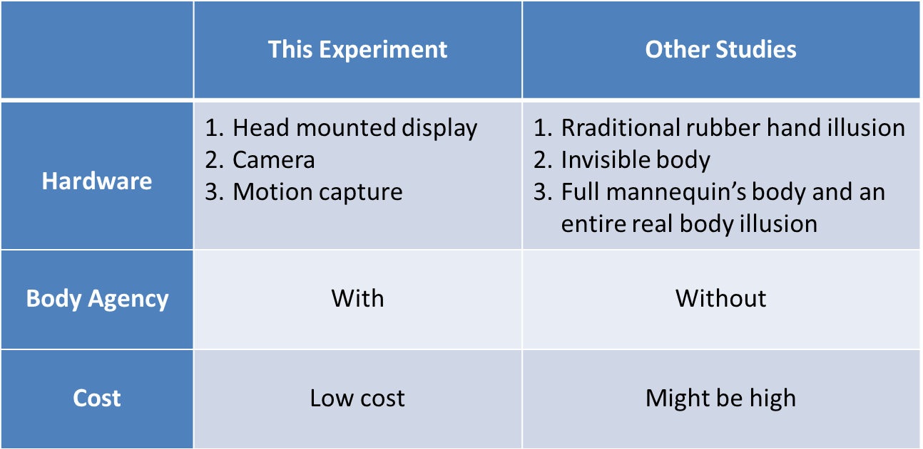
Yunlong Liu (22) - Page 2
Yunlong Liu (22) - Page 2
Comparison
Table: Comparison with other studies related to body ownership illusion present

Slide 13
Yunlong Liu (22) - Page 3
Yunlong Liu (22) - Page 3
Future work
Future work: 1. Develop better localization of standard questionnaires
2. Increasing the number of participants and reducing the time spent by each during the experiment.
3. Improve the hardware part of the system: replacing the moving mechanical part of the system with two 180 degrees cameras graphics processing software.
Possibilities area:
neuroscience
psychology
education
social science.

Slide 14
END
COMP-SCI 5542 (SP17) - Big Data Analytics and Applications
Paper 12 Presentation (Team 9 and Team 15)
Virtual Body Swap: A New Feasible Tool to be Explored in Health and Education
This is the END of the presentation.
Thank you!

