Slide 1
Title Page
COMP-SCI 5542 (SP17) - Big Data Analytics and Applications
Project Presentation
Bidirectional Tunneling of Emoticons with Text
Dayu Wang (45)
(dwk89@mail.umkc.edu)
Yunlong Liu (22)
(yln69@mail.umkc.edu)
Chen Wang (44)
(cwrp3@mail.umkc.edu)
May 4th, 2017

Slide 2


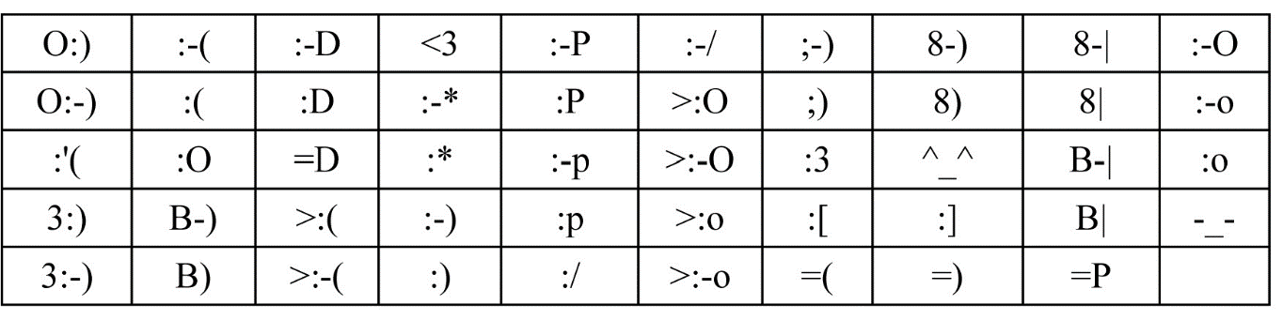

Emotion
·Emotion
Emotion: Brief conscious experience characterized by intense mental activity and a high degree of pleasure or displeasure.
Emoticon: Pictorial representation of a facial expression using punctuation marks, numbers and letters, usually written to express a person's feelings or mood.

Slide 3

Plutchik’s Wheel
·Plutchik’s Wheel - The key concept we put in the project
Cosine Similarity
Plutchik’s Wheel of Emotion
Our Implementation of the Model
Three degrees of each
Spark Word2Vec Model
Serenity < Joy < Ecstasy
Cosine Similarity, Magnitude

Slide 4
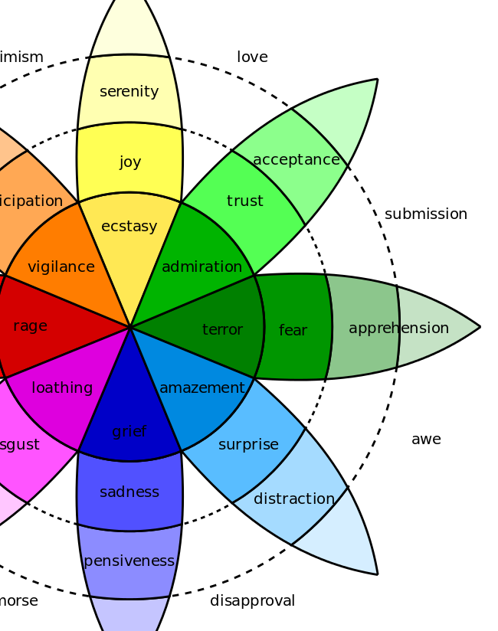

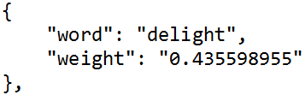
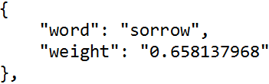





Text-To-Image
·Text-To-Image - Can I extract your mood from your words?
Training Methodology
joy
Synonym
Negation
Antonym
Workflow of the Text-To-Image System
Joy | %
Anticipation | %
Anger | %
Disgust | %
Sadness | %
Surprise | %
Fear | %
Trust | %
Selection
from
Emoticons

Slide 5


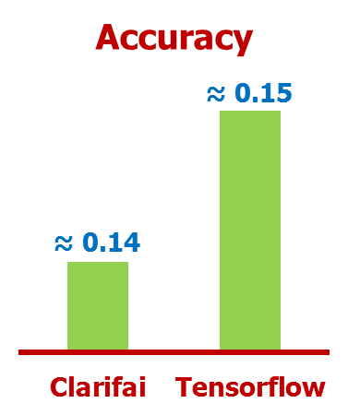

Image Training
·Image Training - Accuracy Comparison of Clarifai and Tensorflow
Class | Size
Joy | ~100
Anticipation | ~100
Anger | ~100
Disgust | ~100
Sadness | ~100
Surprise | ~100
Fear | ~100
Trust | ~100
Training Methodology
Not showing exactly Ems
Pure Image Input
Single Iteration
Only consider W_{max}.
·Workflow of the Image Training System
Machine Learning
Deep Learning
Processor
8 Classes
Weight of Each

Slide 6

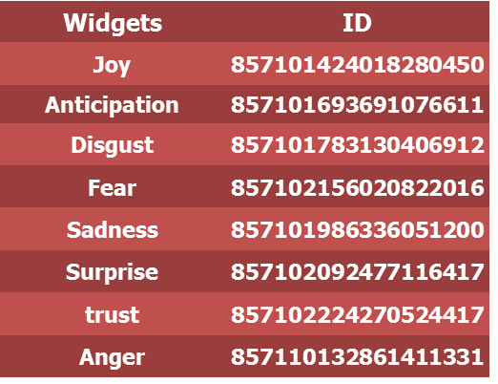
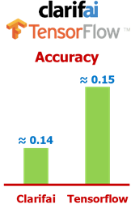
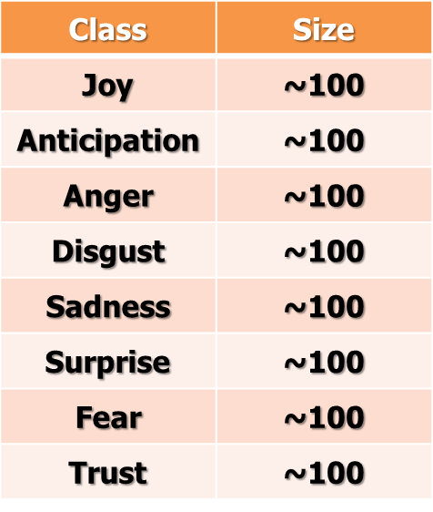

Image-To-Text
·Image-To-Text - Web Application of Bidirectional Emoji Translation

