Slide 1

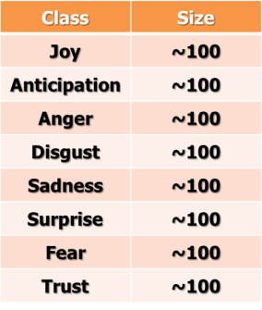
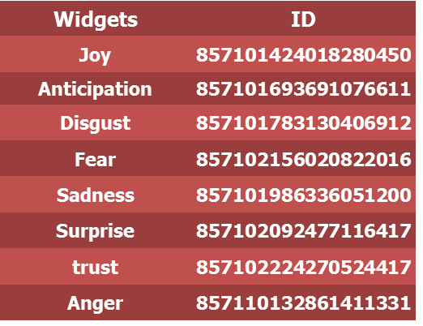

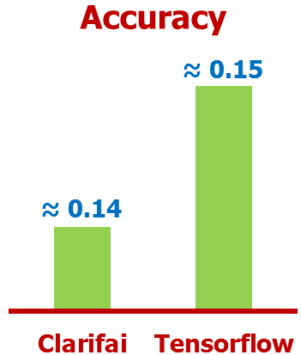
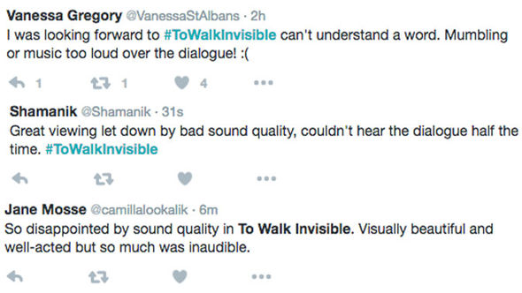
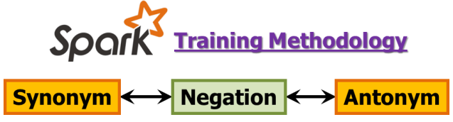
Project Statement
Dayu Wang (45)
(dwk89@mail.umkc.edu)
Yunlong Liu (22)
(yln69@mail.umkc.edu)
Chen Wang (44)
(cwrp3@mail.umkc.edu)
COMP-SCI 5542 (SP17) - Big Data Analytics and Applications
Class Project - Bidirectional Tunneling of Emoticons with Text
Presentation Video
Text-To-Image
Automatically adding emoticon.
Image-To-Text
What to tweet?
Plutchik’s Wheel of Emotion
Our Implementation
“I am not happy” versus “I am happy, but not very happy”?

Slide 2
Credit Statement
·Credit Statement
This work was done in partial fulfillment of the requirements of COMP-SCI 5542: Big Data Analytics and Applications, Department of Computer Science and Electrical Engineering, University of Missouri-Kansas City (Spring 2017).
Instructors: Dr. Lee, Yugyung
Instructors: Chandra Shekar, Mayanka
TAs: Maddula, Manikanta
TAs: Peddinti, Sudhakar Reddy
TAs: Vadlamudi, Naga K.
The END of the Video

