Slide 1
Proxy
Design Pattern
By Joshua Neutrom (#39), Yunlong Liu (#25), Chen Wang (#58), Dayu Wang (#59)

Slide 2
Introduction
Definition Input/Output of Code
Relationship Questions
Benefits
Negatives
UML
Illustration
Code Example

Slide 3
Definition
Structural design pattern
Surrogate/pointer to real object
First Request - Create object
Future requests - Directed to real object

Slide 4
Definition
Types of Proxies
Virtual - Resource intensive objects
Remote - Object at different location
Protective - Permission to access
Smart - Features such as counts, locks, and loading

Slide 5
Comparisons
Difference in interface of Proxy (same as object) from:
Adapter - different from object
Decorator - enhanced from object
Similar structure to Decorator

Slide 6
Benefits
Enhanced efficiency and lower cost
Decoupling clients from the location of remote server components
Separation of housekeeping code from functionality

Slide 7
Negatives
Less efficiency due to indirection
Complex implementation

Slide 8
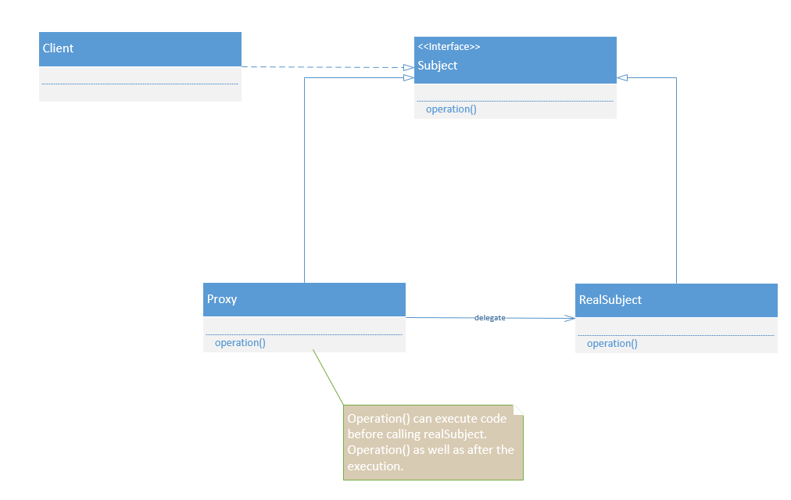
UML

Slide 9
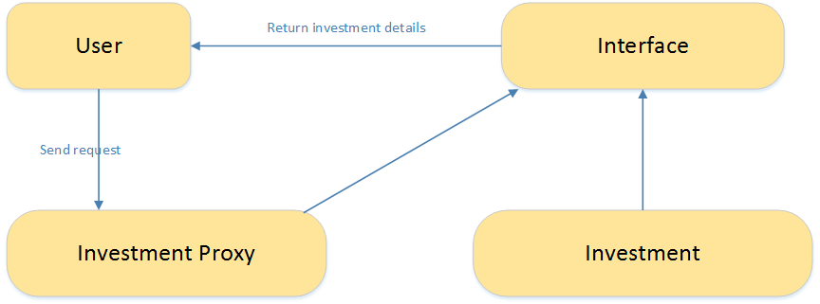
Illustration

Slide 10
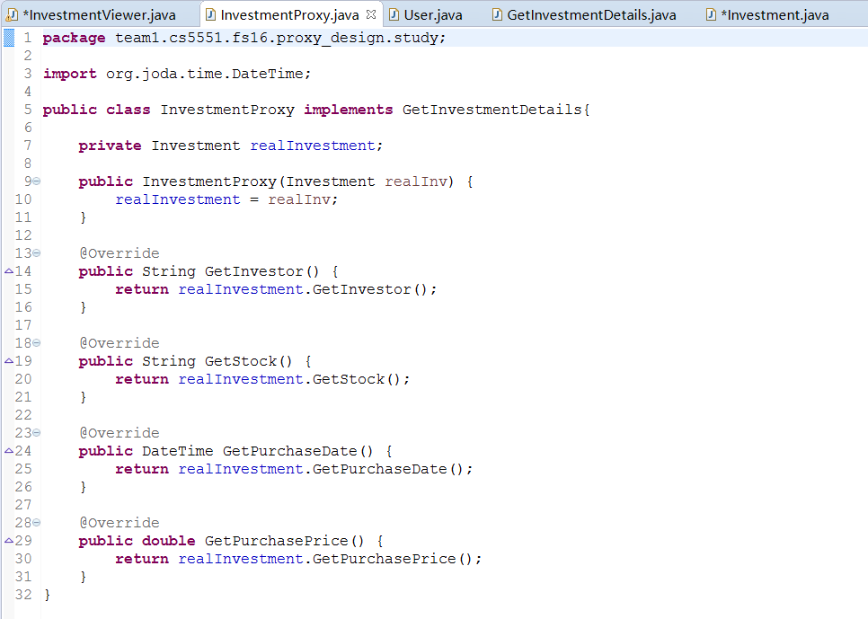
Sample Code

Slide 11
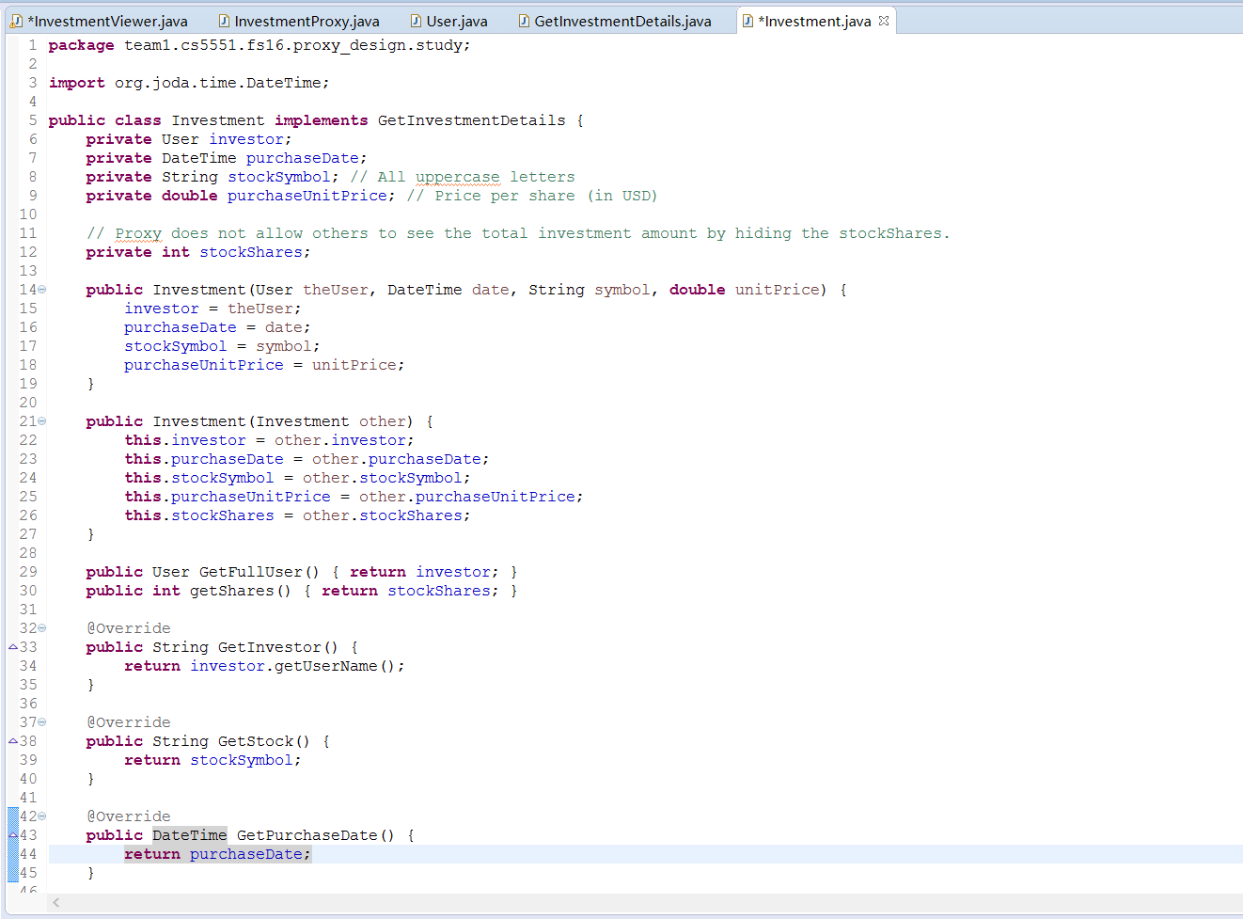
Sample Code

Slide 12
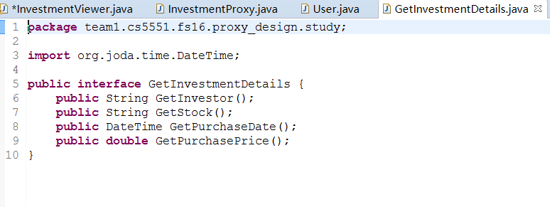
Sample Code

Slide 13
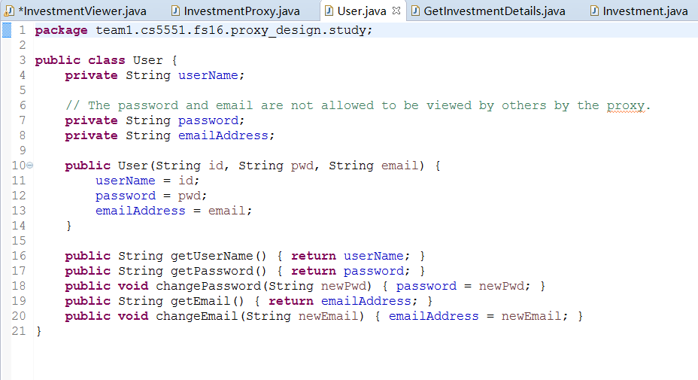
Sample Code

Slide 14
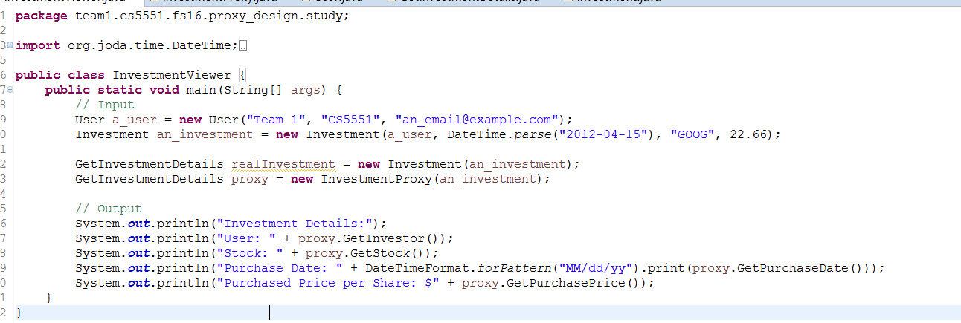
Input

Slide 15
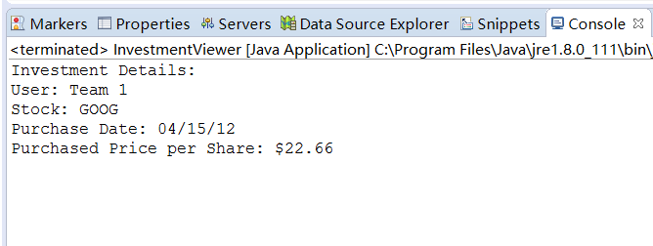
Output

Slide 16
Conclusion
Definition Questions
Benefits
Negatives
Illustration
UML
Code Example
Input/Output of Code

Slide 17
Questions/Compliments

