Slide 1
COMP-SCI 5551 (FS16) - Advanced Software Engineering
Active Learning
Observer Design Pattern
by
Project Team 1
Joshua Neustrom (39)
Yunlong Liu (25)
Chen Wang (58)
Dayu Wang (59)

Slide 2
·Introduction
Definition
Relationship
Illustration
Code Example
Input/Output of Code
Code Demo
Questions

Slide 3
·Definition
Behavioral Design Pattern
One  Many
Subject (One Keeper) Change  Observers (Many)
Encapsulation (e.g. MVC)

Slide 4
·Comparison
Differences in the following send/receiver divisions
Observer (Many at Runtime)
Chain of Responsibility (Chain)
Command (Subclass)
Mediator (Indirect, Encapsulate Others' Communications)
Mediator can use Observer.

Slide 5
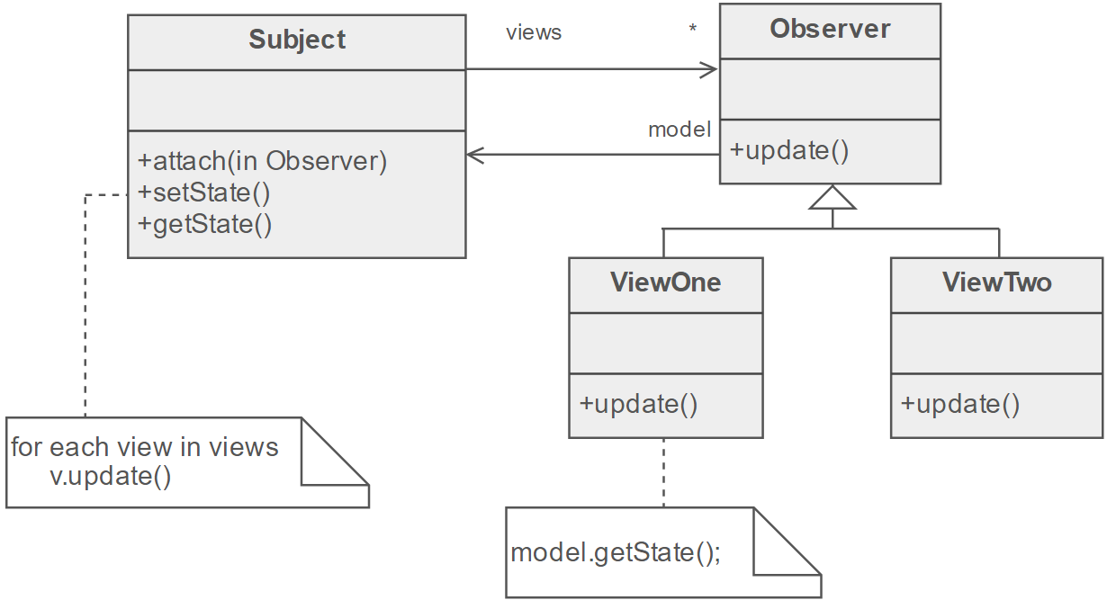
·Conceptual UML Diagram
Reference: https://sourcemaking.com/design_patterns/observer

Slide 6
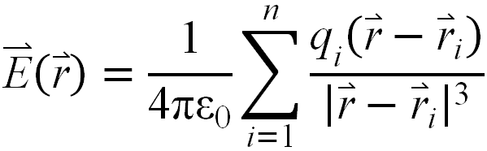


·Code Example - Calculation of Electrostatic Field in Cartesian System
Subject
Views
Observer
Electrostatic Field Calculator
Model
Get $\overset{⃑}{\text{E}}$
ε₀ | Vacuum permittivity (Farad/m)
$$\overset{⃑}{\text{r}}$$ | Target point location vector (m)
$${\overset{⃑}{\text{r}}}_{i}$$ | i ^{th} source point location vector (m)
$${\text{q}}_{i}$$ | i ^{th} source point charges (Coulomb)
x_observer
y_observer
z_observer
Get E(x)
Get E(y)
Get E(z)

Slide 7
·Code Example - Subject
1
Monitor change of user input.
2
Update the calculated electrostatic field.
3
Update the observers

Slide 8
·Code Example - Observer

Slide 9
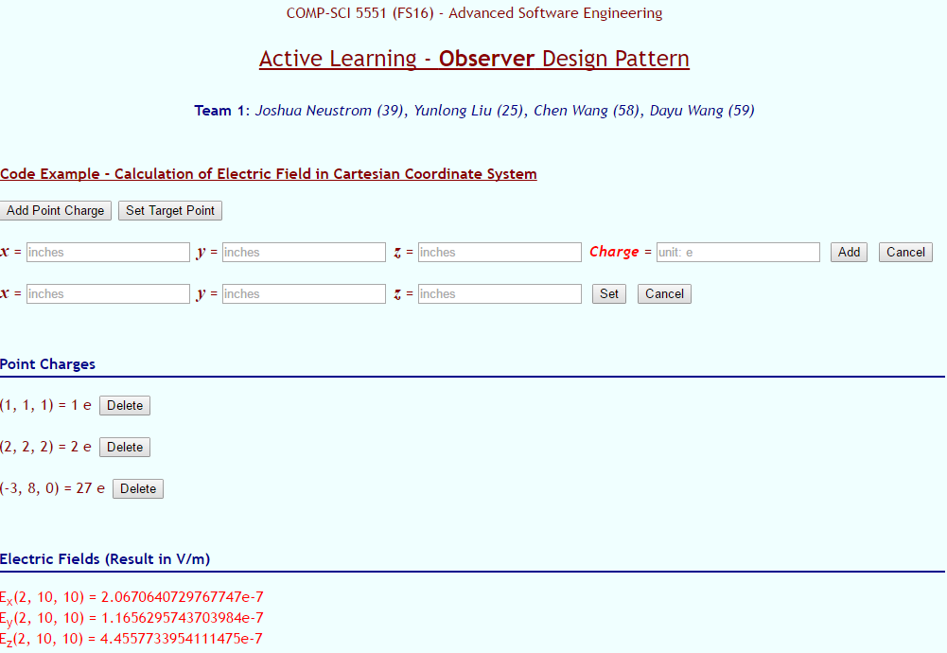
·Code Example
Input / Output

Slide 10
·Conclusion
Definition
Relationship
Illustration
Code Example
Input/Output of Code
Code Demo
Questions

Slide 11
·Questions?

