Slide 1

COMP-SCI 5551 (FS16) - Advanced Software Engineering
Project Presentation (Dec 6th, 2016)
Team 1
Joshua Neustrom (39)
Yunlong Liu (25)
Chen Wang (58)
Dayu Wang (59)
Pocket Manager
$

Slide 2
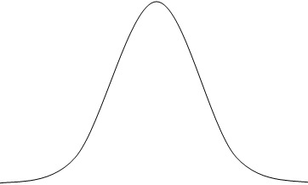
·Problem Intended to Solve - Can college students manage
·Problem Intended to Solve - their money wisely?
Problem 1: A “millionaire” at the beginning of the month
Problem 1: A “pauper” at the end of the month.
Solved
Problem 2: Credit Card Abuse
Solved
Credit Card Debt
of Graduating College Student
$3,000
Problem 3: Never record his/her expenses.
Problem 3: Never be aware of his/her bad spending habits.
Solved

Slide 3
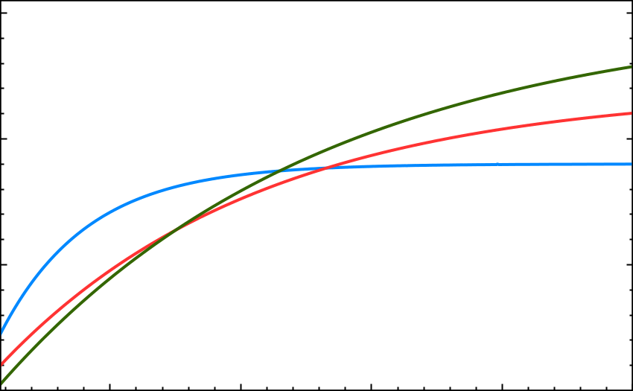

·Budget Generation - Fitting Curves - Core Philosophy
Column | A | B | min | max
Food | －1350 | 1.0003 | 800 | 1800
Living | －2200 | 1.0001 | 800 | 2400
Entertainment | －2950 | 1.00008 | 800 | 3000
$$\text{y}=\text{A}∙{\text{B}}^{\text{min}−\text{x}}+\text{max}$$
3K
Entertainment
Living
2K
Low Income - Food Budget
Food
High Income - Entertainment
1K
0
5K
10K
15K
20K
25K

Slide 4

·Separating Needs from Wants - Searching and Suggesting
Step 1: Search an item you want.
Step 2: Get our suggestion.
Design Rationale
1. How to define “affordable” and 1. “not affordable”?
2. Credit card debts are mostly 2. accumulated by multiple small
2. expenses.
3. We trust that an adult has at 3. least some ability of self-control.
Column 3
Price > Income × 15%
Column 2
Price ≤ Income × 15%
Column 1
Price ≤ Income × 3%

Slide 5
·Record Your Every Expense - Lazy? Just take a picture!
Characteristics
1. Classified into budget columns.
2. Budget deductible
3. Can save receipt picture as well.
Research Work
Automatic Receipt Input
Future Work
1. Splitted receipts
2. Automatic recognition of some 2. store receipts.
3. Self-adjusting mathematical 3. fitting curves.
The Broker’s Store
5110 Rockill Rd,
Kansas City, MO 64110
8162352296
Cashier Emily 12/04/2016 0017544
1 Coffee Mug $6.99
2 Chips (@ 2.49 each) $4.98
1 Butter $1.99
Total $13.96
Tax (10.35%) $1.44
Grand Total $15.40
Payment (Cash) $20.00
Change $4.60
Total Due $0.00
Thank you for shopping!
In most cases, the number we need in the receipt is not the largest number extracted from the OCR API.

Slide 6
The END
Thank you!

