Slide 1
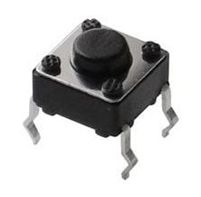
Not pushed
Pushed
Button State
MomentaryButton
PushEventButton
(capture push)
Value of “pushed()”
PushEventButton
(capture release)
LatchingButton
Legend:
True
False

Slide 2
Not pushed
Pushed
True
False
LatchingButton
(short press)
Not pushed
Pushed
LatchingButton
(long press enabled, reset state is off)
LatchingButton
(long press enabled, reset state is off)

