Slide 1

GL Management system

Slide 2
About the solution
GLMS – General ledger Management System platform is a solution for GL Control and all parties involved in GL creation and closure to enable the following:
Automate and streamline the Internal Control GL’s management process
All branches and departments request new GL creation and closure
GL reporting for GL control and Finance

Slide 3
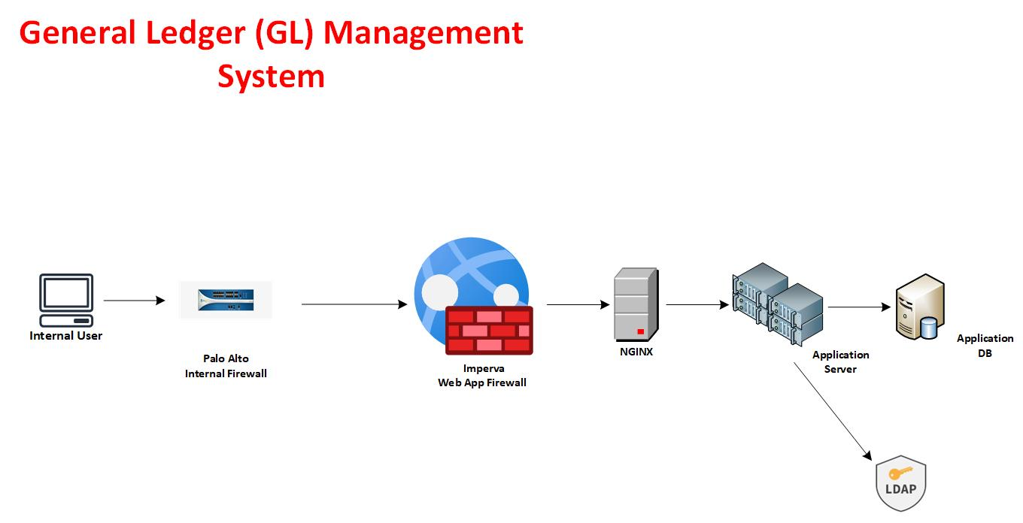
WEB APP architecture
To be replicated on DR.

Slide 4
Protocols/technology utilized
HTTPS
MSSQL Server
.Net Core 4.8

