Slide 1
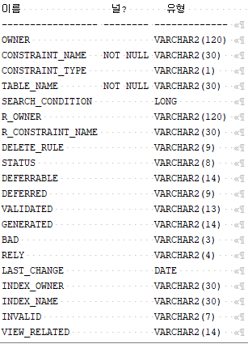
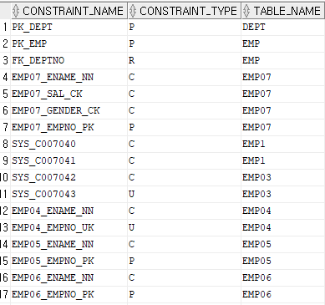
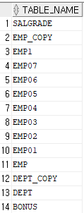
문제1
1_1
select table_name
from user_tables
order by table_name desc;
1_2 desc user_constraints;
1_3
select constraint_name,constraint_type,table_name
from user_constraints;

Slide 2
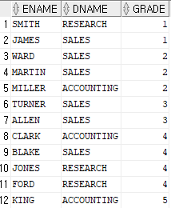
문제2
2
select ename,dname,grade
from emp e,dept d, salgrade g
where e.deptno=d.deptno and e.sal between g.losal and g.hisal;

Slide 3
문제3
3_2
create table dept01
(
deptno number(2) CONSTRAINT pk_deptno primary key,
dname varchar2(14),
loc varchar2(13)
);
3_1
create table EMP01
(
empno number(4) CONSTRAINT pk_empno primary key,
ename varchar2(10),
job varchar2(9),
mgr number(4),
hiredate date,
sal number(7,2),
comm number,
deptno number(2) CONSTRAINT fk_deptno REFERENCES dept01
);
3_3
create table salgrade01
(
grade number,
losal number,
hisal number
);

Slide 4
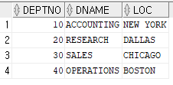
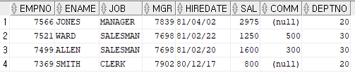
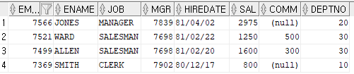

문제4
4_1
insert into dept01
values(10,'ACCOUNTING','NEW YORK');
insert into dept01
values(20,'RESEARCH','DALLAS');
insert into dept01
values(30,'SALES','CHICAGO');
insert into dept01
values(40,'OPERATIONS','BOSTON');
4_2
insert into emp01
VALUES(7566,'JONES','MANAGER',7839,'81/04/02',2975,NULL,20);
insert into emp01
VALUES(7521,'WARD','SALESMAN',7698,'81/02/22',1250,500,30);
insert into emp01
VALUES(7499,'ALLEN','SALESMAN',7698,'81/02/20',1600,300,30);
insert into emp01
VALUES(7369,'SMITH','CLERK',7902,'80/12/17',800,NULL,20);
4_3
update emp01
set deptno=10
where ename = 'SMITH';
COMMIT;
4_4
delete from emp01
where deptno=30;
rollback;

Slide 5
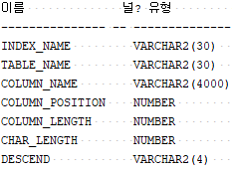
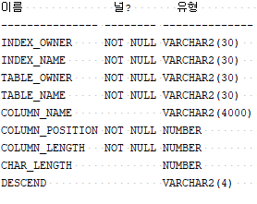
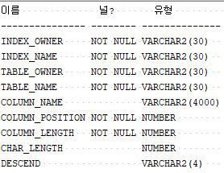
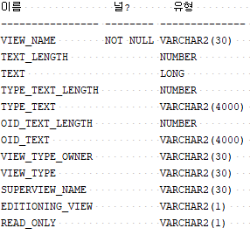
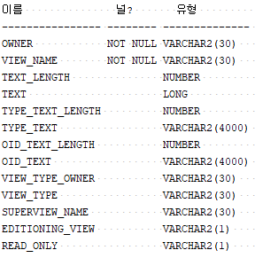
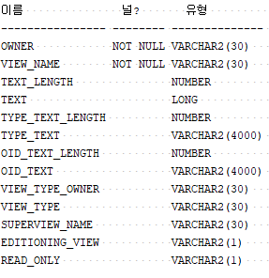
문제5
5_1
desc user_IND_COLUMNS;
desc user_views;
5_2
desc all_ind_columns;
desc all_views;
5_3
desc dba_ind_columns;
desc dba_views;

Slide 6

문제6
6_1
create index IND_ename
on EMP(ename);
6_2
select index_name,table_name
from user_ind_columns
where table_name IN ('EMP');
6_3
DROP INDEX IND_ename;
6_4
많은 데이터가 저장되었다는 가정하에 검색에 있어서 시간이 많이 걸리는 반면 상대적으로 인덱스를 사용하면 검색시간을 줄일수 있다.

Slide 7

문제7
7_1
CREATE TABLE EMPCOPY
AS
SELECT * FROM EMP;
7_2
CREATE VIEW EMPVIEW
AS
SELECT * FROM EMP;
7_3
DROP TABLE EMPCOPY;
DROP VIEW EMPVIEW;

