Slide 1
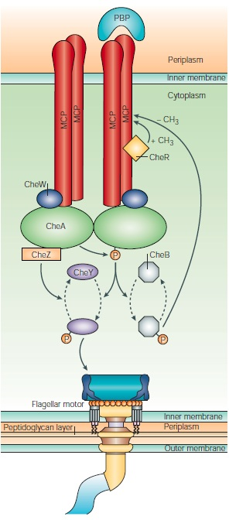
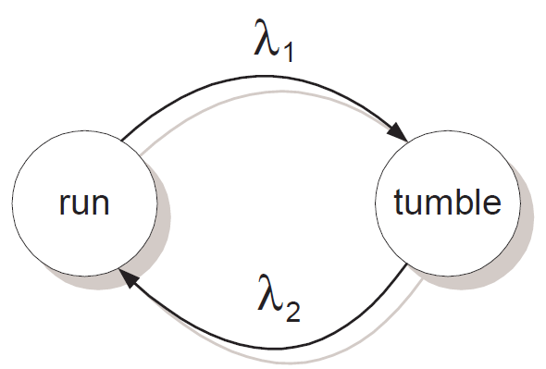
Chemotaxis Network
Wadhams, Armitage 2004
Notes:
What is chemotaxis?
Involves:
Kinases, enzymes, proteins,
Simplified model with
4 reactions
2 proteins : Che A and Che Y
2 different motor states : Run / Tumble
Receptor that changes the reaction rates
CheA : chemotaxis protein
CheY : controls flagellar motor switching

Slide 2
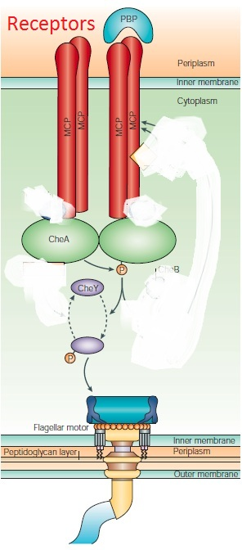
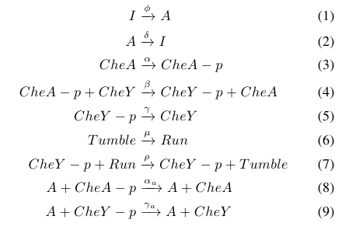
Chemotaxis Model
Wadhams, Armitage 2004
Notes:
Simplified model involving:
Receptor MCP: Monocyte chemo attractant protein
4 reactions
2 proteins : Che A and Che Y
2 different motor states : Run / Tumble
Receptor that changes the reaction rates
(ignore components that are responsible for adaptation)
1: Reactions that occur all the time, regardless of receptor state
Phosphorelatio of CheA, transfer of phorsphoryl group to CheY, dephos of Y, Run and Tumble transition
2: Reactions that occur when an chemo-attractant is detected to modulate the amounts of CheA and Che Y
Receptor is active: reduce level of CheY
3: First to validate the model, match simuation results with experimentally observed behaviors
Model as a Gillespie simulation. Reaction rates were obtained from literature.

Slide 3
Microbiorobot in Free Solution
Simulation
Notes:
4 cells attached to a rigid plate, behavior is random and independent
Position of the cells are fixed, but they are free to rotate
When they run, exerts a force, tumble – no force
Do not model any interactions, hydrodynamics

Slide 4
Simulation Flow
Single Cell
Generate random number to determine which reaction happens next
Update position and orientation of cell
MBR (multiple cells in parallel)
Initialize: Generate randomly when reactions happen
Execute reaction in specific cell with next time event. Generate time of next reaction for that cell.
Update state of cells and MBR (position, velocities.)

Slide 5
How will we experimentally validate model?
Rates of reaction:
from literature
should reflect 10 to 1 ratio of time spent in run to tumble state for single cell
Run state:
Model as exerting a force along line of cell
Value of force from literature
Tumble state
Cell is stuck, does not change orientation
Magnitude of torque exerted
Bacteria patterning on cell
Study existing MBR patterns
Compare to E.coli cell division patterns in 2D

Slide 6
Simulation Characteristics
Parameter selection
Bacteria Distribution
Attachment mechanism and how that affects the forces and torques exerted
Fluid drag model
Side effect (bacteria colliding?)
Near-wall effects (flagella hanging off the edge)

Slide 7
Experiment Details
Develop cell counting and orientation code
Look for distribution patterns
Track experiments with MBRs exposed to blue-light (tumbling) and approximate exerted torque as well as behavior during tumble.
Chemical shock

