Slide 1
Jaco
Author:
Date:
Version:
David Wong
February 2017
1.0
Notes:
The purpose of this Project Initiation Presentation (PIP) is to communicate the ideas and decisions developed during a preliminary envisioning or inception phase. The goal of the phase, represented by the content of this document, is to analyse an initial concept at a strategic level of detail and attain agreement between the business and IS on the desired solution and overall project direction.
The PIP will be completed in 2 phases; the initial version will contain the first 2 sections (Vision and Business Opportunity) together with indicative costs for the project and for the secondary planning phase. After this second phase this PIP will be revised to incorporate the remainder of the sections in order to provide a fuller and clearer picture of the proposed project.
The PIP is contains six main sections:
Vision: An executive summary of the vision and scope of the intended project
Business Opportunity: a description of the business situation and needs
Solution Concept: the approach the project team will take to meet the business needs
Scope: the boundary of the solution defined by itemising the intended features and functions, determining what is out of scope, a release strategy and the criteria by which the solution will be accepted by users and operations
Solution Design Approach: the architectural and technical designs used to create the customer’s solution
Project Structure: a strategic overview of project work scope, team requirements, issues and risks
The PIP will be used during a follow-up analysis and design phase as the context for developing more detailed technical specifications and project management plans. It provides a clear direction for the project team; outlines project goals, priorities, and constraints; and sets business expectations.
The Business Owner and IS Product Manager together are the primary drivers of the envisioning phase. They are responsible for identifying the team and for facilitating each member’s input during the envisioning phase.

Slide 2
Problem/Opportunity
Redesign Website
Less Channel Payment
Need Sms notification
Notes:
What’s the Problem or Opportunity the project is trying to address?
The Problem/Opportunity Statement section describes the business’s current situation that creates the need for the project.
This section examines in some detail the business opportunity to be addressed. It is expressed in business language, not technical terms. It should contain a statement of the business opportunity and the impact – in both a positive and negative sense - of capitalising on that opportunity. Aspects such as product innovation, revenue enhancement, cost avoidance, operational efficiencies, augmenting knowledge should all be considered.
It is also important to demonstrate that the business proposition is aligned with the relevant overall company business strategy and drivers and that revenue protection, cost reduction, regulatory compliance, and technology strategy have been considered.
This section will provide the project team and other readers with the strategic context for the remaining sections.

Slide 3
Project Vision
Redesign Website
by delivering a new system with improved plugins
Notes:
What are we going to do about it?
The Vision Statement section clearly and concisely describes the future desired state of the customer’s environment once the project is complete. This can be a restatement of the opportunity; however, it is written as if the future state has already been achieved. This statement provides a context for decision-making. It should be motivational to the project team and the customer.
A shared Vision Statement among all team members helps ensure that the solution meets the intended goals. A solid vision builds trust and cohesion among team members, clarifies perspective, improves focus, and facilitates decision-making.

Slide 4
Business Benefits
Reduce production costs by 20%
Enable 10% increase in sales
Strategic alignment – our competitive position is based on fastest delivery
Notes:
What’s are the Business Benefits?
The Business Benefits section describes how the business will derive value from the proposed solution. It connects the business goals and objectives to the specific performance expectations realized from the project. These performance expectations should be expressed numerically if at all possible.
Usually the benefits should fall into one or more of the following categories:
Increase revenue
Reduce or avoid costs
Reduce risk
Strategic alignment – i.e. the project is needed to get the business where it wants to be.

Slide 5
Budgetary Costs
Estimated Cost £200k
(based on team of 8 for 6 months)
Planning Cost £40k
    Product Backlog
    Product Roadmap/Release Plan
    Proof-of-Concept
Notes:
How much is it likely to cost?
The Budgetary Costs section should clearly indicate how much the overall project is likely to spend (Estimated Cost) together with a firmer estimate of how much will need to be spent in the next planning or elaboration phase (Planning Cost).
The Planning Cost is the amount of money needed to fund a more in-depth investigation of the proposed project in order to obtain the information necessary to complete the remainder of this PIP, and/or to establish that the project is feasible and the benefits could be delivered. This may include prototyping, user research, some high-level requirements analysis , proof-of-concept, even the first few sprints to establish the team’s velocity.

Slide 6
Solution Overview
(following slides only to be completed following further elaboration/planning phase)
Notes:
This slide begins the sections of this PIP that can only be completed in a second phase or revision, once some further elaboration/planning has been completed.
The Solution Concept provides a general description of the technical approach the project team will take to meet the business needs. This includes an understanding of the users and their requirements, the solution’s features and functions, acceptance criteria, and the architectural and technical design approaches.
The Solution Concept will provide teams with limited but sufficient detail to prove the solution to be complete and correct; to perform several types of analyses including feasibility studies, risk analysis, usability studies, and performance analysis; and to communicate the proposed solution to the buisness and other key stakeholders.

Slide 7
Solution Concept
[insert diagram, wireframes or visuals here]
Notes:
What is the intended solution?
This slide should provide a high-level outline of the solution, either as a high-level architecture or a conceptual diagram showing the scope of the solution. Alternatively, if wireframes or visuals have already been done, this section could be a few slides to show how the intended solution will look.

Slide 8
User Roles/Personas
Production Manager
Schedules work and manages work-in-progress for the Production department
Production Workers
Book time to specific production tasks and projects
Notes:
Who are the users?
This section should describe the principal user roles of the proposed solution together with the key characteristics of those roles. This information will inform and facilitate the solution design and the user scenarios. A complete set of roles helps to ensure high-level requirements can be identified for the product backlog.
This slide or section is only required if it’s not obvious to who the target users are.

Slide 9
Scope/Key Features
Production Scheduling
Production Management
Management Reporting
System Administration
Notes:
What is the broad scope of the solution?
The Scope places a boundary around the solution by detailing the range of features and functions. The Scope clearly delineates what stakeholders expect the solution to do, thus making it a basis for defining project scope and for performing many types of project and operations planning.

Slide 10
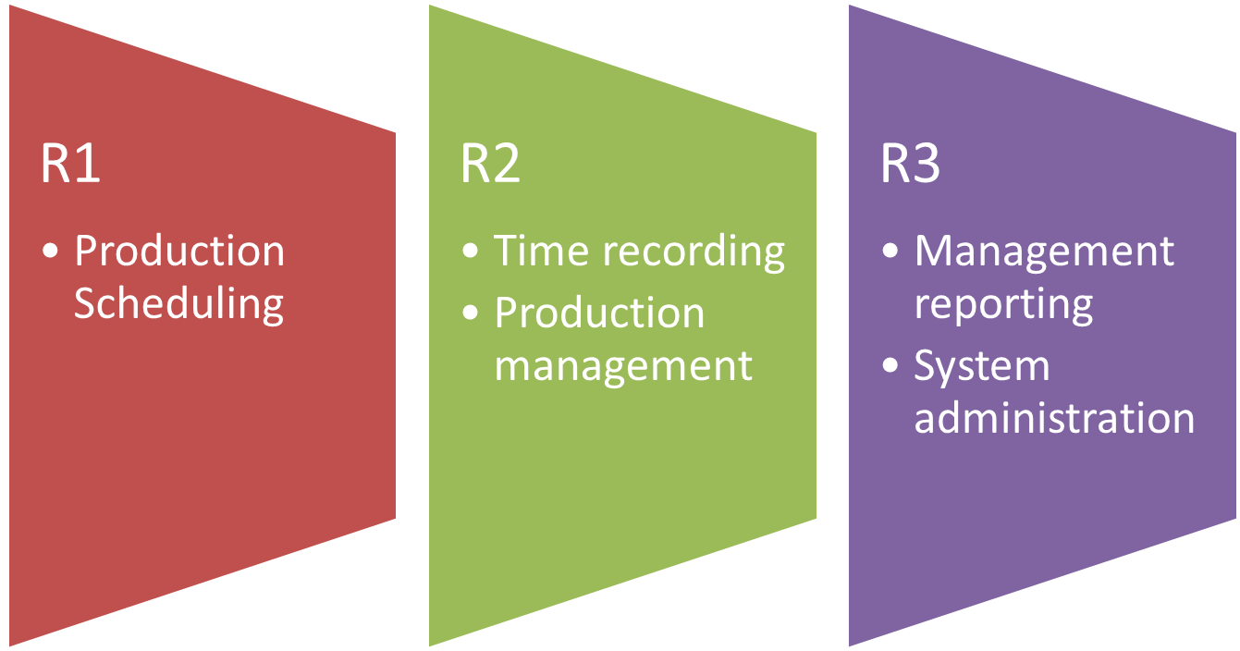
Product Roadmap/Release Strategy
Notes:
What is the Roadmap for the product / approach to releases?
The Version Release Strategy section describes how the project will deliver incremental sets of features and functions in a series of releases to completion. The Version Release Strategy enables the business to plan for an orderly implementation of the solution and defines how the scope can be allowed to flex.

Slide 11
Out of Scope
Integration with Finance systems
Notes:
The Out of Scope section lists and defines a limited set of features and functions excluded from the intended solution. It does not list everything that is Out of Scope; it only lists and defines features and functions that some users and other stakeholders might typically associate with a type of solution or product.
This section helps to clarify the solution scope and explicitly states what will not be delivered.

Slide 12
Project Structure
(following slides only to be completed following further elaboration/planning phase)
Notes:
This section should describe the team organisation and structure for the project.

Slide 13
Key Project Objectives
Deliver a new production system that significantly improves automation
Deliver highly flexible management reporting system
Deliver system admin tools that don’t require expert intervention
Notes:
What are the objectives of the project?
The Project Objectives section specifies the product’s objectives, showing how the project’s final aim will be achieved by a series of measurable components.

Slide 14
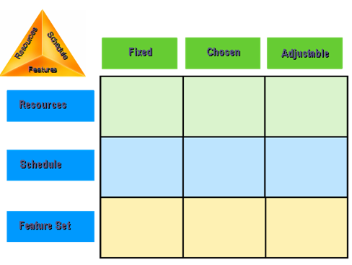

Trade-off Decisions
Given fixed schedule, we will choose resources and adjust features
Notes:
Be explicit about the project’s priorities, using the classic project management trade-off triangle.
Change underlined words accordingly and drag ticks into right position in matrix.
The Project Trade-off Matrix is a table that represents the customer’s preferences in setting priorities among schedule, resources and features. The Trade-off Matrix sets the default standard of priorities and provides guidance for making trade-offs throughout the project. These trade-offs should be established up front and then reassessed throughout the project’s life.

Slide 15
Project Approach
Agile development approach
Incremental delivery in phases
Fixed time, variable scope
Will use existing team
Notes:
This section should highlight a few key points to explain the overall approach for the project.

Slide 16
Project Costs
Development team £350k
Hardware £20k
Implementation £10k
Training £20k
Total Cost £400k
Notes:
This section should contain a breakdown of the key costs required for the project team to accomplish its work.

Slide 17




Outline Plan
Release 1
Production Scheduling
Release 2
Time Recording
Production Management
Release 3
Management Reporting
System Admin
Notes:
This slide should contain an outline plan, indicating the timescales for the key phases of the project.

Slide 18
Key Project Risks
Impact
3. High
Text Here
Text Here
Text Here
2. Medium
1. Low
Probability
1. Low
2. Medium
3. High
Notes:
Assess probability and impact of key project risks.
Explain mitigation and contingency if appropriate, and response if risk becomes reality

Slide 19
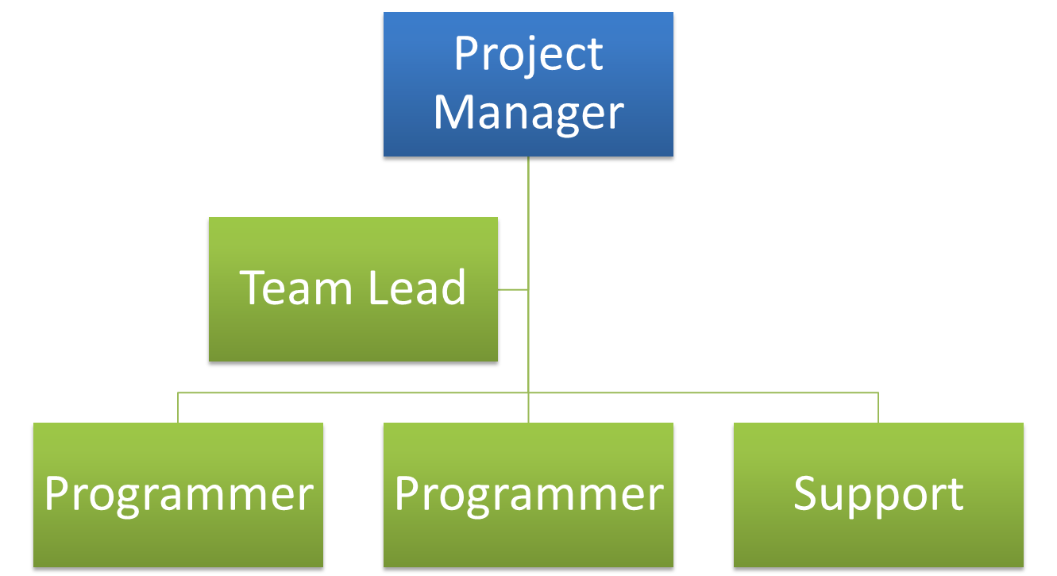
Project Team Structure
Notes:
Draw project team structure here, including all the key roles for the project.

Slide 20
Project Summary
Speed up production by 20%
Enable 10% increase in sales
Existing team of 4 people
Deliver in 1.5 months
Notes:
Summarise Costs, Benefits and Timescales.

