Slide 1


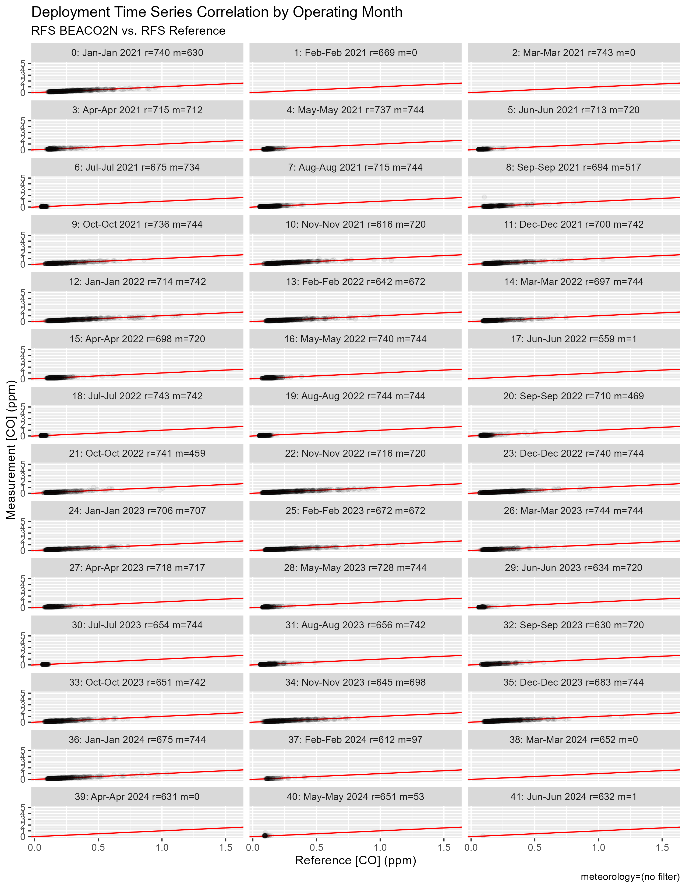
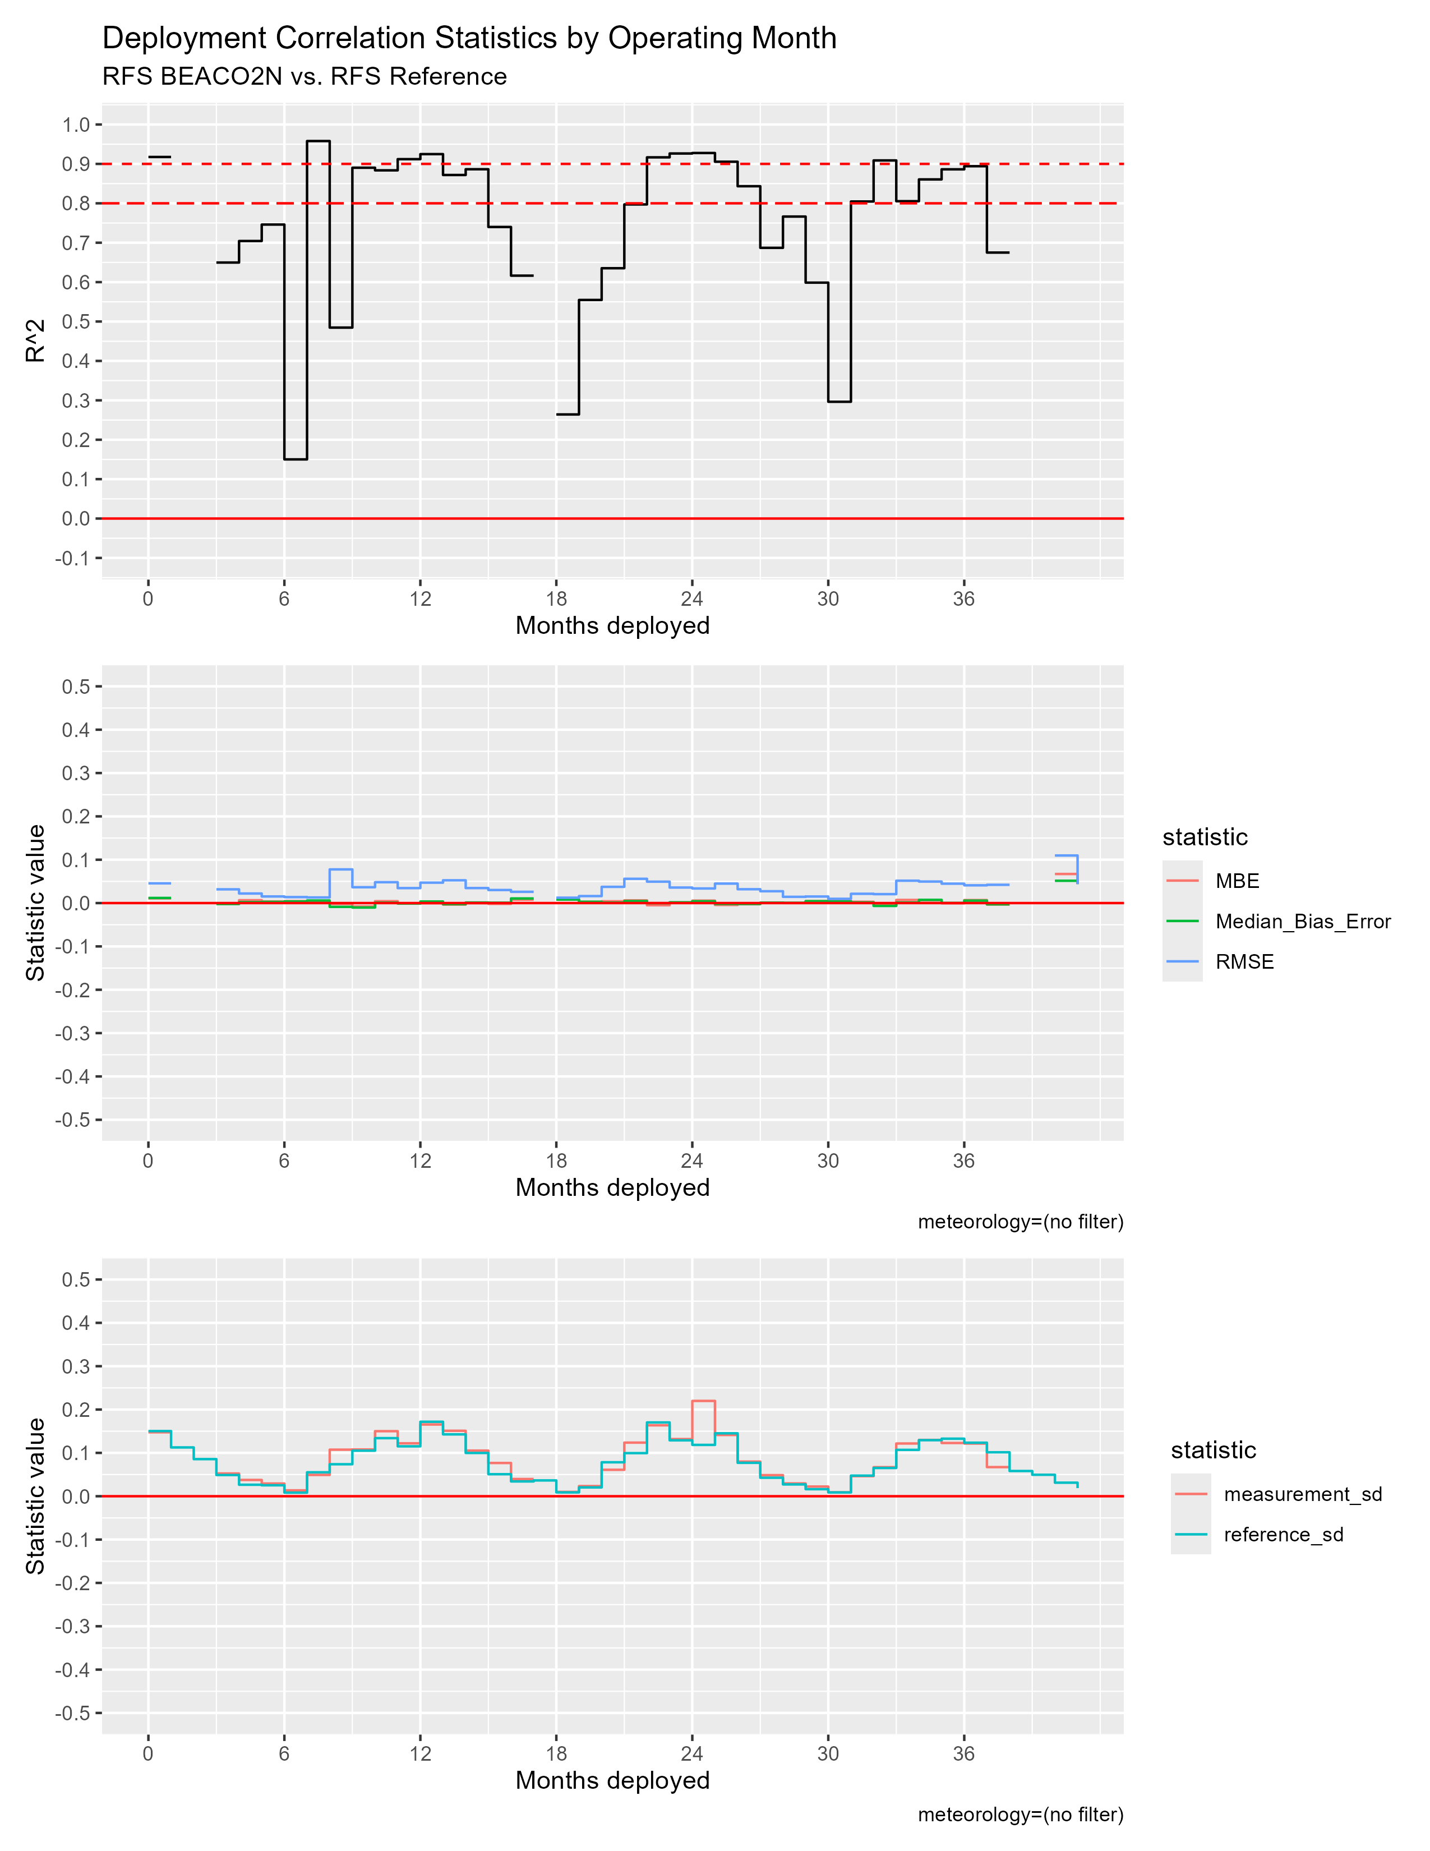
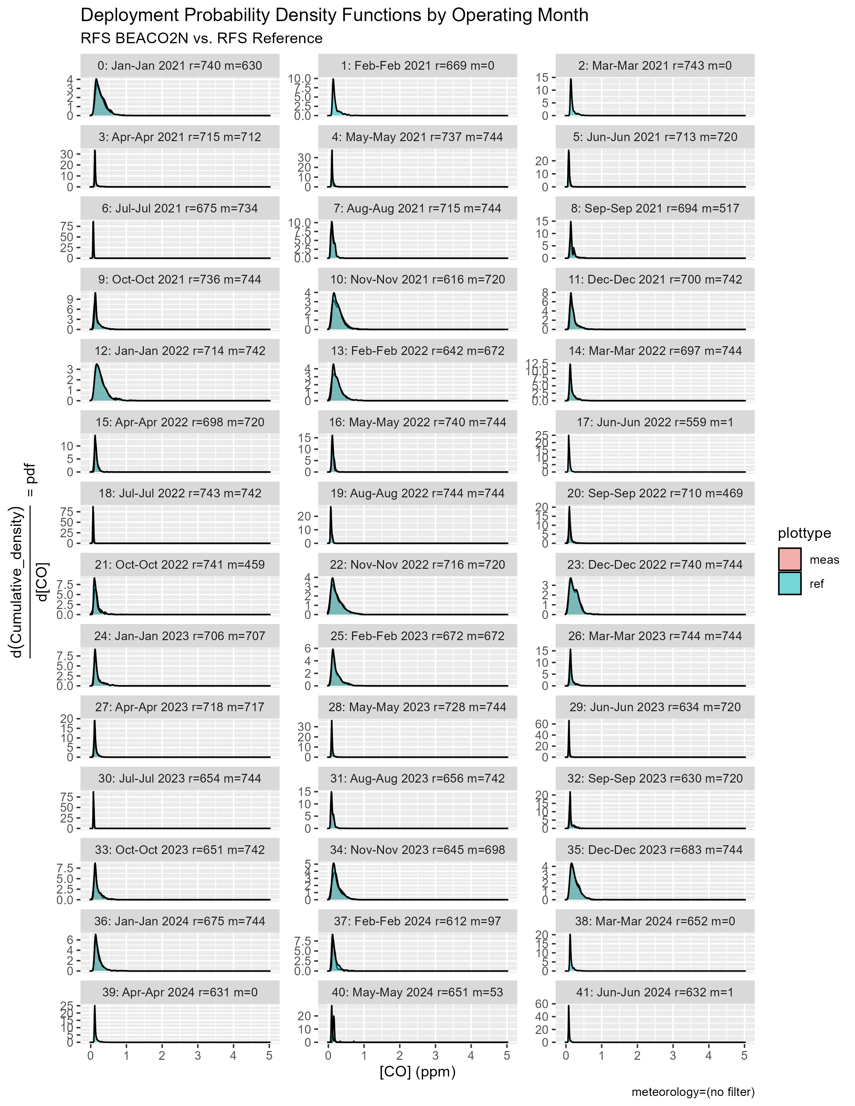
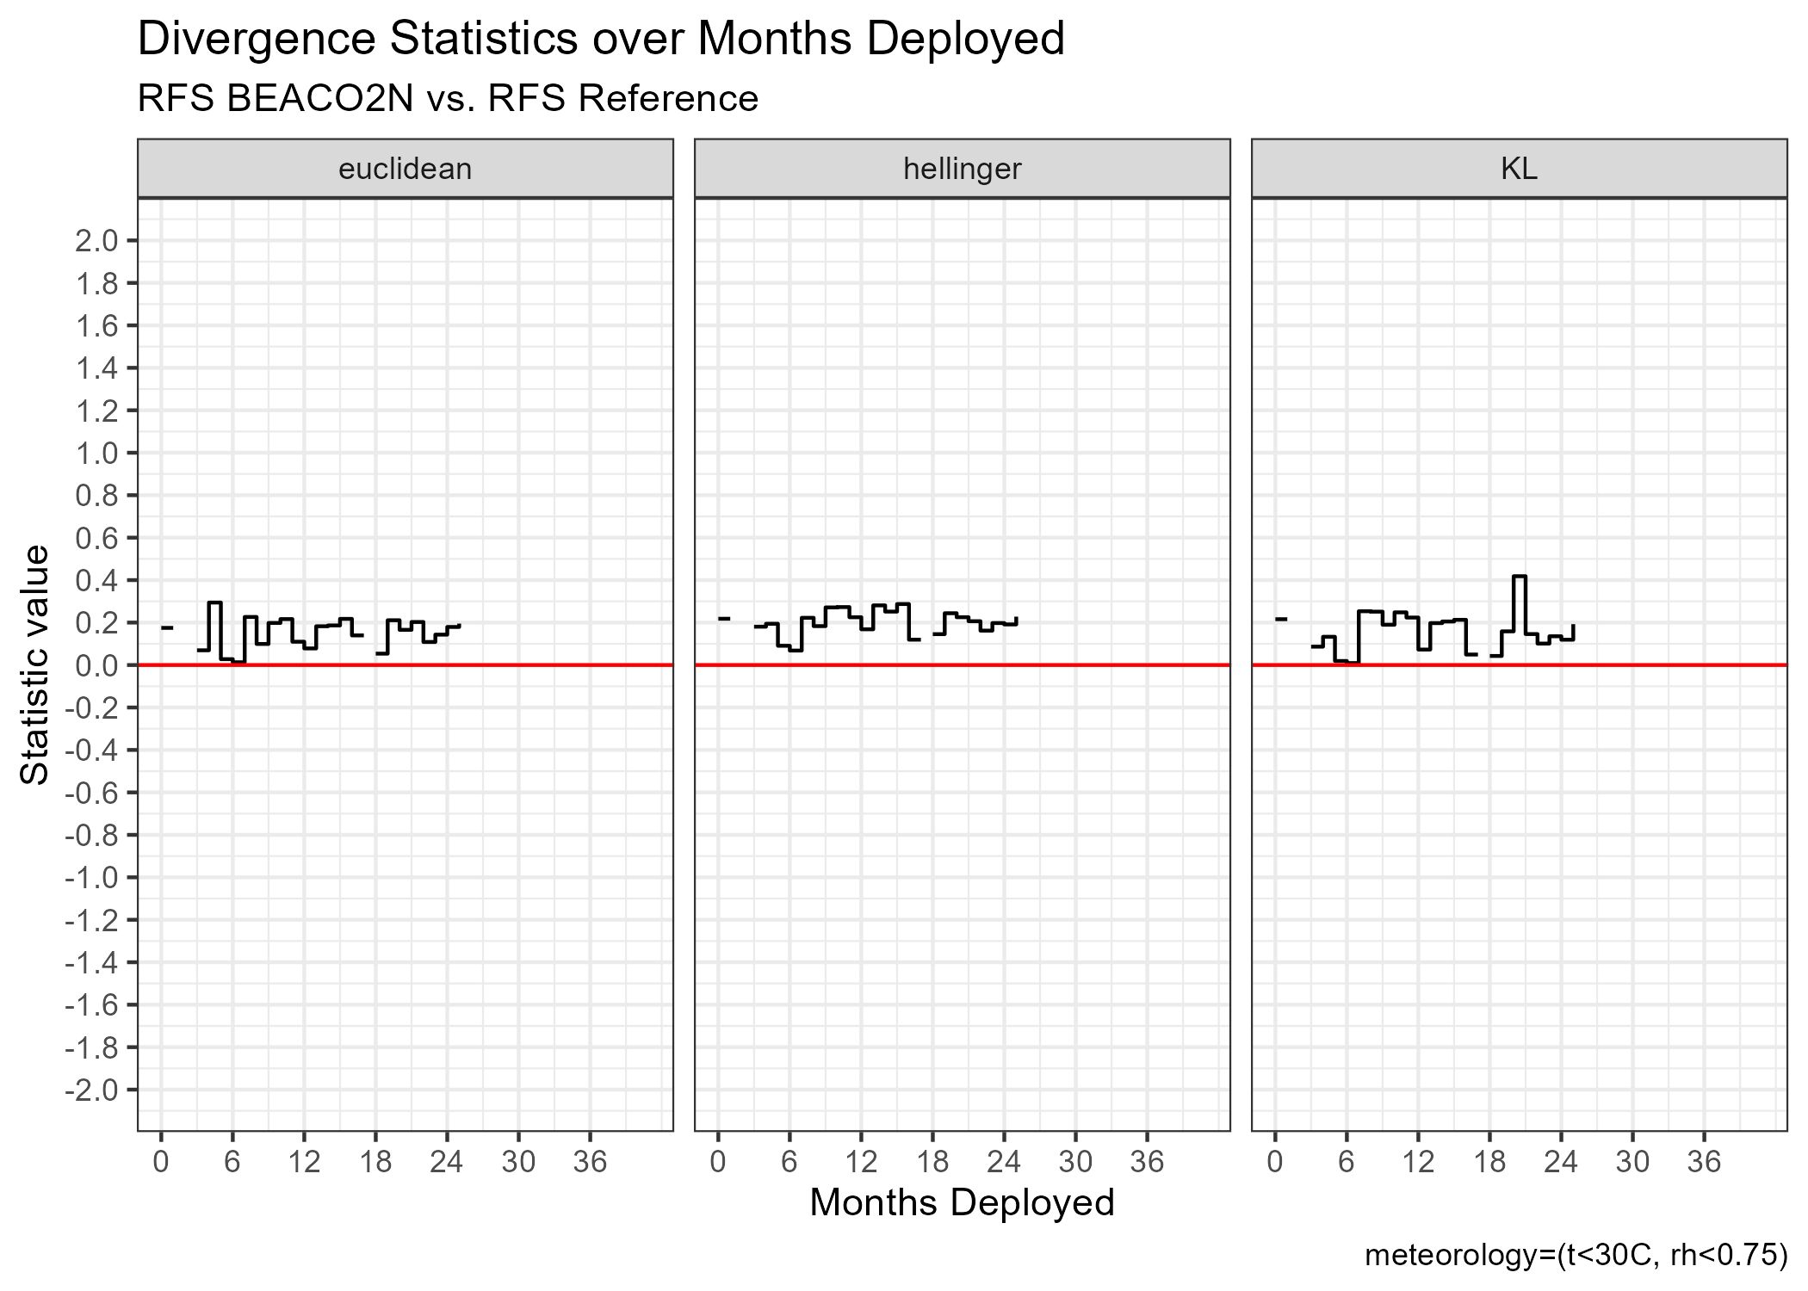
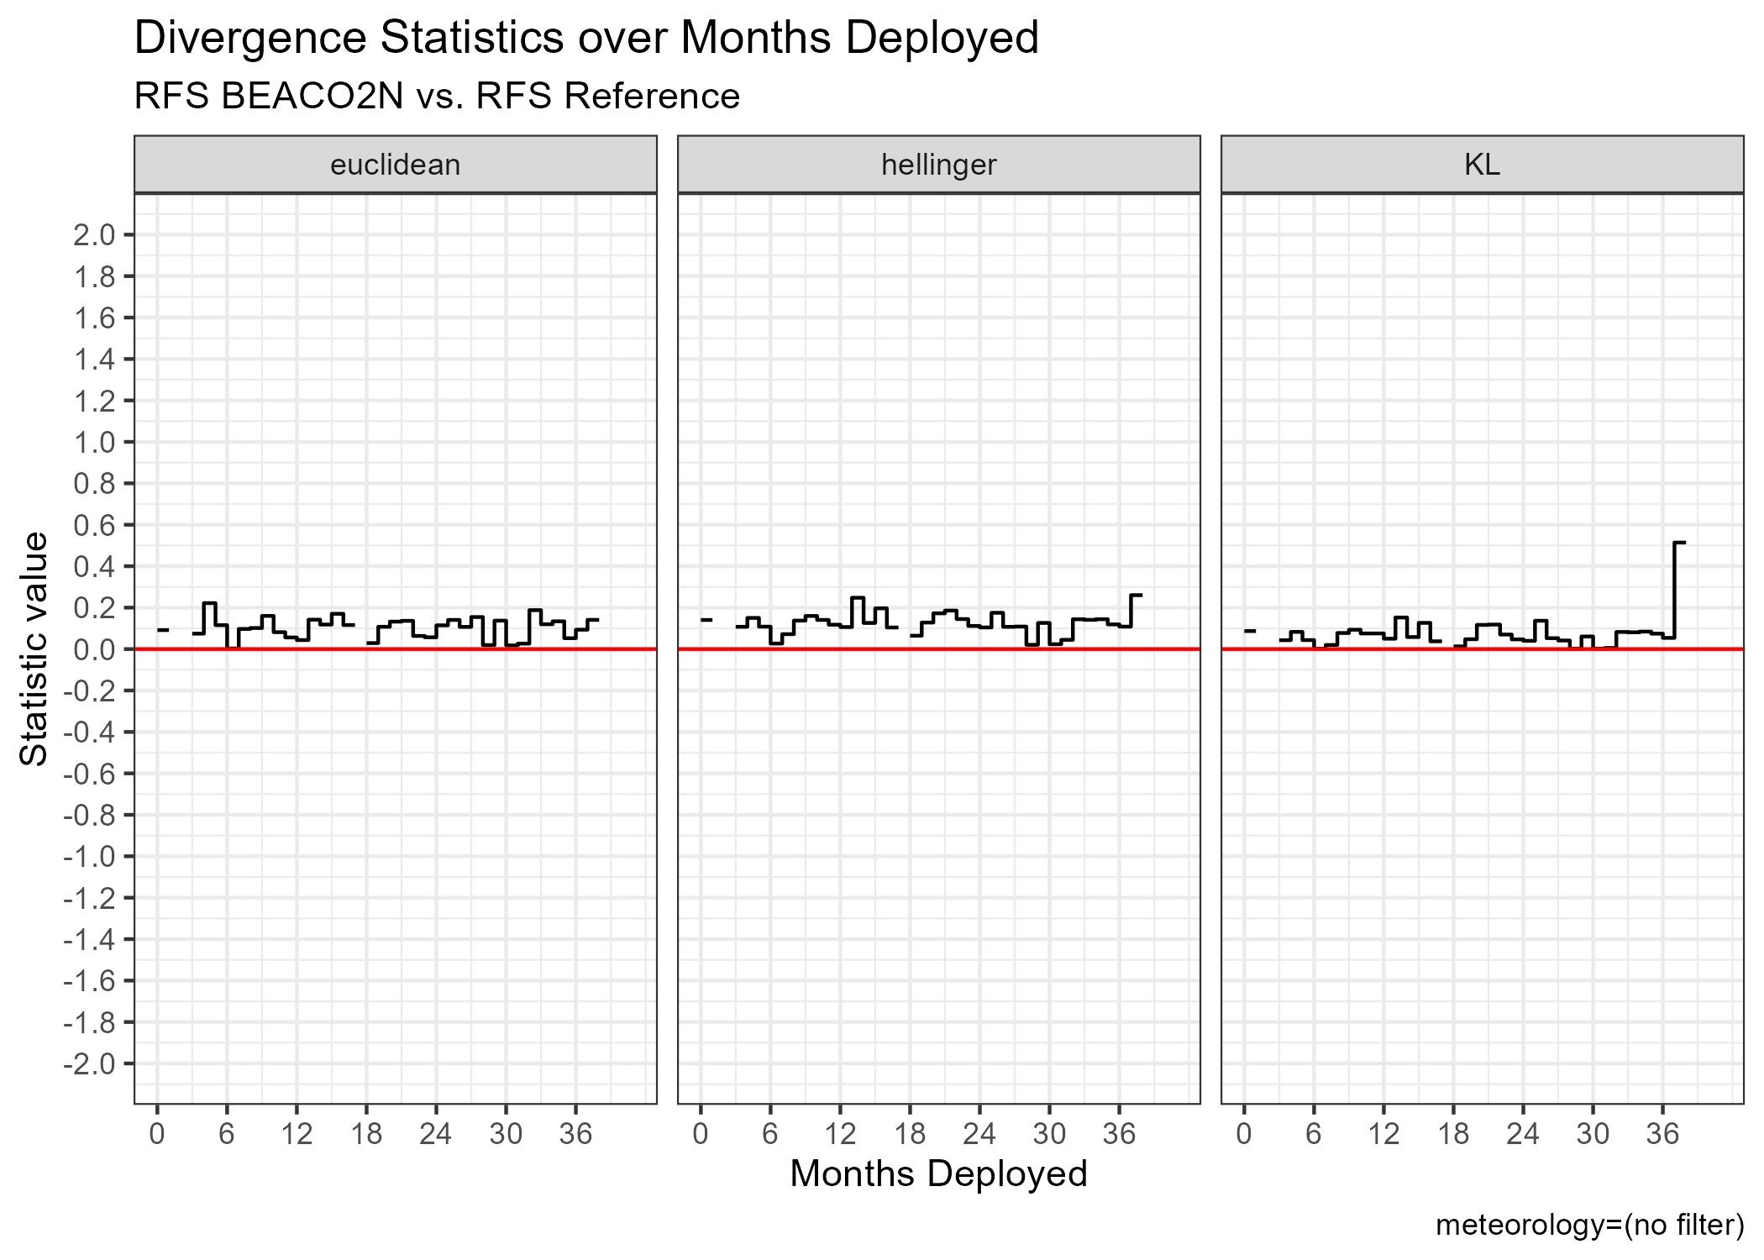
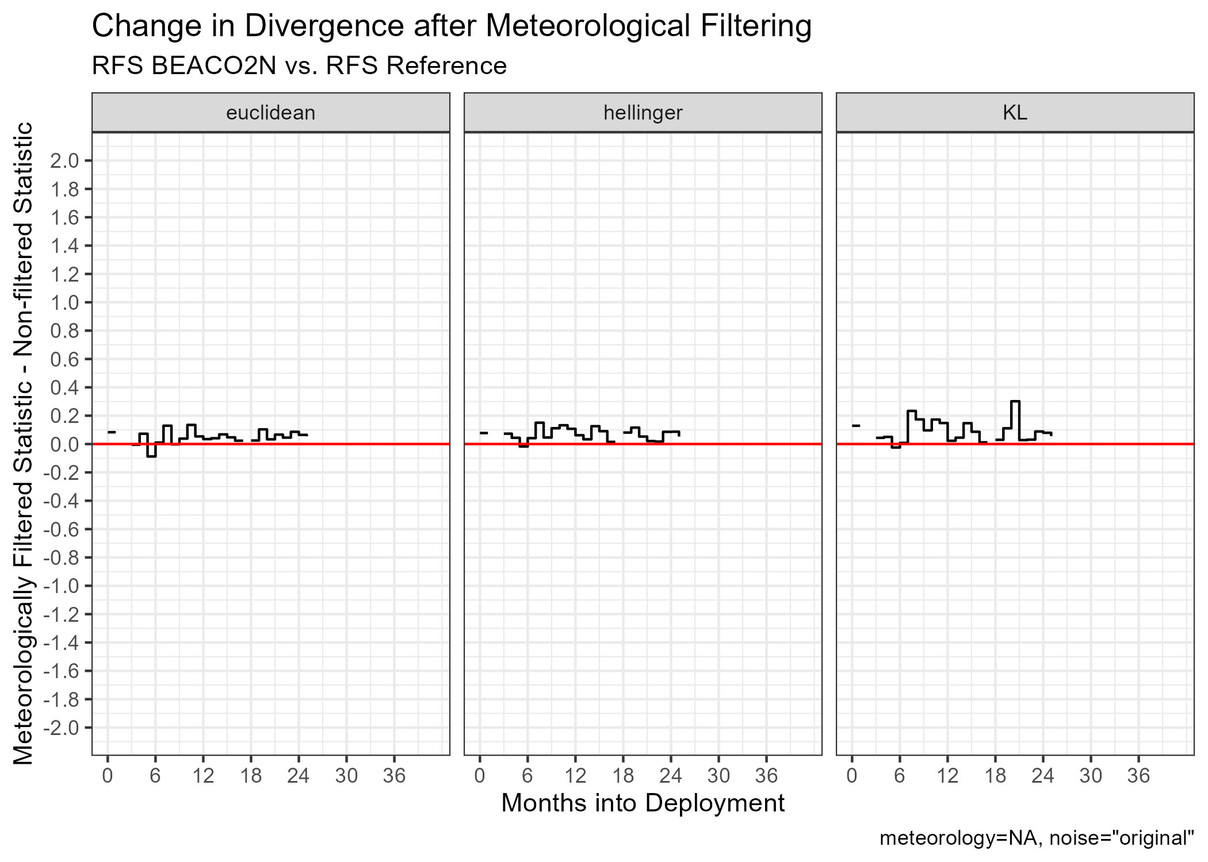
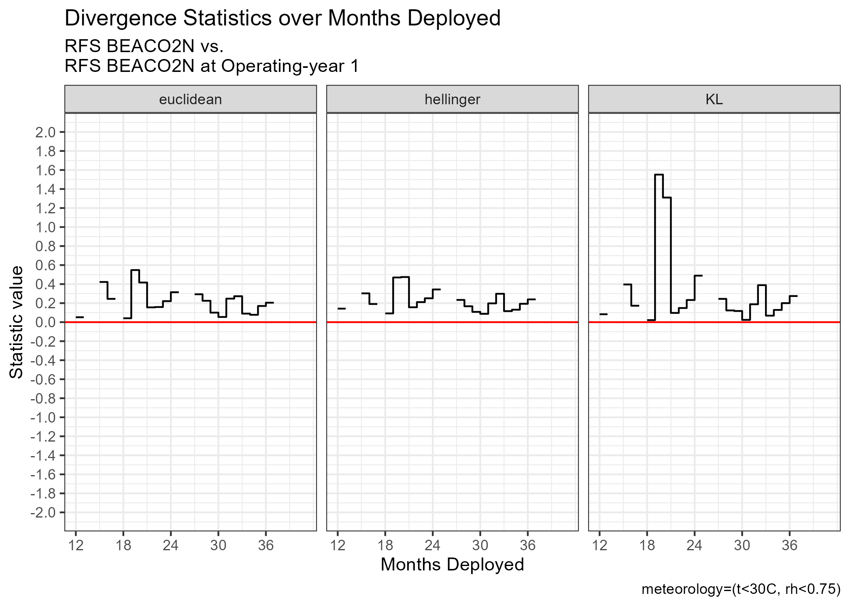
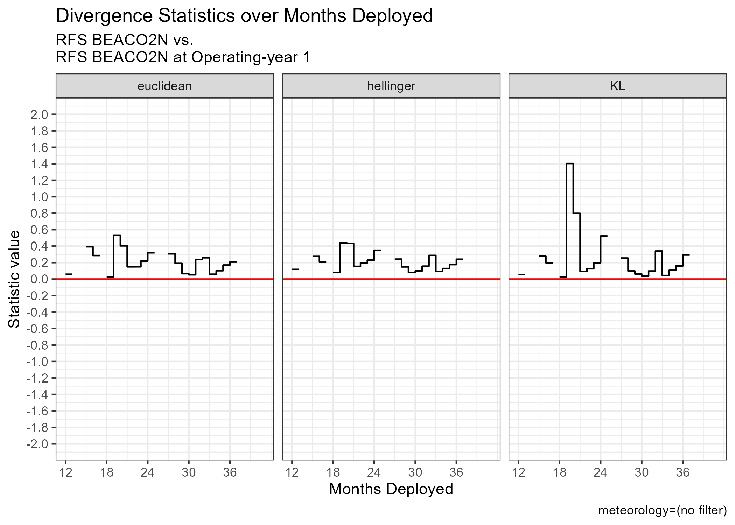
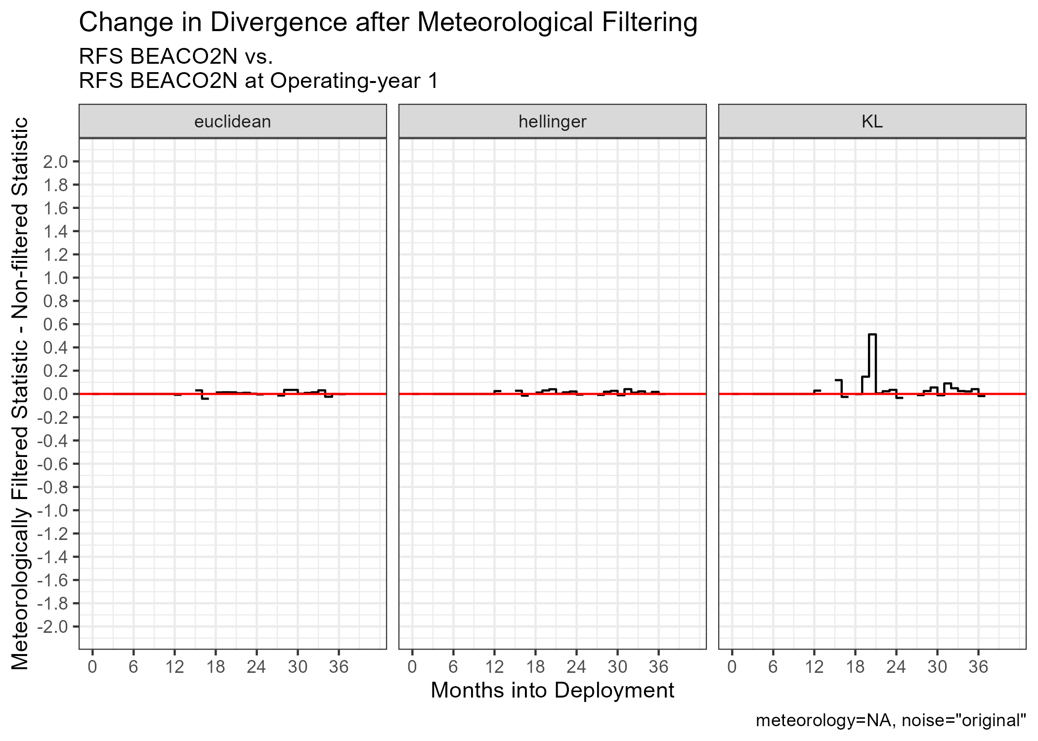

Breathe Providence: Towards a Distributed Method for Quantifying the Reliability of Low-Cost Air Quality Sensors
Mike Woodilla — Advisor: Professor Meredith Hastings
Junior studying
Mathematics and
Computer Science
ABSTRACT
METHODS
RESULTS AND DISCUSSION
Low-cost sensors for measuring common air pollutants have made urban air quality research possible at high spatial and temporal resolution. This high-resolution data can be used to identify air quality events and trends at scales that are impractical for expensive reference-grade instruments to measure, however calibration of low-cost sensors remains challenging. Sensor applications in large distributed air quality monitoring networks further complicate calibration needs – laboratory calibration translates poorly after sensor deployment and requires downtime for every sensor in the network, and in situ gas calibration requires frequent site visits to account for seasonal interferences to sensor measurements. Alphasense electrochemical gas sensors and Plantower nephelometric particulate matter sensors are also known to be cross-sensitive to temperature and relative humidity, which are seasonally-dependent and can cause poor sensor performance, especially in summer months, and induce drift over time.
This project seeks to characterize the reliability of carbon monoxide and fine particulate matter (FPM) sensors in the Breathe Providence air quality monitoring network using distributed methods. Reliability of Alphasense CO-B4 carbon monoxide sensors is examined over time with respect to season and length of sensor deployment (i.e. sensor age). Time series and distribution drift (binned by season and month since sensor deployment) are quantified using residual values and f-Divergences compared to reference distributions. Due to the limited availability of reference-grade air quality monitoring stations operated by the Environmental Protection Agency in the city of Providence, the first year of sensor deployment data is used as a reference (with measurement data matched with reference data from the same datetime of the reference year, to account for seasonal signal variation), alongside real-time reference data from the Rhode Island Department of Environmental Management’s Cranston and East Providence sensor locations.
These methods for characterizing sensor reliability are subsequently applied to the Breathe Providence network’s fine particulate matter (FPM) sensors. FPM is defined as aerosolized particle pollution less than 10 micrometers in diameter; it is classified into size bins of PM1 (<1µm), PM2.5 (<2.5µm), and PM10 (<10µm) and presents unique public health concerns. FPM is linked with higher rates of asthma, decreased lung function, increased heart attack risk, and premature death for individuals with preexisting cardiovascular problems. These adverse effects underlie this project’s investigation of sensor reliability and data quality assurance.
TEXT HERE
Graphs of BEACO2N CO observation characteristics at Richmond Field Station, Berkeley CA, across months deployed.
Row 1: Time series residuals; Time series residual statistics; Probability density functions of observations from measurement and reference sensors;
Row 2: f‑Divergences with meteorological filtering; f‑Divergences without meteorological filtering; f‑Divergence change after meteorological filtering. Reference is external RFS Picarro CO sensor.
Row 3: Same as Row 2 but with distributions from first 12 operating months of BEACO2N sensor used as reference.
As an experimental control, we first examine reliability statistics for BEACO2N @ Richmond Field Station (RFS), Berkeley CA; existing reliability statistics for this sensor are published by Winter et. al. (June 2025) which allows us to be confident in the true reliability state of the sensor. Time series correlation statistics are plotted over duration of deployment for the sensor. We find strong residual correlation with reference for this particular sensor over time, however we seek a reliability characterization method that relies minimally on simultaneous reference observations. We therefore estimate the probability density function (PDF) of sensor observations for each month of deployment and characterize the divergence between reference and measurement distributions using Kullback-Liebler, Hellinger, and Euclidean divergences. PDFs are estimated via a discrete histogram approximation with bin width set to 0.05 ppm; this approximation granularity was found to be necessary to reduce sensor noise uptake in the distribution estimation and to prevent floating-point arithmetic underflow. Since low-cost sensors are likely to be inaccurate at high temperature and relative humidity values, we compare residual correlation and PDF divergence with and without a meteorological filter which excludes observations at Temp > 30°C and RH > 0.75. We also compare trends in divergence when the first 12 months of the sensor’s operation are treated as reference distributions. We find that there is no significant trend in divergence when the source of reference data is either external or internal, nor do we find significant change in divergence before and after meteorological filtering.
OBJECTIVES
CONCLUSIONS AND FURTHER RESEARCH
To characterize the long-term deployment reliability of Breathe Providence Network CO and FPM sensors using existing frameworks.
To develop a new framework for sensor reliability characterization that minimally relies on external reference measurements.
To test this new framework against existing reliability characterizations.
To apply this new framework to the Breathe Providence Network and report findings.
[TEXT HERE]
ACKNOWLEDGMENTS
[TEXT HERE]

