Slide 1


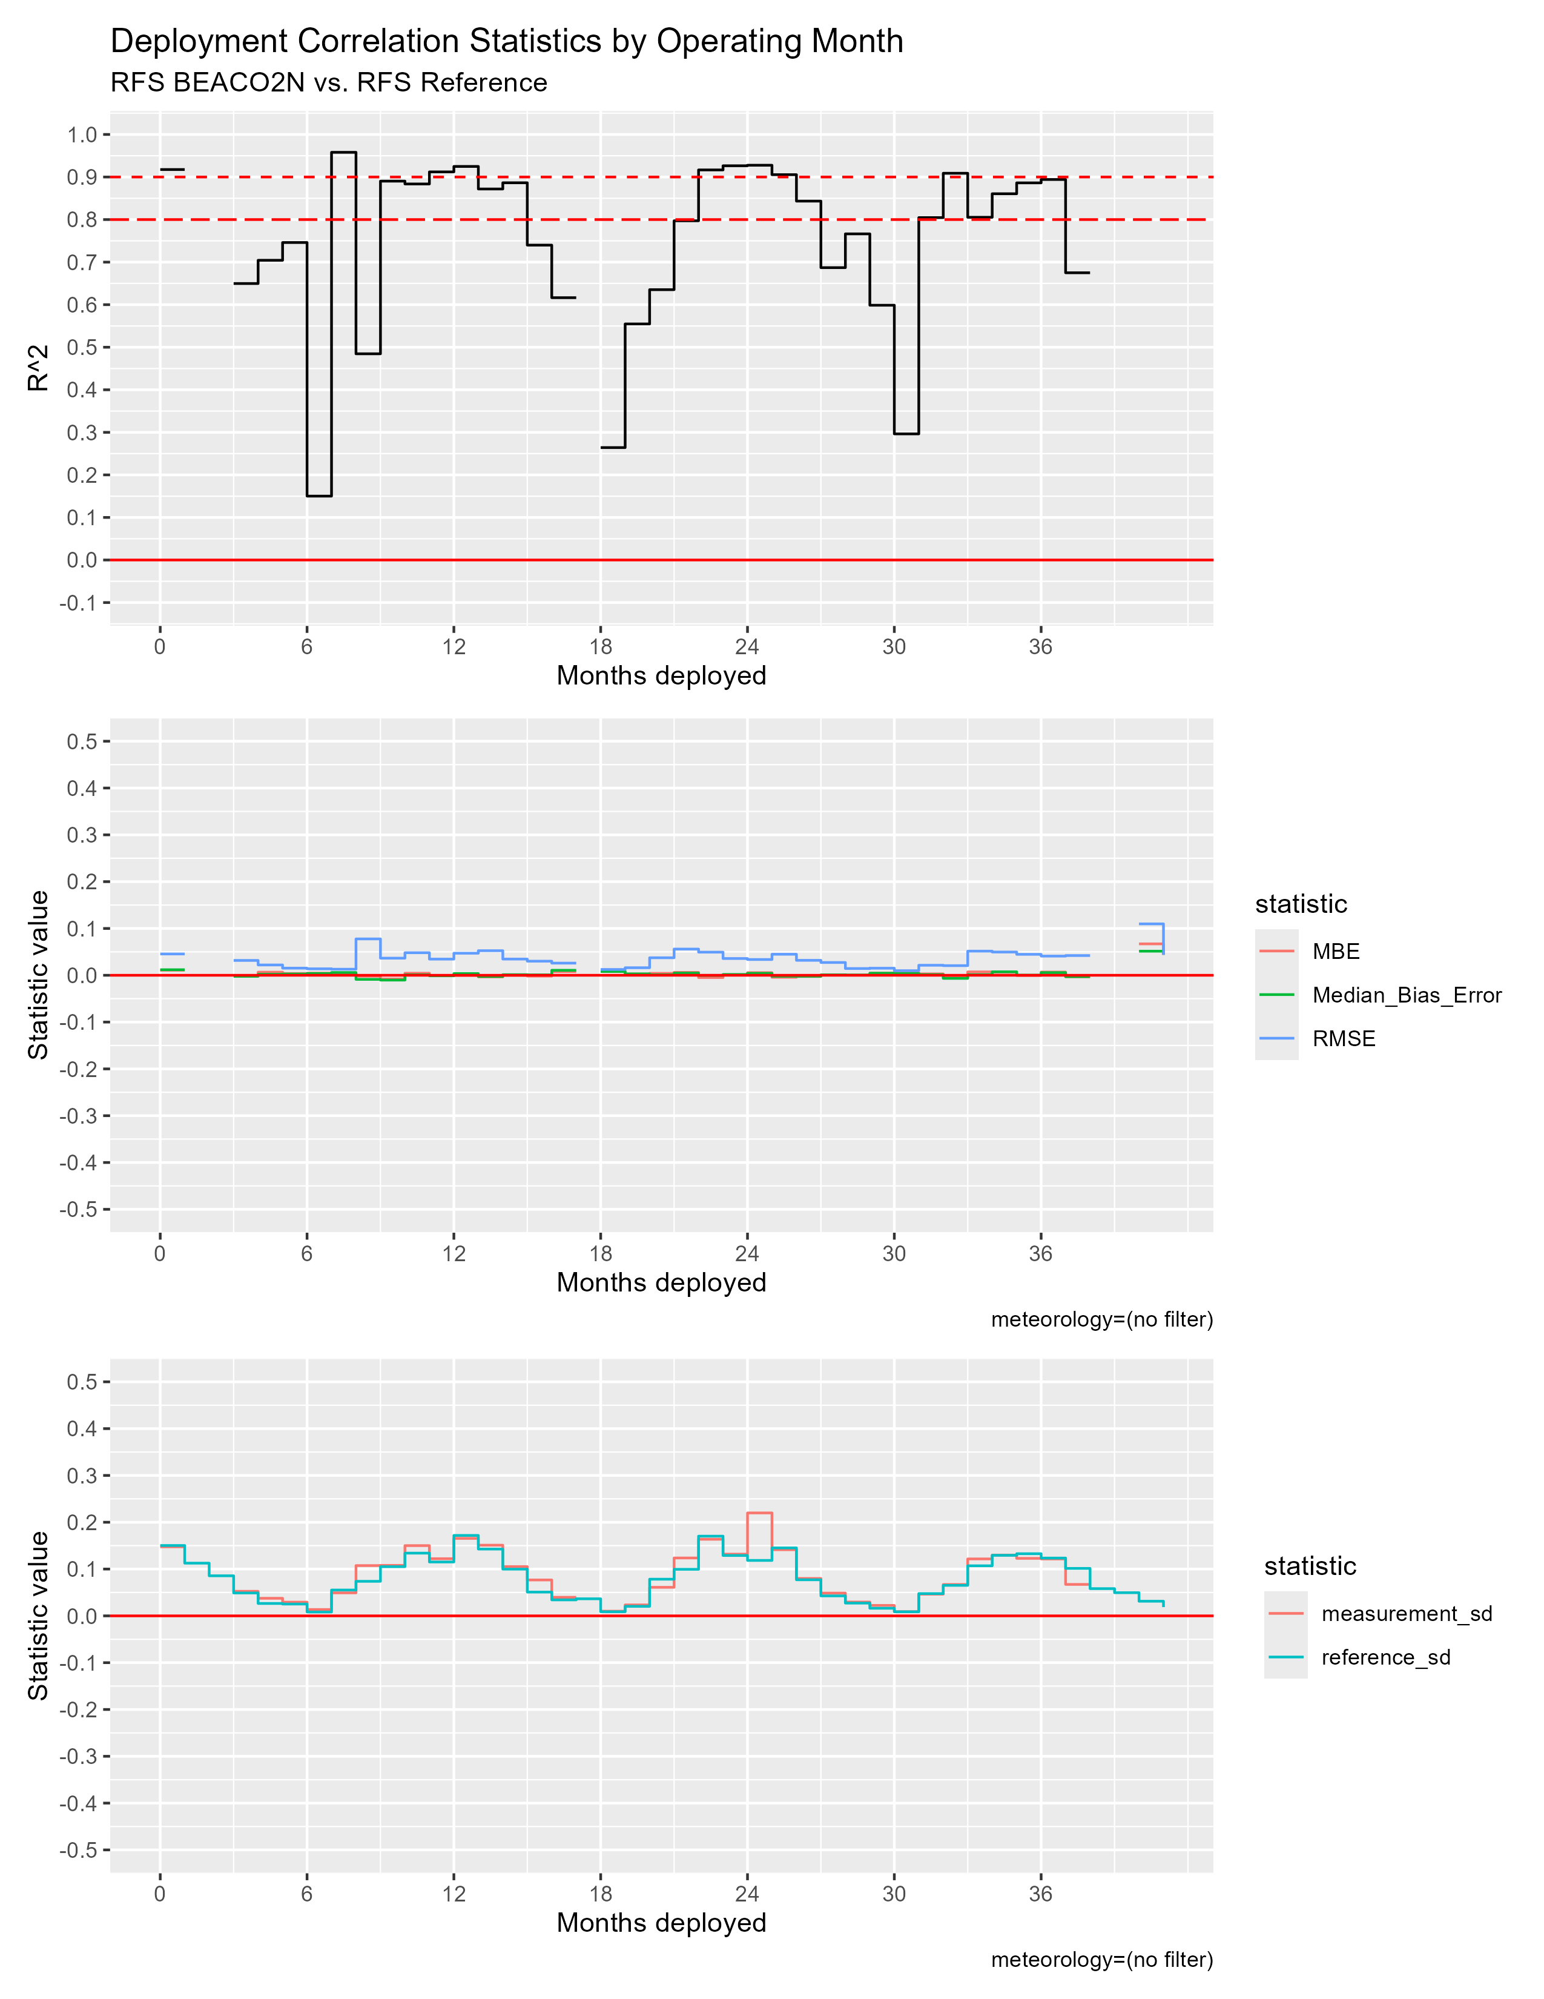
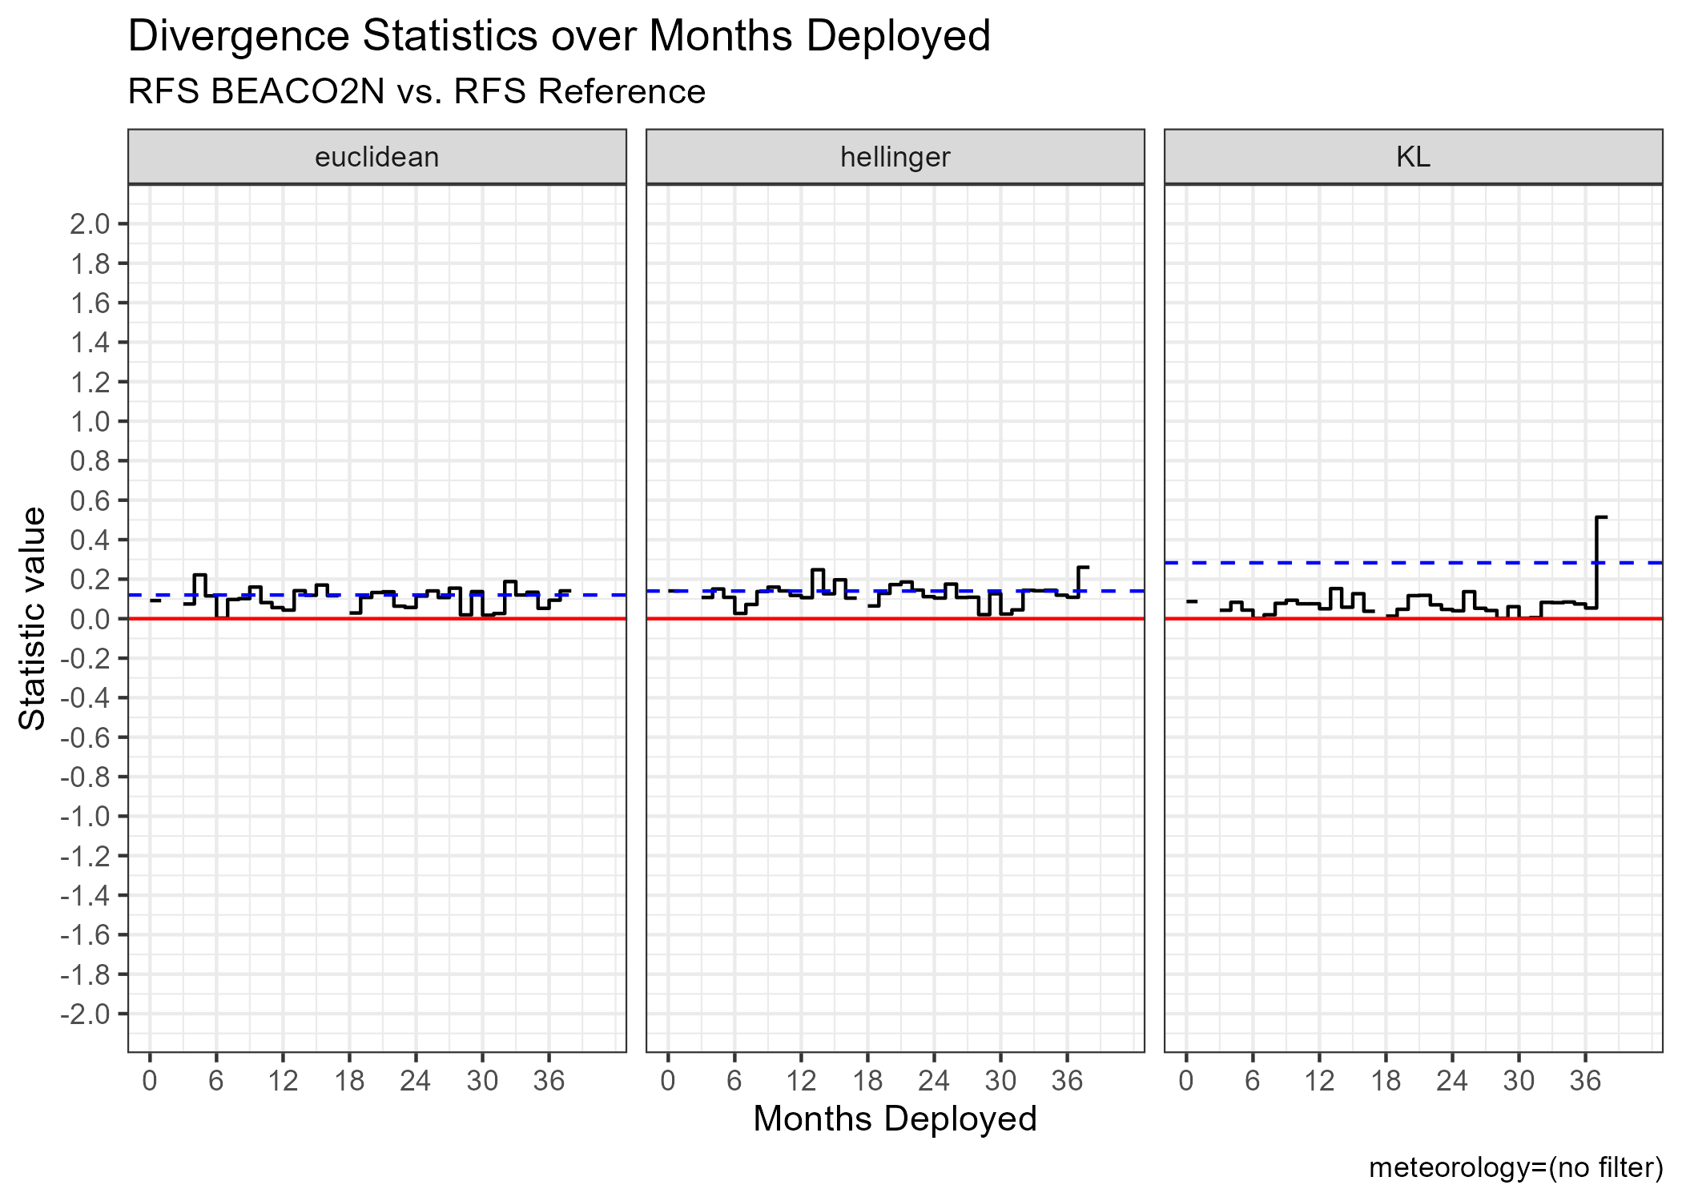
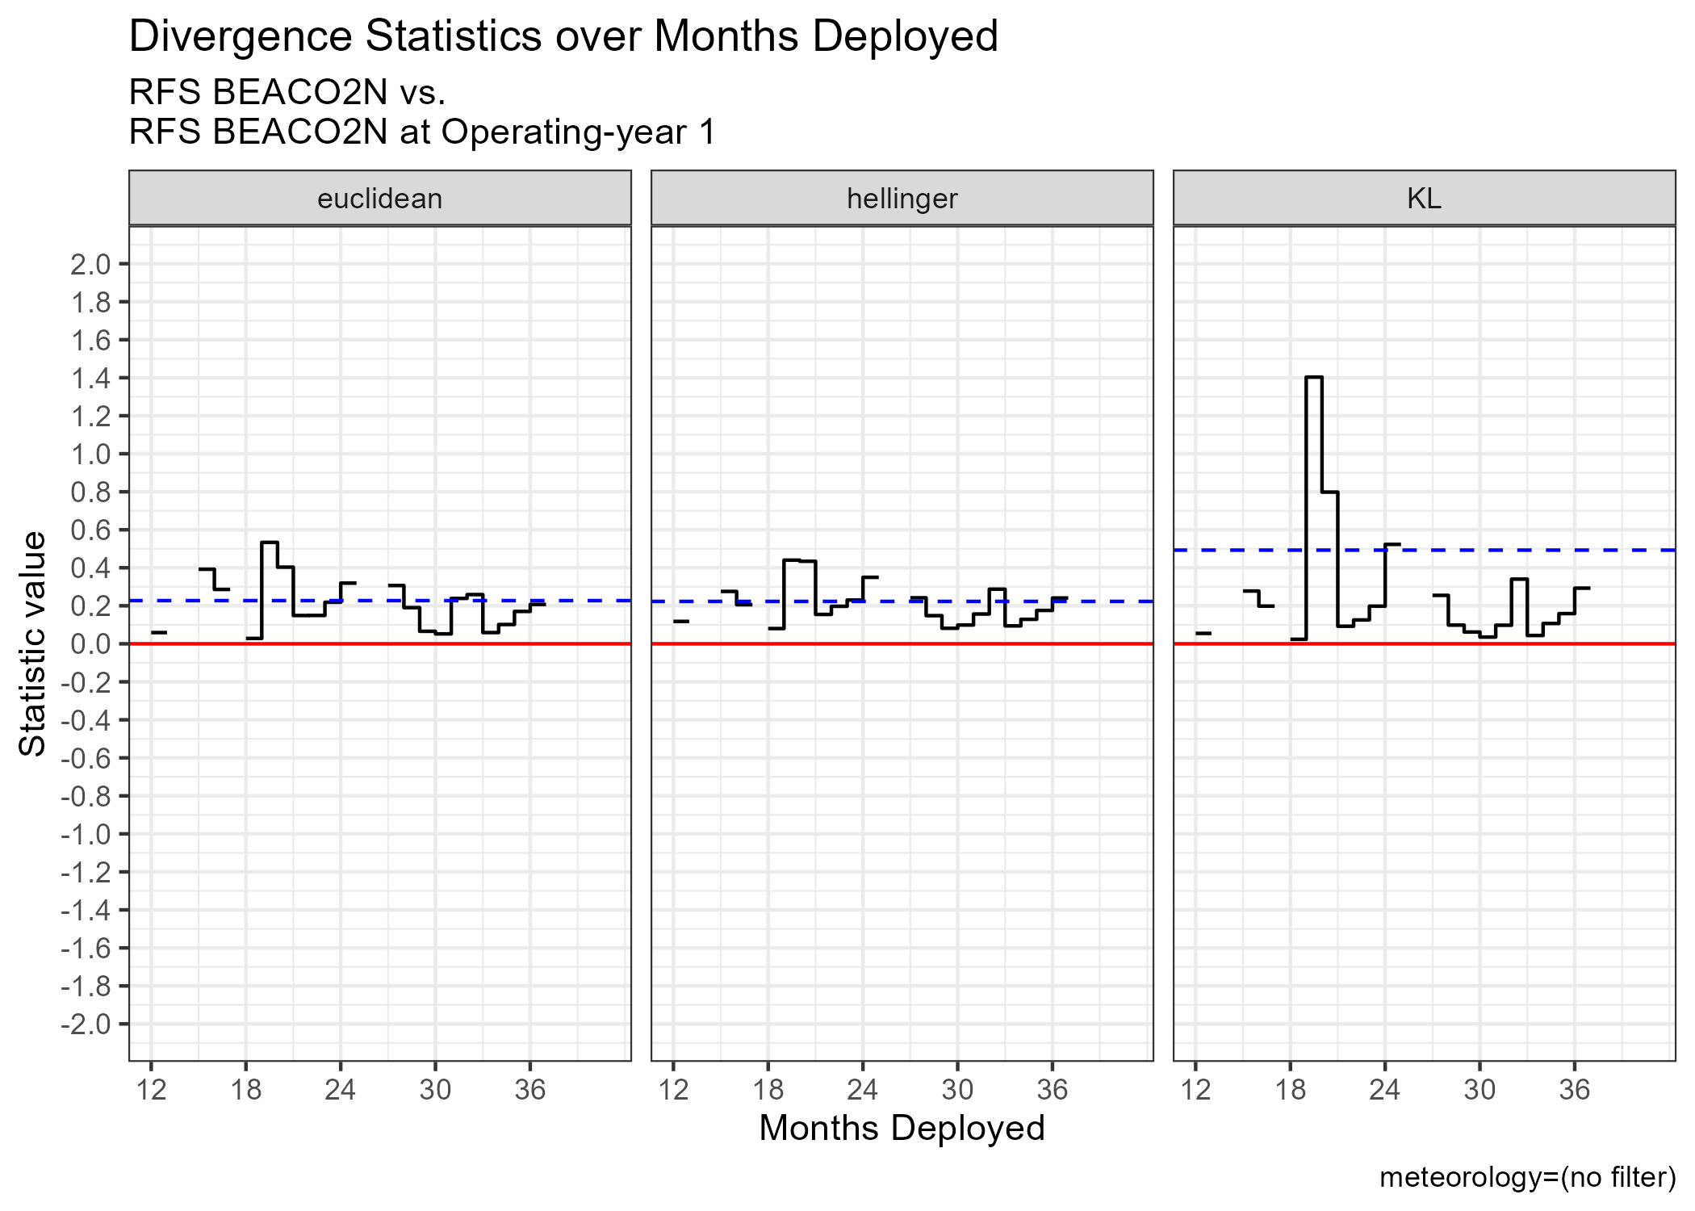
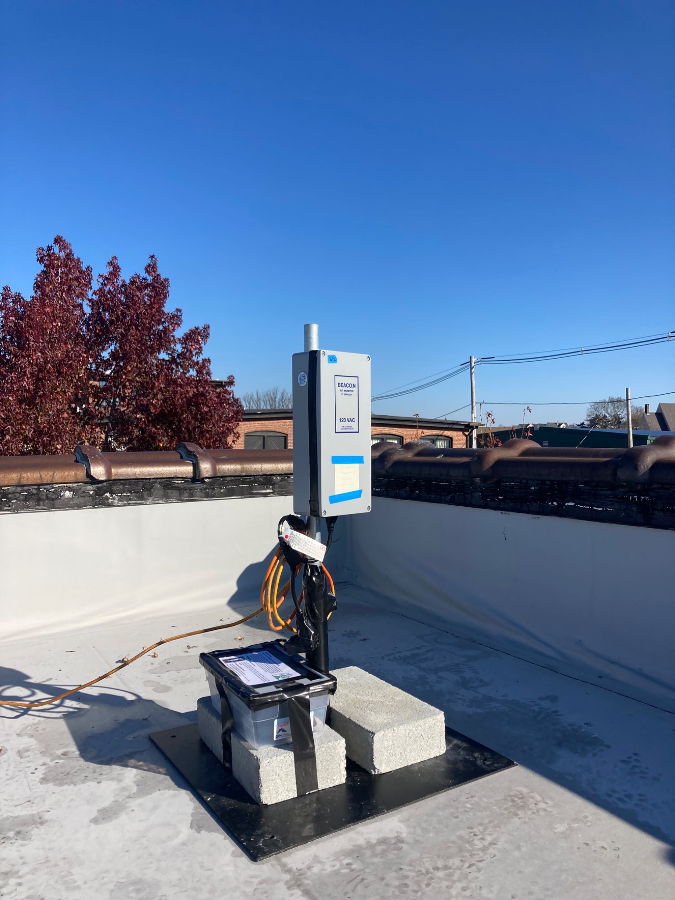
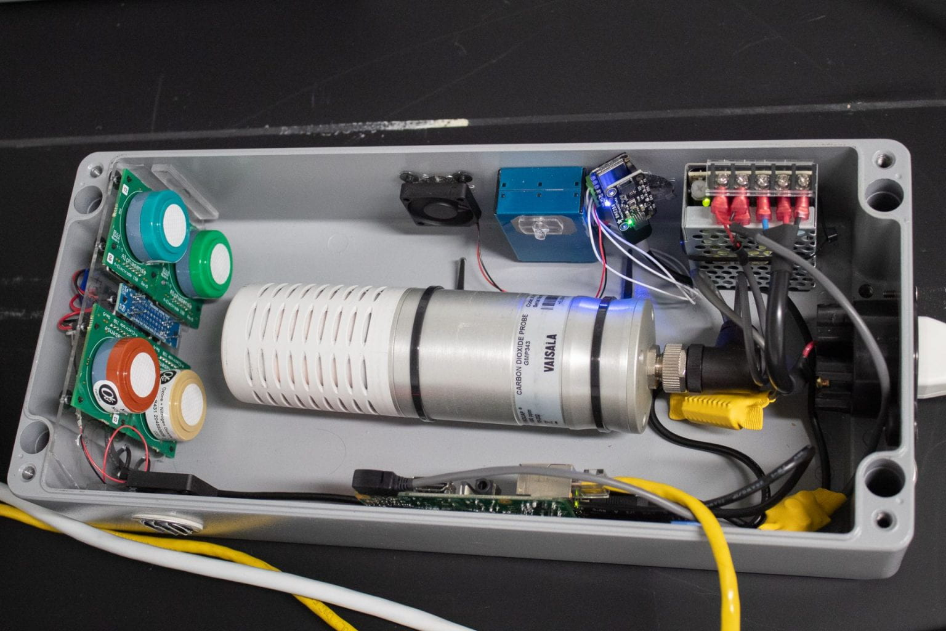
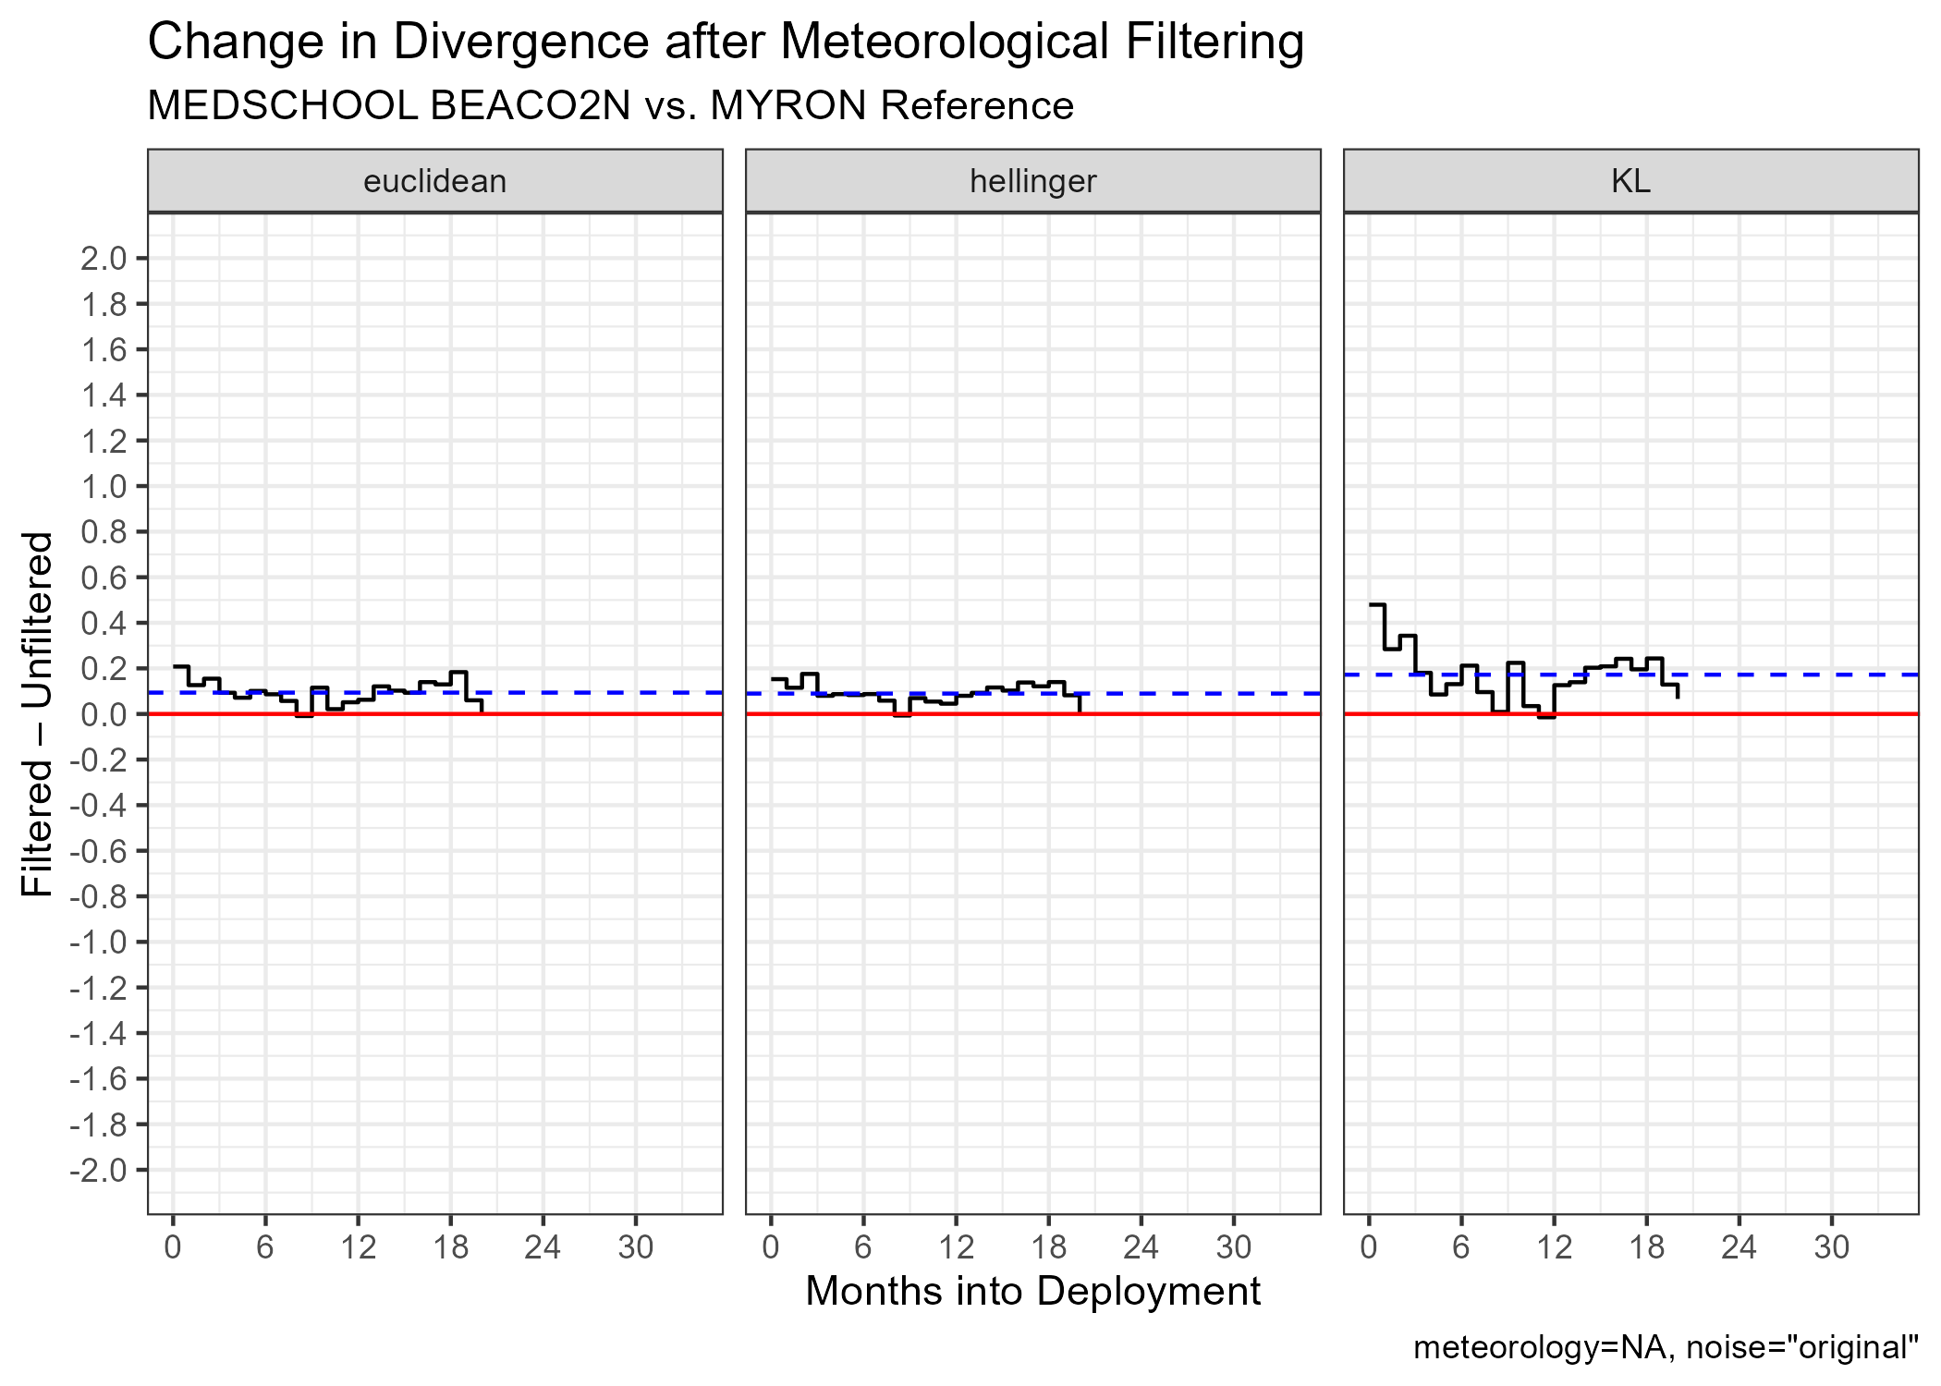
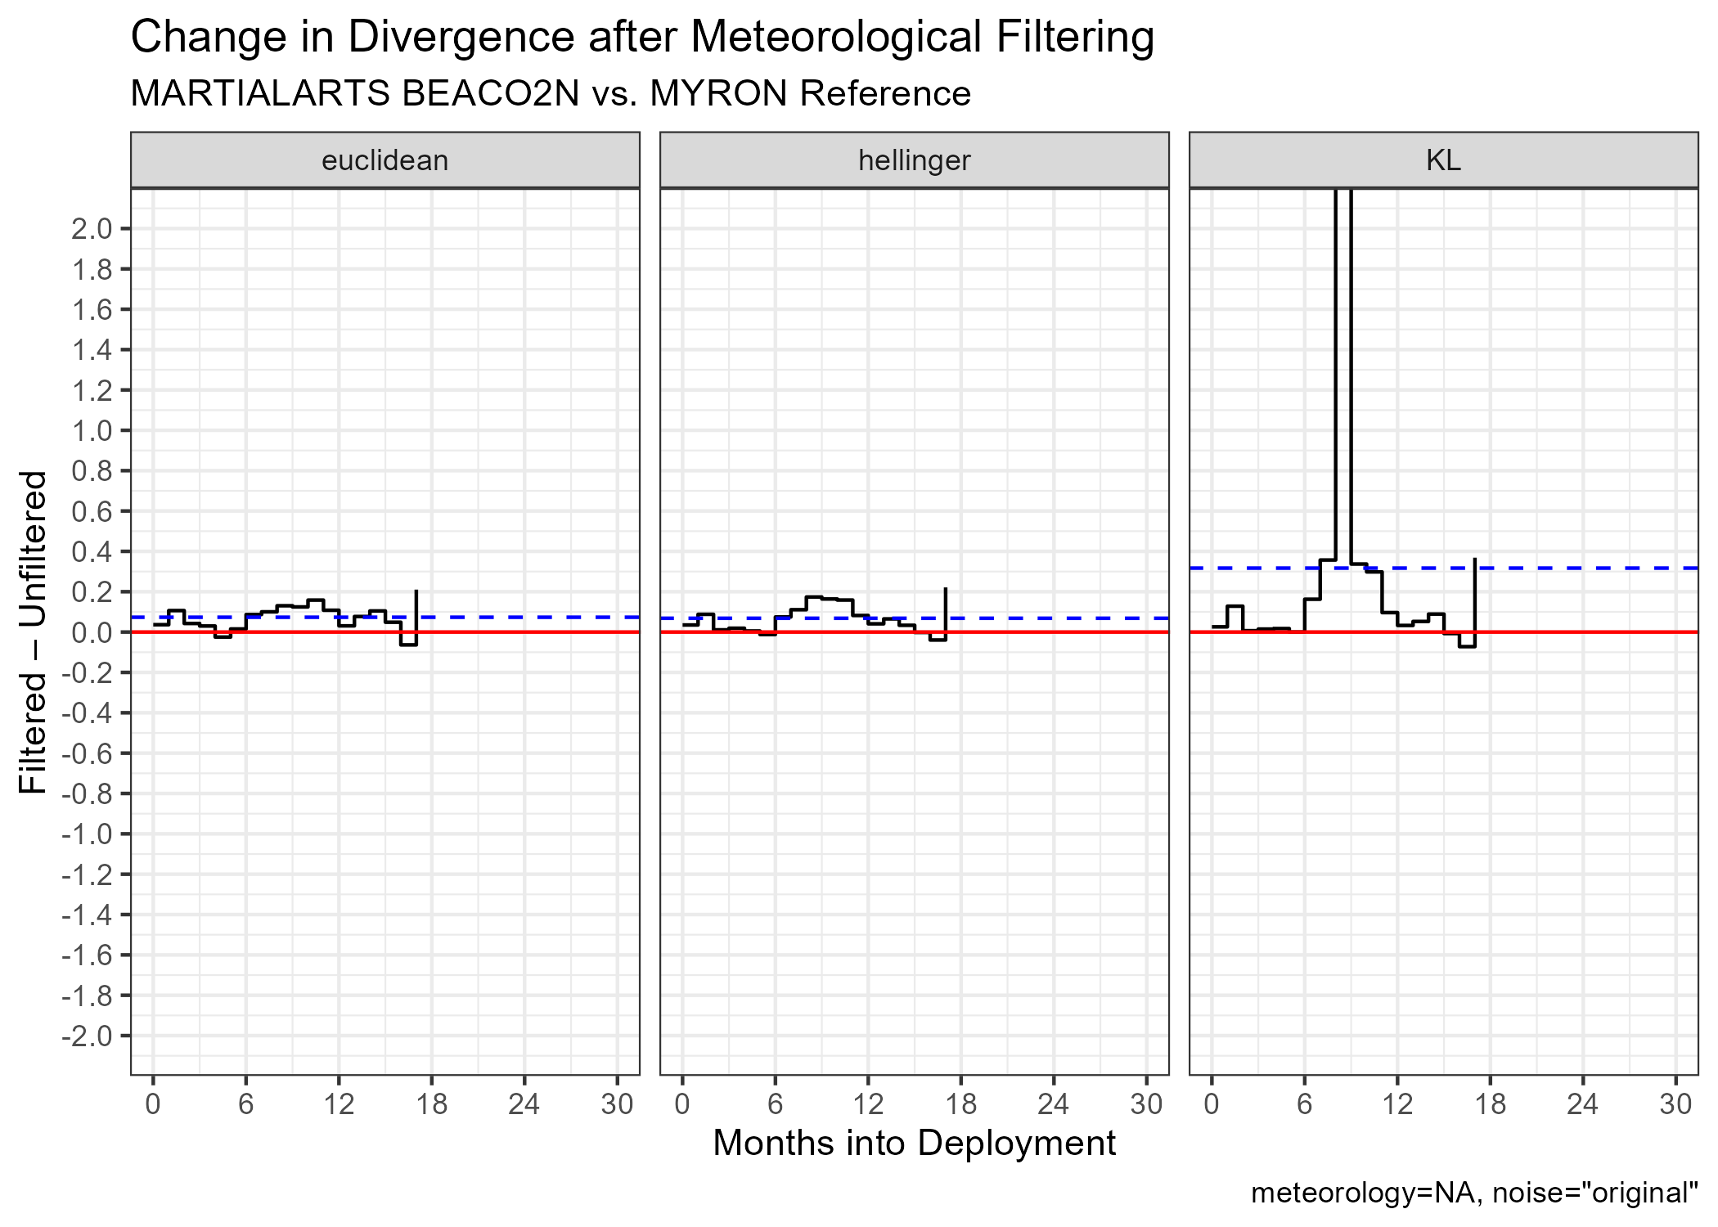
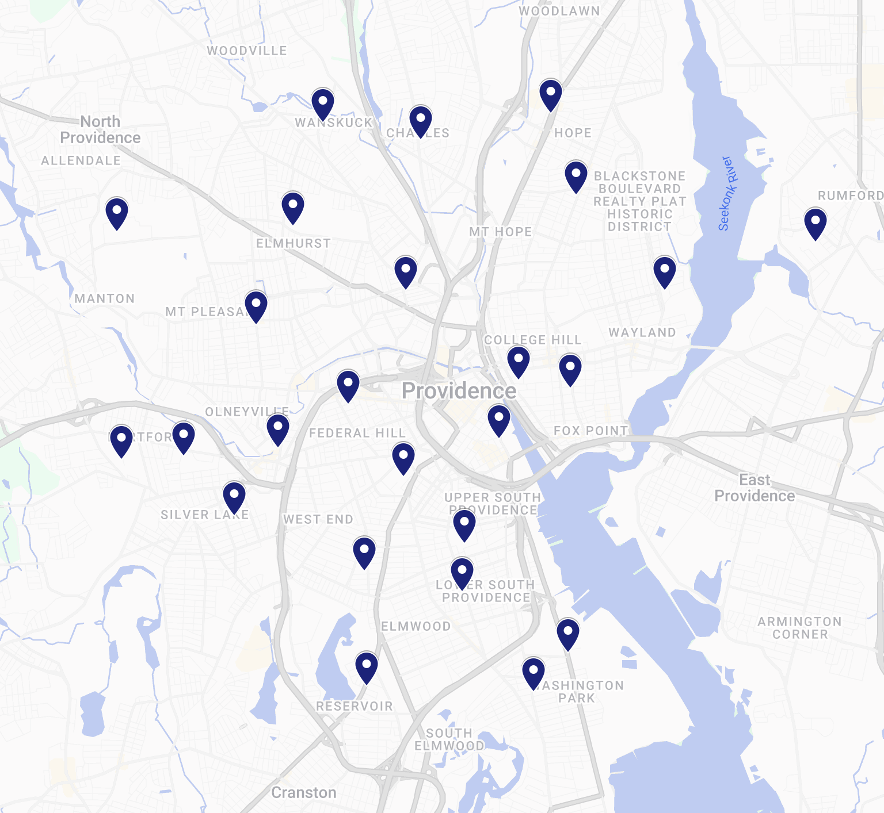
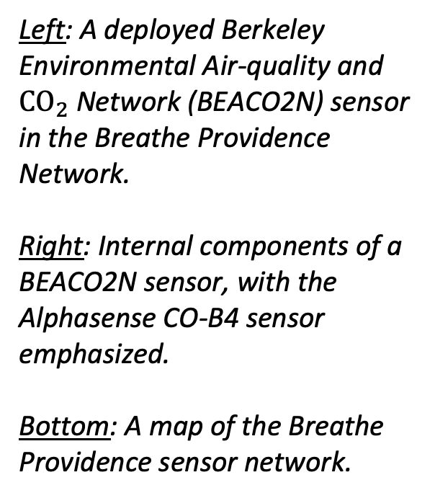
Breathe Providence: Towards a Distributed Method for Quantifying the Reliability of Low-Cost Air Quality Sensors
Mike Woodilla — Advisor: Professor Meredith Hastings
ABSTRACT
Low-cost sensors for measuring common air pollutants have made urban air quality research possible at high spatial and temporal resolution. This high-resolution data can be used to identify air quality events and trends at scales that are impractical for expensive reference-grade instruments to measure, however calibration of low­ cost sensors remains challenging. Sensor applications in large distributed air quality monitoring networks further complicate calibration needs — laboratory calibration translates poorly after sensor deployment and requires downtime for every sensor in the network, and in situ gas calibration requires frequent site visits to account for seasonal interferences to sensor measurements. The Breathe Providence Network maintains 25 air quality sensors measuring air quality at an intra-urban scale in effort to support understanding of air quality exposure and health impacts in Rhode Island. To meet the project’s goals, the data collected from these air quality sensors must be deemed reliable based on calibrations against reference data (i.e. Environmental Protection Agency approved monitoring) and an understanding of the low-cost sensors’ behavior over time. However, there is limited reference-grade data available in RI, with only one major reference site located in East Providence, RI. This project examines methods for characterizing sensor reliability and develops a framework that can be applied to the Breathe Providence network’s variety of gas and particle phase data.
METHODS
RESULTS AND DISCUSSION
Across the Breathe Providence network, we find that CO sensors do not exhibit significant trends in divergence from external or internal reference distributions with or without meteorological filtering; standard deviations of measurement distributions exhibit seasonal variation but do not exhibit long term trends for any CO sensors in the network. This finding does not necessarily affirm the reliability of our sensors, but merely indicates that no significant drift was detected in the network.
Furthermore, we find evidence that meteorological filtering tends to increase distribution divergence and information loss for CO sensors in the Breathe Providence Network. Of the 25 CO sensors examined, 13 (52%) exhibited an increase in average Kullback-Liebler (KL) divergence after meteorological filtering of either external or internal reference data. Of these 13 sensors, 6 (24% of total) exhibited an average increase in KL divergence of greater than 0.1 part per million. Only 2 sensors in the network exhibited any average decrease in KL divergence after meteorological filtering of either external or internal reference data. KL divergence is interpreted as the information lost by using a measurement distribution to approximate a reference distribution, therefore an increase in KL divergence after meteorological filtering indicates that low-cost CO sensors lose information that is captured by the reference sensor (which is also filtered) when observations during strenuous meteorological conditions are omitted.
Alphasense CO-B4
BEACO2N CO observation statistics at Richmond Field Station (RFS), Berkeley CA, across months deployed.
Left: Residual correlation statistics versus a collocated reference instrument.
Top Right: Divergence statistics versus a collocated reference instrument.
Bottom Right: Divergence statistics with first year of observations treated as reference.
The sensor hubs used in the Breathe Providence Network (BEACO2N nodes) have been similarly deployed in Berkeley, CA for more than 5 years. As an experimental control, we first examine reliability statistics for a common pollutant (carbon monoxide, CO) for a reference site (Richmond Field Station, RFS). Existing reliability statistics for this sensor are published by Winter et. al. [1], which allows us to build confidence in this methodological approach.
Time series correlation statistics indicate the RFS BEACO2N sensor remains strongly correlated with collocated reference measurements throughout the sensor’s deployment, with expected seasonal variability.
Limited reference data availability in RI requires that we seek a reliability characterization method that relies minimally on simultaneous reference observations.
We therefore characterize the divergence between reference and measurement distributions using Kullback-Liebler, Hellinger, and Euclidean divergences.
Probability density functions (PDFs) are estimated via a discrete histogram approximation (bin width=0.05 ppm) for every month since the sensor’s deployment.
Low-cost sensors are sensitive to high temperature and relative humidity, thus we compare residual correlation and PDF divergence with and without a meteorological filter which excludes observations at Temp > 30°C and RH > 0.75. However, we find evidence of information loss after meteorological filtering.
Left: A deployed Berkeley Environmental Air-quality and ${\text{CO}}_{2}$ Network (BEACO2N) sensor in the Breathe Providence Network.
Right: Internal components of a BEACO2N sensor, with the Alphasense CO-B4 sensor emphasized.
Bottom: A map of the Breathe Providence sensor network.
Change in divergence after meteorological filtering for two Breathe Providence Network nodes. Environmental Protection Agency air quality monitor observations from Myron J. Francis Elementary School are used as reference in both cases. Blue dashed line shows mean divergence change across months deployed.
This finding indicates that more study is needed regarding how low-cost sensor observations at strenuous meteorological conditions are processed. To the author’s knowledge, no reliability or calibration studies of low-cost gas sensors in air quality monitoring applications specifically examine data recorded at high temperature or relative humidity. Existing literature characterizes low-cost gas sensors as being unreliable at these meteorological conditions, however this characterization is solely determined by examining correlation with reference instruments. Though low-cost gas sensors may not correlate one-to-one with reference-grade instruments at these meteorological conditions, this finding suggests that these observations still carry information about the distribution of air quality during a given period.
OBJECTIVES
To characterize the long-term deployment reliability of Breathe Providence Network carbon monoxide sensors using existing frameworks.
To develop a new framework for sensor reliability characterization that minimally relies on external reference measurements.
To compare this new framework with existing reliability characterizations.
To apply this new framework to the Breathe Providence Network.
ACKNOWLEDGEMENTS
I am sincerely grateful to Professor Meredith Hastings for the opportunity to contribute to the Breathe Providence Project and for her insightful guidance and support. I also acknowledge the BEACO2N team at the University of California Berkeley, whose research on low-cost air quality monitor performance provided inspiration for this work.
REFERENCES
[1] Sustained Performance of Low-Cost Air Quality Sensors in Long-Term Deployments. Anna R. Winter, Yishu Zhu, Naomi G. Asimow, Milan Y. Patel, and Ronald C. Cohen. ACS Sensors 2025 10 (6), 4329-4335. DOI: 10.1021/acssensors.5c00566

