Slide 1

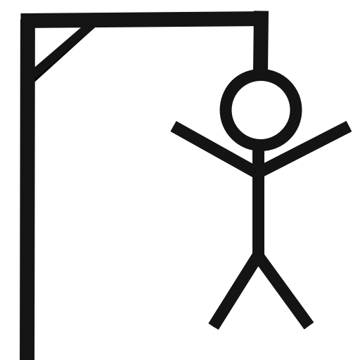
Hangman with Difficulties
Game by Dakota Woods
A classic game of Hangman with different levels of difficulties
There is a different word list associated with each level of difficulty
https://github.com/dwoods-40/Hangman_with_Difficulties

