Slide 1

Object-Oriented Programming Using Java Inheritance and Polymorphism
Air Force Institute of Technology
Scott Nykl, PhD

Slide 2
Outline
Object-oriented language paradigm
IS-A versus HAS-A
Defining a protocol/interface contract with inheritance
Polymorphism
Overriding versus Overloading

Slide 3
Object-Oriented Language Paradigm
An object-oriented programming language supports
encapsulation,
polymorphism, and
inheritance.
Definitions vary (e.g., modularity, structured exception handling, higher-order functions/polymorphism)

Slide 4
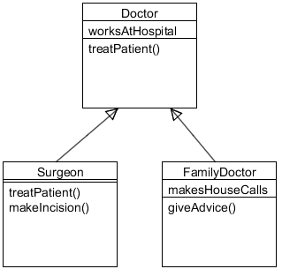
Exercise
How many fields/methods does a Surgeon have?
How many fields/methods does a FamilyDoctor have?
How many fields/methods does a Doctor have?
Can a FamilyDoctor do treatPatient()?
Can a FamilyDoctor do makeIncision()?
Can a Doctor do makeIncision()?
Notes:
Page 169

Slide 5
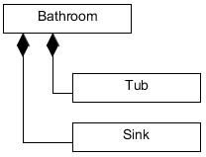
IS-A versus HAS-A
Caution:
Use composition for “HAS-A”
Example: Bathroom, Tub, Sink
OK or Composition or Reversed
Oven extends Kitchen
Guitar extends Instrument
Person extends Employee
Ferrari extends Engine
Fried Egg extends Food
Beagle extends Pet
Container extends Jar
Metal extends Titanium
GratefulDead extends Band
class Bathroom{ Sink sink = new Sink(); Tub tub = new Tub(); ... }
Java

Slide 6
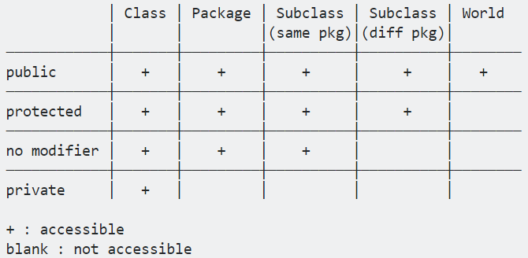
Who Inherits What?
If you need to get the superclass method call it
super()
Four levels of variable and method access control
public
protected
private
default
Public is available to all and inherited
Protected accessible inside package and outside via inherited subclasses
Private not inherited, only accessibe in declared class
Default only inherited by classes within the package.
Notes:
(pg 668)

Slide 7
The Java Tutorials
http://docs.oracle.com/javase/tutorial/java/javaOO/accesscontrol.html

Slide 8
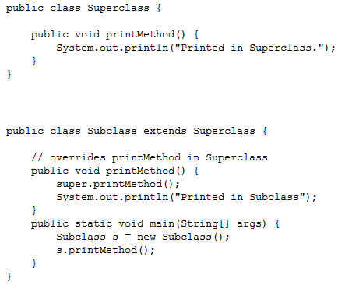
Example

Slide 9
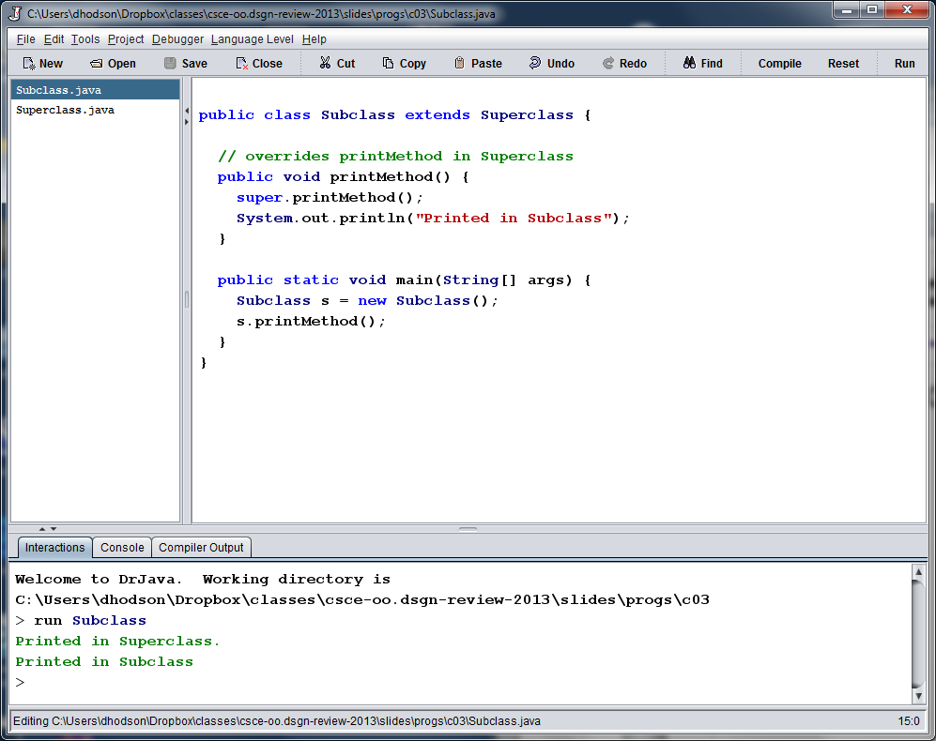
Output

Slide 10
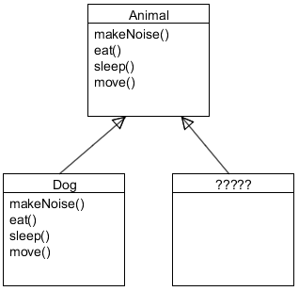
Defining a Protocol/Contract
Inheritance lets you guarantee that all classes grouped under a certain supertype have all the methods that the supertype has
The supertype defines a common protocol for a set of classes related through inheritance
This common protocol is an interface contract

Slide 11
Polymorphism
When you define a supertype for a group of classes, any subclass of that supertype can be substituted where the supertype is expected
Assignments
Method calls
Return values
Animal a = new Dog()
public void cage(Animal a) {…} … Dog fido = new Dog(); zoo.cage(fido);
List<Animal> l = new ArrayList<Animal>(); Animal fido = new Dog(); Animal dumbo = new Elephant(); l.add(fido); l.add(dumbo); for (Animal a : l) { a.makeNoise(); }
public Dog getStray() {…} … Animal fido = pound.getStray();
We can also make collections!

Slide 12
Polymorphism
Bottomline:
“You can write code that doesn’t have to change when you introduce new subclass types into the program”
class Registrar {
public void registration (Course c) {
//do some stuff
c.getTitle();
}
}
…
registration(STAT583);

Slide 13
Aggregation vs. Inheritance
class Video
{
String title;
int length;
boolean avail;
public Video( String ttl )
{
title = ttl; length = 90; avail = true;
}
public Video( String t, int l )
{
title = t; length = l; avail = true;
}
public void show()
{
System.out.println( title + ", " + length + " min. available:" + avail );
}
}
public class VideoStore
{
public static void main ( String args[] )
{
Video item1 = new Video("Jaws", 120);
Video item2 = new Video("Star Wars”);
item1.show();
item2.show();
}
}

Slide 14
Aggregation vs. Inheritance
class Video
{
String title;
int length;
boolean avail;
public Video( String ttl )
{
title = ttl; length = 90; avail = true;
}
public Video( String t, int l )
{
title = t; length = l; avail = true;
}
public void show()
{
System.out.println( title + ", “ + length + " min. available:" + avail );
}
}
class Movie extends Video
{
String director;
String rating;
public Movie( String ttl, int lngth,
String dir, String rtng )
{
super( ttl, lngth );
director = dir; rating = rtng;
}
}
The statement super(ttl, lngth) invokes a constructor of the parent to initialize some of the data.
The next two statements initialize the members that only Movie has.
Note: super() must be the first statement in the subclass's constructor.

Slide 15
Overriding versus Overloading
To override a method
Arguments MUST be the same, and return types must be compatible
The method can’t be less accessible
Always use @Override annotation to let the compiler check
To overload a method
The return types can be different
You can’t change ONLY the return type (usually a compiler error)
You can vary access levels in any direction

Slide 16
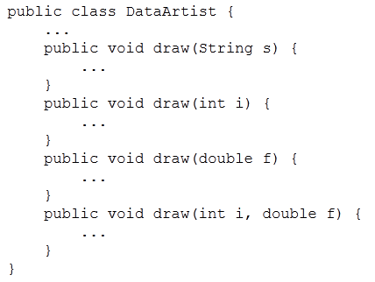
Example: Overloading

Slide 17
Object-Oriented Programming Using Java — Serious Polymorphism —

Slide 18
Outline
Design problems
Abstract classes and methods
Using final
Java “Object”

Slide 19
Design Problem
What the heck is a “shape”
We can say new Shape() in our code…
Some classes just should not be instantiated
Should we get rid of the shape class?
What purpose does it serve?
Shape
rotate() playSound()
Scary objects
Square
Circle
Triangle
Amoeba
rotate() playSound()

Slide 20
Solution: Abstract
Java allows us to declare methods and classes as being abstract
You can’t create an instance of an abstract class
Any class with an abstract method is required to be declared abstract
Use abstract methods when you want to require the method, but do not have a generic implementation (contract again)
Java uses the “final” key word to stop any further overriding

Slide 21
Solution: Abstract
Consider adding a draw method
What should it do at the shape level?
Shape
rotate() playSound() draw()
Square
Circle
Triangle
Amoeba
rotate() playSound()

Slide 22
The Java Tutorials
http://docs.oracle.com/javase/tutorial/java/IandI/abstract.html

Slide 23
Java “Object”
Ultra-Super-Megaclass in all of Java—”Object”
Every object inherits from “Object”
Except for primitives
int, float, double, char, boolean, byte, short, long
Note the class versions of primitives are
Integer, Float, Double, Character, Boolean, Byte, Short, Long
Ex: int x = Integer.parseInt( “8” );
Integer xx = new Integer( x );

