Slide 1

Object Oriented Programming Using Java Using the Java Library
Air Force Institute of Technology
Scott Nykl, PhD

Slide 2
Outline
Primitives and References
Wrappers
Collections
Overview of the standard collections
Lists
Sets
Maps

Slide 3
Primitives
Hold fundamental values, i.e., simple bit patterns
Have a name, size, and type:
int count;
Sizes (in bits):
Java is strongly typed language
byte: | 8 | long: | 64
short: | 16 | float: | 32
char: | 16 | double: | 64
int: | 32 | boolean: | ???

Slide 4
Identifiers
Three basic rules for names:
Must start with a letter, underscore, or dollar sign.
After the first character, you can use numbers. However, a name cannot start with a number.
Cannot be a reserved word
Java is case sensitive
int and Int are entirely different things

Slide 5
Object References
No such thing as an object variable
Only an object reference variable
Object reference variables
Represent a way to access an object – what is inside doesn’t matter
Something like a pointer or an address
JVM knows how to access the object that is referenced
Can think of an object reference as a remote control for an object in memory
Used to access objects – cannot do arithmetic on them, increment them, etc. Java is not C!

Slide 6
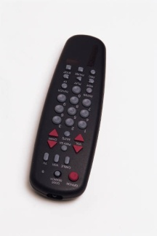
Pointers
Book b = new Book();
Book c = new Book();
Book Object
Book Object
b
c

Slide 7
Pointers
Book d = c;
Book Object
Book Object
b
c
d

Slide 8
Pointers
c = b;
Book Object
Book Object
b
c
d

Slide 9
Pointers
c = null;
Book Object
Book Object
b
c
d

Slide 10
Pointers
b = d;
Book Object
Book Object
b
c
d

Slide 11
Pass-by-value
int x = 7;
foo.go(x);
System.out.print(x);
…
public void go (int z) {
z = 0;
}
int x = 7;
int y = 0;
y = foo.go(x);
System.out.print(x + “ “ + y);
…
public int go (int z) {
z = 3;
return z;
}

Slide 12
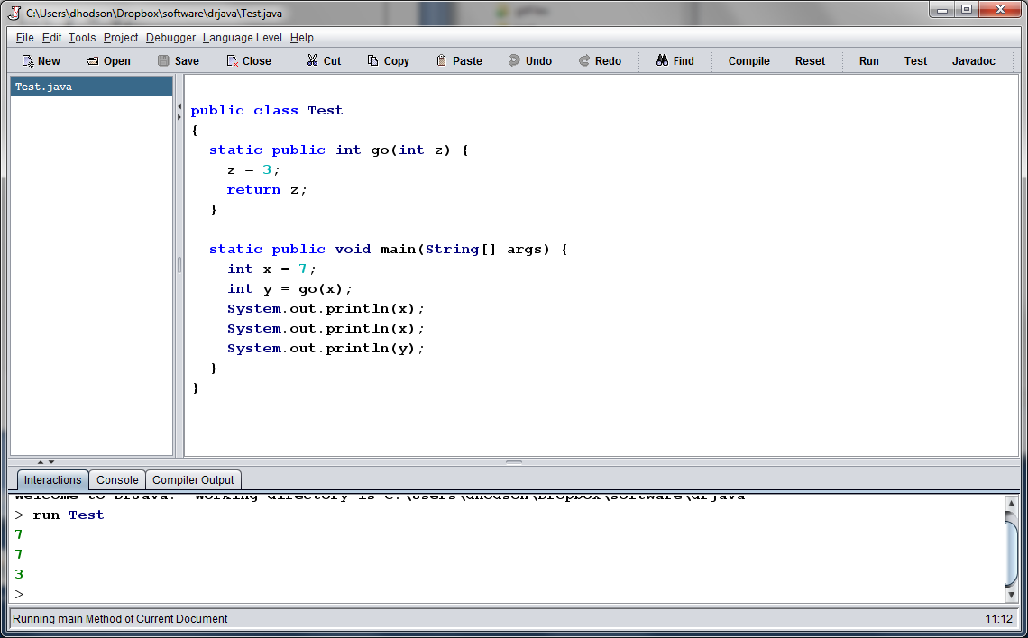
Example Output

Slide 13
Pass by value (Really?)

Slide 14
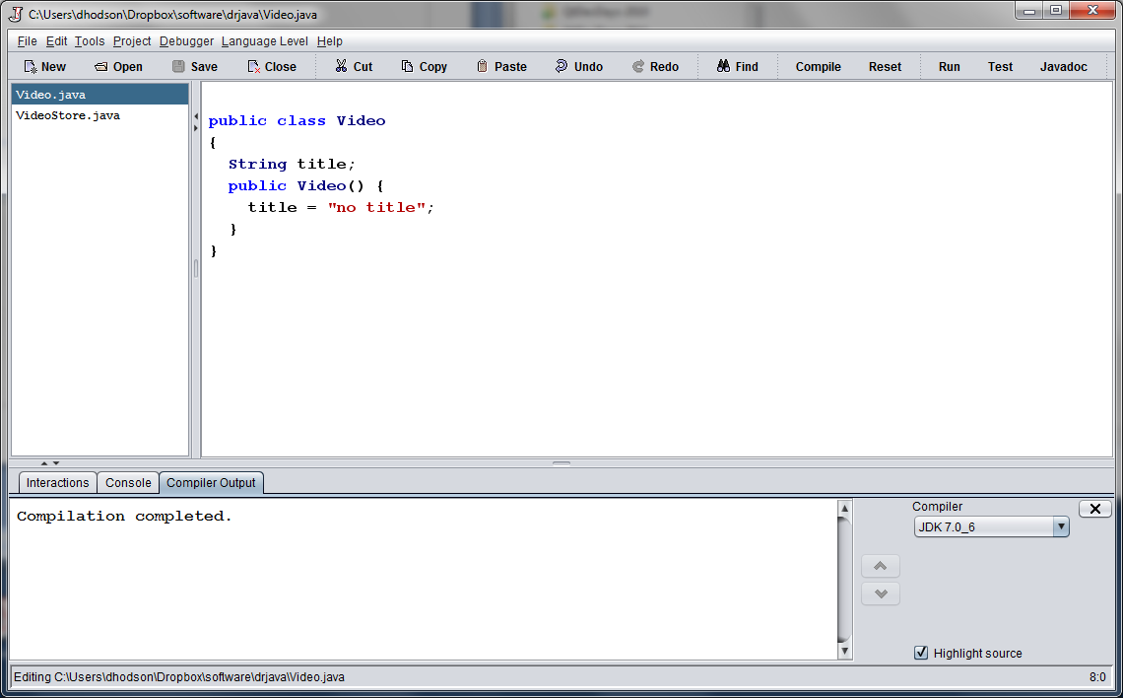
Example: Video class

Slide 15
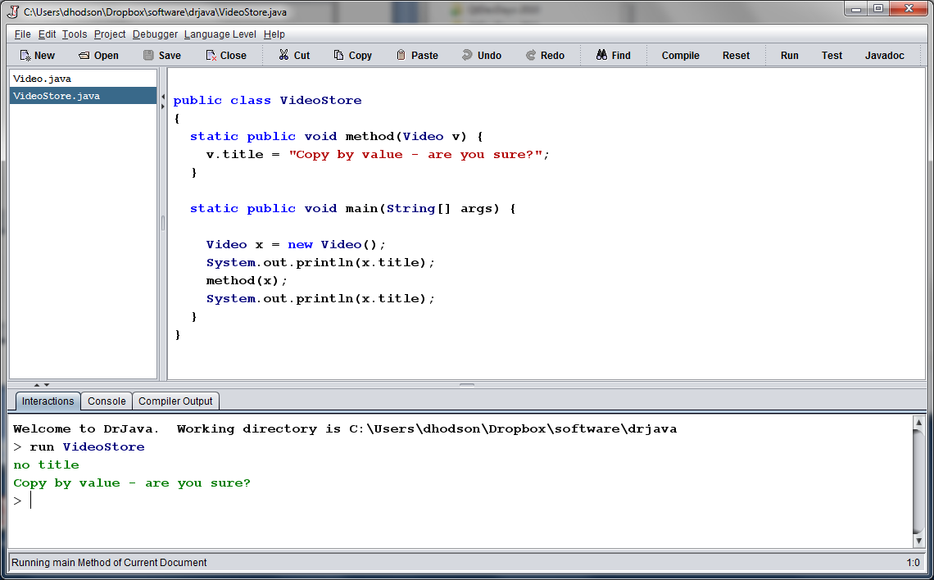
Example: Pass by Value?

Slide 16
Pass by value (Really?) Yes, the REFERENCE is passed by value!

Slide 17
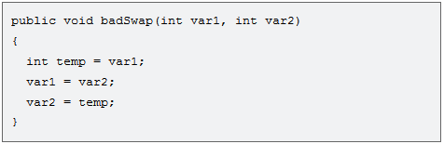
Method Arguments
Java doesn’t pass method arguments by reference; it passes them by value
The following code will not swap values

Slide 18
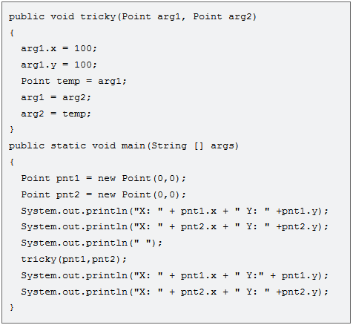
Exercise – What is the Output?

Slide 19
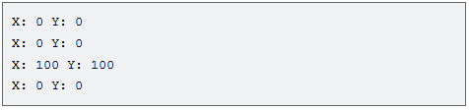
Output
Example presented here
http://www.javaworld.com/javaqa/2000-05/03-qa-0526-pass.html

Slide 20
Wrappers
Boolean
Character
Byte
Short
Integer
Long
Float
Double
Integer.toString(int x);
Integer.parseInt(String s);
Double.parseDouble(String s);
String str = “244.85”;
Integer.toString(3);
Integer.parseInt(str);
Double.parseDouble(str);
String str = “Hello”;
Integer.parseInt(str);

Slide 21
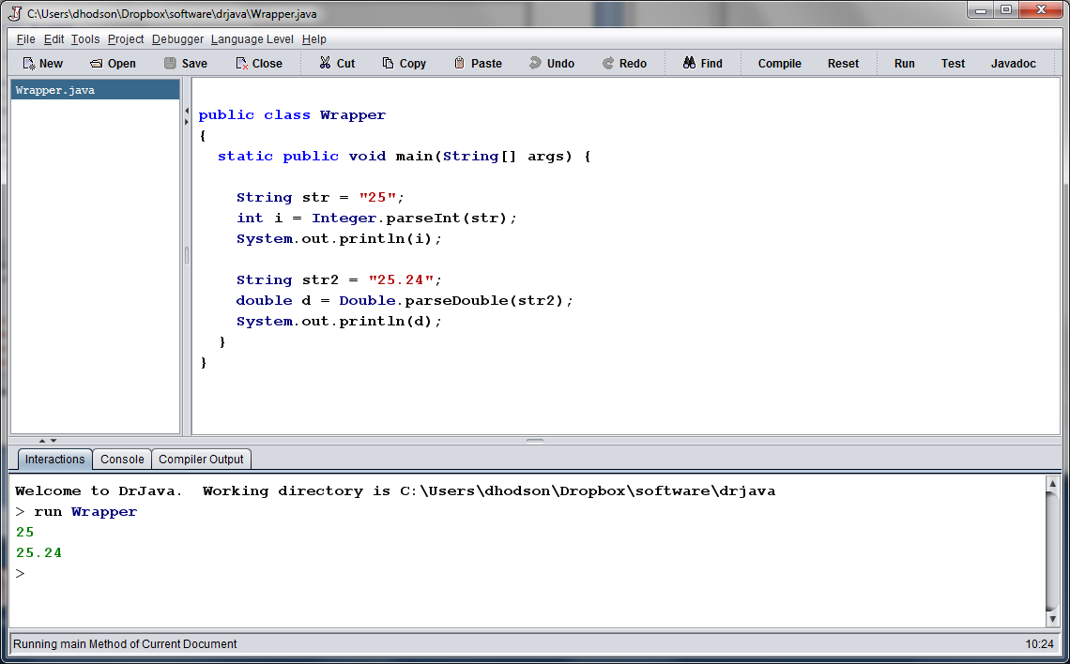
Example Output

Slide 22
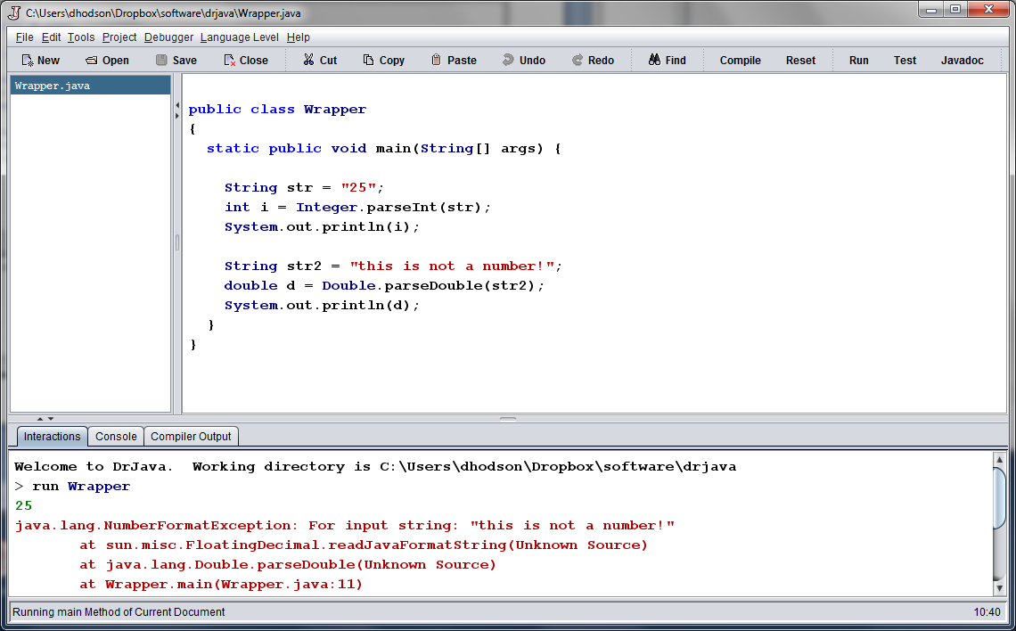
Example Output – Exception!

Slide 23
Collections
Store groups (or collections) of object references
Key Interfaces
ArrayList
List
Set
Map
Approach:
Pick an interface (program requirements)
Pick a concrete implementation (size/time tradeoffs)

Slide 24
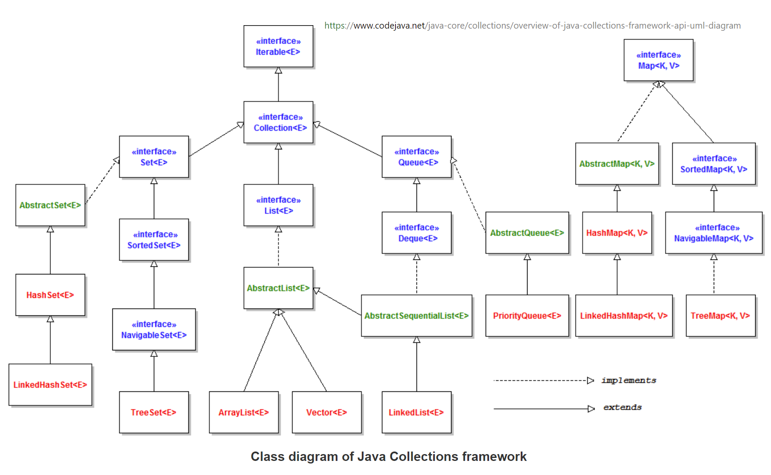
Collections

Slide 25
Lists
Use List interface for fast insertion and removal:
List<Egg> eggList = new ArrayList<Egg>();
You can copy a list by passing it to the constructor
List<Egg> aCopy = new LinkedList<Egg>(eggList);
Use ArrayList for direct access:
List<Egg> myEggVector = new ArrayList<Egg>();
Egg one = myEggVector.get(1);
Use LinkedList for “queue-like” uses
List<Egg> myEggQueue = new LinkedList<Egg>();
myEggQueue.add(e1);
Egg first = myEggQueue.getFirst();
Egg last = myEggQueue.getLast();

Slide 26
Sets
Typical pattern:
Set<Egg> myEggs = new HashSet<Egg>();
Sets use “semantic” equality, i.e., “.equals()” not ==
No duplicates
Ignores you if you try to add something twice—which can simplify your code (e.g., Observer pattern).

Slide 27
Maps
Typical pattern:
Map<String, Egg> nameToEgg = new HashMap<String, Egg>();
For each “key” in the map (the first type) one “value” may exist in the map (the second type)
If you “put” the same key twice the original value is overwritten.
Example: Think of a map like a phone book
Key: name
Value: phone number
Map<String, String> phoneList = new HashMap<String, String>();
String number = phoneList.get(String);

