Slide 1

Programming Paradigms: Functional and Object Oriented Introduction
Air Force Institute of Technology
Scott Nykl, PhD

Slide 2
Administrative
Programming Paradigms: Functional and Object Oriented
Date: 10 Sept - 26 Sept
Time: 0800-1100
Location: Bldg 646, Rm 102
My information
Office: Bldg 642, Rm 203 (Across from Gecko CCR Lab)
Phone: x4395
Course Materials
https://git.nykl.net/csce093/csce093
No grade

Slide 3
Dr Mullins Research Talk @ 1300
Mandatory All ENG: Building 646 Room 102
TODAY (10 Sept 2019)!

Slide 4
Educational Objectives
Object-oriented programming concepts
Knowledge of fundamental object-oriented concepts such as polymorphism, inheritance, encapsulation and operator overloading
Understanding of these concepts in a few popular languages
Java
Python
C++
Functional programming concepts (time permitting)
Concepts – difference between object-oriented concepts

Slide 5
Overall Structure
Week #1
Class: Mon-Fri (10 Sept - 12 Sept)
Topic: Programming Tools, GIT, Java JDK, VS Code
Week #2
Class: Tues-Fri (17-19 Sept)
Topic: Java – Fundamentals, procedural and OO programming
Week #3
Class: Mon-Fri (14-26 Sept)
Topic: Python – Fundamentals, procedural and OO programming
Topic: Functional programming

Slide 6
GIT
Distributed Version Control System
https://try.github.io/levels/1/challenges/1
https://www.youtube.com/watch?v=cEGIFZDyszA&list=PL6gx4Cwl9DGAKWClAD_iKpNC0bGHxGhcx
GIT Tutorials on YouTube

Slide 7
Programming in Java

Slide 8
Tools
JRE / JDK
JRE: Java Runtime Environment
JDK: Java Development Kit
IDEs (development environments)
Dr. Java
Eclipse
Netbeans
IntelliJ IDEA
VS Code***

Slide 9

Eclipse IDE - Heavyweight

Slide 10
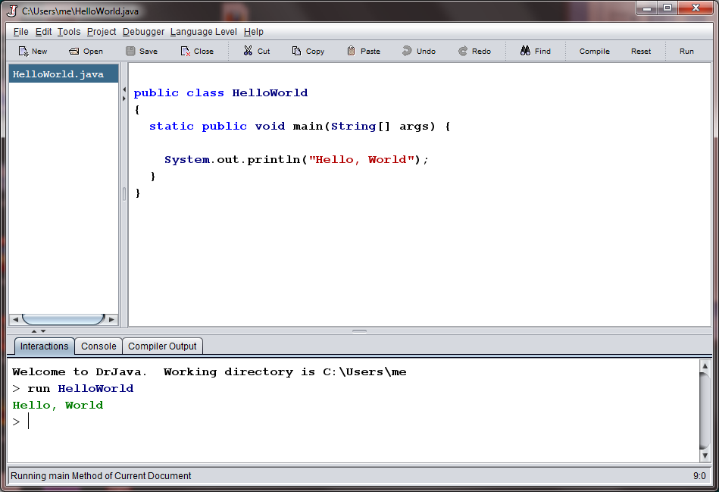
Dr Java – Lightweight IDE

Slide 11


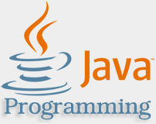
Java Tutorial – Tutorials Point
URL
http://www.tutorialspoint.com/
http://www.tutorialspoint.com/java/index.htm
Pros
Comprehensive
Many other Java related technologies are also offered
AWT, Swing, ANT, eclipse, spring, Maven
Cons
Not online “interactive” – so you will need an IDE

Slide 12
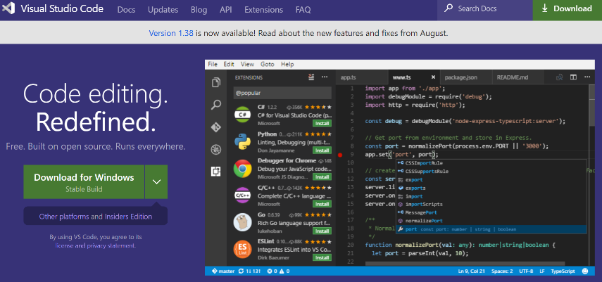
VS Code
Plugins
Java Extension Pack
C/C++
LaTeX

Slide 13
Programming in Python

Slide 14


Tools
Python
Enthought Python
Free for academic usage

Slide 15
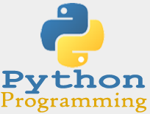
Python Tutorial – Tutorials Point
URL
http://www.tutorialspoint.com/
http://www.tutorialspoint.com/python
http://www.tutorialspoint.com/codingground.htm
Pros
Comprehensive
Cons
You will need an IDE
Or use http://www.tutorialspoint.com/execute_python3_online.php

Slide 16

Python Tutorial – codecademy
URL
http://www.codecademy.com/
Pros
Structured
Accessible, all lessons are online and executed within browser
Very straightforward
Cons
Maybe too structured
Each step must be followed, little freedom to ‘explore’ beyond what is being presented

Slide 17
Programming in R (if we get there)

Slide 18


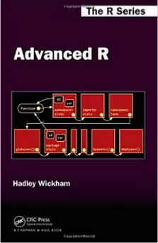
Resources - Books
Discovering Statistics Using R
R in Action, 2nd Edition
Advanced R
Discovering statistics – good depth to learning statistics using R as a tool
R in action – less learning stats, but very good overview or stats in relation to R functions (worth purchasing)
Advanced R – less about statistics, mostly focused on R as a programming language (free online!)
http://www.tutorialspoint.com/codingground.htm

Slide 19
Using R – Ad hoc verses Programming
Ad hoc
Many user of R fall into this category
Examples: plot a histogram, perform a regression analysis
Programming
Developing software using R as a programming language
Examples: development of statistical reports, statistical methodology, production of sophisticated graphical presentation of data, students in statistical computing courses

Slide 20
Tools
Install
R
The R Project for Statistical Computing
URL: http://www.r-project.org/
RStudio
IDE for R
URL: http://www.rstudio.com/
Also at

Slide 21
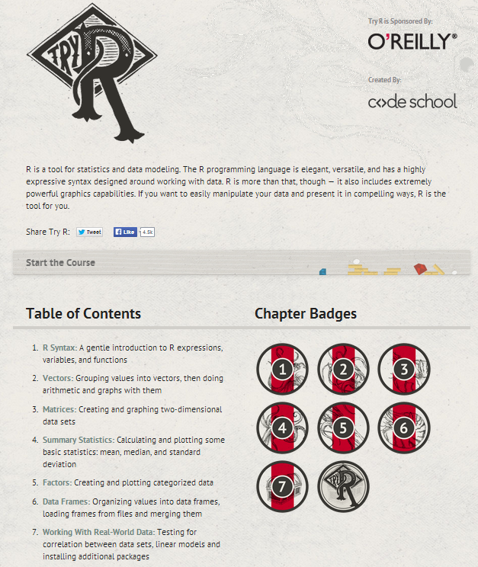
R Tutorial – Try R
URL
http://tryr.codeschool.com/
Pros
Structured
Accessible, all lessons are online and executed within browser
Very straightforward
Cons
Maybe too structured
Each step must be followed, little freedom to ‘explore’ beyond what is being presented
Won’t become familiar with ‘RStudio’ an important IDE

Slide 22
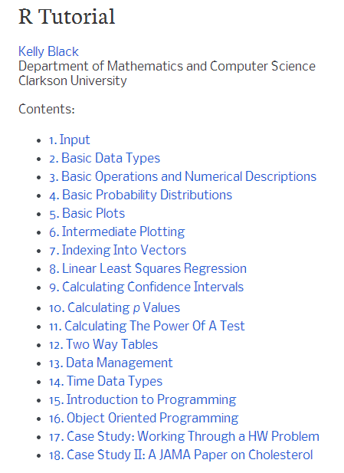
R Tutorial – R Tutorial
URL
http://www.cyclismo.org/tutorial/R/
http://www.tutorialspoint.com/codingground.htm
Pros
Comprehensive, both R as a language and as a statistical tool are covered
Use RStudio to work problems
Cons
A bit of intermixing “language” issues with application domain focus (statistical calculations)

