Slide 1
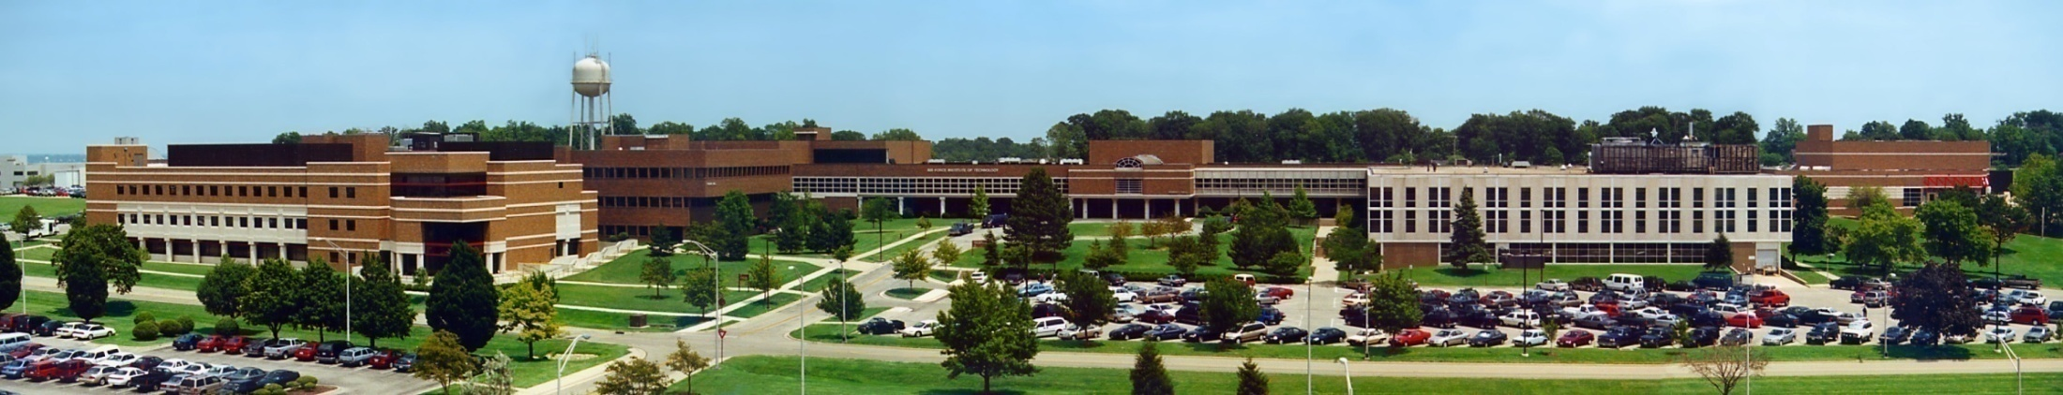
Object Oriented Programming Using Java Introduction to Java
Air Force Institute of Technology
Scott Nykl, PhD

Slide 2
Topic Overview
Introduce programming
Introduce Java
Setting up a Java development environment
Compiling and running your first Java program

Slide 3
What is a Program?
A step-by-step procedure for computing something
What do you mean by procedure?
A set of instructions
A recipe (as opposed to a cake)
Complete and unambiguous
To whom?
What do you mean by computing something?
Could be almost anything
A calculator computes the results of mathematical expressions
A first-person shooter game computes a virtual world and gratuitious violence
The computers in your car compute the timing of the fuel injectors and spark plugs, control the anti-lock brakes, monitor collision sensors to activate the air bag, tune the radio, & so on

Slide 4
What Languages are Used for Programming?
We need a notation for writing sets of instructions
That make sense to a human
That make sense to a computer
The fact is, no one language can serve two masters
Translators convert one language to another
E.g., from a human-readable one into a machine one
Rarely done the other way, because the first way is “lossy”
Abstract structure is lost that cannot be reconstructed
Semantic Gap
Notes:
A program always has two audiences
One is people—the ones who create the program in the first place and the ones that have to maintain it. A program needs to be intelligible to people.
The other is machines—the devices that store and execute streams of instructions at high speed. Each make and model of computer chip (or CPU) has its own unique set of very primitive instructions that it can execute. Such devices lead mind-numbing existences—read the next instruction, execute it, repeat. Millions (or billions) of times each second, for days or years on end.
There are two kinds of translator
A compiler takes a program in the source language and translates it all at once into an equivalent program in the target language. The target program can then be executed as many times as desired without being recompiled.
An interpreter takes a program written in the source language, reads and executes the first instruction, then the next, and so on. The target program has to be interpreted every time it is run (in fact, each statement may have to be interpreted every time it is encountered). This process may not seem much like “translation,” but in effect the interpreter is translated the source language into the language used to write the interpreter (are you lost yet?).
Ultimately, machine languages are “interpreted” by a piece of hardware that reads and executes each instruction without translating them into some other form. The use of the term in the previous bullet refers specifically to software interpreters, but the concept is the same.
Difference between two descriptions of something using different linguistic representations is called the semantic gap. One one hand we have high level natural language humans understand, but it ambiguous, and precise, unambiguous computational representation.

Slide 5
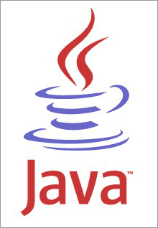
Introducing… Java!
A programming language
A human-readable notation for describing how to compute something
Translatable into a machine-interpretable form for execution
An object-oriented language
The basic building blocks of Java programs are “objects” and “classes”
Key design goal: “write once, run anywhere”
Write one application and have it work properly on whatever device it happens to run on

Slide 6
The Java Environment
Java “source code” is compiled to an intermediate form called “bytecode”
The bytecode is interpreted by a simulated computer (i.e., a program) called the Java Virtual Machine (JVM) that is specific to your machine
Java
Code
Java
Compiler
Byte
Code
JVM
CPU

Slide 7
The Java Environment
Java maintains its portability by keeping the bytecode the same across all platforms
The JVM specification is open so that vendors can write one for their platforms
JVMs are available for Windows, Linux, Android, and others
Byte
Code
JVM
CPU

Slide 8
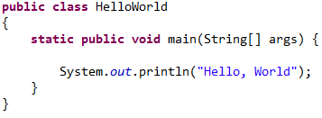
Example Java Program
Notes:
A source code file has one class definition
A class has one or more methods
Methods consist of statements. The main method is where your program starts running.

Slide 9
Setting Up a Java Development Environment
Download and install Java Software Development Kit (JDK)
Download and VS Code (IDE)
Install the “Java Extension Pack” extension

Slide 10
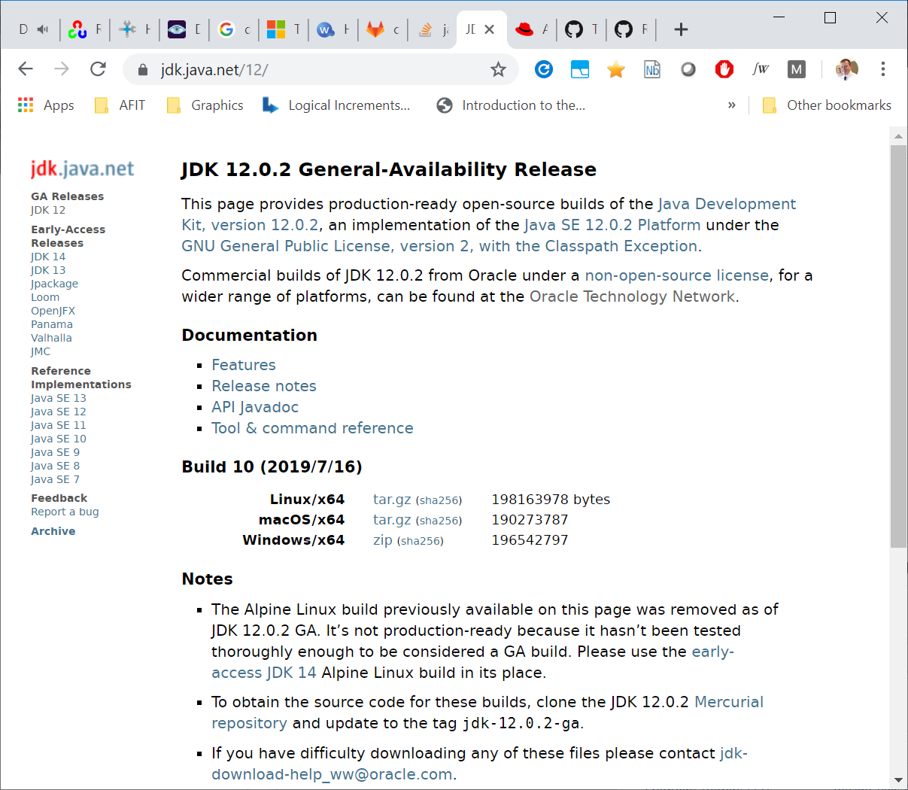
Download Java JDK
https://jdk.java.net/12/

Slide 11
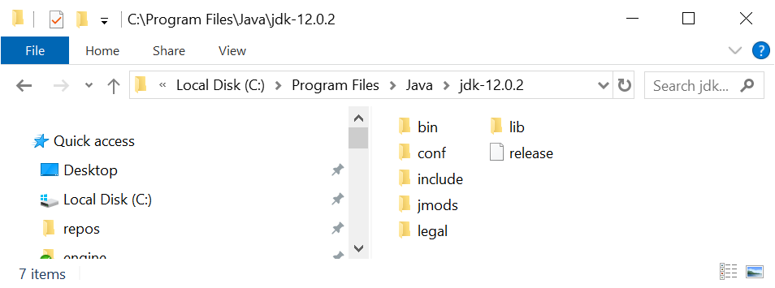
Setup your machine’s Environment
JAVA_HOME=C:\Program Files\Java\jdk-12.0.2
PATH=%PATH%;C:\Program Files\Java\jdk-12.0.2\bin
Windows
PATH=$PATH:/dir/to/bin
Linux / OS X

Slide 12
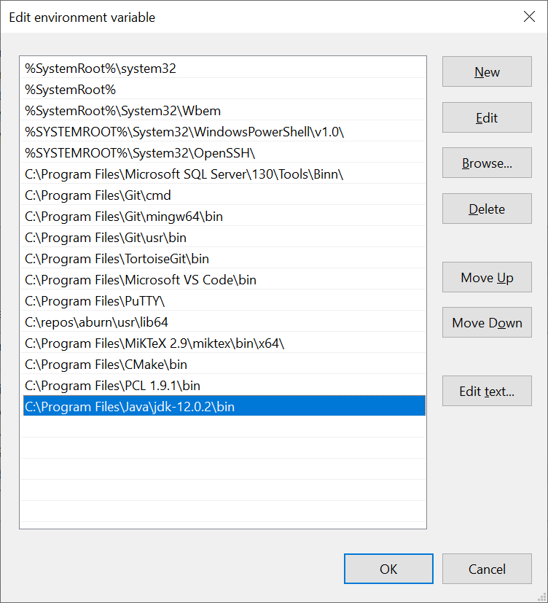
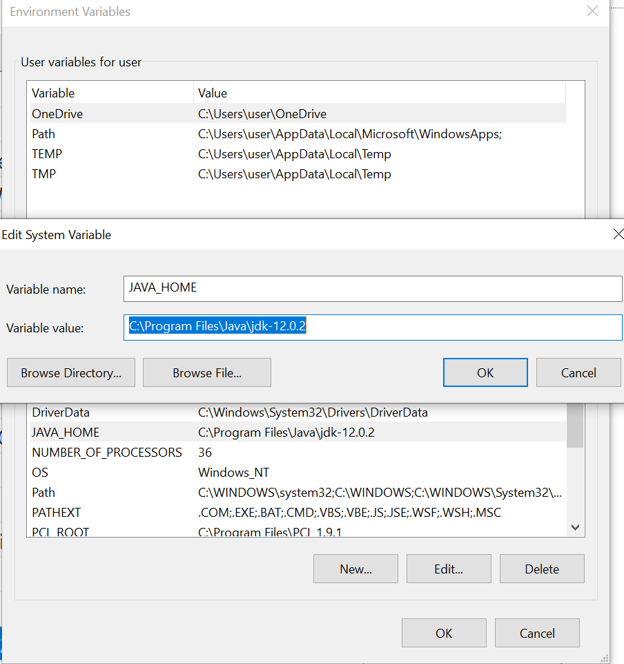
Set PATH. Set JAVA_HOME env var

Slide 13
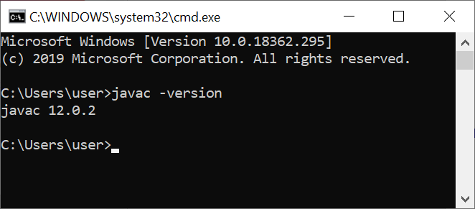
Test path from Command Window

Slide 14
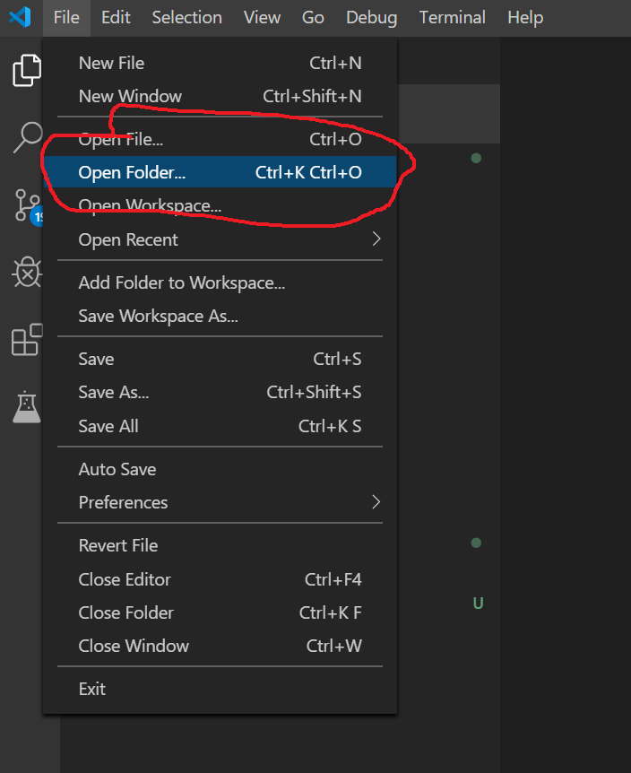
VS Code w/ Java Extension Pack
To open multiple java files, open VS Code to the root folder.
May need to click through each file before VS Code indexes each file and properly compiles all needed files.

Slide 15
Java Program: HelloWorld

Slide 16
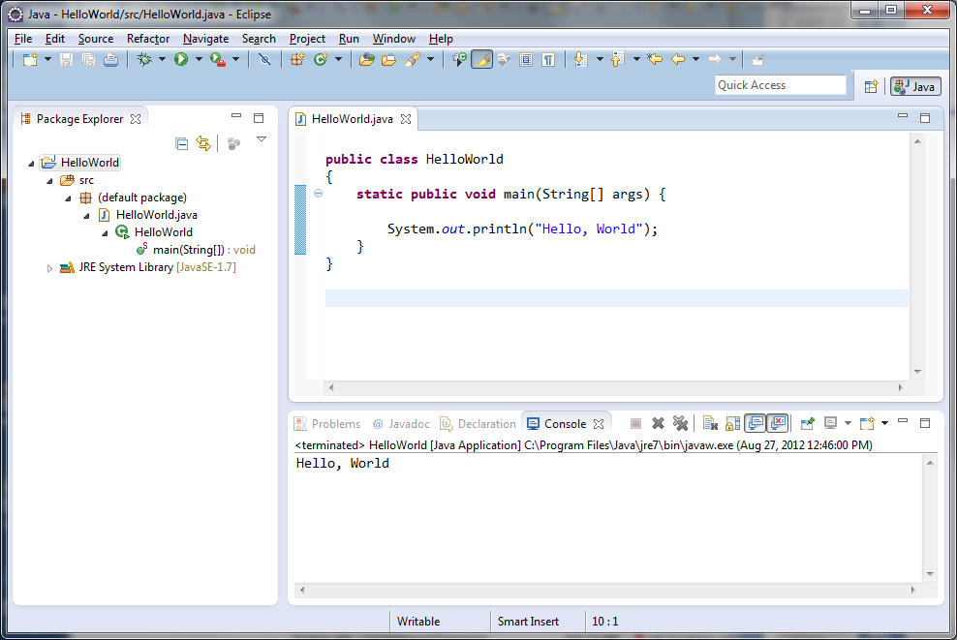
Eclipse Project and Program Output

