Slide 1

Object Oriented Programming Using Java Exceptions
Air Force Institute of Technology
Scott Nykl, PhD

Slide 2
Outline
Exceptions
Motivation
What is structured exception handling
Examples
Exceptions in Java
How to throw an exception
How to catch an exception
Finally—critical code in the face of exceptional control flow
Best Practice
Josh on Exceptions (Effective Java)

Slide 3
“Why Have Structured Exception Handling?”
Compilers can prove the absence of some anomalous behaviors at runtime
What about everything else?
Early languages just crashed—they let the OS deal with the mess
Modern languages include structured exception handling
Structured exception handling is a principled way for the language to define its runtime behavior even in the presence of anomalous events
What does a C program do when dereferencing a 0 pointer?
What does a Java program do when dereferencing a null pointer?
Exceptions happen at runtime—not at compile time

Slide 4
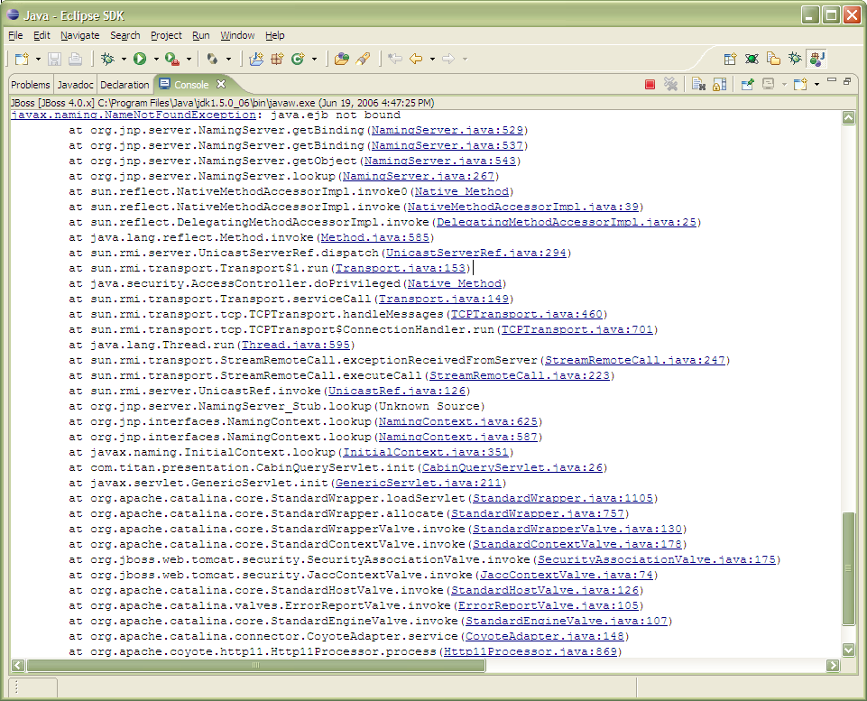
Ever seen this…
Because exceptions happen at runtime—the default is to print a stack trace

Slide 5
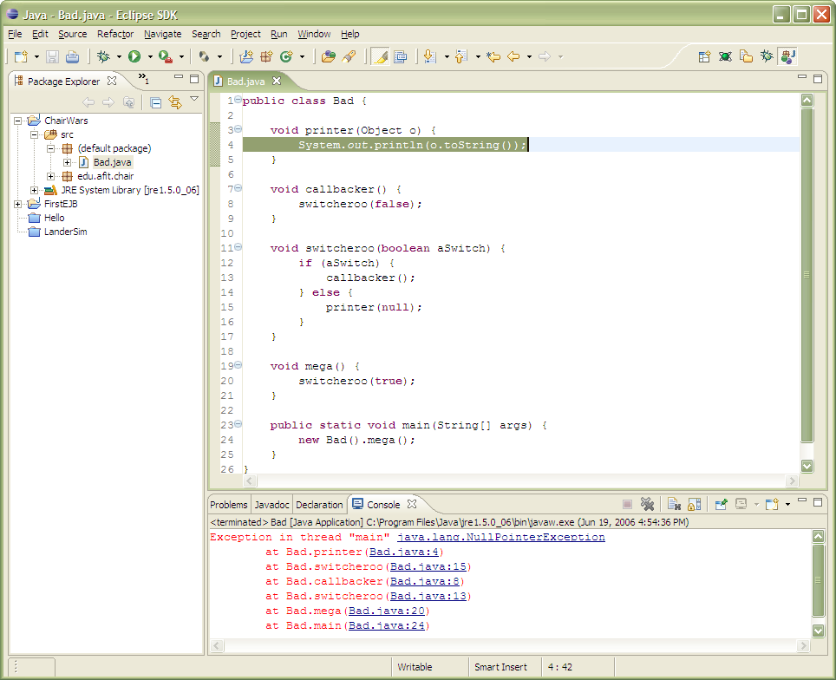
A Simple Example
The stack trace is the “path” through your code that raised the exception
Eclipse has hyperlinks to source locations

Slide 6
Exceptions in Java
Throwable is the base class for all exceptions
Java has checked and unchecked exceptions
Subclass Exception for exceptions for things that can go wrong at runtime
Subclass RuntimeException for things that can go wrong because you messed up
Subclass Error for unrecoverable problems
One shouldn’t catch an error (except in test code)
Throwable
Error
Exception
…
checked
…
RuntimeException
assert throws AssertionError
Best Practice: Reuse standard exceptions whenever
…
Notes:
Errors:
AssertionError - Thrown to indicate that an assertion has failed.
LinkageError - Subclasses of LinkageError indicate that a class has some dependency on another class; however, the latter class has incompatibly changed after the compilation of the former class.
VirtualMachineError - Thrown to indicate that the Java Virtual Machine is broken or has run out of resources necessary for it to continue operating.

Slide 7
How to Throw an Exception
Example
throw new IllegalStateException();
Exceptions are normal objects and can have constructor arguments
throw new IllegalArgumentException(
“x value of “ + x +
“ is larger than the board width of “ +
board.width);
Make message as detailed as possible (so you understand what went wrong)

Slide 8
Catching an Exception/Must-run Code in the Face of Exceptions
Use a try-catch block to catch an exception
try {
doSomething();
catch (IOException e) {
throw new IllegalStateException(“lost my file”, e);
}
Use a try-finally block when something must always run
ReadWriteLock l = new ReentrantReadWriteLock();
l.readLock().lock();
try {
// do critical section
} finally {
l.readLock().unlock();
}

Slide 9
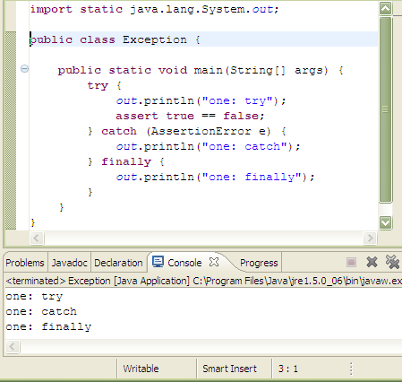
The finally block always gets run

Slide 10
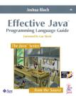
Best Practice
Exception | Occasion for Use
IllegalArgumentException | Parameter value is inappropriate
IllegalStateException | Object state is inappropriate for method invocation
NullPointerException | Parameter value is null where prohibited
IndexOutOfBoundsException | Index parameter value is out of range
ConcurrentModificationException | Concurrent modification of object has been detected where prohibited
UnsupportedOperationException | Object does not support method
Reuse Subclasses of RuntimeException
Avoid throwing/catching Throwable or Exception
Actually do something when you catch an exception
Avoid empty catch blocks—comment them to avoid the “is this intended? Or a bug?” thinking by the maintainer

Slide 11

Josh on Exceptions
Use exceptions only for exceptional conditions
Use checked exceptions for recoverable conditions and run-time exceptions for programming errors
Avoid unnecessary use of checked exceptions
Favor the use of standard exceptions
Throw exceptions appropriate to the abstraction
Document all exceptions thrown by each method
Include failure-capture information in detail messages
Strive for failure atomicity
Don’t ignore exceptions
Items 39-47 of Effective Java

Slide 12
Checked Exceptions
Checked: Checked at compile time.
If some code throws a checked exception, then the method must either handle the exception or it must specify the exception using throws keyword.
import java.io.*; class Main { public static void main(String[] args) { FileReader file = new FileReader("C:\\test\\a.txt"); BufferedReader fileInput = new BufferedReader(file); // Print first 3 lines of file "C:\test\a.txt" for (int counter = 0; counter < 3; counter++) System.out.println(fileInput.readLine()); fileInput.close(); } }

Slide 13
Try to compile previous slide’s code:
Exception in thread "main" java.lang.RuntimeException:
Uncompilable source code - unreported exception
java.io.FileNotFoundException;
must be caught or declared to be thrown at Main.main(Main.java:5)

Slide 14
Unchecked Exception
Unchecked: Not checked at compiled time.
In C++, all exceptions are unchecked -- not forced by the compiler to either handle or specify the exception.
Up to the programmers to be civilized, and specify or catch the exceptions.
In Java exceptions under Error and RuntimeException classes are unchecked exceptions, everything else under throwable is checked.

Slide 15
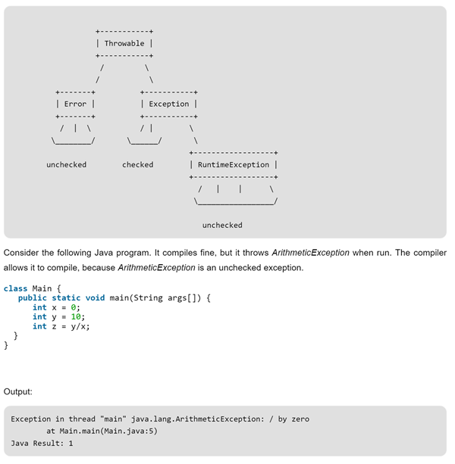
http://www.geeksforgeeks.org/checked-vs-unchecked-exceptions-in-java/

Slide 16
Use or Abuse
Consider the below Java snippet
try {
int i = 0;
while (true)
a[i++].f();
} catch (ArrayIndexOutOfBoundsException e) {}

Slide 17
Use or Abuse
Consider the below Java snippet
import edu.afit.dbwrapper.Database;
import com.oracle.OracleQueryException;
…
try {
Database db = Database.getInstance();
db.setQuery(“select * from FOLKS”);
db.runQuery();
} catch (OracleQueryException e) {}

