Slide 1

Object Oriented Programming Using Java Getting GUI
Air Force Institute of Technology
Scott Nykl, PhD

Slide 2
Outline
Getting started
SimpleGUI
The Observer Pattern
Reacting to events
Java Programs

Slide 3
Making a Simple GUI
Create a frame (a JFrame)
JFrame frame = new JFrame();
Make a widget (button, text field, etc.)
JButton button = new JButton("Click me");
Add the widget to the frame
frame.getContentPane().add(button);
Display it (give it a size and make it visible)
frame.setSize(300,300);
frame.setVisible(true);

Slide 4
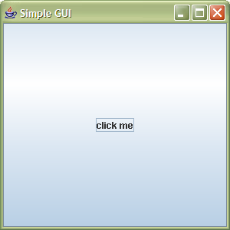
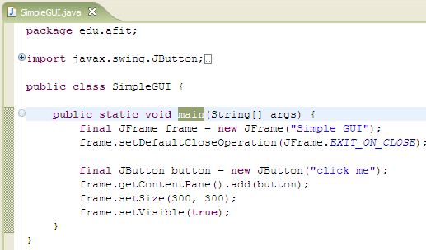
Simple GUI
Can’t we use the button to exit?
Use final as much as possible…Why? Because anonymous inner classes can reference them

Slide 5
Event-driven programming
Who is in control of SimpleGUI? You or SWING?
How is this different from other Java programs we have written?

Slide 6
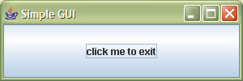
The Observer Pattern (Gang of Four)
Defines a one-to-many dependency between objects so that when one object changes state, all of its dependents are notified and updated automatically
CLICK!
Observer objects to the click
The Subject
The Observer

Slide 7
The Observer Pattern
You can think of this as an OO “callback” from the subject (e.g., the button) to the observers (e.g., our program)
The subject is not directly coupled to the observer
SWING has to ship without our program!
Thus our program ACTS-AS a button observer
An interface is used!
«interface» Observer
*
Subject
registerObserver() removeObserver() notifyObservers()
notify()
ConcreteObserver
ConcreteObserver
This is the pattern
notify()
notify()

Slide 8
Our Program Observing JButton
«interface» ActionListener
*
JButton
addActionListener() removeActionListener()
actionPerformed()
mapping
Our program and JButton
OurProgram ?
actionPerformed()
Pattern
«interface» Observer
*
Subject
registerObserver() removeObserver() notifyObservers()
notify()
ConcreteObserver
ConcreteObserver
notify()
notify()

Slide 9
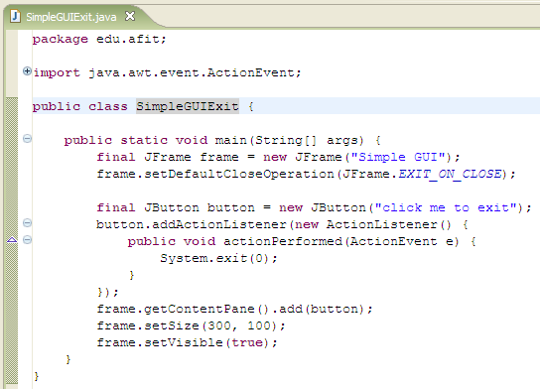

Click to exit
We’ll use an anonymous inner class
new on an interface?

Slide 10
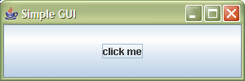
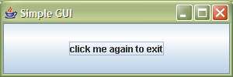
Eclipse exercise
Eclipse helps you with inner classes
When you type new ActionListener(){} it will fill in the unimplemented methods (correctly) for you
Let’s change the program to take two clicks
CLICK!
CLICK!

Slide 11
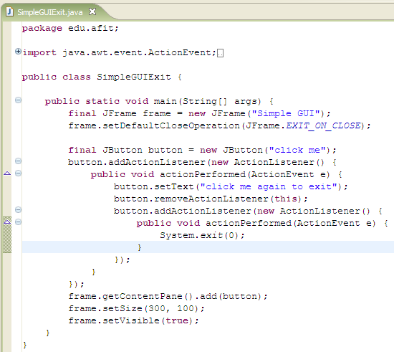
One solution
Remember final is required!

Slide 12
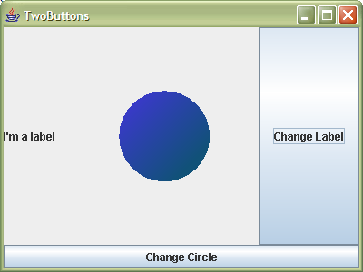
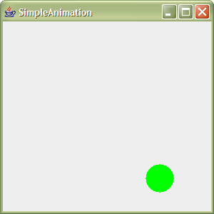
Java exercises
Refresh problems!!!

Slide 13
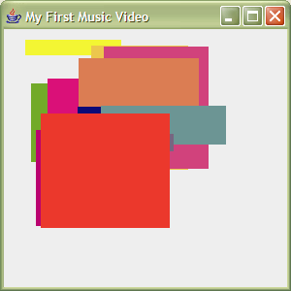
Mini music video

