Slide 1
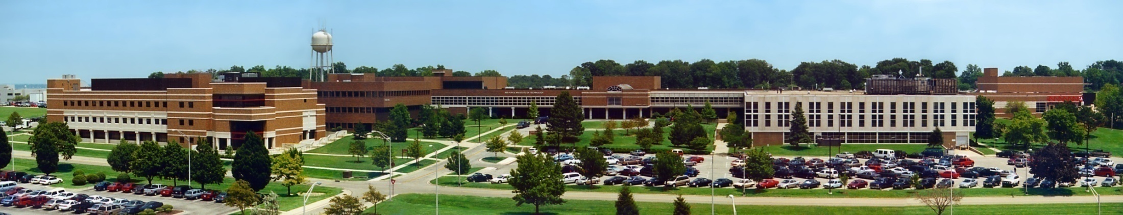
Object Oriented Programming Using Java Odds & Ends
Air Force Institute of Technology
Scott Nykl, PhD
Bldg 642, Rm 203
255-3636 x4395

Slide 2
Oddity
The following method determines whether its sole argument is an odd number. Does it work?
public static boolean isOdd(int i) {
return i % 2 == 1;
}
Puzzlers [Bloch Gafter]

Slide 3
Oddity
No! When the remainder operator returns a nonzero result, it has the same sign as its left operand
Test your methods with negative, zero, and positive values
Use JUnit (nicely integrated into Eclipse)
Easy to fix:
public static boolean isOdd(int i) {
return i % 2 != 0;
}
faster: return (i & 1) != 0;

Slide 4
Long Division
What does the program print?
public class LongDivision {
public static void main(String[] args) {
final long MICROS_PER_DAY = 24*60*60*1000*1000;
final long MILLIS_PER_DAY = 24*60*60*1000;
System.out.println(MICROS_PER_DAY / MILLIS_PER_DAY);
}
}

Slide 5
Long Division
It prints “5”
When working with numbers, watch out for overflow—it’s a silent killer
Just because a variable is large enough to hold a result doesn’t mean the computation leading to the result is the correct type
final long MICROS_PER_DAY = 24L*60*60*1000*1000;
final long MILLIS_PER_DAY = 24L*60*60*1000;
Language design flaw (throw an exception like Ada, switch to a larger internal representation like Lisp)

Slide 6
It’s Elementary
What does the program print?
public class Elementary {
public static void main(String[] args) {
System.out.println(12345 + 5432l);
}
}

Slide 7
It’s Elementary
It prints “17777”
The second number is 5432l
Always use 5432L

Slide 8
Hello Whirled
What does the program print?
/**
* Generated by the IBM IDL-to-Java compiler, version 1.0
* from F:\TestRoot\apps\a1\units\include\PolicyHome.idl
* Wednesday, June 17, 1998 6:44:40 o'clock AM GMT+00:00
*/
public class Test {
public static void main(String[] args) {
System.out.print("Hell");
System.out.println("o world");
}
}

Slide 9
Hello Whirled
It doesn’t compile
The problem is in the 3rd line of the comment which contains the characters \units
These characters begin with \ followed by a u—denotes the start of a Unicode escape
Unicode escapes must be well formed, even if they appear in comments
Don’t put Windows filenames into Java source files

Slide 10
Victim of the Slasher
What does the program print?
package edu.afit.puzzles;
public class Me {
public static void main(String[] args) {
System.out.println(
Me.class.getName().replaceAll(".", "/") +
".class");
}
}

Slide 11
Victim of the Slasher
It prints “///////////////////.class”
replaceAll takes a regular expression
“.” means any character
Fix:
replaceAll(“\\.", "/")
Be careful when using unfamiliar library methods

Slide 12
Dupe of URL
What does the program print?
public class BrowserTest {
public static void main(String[] args) {
System.out.print("iexplore:");
http://www.google.com
System.out.println(":maximize");
}
}

Slide 13

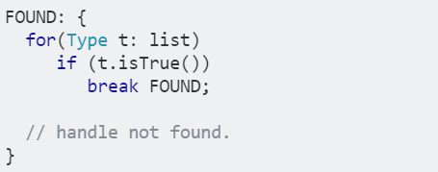
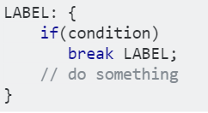
Dupe of URL
It prints “iexplore::maximize”
The “URL” that appears is a statement label followed by and end-of-line comment
Misleading comments and extraneous code cause confustion

Slide 14
Hello, Goodbye
What does the program print?
public class HelloGoodbye {
public static void main(String[] args) {
try {
System.out.println("Hello world");
System.exit(0);
} finally {
System.out.println("Goodbye world");
}
}
}

Slide 15
Hello, Goodbye
It prints “Hello world”
The System.exit method halts the execution of the current thread and all others dead in their tracks

