Slide 1

Programming Paradigms: Functional and Object Oriented Python 3 Language Tutorial – Part III
Air Force Institute of Technology
Scott Nykl, PhD
Bldg 642, Room 203
255-3636 x4395

Slide 2

Language

Slide 3
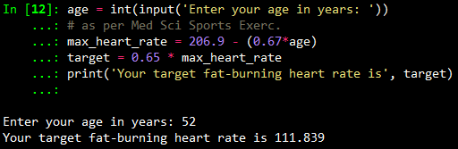
Input and Output
Console
print() function
input() function

Slide 4
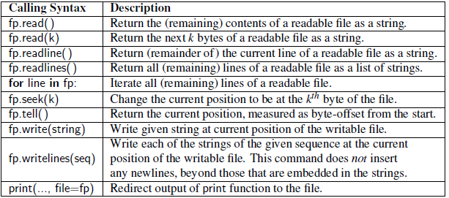
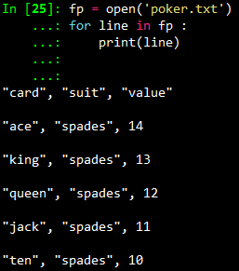

Slide 5
Exception Handling
Exceptions are unexpected events that occur during the execution of a program
Might result from a logical error or an unanticipated situation
In Python, exceptions (i.e., errors) are objects that are raised (or thrown) by code that encounters an unexpected circumstance
A raised error may be caught by a surrounding context that handles the exception in an appropriate fashion
If uncaught, interpreter might stop executing the program

Slide 6
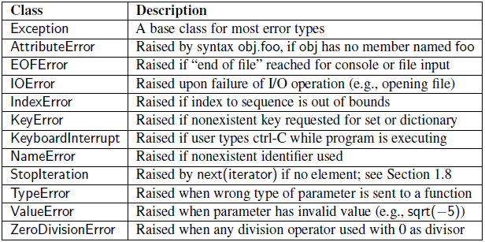
Common Exception Types
The exceptions marked would most likely raise an error when compiling Java or C++ code

Slide 7
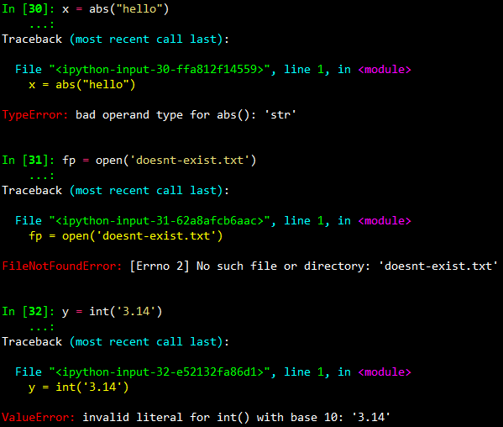
Examples

Slide 8
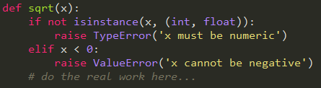
Raising an Exception
Checking the validity of function parameters
Check type
Then check for appropriate value
Checking the type and value of each parameter demands additional execution time and, if taken to an extreme, seems counter to the nature of Python

Slide 9

try/except
Advantage of try-except structure is that the non-exceptional case runs efficiently, without extraneous checks for the exceptional condition
However, handling the exceptional case requires slightly more time compared to standard conditional statements

Slide 10
Iterators
An iterator is an object that enables a programmer to traverse a container
Basic container types, such as list, tuple, and set, qualify as iterable types
A string can produce an iteration of its characters
A dictionary can produce an iteration of its keys
A file can produce an iteration of its lines

Slide 11
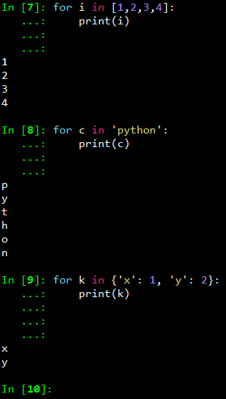
Iterator Examples
Looping over objects in a list
Looping over characters in a string
Looping over keys in a dictionary

Slide 12
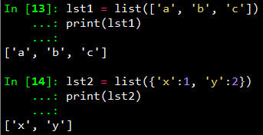
Functions Can Consume Iterables
Iterable
Iterable: An object that can produce an iterator
An object that manages an iteration through a series of values (i.e., traverse a container)
Iterable

Slide 13
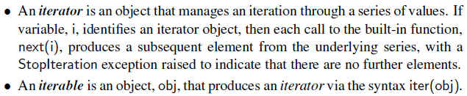
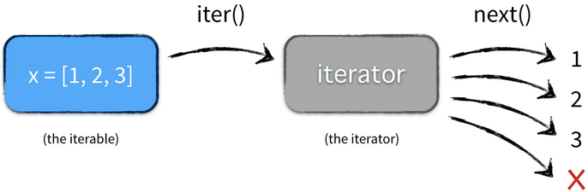
Iterator

Slide 14
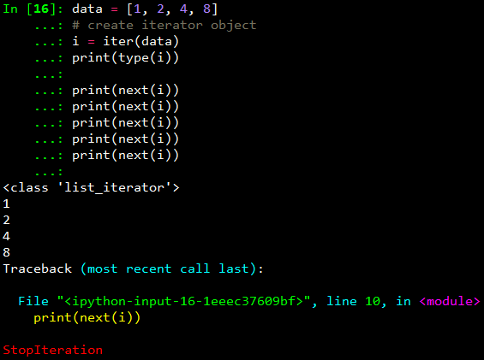
Iterator Example

Slide 15
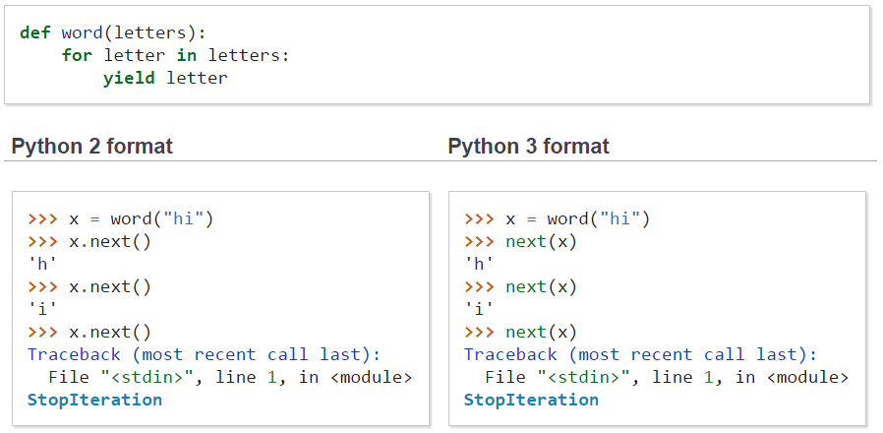
Iterating: Python 2 vs Python 3
Generator
Reference: http://docs.pythonsprints.com/python3_porting/py-porting.html

Slide 16
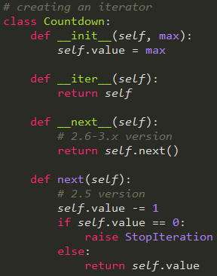
Iterators are Classes
Needed for Python 2.6-3.x
Needed for Python 2.5

Slide 17
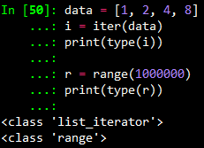
Iterator
Python also supports functions and classes that produce an implicit iterable series of values, that is, without constructing a data structure to store all of its values
For example, range(1000000) does not return a list of numbers; it returns a range object that is iterable
Object generates values one at a time, and only as needed
"lazy evaluation"

Slide 18
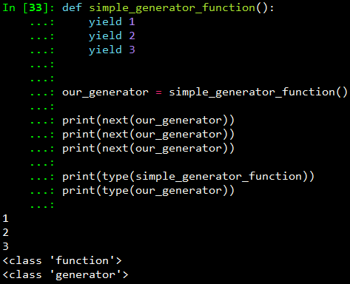
Generators
Generators simplifies the creation of iterators
A generator is implemented with a syntax very similar to a function, but instead of returning values, a yield statement is executed to indicate each element of a series

Slide 19
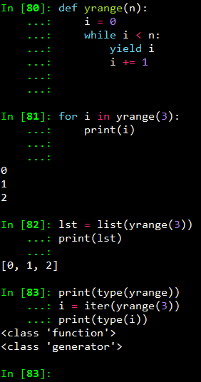
Generator Example
yrange() is like range()
A generator is an iterator!

Slide 20
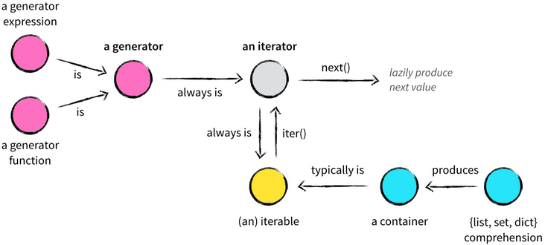
Iterables vs Iterators vs Generators

Slide 21
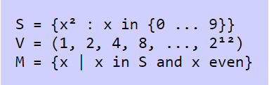
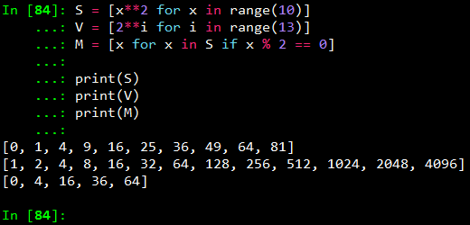
List Comprehensions
Mathematical notation

Slide 22
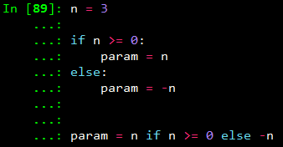

Python Conveniences
Simultaneous Assignments
Conditional Expressions

Slide 23
Scopes and Namespaces
The process of determining the value associated with an identifier is known as name resolution
Whenever an identifier is assigned to a value, that definition is made with a specific scope
Top level assignments are global scope
Assignments within functions are local scope

Slide 24
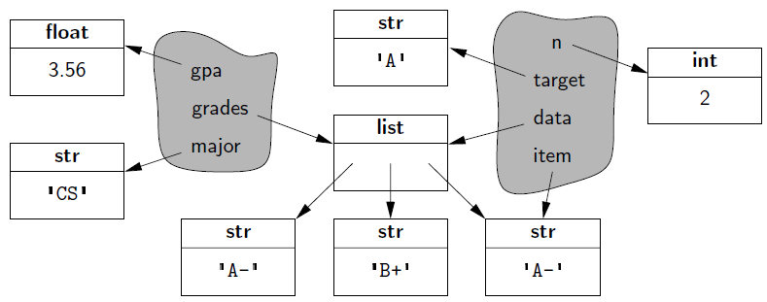
Scopes and Namespaces
Each distinct scope in Python is represented using an abstraction known as a namespace
A namespace manages all identifiers that are currently defined in a given scope

Slide 25
Implementation
Python implements a namespace with its own dictionary that maps each identifying string to its associated value
The function dir() reports the names of the identifiers in a given namespace (i.e., the keys of the dictionary)
The function vars(), returns the full dictionary

Slide 26
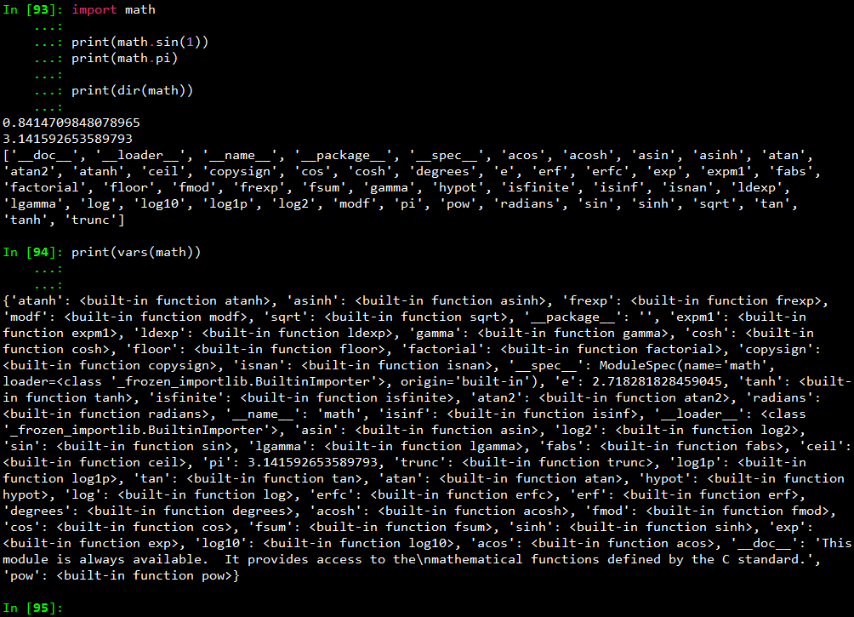

Slide 27


First-Class Objects
First-class objects are instances of a type that can be assigned to an identifier, passed as a parameter, or returned by a function
In terms of namespaces, the assignment introduces the identifier into the current namespace

Slide 28
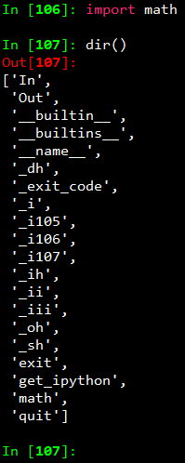
Modules and Import Statement
Libraries are organized into modules
Modules can be imported
import math
Formally, this add the identifier, math, to the current namespace
With the module as its value!

Slide 29
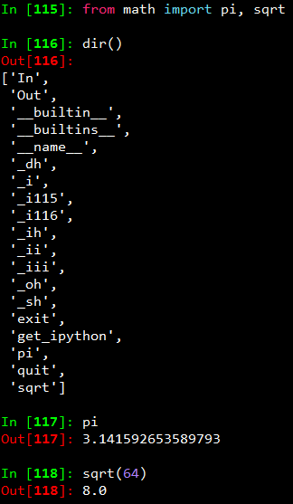
Loading Definitions
One form of an import statement (using from keyword) loads definitions into current namespace

Slide 30
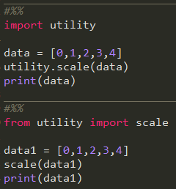
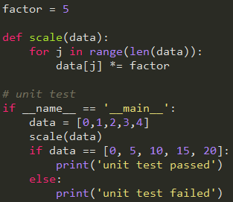
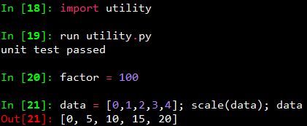
Creating a New Module
script using module
utility.py module

Slide 31
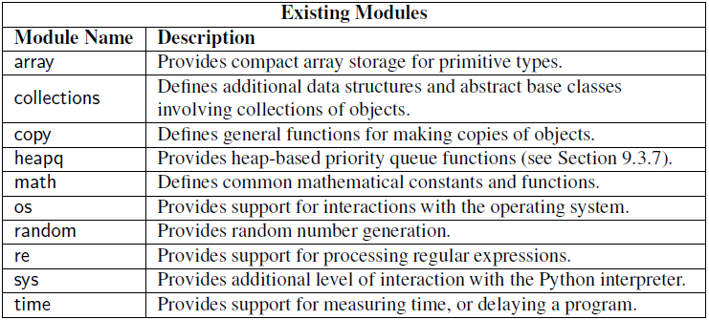
Existing Modules

