Slide 1

Programming Paradigms: Functional and Object Oriented Python 3 Language Tutorial – Part IV
Air Force Institute of Technology
Scott Nykl, PhD
Bldg 642, Room 203
255-3636 x4395

Slide 2

Language

Slide 3
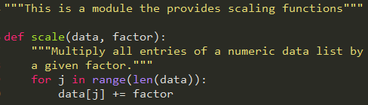
Code Documentation
docstring.py

Slide 4
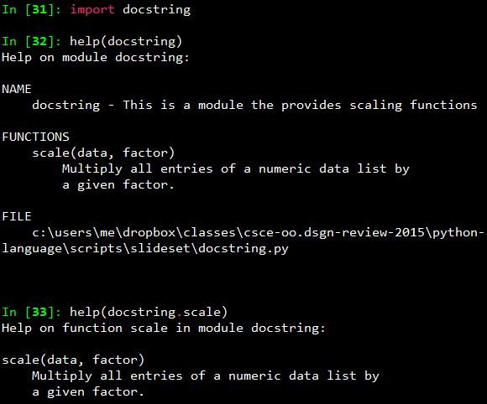
help(object)

Slide 5
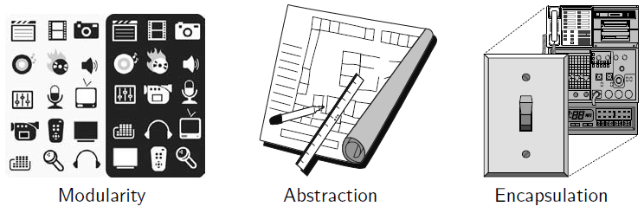
Object-Oriented Design Principles
Modularity
Implemented by using modules to group closely related functions and classes
Abstraction
Abstract base classes
Encapsulation
Python provides only loose support for encapsulation
By convention, names that start with a single underscore (e.g., _secret) are assumed to be nonpublic and should not be relied upon

Slide 6
Class Definitions
Classes serve as the primary means for abstraction in object-oriented programming
Syntactically, self identifies the instance upon which a method is invoked

Slide 7
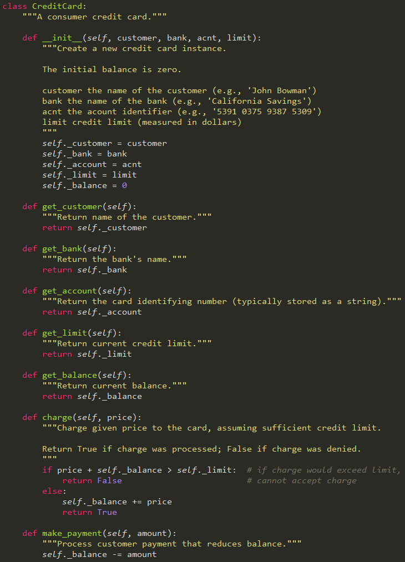

Slide 8
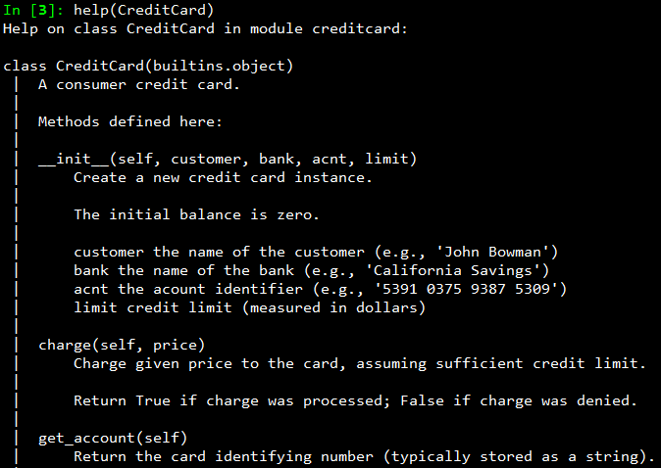

Slide 9
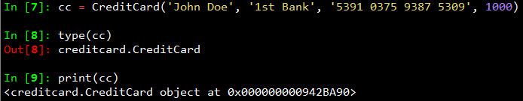
Create Instance

Slide 10
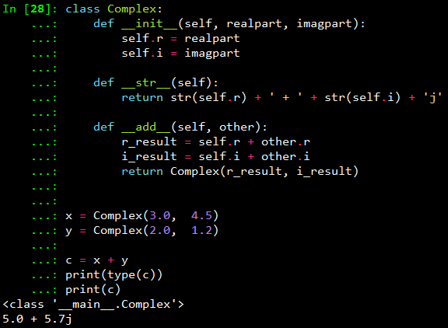
Meaningful Methods

Slide 11
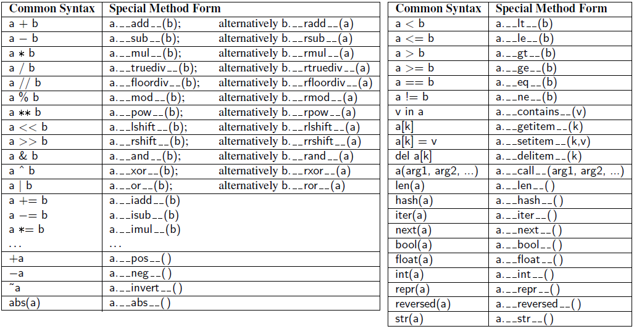
Meaningful Methods to Override

Slide 12
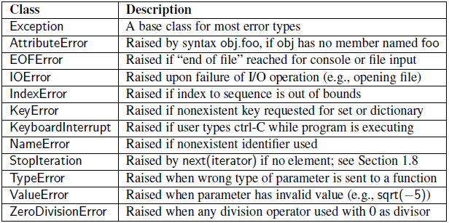
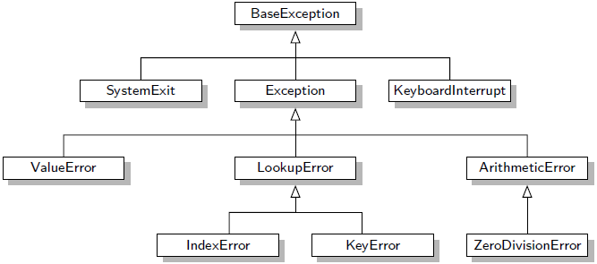
Exception Hierarchy

Slide 13
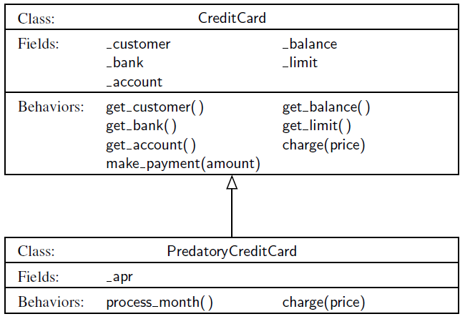
Inheritance

Slide 14
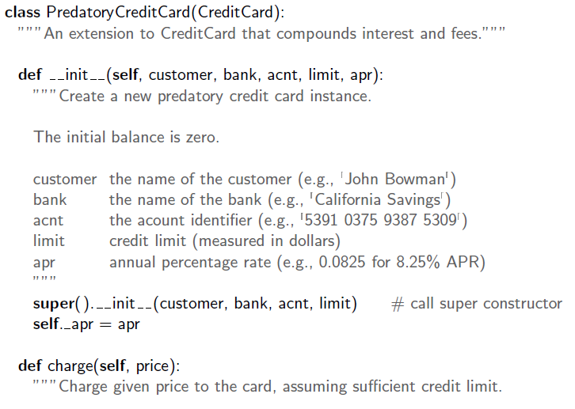
Inheritance Example

Slide 15
Protected Members
Python does not support formal access control, but by convention
Names beginning with a single underscore are conventionally akin to protected
Names beginning with a double underscore (other than special methods) are akin to private

Slide 16
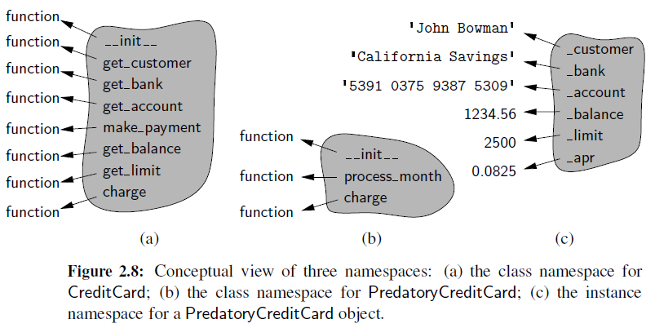
Instance and Class Namespaces
The use of ‘self’ is what causes identifiers to be added to instance namespace
There is a single instance namespace per object

Slide 17
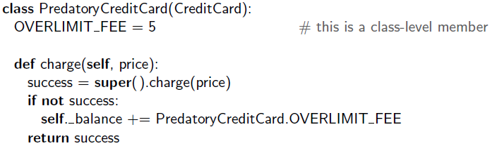
Class Data Members

Slide 18
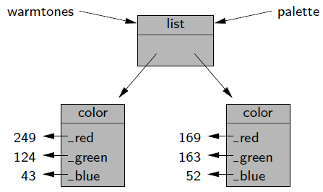
Shallow and Deep Copying
How do I copy an object?
Consider a variable pointing to a list of colors
palette = warmtones; # does not copy – just creates an alias
Two aliases for the same list of colors

Slide 19
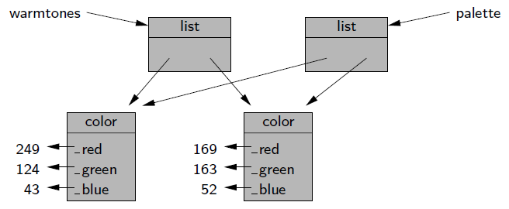
Shallow and Deep Copying
How about creating a new instance, and passing list of interest to constructor?
palette = list(warmtones); # a new list is created but items are referenced
A shallow copy of a list of colors

Slide 20
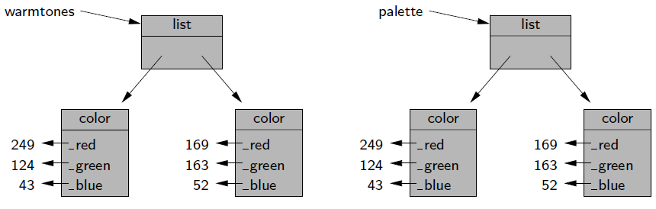
Shallow and Deep Copying
Shallow is useful in some circumstances, but sometimes we prefer a "full" "deep" copy
We prefer this – a deep copy of a list of colors

Slide 21
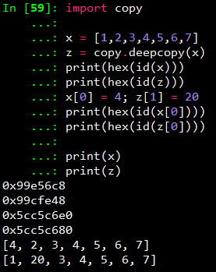
Shallow and Deep Copying
Python's copy module
Supports two functions, copy() and deepcopy()
copy.copy()
copy.deepcopy()

Slide 22
One More Thing...

Slide 23

Dynamic Typing
Python is a dynamic but strongly typed language
Variable hasn't changed type – it's just an identifier (i.e., name)
The first statement we created an integer object with the value 3 and bind the name 'variable' to it
We say Python is strongly typed because objects don't change type

Slide 24
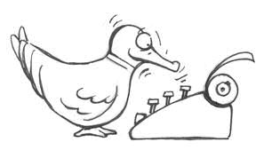
Duck Typing
When I see a bird that walks like a duck and swims list a duck and quacks like a duck, I call that bird a duck
It doesn't actually matter what type my data is – just whether or not I can do what I want with it
Duck typing in Python allows us to use any object that provides the required behavior without forcing it to be a subclass
As an interpreted and dynamically typed language, there is no 'compile time' checking of data types in Python, and no formal requirement for declarations of abstract base classes

Slide 25
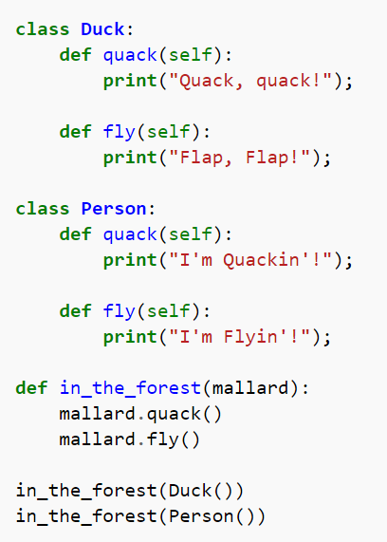
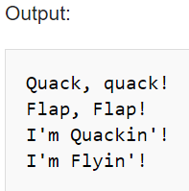
Duck Typing in Python

