Slide 1
AQ Route Explorer
An extension of the AQExplorer’s path functionality
Allows users to select Paths/Routes and get pollution data along the path
Interest from the public (Routes and Pollution Point Estimates)
Possible applications for researchers (Elevation)

Slide 2
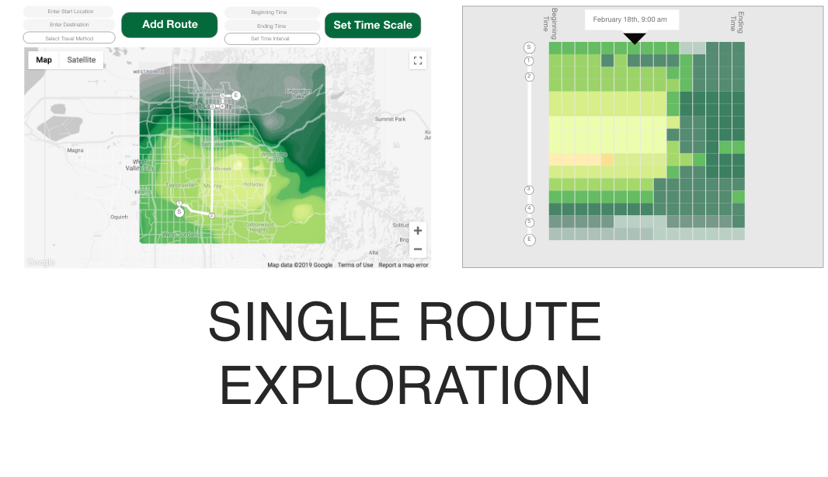

Slide 3
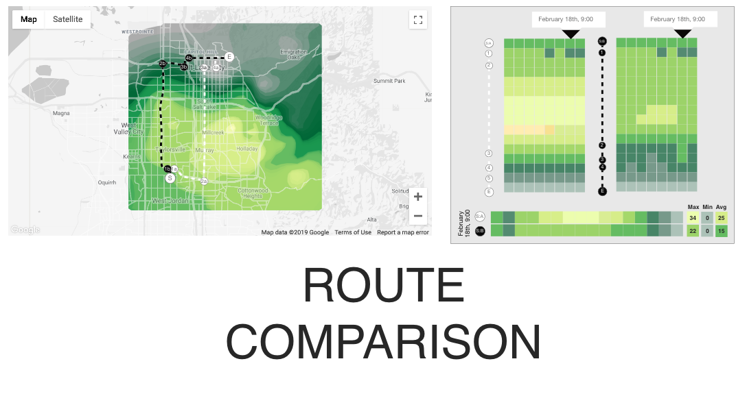

Slide 4
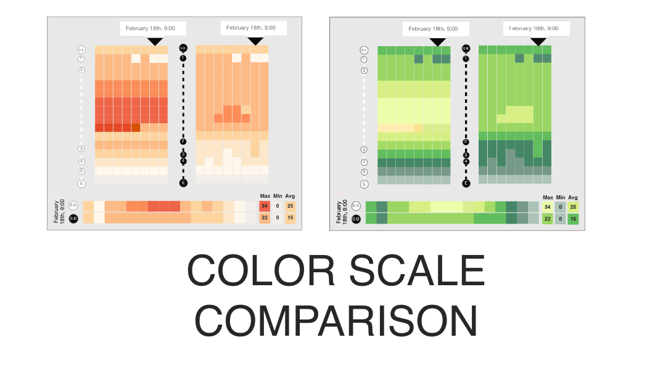

Slide 5
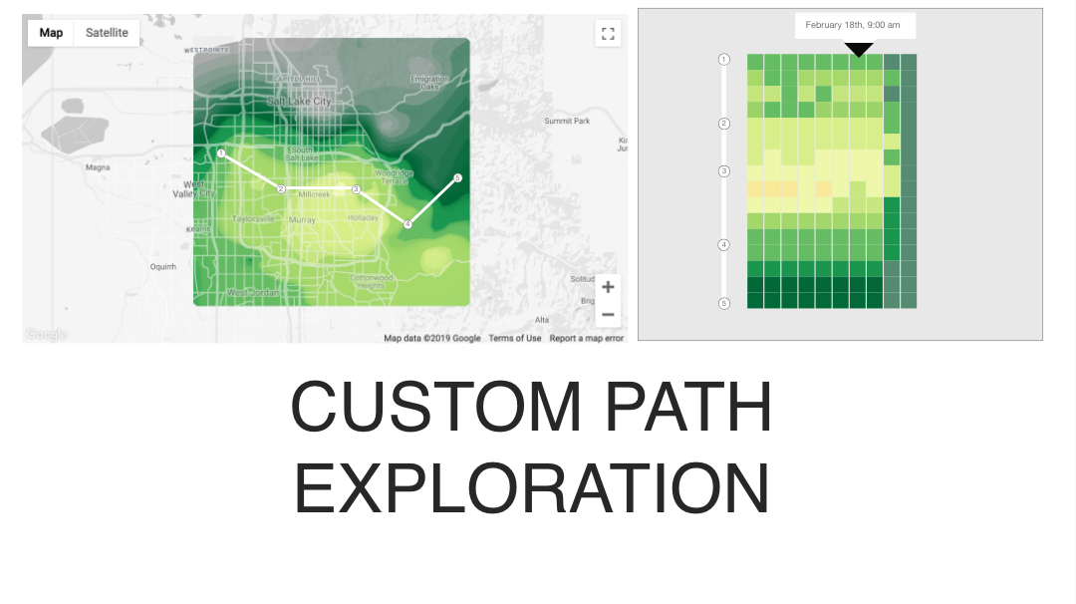

Slide 6
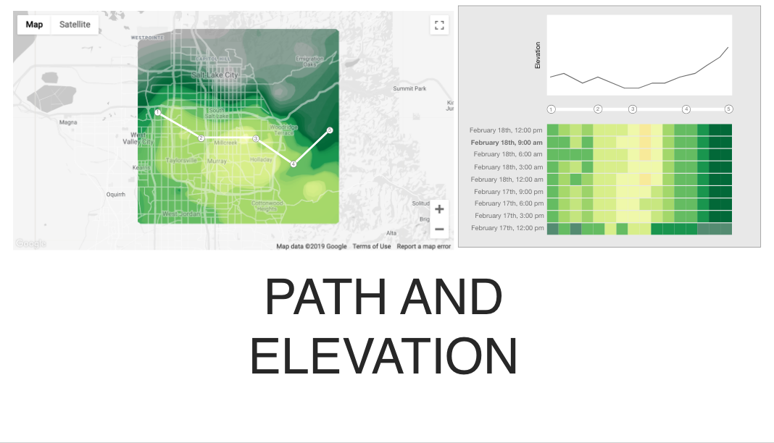

Slide 7
